Slide 1
Github part 2
Working in a multi user environment

Slide 2
Recap
Git Init
Git clone
Git add
Git log
Git diff
Git Tag
Git commit

Slide 3


Commit Revisited
A commit is the save state of your entire repository
.git
Helloworld.java
Helloworld.o
Commit ID
Branch name
Current Commit pointer
Your Local Repo

Slide 4
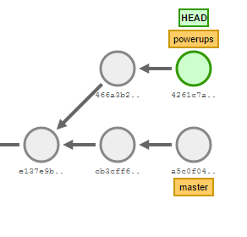
Branching
Multiple versions from the same starting point
Great for working on a new feature from the existing codebase

Slide 5
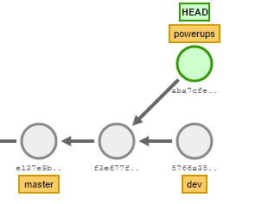
Workflow
Repositories can get messy without a structure to organize branches
Keep the master branch for code that is ready to be delivered
Make a dev branch to work on
Make a feature branch for every major feature

Slide 6
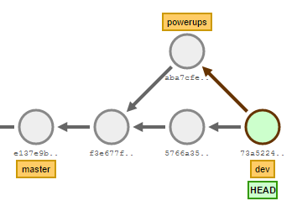
Merging
Merging is what happens when we want to combine two different commits
A merge may clobber files so be careful

Slide 7
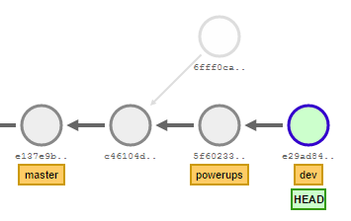
Rebasing
Current branch sneaks in the commits of the other branch within its history
Destroys the ancestry of the list of commits making the history linear

Slide 8




Working with Friends
.git
Helloworld.java
Helloworld.o
Remote Repo
Github.com
Best Friend
His Computer
You
Your Computer
.git
.git
Helloworld.java
Helloworld.java
Helloworld.o
Helloworld.o
His Local Repo
Your Local Repo
Notes:
In the git model a full working copy of the repository lives in your computer locally as well as on a remote repository somewhere in the cloud
We cloned the current version of the class notes to our computer
To synchronize across machines by push and pull commands
When adding new changes to your files you can push commits to update the remote repo
If you know your friend has updated the remote repo you can pull to get these commits

Slide 9
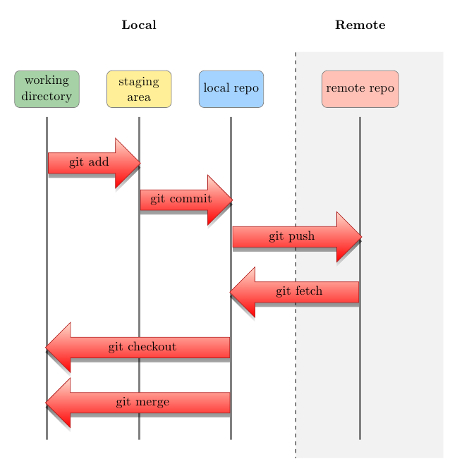
Uploading your local Repository to the cloud
Notes:
Now that you have linked your local repository to one in the cloud, you can push commit to synchronize the remote repo, or pull commits to synchronize the local repo.

Slide 10
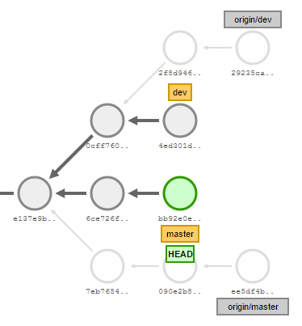
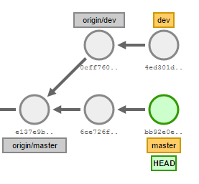
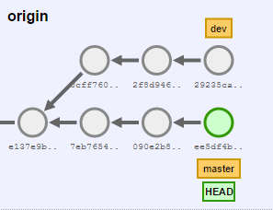
Fetching
Downloads all new commits to your local repository
Local Repo Before
Local Repo After

Slide 11
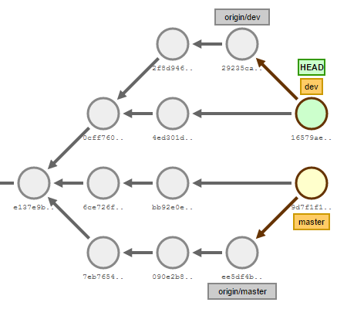
Pulling
Pull is two commands in one.
It fetches from the remote repo
Then merges the local repo with the new commits
Can do rebase instead of merge using the command:
git pull --rebase

Slide 12
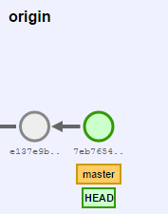
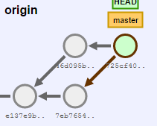
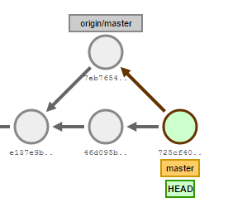
Pushing
Adds new commits to the remote repository
Must always pull before pushing
Remote Repo Before
Remote Repo After
Local Repository

Slide 13
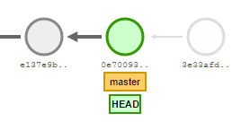
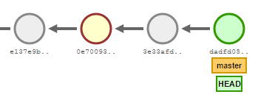
Revert vs Reset
Reset is to bring your head Pointer back by a commit
Revert is to create a brand new commit of a previous commit. Use this when trying to revert to a previous version in a multi-user environment. Can you guess why?
Reset
Revert

Slide 14
Interactive Demo
Go to: http://www.wei-wang.com/ExplainGitWithD3

Slide 15
Some Pro tips
Don’t forget to Tag your code: for your code submissions we will look at the commit that you tag as your submission
Avoid merge conflicts: two people should avoid working on the same file
Always rebase your master: it will keep your branch structure linear
Checkout your branch structure by using: git log --graph

Slide 16
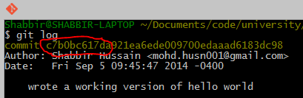


Tagging commits
1
2
3
Notes:
Identify a few digits of the commit you want to tag
Tag the commit using “git tag <tagname> <firstFewDigitsOfCommit>”
Check tag using git log
Tagging is useful if you want to identify a point in your code using human words. For example, if you have multiple versions of your code, you can tag which commit corresponds to version 1. Tagging will be useful for your class assignments
Also, we used a different flavor of git log. We added some options so that it would show us the log in a different format.

Slide 17
More resources
Vogella Reference: http://www.vogella.com/tutorials/Git/article.html
SSH keys tutorial: https://help.github.com/articles/generating-ssh-keys
Git Cheetsheet: https://raw.githubusercontent.com/nerdgirl/git-cheatsheet-visual/master/gitcheatsheet.png
Merge vs rebase: http://blog.sourcetreeapp.com/2012/08/21/merge-or-rebase/

