Slide 1
Software Requirement Specifications
The most fun part of Software Engineering
Notes:
We designed this template so that each member of the project team has a set of slides with its own theme where he/she can present their research. Members, here’s how you add a new slide to just your set:
Mark where you want to add the slide: Select an existing one in the Thumbnails pane, click the New Slide button, then choose a layout.
The new slide gets the same theme as the previous one you selected.
Careful! Don’t annoy your fellow presenters by accidentally changing their themes. That can happen if you choose a theme Variant from the Design tab, which changes all of the slides in your presentation to that look.

Slide 2
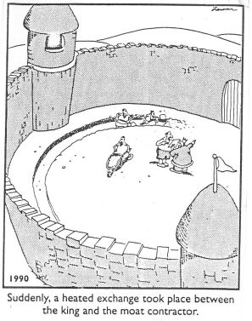
Why write requirements?
Why not just build it?

Slide 3
Why write requirements?
Serves to understand and document the system’s functions, behavior, and constraints
Write solution from user’s perspective
“Establish a common understanding between the project sponsor, customers, developers and other stakeholders” –Vijay Sankar, link 2
Useful for verification and Testing

Slide 4

Overview
Types of Requirements
Best practices
Case study of Facebook Messenger app

Slide 5
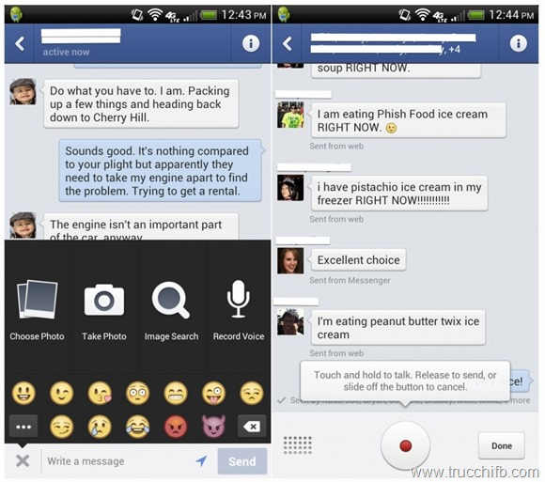
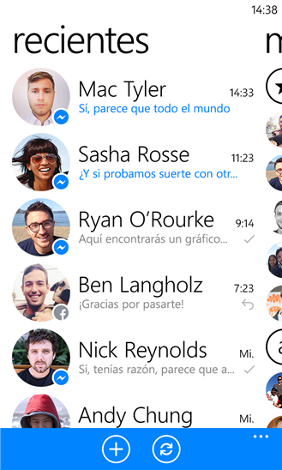
Overview

Slide 6
Types of Requirements
Functional Requirements
Non-Functional Requirements
Performance
Usability
Security
Reliability and Availability
Precision and Accuracy
Maintainability
The two major types

Slide 7
Functional Requirements
Describes behaviour or state based on: inputs, outputs, error state, Initial state.
Functional requirements are features
Examples
When the app is first opened, the user shall be prompted with a login Screen.

Slide 8
Non Functional Requirements
Describe some quality of the software
Functional requirements are features
Quality requirements are usually more quantifiable (e.g., response time)
Also includes
Design constraints (e.g., platform or required interface)
Process constraints (e.g., required documentation or process)
The following are all Non-Functional Requirements

Slide 9
Performance Requirements
Execution speed, response time, or throughput?
How much data will flow through the system?
How often is data sent or received?
What are the limits of the system?

Slide 10
Usability Requirements
What kind of training is required?
Ease of understanding the system or user interface?
How difficult should it be to misuse the system?

Slide 11
Security Requirement
Is access to the system controlled? To all features?
Different levels of user access?
Should portions of the system be isolated from others?
Precautions against theft?

Slide 12
Reliability and Availability Requirements
Does the system detect/isolate faults?
Mean time between failures?
Maximum time to recover from failure?
System backups?

Slide 13
Precision and Accuracy Requirements
How accurate should calculations be?
What should be the precision of stored data?

Slide 14
Maintainability Requirements
Will maintenance just be correcting errors, or will additional features be added?
How easy should it be to add features?
How easy to port to other platforms?

Slide 15
Writing Good Specs
Good spec qualities
Case studies
Best Practices

Slide 16
Qualities of a good spec
Consistent: No conflicting requirements
Unambiguous: avoid multiple interpretation
Complete: All behaviour and state is specified
Feasible: It is possible to build a solution that meets the customer’s needs
Relevant: All features are directly related to customer’s need
Testable: Requirement should suggest a test that could demonstrate requirement is met
Traceable: Organized an uniquely labeled
Design Free: No implementation details

Slide 17
Example 1
2.1 Login Screen
2.1.2 The login screen shall have an input field for username and password and a button for submitting the information.
2.1.3 The password shall also be obfuscated such that an onlooker will not able to read the typed message.
2.1.3 The login screen will lock the app after detecting any significant attempts to hack into the app.

Slide 18
Example 2
3.1 File Transfers
3.1.1 File Types
Only files with .jpg extension can be sent
3.1.2 File size
Files cannot Exceed 100kb
3.1.3 Analytics & Reporting
Collect File transfer rate in nano seconds as a Key Performance indicator using Google Analytics library
3.1.4 …..

Slide 19
Example 3
Expert Video: https://www.youtube.com/watch?v=BKorP55Aqvg

Slide 20
Extra Credit
Expert Video: https://www.youtube.com/watch?v=BKorP55Aqvg
Ruby Spec: http://vk.com/video1678620_163231929

Slide 21
References
https://www.ibm.com/developerworks/community/blogs/requirementsmanagement/entry/good-requirements-writing?lang=en
http://www.incose.org/chicagoland/docs/Writing%20Effective%20Requirements.pdf
https://github.com/sayar/talks/blob/master/ecse321/tutorial4/reqs_tutorial.md

