Slide 1
Software Requirement Specifications
The most fun part of Software Engineering
Notes:
We designed this template so that each member of the project team has a set of slides with its own theme where he/she can present their research. Members, here’s how you add a new slide to just your set:
Mark where you want to add the slide: Select an existing one in the Thumbnails pane, click the New Slide button, then choose a layout.
The new slide gets the same theme as the previous one you selected.
Careful! Don’t annoy your fellow presenters by accidentally changing their themes. That can happen if you choose a theme Variant from the Design tab, which changes all of the slides in your presentation to that look.

Slide 2
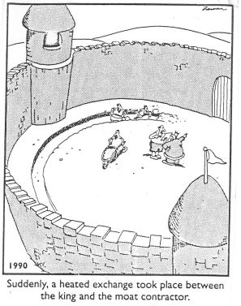
Why write requirements?
Why not just build it?
(video)

Slide 3
Why write requirements?
Serves to understand and document the system’s functions, behavior, and constraints
Write solution from user’s perspective
“Establish a common understanding between the project sponsor, customers, developers and other stakeholders” –Vijay Sankar, link 2
Useful for verification and Testing

Slide 4

Overview
Types of Requirements
Best practices
Case study of Facebook Messenger app

Slide 5
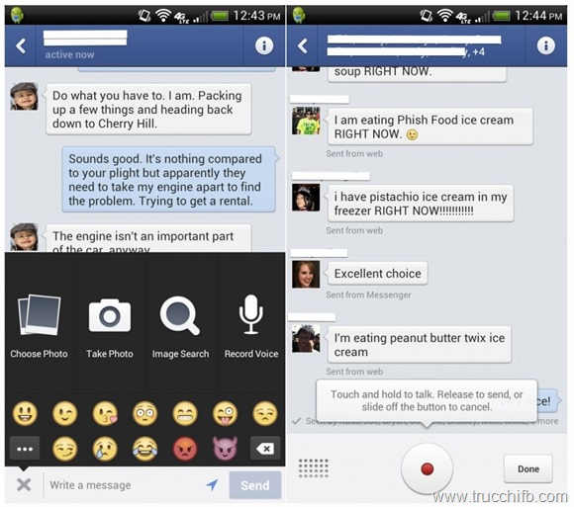
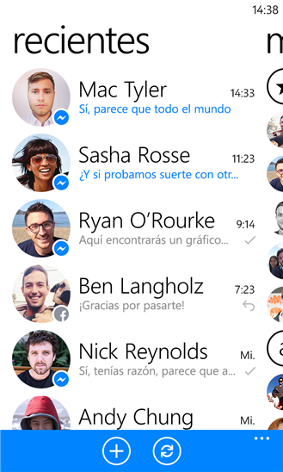
Overview

Slide 6
Types of Requirements
Functional Requirements
Non-Functional Requirements
Performance
Usability
Security
Reliability and Availability
Precision and Accuracy
Maintainability
The two major types

Slide 7
Functional Requirements
Describes behaviour or state based on: inputs, outputs, error state, Initial state.
Functional requirements are features
Examples
When the app is first opened, the user shall be prompted with a login Screen.

Slide 8
Functional Requirements
Describes behaviour or state based on: inputs, outputs, error state, Initial state.
Functional requirements are features
Examples
When the app is first opened, the user shall be prompted with a login Screen.
Within a conversation, the user can scroll up to see their conversation history.

Slide 9
Non Functional Requirements
Describe some quality of the software
Functional requirements are features
Quality requirements are usually more quantifiable (e.g., response time)
Also includes
Design constraints (e.g., platform or required interface)
Process constraints (e.g., required documentation or process)
The following are all Non-Functional Requirements

Slide 10
Performance Requirements
Execution speed, response time, or throughput?
How much data will flow through the system?
How often is data sent or received?
What are the limits of the system?

Slide 11
Performance Requirements
Execution speed, response time, or throughput?
How much data will flow through the system?
How often is data sent or received?
What are the limits of the system?
Examples
For a connected device, a new message should arrive under 5 seconds
Group conversations shall include a maximum of 100 participants

Slide 12
Usability Requirements
What kind of training is required?
Ease of understanding the system or user interface?
How difficult should it be to misuse the system?

Slide 13
Usability Requirements
What kind of training is required?
Ease of understanding the system or user interface?
How difficult should it be to misuse the system?
Examples
All interfaces shall use a color blind friendly color scheme to be usable by color blind users

Slide 14
Security Requirement
Is access to the system controlled? To all features?
Different levels of user access?
Should portions of the system be isolated from others?
Precautions against theft?

Slide 15
Security Requirement
Is access to the system controlled? To all features?
Different levels of user access?
Should portions of the system be isolated from others?
Precautions against theft?
Examples
During the authentication, a 128bit SSL connection will be established to ensure secure exchange of credentials from device to authentication server
Upon logout, all user specific data will be permanently deleted from the device

Slide 16
Reliability and Availability Requirements
Does the system detect/isolate faults?
Mean time between failures?
Maximum time to recover from failure?
System backups?

Slide 17
Reliability and Availability Requirements
Does the system detect/isolate faults?
Mean time between failures?
Maximum time to recover from failure?
System backups?
Examples
Messages will show a delivery receipt in order to indicate successful delivery
User’s messages will be stored in two separate data centers to prevent data loss

Slide 18
Precision and Accuracy Requirements
How accurate should calculations be?
What should be the precision of stored data?

Slide 19
Precision and Accuracy Requirements
How accurate should calculations be?
What should be the precision of stored data?
Examples
Messages saved on the device will be stored using base 64 encoding
When location service is enabled, messages shall display users location based on city

Slide 20
Maintainability Requirements
Will maintenance just be correcting errors, or will additional features be added?
How easy should it be to add features?
How easy to port to other platforms?

Slide 21
Maintainability Requirements
Will maintenance just be correcting errors, or will additional features be added?
How easy should it be to add features?
How easy to port to other platforms?
Examples
Messages will pass through Facebook Messaging servers rather than device to device in order to ensure maintainability of message delivery and storage requirements
Android, iOS, Windows and web devices shall connect to the same messaging servers in order to centralize maintenance of message delivery and storage.

Slide 22
Writing Good Specs
Good spec qualities
Case studies
Best Practices

Slide 23
Qualities of a good spec
Consistent: No conflicting requirements
Unambiguous: avoid multiple interpretation
Complete: All behaviour and state is specified
Feasible: It is possible to build a solution that meets the customer’s needs
Relevant: All features are directly related to customer’s need
Testable: Requirement should suggest a test that could demonstrate requirement is met
Traceable: Organized an uniquely labeled
Design Free: No implementation details

Slide 24
Example 1
2.1 Login Screen
2.1.2 The login screen shall have an input field for username and password and a button for submitting the information.
2.1.3 The password shall also be obfuscated such that an onlooker will not able to read the typed message.
2.1.3 The login screen will lock the app after detecting any significant attempts to hack into the app.

Slide 25
Example 1
2.1 Login Screen
2.1.1 Screen Layout
The login screen shall have an input field for username, an input field for password and a button for submitting the information.
2.1.2 Password Protection
The password shall be obfuscated such that an onlooker will not able to read the typed message.
2.1.3 Intrusion Detection
The login screen will prevent subsequent login attempts for 3 minutes after detecting 3 failed login attempts. This will prevent unauthorized access.
2.1.4 Successful Login
Upon Successful login attempt the user will be presented to conversations Screen
Notes:
Consistent numbering system: traceable
Titles for each requirement
Use unambiguous wording for input fields. (make it clear that there are 2 input fields 1 for uname 1 for pw)
Relevance. How is hacking into the app a customer issue

Slide 26
Example 2
3.1 File Transfers
3.1.1 File Types
Only files with .jpg extension can be sent
3.1.2 File size
Files cannot Exceed 100kb
3.1.3 Analytics & Reporting
Collect File transfer rate in nano seconds as a Key Performance indicator using Google Analytics library
3.1.4 …..

Slide 27
Example 2
3.1 File Transfers
3.1.1 File Types
Only files with .jpg extension can be sent
3.1.2 File size
Files cannot Exceed 5Mb
3.1.3 Analytics & Reporting
Collect File transfer rates in milliseconds as a Key Performance indicator
3.1.4 …..
Notes:
What value is there in jpg < 100kb
Nano seconds are not feasible by today’s standards
Google analytics is too much of an implementation detail

Slide 28
Example 3
Why should we (engineers write specs?)
Expert Video: https://www.youtube.com/watch?v=BKorP55Aqvg

Slide 29
Extra Credit
Expert Video: https://www.youtube.com/watch?v=BKorP55Aqvg
Ruby Spec: http://vk.com/video1678620_163231929

Slide 30
References
https://www.ibm.com/developerworks/community/blogs/requirementsmanagement/entry/good-requirements-writing?lang=en
http://www.incose.org/chicagoland/docs/Writing%20Effective%20Requirements.pdf
https://github.com/sayar/talks/blob/master/ecse321/tutorial4/reqs_tutorial.md

