Slide 1

Descriptive Analysis, Prediction and Communication
Presented by :
Rahul Aryan Rajashekhar

Slide 2
Data Overview
Dataset contains information of 1997 used car sales.
It had 1 duplicate row.
Initially 717 blank/empty values.
Petrol | Diesel | CNG | CNG + CNG | Electric | LPG | Hybrid | Petrol + CNG | Petrol + LPG
910 | 1018 | 50 | 1 | 7 | 5 | 3 | 1 | 1

Slide 3
Summary Statistics: Selling Price
Column1
Mean | 1663665.785
Standard Error | 53326.15285
Median | 819999
Mode | 425000
Standard Deviation | 2382432.043
Sample Variance | 5.67598E+12
Kurtosis | 43.51119705
Skewness | 5.162770226
Range | 34951000
Minimum | 49000
Maximum | 35000000
Sum | 3320676907
Count | 1996
• Mean (₹1,663,665.79): Average selling price, affected by high values.
• Median (₹819,999): Middle value, showing that half of the prices are below this.
• Mode (₹425,000): Most frequently occurring selling price.
• Standard Deviation (₹2,382,432.04): Indicates wide variability in prices.
• Range (₹34,951,000): Difference between the highest and lowest prices.
• Skewness (5.16): Right-skewed distribution, with very high prices.
• Kurtosis (43.51): Heavy-tailed distribution, suggesting extreme outliers.

Slide 4
Selling Price vs Kilometers
Inverse Relationship: As kilometers driven increase, the selling price generally decreases.
Rapid Depreciation: There is a steep decline in price at lower kilometers, indicating cars lose value quickly with initial use.
Business Insight:
Strategy: Focus on acquiring cars with lower kilometers to maximize resale profitability.

Slide 5
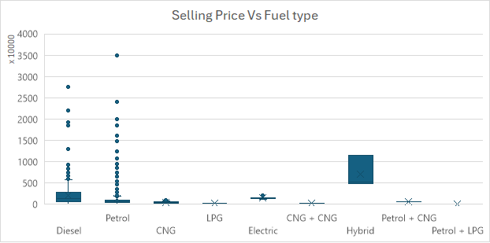
Selling Price vs Fuel Type
Diesel & Petrol: Most cars are diesel or petrol. Petrol cars show more variability, with some very high prices.
Hybrid Vehicles: Higher median selling prices, indicating a premium value.
Other Fuel Types: CNG, LPG, and electric vehicles have lower and more consistent prices.
Business Insight →
Focus on Hybrids: High resale potential.
Market Strategy: Consider affordability factors for CNG and electric vehicles.

Slide 6
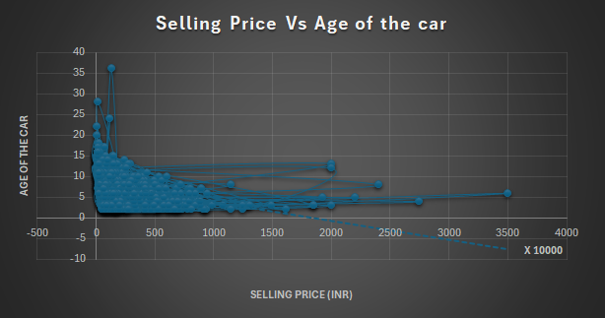
Selling Price vs Age of the Car
Graph Explanation:
Inverse Relationship: Selling price decreases as car age increases.
Steep Depreciation: Significant price drop in the first few years, then a slower decline.
High-Value Outliers: Some older cars maintain higher prices, possibly due to rarity or special features.
Business Insight:
Strategic Focus: Prioritize newer cars to maximize resale value.
Explore Opportunities: Investigate older, high-value models for potential profitable investments.

Slide 7
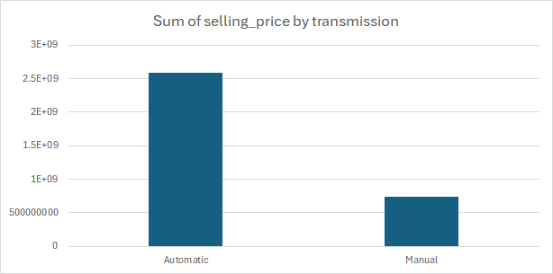
Sum of Selling Price by Transmission
Graph Explanation:
Automatic vs. Manual: Automatic cars have a much higher total selling price compared to manual cars.
Key Insight: This suggests a stronger market demand or higher value associated with automatic transmission vehicles.
Business Insight:
Investment Strategy: Prioritize purchasing automatic cars to maximize sales revenue.
Market Analysis: Continue monitoring trends to adapt to changing preferences between transmission types.

Slide 8
Correlation Analysis: Selling Price vs Various Factors
Key Correlation Values:
Kilometres (-0.15): Weak negative correlation; selling price slightly decreases as kilometres increase.
Car Age (-0.32): Moderate negative correlation; older cars have lower selling prices.
Length (0.55): Moderate positive correlation; longer cars are generally more valuable.
Fuel Tank (0.58): Strong positive correlation; larger fuel tanks are associated with higher selling prices.
Business Insight:
Investment Strategy: Focus on cars with greater length and fuel tank capacity for higher resale value.
Additional Considerations: Although age and kilometres influence price, they are less significant predictors.

Slide 9

Regression Analysis Summary
1. Selling Price vs. Kilometres
1
Multiple R: 0.15 (weak correlation)
R Square: 0.02 (only 2.2% of price variation explained)
Significance F: 3.14E-11 (model is statistically significant)
Coefficient: -6.07 INR per kilometre (selling price decreases slightly with more kilometres)
P-value: 3.14E-11 (highly significant)
2. Selling Price vs. Car Age
2
Multiple R: 0.32 (moderate correlation)
R Square: 0.10 (10.2% of price variation explained)
Significance F: 9.31E-49 (model is highly significant)
Coefficient: -226,340.50 INR per year (price drops significantly with car age)
P-value: 9.31E-49 (extremely significant)
3. Insights:
3
Kilometres: Weak impact on selling price, but still statistically significant.
Car Age: Stronger negative impact, suggesting that age is a more influential factor in determining price.

Slide 10
Business Insights and Next Steps
Model Enhancement: Incorporate additional variables such as car condition, brand, and market demand to refine our predictive pricing model.
Market Segmentation: Use clustering techniques to categorize cars by price and features, enabling more strategic buying decisions.
Automated Valuation: Develop an automated valuation system to quickly identify and purchase undervalued cars, staying ahead of competitors.
Focus on Newer Cars: Age is a crucial determinant of value. Investing in younger cars can yield higher returns.
Feature Consideration: Cars with larger dimensions and fuel tank capacities are priced higher. These should be targeted for better profitability.
Mileage Impact: While mileage matters, it should be considered alongside other factors for a holistic evaluation.

Slide 11

Conclusion
The analysis of the sales data reveals a significant opportunity for Used Cars R Us Pvt Ltd to increase profitability by strategically targeting undervalued vehicles. Diesel cars remain the most profitable segment; however, the electric and hybrid segments offer future growth potential. By developing a data-driven model to identify undervalued listings and launching a focused pilot program, the company can optimize its acquisition strategy and stay ahead in the competitive used car market.

Slide 12
Thank you

