Slide 1
VMware Hitachi Correlation

Slide 2
HYPERVISOR
A hypervisor, also called a virtual machine manager, is a program that allows multiple operating systems to share a single hardware host.
Each operating system appears to have the host's processor, memory, and other resources all to itself..
A computer on which a hypervisor is running one or more VM is defined as a host machine.

Slide 3
Types of Hypervisor
Type-1: native or bare-metal hypervisors
  These hypervisors run directly on the host's hardware to control the hardware and to manage guest operating systems. For this reason, they are sometimes called bare metal hypervisors.
Example :
Oracle VM Server for SPARC, Oracle VM Server for x86, the Citrix XenServer, VMware ESX/ESXi and Microsoft Hyper-V 2008/2012

Slide 4
Types of Hypervisor
Type-2: hosted hypervisors
  These hypervisors run on a conventional operating system just as other computer programs do. Type-2 hypervisors abstract guest operating systems from the host operating system.
Example:
VMware Workstation and Virtual Box are examples of type-2 hypervisors.

Slide 5
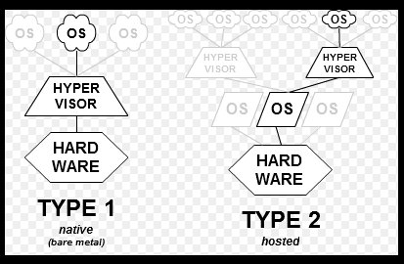
Difference Type 1 and 2

Slide 6
Component of ESX
Data Center
Cluster and Compute Resource
VMware
DataStore
Resource Pool

Slide 7
Data Center
Data Center is primary container of inventory object such as host, virtual machine, cluster.
vcenter server can contain multiple datacenters.
Object are interact with in datacenter but interaction across datacenters is limited.
Ex: vm across host with in datacenter.

Slide 8
Compute Resource
A compute resource is an object that represents a host, host cluster, or pool in a virtualization platform

Slide 9
Cluster
It is a group of hosts.
When you add a host to cluster, the host resources become part of the clusters resource then after cluster manages the resources of the all hosts with in .
Hosts are either the part of compute resource or cluster
VMware DRS (Distributed Resource Scheduler) is a utility that balances computing workloads with available resources in a virtualized environment

Slide 10
Vmware details
Virtual machines running on vSphere ESXi come with support for the following features and capabilities:
    Virtual machines can support up to 128 virtual CPUs.
    Virtual machines can support up to 4 TB of RAM.
    Maximum VMDK size is 62 TB.

Slide 11
DataStore
Data stores are logical containers, analogous to file systems, that hide specifics of each storage device and provide a uniform model for storing virtual machine files.
Data stores can also be used for storing ISO images, files that make up a virtual machine templates, and floppy images.
Data store can be created from local disk or Storage LUNS(one or multiple).

Slide 12
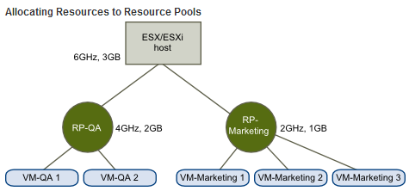
Resource Pool
It is used to hierarchically partition available cpu and memory resources of the host.
Each standalone host and each DRS cluster has an (invisible) root resource pool that groups the resources of that host or cluster.
The root resource pool does not appear because the resources of the host (or cluster) and the root resource pool are always the same.

Slide 13
Inventory object
Systems in the datacenter: Host, Virtual Machine, and VirtualApp.
Support components: Compute Resource, Data store, Network, and virtual devices.
Organizational components: Folder and Datacenter

