Slide 1

What is Client Side Rendering
What is Server Side Rendering
What are Isomorphic Apps
Difference between CSR and SSR
Pros and cons of CSR and SSR
When to use CSR
When to use SSR

Slide 2
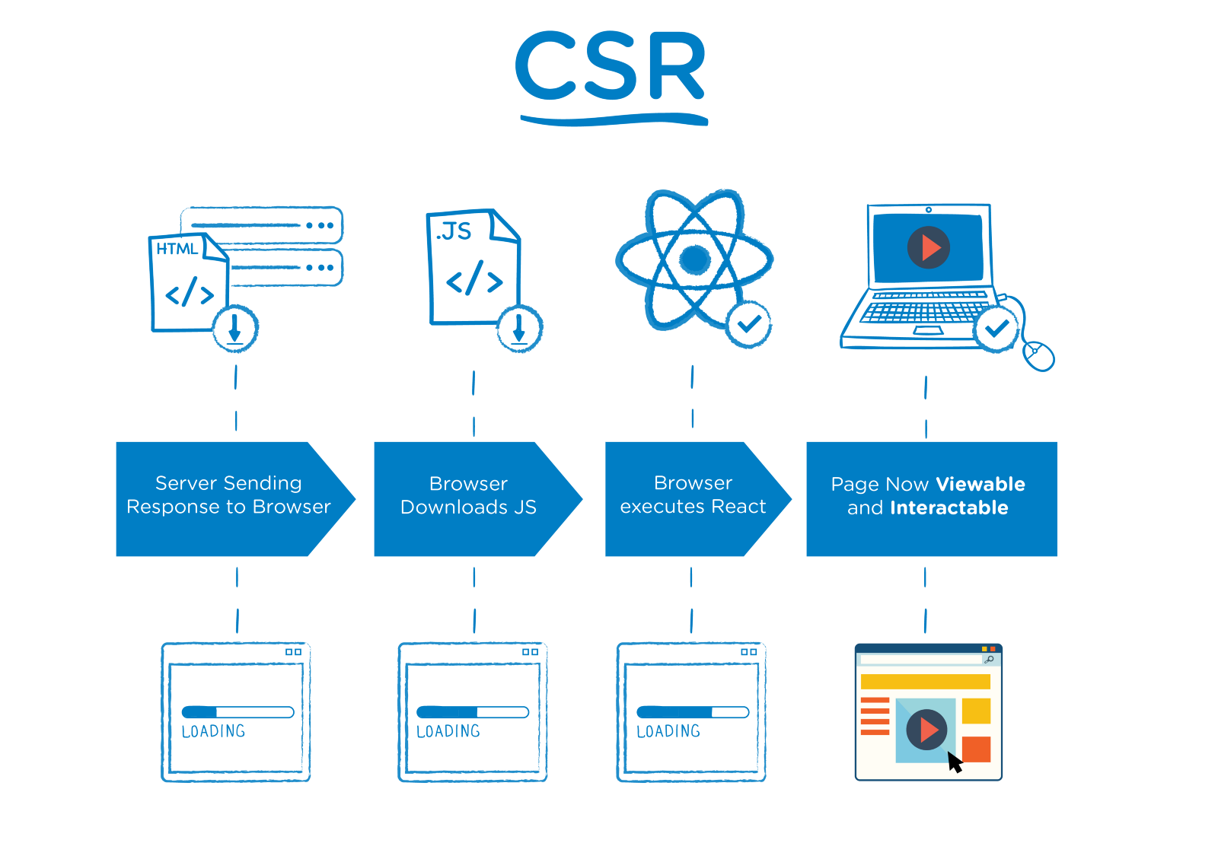
Client-Side Rendering the client, that is, the browser somehow gets the data, forms the DOM nodes, manipulates the DOM and displays the elements (rendering);

Slide 3
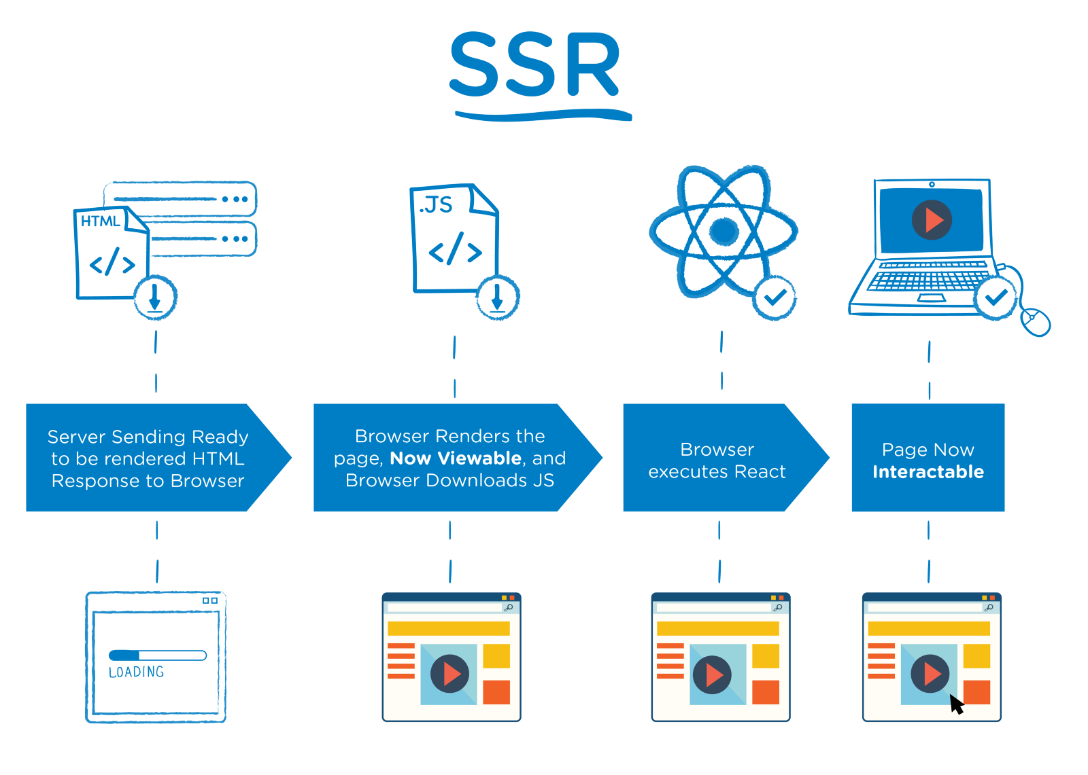
Server-side Rendering the server sends a pre-rendered (i.e., all the steps I outlines above been executed on the server-side) page, and that is displayed to the user.

Slide 4
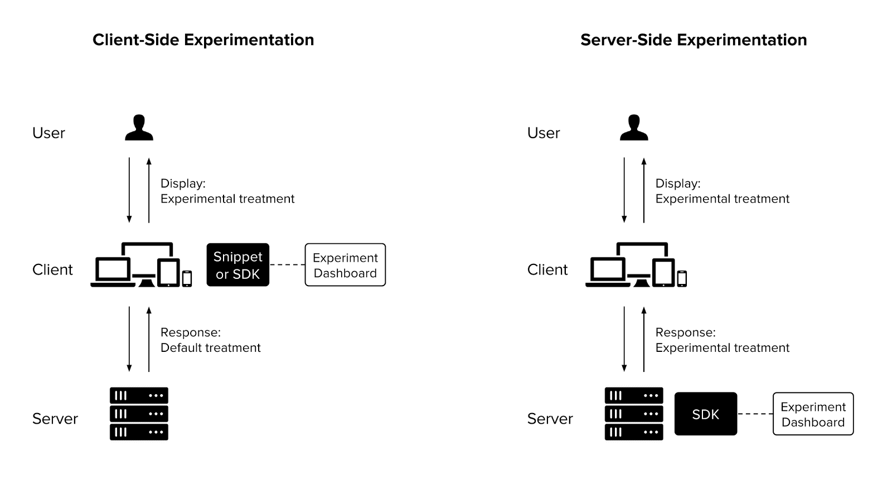

Slide 5
 | Server Side Rendering | Client Side Rendering
Initial Load | Fast | Slow
SEO | Rendering server-side helps search engine crawlers find your content. | Not All search engine have capability to craw client side rendering content. (Google can crawl CSR content partially.)
Rich Content | Non-rich site interaction | Rich site interactions
Cost | More | Less

Slide 6
Server-side pros:
Search engines can crawl the site for better SEO.
The initial page load is faster.
Great for static sites.
Server-side cons:
Frequent server requests.
An overall slow page rendering.
Full page reloads.
Non-rich site interactions.

Slide 7
Client-side pros:
Rich site interactions
Fast website rendering after the initial load.
Great for web applications.
Robust selection of JavaScript libraries.
Client-side cons:
Low SEO if not implemented correctly.
Initial load might require more time.
In most cases, requires an external library.

Slide 8
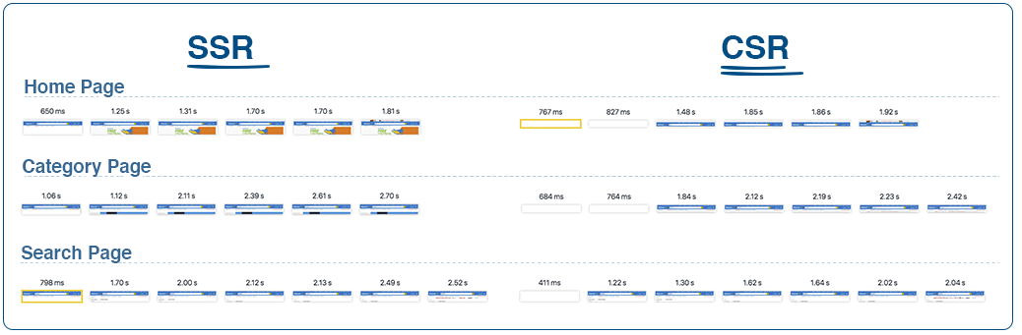
Production applications of walmart.com rendered with SSR vs CSR.
We compared three of our applications(home, category, and search) in SSR vs CSR. These are the chrome network screen grabs of the pages being rendered. You’ll notice that SSR renders faster, and that using CSR has the blank white page while loading. Most applications that use CSR will obviously replace the blank white page with a loading icon, but since we use SSR for our normal operations, when forced into CSR mode, the pages are blank. Please note these are one off captures, with our machines, at a certain time of day with the current prod build, so individual performance can vary-but this should be the general trend that you see for apps.

Slide 9
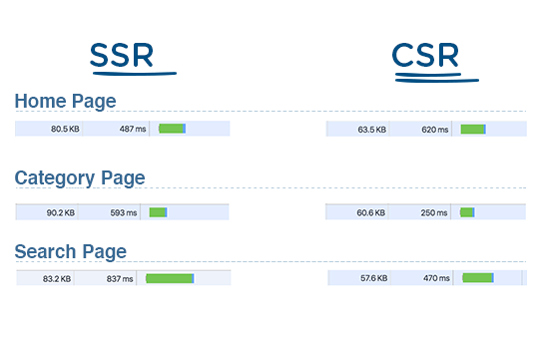
Here is the first server response for home, category and search pages. I would ignore the green bar, because that is more relative compared to the rest of the network graph. The two things I want to call attention to is the document size and the TTFB. Since the server is responding with HTML for the page, you’ll notice the document size for SSR is always bigger. Another point that was talked about earlier, the CSR response is faster(except for home page for some reason in this test).

Slide 10
When to use CSR
If your app/site have Rich Content or Interactive UI.
Fast page loads after initial page load.
If you are using different js libraries.
When to use SSR
Good for static content.
If you want to make site Search Engine Friendly.
For faster initial page load.

