Slide 1
Intuit Craft Demo
By Rahul Bansal

Slide 2
Index
Introduction
Functional Requirements
Non-Functional Requirements
Assumptions
System Targets
Back-of-the-envelope Estimation
Implemented Design & Tech Stack used
API Design
Low Level Design
Extended Requirements
High Level Design

Slide 3
Introduction
Currently Working as a Software Engineer at PayPal
3 years of total experience
Working on configuration platform, allowing applications to manage and modify application configurations independently from code, enabling dynamic updates without requiring to restart the instance.
Features developed
Implemented ”Live Test” functionality where users can deploy configurations on select few instances before going for a full rollout, which reduces deployment errors.
The tech stack that I am working on is Java, Spring Boot and MySQL

Slide 4
Functional Requirements
You are building a Market Place where people can post contract jobs to be performed. The jobs are bid on in an auction format similar to eBay but for jobs/tasks instead products.
The site has a home page that
Displays the 10 most recently published job postings.
Displays the top 10 most active and open jobs (measured by number of bids).
Includes a link to publish a new job posting
The site has a page allowing new jobs to be posted that:
Displays a form collecting the following data points
Job description with maximum length of 16KB.
Job requirements with maximum length of 16KB.
Name and contact info of the job poster.
Displays the current lowest bid amount
Displays the number of bids.
Displays the auction expiration date/time and time remaining to bid.
Includes a form for placing a bid.
The system:
Automatically closes bidding when the posting expiration date/time is reached.
Automatically assigns the lowest Bidder as the winner of the auction when the auction is closed

Slide 5
Non-Functional Requirements
Demonstrable & functionally correct code
Unit Testing for the core functionalities
Functional APIs
Ensure high availability and reliability of the bidding service to handle concurrent requests and system load.
Code readability, Entity modelling, Modularity & Extensibility, Separation of concerns, Abstractions. Use design patterns wherever applicable
Apply relevant design patterns for common design problems.

Slide 6
Assumptions
Authentication is Not implemented at this stage, assumed users are authorized based on their provided data.
Users can both post jobs and place bids on other jobs. A single user can act in multiple roles.
Users will register with contact information, which will be used for jobs they post.
A bid is successful only if the bid price is lower than the current lowest bid price for that job.
When a job is closed, the lowest bidder is decided as the winner, but future changes to this approach are possible

Slide 7
System Targets
There are 100K registered Bidders with 2K new Bidders registered per day.
1k jobs are posted every day growing at a rate of 250 jobs per week.
Every job receives an average of 20 bids.

Slide 8
Back-of-the-envelope Estimation
Traffic Estimation (For next 5 Years):
Registered Bidders: ~3,75,000 (100K + 2K new per day)
DAU (Daily Active Users) = ~375,000 (Assuming 10% of Total bidders)
Jobs Posted per day = 1,375 (1,000 initial + 250 increase per week)
Bids per day = 20,720 (1,000 jobs per day * 20 bids per job)
QPS(for bid placement) = 0.24/sec
Total QPS = 4/sec
Storage Estimation (For next 5 years):
Total jobs: ~2 Million
Average job size: 33KB (16KB description + 16KB requirements + ~1KB)
Total bids: 2M * 20 = 40 Million
Average bid size: 100 Bytes
Total storage for next 5 years = (2M jobs * 33 KB) + (40M bids * 100 Bytes) ≈ 66GB + 4GB = 70GB

Slide 9
Implemented Design & Tech Stack used
Spring boot is used for developing Rest APIs
An SQL Database is used for storing User and Job information, ensuring relational integrity and consistency.
Concurrency Management: Optimistic locking is employed to handle concurrent access and modifications to job and bid records.
Strategy design pattern is used to decide the winning bid for the job, with the default strategy being the lowestBidderStrategy. This is configurable and can be changed in the future.
Mediator design pattern is applied to facilitate communication between Job and Bid entities, with the Auction Mediator managing bid operations and job status changes.

Slide 10
API Design
1. Create a Job - Creates a new job posting.
Endpoint: POST /api/v1/jobs
Request Body:
title: The title or name of the job
description: A detailed description of the job
requirements: Specific qualifications required for the job.
expirationDate: The date and time when the job posting expires.
startingPrice: The starting price or budget for the job (e.g. - 100.0).
jobType: The type of job (e.g. – “DESIGN”, “WRITING”).
userId: userId of the poster
Response:
Status Code: 201 Created
Description: Returns the details of the created job
2. Get list of Jobs – get list of Jobs
Endpoint: GET /api/v1/jobs
Query parameters:
jobStatus, jobType, sortBy, createdAt, userId, order, page, size
Top 10 Active jobs - /api/v1/jobs?jobStatus=OPEN&sortBy=bidCount&order=DESC&page=0&size=10
Top 10 Recent jobs - /api/v1/jobs? jobStatus=OPEN&sortBy=createdAt&order=DESC&page=0&size=10

Slide 11
Contd.
2. Place a Bid - Places a bid on a job.
Endpoint: POST /api/v1/jobs/{jobId}/bids
Request Body:
bidPrice: The amount being bid for the job (e.g., 150.0).
userId: userId of the bidder
Response:
Status Code: 200 OK
Description: Returns the details of the placed bid, including the bid ID, bid price, bidder’s details, and the job details
3. Delete a Bid - Deletes a bid from a job.
Endpoint: DELETE /api/v1/jobs/{jobId}/bids/{bidId}
Query Parameters:
user_id: ID of the user attempting to delete the bid.
Response:
Status Code: 200 OK
Description: Confirms successful deletion of the bid.

Slide 12
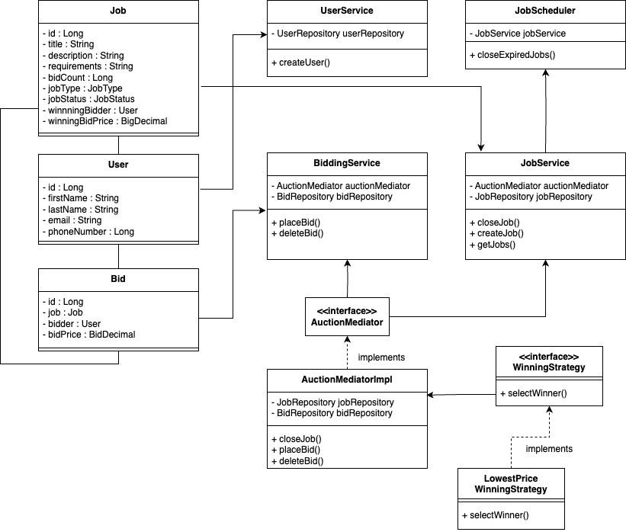
Low level design

Slide 13
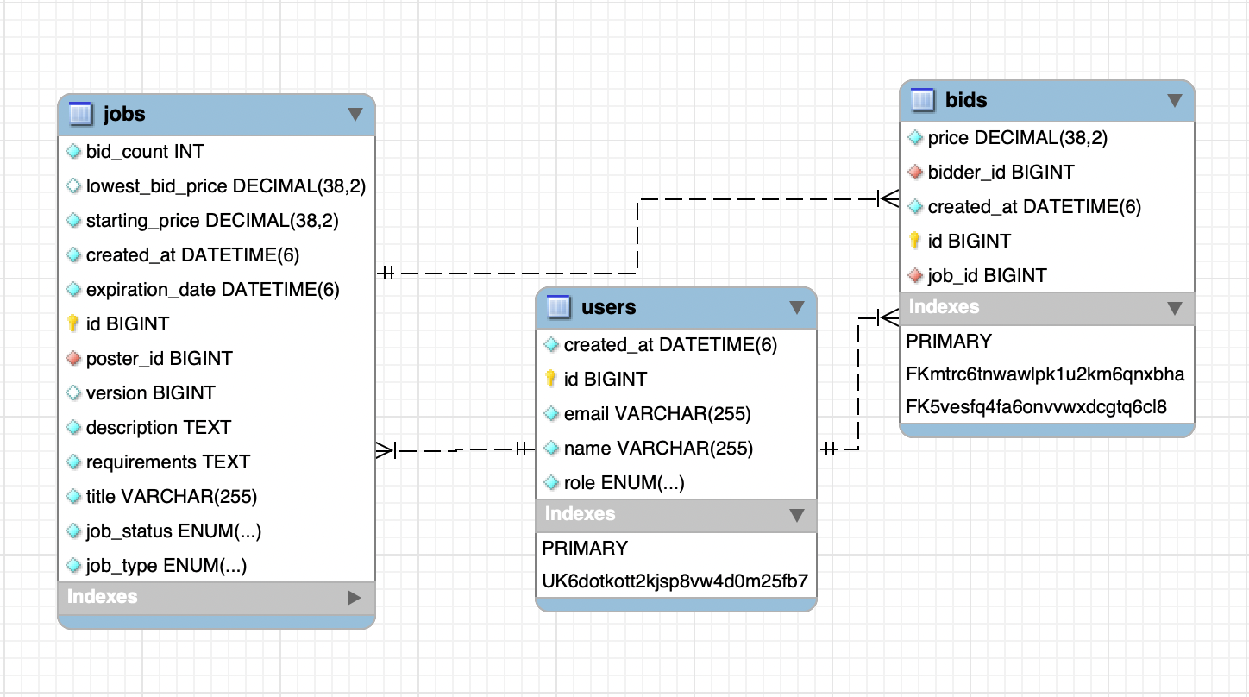
Database selection and design
MySQL supports a well-defined relational schema that efficiently handles the structured data of users, jobs, and bids.
ACID properties ensures data integrity and supports transactions, which is needed for maintaining consistency in job and bid records.
Optimistic locking can be used to manage concurrent updates.

Slide 14
Extended Requirements
Authentication & Authorization
Real-time Notifications for bid updates, job status changes and other events to enhance user experience.
SSE(server-sent events can be used for real-time bid updates on a job posting)
Auditing service can be implemented for bid actions to track changes, maintain records.

Slide 15
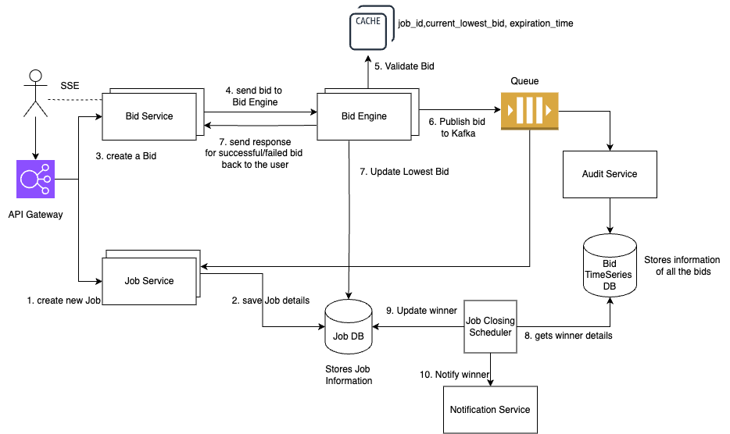
High Level Design - Extended Requirements

Slide 16


