Slide 1
LLM101 — Build Your LLM From Scratch
A 12-step tour of building a ~15M-parameter GPT-style transformer in ~800 lines of PyTorch
RMSNorm · RoPE · SwiGLU · Causal Self-Attention · Weight Tying · KV Cache · BPE Tokenizer

Slide 2
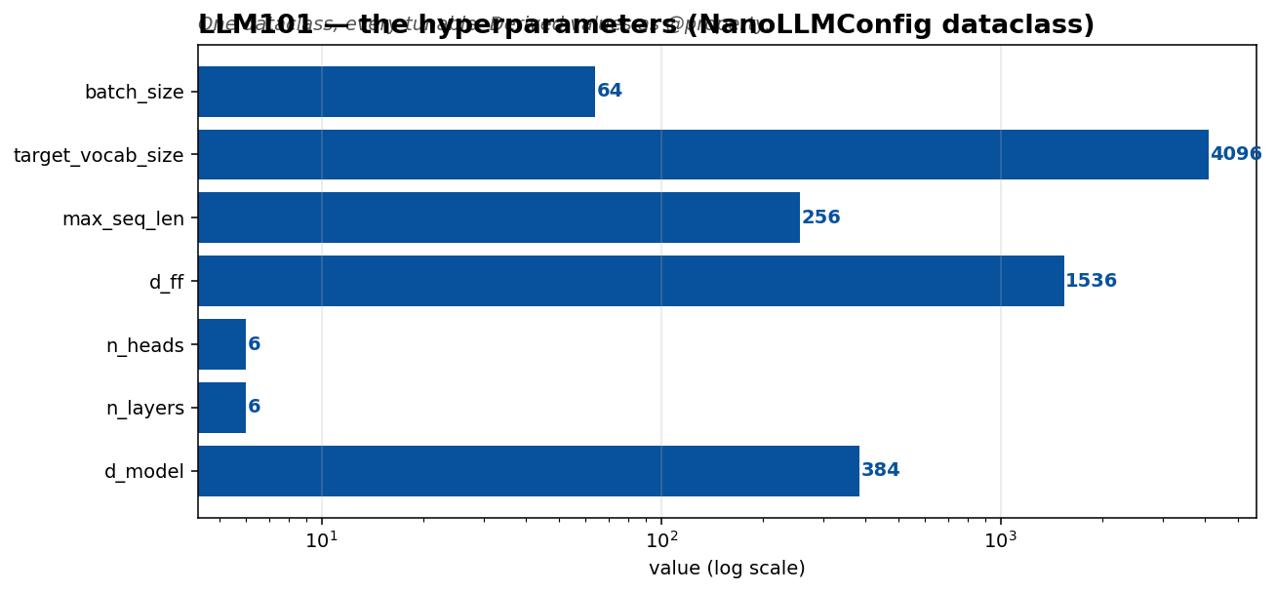
1 · Pin the hyperparameters — config.py
Start here, not at model.py. A single dataclass owning every tunable keeps the rest of the code uncluttered and reproducibility mechanical.
Non-obvious choice: vocab_size starts at 0. Every script that builds the model must set config.vocab_size = tokenizer.vocab_size before instantiation. This avoids hardcoding and keeps the tokenizer and model coupled through a single variable.
Derived values live in @property, with assertions that catch misconfiguration at access time rather than during a forward pass.

Slide 3
2 · Byte-level BPE tokenizer — tokenizer.py
BPE from scratch in ~200 lines. Byte-level means the base vocab is always 256 (every possible byte), so any UTF-8 text round-trips losslessly — no <UNK> explosion on new characters.
Vocabulary layout:
0-3 : <PAD>, <BOS>, <EOS>, <UNK> (4 specials)
4-259 : raw bytes 0x00-0xFF (256 base)
260+ : learned BPE merges
Gotcha: A corpus of 'hello world' * 100 collapses into a single token after ~10 merges. BPE tests need real variation.

Slide 4
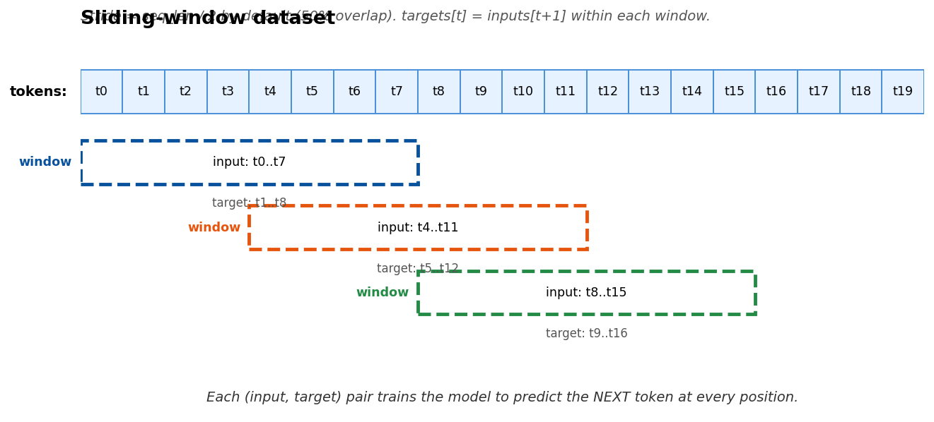
3 · Sliding-window dataset — dataset.py
Turns a token stream into (input_ids, targets) pairs where targets = input_ids shifted +1. This is the core causal-LM training invariant.
Default stride is seq_len // 2 (50% overlap). Non-overlap gives cleaner evaluation but halves the sample count.
Tested by an invariant: target[:-1] == input[1:].

Slide 5
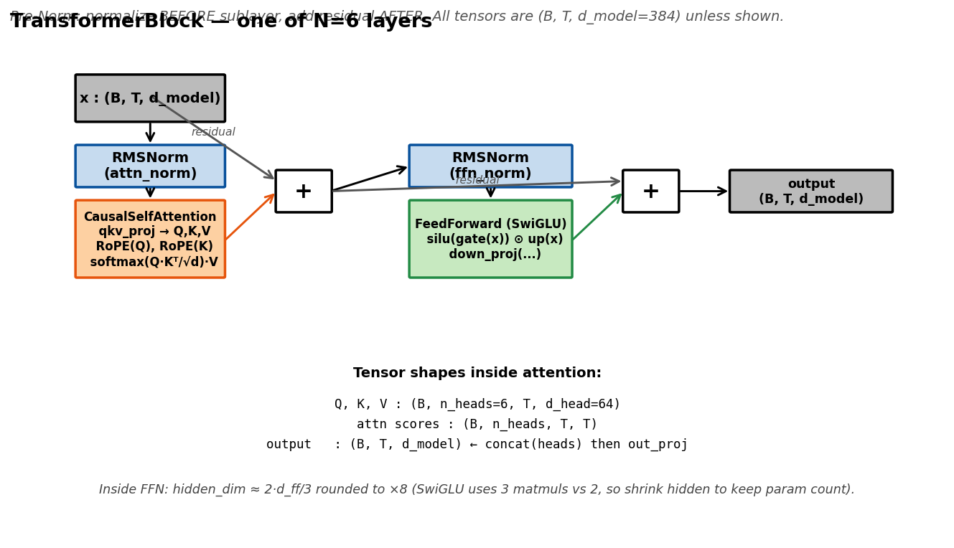
4 · The Transformer block — model.py
Build bottom-up: RMSNorm → RoPE → Attention → SwiGLU → Block.
Pre-Norm (normalize before the sublayer, add residual after) keeps deep stacks stable without learning-rate warmup knife-edge. Modern LLMs all use this pattern.
Weight tying: self.lm_head.weight = self.token_emb.weight — not a copy, the SAME tensor. Test with 'is' not torch.equal.
GPT-2 residual-projection init: scale by 1/√(2·n_layers) to keep activation variance stable as depth grows.

Slide 6
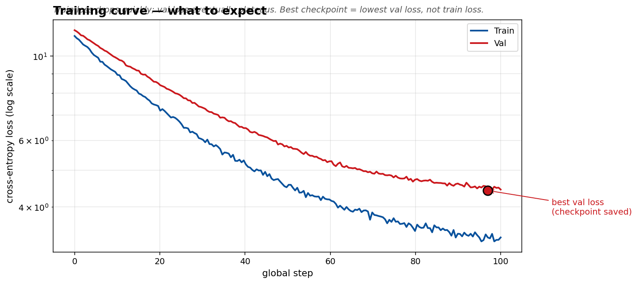
5 · Training loop — train.py
The ingredients, in descending order of impact:
1. bf16 mixed precision on Ampere+ — 2× speedup, basically free
2. AdamW with weight-decay groups — decay on 2D weights only
3. Linear warmup → cosine decay to 10% of peak LR
4. Grad clip 1.0 — cheap insurance against loss spikes
5. Val split is sequential 90/10 — random split leaks
6. 'Best' checkpoint on val loss, not train loss
At the end, dump loss_curve.png — students can SEE the train/val gap open up. That IS overfitting.

Slide 7
6 · Autoregressive generation (naive)
Forward the full context, sample from last-position logits, append, repeat.
The sampling filter (temperature → top-k → top-p) is shared between generate(), generate_fast(), and teach.py's sampling rollout — one source of truth: _sample_from_logits().
The scatter at the end of top-p looks fragile but is correct: sorted_idx is a permutation over ALL vocab positions, so every slot is written.

Slide 8
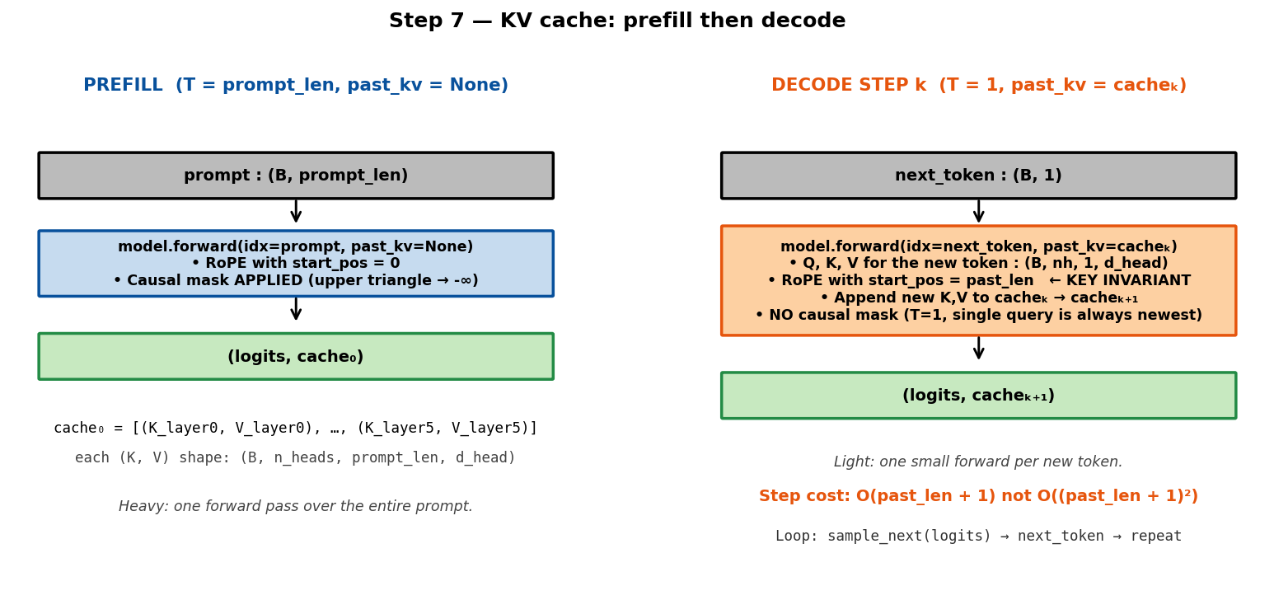
7 · KV cache — generate_fast()
Without a cache, every decode step recomputes Q, K, V for the entire context. With a cache, keep K, V from prior steps and only compute for the new token. Cost: O(total_len) instead of O(total_len²).
Two invariants easy to miss:
• RoPE offset: new token's angle must use start_pos = past_len, not 0
• Causal mask: applied during prefill (T>1), skipped during decode (T=1)
Correctness test: prefill(prompt) then 1-step decode must match a full forward. max |Δlogit| < 1e-4.

Slide 9
8 · Teaching hooks — teach.py
Capture intermediate tensors via forward hooks without modifying model.py.
block.attn.register_forward_pre_hook(attn_hook)
def attn_hook(module, inp):
x = inp[0]
# Recompute Q, K, V, scores, weights from x
store['attn_weights'] = ...
The alternative — sprinkling return_attention=True kwargs through production code — poisons model.py. Hooks keep teaching instrumentation strictly orthogonal.
Re-render on-the-fly: the whole point is that changing the prompt flips the attention.

Slide 10
9 · Attention visualisation — visualise.py
Two things worth rendering:
1. Per-head heatmap — attn_weights[layer][0, head], shape (T, T), viridis colormap, row = query, column = key.
2. Attention rollout (Abnar & Zuidema 2020) — multiply attention matrices across all layers to see effective attention flow. More interpretable than any single layer.
Both are in the Attention tab. Pick any prompt + layer + head to see the heatmap live.

Slide 11
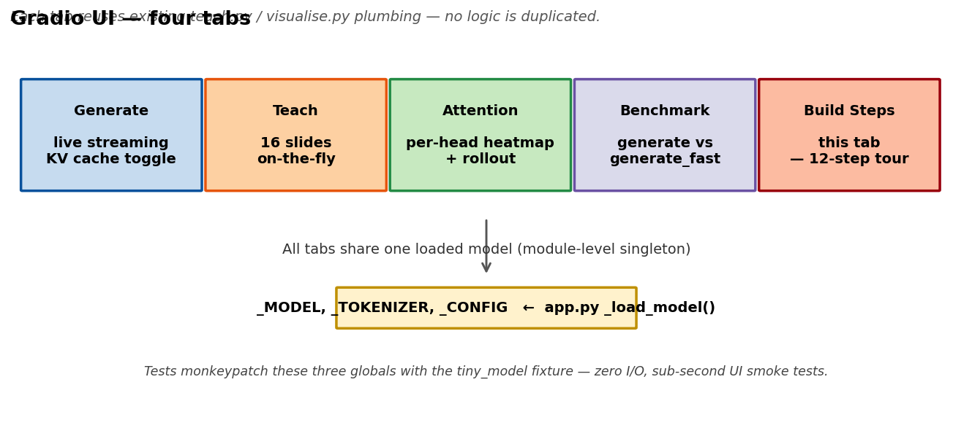
10 · Gradio web UI — app.py
A single browser app as the webinar entrypoint. All handlers import and call existing functions — no logic re-implemented.
Two Gradio patterns worth learning:
1. Streaming via yield — a generator handler gives per-token typewriter output for free.
2. Module-level singletons + monkeypatch for tests — load the model once at startup; tests inject a tiny model. No I/O, sub-second UI smoke tests.
Version pin: gradio>=5,<6 (4.44.x has a schema-introspection bug).

Slide 12
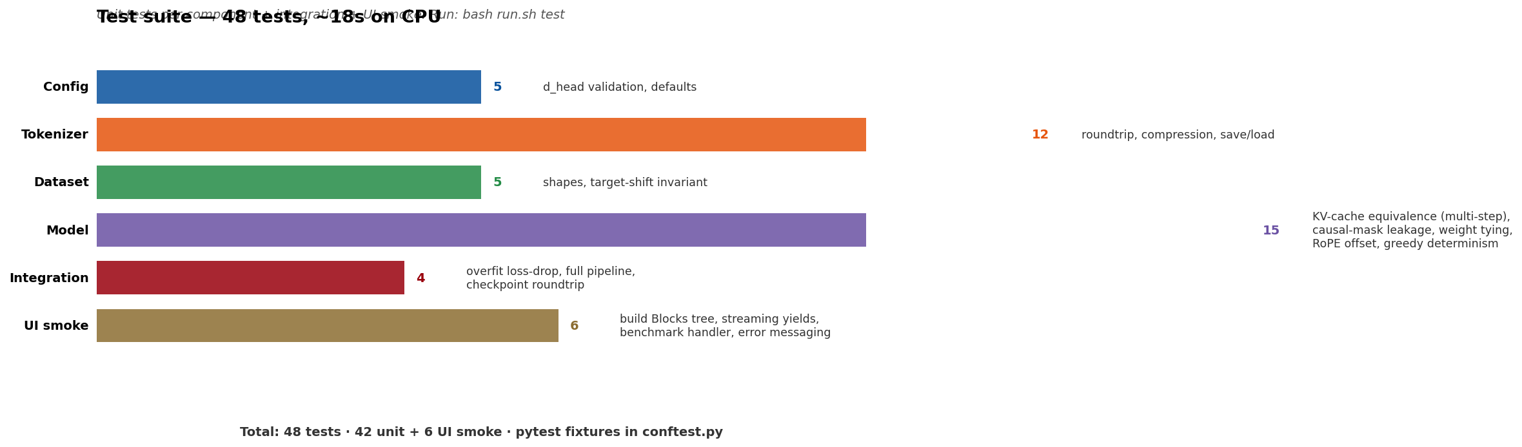
11 · Test suite — tests/
55 tests, CPU-only, ~15s end-to-end.
Highest-value tests guard invariants rather than shapes:
• test_kv_cache_matches_full_pass → RoPE start_pos invariant
• test_causal_mask_no_future_leakage → perturbing token T-1 leaves earlier logits unchanged
• test_weight_tying → 'is'-check: lm_head.weight and token_emb.weight are the SAME tensor
• test_training_step_reduces_loss_on_tiny_overfit → end-to-end backward/optimizer moves parameters
Invariant tests survive refactoring. Shape tests get rewritten every time.

Slide 13
12 · Ship it — run.sh
Commands unified through one bash dispatcher:
bash run.sh setup # venv + torch + TinyShakespeare
bash run.sh verify # model.py sanity check
bash run.sh train # full training
bash run.sh generate --fast
bash run.sh benchmark # generate vs generate_fast
bash run.sh teach # 16 static PNGs
bash run.sh visualise # attention heatmaps + rollout
bash run.sh ui # Gradio webinar console
bash run.sh test # pytest suite
Explicit subcommands > magic auto-detection. A new user running bash run.sh with no arg gets a helpful usage message.

Slide 14
Hyperparameter Effects
How each training hyperparameter shapes the loss curve — schematic charts based on standard ML literature and observed behavior on small transformers

Slide 15
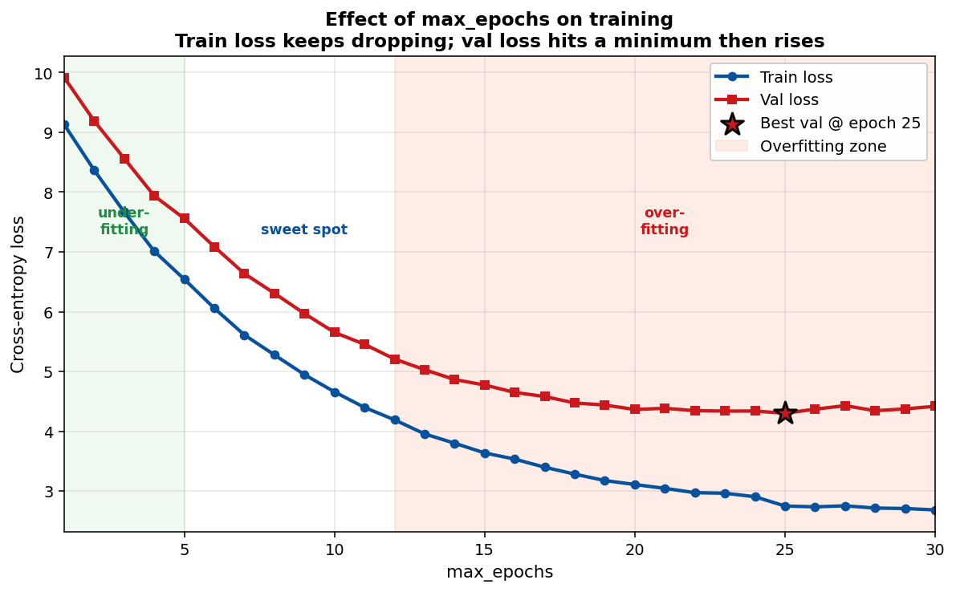
Effect of max_epochs
Train loss drops monotonically. Val loss hits a minimum then rises. The gap between them is your overfitting signal — the wider the gap, the more your model is memorizing rather than generalizing. "Best val" gives you the ideal number of epochs for this data.
Rules of thumb: on TinyShakespeare, expect sweet-spot around epoch 8-12; by epoch 20+ overfitting dominates.

Slide 16
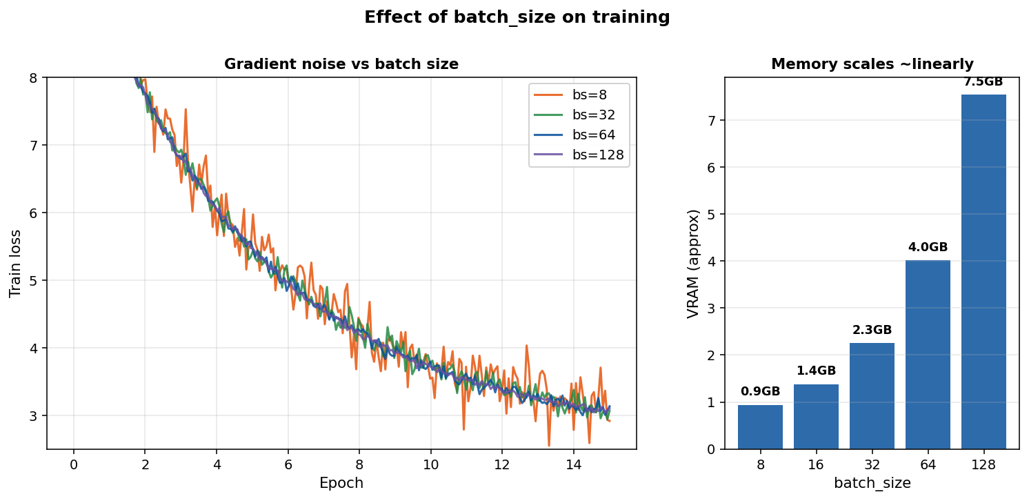
Effect of batch_size
Larger batch = smoother gradient + fewer updates per epoch + linear memory cost. Small batches (bs=8) are noisy but train in less wall-clock time; large batches (bs=128) are stable but may need more epochs to match. Final loss is roughly equal across reasonable batch sizes.
Rules of thumb: pick the largest batch that fits in VRAM, then tune learning rate to match (bigger batch → slightly higher LR).

Slide 17
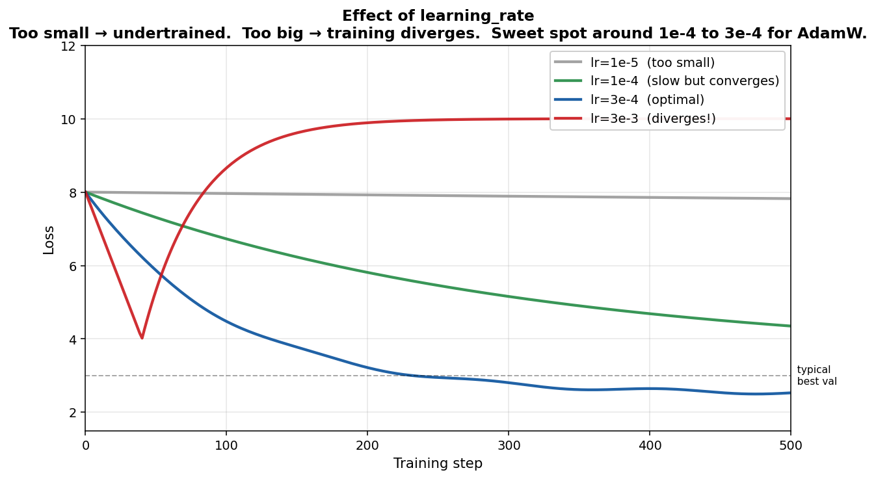
Effect of learning_rate
Too small → loss barely drops in your step budget. Too big → loss diverges, possibly NaNs. There's a sweet spot where convergence is fast and stable.
Rules of thumb: for AdamW with warmup + cosine schedule, 1e-4 to 3e-4 works for most small transformers. If loss explodes, halve the LR. If loss drops slowly, double it.

Slide 18
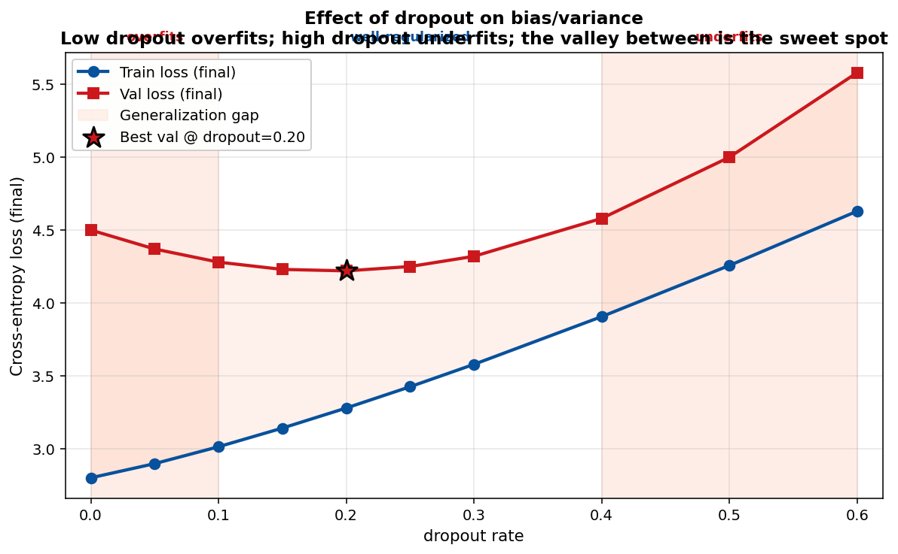
Effect of dropout
Dropout is a bias-variance knob. With dropout=0, the model fits training data tightly but generalizes poorly — train and val diverge. With high dropout (>0.4), the model can't fit even the training data. The valley between is where val loss is lowest.
Rules of thumb: start at 0.1 for small datasets, 0.2-0.3 if you see a growing train/val gap.

Slide 19
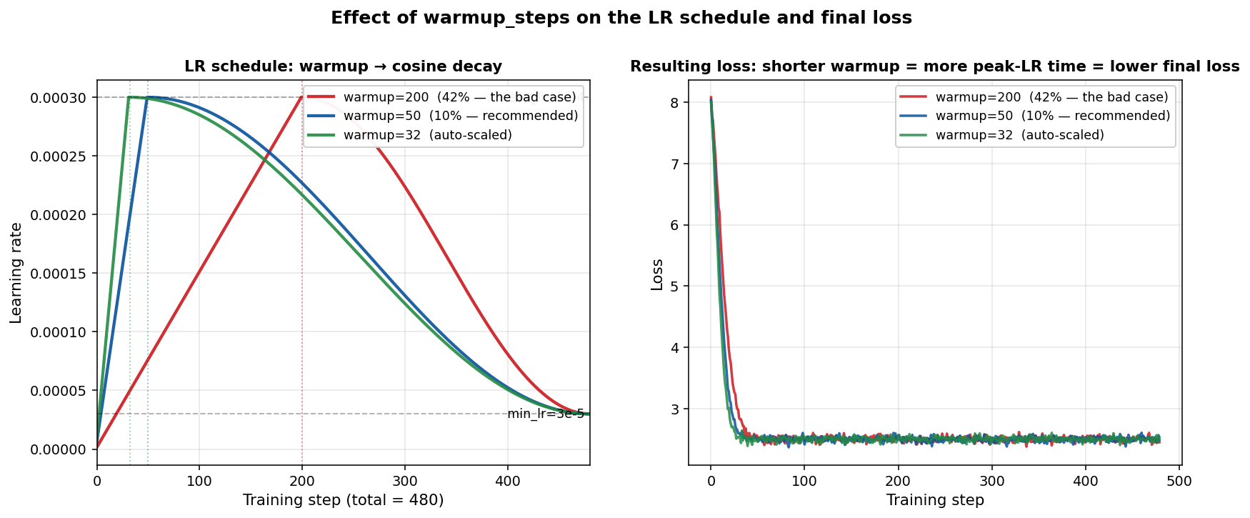
Effect of warmup_steps
The LR schedule is linear warmup → cosine decay. If `warmup_steps` is too large a fraction of total_steps (the `200/480 = 42%` case you just hit), the model barely gets any time at peak LR and learns slowly. Short warmup gives the model more peak-LR training time.
Rules of thumb: warmup ≈ 5-10% of total steps. The auto-scale in `train_iter` now enforces this automatically when you leave the slider at 0.

