Slide 1
Agentic ai using ibm cloud
CAPSTONE PROJECT
Presented By:
1. Rahul Bera - Netaji Mahavidyalaya, Arambagh - Computer Applications

Slide 2
OUTLINE
Problem Statement (Should not include solution)
Proposed System/Solution
System Development Approach (Technology Used)
Algorithm & Deployment
Result (Output Image)
Conclusion
Future Scope
References

Slide 3
Problem Statement
With the evolution of AI, organizations require platforms that can help in building intelligent agents capable of automating tasks. The challenge lies in integrating AI models with cloud services for real-time deployment and scalability without deep infrastructure knowledge.

Slide 4
Proposed Solution
This project demonstrates the development of an Agentic AI using IBM Cloud's Watsonx.ai. The agent is trained to automate tasks and deploy services using a user-friendly cloud interface without requiring extensive backend configuration.
Key Components:
- IBM Watsonx.ai
- AI Foundation Models (Mistral-Large)
- API Deployment and Sandbox Integration
- Runtime Services

Slide 5
System Approach
Technologies Used:
IBM Watsonx.ai (AI Agent builder)
IBM Cloud Sandbox & Runtime Services
Mistral-Large Foundation Model
Web-based deployment interface
Approach:
Used sandbox to configure agent
Created runtime environment
Trained agent using a visual interface
Deployed AI service with auto-generated API key

Slide 6
Algorithm & Deployment
Model: Mistral-Large Foundation Model
Steps:
1. Selected Watsonx.ai environment
2. Created sandbox and project
3. Associated runtime service
4. Selected pre-trained AI model
5. Trained and tested agent with user prompts
6. Deployed with API integration
No custom ML algorithm – used IBM's pre-configured foundation models for task automation.

Slide 7
Result
Successfully deployed the AI Agent using Watsonx.ai.
The agent was able to answer queries in real-time using the selected model.

Slide 8
Conclusion
This project successfully demonstrates building and deploying an intelligent AI agent using IBM Watsonx.ai. The simplified visual tools and pre-trained models make it easier for students and professionals to create AI services without coding.

Slide 9
Future scope
- Integrate multiple AI agents for complex workflows.
- Use APIs to connect to third-party tools.
- Deploy agents on mobile or web apps.
- Train custom models for industry-specific use cases.

Slide 10
References
IBM Cloud Documentation
IBM Watsonx.ai

Slide 11
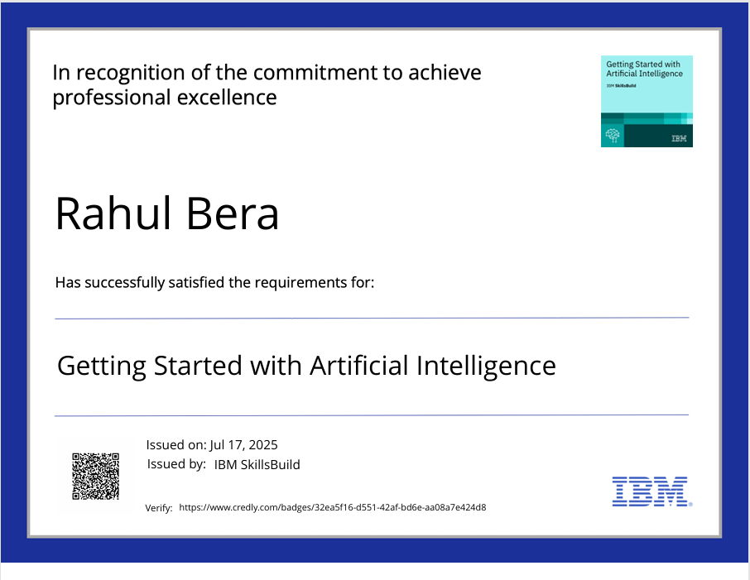
IBM Certifications

Slide 12
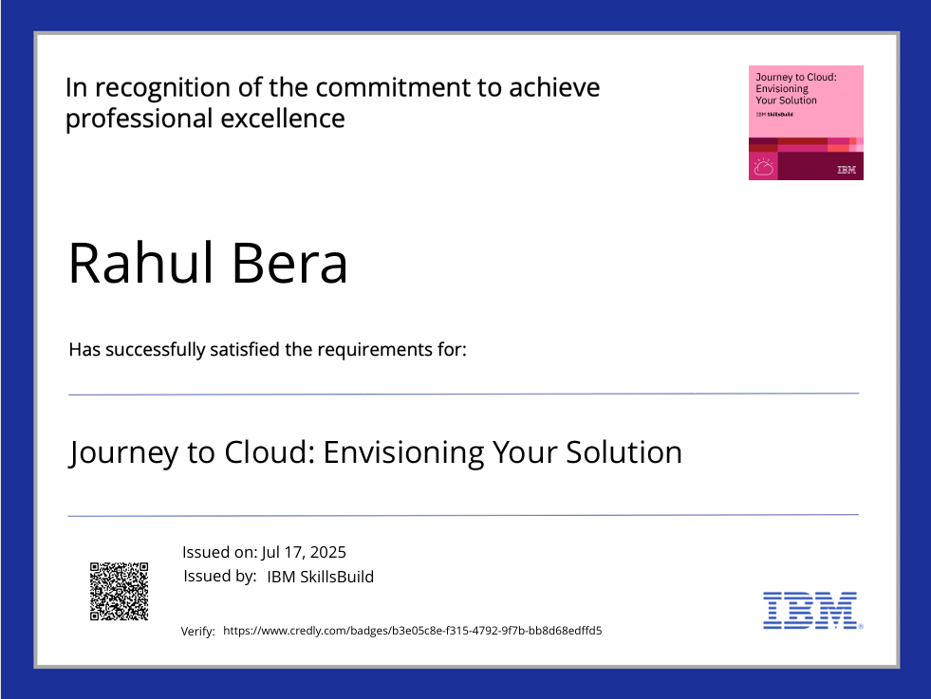
IBM Certifications

Slide 13
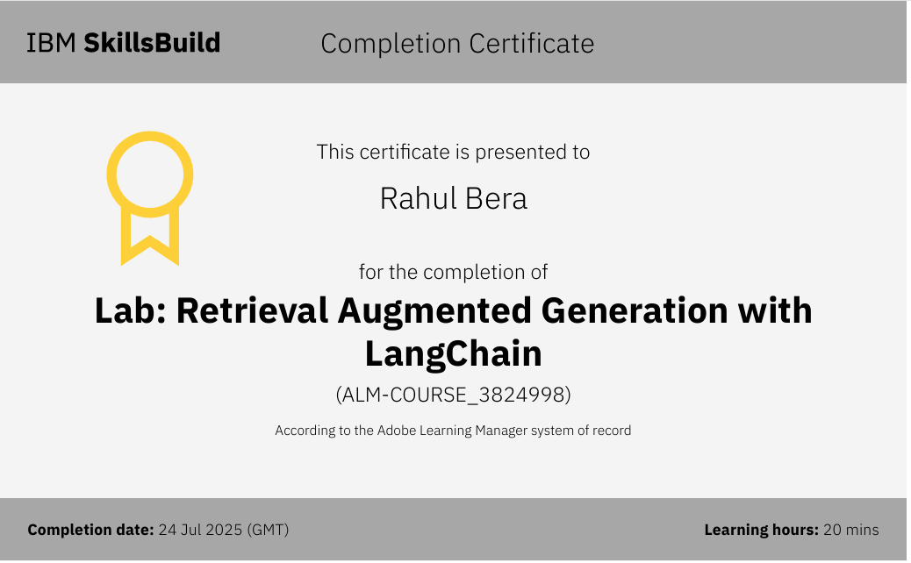
IBM Certifications

Slide 14
THANK YOU

