Slide 1

INTELLIGENT ROAD ACCIDENT DETECTION IN IOV
SNO: PROJECT REVIEW 2
GROUP
Harsha Lokesh -19BCT0240
Rahul Bhassy – 19BCT0099
Nikhil Janga -19BCT0244
Joel Daniel Johnson -19BCT0263

Slide 2
ABSTRACT
Road accidents are one of the highest causes of death and injuries world over, which can not only be prevented but also avoided all together, modern technological advancements with the use of interconnection of Vehicles and WSN. In this paper we provide a comprehensive study and summary of papers needed for road accident detection, smart alert systems and accident avoidance, by making use of intelligent routing and providing machine learning models for adaptive internet of vehicles. The machine learning model provide an accurate model for accident detection of vehicles, and also avoidance.

Slide 3
PROPOSED METHOD
In the paper we provide two model for intelligent accident detection and accident avoidance of Internet of vehicles. For accident avoidance we use a dataset for giving an accurate estimate with Machine learning techniques, to predict and depict accident zones within a few kilometers of range before the accident-prone zone and in turn warn the driver or slow down the car automatically.
The second model we analyze an accident detection dataset for providing accurate estimate of patient condition so that critical help can be provided in time to the accident victim or most critical victim in case of multiple vehicular collision. The data is mainly obtained with the help of various sensors such as biomedical, accelerometer, GPS, etc.
The models provide accurate estimates with lesser fault rate and can help avoid accidents and also provide proper assistance in case of accidents.

Slide 4
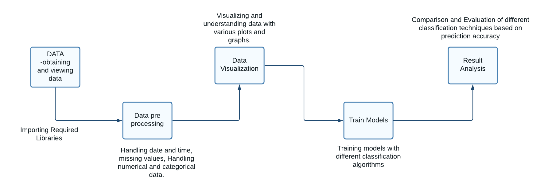
PROCESS FLOW AND IMPLEMENTATION AND RESULT ANALYSIS
The data obtained through the cars Lidar sensors and other IoT sensors can be interpreted and a valid pre-trained model can be used to determine if the vehicle is going to have an accident and the car can be slowed down, or a warning can be given to the driver in order to slow down or stop the car. The model provides accident detection and prevention probabilities and also accident severity for ambulance services and help for respective action to be taken.

Slide 5
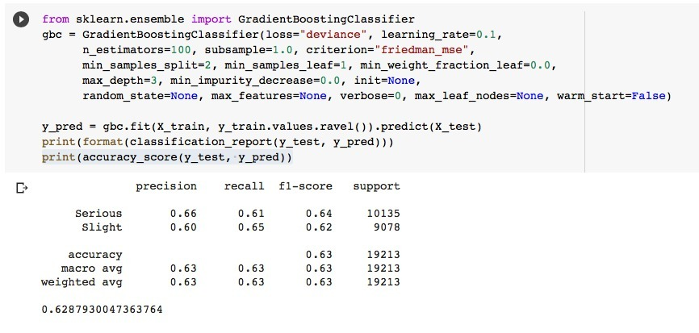
GRADIENT BOOSTING MACHINE
This technique is utilized for regression, classification-based tasks. Boosting comes under the category of ensemble learning technique where it consists of weaker prediction models (which are decision trees) correcting the errors of previous model thus giving more accurate prediction after each model. The process is sequential. This algorithm works well on under sampled data/imbalanced data as every time a weaker model makes an incorrect prediction, the next successive model focuses more that incorrect prediction. But the algorithm needs higher computational demand, making its implementation difficult.
Fig 2. Gradient boost classification accuracy for accident severity detection

Slide 6
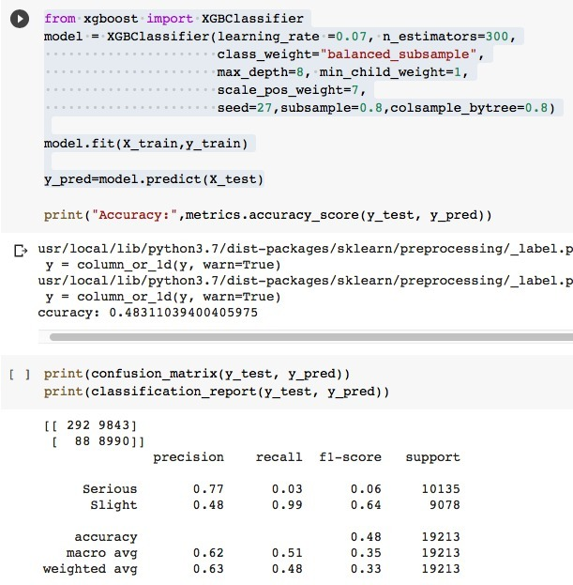
XGB CLASSIFICATION
It’s a version of gradient boosting machines. There are minimal frills in the library since it is intently made for superior computing speed and model execution. It still does, however, provide a lot of sophisticated functions. The gradient boosting decision tree methodology is incorporated in the XGBoost package. Gradient boosting, multiple additive regression trees, stochastic gradient boosting, and gradient boosting machines are all terms used to describe this approach. Gradient boosting is a method in which different models are developed that forecast the covariances or mistakes of previous versions, which are then combined to form the end output. Xgboost is so named since it employs a gradient descending approach to minimize losses while developing newer versions. This method is applicable to both 'regression and classification predictive modeling issues. It is an assembly procedure that requires creating extra models to old models to rectify flaws. Models are created in a logical order until there are no more refinements that can be performed. The two major highlights of XGB classifier is its superior speed and model performance.
Fig 3. XGB classification accuracy for accident severity detection

Slide 7
GUASSIAN NAÏVE BAYES CLASSIFIER
Naïve Bayes algorithms comes within the group of supervised ml algorithms. The algorithm is made using the bayes theorem. The classification technique is simple and provides higher functionality. The algorithm is used to implement many classification problems which are very complex (when dimensionality of input data is very high). Bayes theorem is used in probability for the calculation of conditional probability. The assumption we take while using this technique is that features of the data are strongly independent from each other. Since the features we use in our accident severity dataset are independent, it works well to predict the values for the input set of features. Gaussian naïve bayes comes under naïve bayes techniques. In this model, if the data is continuous, we can assume values tied with each feature/class are distributed according to gaussian (normal) distribution. That is no covariance between dimensions. If the features in the dataset chosen are discrete, we should use multinomial Naïve bayes classification technique for optimal results.

Slide 8
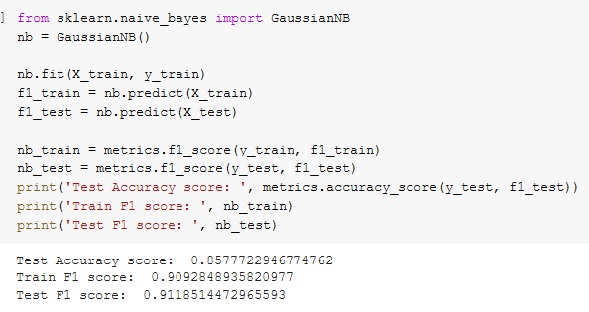
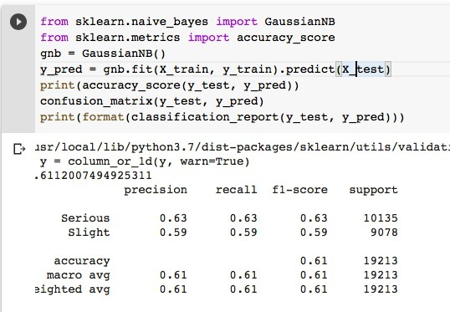
Fig 4. Gaussian naïve bayes classification accuracy for accident prevention
Fig 5. Gaussian naïve bayes classification accuracy for accident severity prevention

Slide 9
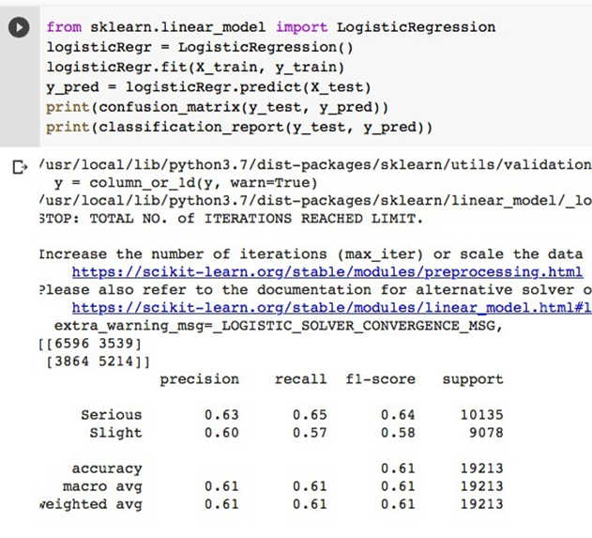
LOGISTIC REGRESSION
It is one of the fundamental classification techniques. It is the part of linear classifier, and has similarities with polynomial and linear regression. Even though it’s a method for binary classification, multiclass problems are also classified with this technique. The probability of categorical dependent variable can be predicted by logistic regression. The assumptions that we take while using logistic regression are categorical dependent variable should be binary. In binary regression desired result is represented as 1 (dependent variable). There should be no covariance/multicollinearity between independent variables. The data set should be quite large. The logistic regression technique measures the dependence of categorical independent variable with other independent variables using a logistic function (sigmoid function) to find their probabilities, which helps in categorizing data into a discrete classes. But we should not use logistic regression technique when no of features is greater than observations as it may lead to overfitting problem. As logistic regression assumes linear dependence between categorical dependent variable and independent variable, it is a major limitation. It should be noted that nonlinear problems cannot be solved with logistic regression.

Slide 10
K- NEAREST NEIGHBOURS
K nearest neighbours basic classification algorithm in machine learning. It is a type of supervised learning techniques. It is used in classification and regression problems as well. A labelled input data is used in supervised learning to train the model and helps in prediction a valid result when unlabeled data is given. This technique does not assume anything about the distribution of data (as some techniques like gaussian Naïve Bayes assume gaussian distribution of the input data). KNN can be used for assigning missing values and resampling input data. K nearest neighbours algorithms learning is based on: Instance based learning, lazy learning and non-parametric. But it is important to keep in mind, there much faster algorithms to produce regression, classification results. KNN does not work with huge dataset, also the used data should not be high dimensional. We should do feature scaling of data before applying K nearest algorithms to get correct predictions.

Slide 11
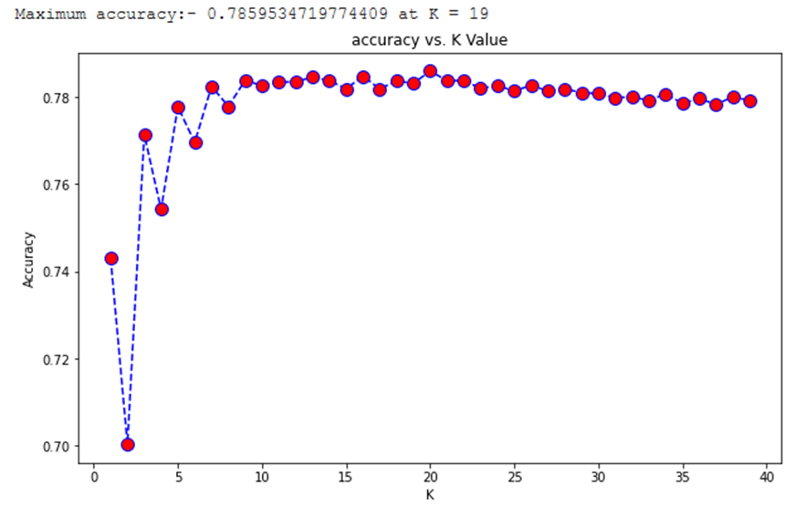
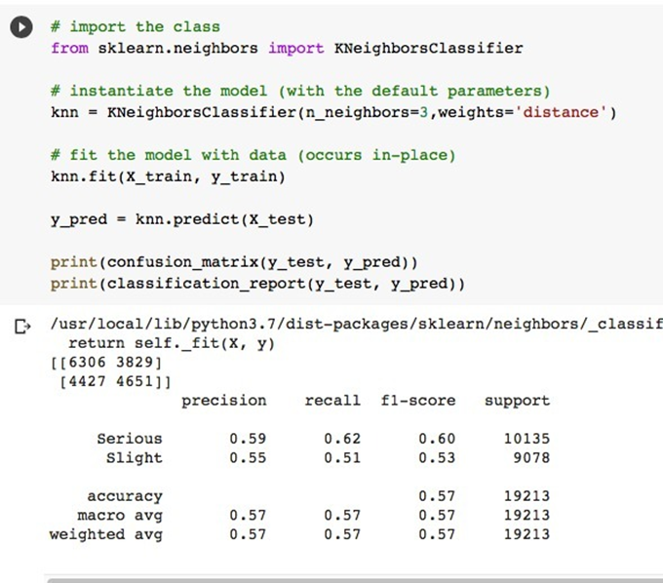
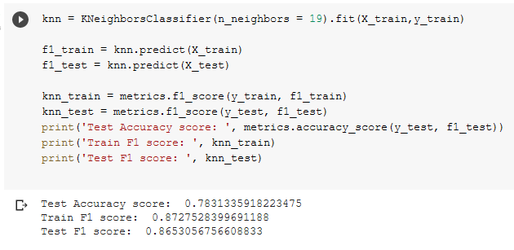
Fig 7. K nearest neighours classification most efficient K value determination
Fig 9. K nearest neighbours classification accuracy for accident severity detection
Fig 8. K nearest neighbours classification accuracy for accident prediction

Slide 12
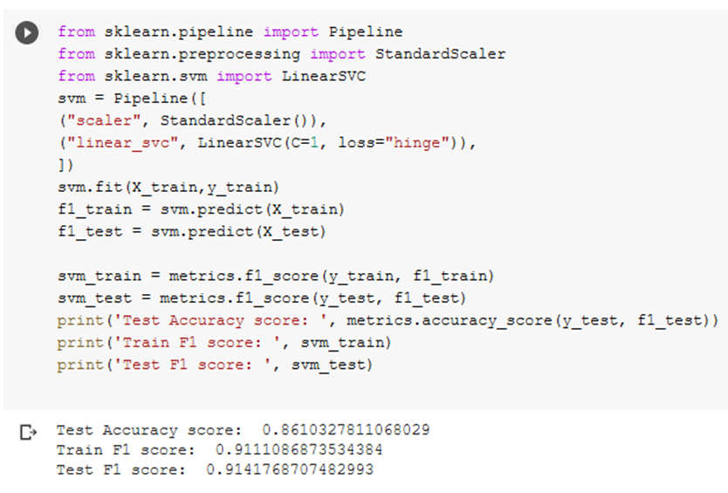
SCALAR VECTOR MACHINE
The "Support Vector Machine" (SVM) is a supervised machine learning technique that can solve classification and regression problems. It is, however, mostly employed to solve categorization difficulties. Each data item is plotted as a point in n-dimensional space, with the value of each feature being the value of a certain coordinate in the SVM algorithm. Then we classify the data by locating the hyper-plane that separates the two groups. Hyperplanes are decision boundaries that aid in data classification. Different classes can be assigned to data points on either side of the hyperplane. The hyperplane's dimension is also determined by the number of features. If there are only two input characteristics, the hyperplane is merely a line. The hyperplane becomes a two-dimensional plane when the number of input features reaches three. When the number of features exceeds three, it becomes difficult to examine. Support vectors are data points that are closer to the hyperplane and have an influence on the hyperplane's position and orientation. We maximize the classifier's margin by using these support vectors. The hyperplane's position will be altered if the support vectors are deleted. The following are some of the benefits of support vector machines: In high-dimensional spaces, it works well. When the number of dimensions exceeds the number of samples, the method is still effective. The goal of SVM is to find a maximum marginal hyperplane (MMH) that splits a dataset into classes as evenly as possible.
Fig 12. Scalar Vector Machine classification accuracy for accident prevention

Slide 13
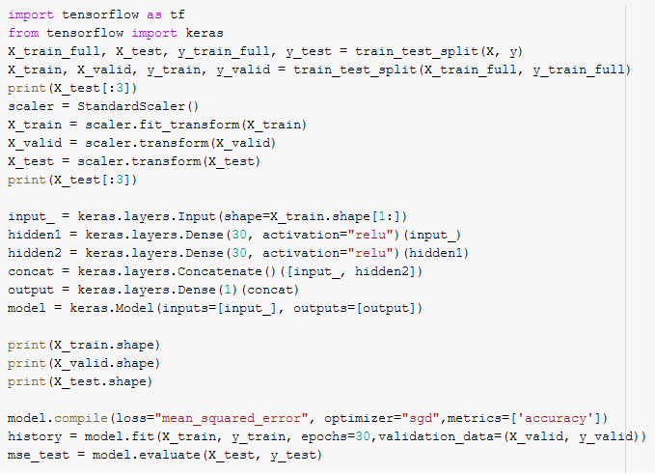
NEURAL NETWORK
Neural network-based machine learning algorithms don't need to be designed with precise rules that describe what to expect from the input. Instead, the neural net learning algorithm learns by analyzing a large number of labelled instances provided during training and using this answer key to determine which input qualities are required to construct the proper output. After a sufficient number of examples have been processed, the neural network can begin to handle new, unknown inputs and accurately deliver results. Because the computer learns from experience, the more examples and types of inputs it sees, the more accurate the outputs become. Neural networks may be used to solve a wide range of problems and can evaluate a wide range of input types, including photos, videos, files, databases, and more. They also don't necessitate any explicit programming to interpret the contents of those inputs. Because of the generic approach to problem solving that neural network provide, the domains in which this technique can be used are essentially limitless. Image/pattern recognition, self-driving vehicle trajectory prediction, facial identification, data mining, email spam filtering, medical diagnosis, and cancer research are some of the common applications of neural networks nowadays. Today, neural networks are used in a variety of ways, and their popularity is growing rapidly. Each layer of nodes in a deep-learning network trains on a different set of features based on the output of the preceding layer. Because nodes aggregate and recombine features from previous layers, the more complex the features your nodes can identify as you progress deeper into the neural net.

Slide 14
CONCLUSION
It was noted that with efficient pre processing and using imbalanced techniques we are getting optimal prediction accuracies. With this paper we like to comprehensively conclude that the accuracy obtained from various classifications and techniques can be implemented in real life scenarios, the models can be used to train in vehicles in order to prevent accidents and also detect accident severity for emergency services. The prediction or accuracy obtained is compared with other test case dataset in order to determine the most effective data model for the vehicle, the models can be implemented and the model with the least error rate can be used for further betterment and advancement of the technology. Cloud as a service for intelligent vehicle communication can be used for effective APIs for the vehicles in order to warn the drivers in case of accident prevention and send emergency services in case of accident severity detection. The two models are tested for the most accurate result possible for numerical data. The machine learning models are only as effective as the data they are given for implementation, the data for learning can be further modified, cleaning, and better more effective parameters can be given in order for better accuracy result. The paper also gives an analysis of the IoV techniques, such as IoV security measures, VANET communication, vehicle safety, networking, V2X communication, routing. Next, we would like to include various other aspects of Internet of Vehicle transportation and real-life application would be a start.

Slide 15
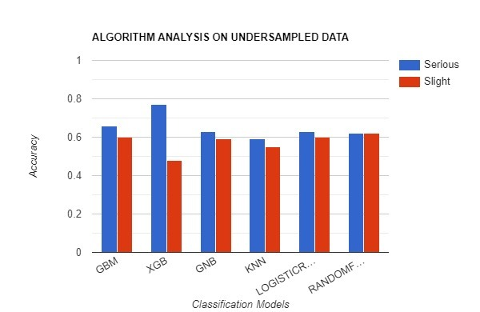
During accident severity prediction the model with most accuracy for a given input is selected and used to predict accident severity.
During accident detection and prevention the model with most accuracy for a given input is selected and used to predict accident detection.
Accuracy
Classification model

Slide 16
FUTURE WORKS
Intelligent transportation has a lot of safety, security, privacy, implementation, accuracy concerns still remaining to be addressed, in the future we would like to use more datasets for accurate model implementation and providing the accident detection and accident-avoidance accuracy. The data used can be obtained and trained using real time vehicle sensors rather than using previous datasets with parameters, providing and measuring additional sensors data could help in determining better and faster models. Real world scenarios and live testing of our development would also be one of our many goals. The machine learning models we have implemented can have better build in order to improve the accuracy with the help of better algorithms and classifiers. Improvements on neutral networks can be done in order to improve efficiency. Models can be trained with better GPUs with lesser data lose. The future work we need to address the security concern related to connection vehicles to the Internet as this can have major impact on national security as increase in number of devices connected to the internet can cause increase in number of vulnerability and prone to attacks. The concern about the power requirements and need for clever sources of renewable power in order to run the various sensors for intelligent vehicles also needs to be addressed.

