Slide 1

Health Insurance Marketplace Analysis using Hadoop & Hive
Aishwarya Gupta,
Priyanka Thota, Rahul Bhogale,
Prathush Reddy, Rishabh Shah.

Slide 2
INTRODUCTION
Most likely, we constantly hear people discussing their health insurance. However, you could feel as though you don't really grasp it. The only major industrialized country without universal health insurance is the United States, and the quality of care has declined over the previous six years.
Health insurance can help you get the care you require and make it easier for you to pay for your medical expenses.

Slide 3
PROBLEM STATEMENT
It has been difficult to find the necessary insurance in the USA. Thus, it is agreeable for individuals to assess their needs and thereafter choose the desired/appropriate care with the use of the CMS dataset (produced and made available by the Centers for Medicare & Medicaid Services (CMS).
The 3GB dataset primarily focuses on health and dental policies provided to individuals and small enterprises located in the USA. In order to support timely benefits, rate analysis, copayments, premiums, geographic coverage, etc. for our data analysis, Health Insurance Exchange Public Use Files (Exchange PUFs) are available for plan years 2017 through 2021.
In a nutshell, we can implement a clinical strategy that caters to the need of families/individuals/employees and allows them to navigate through various healthcare insurance plans and handpick the most significant one based on their income/expenses.

Slide 4
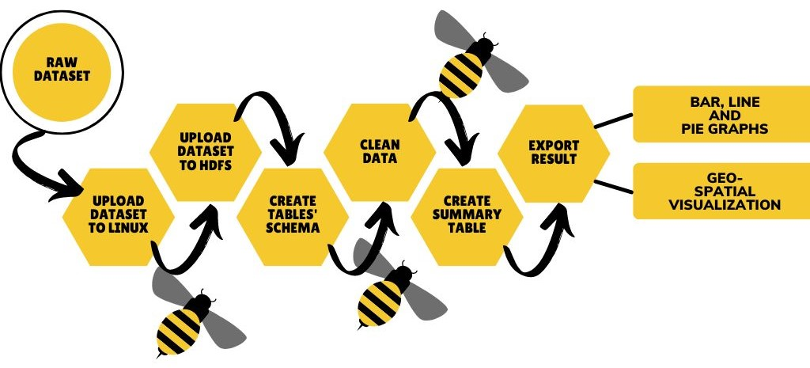
FLOW CHART

Slide 5

DATA SET URL:
https://www.cms.gov/cciio/resources/data-resources/marketplace-puf GitHub Url https://github.com/rahulbhogale/5200

Slide 6
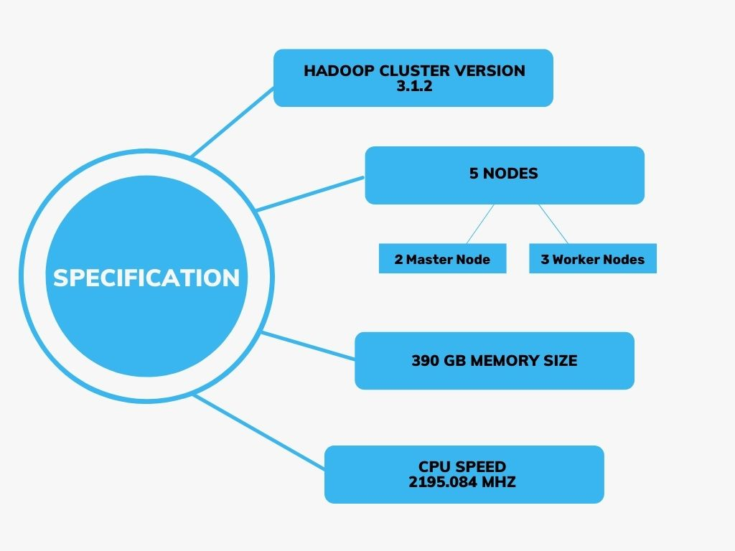

Slide 7
VISUALIZATION ON TABLEAU

Slide 8
PLANS AND METAL LEVELS
EPO
HMO
POS
PPO
INDEMITY
BRONZE
SILVER
GOLD
PLATINUM
CATASTROPHE

Slide 9
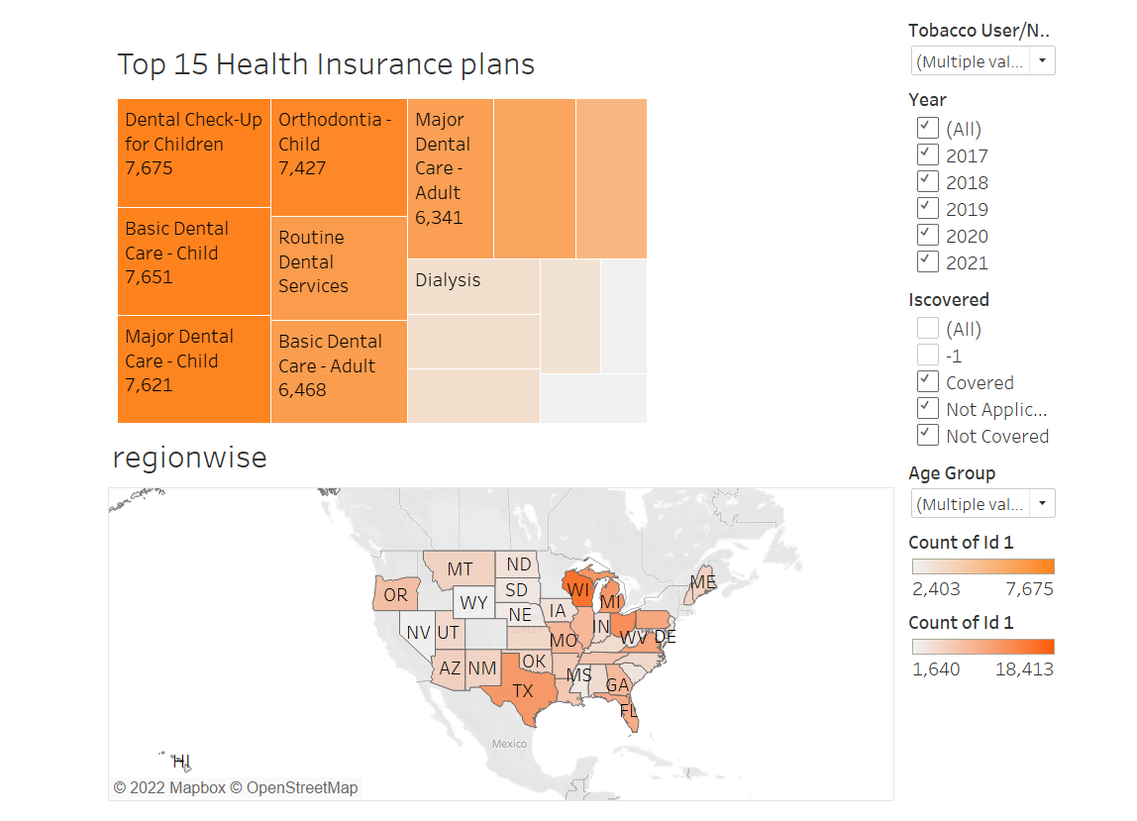

Slide 10
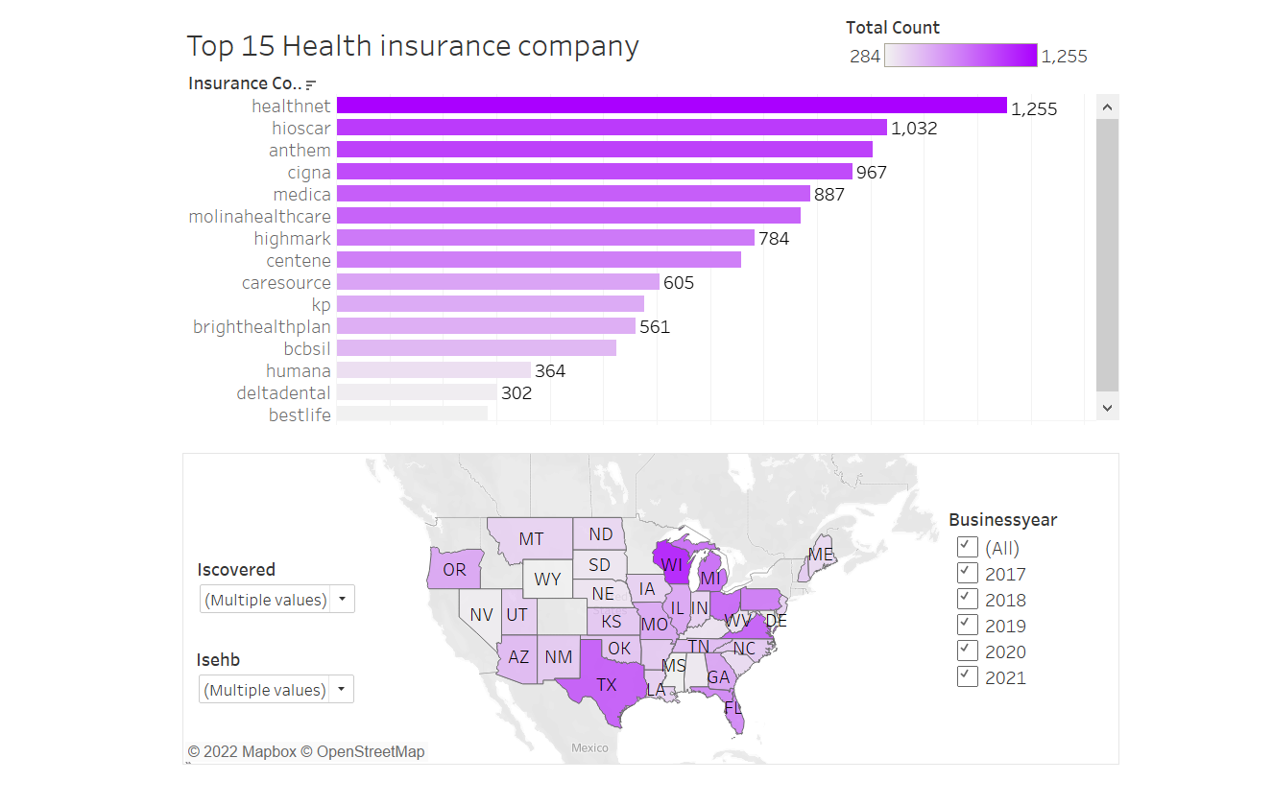

Slide 11
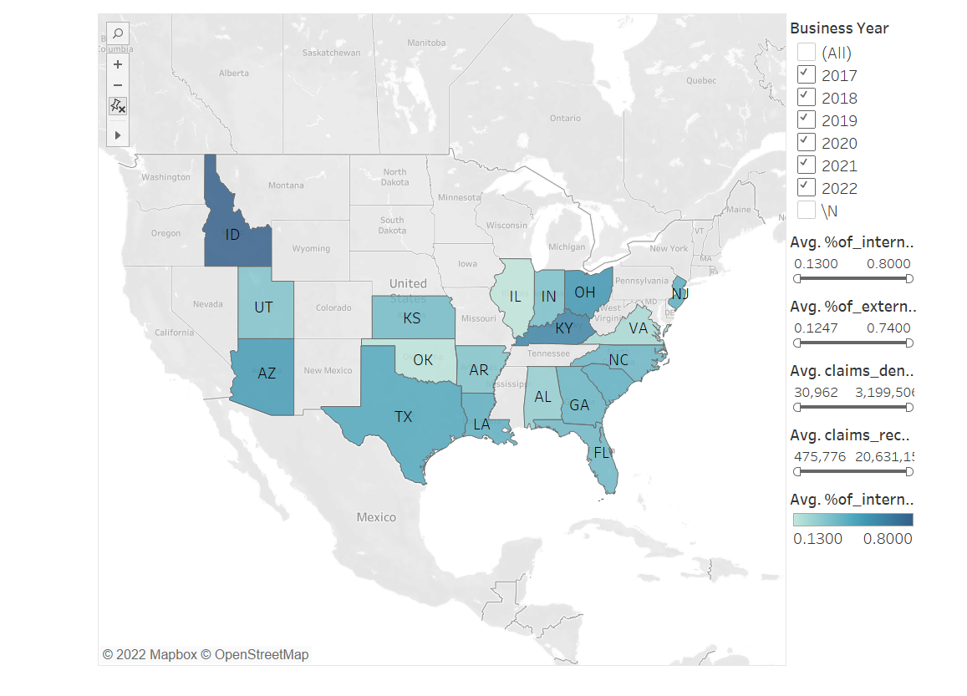

Slide 12
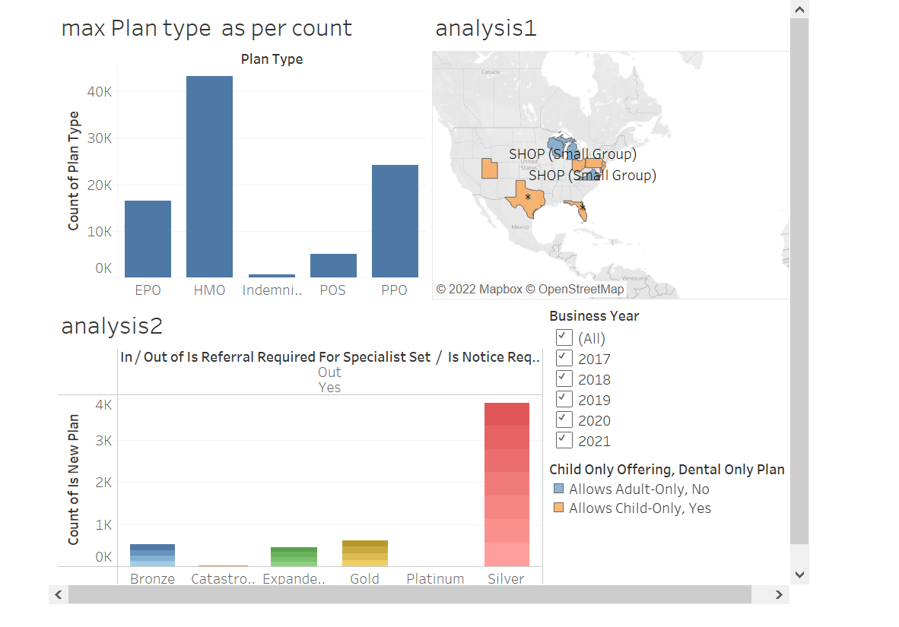

Slide 13
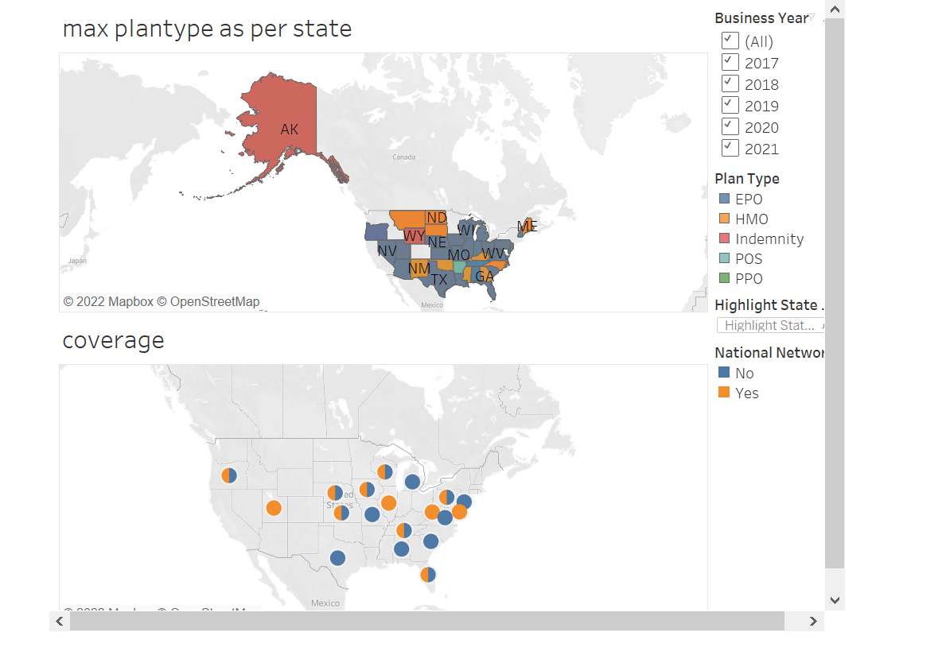

Slide 14
