Slide 1
Heart Disease Prediction Using Machine Learning
By
Rahul Ranjan

Slide 2
INTRODUCTION
What is Machine Learning ?
Goal of the Project
What is Supervised Learning ?

Slide 3
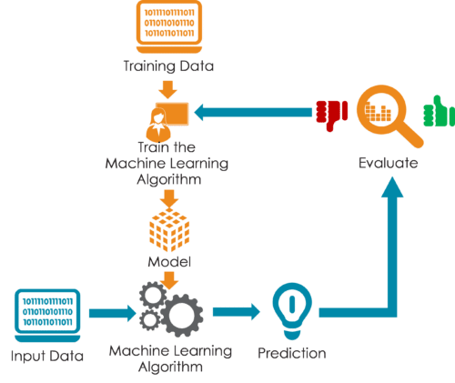

Slide 4
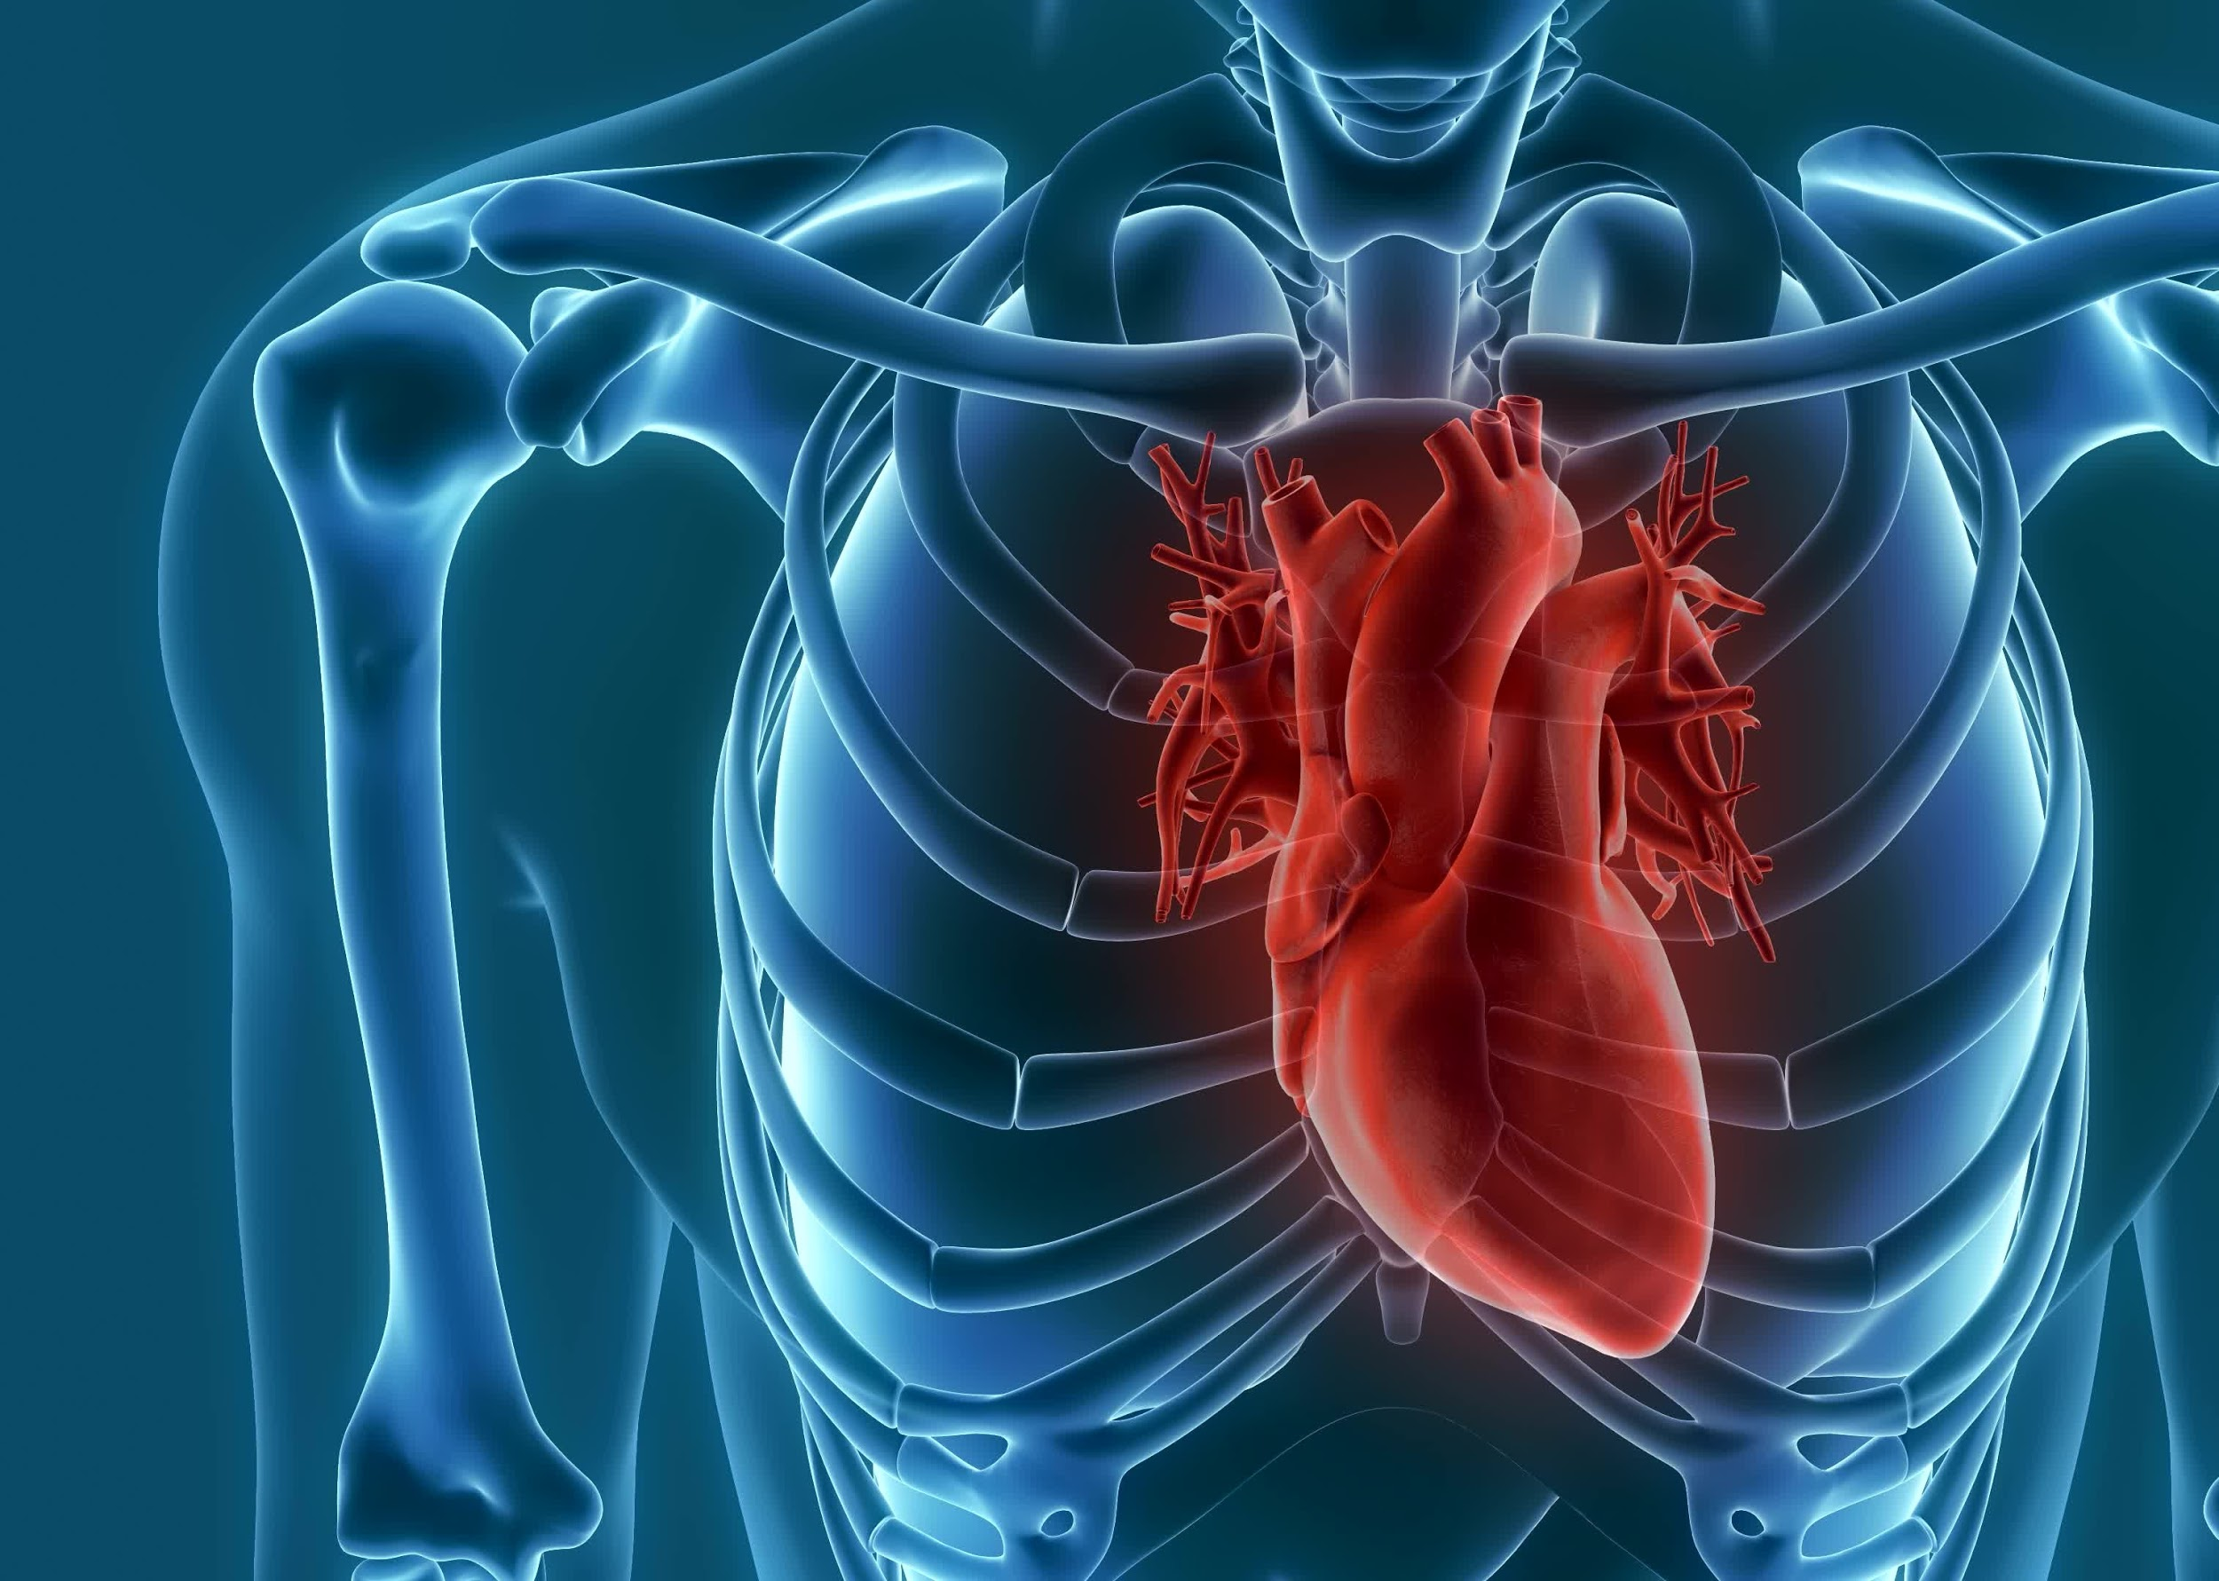
The Working of the Project

Slide 5

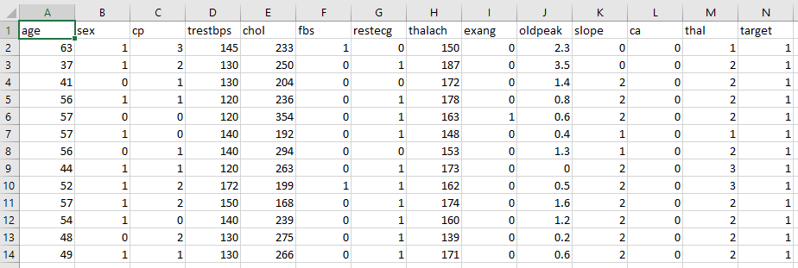
Dataset

Slide 6
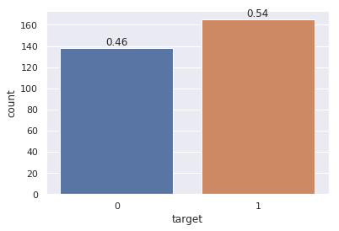
1 165
0 138

Slide 7
3 step process
Split the dataset
Train the dataset
Compare the Algos

Slide 8






Slide 9
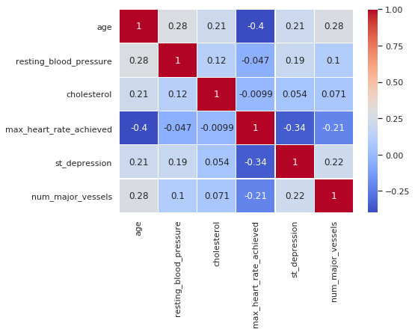
Correlation
Plot

Slide 10
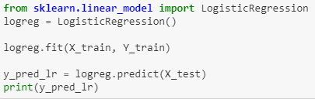
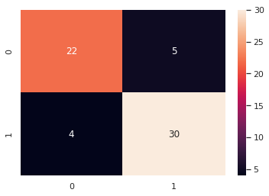
Logistic Regression
accuracy score : 85.25 %
Precision: 0.85
Recall is: 0.88
F-Score: 0.86

Slide 11
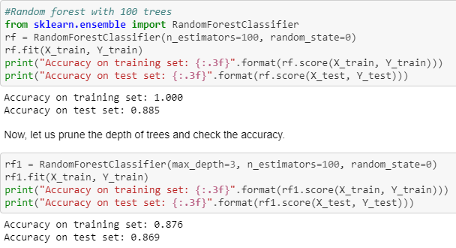
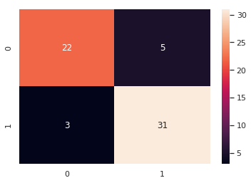
Random Forest
Precision: 0.86
Recall is: 0.91
F-Score: 0.88

Slide 12
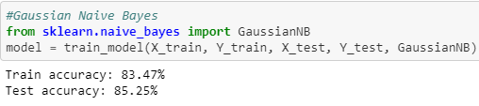

Naive Bayes
Precision: 0.83
Recall is: 0.91
F-Score: 0.87

Slide 13

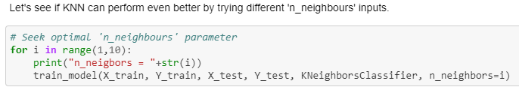
K-Nearest Neighbor

Slide 14
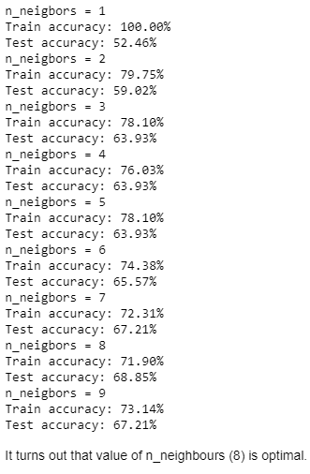
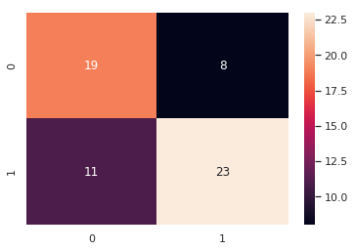
Precision: 0.74
Recall is: 0.67
F-Score: 0.70

Slide 15
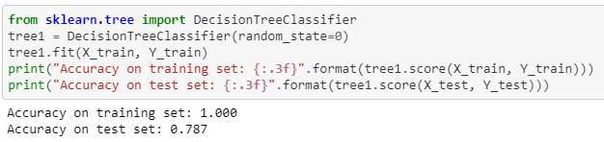
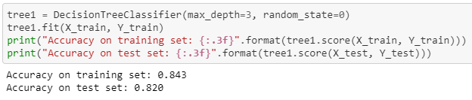
Decision Tree

Slide 16
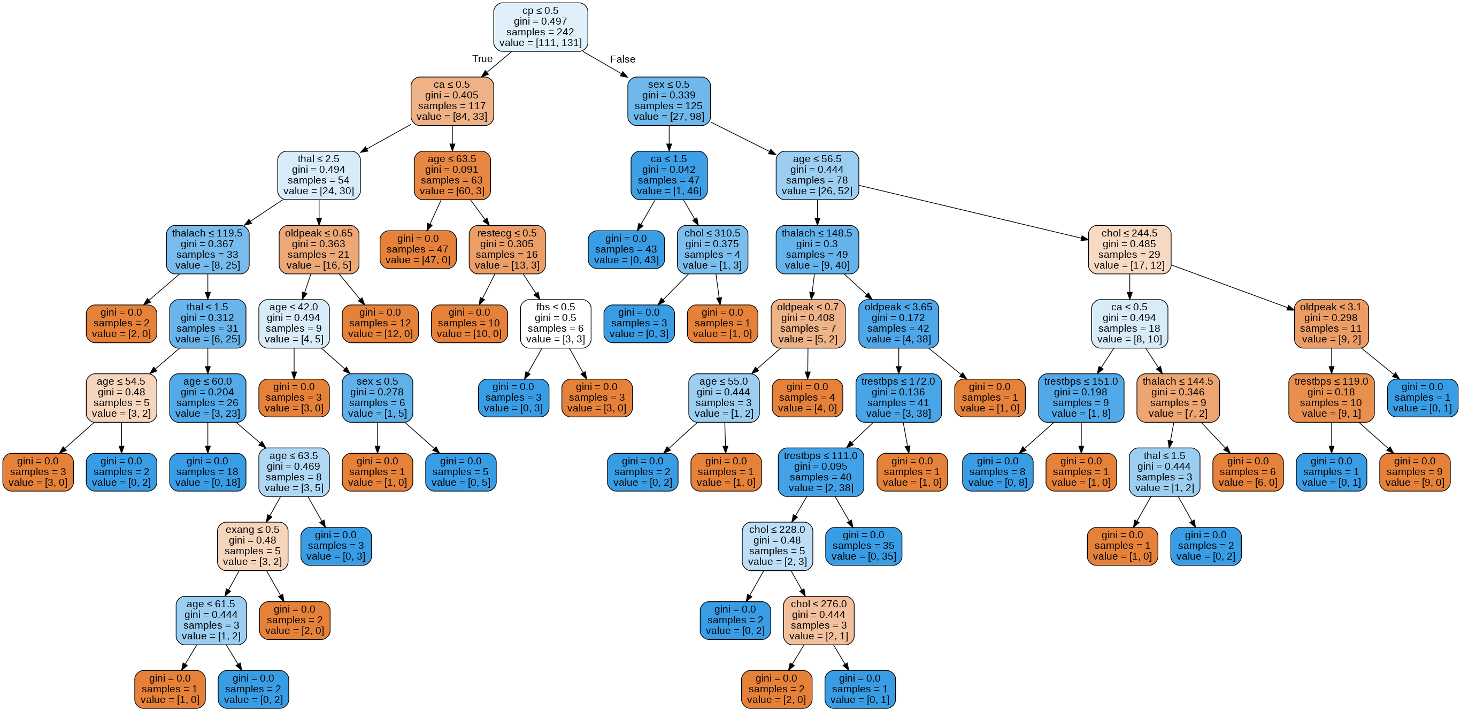
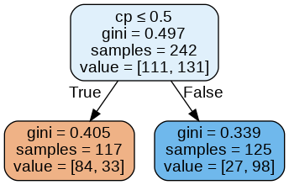

Slide 17
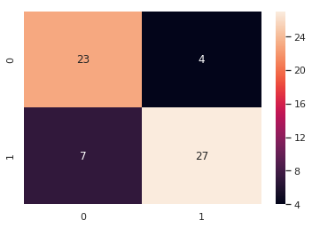
Precision: 0.87
Recall is: 0.79
F-Score: 0.83

Slide 18
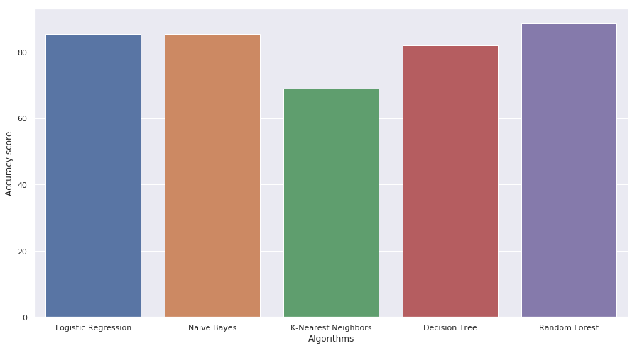
Results
85.24%
68%
81.9%
88.52%
85.24%

Slide 19
Conclusion
Drawbacks
Future Scopes

Slide 20


