Slide 1
Predicting car prices using machine learning
RAHUL KUMAR SINGH
2017BCS0045
FINAL YEAR BETCH PROJECT
Guide:Dr.Manjith

Slide 2
INTRODUTION :-
The prices of new cars in the industry is fixed by the manufacturer with some additional costs incurred by the Government in the form of taxes. So customers buying a new car can be assured of the money they invest to be worthy
But due to the increased price of new cars and the incapability of customers to buy new cars due to the lack of funds, used cars sales are on a global increase. Predicting the prices of used cars is an interesting and much-needed problem to be addressed.
Customers can be widely exploited by fixing unrealistic prices for the used cars and many falls into this trap. Therefore, rises an absolute necessity of a used car price prediction system to effectively determine the worthiness of the car using a variety of features.
Due to the adverse pricing of cars and the nomadic nature of people in developed countries, the cars are mostly bought on a lease basis, where there is an agreement between the buyer and seller. These cars upon completion of the agreement are resold. So reselling has become an essential part of today’s world.
Given the description of used cars, the prediction of used cars is not an easy task. There are a variety of features of a car like the age of the car, its make, the origin of the car (the original country of the manufacturer), its mileage (the number of kilometers it has run).
Due to rising fuel prices, fuel economy is also of prime importance.

Slide 3
OBJECTIVE:-
To build a supervised machine learning model for forecasting value of a vehicle based on multiple attributes
The system that is being built must be feature based i.e. feature wise prediction must be possible.
Providing graphical comparisons to provide a better view.

Slide 4
RELATED WORK :-
[1] Strauss, Oliver Thomas, and Morgan Scott Hansen. "Advanced data science systems and methods useful for auction pricing optimization over network." U.S. Patent Application No. 15/213,941
This patent describes a generic engine platform for assessing the price of an asset. This platform provides a price computation matrix for asset price prediction. To compute the price for vehicles, this platform may compute linear regression model that defines a set of input variables. However, it does not give details as what features can be used for specific type of vehicles for such prediction. We have taken important features for predicting the price of used cars using random forest models.

Slide 5
2:Xinyuan Zhang , Zhiye Zhang and Changtong Qiu, “Model of Predicting the Price Range of Used Car”, 2017
use Kaggle data-set to perform price prediction of a used car. The author evaluates the performance of several classification methods (logistic regression, SVM, decision tree, Extra Trees, AdaBoost, random forest) to assess the performance.
Among all these models, random forest classifier proves to perform the best for their prediction task. This work uses five features (brand, powerPS, kilometer, sellingTime, VehicleAge) to perform the classification task after removal of irrelevant features and outliers from the dataset which gives an accuracy of 83.08% on the test data.
We also use Kaggle data-set to perform prediction of used-car prices. However, the difference lies in the inclusion of few more relevant features in prediction model - the price of the car, and vehicleType.
These two features play an important role in predicting the price of a used car which seems to be given less importance in the paper [2]. In addition to this, the range of features year of registration, PowerPS, the price seems to be narrowed down in work [2] due to which test data-set gives less accuracy w.r.t what we evaluate by broadening the range of the above-said features.

Slide 6
Dataset:-
I used kaggel cardekho dataset because it had a variety of categorical and numerical data and allows you to explore different ways of dealing with missing data.

Slide 7
TECHNOLOGY USED:-
1. NUMPY:
NumPy is a general-purpose array-processing package. It provides a high-performance multidimensional array object and tools for working with these arrays. It is the fundamental package for scientific computing with Python.
2. SCIPY:
SciPy is a free and open-source Python library used for scientific computing and technical computing. SciPy contains modules for optimization, linear algebra, integration, interpolation. SciPy builds on the NumPy array object and is part of the NumPy stack which includes tools like Matplotlib, pandas, International Journal of Computer Sciences and Engineering.
3. SCIKIT-LEARN:
Scikit-learn provides a range of supervised and unsupervised learning algorithms via a consistent interface in Python. It is licensed under a permissive simplified BSD license and is distributed under many Linux distributions, encouraging academic and commercial use. The library is built.
4. JUPYTER NOTEBOOK:
The Jupyter Notebook is an open-source web application that allows you to create and share documents that contain live code, equations, visualizations, and narrative text. It includes data cleaning and transformation, numerical simulation, statistical modeling, data visualization, machine learning, and much more.

Slide 8
Understanding my data:
Using df.shape, df.columns, and df.head(), I’m able to see what features I’m working with and what each feature entails.
By using df.shape I found that my rows=1091 and columns=9
By using df. head() we can see the first 5 datas of my data sets.
From which we visualize the the column and rows .
By using df.describe() is used to view some basic statistical details like percentile, mean, std etc. of a data frame or a series of numeric values.

Slide 9
->df.ununique()function return Series with number of distinct observations over requested axis. If we set the value of axis to be 0, then it finds the total number of unique observations over the index axis. If we set the value of axis to be 1, then it find the total number of unique observations over the column axis. It also provides the feature to exclude the NaN values from the count of unique numbers.

Slide 10
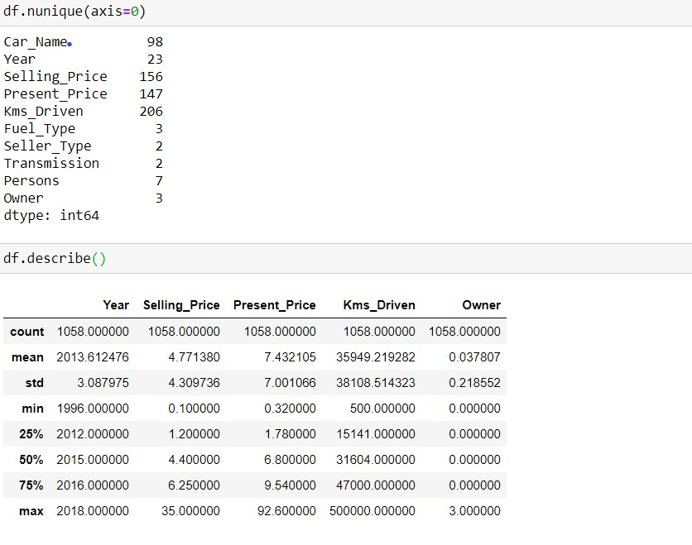

Slide 11
Data Cleaning
The unique() function is used to find the unique elements of an array. Returns the sorted unique elements of an array. ... the indices of the unique array that reconstruct the input array. the number of times each unique value comes up in the input array.
We are using df.unique() to find the unique variables in the categorical features like ‘Seller_type’,’transmission_type’,etc.
So that we can know how much different types of variables are there in each column

Slide 12
Removing Null Value
We will use df.isnull.sum() to know which features in the the data set having how much null value .
If the feature has lots of null values it is better to remove that feature because that is not feasible for predicting.
If the feature has few null values we can fill that null value with the mean or median of that feature
For removing the null value we can use df.dropna() it well remove the the null value.

Slide 13
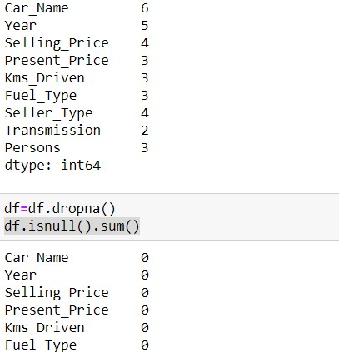
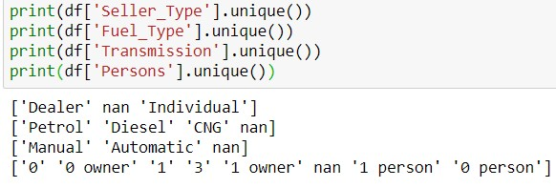

Slide 14
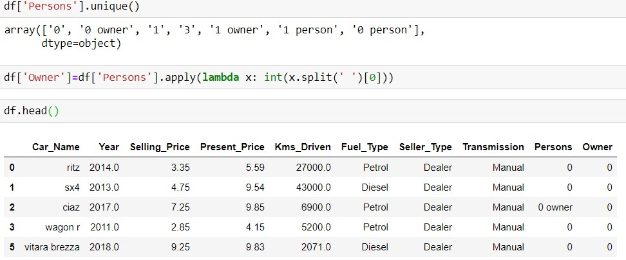
In few features we can see the feature represented in different forms so we tried to convert the feature representation in one form which is more feasible

Slide 15
Feature enginnering
In feature enginnering we try to do some manuplation in data set so that we can get good data set which will be very much feasible for prediction.
Here in my data set I have year feature column which tell the year in which car was bought. So it will be better to how much year old the car is . For that I have inserted a new current year column in my data set.By using that I have calculated a column with how much year old the car is.
After that we will drop unnecessary column like year
We will also drop car name column as it contains 75 types of different car names. Which will create problem in hot encoding so we will drop it by using (final_dataset.drop(['Year'],axis=1,inplace=True) )

Slide 16
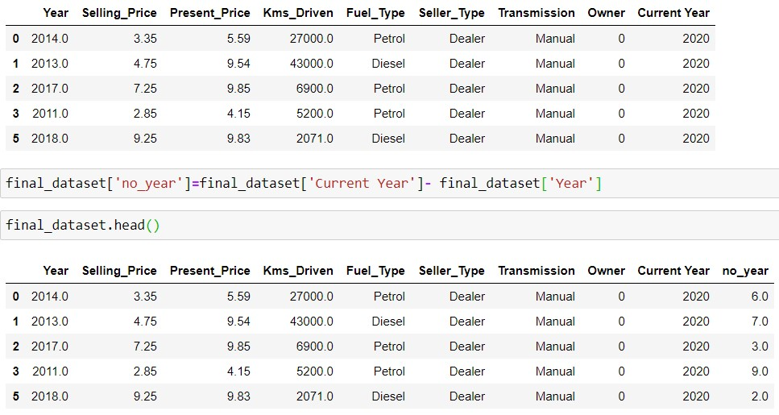

Slide 17
Outlier removal
In outlier removal we try to remove the values which seen very much different or extreme from 90% of the other values.
In my no_year column there are 1 year and as well as 20 year old cars are also available. So buying too much old car is not going to be feasible as it is very old generation .
So first we will plot histogram with no_year in x-axis and count in y-axis to see in what no_year range more car lies .
So we can see more cars are less than 15 years old . So we will remove car which are more that 15 years old.

Slide 18
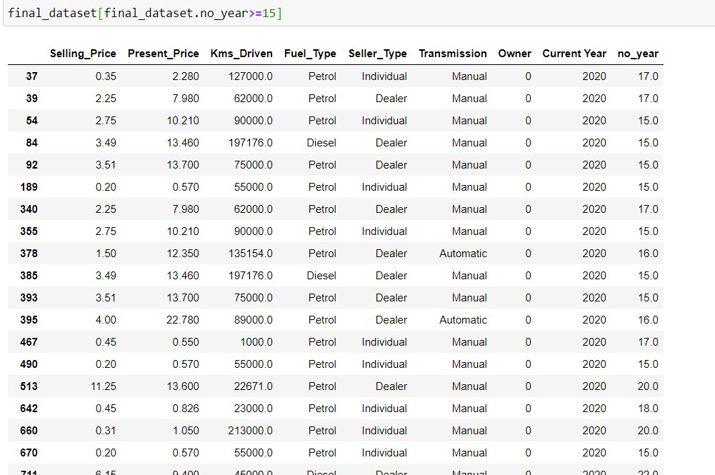

Slide 19
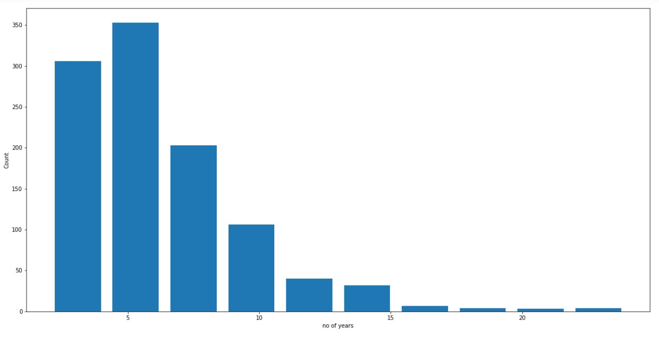

Slide 20
Standard deviation
We will use standard deviation to remove the outlier and try to get normal distribution.
In standard deviation we know most of the data lie between (mean-3*std) and (mean+3*std)
M=np.mean(data)
Std=np.std(data)
Lower bound=m-3*std
Upper bound=m+3*std

Slide 21
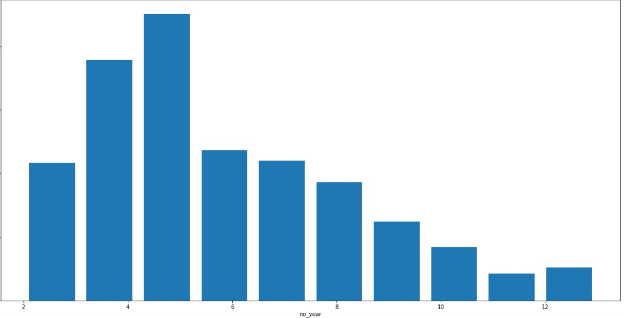

Slide 22
One-Hot Encoding:
->In our dataset we have lots of categorical features which is not good
for predicting the result
->Basically it will be better and easier to predict the result if all the
values will be in mathematical form
->So to convert the categorical features into mathematical form we
use pd.get_dummies() function.
-> In pd.get_dummies() function we will use drop_first=TRUE so to
prevent dummy variable trap which will happen in Fuel_Type feature

Slide 23
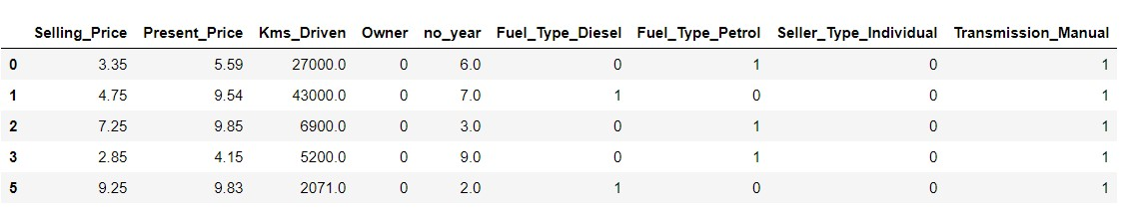

Slide 24
Correlation:
->Correlation is a measure of how strongly one variable depends on
another.
->It is a important tool in building machine learning models.
-> If two predictors are strongly correlated to each other then we only
need one of them.
-> This will make modal more simpler and easier. We will use corr()
function to see the correlation between our variable

Slide 25
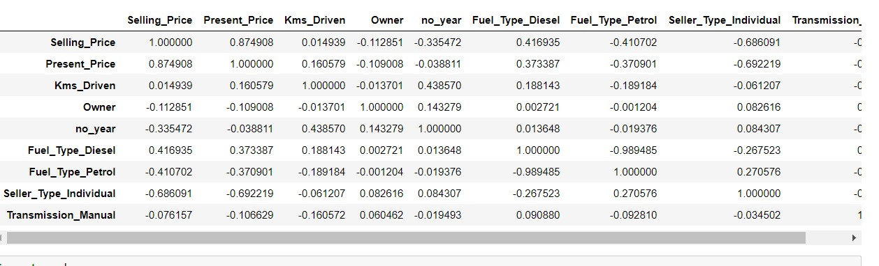

Slide 26
Heat Map:
-> A heat map is a graphical representation of data where values are
depicted by colours.
-> Heat map make it easier to visualize data understand it at a glance
-> In heat map red means the variables are inversely correlated and
green means the variables positively correlated .
-> we use seaborn package to implement heat map. We will use g=sns.heatmap(df6[top_corr_features].corr(),annot=True,cmap="RdYlGn") for implementing heat map.
-> In this diesel and petrol are negatively correlated.

Slide 27
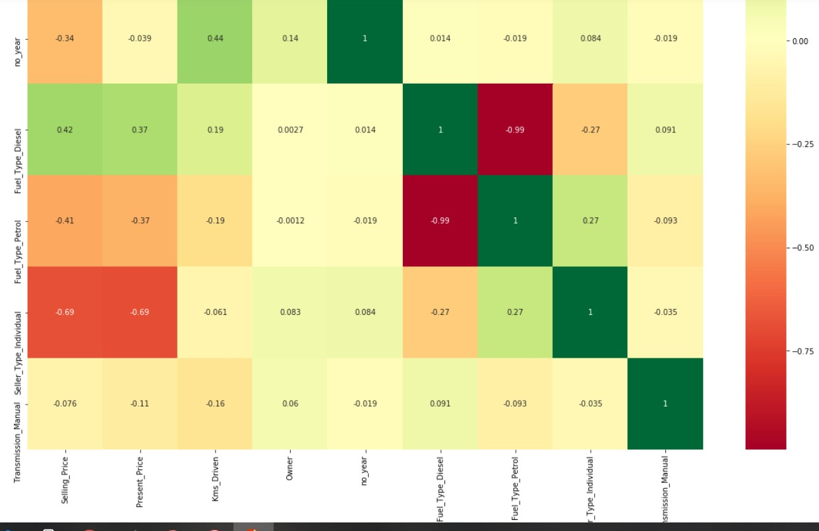

Slide 28
Train_Test_Split:
->Selling_price is a dependent feature so we put that into Y variable
using (y=df6.iloc[:,0])
-> other variables are independent features so we put them into X
variable using (X=df6.iloc[:,1:])
->Now we will split the dependent and independent variables into
train and test samples out of which 30% will be test rest will be train
->from sklearn.model_selection import train_test_split
X_train, X_test, y_train, y_test = train_test_split(X, y, test_size=0.3, random_state=0)

Slide 29
Parameter Tunning:
-> We have used random forest regressor as it contains lots of
parameters through which we can play by using hyper para meter
tunning to overcome overfit and underfit problem
->We will initialize different values to the parameters
e.g: n_estimator is a decision tree we will initialize value from 100 to
1200 and try to find best value
->for finding the best value for parameters we will use randomsearchcv

Slide 30
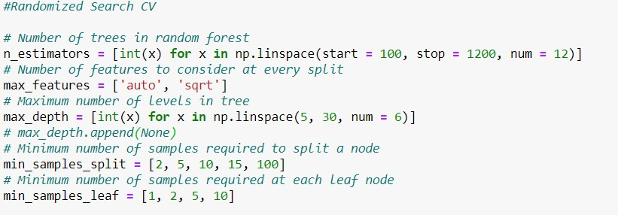

Slide 31
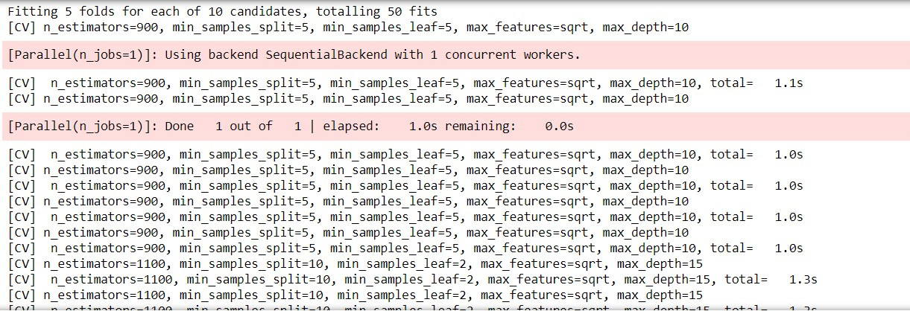

Slide 32
Prediction:
->Now we we will do the prediction using
predictions=rf_random.predict(X_test)
->now for comparison we will use distplot having (y_test-predictions)
we got a normal distribution graph which shows the model we create
is a giving a good result because the difference we get giving normal
distribution
->now we plot a scatter plot and we get a linear plotting which shows
our prediction is good

Slide 33
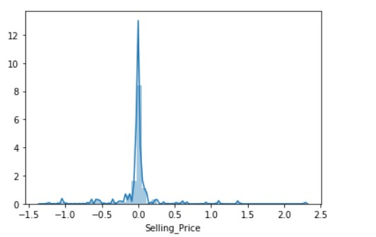
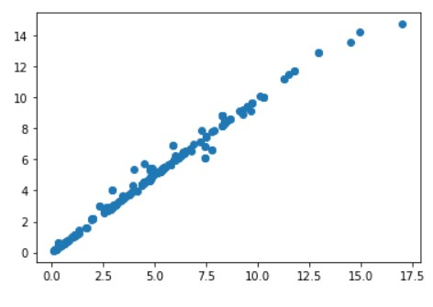

Slide 34
Frontend Development:
Now we will create the frontend for the project by making files
The files for the frontend development are app.py and index.html
We will use “Year = int(request.form['Year'])” to take the year value
“Present_Price=float(request.form['Present_Price'])” use to take present price value
“Kms_Driven=int(request.form['Kms_Driven'])”, “Owner=int(request.form['Owner'])” are used to take km and owner value
if(Fuel_Type_Petrol=='Petrol’):
Fuel_Type_Diesel=0
elif(Fuel_Type_Petrol=='Diesel’):
Fuel_Type_Petrol=0
Fuel_Type_Diesel=1
In the same way we will take transmission type value and seller type value
In the same way we will take transmission type value and seller type value

Slide 35
CONCLUSION:
we have taken a dataset which contains different features of old
vehicles . We use it for prediction of car prices it contain lots of
unwanted and noisy data which have removed and train our model
with random forest algorithm.
After prediction and comparing we found the normal distribution
graph of data which show our model is predicting very much
accurately
After a complete evaluation of the predictive model, we can conclude that the accuracy of this model is very and Random Forest and Extra Tree Regression is one of the best algorithms for regression problems. These two algorithms are highly accurate and fast in prediction irrespective of the size of the dataset.

Slide 36
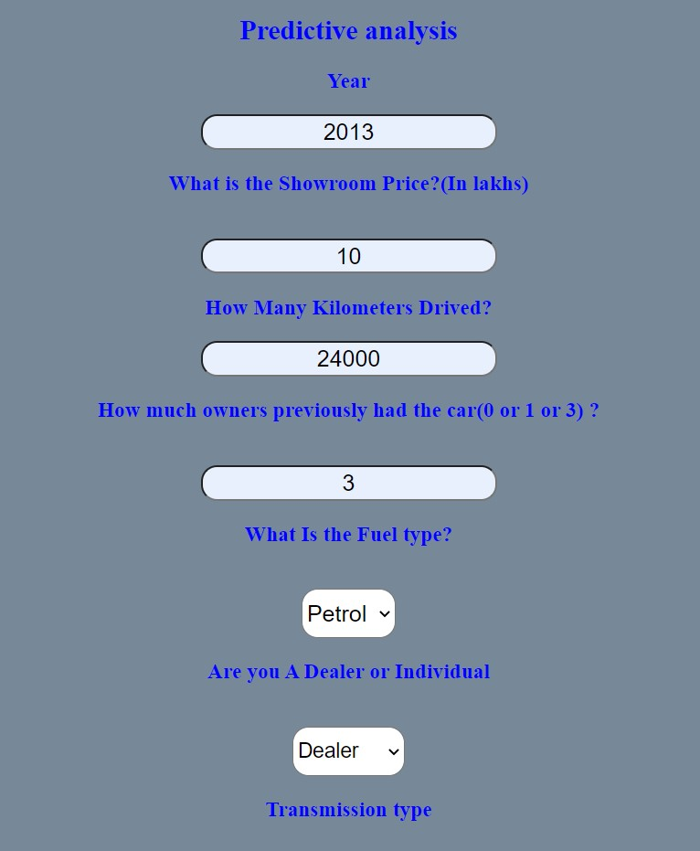

Slide 37
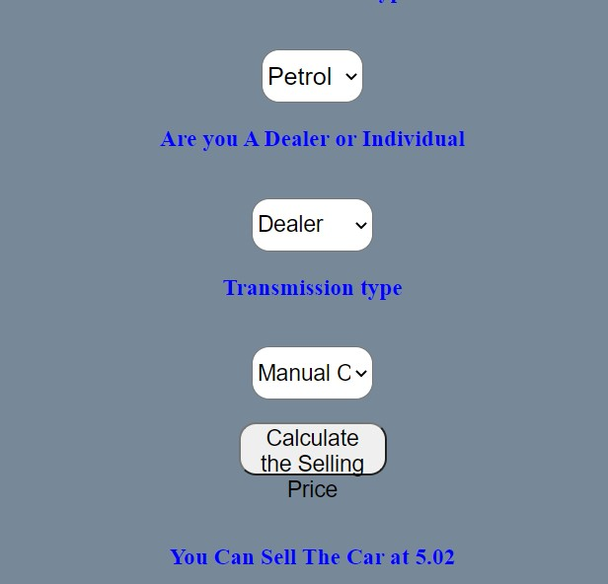

Slide 38
References:
->https://towardsdatascience.com
->https://www.geeksforgeeks.org/random-forest-regression-in-python
->https://blog.bigml.com
->https://machinelearningmastery.com->https://www.sas.com/en_in/insights/analytics/machine-learning.html
->[1] Strauss, Oliver Thomas, and Morgan Scott Hansen. "Advanced data science systems and methods useful for auction pricing optimization over network." U.S. Patent Application No. 15/213,941

Slide 39
->[2] Xinyuan Zhang , Zhiye Zhang and Changtong Qiu, “Model of Predicting the Price Range of Used Car”, 2017
->Pudaruth, Sameerchand. "Predicting the price of used cars using machine learning techniques." Int. J. Inf. Comput. Technol 4.7 (2014): 753-764.

