Slide 1


Enhanced Analytic System for Smart University Assistance
A Minor Project Associated
School of Computer Engineering KIIT-DU
Computer Science and Communication Engineering
Navonaya Brahmachari 1729037
Rahul Bordoloi 1729048
Ritwik Das 1729054
Saptarshi Mazumdar 1729058
Suranja Bakshi 1729228
Under the guidance of
Prof. Rajdeep Chatterjee

Slide 2
Overview
Introduction and Objective
System Architecture and Different Components
Implementation of Classifiers in Comparative Approach
Data Transfer API Processing- The Backbone Preparation
System Deploy and Server Establishment
Web Development and UX Creation
Marker Based Augmented Reality for Enhanced Security
Android Application
Snapshots of Project
Conclusion and Future Work

Slide 3

Introduction and Objectives
Often after higher secondary results students find themselves in a turmoil in deciding what stream of engineering is best suited for them. The proposed system aims to be a guide. Moreover, the pre-final and final year students face difficulty in opting the right field or domain for their career paths to grow. BEFRIEND will help them make this decision.
The classical process of allocating rooms to the borders is completely manual and it takes a lot of time and effort to provide the confirmed rooms to borders due to which the students face a lot of problems.
Also to manage things efficiently, the proposed system has an event scheduler where a student can keep track of his/her due academic projects, assignments, quizzes and also nonacademic activities.

Slide 4
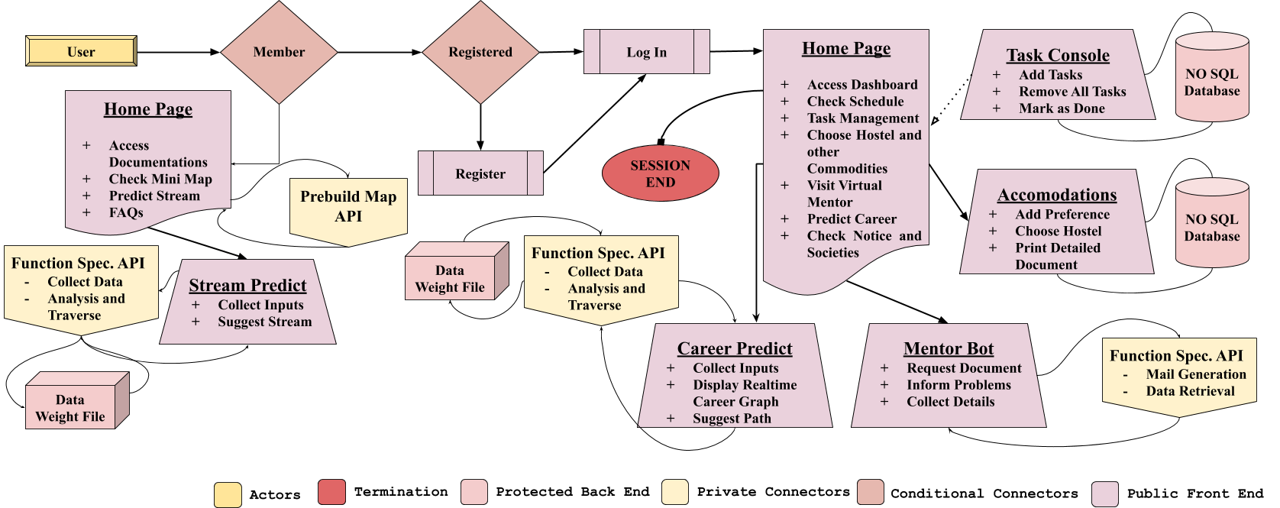
System Architecture and Different Components

Slide 5
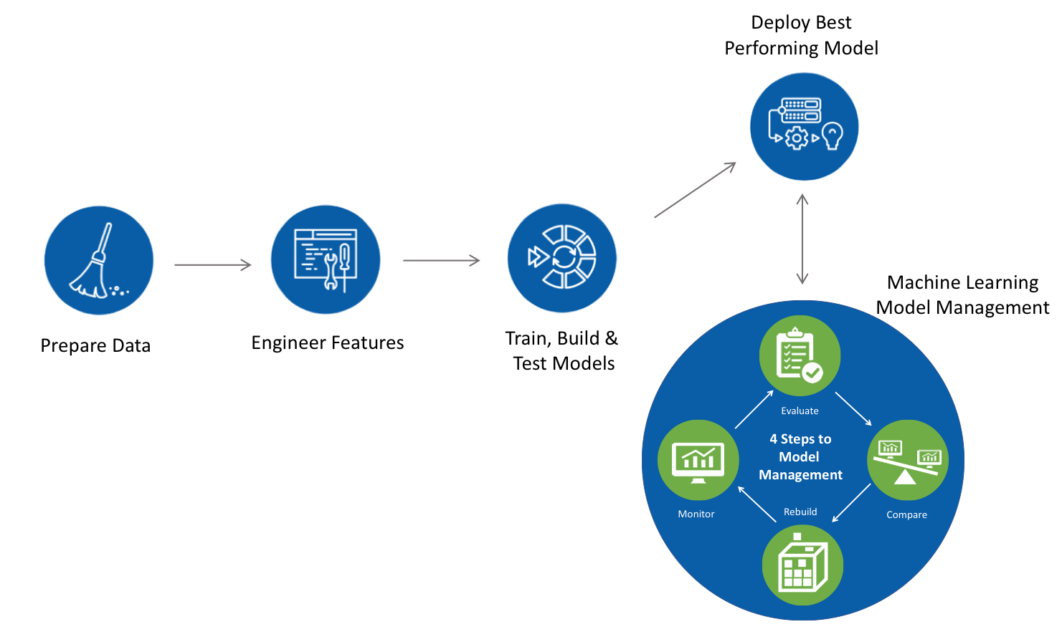
Implementation of Classifiers in Comparative Approach
Machine Learning
Applications
The Machine learning approach which was followed is to find a set of different hyper-parameters and tune the normal ensemble classifier to boost-up the accuracy precision and creating a much more robust and especially adaptable model.

Slide 6
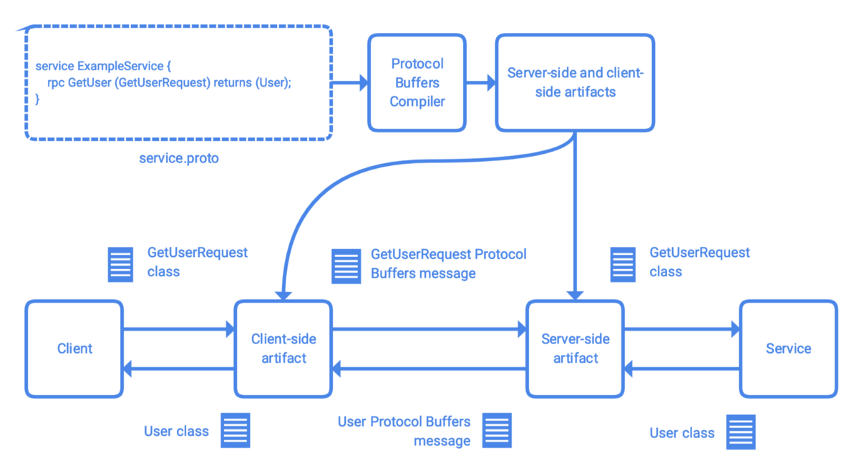
Data Transfer API Processing- The Backbone Preparation
API Preparation and Integration
1
The key approach to prepare a robust but secure system is to differentiate and isolate ends. The python based APIs used here dependent on secure Ubuntu based WSGI Server
2
Cloud based NoSQL Database integration to avoid Query Injection is one more major step to achieve more reliability

Slide 7
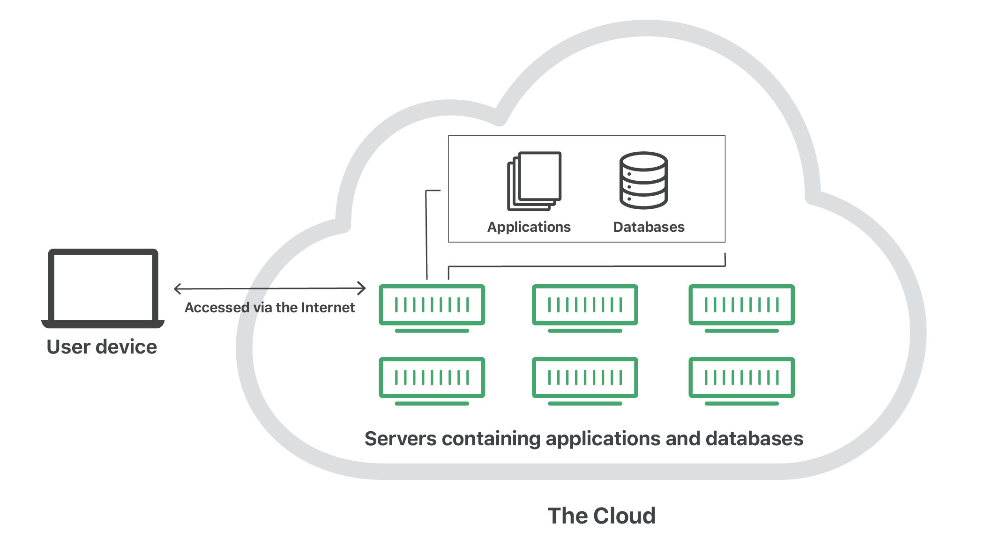
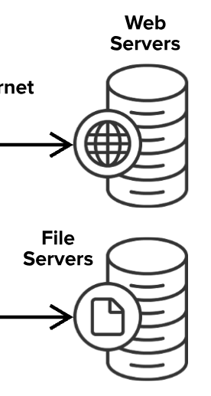
System Deploy and Server Establishment
System Deployment Load Balancing
For complete system deployment, two different clouds were used to balance to overall load and manage the complete process with an encapsulated backend. Both global systems are accessed by the local machine and maintained locally.

Slide 8
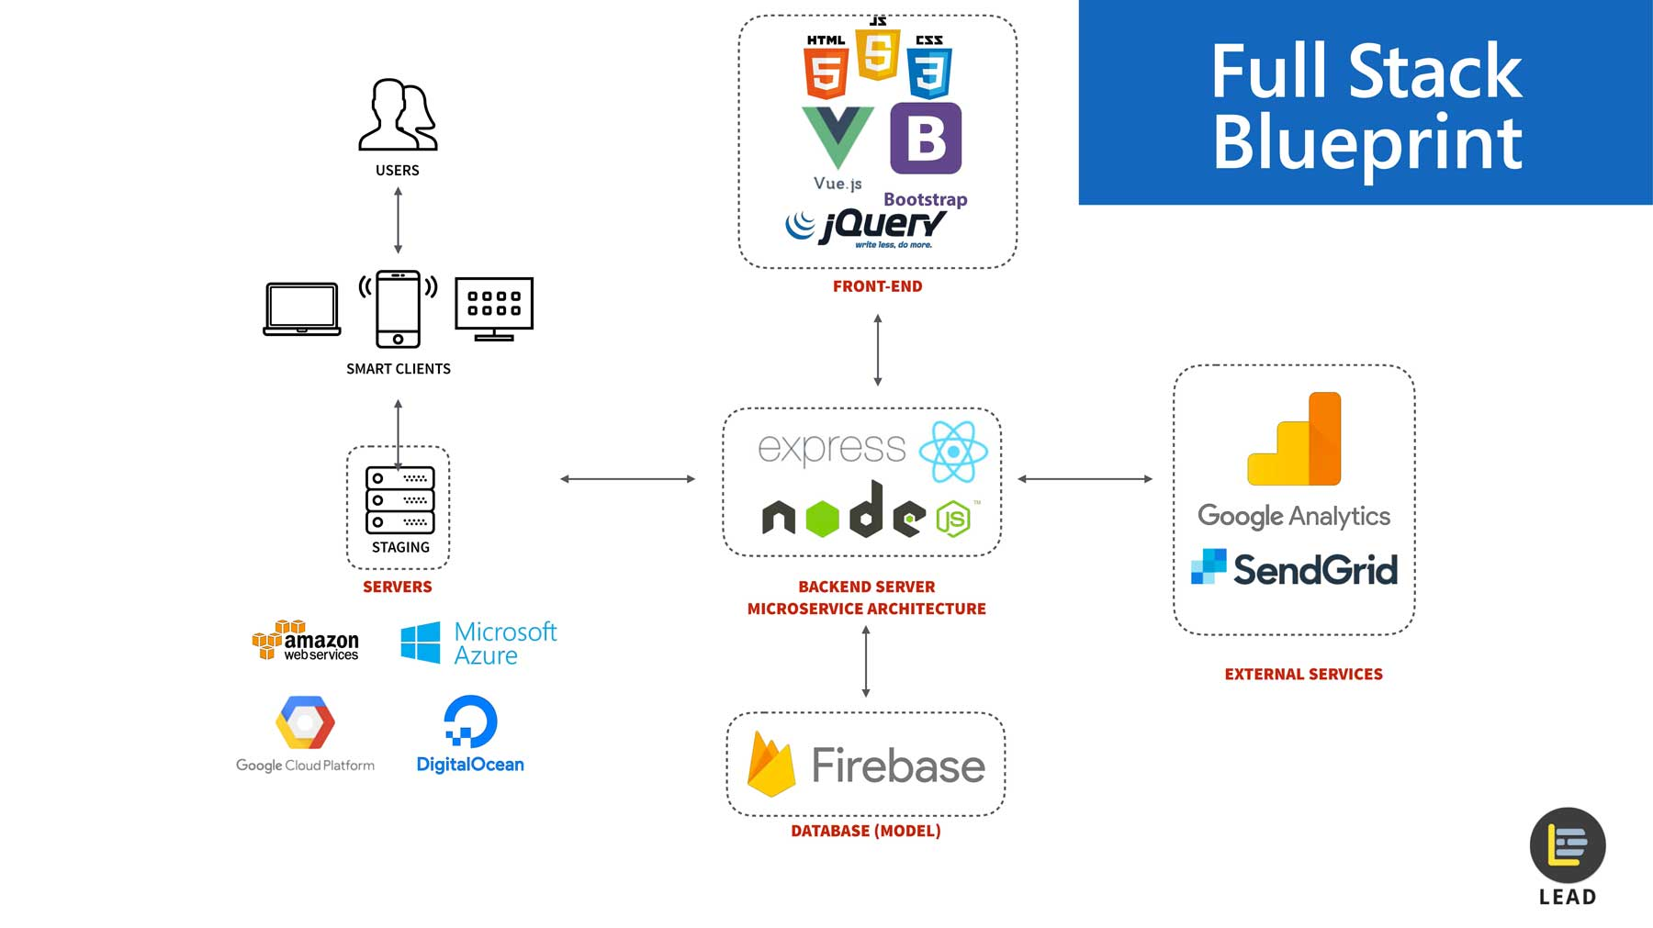




Web Development and UX Creation
Web Components Building
Several node packages and PHP vendors were used throughout the development to provide a handful of experience to an user and making noticeable versatility for different programs

Slide 9

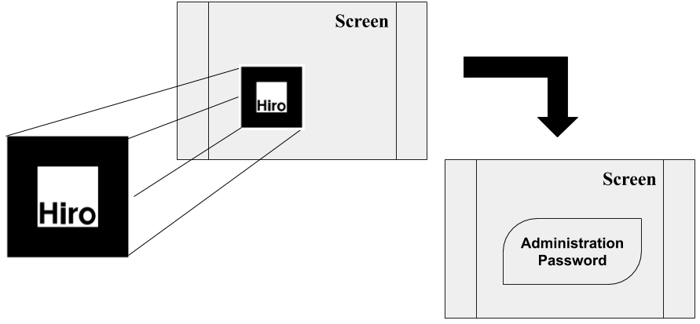
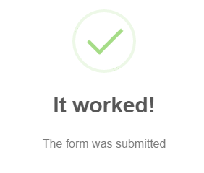
Marker Based Augmented Reality for Enhanced Security
1
2
3
Selecting the Marker and preparing for scanner
Scanned by the camera, system will jump into next validation
On a successful completion of verification, it’ll allow admin to access the console

Slide 10
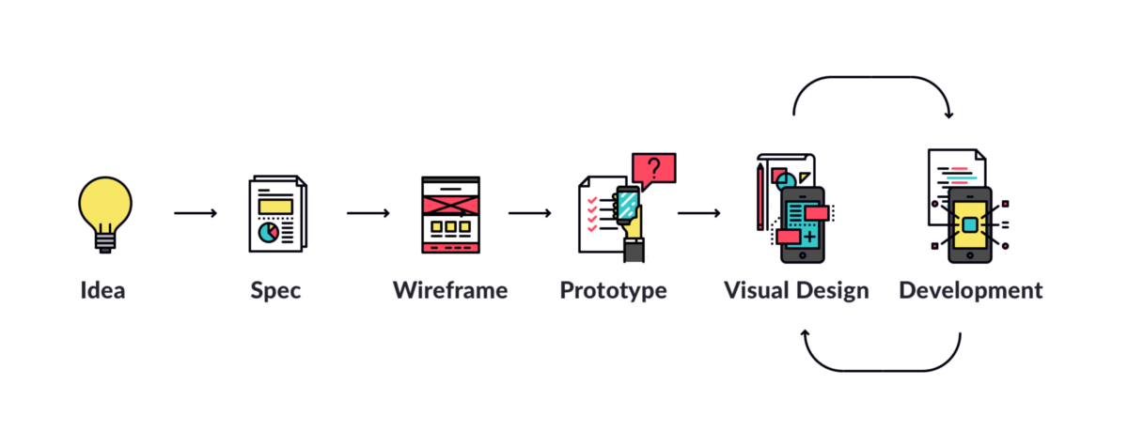
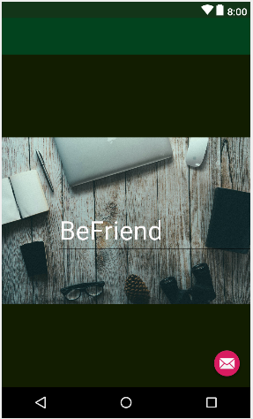
Android Application
Android Studio application was used to build the required mobile app. Java and XML are the languages used for the development.

Slide 11
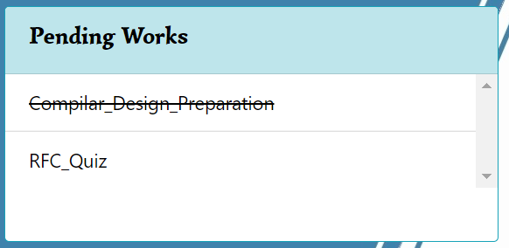
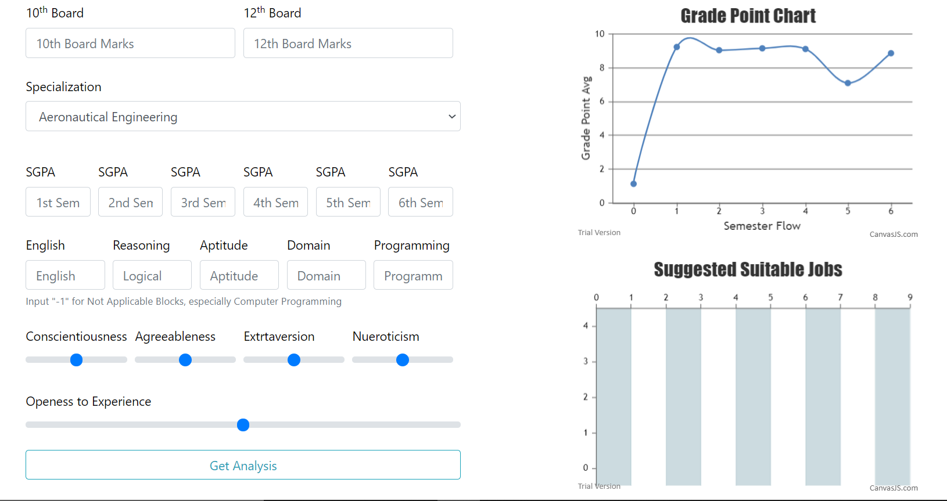
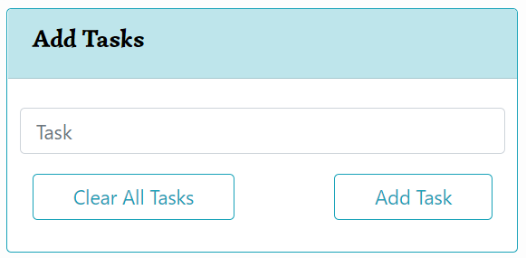
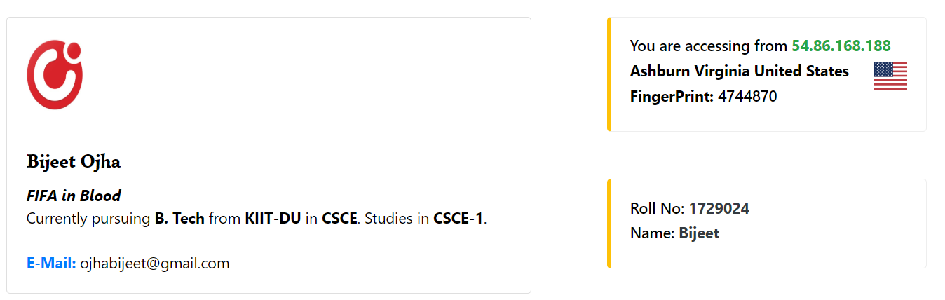
Snapshots of Project

Slide 12

Conclusion and Future Work
This project has the potential to become the official portal of the university. A lot more functionalities can be added (Bus routes and bus timings for day boarders etc.). Basically it could be an upgraded version of currently used product. The connection established with alumni can be tapped for future mentorship programs and guidance. For maintenance purposes, once a specification is being brought into action, it is valid for both Android and IOS environments. Further changes if required is needed only to be done once for a single environment it gets automatically incurred in other one.

Slide 13
Thank You
______

