Slide 1

Corporate+ Administering Expertly
IT407 – Software Project Major
Created and Presented by :
PRJ/2020/IT/40
Internal Guide: Prof. Pritesh Prajapati
External Guide: Mr. Bhavin Patel (Tech Elecon Pvt. Ltd.)

Slide 2
Outline:
Introduction
Project Flow (DFD)
Project Flow (Use Case Diagram)
Database Diagram (Relationship among tables)
Project Demo

Slide 3
Introduction
Corporate Plus is an Enterprise Resource Planning web application that helps an organization to manage its different departments like Manufacturing, Inventory, Sales, Customers, Service, Accounts, Human Resources and many more from a centralized module.
ERP Administrator – An Admin will have the authority to give the priority and access to the other employees of various departments within an organization. Alongside, admin will have all rights to the system.
Manufacturing – This module will help in managing the product development and its production. The requested product after getting approved for production will be manufactured under this department.
To begin with, Manufacturing department will check for the raw materials of the product with the Inventory department. Then, if the material is available it will be brought to Manufacturing department for the production.
If the material is not available in the Inventory, the request for the raw material will be sent to the Vendors. Thus, a product will be manufactured under the Manufacturing department.

Slide 4
Introduction (cont.)
Sales – Sales department will deal with sales and returns of the products manufactured by the organization. Also, it will manage the Service Level Agreements set by an organization.
Customer Relationship - A CRM as part of this system provides complete customer data in one place. It allows for quick user access when customer data is needed for shipping, billing or marketing purposes.
Accounting - Accounting tools support accounts receivable, accounts payable and general ledger functions to manage the organization’s finances.
Human Resources – This module covers all HR functions an employee goes through during their time with the company. One especially important function is applicant tracking. It enables the HR staff to search for the best candidates according to the criteria an organization sets.

Slide 5
Project Flow (DFD):
The diagram displays the flow of entire system.

Slide 6
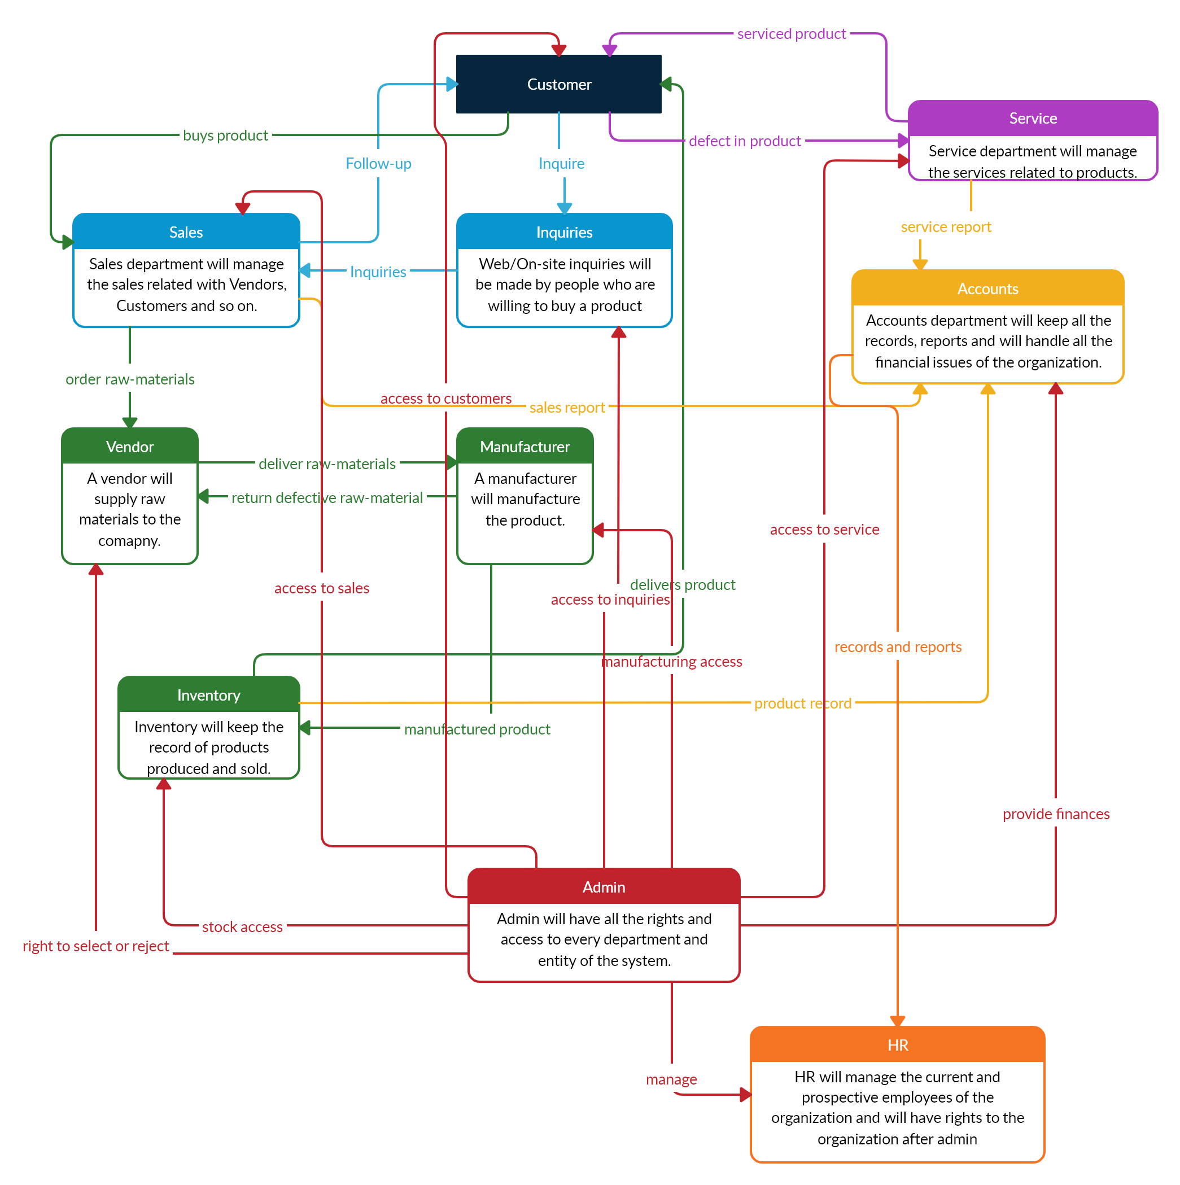

Slide 7
Project Flow (Use case Diagram):
The diagram displays the flow of entire system.

Slide 8
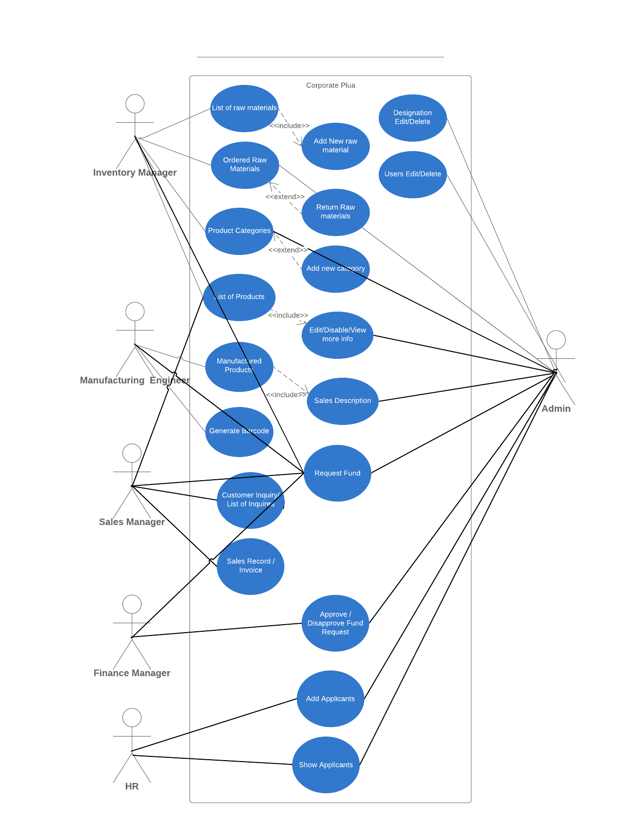

Slide 9
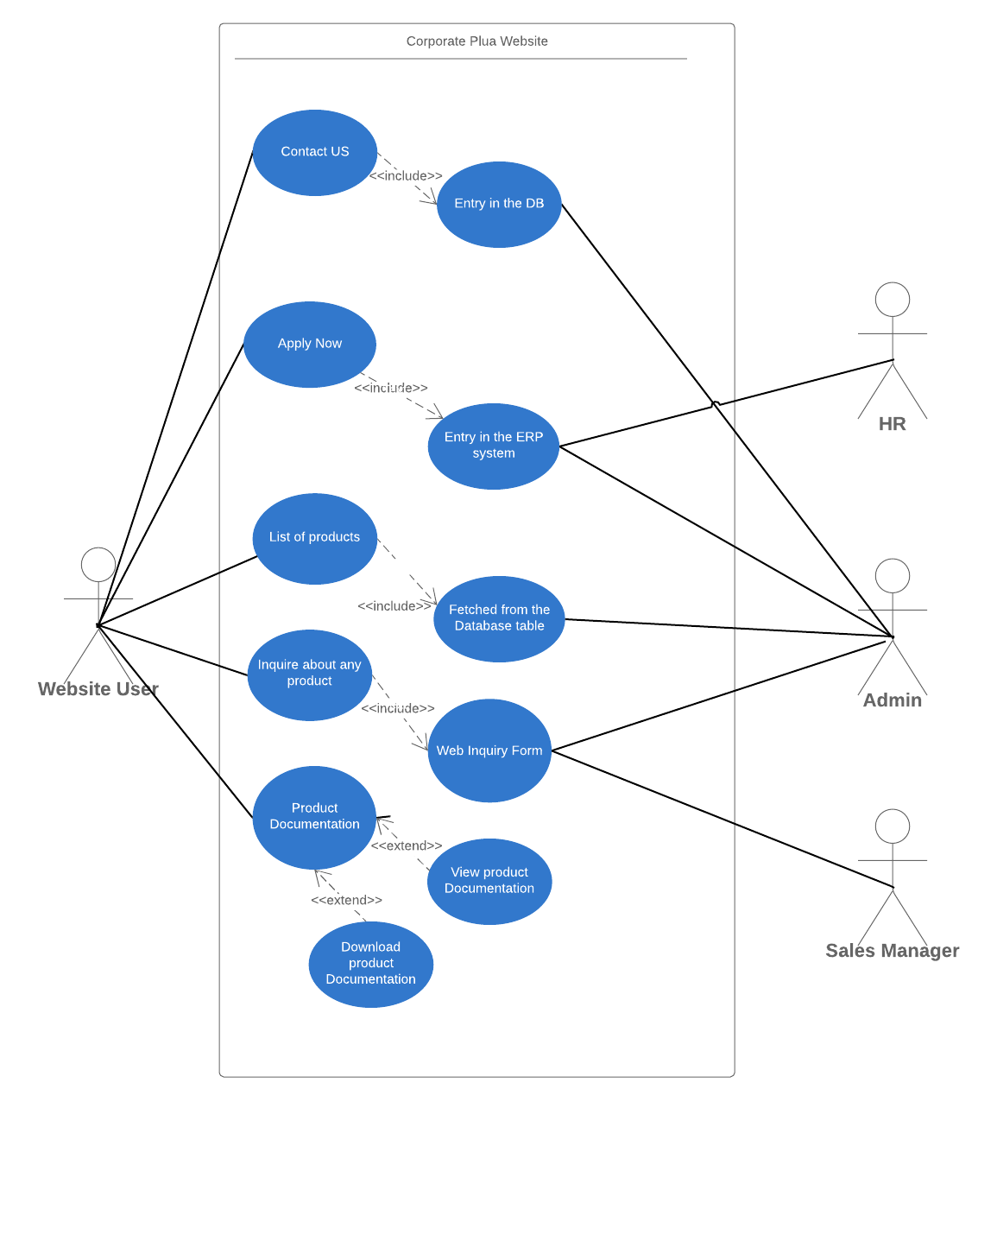

Slide 10
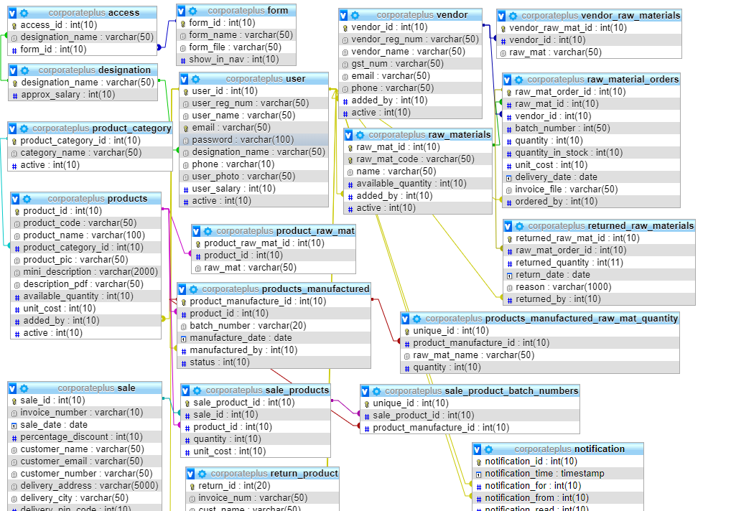

Slide 11
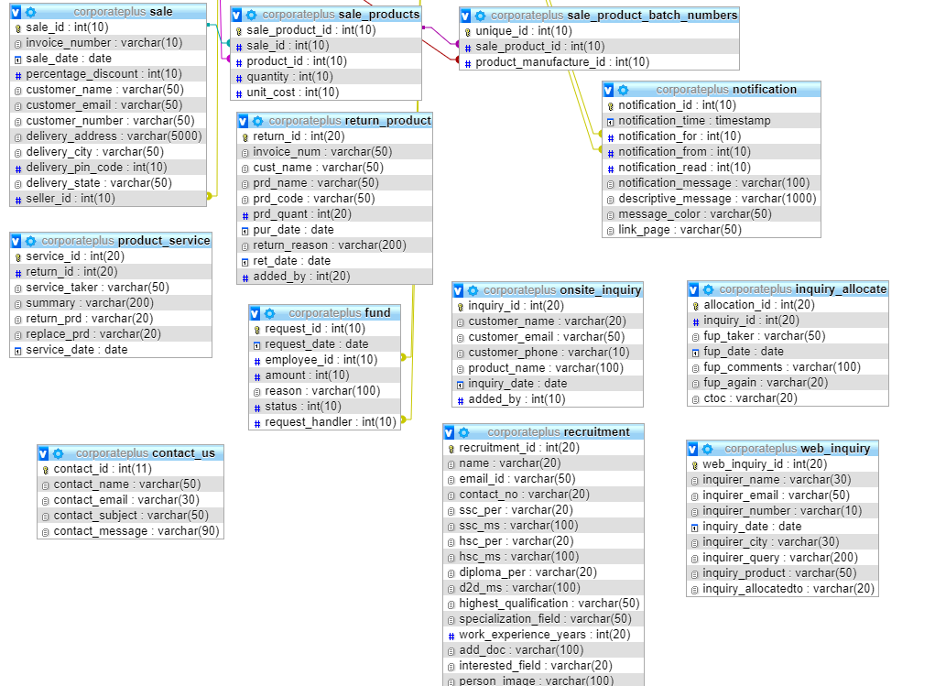

Slide 12
Tools and Technology:
PHP 7.3.5
XAMPP 7.3.5
Apache 2.4.39
phpMyAdmin 4.8.5
Frontend technology
HTML
CSS
Bootstrap
JavaScript

Slide 13
Hardware and Software specifications:
Hardware
Hard Drive: Minimum 20 GB
Dual core processor
Processor: Recommended 2GHz or more.
Memory (RAM): Minimum 4GB
Software
Web Browser : Microsoft Internet Explorer, Google Chrome, Mozilla
XAMPP/WAMP server
NetBeans IDE / Sublime Text Editor

Slide 14
Functional requirements:
System should contain numerous forms and as per the category of the user, admin can provide the rights to the user giving access to number of forms which are concerned to that user.
Admin should possess the entire right to system.
Every user according to their category should login and only access to the data which has been allowed by the admin.
Various forms concerning to all the departments like vendor, sales, HR, etc. should be available in the system.
All the data from scratch should be clearly visible from the system, including raw material, costing, manufacturing, sales, and customer inquiry handling.
There should be a dashboard, which would give a clear overview according to the relevant data for the logged in user.

Slide 15
Non-functional requirements:
The portal should load in less time.
It should be compatible with all the browsers.
Shifting the system to other server having whatsoever environment (OS/Hardware) should not cause any conflicts.
Login password should be strong enough to make it more secure.
Numerous users can access the system without any system failure.

Slide 16
Motivation for choosing the project and company:
Tech Elecon is the IT division of the Elecon group of companies and has an experience of more than 25 years in the field of hardware, software and networking solutions.
Situated in the heart of Vitthal Udyognagar an Industrial Estate and in the proximity of the educational town of Vallabh Vidyanagar, Tech Elecon is all set to reach new heights in the field of IT solutions.
To get broad knowledge and understanding about the functioning of industries, we decided to opt in for the project of an Enterprise Resource Planning web application where we can fully understand how an organization works in the real world.

Slide 17
Learning outcome till date:
We got to learn about the different departments of an organization and how they are interrelated to each other.
We also got the knowledge about functioning of an organization.
Model View Control (MVC) Architecture.
Creating attractive web pages.
Creating a profile page which supports the functionality of editing an image and previewing the same before editing.
Giving access of certain web pages to only authorized users.

Slide 18
Further planning:
Adding forms and creating database records for various departments of the organization and giving a dependency between them.
Managing accessibility and providing access only to specific users.
Generating invoice dynamically on purchase of a product.
Generating barcode for the manufactured products and make them ready to sell.
Maintain a system which keeps the backup of database periodically.
Create a responsive informational website that displays the products manufactured by the organization.
Linking the informational website with the ERP system.

