Slide 1

Corporate+ Administering Expertly
IT407 – Software Project Major
Created and Presented by :
PRJ/2020/IT/40
Internal Guide: Prof. Pritesh Prajapati
External Guide: Mr. Bhavin Patel (Tech Elecon Pvt. Ltd.)

Slide 2
Outline:
Introduction
Project Flow (System Work Flow)
Project Flow (Use Case Diagram)
Scope
Tools and Technology Used
Hardware and Software Specification
Functional and Non Functional Requirements
Project Demo
Conclusion

Slide 3
Introduction
Corporate Plus is an Enterprise Resource Planning web application that helps an organization to manage its different departments like Manufacturing, Inventory, Sales, Customers, Service, Accounts, Human Resources and many more from a centralized module.
The informational website gives any outsider an overview of the products the organization manufactures and sells.
ERP Administrator – An Admin will have the authority to give the priority and access to the other employees of various departments within an organization. Alongside, admin will have all rights to the system.
Manufacturing – This module will help in managing the product development. The requested product after getting approved for production will be manufactured under this department.
To begin with, Manufacturing department will check for the raw materials of the product with the Inventory department. Then, if the material is available it will be brought to Manufacturing department for the production.
If the material is not available in the Inventory, the request for the raw material will be sent to the Vendors. Thus, a product will be manufactured under the Manufacturing department.

Slide 4
Introduction (cont.)
Sales – The Sales department of the organization will play a very important role. Any to All sale of the manufactured products, inquiries and follow up will be handled by the Sales department of the organization.
Accounting – Accounting (Finance) department will be having the rights to either approve or reject a Fund request made by different employees of the organization and manage the organization’s finances.
Human Resources – This module covers an important function which is applicant tracking. It enables the HR staff to search for the best candidates among the applied ones according to the criteria set by an organization.
Inventory - Inventory department will keep a record of all the products and raw materials kept in the inventory of the organization. It will be the role of an Inventory Manager to request the vendors for raw materials that have been out of stock.
Service - If there is a defect in the manufactured product after its sale, then the product is returned to the Service department of the organization where the Service Engineer performs the servicing of the defective product and makes sure that the customer needs not to worry about the product again.

Slide 5
Introduction (cont.)
The Informational Website - The informational website can display the products manufactured and sold by the company under the products categories.
The user who has access to the website can inquire about the same through the web inquiry form.
Any willing applicant can submit the application for job under the apply now module.
If user has any query, then it can be submitted under contact us section in the website.

Slide 6
Project Flow (System Work Flow):
The diagram displays the flow of entire system.

Slide 7
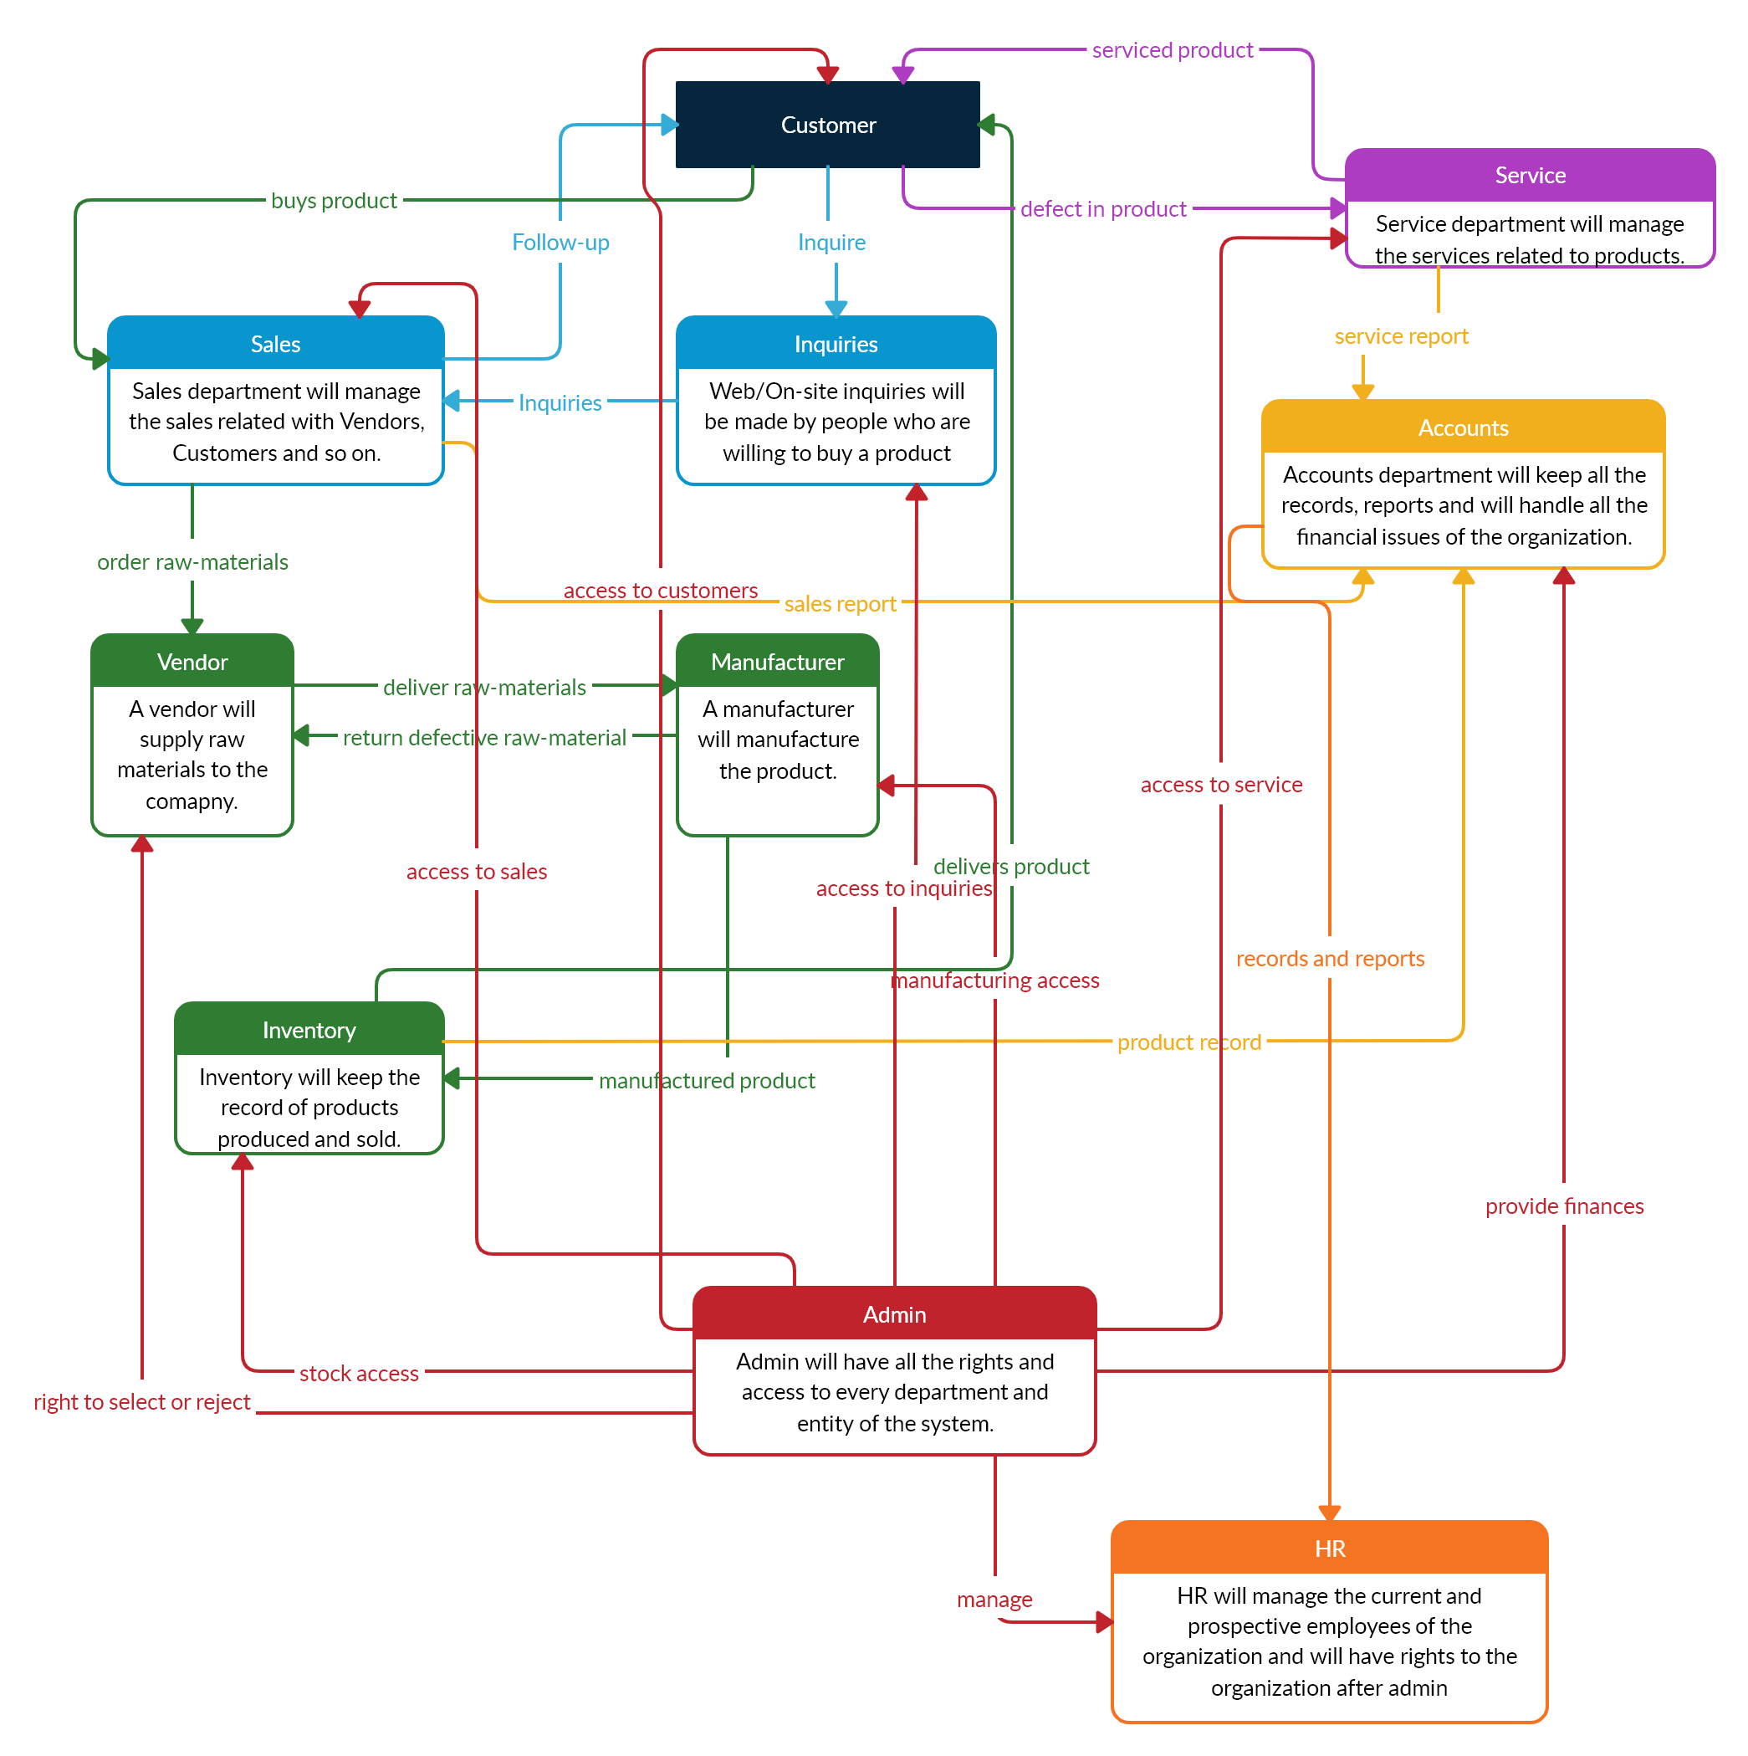

Slide 8
Project Flow (Use case Diagram):
The diagram displays the individual responsibilities of each user of the system.

Slide 9
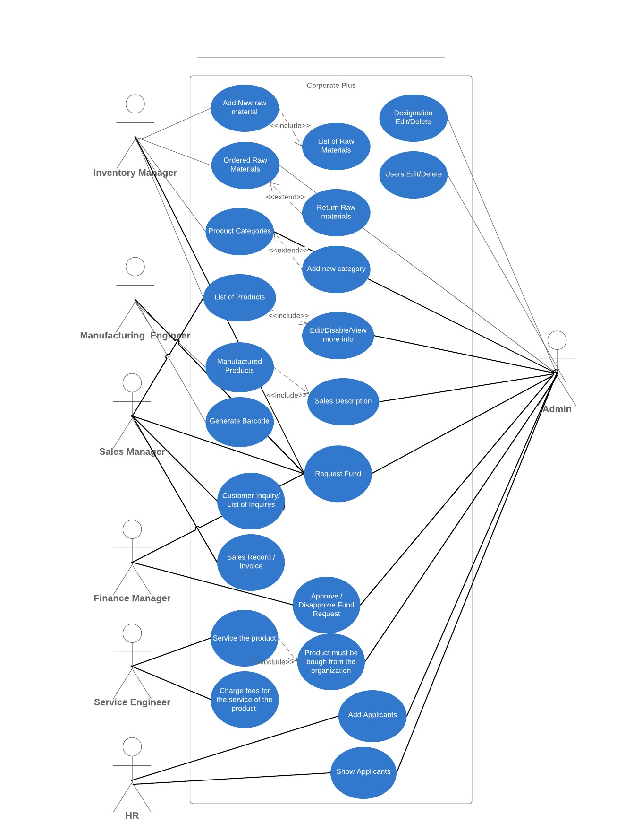

Slide 10
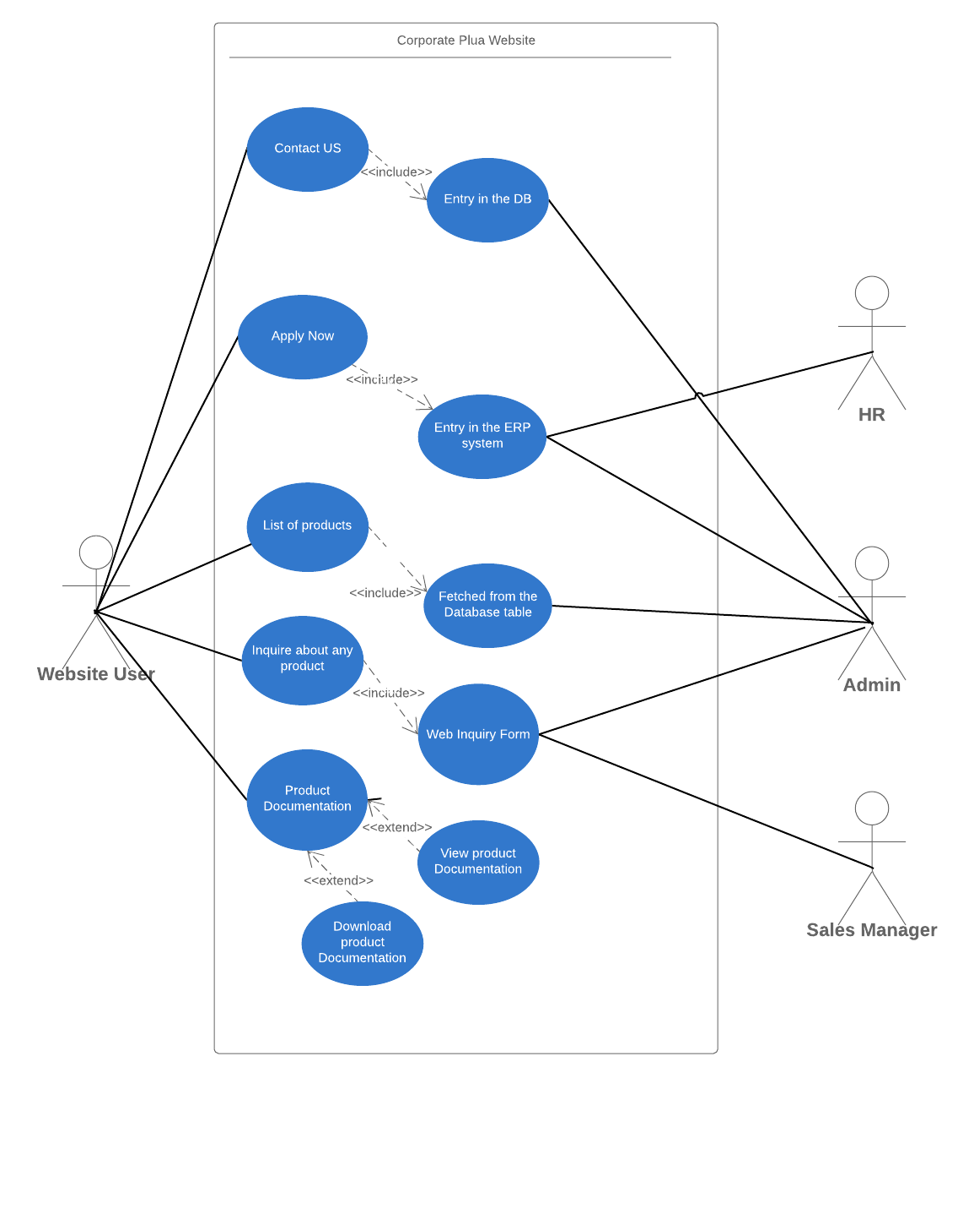

Slide 11
Scope
The scope of this project is to allow the organization’s departments to function under one centralized system.
Allowing the Administrator to add new designations to the system according to the organization.
Allowing any user from the system to access the Web application according to their access rights and priorities, they can modify their profile, by using the functionalities provided under their designation they can add or update/delete any existing record from the shared database.
For instance, consider the manufacturing department, it will have the rights to view the raw materials in the system along with their available stock, also the vendor information will be provided so that at the time of raw material requirement, the respective vendor can be searched and contacted.
The informational website displays the products that the company manufactures and all the information is fetched dynamically from the database, the web portal provides option for any user to inquire for particular product.

Slide 12
Tools and Technology:
PHP (v7.3.5)
XAMPP (v7.3.5)
Apache (v2.4.39)
phpMyAdmin (v4.8.5)
Model-View-Control (MVC Architecture)
Frontend technology
HTML
CSS
Bootstrap
JavaScript

Slide 13
Tools and Technology (cont.)
PHP
PHP (recursive acronym for PHP: Hypertext Preprocessor) is a widely-used open source general-purpose scripting language that is especially suited for web development and can be embedded into HTML. One can even configure their web server to process all their HTML files with PHP.
The reasons for using PHP in this project are that it supports cross platform availability, it is web oriented, has a wide range of community and resources both online and offline, has a wide range of frameworks and we have a good experience on working with PHP.
MVC Architecture
Model-View-Controller (MVC) is an architectural pattern that separates an application into three main logical components: the model, the view, and the controller. Each of these components are built to handle specific development aspects of an application.
MVC is one of the most frequently used industry-standard web development frameworks to create scalable and extensible projects.

Slide 14
Hardware and Software specifications:
Hardware
Hard Drive: Minimum 20 GB
Dual core processor
Processor: Recommended 2GHz or more.
Memory (RAM): Minimum 4GB
Software
Web Browser : Microsoft Internet Explorer, Google Chrome, Mozilla
XAMPP/WAMP server
NetBeans IDE / Sublime Text Editor

Slide 15
Functional requirements:
The system must be centralized in order to support and allow the users to manage grouped task and exchange data between various departments.
Administrator of the system must possess all the rights of the system and should have the access to add new designations according to the departments with giving the particular designation, rights to certain forms according to the functions to be performed and their role in the organization.
Any designation user (employee) must be able to perform their tasks and functions without any issues according to their rights and role at the organization.
There must be one centralized ERP database between all the users so that all the data is stored at one place and can be made easily accessible to any of the user who needs it to perform any task.
Any interested person willing to inquire more about any particular product can fill in a inquiry form in the website which will then be submitted to the organization’s ERP system through which it can be processed further.
Dashboard must display the necessary graphs and information about newly added products, to-do list, sales information and so on.

Slide 16
Non-functional requirements:
Efficiency – This system must be able to deal with load caused due to large number of users performing their business operations through this ERP system.
Accuracy – Accuracy is an important aspect when considering the functioning of entire organization which has various departments, so the ERP system must be accurate in terms of its functions.
Reliability – The system that is to be used in any organization with various departments must be reliable enough to ensure that no errors are occurring in the modules and if they are occurring, they need to be solved by the use of error handling mechanism.
Performance – The portal must load within specified amount of time and must be compatible with all the browsers. Once the ERP system is deployed in the organization it must deliver high performance to the users.

Slide 17
Conclusion:
Corporate Plus is an Enterprise Resource Planning Web application that assists an organization to manage its different departments like Manufacturing, Inventory, Sales, Customers, Service, Accounts, Human Resources and many more from a centralized module.
The Corporate Plus ERP Web Application provides various functionalities as required by any organization, there is an Administrator in the system possessing all the rights and access, it is the duty of Administrator to add new designations according to the organization.
Designations like HR, Finance Manager, Manufacturing Engineer, Sales Manager, Inventory Manager, Service Engineer are already present in this system. According to their roles in the system, they are allocated certain access rights so that they can perform their functions and tasks.
The ERP Web application dashboard designed to display number of users, products, manufactured products, sales record entries, feature called to-do list, along with various charts and graphs.
The Website designed for the organization gives any outsider an overview of the products the organization manufactures and sells, as well as sending a web inquiry regarding any product in which the website user is interested, the functionality regarding applying for a job at the organization and also contacting the organization regarding any query.

