Slide 1

Effective Fire Detection System using FOG computing
Prepared by : Rushabh Shah(16IT126)
Rahul Tiwari(16IT139)
Guided By : Prof Ravi Patel Sir

Slide 2
CONTENTS
Abstract
Introduction
Existing System
Proposed System
Scenarios
Security Issues
Example

Slide 3
ABSTRACT
Fog Computing is a paradigm that extends Cloud computing and services to the edge of the network. Similar to Cloud, Fog provides data, compute, storage, and application services to end-users. The motivation of Fog computing lies in a series of real scenarios, such as Smart Grid, smart traffic lights in vehicular networks and software defined networks.

Slide 4
INTRODUCTION
CISCO recently delivered the vision of fog computing to enable applications on billions of connected devices to run directly at the network edge. Customers can develop, manage and run software applications on Cisco framework of networked devices, including hardened routers and switches. Cisco brings the open source Linux and network operating system together in a single networked device

Slide 5
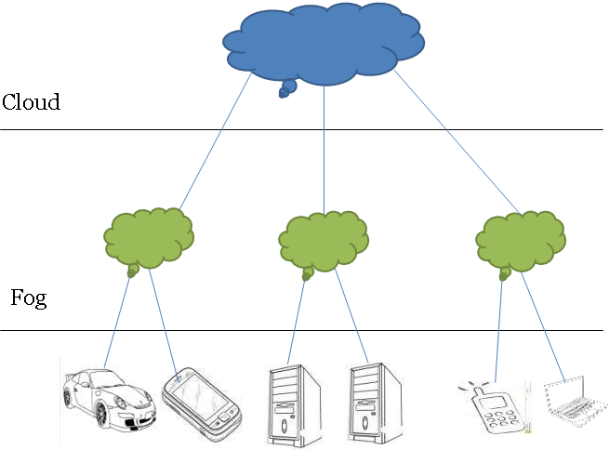

Slide 6
Continue..
A simple three level hierarchy as shown in above Figure
In this framework, each smart thing is attached to one of Fog devices. Fog devices could be interconnected and each of them is linked to the Cloud

Slide 7
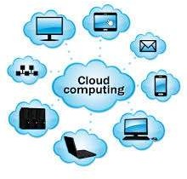
EXISTING SYSTEM
Cloud computing has provided many opportunities for enterprises by offering their customers a range of computing services. Current “pay-as- you-go” Cloud computing model becomes an efficient alternative to owning and managing private data centers for customers facing Web applications

Slide 8
Fog Computing and the Internet of Things

Slide 9
By 2020, the number of “things” that are part of the IoT may reach up to 50 billion. That’s a lot of data being generated.

Slide 10

Current cloud computing models can’t keep up with the amount of bandwidth that will be needed

Slide 11
Fog computing goes around the internet entirely by processing data locally.

Slide 12
Fogging basically helps cloud systems by easing the burden of processing data

Slide 13
FOG COMPUTING USES

Slide 14
Smart Cities
Fog computing helps collect data on city activities from trafic to utilities, ensuring everything is running eficiently

Slide 15
Air Travel
A single engine on a Boeing 747 generates 0.5TB of data. Fog computing can process that data locally and send only the most important bits of information to those who need to see it.

Slide 16
CONCLUSION
Fog computing advantages for services in several domains, such as Smart Grid, wireless sensor networks, Internet of Things (IoT) and software defined networks (SDNs). We examine the state- of-the-art and disclose some general issues in Fog computing including security, privacy, trust, and service migration among Fog devices and between Fog and Cloud.

Slide 17
THANK YOU

