Slide 1

Emergency Department Dataset : Data Visualization & Dashboard
Presented By: Rahul Tiwari (N01416281)

Slide 2

About Data
Emergency Dept dataset is related to patient encounters in a hospital setting.
It contains information such as patient demographic details, clinical information, and operational metrics.
The data can be used to gain insights into various aspects of patient care, such as identifying trends in patient demographics and diagnoses, analyzing admission and discharge patterns, and evaluating operational performance metrics such as wait times and length of stay.

Slide 3

Visualizations

Slide 4
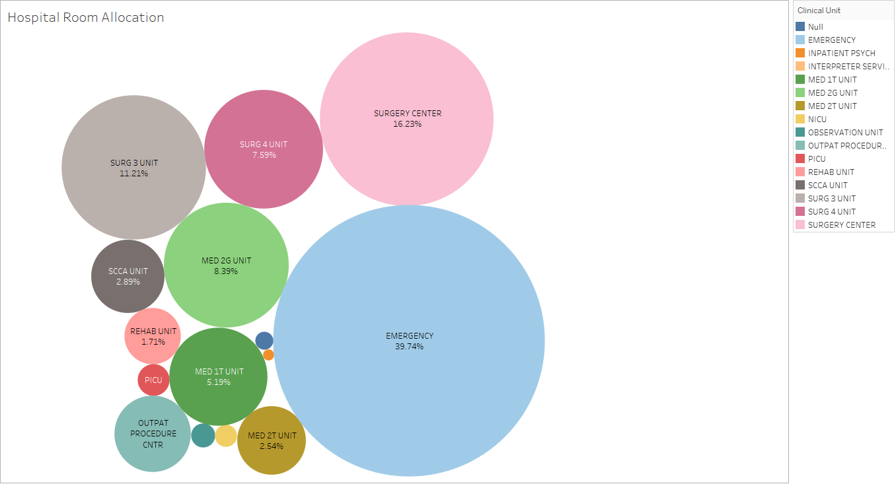
Almost 40% of all the hospital rooms are allocated to the EMERGENCY Clinical Unit.
Surgery Center and surgery units account for 35% of total hospital room allocation.
INPATIENT PSYCH, NICU, OBSERVATION UNIT and PICU takes less than 1% of the overall rooms.
Business Intelligence - ITE-5421-0NA

Slide 5
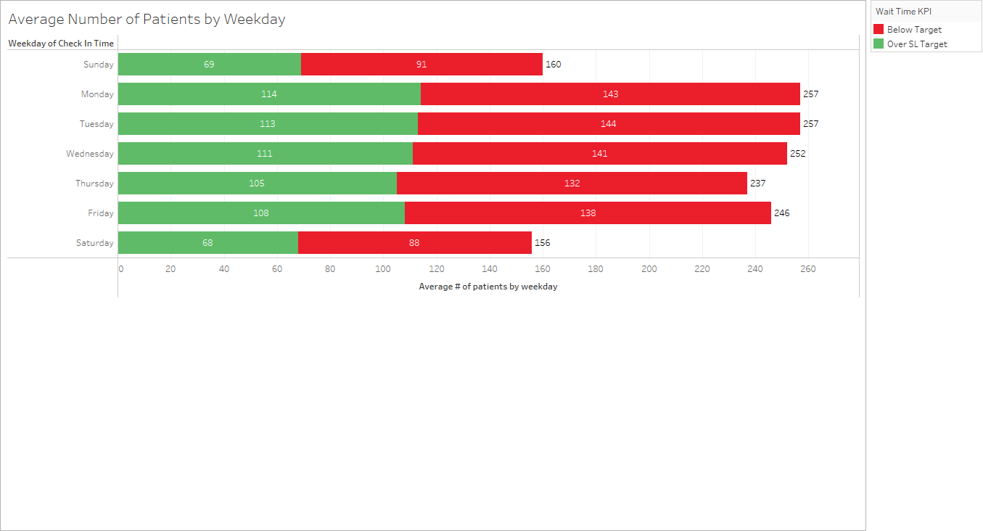
Average number of patients is at the peak during the start of the week (Mon & Tue).
During the weekends (Sat & Sun), least number of patients are recorded.
Approximately 40% of the patients have to face Over SL Target wait time, everyday.
Business Intelligence - ITE-5421-0NA

Slide 6
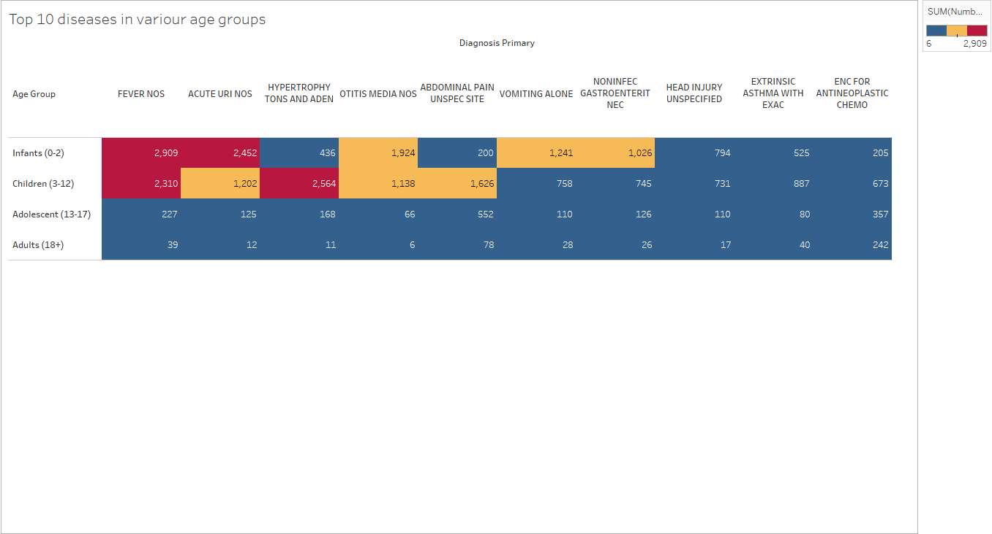
From the highlighted table above, we can conclude that infants and children are the most prone to diseases, whereas adults are the least prone to catching a disease.
FEVER NOS is the most common diagnosis amongst all, for all the age groups.
HYPERTROPHIC TONSILS AND ADENOID and ABDOMINAL PAIN UNSPECIDIED SITE are the two diseases that are most commonly seen in children than any other age group, including infants.

Slide 7
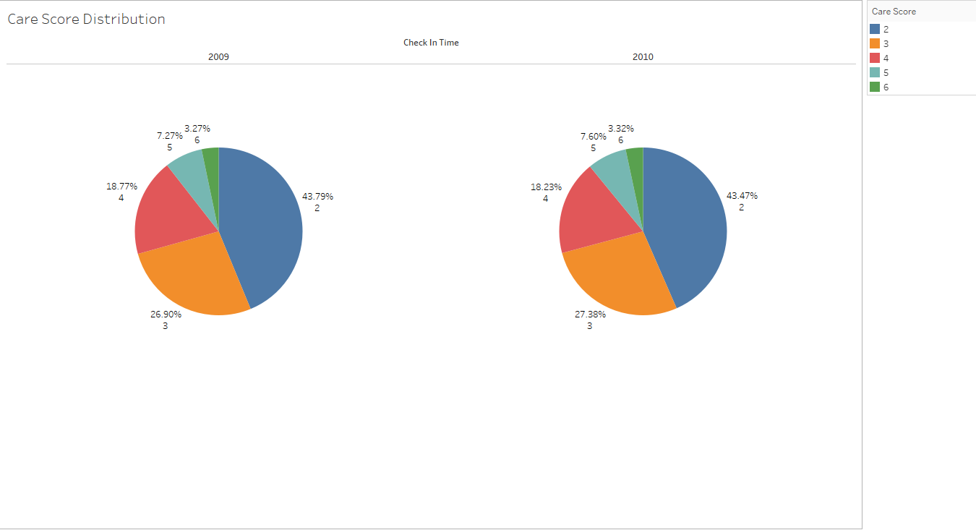
Based on the above pie charts, it appears that there was no substantial improvement in the distribution of care scores between 2009 and 2010.
Around 40% of all patients provided a care score of 2, while only about 3% awarded a score of 6.
It is clear that the hospital needs to make significant improvements in their services to patients in order to raise their care score.

Slide 8
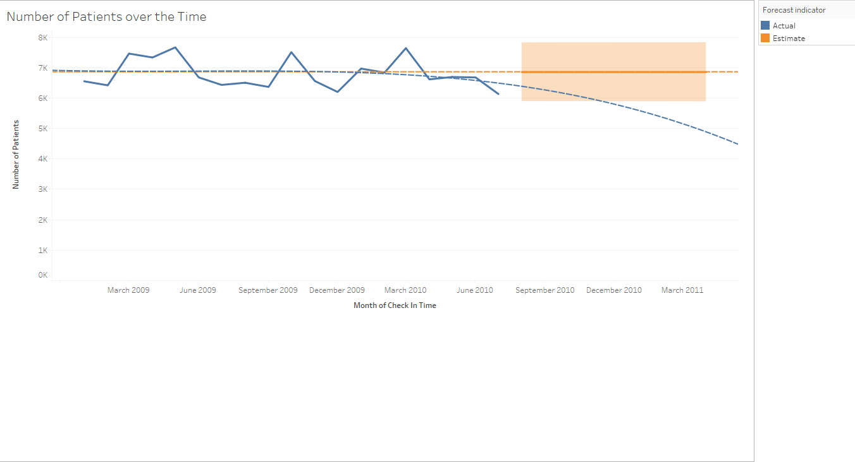
The number of patients reached its peak three times, with approximately 7.5K patients per month. However, the lowest number of patients (about 6K) was observed in July 2010.
The trend line indicates that the number of patients has been gradually decreasing over time, while the forecast line suggests that it will remain constant at 7K.

Slide 9

DASHBOARD

Slide 10
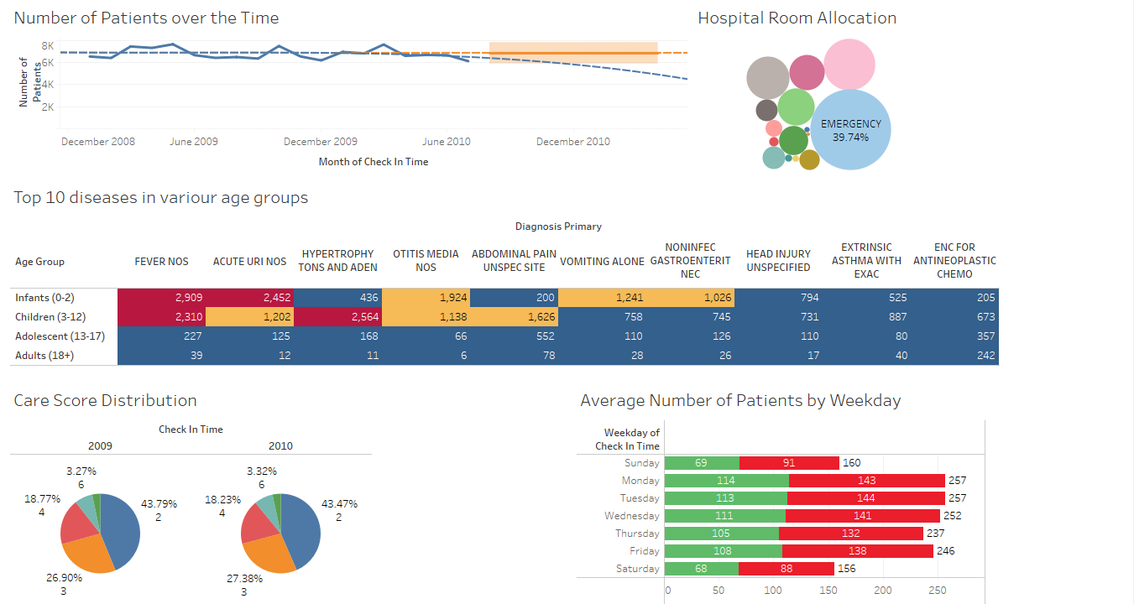

Slide 11
Conclusion
The hospital appears to be experiencing a gradual decline in the number of patients visiting over time.
The majority of the rooms in the hospital seem to be allocated to the Emergency Clinical Unit.
FEVER NOS was found to be the most common diagnosis across all age groups of patients.
The hospital's review scores in terms of patient care are quite poor.
Furthermore, the wait time Key Performance Indicator (KPI) exceeds the Service Level (SL) target for nearly 40% of patients on a daily basis.
Overall, it is crucial for the hospital to improve their customer service if they want to attract more patients, reduce wait times, and enhance the overall patient care score.

Slide 12

THANK YOU

