Slide 1

Numpy
By Rahul Bunker

Slide 2
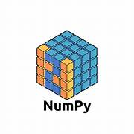
What is Numpy
NumPy is a Python library used for fast numerical calculations using arrays.

Slide 3
Why Numpy ?
NumPy is used to perform fast mathematical operations on arrays with less code.
Fast calculations (High Performance)⚡
Easy array handling 📊
Less code ✍️
Better performance 🚀
AI , Machine Learning ,Data Science & Data Analyst Foundation

Slide 4

Array
An array is a collection of similar data stored in one place.
Array = Same Data Type + Multiple Values + Single Variable
Example:
arr = [10, 20, 30, 40]
Same Data Type → Integer
Multiple Values → 10, 20, 30, 40
Single Variable → arr

Slide 5


Array | List
Stores same data type | Stores different data types
Faster | Slower than array
Uses less memory | Uses more memory
NumPy uses arrays | Python uses lists

Slide 6
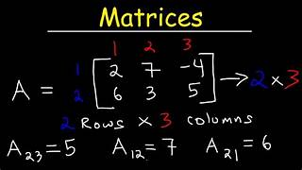

Slide 7
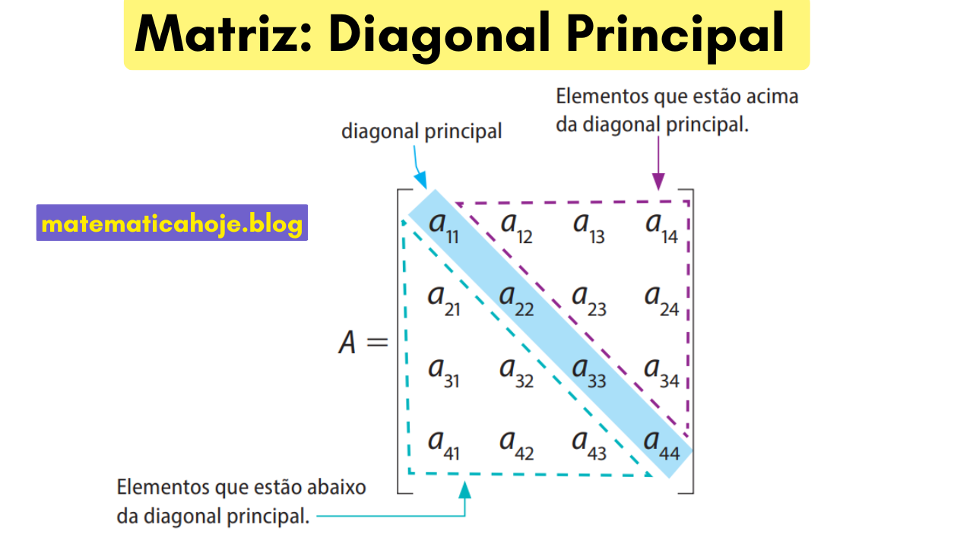

Slide 8
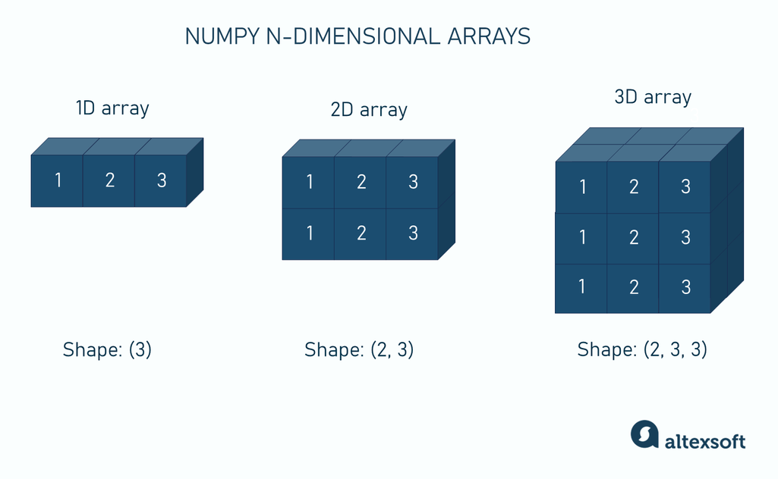

Slide 9
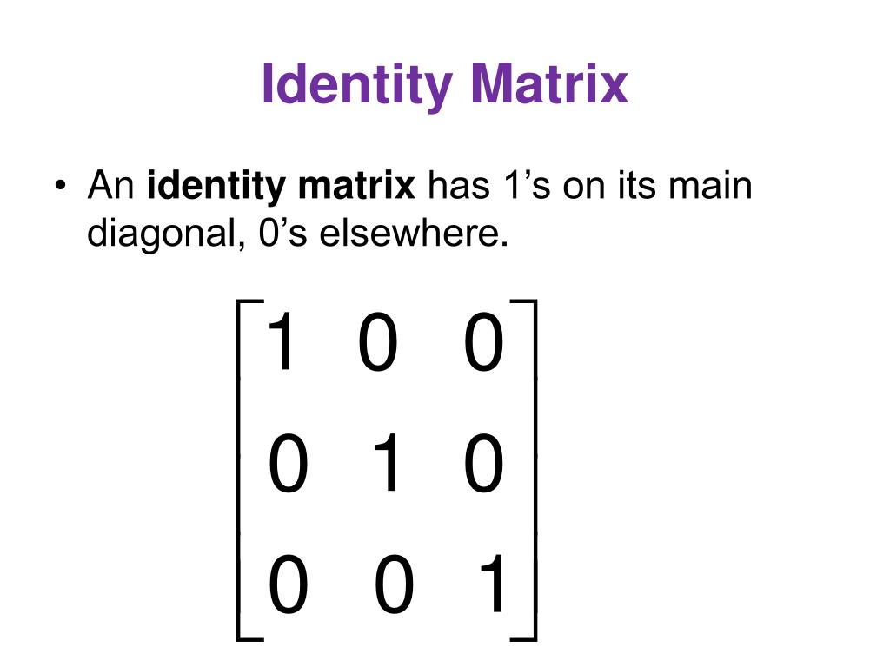

Slide 10
