Slide 1


Reimbursement Claim Process
LTA Cash Voucher Scheme

Slide 2
Contents
LTA Cash Voucher Scheme - Reimbursement Voucher Generation Process
Important Notes on LTA Cash Voucher Scheme

Slide 3
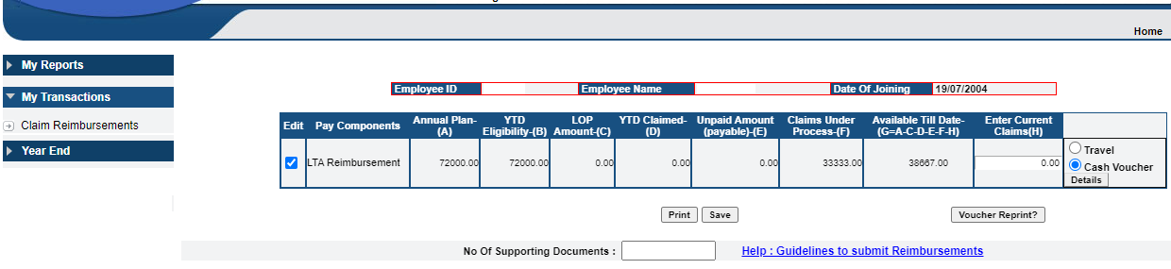



Step 1 - Claim Reimbursements
Click here
New options provided under ‘Details’
Click on “Claim Reimbursements” menu in order to update the reimbursement claim details.
Select the LTA Reimbursement component from the available list of reimbursements.
Click on either ‘Travel’ or ‘Cash Voucher’ options to update either LTA Travel Reimbursement details or Cash Voucher GST bill details, respectively.
Then click on ‘Details’ tab to enter the actual expenditure details.
When once all the details are updated and saved, the Voucher should be generated accordingly. With out generating a voucher, the switch over between Cash Voucher to Travel options is not feasible.
Multiple bills are accepted. Even though multiple bills are accepted, in case of multiple goods or services purchased, please submit the claim considering all bills at a time with the help of a single Voucher. Generation and process of multiple Vouchers will have an adverse impact on LTA Exemption process, as only two exemptions are allowed in the LTA Block of 2018-2021.

Slide 4
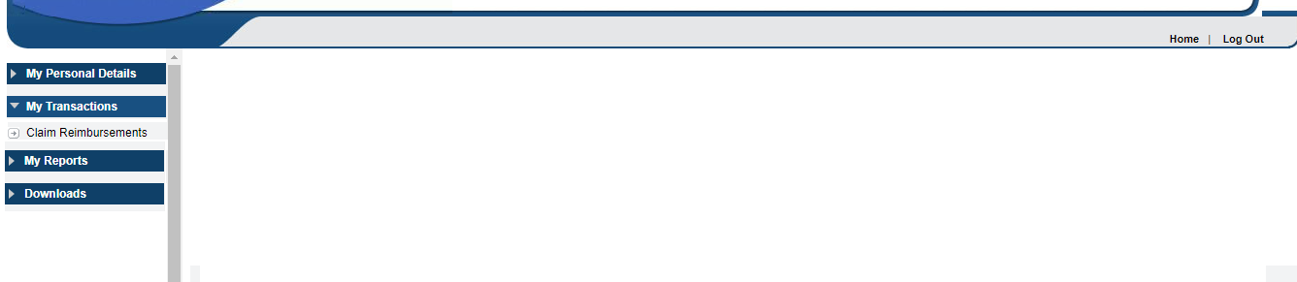
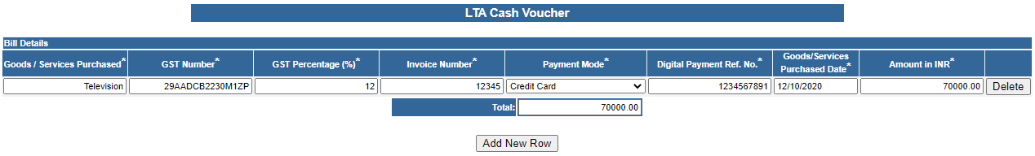
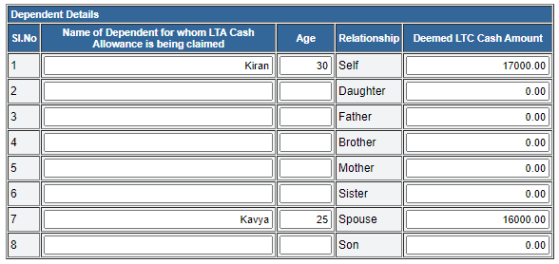
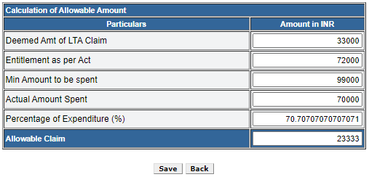

Step 2 - Fill the details
Notes:
Update the details and ‘Save’ the information. Then click ‘Back’ to generate the Voucher.
‘Deemed LTC Cash Amount’ can not exceed INR 36000 per dependent.
Total ‘Deemed LTC Cash Amount’ can not be more than LTA Available Till Date.
‘Save’ the details and click ‘Back’

Slide 5

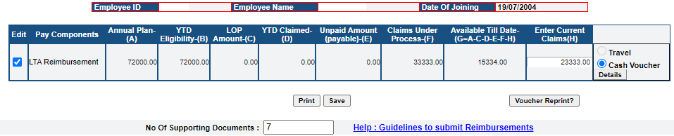



Step 3 - Generate the Voucher
Claimed Amount
Click ‘Save’ to save the data.
Click on ‘Generate Voucher’ when once the details are completely updated.
Enter the number of supporting documents
Basis the data updated under the ‘Details’ tab, the claimed amount appears under current claims.
Click on ‘Voucher Reprint’ to view the generated Voucher details.

Slide 6
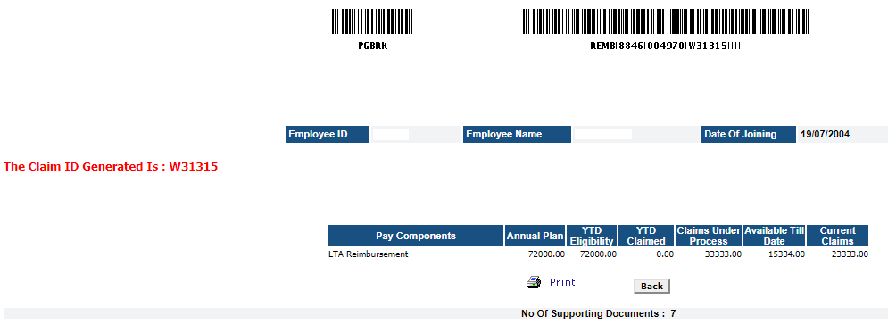

Step 4 - View generated Voucher
Generated Voucher Number which is also a reference for Scan Image Upload Process
Create the zip file of scan images related to the Voucher. In the above example, the Voucher No. W31315 should contain the scan images of only “LTA Cash Voucher Scheme - GST Bills”.

Slide 7
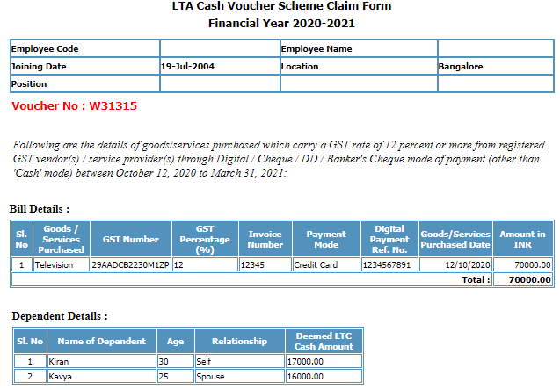
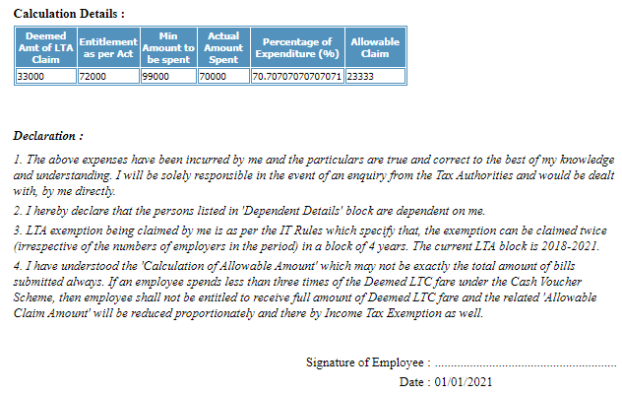
Step 5 - Web Voucher Sample Format
Web Voucher Sample Format

Slide 8
Important Notes
Cash payments are not allowed. Only Digital Payments are allowed. However, the payment can also be made by cheque / DD / Banker’s Cheque.
A voucher from GST registered vendors / service providers indicating the GST number, GST percentage, and the amount of GST paid, total amount spent to be submitted for claiming exemption.
Multiple bills are accepted. Even though multiple bills are accepted, in case of multiple goods or services purchase, you are requested to save the information and submit the claim once after updating details of all bills.
Payment of cash allowance, subject to maximum of Rs 36,000 per person as deemed Leave Travel Concession (LTC) fare per person (Round Trip) to non-Central Government employees, shall be allowed Income Tax exemption subject to fulfilment of conditions.
The employee need to spend a sum equal to three times of the value of the deemed LTC fare on purchase of goods / services which carry a GST rate of 12 per cent or more from GST registered vendors / service providers through digital mode.
The date of purchase of goods/services should be between October 12, 2020 to March 31, 2021.
As this exemption is in lieu of the exemption provided for LTC fare, an employee who has exercised an option to pay income tax under concessional tax regime (under New Tax Regime) shall not be entitled for this exemption.
Premiums paid for insurance policies purchased between October 12, 2020 and March 31, 2021, will be covered under the leave travel concession (LTC) cash voucher scheme. However, Rules had not highlighted anything about getting tax benefits under both Chapter VIA & Cash Voucher exemption for a specific policy. While premiums paid for existing insurance policies would not count, those made towards fresh policies purchased during the specified period would be eligible.
The invoices of the goods and services purchased as per the scheme may be in the name of spouse or any family member who are eligible for LTC fare as declared in the service records. The dependent can be spouse, son, daughter, father, mother, brother, and sister.

Slide 9
Important Notes (Continued..)
In case of a specific invoice is cancelled / reversed after the purchase at a later point in time, the same invoice should not be submitted for claim.
The employee who had opted New Tax Regime will also get option to claim LTA Cash Voucher Reimbursement benefit like LTA Travel Reimbursement. However, even though the approved amount of a claim is considered for payment, the approved amount will not be considered for tax exemption benefit under Sec 10(5) of Income Tax Act, 1961.
This is applicable for Employee who already allocated LTA in their Flexi Planner, so that LTC claims can be uploaded against the same.
Tax Exemption treatment for LTC Cash Voucher would be like LTA Travel; only two claims will be eligible for tax exemption in current LTA Block of 2018-2021.
Employee need not consume his/her leave(s) to avail this benefit.
The beneficiaries need not submit original bills of their purchases in order to avail reimbursement under the scheme and self-attested copies would suffice instead. However, the original bills may be produced on demand for information.
Purchase of any goods or services which attract GST of 12% and above qualify for reimbursement under this scheme. Purchases on EMI basis are also permissible.
If a child is less than 5 years, then the child is counted as a dependent for this scheme, provided the child is eligible as a dependent in accordance with LTC Rules.
An individual can purchase different items which attract GST of 12% and more. The payment should be made through digital mode.

Slide 10
Important Notes (Continued..)
This scheme is for the LTA Block of 2018-21. Normally, a block contains two LTC fares. If one has been availed and the other remaining, the same can be utilized for this purpose. Any unutilized LTA of the Block of 2018-21 is eligible.
Any purchase with digital mode is to be supported by invoice. Based on production of invoice, the spending is calculated. The intention of this scheme is to encourage every mode of purchase. It is for the employee to choose a suitable digital mode.

Slide 11
Thank you

