Slide 1
Assignment 2b
Group 1: Rahul Chamarthi, Ravi Varikuti, and Benjamin I Johnson

Slide 2
Implementation

Slide 3
Circle
def moveInCircle(self):
radius = 1
for i in range(4):
# get speeds
speed = 0.1*np.exp(i) # run at different speeds
omega = speed/radius
distance = 2*math.pi*radius
#Set Twist msg
self.vel.linear.x= speed
self.vel.angular.z = omega
#Setting the current time for distance calculus
t0 = rospy.Time.now().to_sec()
current_distance = 0
#Loop to move the turtle for a specified distance
while(current_distance < distance):
#Publish the velocity
self.velocity_publisher.publish(self.vel)
# print(self.odom)
#Takes actual time to velocity calculus
t1=rospy.Time.now().to_sec()
#Calculates distancePoseStamped
current_distance= speed*(t1-t0)
#After the loop, stops the robot
self.vel.linear.x = 0
self.vel.angular.z = 0
#Force the robot to stop
self.velocity_publisher.publish(self.vel)
The implementation of the circle script for the turtlebot is very much the same as that done for the turtlesim model. It is simply a linear and angular velocity command to track a circle of a given radius. The biggest difference over the implementation I used for the turtlesim was to use a class representation for the turtle instead of a simple script. This allows for using custom methods on different classes and could allow us to run both circle and square methods on the same bot. We did not do that this time. In order to adjust the speed of the bot I used a simple loop (for i in range(4):) and then multiplied base speed by exponent(i). The code is shown to the right.

Slide 4
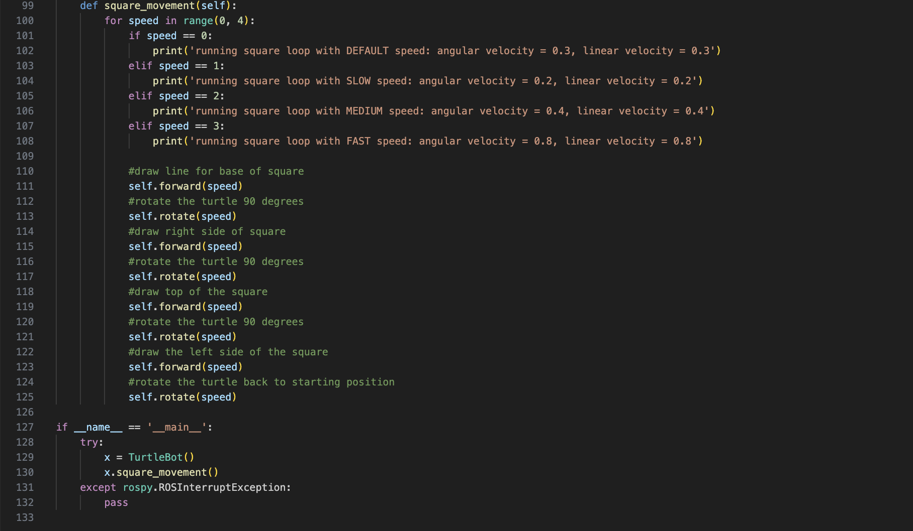
Square
The implementation of the square for the TurtleBot proved to be a little bit more complicated than expected
While there was not sufficient space on this slide to include all the code, I wanted to specifically include the image on the right to highlight the implementation approach
Given that there is no pre-implemented method that we could use, we had to take a custom approach
The method we used was to move the robot forward at a constant linear velocity, then pause, rotate, and move forward once again
Repeating the above method till we had traversed the path of a square

Slide 5
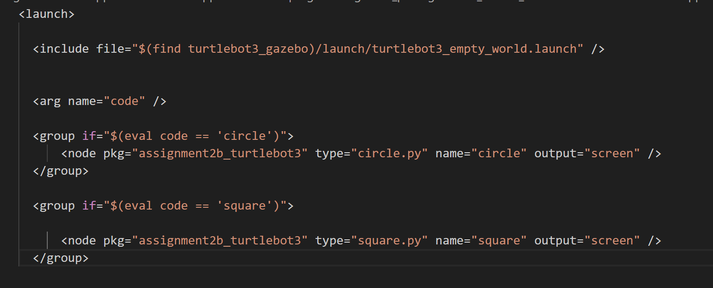
Launch File
Launch file has been created to by using taking input arg such as square or circle.
Given arguments(square or circle)are evaluated in group element using if function.
Launch file can be launched using the following command in terminal.
For circle
For square

Slide 6
Analysis

Slide 7

Circle
As can be seen in the video, the bot tracks the expected trajectory pretty well at low speeds. This is because at low speeds the model converges to kinematic representation. However, as the speeds increase the dynamic model takes precedence and we see the bot is not able to track the expected curvature. It does look cool though.

Slide 8
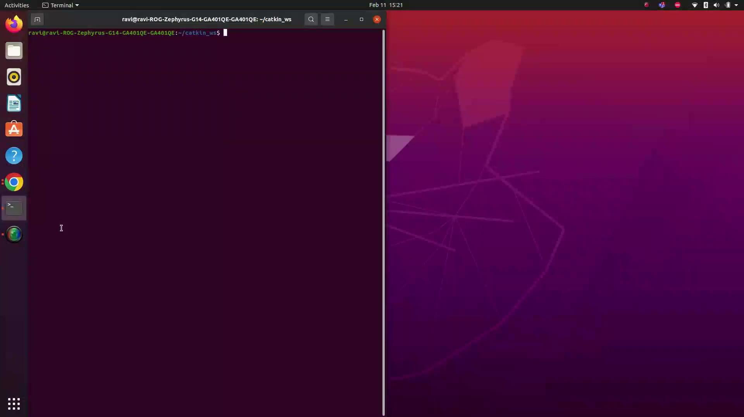
Square
The most interesting thing that you can observe in the run results, shown to the right, is that the robot does not traverse in an exact square
We believe that this lack of desired behavior stems from the open loop nature of our implementation
We expect that as the class continues on, we should be able to create a perfect square with the implementation of a closed loop system

