Slide 1
Assignment-4: TurtleBot3(sim2Real)with Real World TB3
Group 1
Rahul Chamarthi, Ravi Varikuti, and Benjamin I Johnson

Slide 2
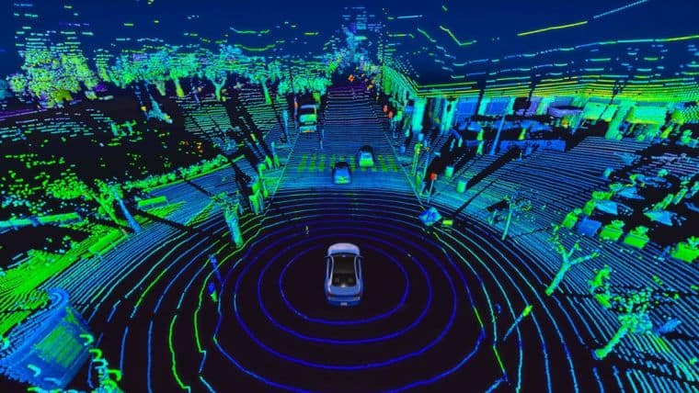
Simultaneous Localization and Mapping (SLAM) in Robotics
SLAM is a fundamental technique in robotics that enables a robot to create a map of its environment while simultaneously determining its own position within that environment.
It plays a crucial role in autonomous navigation, allowing robots to navigate and operate in unknown or dynamically changing surroundings.
The choice of SLAM algorithm can significantly impact a robot's navigation capabilities, influencing factors such as accuracy, computational efficiency, and adaptability to different environments.
GMapping:
Grid-based FastSLAM approach.
Utilizes a particle filter to estimate the robot's pose and a grid-based map representation.
Widely used for its simplicity and efficiency.
Hector SLAM:
Based on scan matching techniques.
Employs a scan matcher for pose estimation and builds a 2D occupancy grid map.
Known for its robustness in dynamic environments

Slide 3
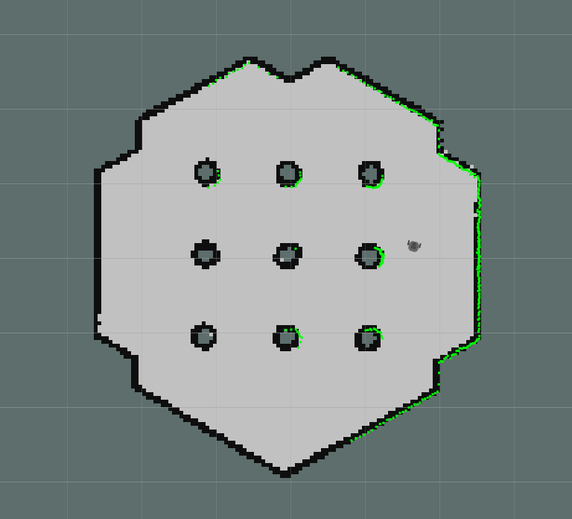
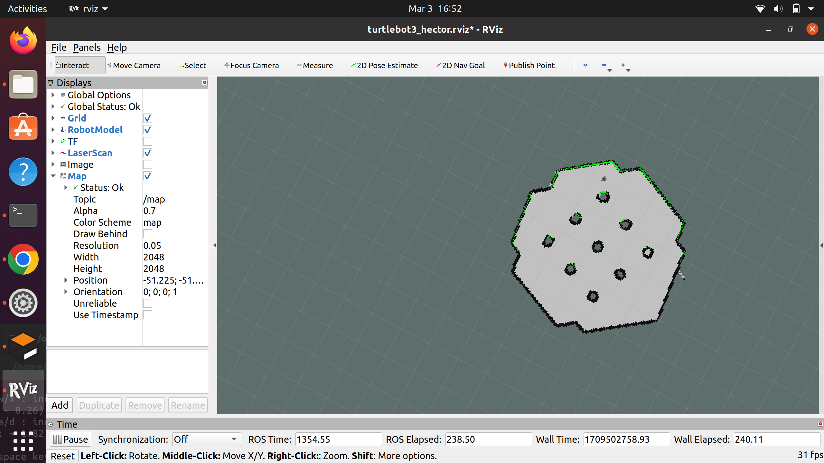
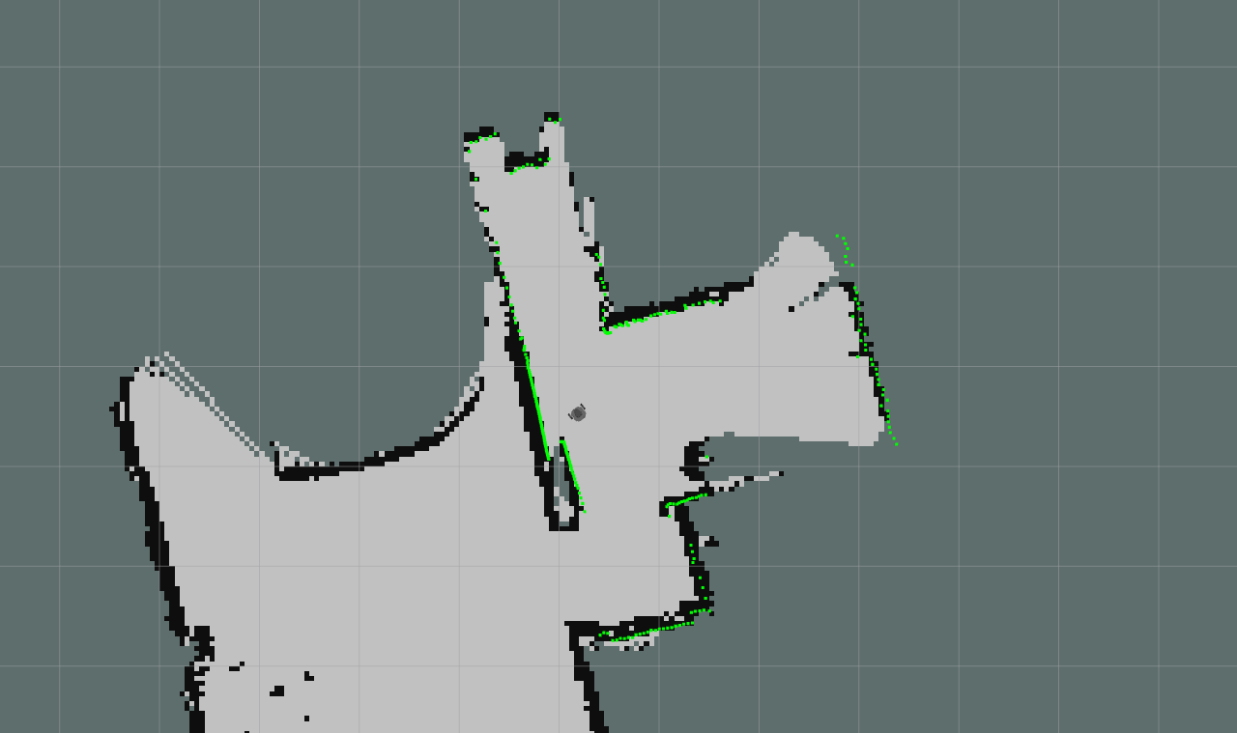
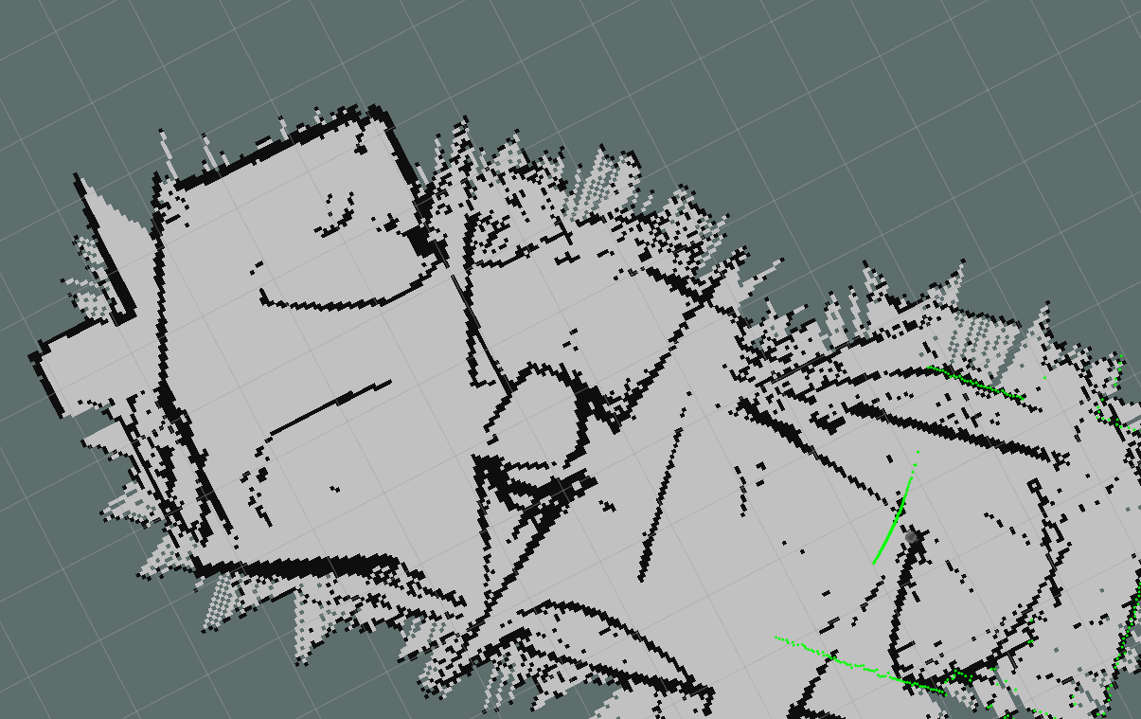
GMapping vs. Hector SLAM in Gazebo and Real world
Both the SLAM algorithms were implemented in gazebo by running the following nodes.
Both Algorithms seems to provide a good scan of environment. However, it is observed from gazebo simulation that there is no noticeable difference found in Hector mapping and gmapping SLAM algorithms.
Both the algorithms were implemented, and maps were saved for future run of autonomous package.
In real world,hector slam provided noisier map compared to gmapping.
Gmapping(gazebo)
Hector(gazebo)
Gmapping(real scan)
Hector(real scan)

Slide 4
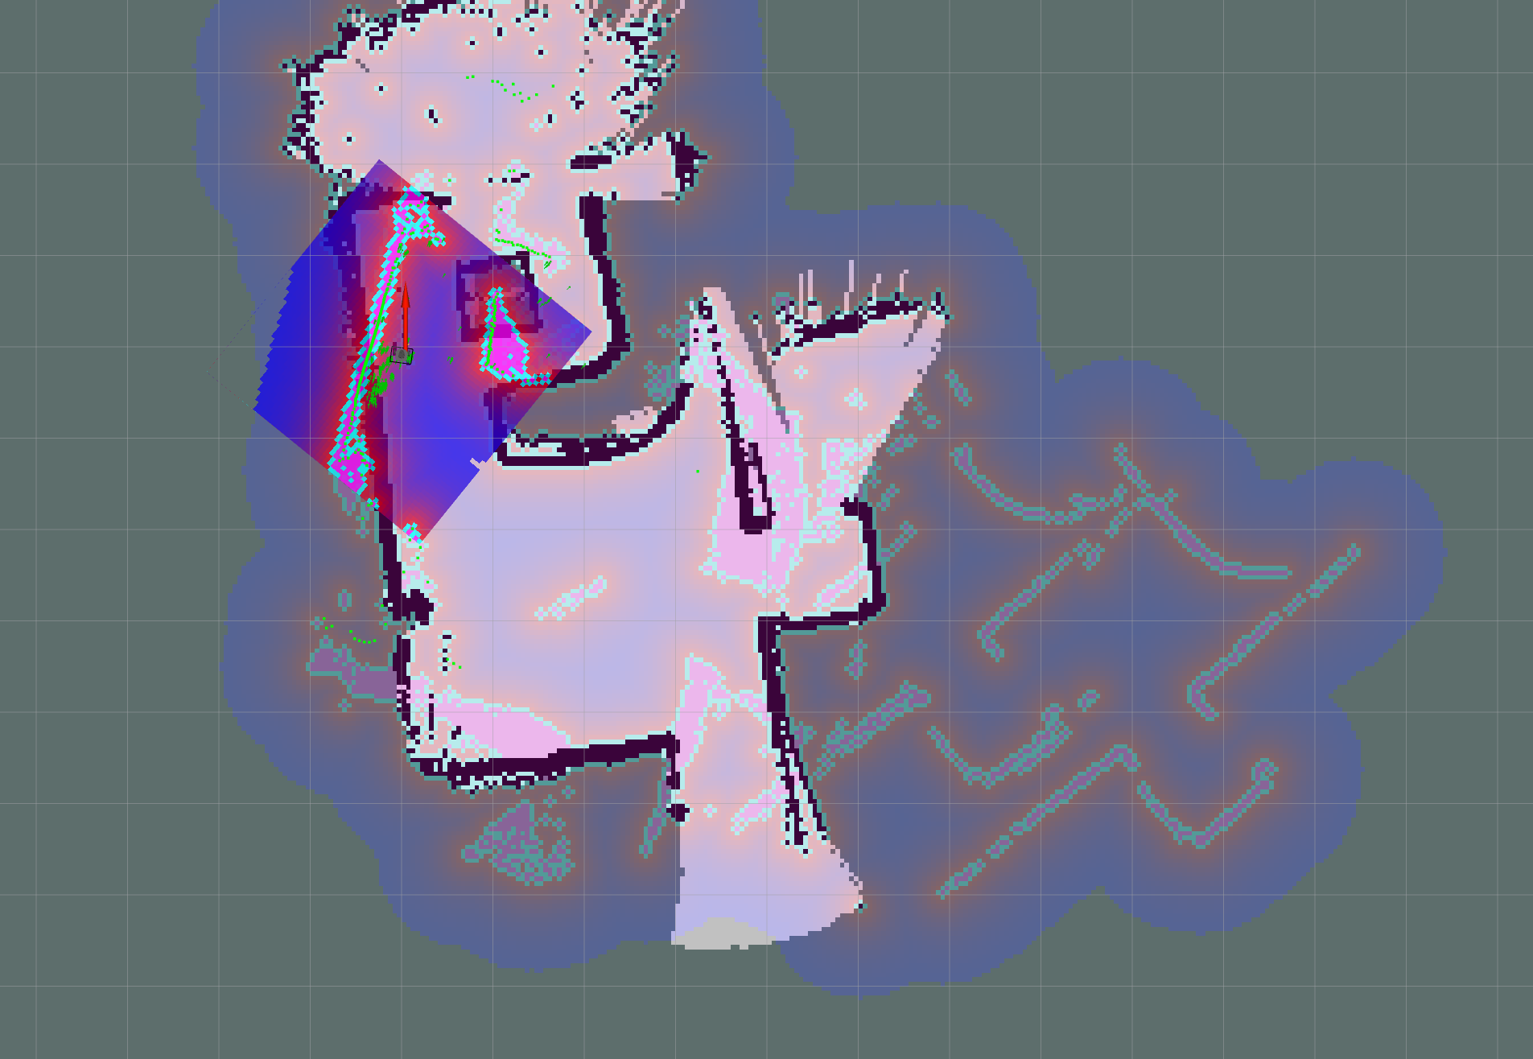
Autonomous Navigation Performance
As hector map seems so noisy it provide difficulties in running autonomous package.
So, gmapping was used to run the autonomous navigation package. The following node had been implemented for autonomous navigation.
A 2d Nav goal was set using Rviz menu.
The robot has rotated for while confused with the position of goal. Ultimately the robot was able to move towards goal.

Slide 5
Differences going from sim2real
Simulation | Real
Mapping accuracy is good. | Mapping accuracy is considerably different than simulation.
gmapping and hector algorithms performed well in simulation. | Gmapping appears to have lesser noise than hector mapping.
Motion of the robot is smooth in simulation. | Motion of the robot is irregular due to rough terrain.
It is observed that the estimation of position has minimal error in simulation. | It is observed that the estimation error of position is considerable in real world.

