Slide 1
Collection Set(Interface)
.

Slide 2

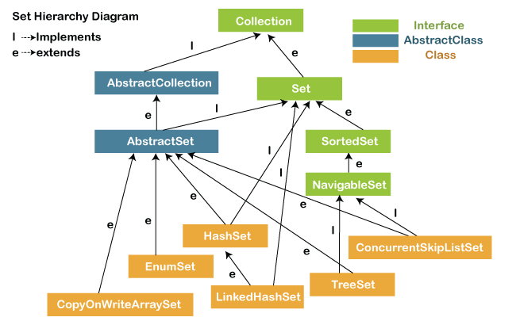
Structure of Collection
.

Slide 3
What is Set(I) ?
The set is an interface available in the java.util package. The set interface extends the Collection interface. An unordered collection or list in which duplicates are not allowed is referred to as a collection interface. The set interface is used to create the mathematical set. The set interface use collection interface’s methods to avoid the insertion of the same elements. SortedSet and NavigableSet are two interfaces that extend the set implementation.

Slide 4
Set Methods :
There are several methods available in the set interface which we can use to perform a certain operation on our sets. These methods are as follows:
1) add()
The add() method insert a new value to the set. The method returns true and false depending on the presence of the insertion element. It returns false if the element is already present in the set and returns true if it is not present in the set.
Syntax:
boolean add(type element).

Slide 5
2) addAll()
The addAll() method appends all the elements of the specified collection to
the set.
Syntax:
boolean addAll(Collection data)
3) clear()
The method removes all the elements from the set. It doesn't delete the reference of the set. It only deletes the elements of the set.
Syntax:
void clear()

Slide 6
4) contains()
The contains() method is used to know the presence of an element in the set. Its return value is true or false depending on the presence of the element.
Syntax:
boolean contains(Object element)
5) containsAll()
The method is used to check whether all the elements of the collection are available in the existing set or not. It returns true if all the elements of the collection are present in the set and returns false even if one of the elements is missing in the existing set.
Syntax:
public boolean containsAll(Collection data)

Slide 7
6) hashCode()
The method is used to derive the hash code value for the current instance of the set. It returns hash code value of integer type.
Syntax:
public int hashCode()
7) isEmpty()
The isEmpty() method is used to identify the emptiness of the set . It returns true if the set is empty and returns false if the set is not empty.
Syntax:
boolean isEmpty()

Slide 8
8) iterator()
The iterator() method is used to find the iterator of the set. The iterator is used to get the element one by one.
Syntax:
Iterator iterate_value = set1.iterator();
9) remove()
The method is used to remove a specified element from the Set. Its return value depends on the availability of the element. It returns true if the element is available in the set and returns false if it is unavailable in the set.
Syntax:
boolean remove(Object O)

Slide 9
11) removeAll()
The method removes all the elements of the existing set from the specified collection.
Syntax:
public boolean removeAll(Collection data)
11) retainAll()
The method retains all the elements from the set specified in the given collection.
Syntax:
public boolean retainAll(Collection data)
12) size()
The method returns the size of the set.
Syntax:
int size()

Slide 10
HashSet
Java HashSet class is a member of Java collections framework. It implements the Set interface. HashSets are used to store a collection of unique elements.
Features Of HashSet
Hashing is used to store the elements in the HashSet.
It contains unique items.
HashSet stores the elements by using a mechanism called hashing.
HashSet allows null value
HashSet doesn't maintain the insertion order. Here, elements are inserted on the basis of their hash code.
HashSet is not thread safe. If multiple threads try to modify a HashSet at the same time, then the final outcome is not deterministic. You must explicitly synchronize concurrent access to a HashSet in a multi-threaded environment.

Slide 11
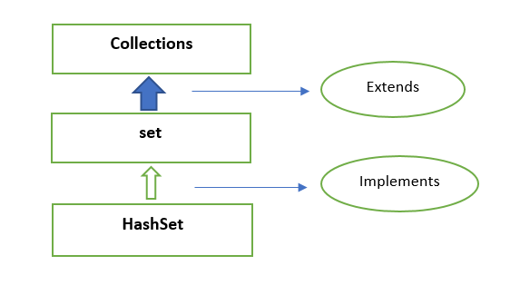
HashSet Hierarchy
HashSet Implements Set
Set Extends Collections

Slide 12
HashSet Methods
add(E e) Used to add the specified element if it is not present, if it is present then return false.
clear() Used to remove all the elements from set.
contains(Object o) Used to return true if an element is present in set.
remove(Object o) Used to remove the element if it is present in set.
iterator() Used to return an iterator over the element in the set.
isEmpty() Used to check whether the set is empty or not. Returns true for empty and false for a non-empty condition for.
set.size() Used to return the size of the set.
clone() Used to create a shallow copy of the set.

Slide 13
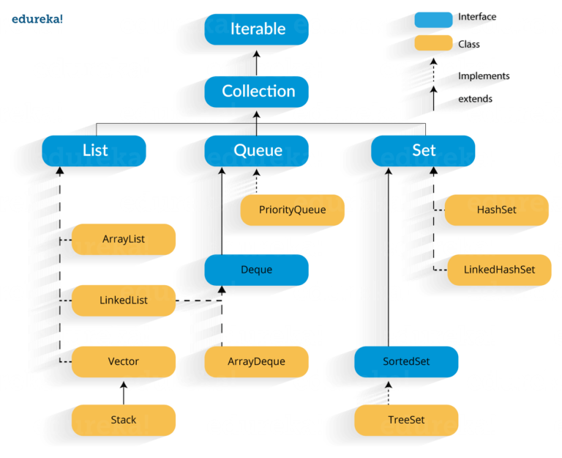
LinkedHashSet

Slide 14
Constructors
LinkedHashSet()
Constructs a new, empty linked hash set with the default initial capacity (16) and load factor (0.75).
LinkedHashSet(Collection<? extends E> c)
Constructs a new linked hash set with the same elements as the specified collection.
LinkedHashSet(int initialCapacity)
Constructs a new, empty linked hash set with the specified initial capacity and the default load factor (0.75).
LinkedHashSet(int initialCapacity,float loadFactor)
Constructs a new, empty linked hash set with the specified initial capacity and load factor.

Slide 15
Features of LinkHashSet
1.No duplicate value accepted
2.Iteration order maintain
3.It permit null value
3.Not Synchronized

Slide 16
The set interface in the java. util package and extends Collection interface is an unordered collection of objects in which duplicate values cannot be stored.
Difference between List and Set:
List | Set
The List is an ordered sequence. | The Set is an unordered sequence.
List allows duplicate elements | Set doesn’t allow duplicate elements.
Elements by their position can be accessed. | Position access to elements is not allowed.
Multiple null elements can be stored. | Null element can store only once.
List implementations are ArrayList, LinkedList, Vector, Stack | Set implementations are HashSet, LinkedHashSet

Slide 17
HashSet | TreeSet
Elements in HashSet are not ordered. | Iteration order present. Ordered by se comparator
Implements set interface | Implements sorted set, navigable set and set interface
The underlying data structure for HashSet is Hash table | TreeSet is implemented using a Self Balancing Binary Search Tree (Red-Black Tree)
NULL elements are allowed in HashSet | TreeSet doesn’t allow null Object and throw NullPointerException
HashSet takes constant time for search, insert and delete | TreeSet takes O(Log n) for search, insert and delete
HashSet is faster | TreeSet is slower
HashSet uses equals() method to compare two objects in Set and for detecting duplicates | TreeSet uses compareTo() method for same purpose.
In HashSet heterogeneous elements are allowed | default natural sorting order, the objects that are being inserted into the tree should be homogeneous and comparable.

Slide 18
HashSet | LinkedHashSet
Elements in HashSet are not ordered. | Elements in LinkedHashSet are not ordered. In the order of insertion
The underlying data structure for HashSet is Hash table | LinkedHashSet maintains a doubly-linked List across all elements with a Hash table
HashSet extends AbstractSet | LinkedHashSet extends HashSet
HashSet internally uses HashMap for storing objects | LinkedHashSet uses LinkedHashMap internally to store objects
The performance of HashSet is faster | The performance of LinkedHashSet is bit slower because in maintain a linked list

Slide 19
TreeSet
TreeSet is basically an implementation of a self-balancing binary search tree. In this implementation, objects are sorted and stored in ascending order according to their natural order.
Features
It stores unique elements
It doesn't preserve the insertion order of the elements
It sorts the elements in ascending order
TreeSet class doesn't allow null element.

Slide 20
Constructors in TreeSet
TreeSet(Comparator): This constructor is used to build an empty TreeSet object in which elements will need an external specification of the sorting order.
TreeSet ts = new TreeSet(Comparator c);
TreeSet(Collection): This constructor is used to build a TreeSet object containing all the elements from the given collection in which elements will get stored in default natural sorting order.
TreeSet(SortedSet): This constructor is used to build a TreeSet object containing all the elements from the given sortedset in which elements will get stored in default natural sorting order.

