Slide 1

Time To Get Proactive Towards Your Health And Wellness Management.......
FIRST TIME IN INDIA & WORLDWIDE
A Wellness & Health Management Guide & Companion
Just for YOU
Here comes................................

Slide 2

Wellness Way 4U
LIFE Ko De Naya Andaaz

Slide 3
Wellness Tracker & Appraisals
Fun ,Info
&
Interaction
Wellness Way 4 U
Rewards for Personal Progress

Slide 4
Individuals are imposed with TIME constraints to pursue a dedicated program for their Wellness
.
The Times that we live in.........
Highly Competitive
Stressful
Growth oriented
Rapidly changing environment
Rapid adaptability
Hence …
The Critical NEED is to make Wellness Program an integral part of daily routine in a viable manner at one’s fingertips…….literally!!

Slide 5





Nutrition
WELLNESS
MANAGEMENT
Your Wellness can be effectively managed by striking a healthy balance between the above factors.
Emotions
Physical Health & Activity
Stress
Lifestyle

Slide 6
Regular SELF AWARENESS & appraisal via our Wellness Assessment Reports
LIFESTYLE MANAGEMENT Consultation
Discover a HAPPIER, HEALTHIER &ENERGETIC YOU
Also Get REWARDED for your wellness initiative
Update your MY DAY TODAY
WELLNESS WAY 4 U

Slide 7
UNIQUE ONE OF ITS KIND FEATURES
1.
MY WELLNESS TRACKER
2.
DIGITAL EMOTIONAL & INFO TOOLS
3.
CUSTOMISED ASSESSMENT REPORTS & CHARTS

Slide 8
MY WELLNESS TRACKER
MY FOOD TODAY
MY ACTIVITY TODAY
Track your activities as well as the time allotted for each. Helpful to manage your time and activities better. To workout your schedules
MY EMOTIONS TODAY
My Workplace
General stressors
Sleep
My Communication/Interaction
My Relation/Socializing
My Major Life events
Addictions
For all the diet conscious ones, An excellent medium to help monitor your sincerity towards your diet plan.
Understand the resultant effects of your diet on your health. Daily inputs generate Great Utility reports
A great tool for gym goers to record their daily workout.
Have a record of your favorites, likes, dislikes & allergics to convince your mom /better half for more of your favorites

Slide 9
UPDATING YOUR TRACKER DAILY WILL HELP YOU
KNOW
How simple choices affect your Wellness and accordingly taking proactive steps
BREAK
The shackles of personal enslavement to a Lifestyle that limit YOUR Daily Lives, Dreams & Happiness.
MONITOR
The WAY – You eat, exercise, your activities, sleep, work, addictions & emotions.

Slide 10
DIGITAL EMOTIONAL TOOLS
A 3 step digital role play of
to get the anger out & make one feel light!! .
ANGER VENT BOX
Expression
Reaction
Relaxation

Slide 11


STRESS BUSTER BOX
A 3 step digital role play of
to kick the stress blues out & bring the million dollar smile back
Expression
Reaction
Relaxation

Slide 12
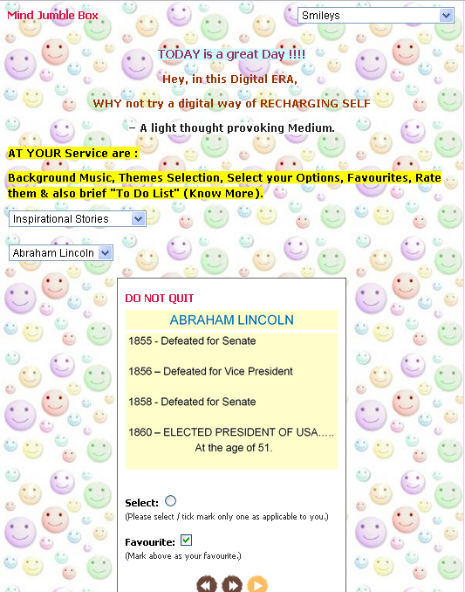
MIND JUMBLE
An interactive thought provoking digital medium to throw light on various important aspects of life. A great online learning & information exchange tool.
INNOVATIVE
INFORMATIVE
INSPIRING

Slide 13




All these Accompanied with
Cool ,Spunky Background Music, Sound & Themes
Rating system, marking favourites, voice your opinion
‘Know More’ short and succinct PDFs
on related topics which can also be stored in one’s Digital Personal Library
And more…………

Slide 14
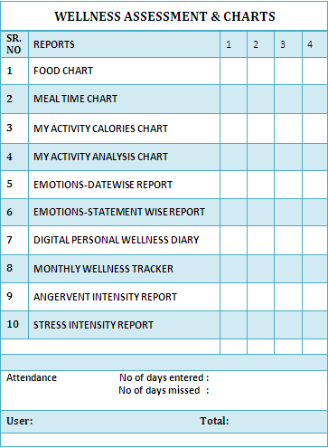
WELLNESS ASSESSMENT
REPORTS & CHARTS
EFFORTLESSLY have your entire dietary, activity & emotional indexes at the end of every month in your hand for further assessment, program designing & improvisation.

Slide 15
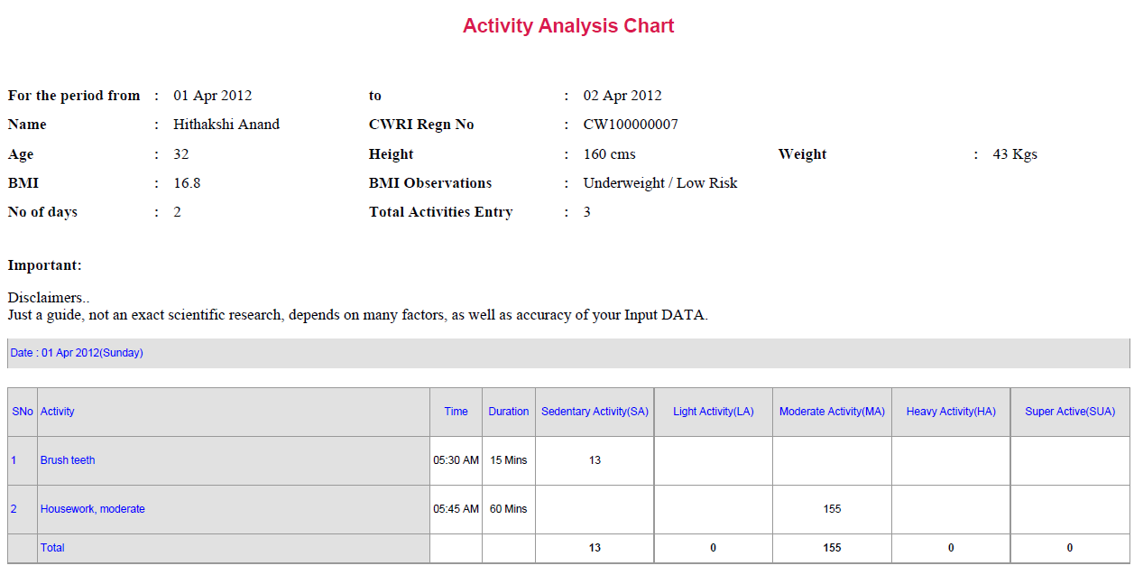
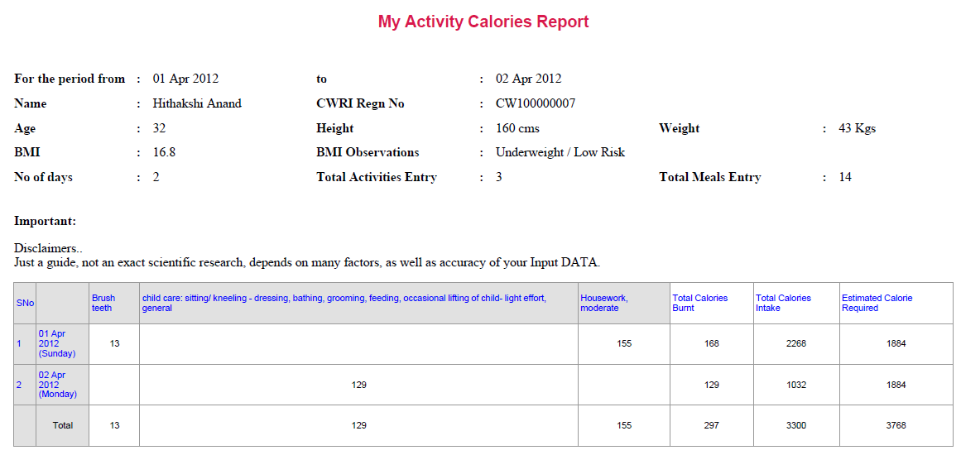
ACTIVITY ANALYSIS REPORT
ACTIVITY CALORIES CHART

Slide 16
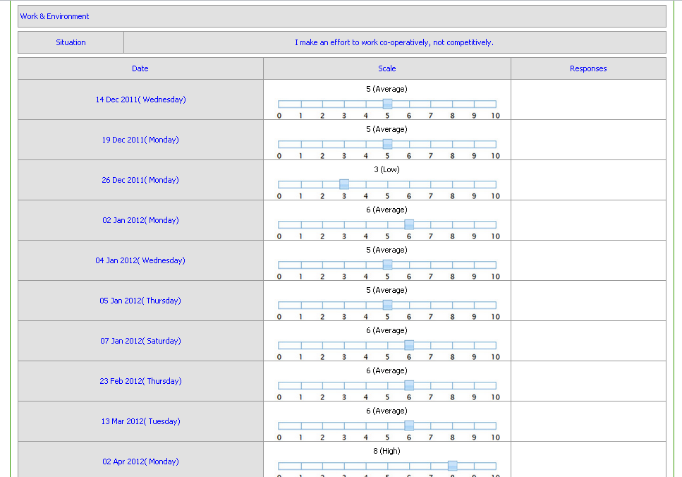
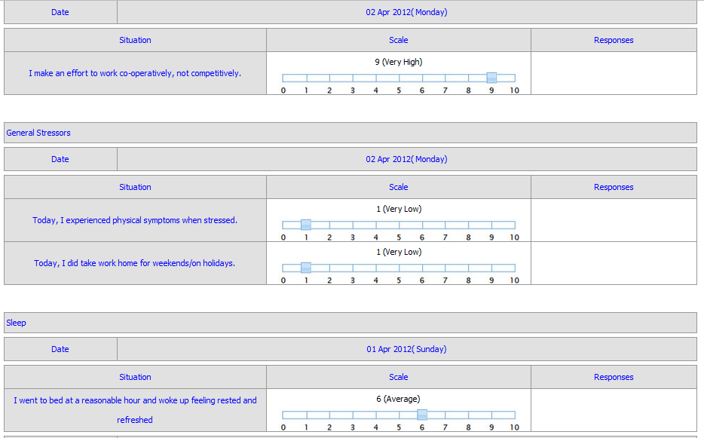
Emotion-wise & Date-wise Reports to facilitate comparisons.
EMOTIONS REPORT-STATEMENTWISE
EMOTIONS REPORT-DATEWISE

Slide 17
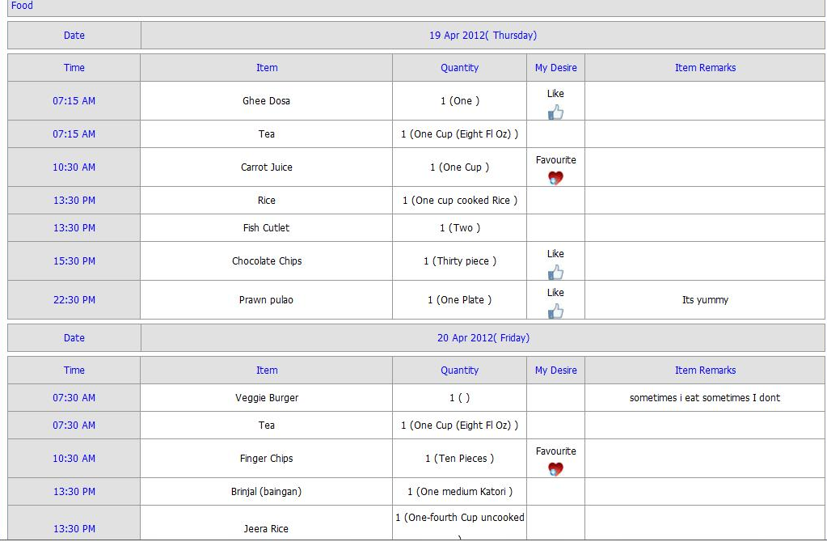
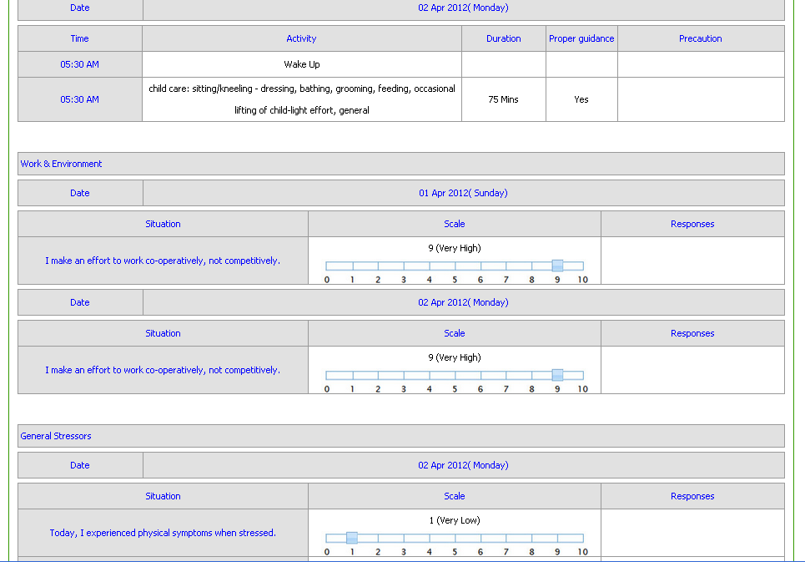
DIGITAL PERSONAL WELLNESS DIARY

Slide 18

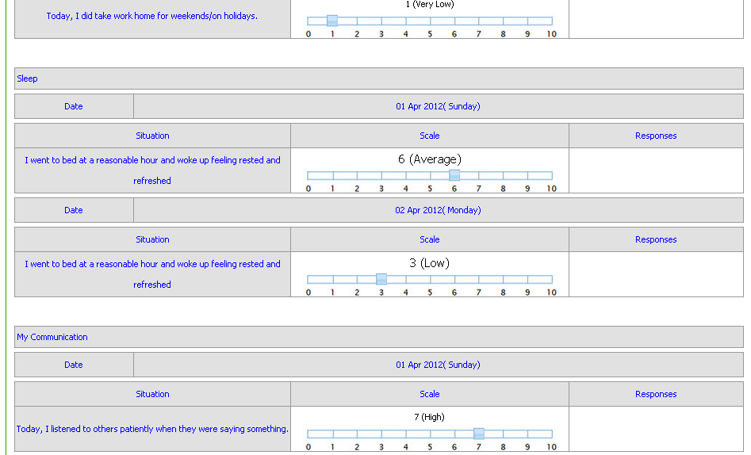
Your Own Ready
Reference
Digital Diary
For all your Physical
&
Emotional Health aspects…..

Slide 19

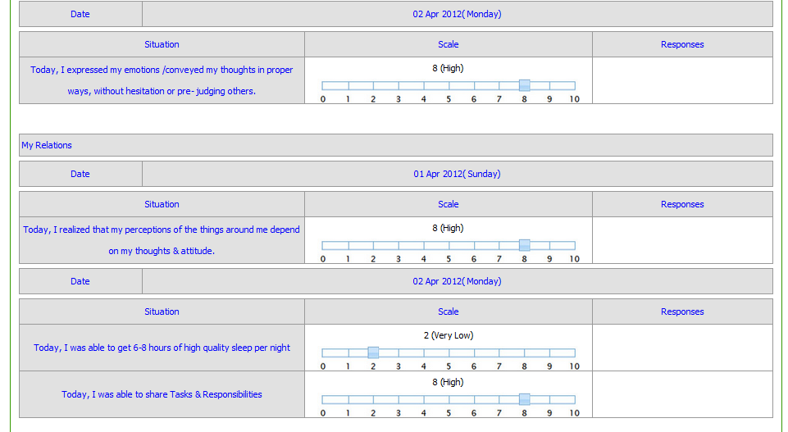
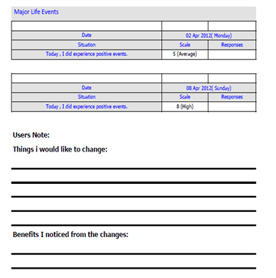
Ranging from
Food,
Activity
Emotional patterns

Slide 20
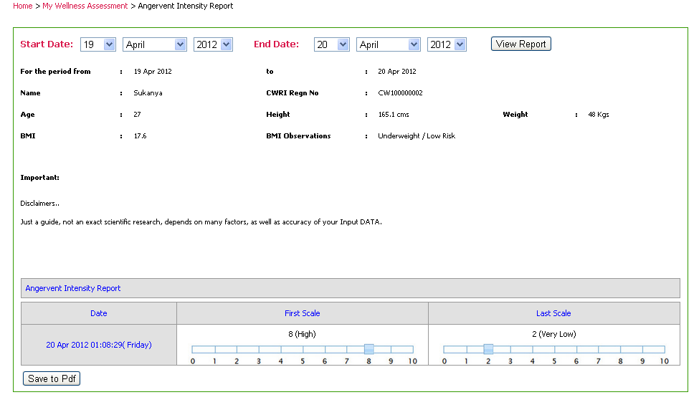
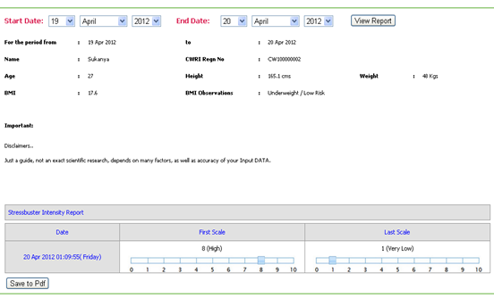
ANGER VENT INTENSITY REPORT
STRESS BUSTER INTENSITY REPORT

Slide 21
And the icing on the cake is that get REWARDED for your personal Wellness Initiative.
Avail our wide range of niche rewards at various levels of your Wellness Journey..........

Slide 22

THANK YOU

