Slide 1

Our Platform – www.wellnessway4u.com provides ecosystem to promote wellbeing awareness in simple steps, and rewards to foster engagement.
Read on to PLAN how you can connect with your target audience in a more dynamic way.
#LifeKoDeNayaAndaaz
Changing Lifestyle, habits & emotions in small steps for positive outcomes.
A Chaitanya Wellness Research Institute Initiative

Slide 2
What’s in it for you –
A platform to enable wider outreach for your products/ services/ initiatives
Leverage the plethora of interactive activities to connect with your target group
Access to ground-level insights with our wellness-focused initiatives
Our Research capabilities and expertise in wellness + your products and services = Gamechanging wellness endeavour

Slide 3

Collaborated Social media campaigns
Sponsored content
Promote initiatives
Conduct polls
Product reviews
Collaborated media content

Slide 4
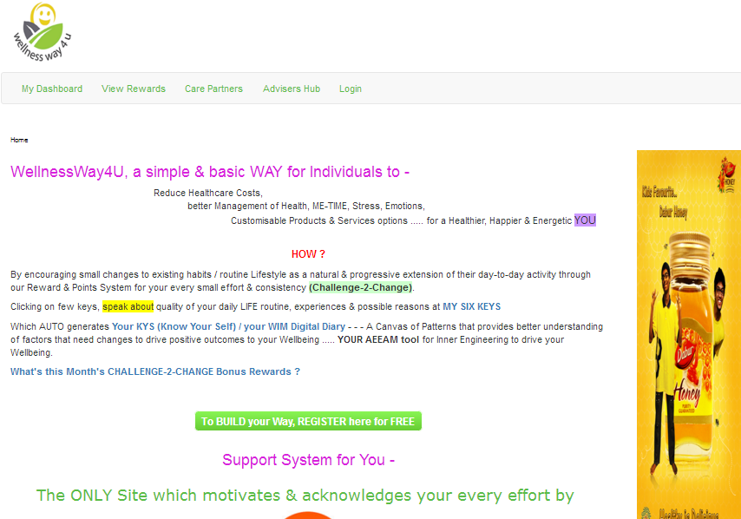
Ad space
Co-branding
Logo
Create product awareness on our homepage

Slide 5
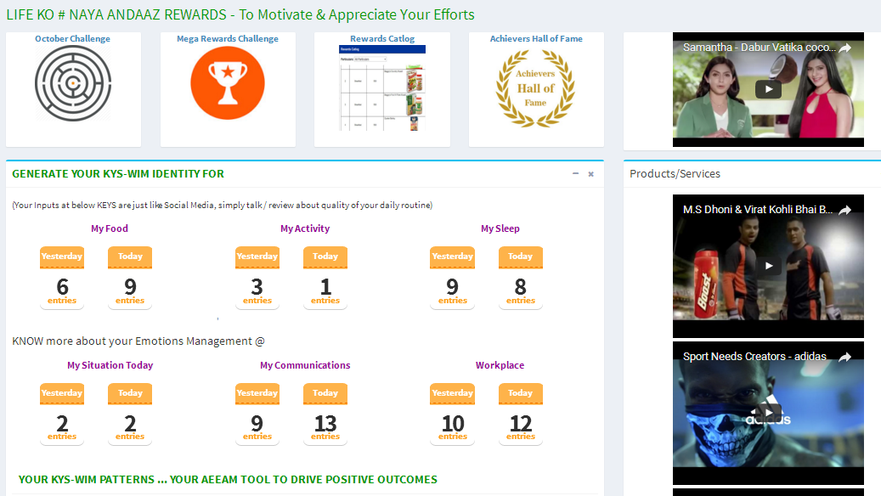
Buzz on the dashboard
Presence on the user dashboard
Run video messages/ content on the dashboard
Run contests, quizzes
Live interactions - chat/ polls

Slide 6
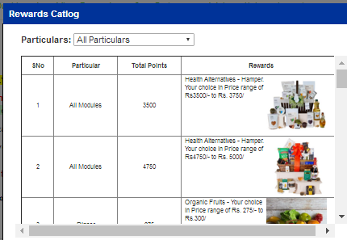
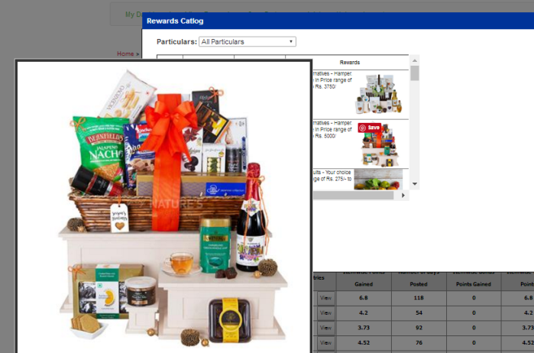
Rewards, Contests and Giveaways
Contest time
#Challenge2Change
Product image
Your chance to win a ---

Slide 7
Wellness Focused Initiatives
Experiential marketing initiative
Online dialogue and Social media engagements
Wellness awareness Roads Shows in large corporate houses
Wellathon -- short sprint runs for corporate houses to promote health and wellness
Co-branded weekly wellness newsletter
Social media campaigning, contests, and related user-engagements
Collaborate for Wellness Caravan – a Wellness festival where we intend to bring the best services/ products in health and wellness under one roof
Brand Optimization on www.wellnessway4u.com
Branding on our wellness tool ( a mobile -responsive website)
Branded reward packages (site-users) for consistency in performance
Gamification and live-contests on www.wellnessway4u.com

Slide 8
Let’s join hands to spread awareness about better living and wellness☺
8108219986 – you are just 10 digits away from knowing more about our initiative

