Slide 1


ACADEMIC PROJECT DEFENSE
BRAINWARE UNIVERSITY
Department of Computational Sciences
LIBRARY
MANAGEMENT
SYSTEM
Presented by
Student code
Rahul Das
BWU/MCA/26/021
Registration no.
Roll no.
26102000139
26102410017
A terminal-based system for smarter library operations
Course: Problem Solving using Python · Course Code: MCA17400(T)

Slide 2

1 · INTRODUCTION · PROBLEM · EXISTING SYSTEM
Library Management System
A terminal-based system for smarter library operations
Catalog
Circulation
Audit
Problem: manual ledgers and fragmented desktop apps cause record discrepancies and delayed fine settlement.
Existing system limitation: users must memorize numeric IDs before every issue or return.
Solution: a Python OOP application with embedded SQLite3 persistence.
Members
Fine Engine

Slide 3
3 · OBJECTIVES
Objectives
Build, persist, and verify an end-to-end terminal system in Python
Model Book, Student, Library, and DatabaseManager with Python OOP
Preview contextual entity tables before every ID prompt
Accrue ₹5.00/day overdue fines through NONE, DUE, and PAID
Enforce SQLite3 foreign keys and custom exceptions

Slide 4
4 · SCOPE OF THE PROJECT
Scope of the project
Target users
Limitations
Operator / Librarian managing circulation, dues, and audits.
Terminal interface only; barcode, email reminders, REST API, and dashboard remain future scope.

Slide 5
5 · PROPOSED SYSTEM & KEY FEATURES
The proposed system runs as one interactive circulation loop
Preview first. Commit the transaction. Track the state. Audit the result.
01
02
03
04
Preview
Issue / return
Fine state
Audit
Preview applicable books, students, active issues, or dues before asking for an ID.
Update stock and issue records transactionally.
Calculate overdue charges at ₹5.00 per late day and move the fine through NONE, DUE, or PAID.
Audit outstanding dues, collected income, active loans, and borrowing statistics.
Key features: contextual entity previews · ₹5.00/day overdue fine · NONE, DUE, PAID · dual issue history

Slide 6
6 · PROJECT METHODOLOGY
Built in six phases over 12 weeks
Iterative incremental lifecycle · Python OOP · SQLite3 · standard-library tools (sqlite3, datetime, unittest)
WBS | Project phase | Core deliverables | Timeline
1.0 | Domain modeling & schema | Entity models (Book, Student), SQLite3 DDL table scripts | Week 1–2
2.0 | Service & circulation engine | Library service class, issue and return methods, copy inventory | Week 3–4
3.0 | Financial engine & dues | Overdue date math, fine status state machine (DUE/PAID), payments | Week 5–6
4.0 | Contextual UI & views | ASCII tables, auto-preview before ID prompts, 16-option main loop | Week 7–8
5.0 | Exception architecture | Custom exception hierarchy (LibraryError base), input sanitization | Week 9–10
6.0 | Unit testing & verification | Comprehensive test suite (54 unit tests), edge cases, reporting | Week 11–12

Slide 7
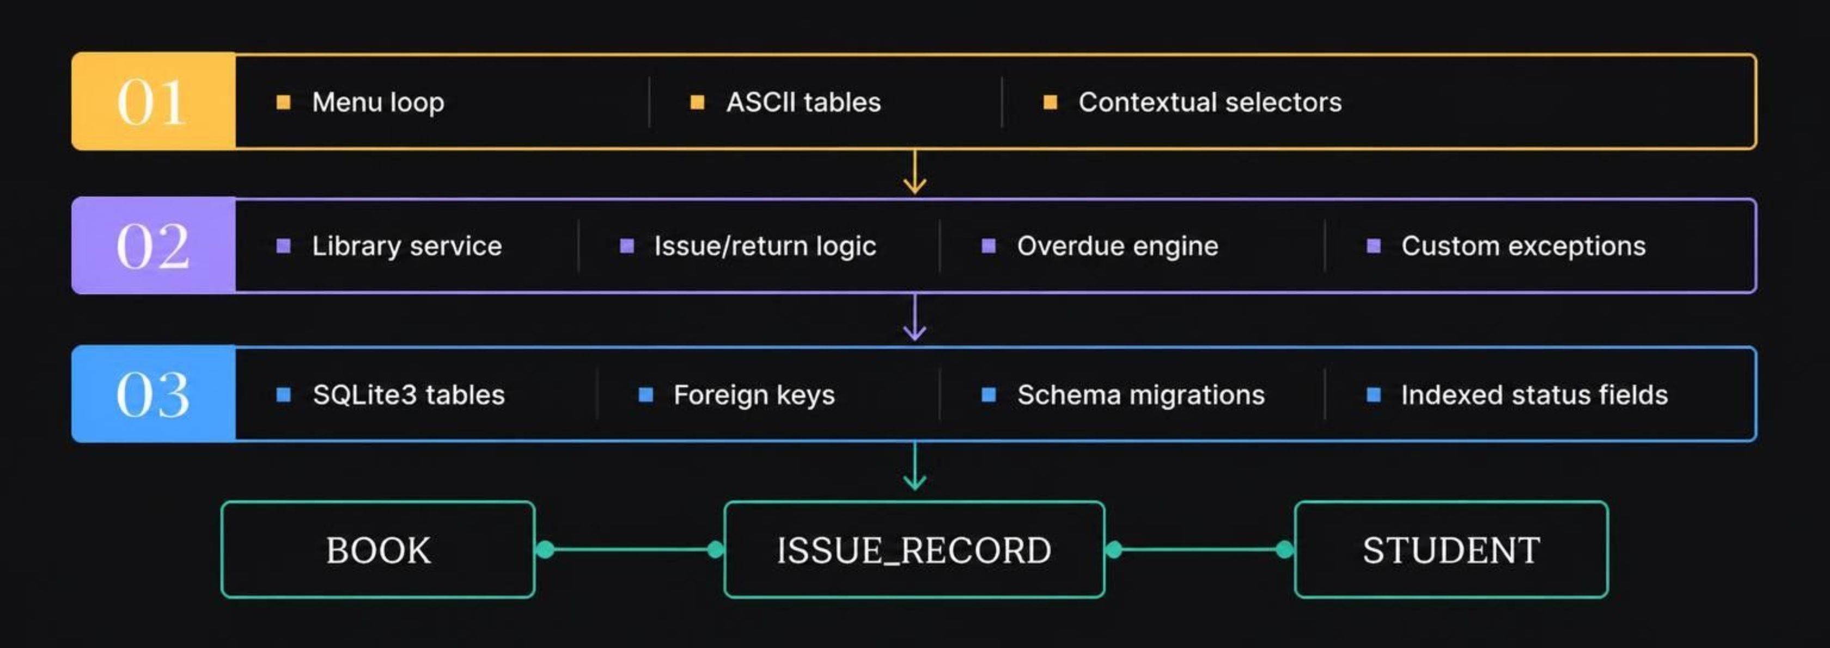
7 · PROJECT INTERNAL STRUCTURE
Three layers keep the rules clear and the data safe
Modules: Book, Student, Library, DatabaseManager · Workflow: select, preview, commit, track fine · Data flow: CLI and SQLite3 DB · Database: issues table with fine_status

Slide 8
8 · IMPLEMENTATION
Every workflow is built into the terminal
Catalog
Members
Circulation
Overdue & fines
Add books with positive stock counts; search by title or author.
Register students with non-blank names and unique email addresses.
Issue books while stock is above zero; return books to restore stock.
₹5.00/day after the 7-day lending window; status NONE, DUE, or PAID.
Dues
Audit & statistics
Contextual previews
Interface flow
List outstanding dues globally or per student; clear a fine with one payment.
Track collected income, income by student, active loans, and top borrowed books.
Show filtered ASCII tables before every ID prompt.
A 16-option terminal menu (0–15) routes each action to its view.

Slide 9
9 · TESTING, CONCLUSION, FUTURE SCOPE & REFERENCES
Reliability is verified, and the platform can extend
TEST RESULT
FUTURE SCOPE
54/54
Ready to extend
Barcode & RFID scanning
Automated overdue email reminders
REST API with graphical dashboard
unit tests passed across 7 test suites
0.154 seconds full suite · under 2 ms relational joins
Conclusion: command-line institutional software can deliver ergonomics, data integrity, and efficiency without heavyweight dependencies.
REFERENCES
Python Software Foundation (2026) The Python Standard Library: sqlite3, docs.python.org.
Lutz, M. (2013) Learning Python, 5th edn, O'Reilly Media.
Pressman, R. S. and Maxim, B. R. (2020) Software Engineering: A Practitioner's Approach, 9th edn, McGraw-Hill.
Owens, M. and Allen, G. (2010) The Definitive Guide to SQLite, 2nd edn, Apress.
Brainware University (2026) Guidelines for MCA Academic Project Documentation and Viva Voce.

Slide 10
Thank You

