Slide 1
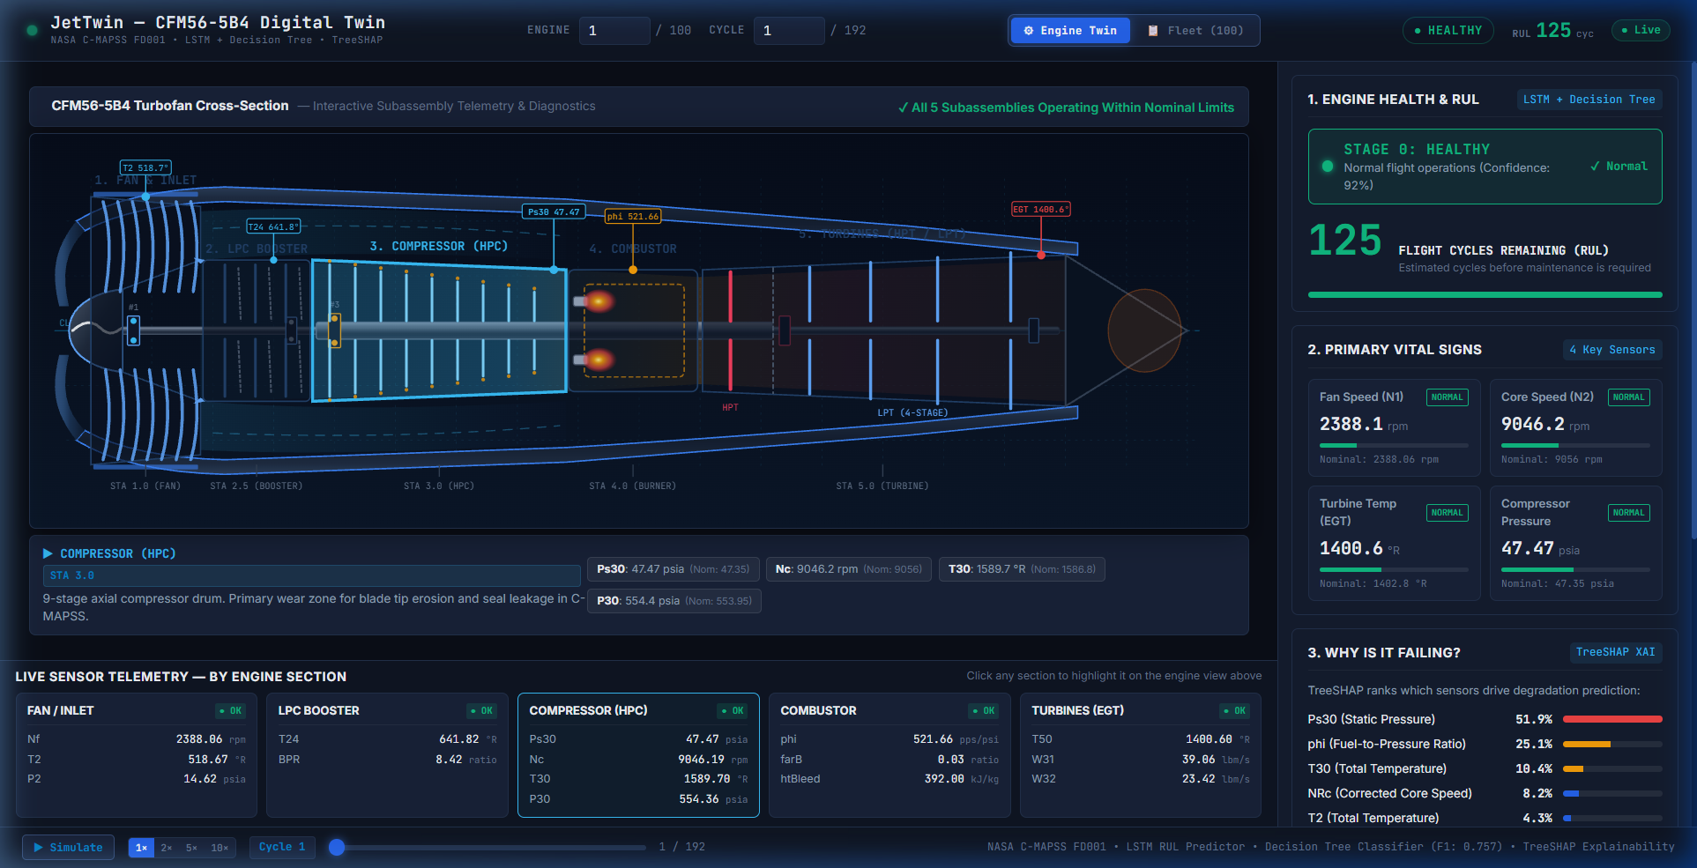
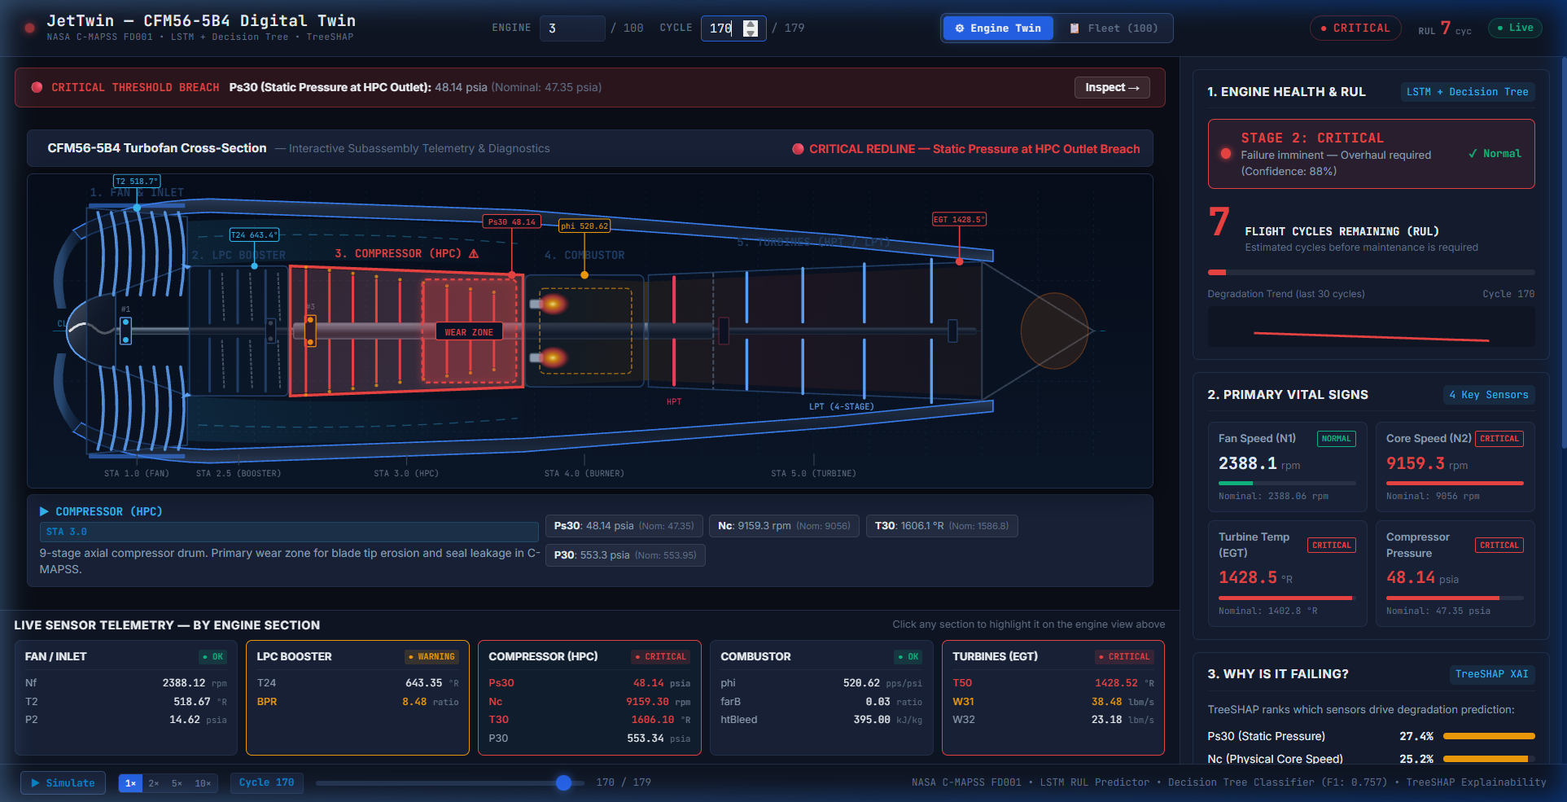
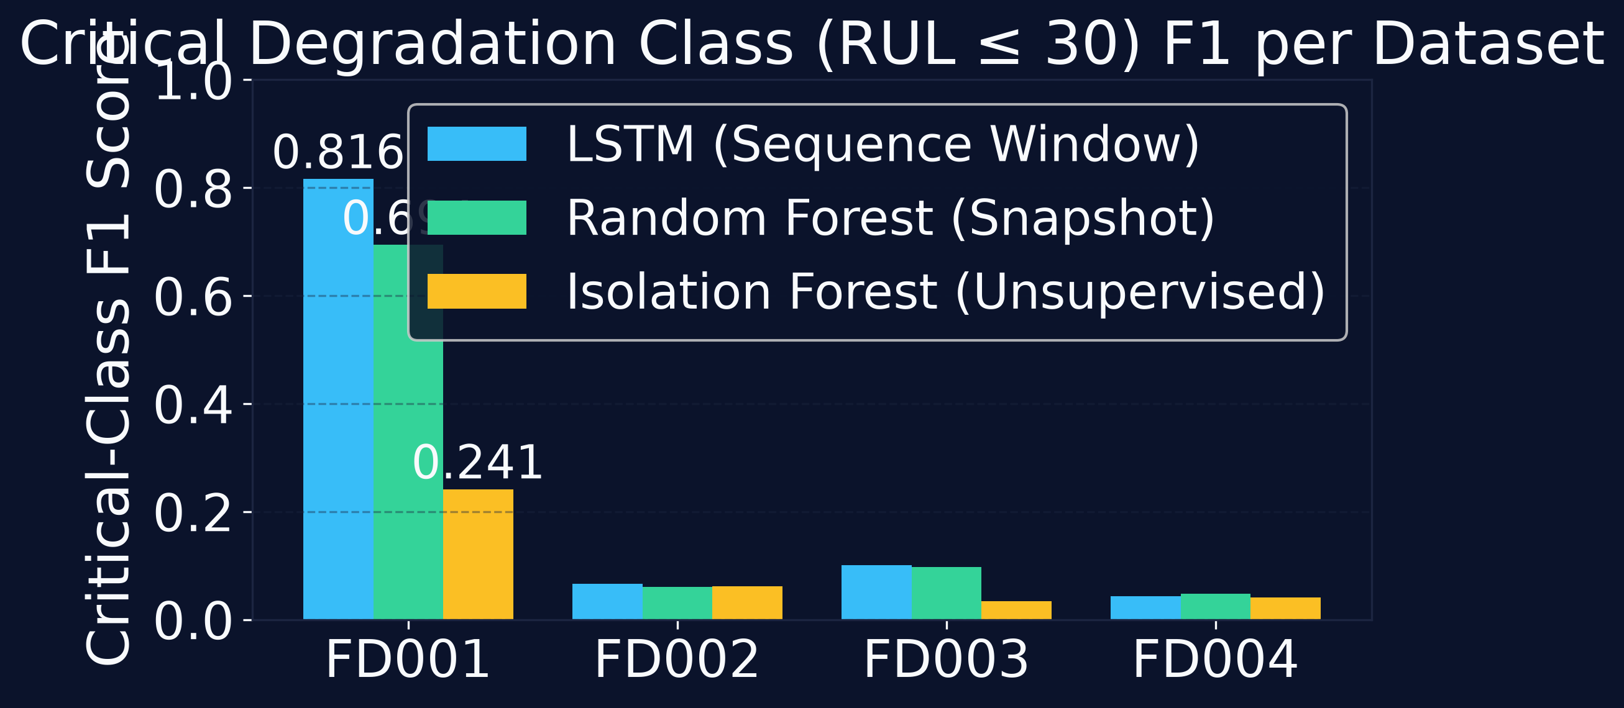
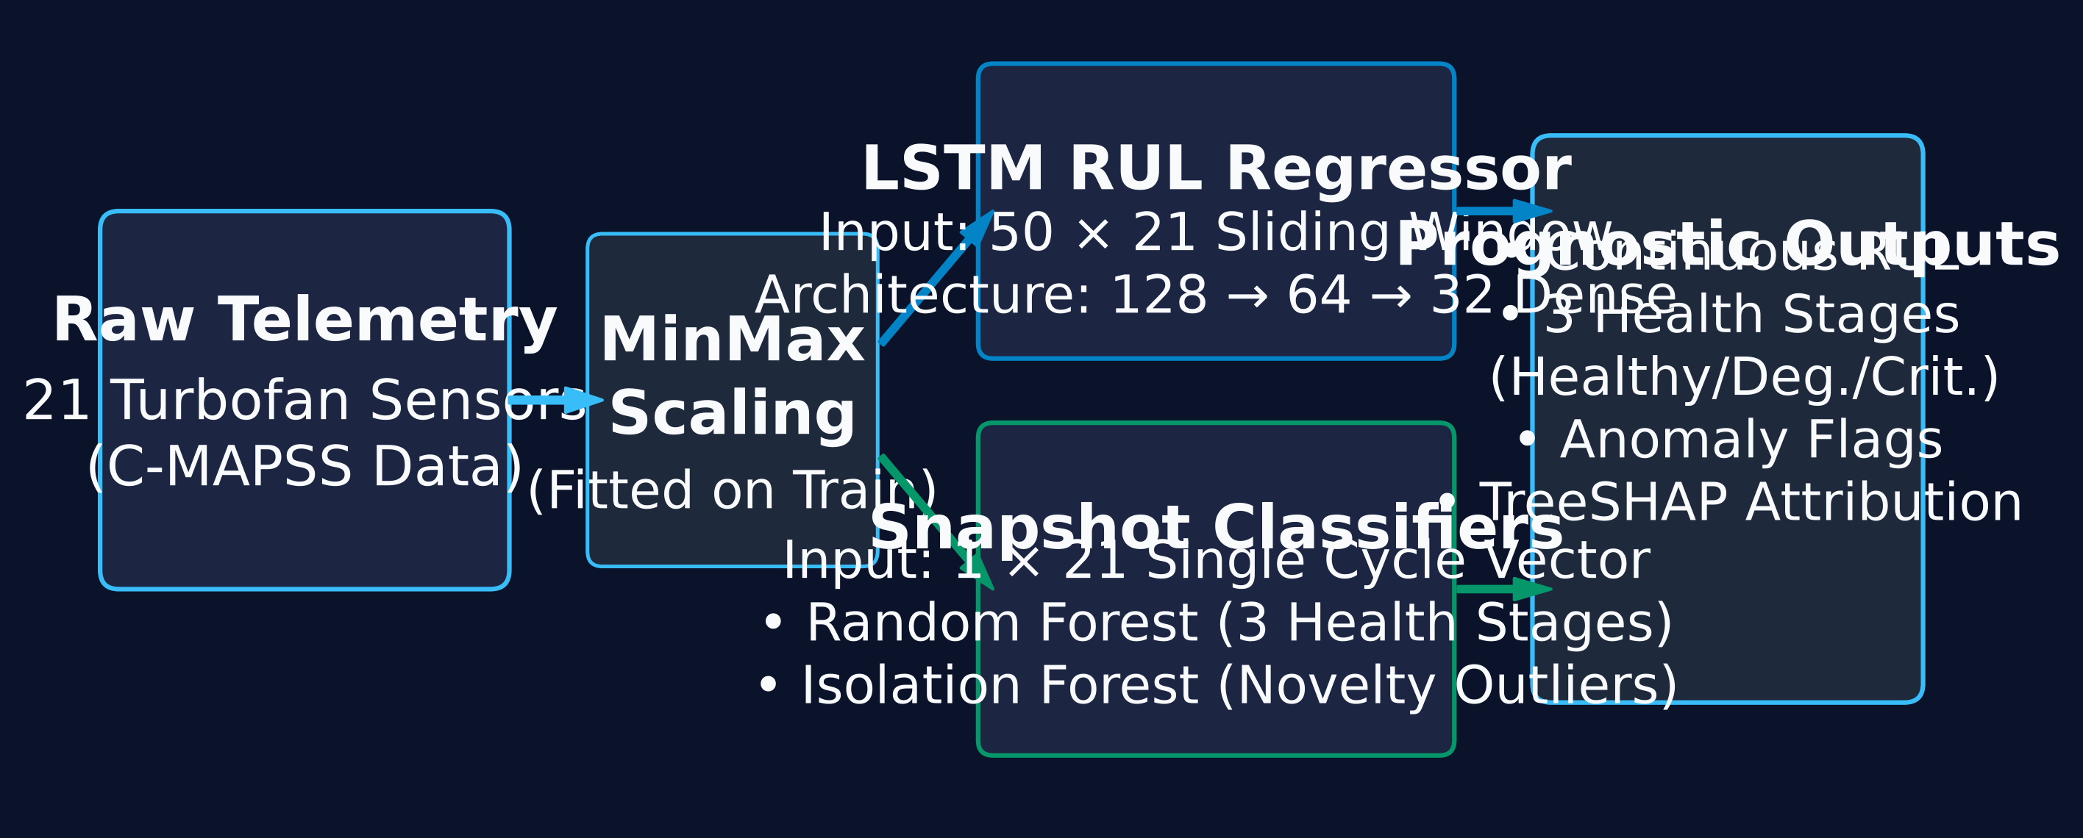
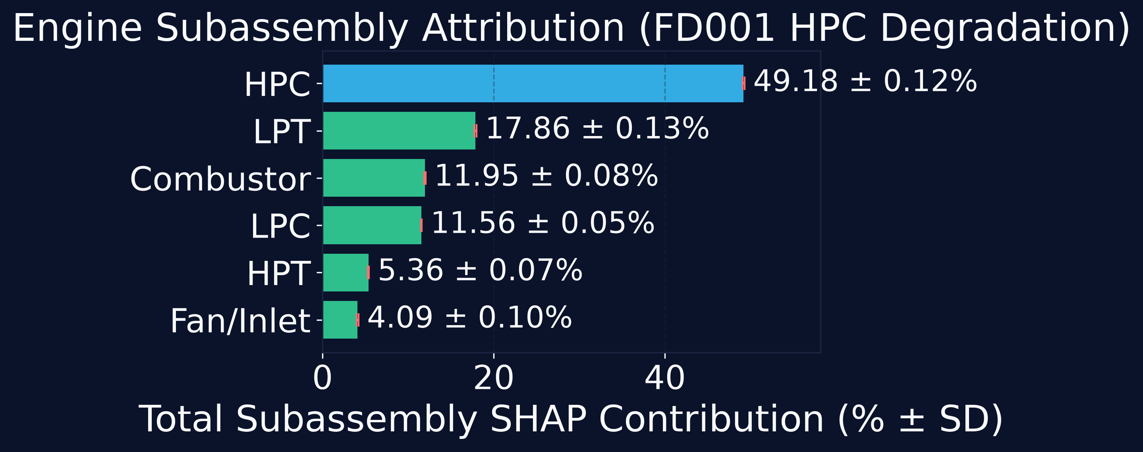
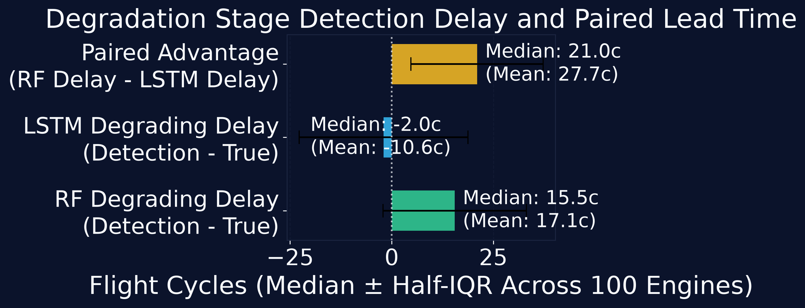

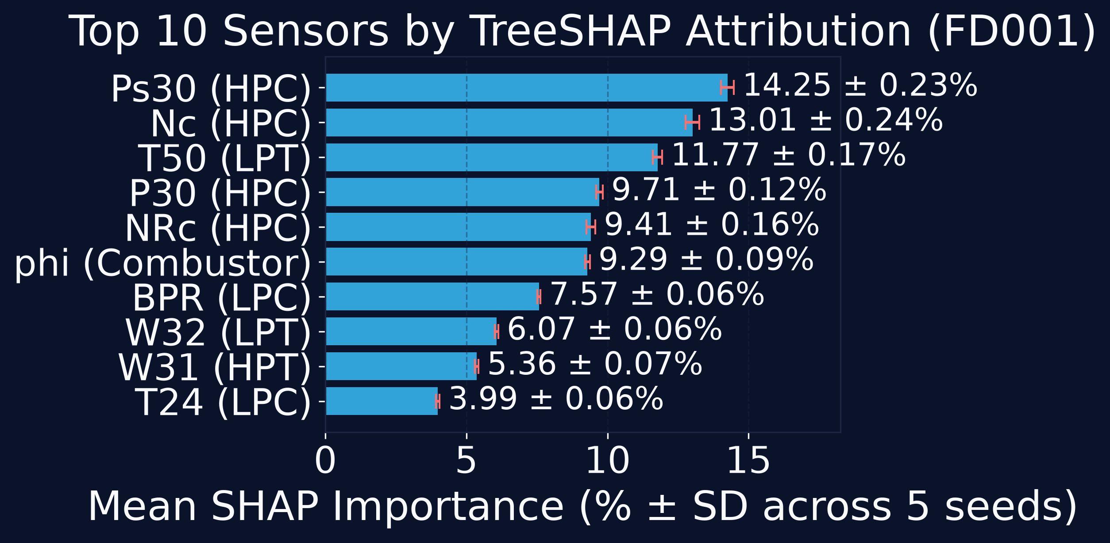
Interpretable Turbofan Degradation & Health Monitoring
NASA C-MAPSS Digital Twin | Multi-Task Classification, RUL Regression & TreeSHAP Attribution
Rahul Bansode, Shubham Vaidya, Gaurav Yadav, Mufeed Rajapkar | TODO_DEPARTMENT
1. OPERATIONAL CHALLENGE
5. KEY EMPIRICAL FINDINGS
9. DIGITAL TWIN DASHBOARD
Turbofan rotating components undergo continuous thermal and mechanical wear. Line maintenance requires discrete health triage before structural failure occurs. Scalar RUL predictions alone lack engineering root-cause explainability for line shop dispatch.
0.8197
LSTM 3-Stage
Macro-F1 (vs 0.730 RF)
+21.0 Cyc
Median Lead-Time
Advantage (80% Eng)
49.18%
HPC Subassembly
SHAP Attribution
6. CRITICAL STAGE DETECTION
2. 3-STAGE LIFECYCLE
Healthy (Stage 0): RUL > 100 cycles
Normal baseline operation; no maintenance intervention.
Degrading (Stage 1): 30 < RUL <= 100 cycles
Active thermodynamic drift; schedule depot borescope inspection.
Critical (Stage 2): RUL <= 30 cycles
Immediate risk; aircraft grounding & engine overhaul required.
Fig. 4. Interactive aerodynamic telemetry pins showing healthy baseline (left) vs critical redline threshold drift (right).
10. LIMITATIONS
Fig. 2. Critical degradation class (RUL <= 30) F1 score comparison across benchmark sub-datasets.
• Synthetic Benchmark: NPSS thermodynamic simulation; not carrier flight telemetry.
• Multi-Regime Collapse: Macro-F1 degrades on FD002/FD004 without operating condition clustering.
• Isolation Forest False Alarms: Unsupervised anomaly score yields high false alarm rates on non-stationary drift.
• Computational Latency: Sequence windowing incurs higher memory footprint than snapshot evaluation.
3. TELEMETRY & STATIONS
7. RUL REGRESSION PERFORMANCE
• All 21 telemetry channels preserved (no arbitrary pruning).
• Flat sensor analysis (CV < 1e-4): 9 flat in FD001, 7 in FD003, and 0 in FD002/FD004.
• Stations: Fan/Inlet, LPC, HPC (core), Combustor, HPT, LPT, and Pressure Ratio (epr).
Dataset | Engines | Capped RMSE | Capped MAE | NASA Score
FD001 | 100 | 15.07 | 10.68 | 493.1
FD002 | 259 | 74.86 | 62.78 | 468759.9
FD003 | 100 | 47.85 | 39.00 | 22149.4
FD004 | 248 | 77.51 | 65.50 | 509085.7
4. PROCESSING PIPELINE
11. FUTURE WORK
• Operating regime clustering (k-means flight condition partitioning) prior to sensor normalization.
• Physics-guided neural networks enforcing thermodynamic work balances.
• Attention-based temporal Transformers for multi-fault trajectory modeling.
8. EXPLAINABILITY & LEAD TIME
12. REFERENCES & ARTIFACTS
[1] A. Saxena et al., PHM08, pp. 1–9, 2008.
[2] S. Hochreiter & J. Schmidhuber, Neural Comp., 1997.
[3] F. T. Liu, K. M. Ting, Z.-H. Zhou, ICDM, 2008.
[4] L. Breiman, Machine Learning, 2001.
[5] S. M. Lundberg & S.-I. Lee, NeurIPS, 2017.
Scan for GitHub Code,
Data & Benchmarks
(>= 60 mm size)
Fig. 3. Subassembly TreeSHAP vs permutation attribution; lead-time delay distribution; top-10 sensor rankings.
Fig. 1. Dual-path architecture: single-cycle Random Forest snapshot classification and 50-cycle LSTM temporal window regression.

