Slide 1
Week 2 Data Models
CPSC 50900

Slide 2
Last time we studied storage models
Storage models concern
How the files that store the data are arranged on a disk
How the data within each file are organized with respect to other data
We saw five different storage models
Hierarchical
Network
Object-Oriented
NoSQL
Relational
We saw several advantages to the Relational Model
We saw that a Relational Database Management System can maximize these advantages and offer additional benefits

Slide 3
Storage models are physical models.

Slide 4
But how do we model what the data means?
Data Models help us capture essential elements of the real world in our data
Coming up with data models involves
Identifying the kinds of things we want to store data about
What aspects of those things we want to store
How different kinds of things are related to each other
Data Models are the focus for this week.

Slide 5
Three kinds of data models
Conceptual
Logical
Physical

Slide 6
Conceptual data model
Most basic and abstract
Focuses on
Entities
The things we are storing
Relationships
How those things are related
No talk of attributes yet
Audience: business stakeholders and data architects

Slide 7
Example of a conceptual model: a library management system
Entities:
Books
Authors
Borrowers
Relationships
Books are written by authors
Books are borrowed by borrowers

Slide 8
Logical data model
Focuses on
Entities
Keys
Relationships
Attributes
Without focusing on physical implementation details
Audience: data architects and database designers
Involves the process of normalization
A process of mapping attributes to entities to minimize redundancy

Slide 9
Example of a logical model: a library management system
Books
Title,
Genre
Author
Authors:
Name
Country
Borrowers:
Name
MembershipDate

Slide 10
Example of a logical model: a library management system
Books
BookID (PK)
Title
Genre
Author
Authors:
AuthorID (PK)
Name
Country
Borrowers:
BorrowerID (PK)
Name
MembershipDate
Add keys to uniquely identify each entity
These are called primary keys (PK)

Slide 11
Physical data model
Most specific / concrete
Translates the data to model to optimized storage with a particular DBMS
For relational models, this involves mapping
Entities to tables
Attributes to columns of tables
Relationships to columns that are duplicated in two tables
foreign keys
Adding bridge entities for many-to-many relationships
Also considers optimization
Indexes
Views
Triggers
Partitions
Clustering
Denormalization
End product: SQL scripts for building the database

Slide 12
Example of a physical model: a library management system
Books
BookID (PK)
Title,
Genre
Author
Authors:
AuthorID (PK)
Name
Country
Borrowers:
BorrowerID (PK)
Name
MembershipDate
Relationships:
A book has an author: AuthorID
Add a foreign key (FK) to create this relationship.

Slide 13
Example of a logical model: a library management system
Books
BookID (PK)
Title,
Genre
AuthorID (FK)
Authors:
AuthorID (PK)
Name
Country
Borrowers:
BorrowerID (PK)
Name
MembershipDate
Relationships:
A book has an author: AuthorID (FK)

Slide 14
Example of a logical model: a library management system
Books
BookID (PK)
Title,
Genre
AuthorID (FK)
Authors:
AuthorID (PK)
Name
Country
Borrowers:
BorrowerID (PK)
Name
MembershipDate
Relationships:
A book has an author: AuthorID (FK)
A borrower can borrow many books
A book can be borrowed by many borrowers

Slide 15
Example of a logical model: a library management system
Books
BookID (PK)
Title,
Genre
AuthorID (FK)
Authors:
AuthorID (PK)
Name
Country
Borrowers:
BorrowerID (PK)
Name
MembershipDate
Relationships:
A book has an author: AuthorID (FK)
A borrower can borrow many books
A book can be borrowed by many borrowers
We probably will need
a place to store borrowing data

Slide 16
Example of a physical model: adding a bridge entity to library management system
Books
BookID (PK)
Title,
Genre
AuthorID (FK)
Authors:
AuthorID (PK)
Name
Country
Borrowers:
BorrowerID (PK)
Name
MembershipDate
BookLending
Borrower
Book
DateLent
DateDue

Slide 17
Example of a physical model: adding a bridge entity to library management system
Books
BookID (PK)
Title,
Genre
AuthorID (FK)
Authors:
AuthorID (PK)
Name
Country
Borrowers:
BorrowerID (PK)
Name
MembershipDate
BookLending
BookLendingID (PK)
BorrowerID (FK)
BookID (FK)
DateLent
DateDue

Slide 18
Example of a physical model: Optimization of library management system
Add index on AuthorID in the Book table for faster lookup by author
Add index on BorrowerID and BookID in the BookLending table for faster lookup by borrower and book

Slide 19
Example of a physical model: Write the SQL scripts to build the actual physical database
CREATE TABLE Books (
BookID INT PRIMARY KEY AUTO_INCREMENT,
Title VARCHAR(255),
Genre VARCHAR(50),
AuthorID INT,
FOREIGN KEY (AuthorID) REFERENCES Authors(AuthorID)
);
CREATE TABLE Authors (
AuthorID INT PRIMARY KEY AUTO_INCREMENT,
Name VARCHAR(255),
Country VARCHAR(100)
);
CREATE TABLE Borrowers (
BorrowerID INT PRIMARY KEY AUTO_INCREMENT,
Name VARCHAR(255),
MembershipDate DATE
);

Slide 20
Let’s do more examples, focusing on conceptual models

Slide 21
Conceptual model - review
What are we storing data about?
What are the entities?
How are those things related to each other?
What are the relationships among the entities?

Slide 22
Example: Movie Rentals
Concerning movie rentals, what might we store data about?
The movie
The renter
The streaming service we rented it from
The rental reservation
These are the entities that make up our data model

Slide 23
How are the entities related to each other in the movie rental example?
A renter makes several rental reservations. Each rental reservation is made by a renter.
A rental reservation is made from one streaming service. A streaming service fulfills several rental reservations.
A rental reservation is made for one movie. A movie may be rented through several rental reservations over time.

Slide 24
Example: University course catalog
What are the entities we want to store data about?
Academic department
Course
Course Section
Student
Teacher

Slide 25
What are the relationships among these entities in the University catalog example?
A department offers many courses Each course is offered by one department
A course has many course sections. Each course section belongs to a course.
A course section is taught by one teacher. A teacher can teach many course sections.
A student takes many course sections. Each course section is taken by many students.

Slide 26
Example: Auto insurance
What are the entities we want to store data about?
Customer
Driver
Agent
Insurance plan
Coverage
Auto

Slide 27
What are the relationships among the entities in the insurance example?
A customer has perhaps several insurance plans. Each insurance plan covers one customer.
Each driver is assigned to a car. A car can be assigned to several drivers.
An insurance plan covers several drivers. A driver is covered by one insurance plan.
An insurance plan offers several types of coverages. A type of coverage could be offered by several insurance plans.
An agent sells many insurance plans. Each insurance plan is sold by one agent.

Slide 28
Relationships have connectivity
Three kinds of connectivity:
One-to-one (1:1)
One-to-many (1:M)
Many-to-many (M:N)

Slide 29
Example: Identify the connectivity of each relationship
A department offers many courses Each course is offered by one department
A course has many course sections. Each course section belongs to a course.
A course section is taught by one teacher. A teacher can teach many course sections.
A student takes many course sections. Each course section is taken by many students.

Slide 30
Relationships can be mandatory or optional
This is called optionality
A relationship could have different optionality in each direction.
For example:
A course section must have a teacher (mandatory)
A teacher doesn’t need to teach any course sections (optional)

Slide 31
Example: Describe the optionality in each case
The relationship between movie and rental agreement
The relationship between customer and insurance plan
The relationship between student and course section

Slide 32
How do we share conceptual models (and logical and physical models for that matter) conveniently?
Entity Relationship Diagrams

Slide 33
An Entity Relationship Diagram (ERD) can show entities and relationships
An entity-relationship diagram (ERD) shows
Entities
Relationships
Attributes
Can be used for all three kinds of data models – conceptual, logical, physical

Slide 34
Crow’s Foot Notation for ERDs

Slide 35
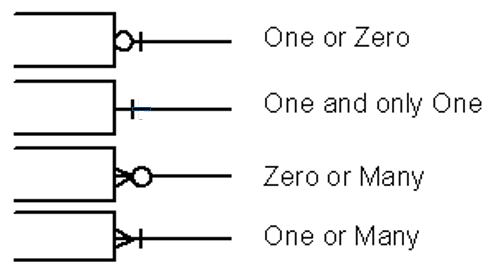
Showing optionality on an ERD

Slide 36
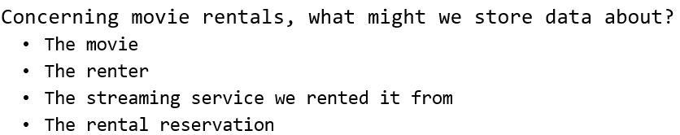
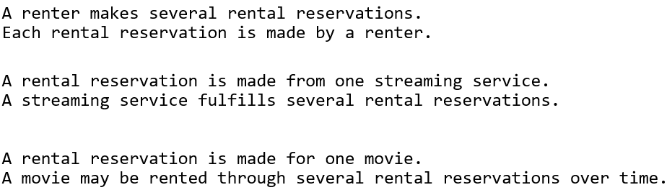
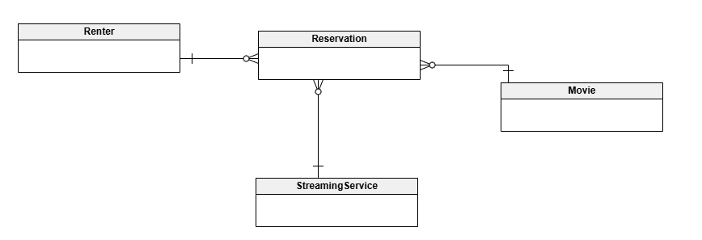
Example: Draw ERD for Movie Rental Conceptual Model

Slide 37
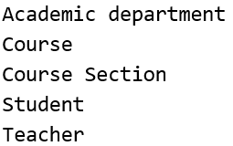
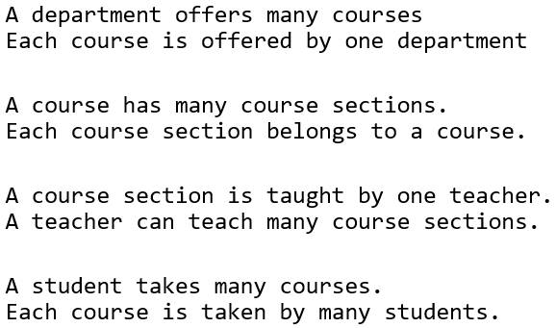
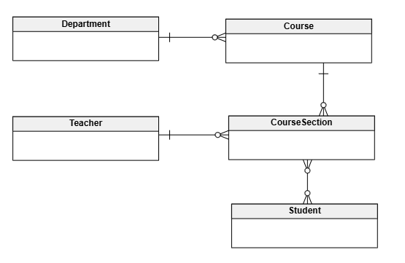
Example: Draw an ERD for the University Catalog Example

Slide 38
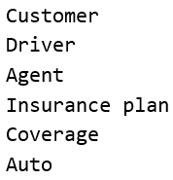
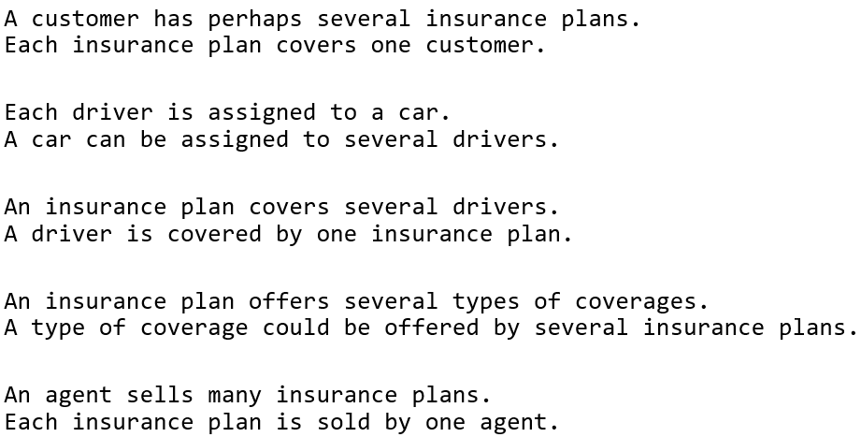
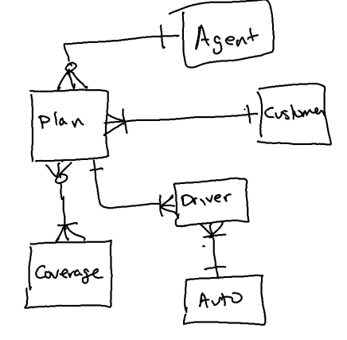
Example: Draw an ERD for the insurance example

Slide 39

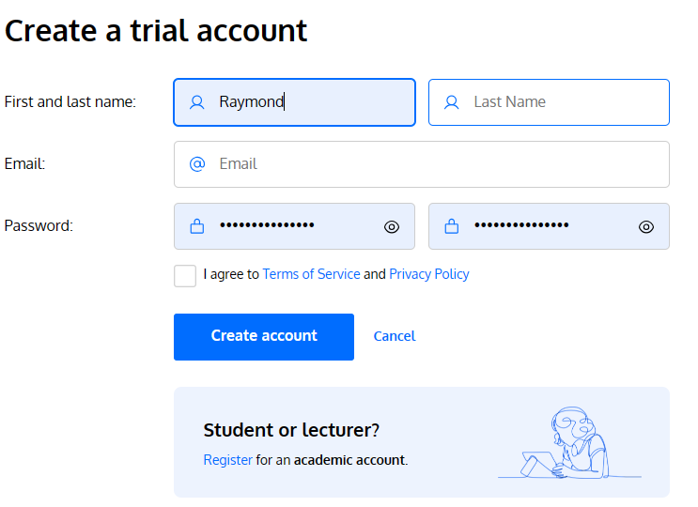
Professional drawing tool – Vertabelo https://www.vertabelo.com/
Can draw a conceptual model and then automatically generate a physical model from it.
Register for the student account.

Slide 40
Summary
We learned how data models are used to capture the meaning of a data set.
There are three types of data models:
Conceptual
Logical
Physical
We focused on conceptual
Entities
Relationships
We learned how to draw ERDs that express the logical model
Next week – we’ll add attributes to the entity sets, including data types
Logical model
Physical model

