Slide 1
Week 3 Logical and Physical Data Models
CPSC 50900

Slide 2
Last time we studied data models with a focus on the conceptual data model
Data model
What the data means
Conceptual data model
Entities
Relationships

Slide 3
Today: Logical Models and Physical Models
Logical data models
Entities
Relationships
Attributes
Primary identifiers - keys
Physical data models
Tables
Columns
Foreign keys
Bridge entities
Optimizations

Slide 4
Entity vs. Entity Set
An entity is a single thing we are storing data about
An entity set is a collection of entities of the same type.
We will use the term entity sets in this note set to talk about collections of a particular kind of thing.

Slide 5
Movie Rental Example
Entity Sets:
Movies
Renters
Streaming Services
Reservations
Relationships
A reservation is for one movie. A movie is rented on several reservations
A streaming service offers several reservations. Each reservation is offered by one streaming service
A renter makes many reservations. Each reservation is made by one renter.

Slide 6
Attribute
An attribute is a characteristic about an entity in an entity set
For example, if we have an entity set named Persons, what are some attributes that can be used to describe each Person?
Firstname
Lastname
Date of birth, etc.
Each attribute has a data type.
char(length) and varchar(length)
int
decimal(length,digits_after_decimal)
Identifying attributes and their data types is the major task of moving to a logical model

Slide 7
Movie Rental Example - Attributes
Movies
Renters
Streaming Services
Reservations
What are the attributes for each?

Slide 8
Movie Rental Example - Attributes
Movies
Title, YearReleased, BoxOfficeEarnings, Length
Renters
FirstName, LastName, Age, Gender
Streaming Services
Name, Headquarters, YearFounded
Reservations
Date, Format, Cost, DueDate, the movie that was rented who rented it the streaming service

Slide 9
The things in red represent relationships
Movies
Title, YearReleased, BoxOfficeEarnings, Length
Viewers
FirstName, LastName, Age, Gender
Streaming Services
Name, Headquarters, YearFounded
Reservations
Date, Format, Cost, DueDate, the movie that was rented who rented it the streaming service
The red items link Reservations to the other entity sets.
They aren’t native to Reservations – they relate to the other entities.

Slide 10
Drawing the logical model
When we draw the logical model, these red items will appear as relationships.
They won’t be listed as attributes
Only the native fields – those that don’t relate to another entity set – will be listed inside the boxes.

Slide 11
Logical Model - Process
Start with Conceptual Model - the entity sets and their relationships
including connectivity
one-to-one, one-to-many, many-to-many
1:1, 1:M, M:N
Identify the attributes that natively belong to each entity set
Natively belong == not a carryover from another entity set
Identify the data types of those things that natively belong.
char, varchar, int, decimal, money, etc.
Draw the boxes for the entity sets and the relationships between them
List the native attributes and their data types inside the boxes

Slide 12
Conceptual Model for Movie Example
Entity sets: Movie, Renter, Reservation, Streaming Service,
Relationships
A reservation has one streaming service; a streaming service has many reservations
A reservation rents one movie; a movie is rented on many reservations
A reservation is made by one renter; a renter makes many reservations.

Slide 13
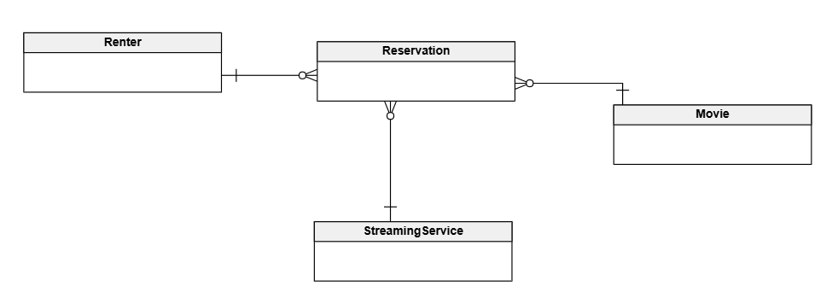
Draw the conceptual model in Vertabelo

Slide 14
Logical Model for Movie Example
Attributes:
Movie: Title, YearReleased, BoxOfficeEarnings, Length
Viewer: FirstName, LastName, Age, Gender
StreamingService: Name, Headquarters, YearFounded
Reservation: Date, Format, Cost, DueDate
Identify data types
strings are chars or varchars of particular length
numbers are ints or decimals or money

Slide 15
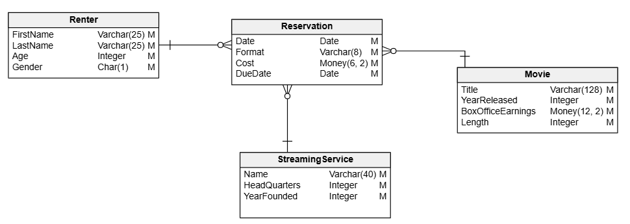
Draw the logical model in Vertabelo

Slide 16
Something is still missing from the logical model – primary identifiers or keys
The last thing we need to add to complete the logical model is to identify how each entity in an entity set will be uniquely identified.
These primary identifiers are also called primary keys

Slide 17
A primary identifier or primary key uniquely distinguishes one entity in an entity set from another.
There are usually multiple choices for the primary key

Slide 18
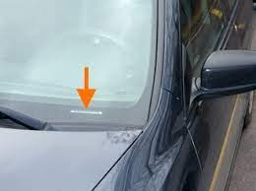
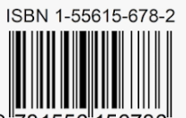
Examples of primary – unique - identifiers
Student
StudentID
Car
VIN
Book
ISBN
Some kinds of things just naturally have a characteristic that uniquely distinguishes one from another

Slide 19
Unique identifier of an entity set
The unique identifier of an entity set enables us to distinguish one entity in the set from another.
The unique identifier consists of the attribute or attributes that determine the values of all other attributes of the entity.

Slide 20
When an attribute depends on another, we call this a functional dependence
An attribute B is functionally dependent on another attribute A if and only if knowing A enables you to know what B is.
Attribute A is then called the determinant for B
Because the value of A determines the value of B

Slide 21
Example: determinants and functional dependence
Book
ISBN → title, author, number of pages, copyright
Car
VIN → manufacturer, model, color, year
Student
ID → firstname, lastname, gpa

Slide 22
Some attributes determine the values of other attributes
The attribute or attributes that determine the value of all other attributes of an entity uniquely identifies that entity.
The attribute or attributes that uniquely identify each entity in an entity set is called the primary identifier or primary key

Slide 23
Primary key
The primary key for an entity set is the column or columns that uniquely identify each entity in the entity set.
Sometimes the primary key is obvious because it’s standardized, but other times it’s not.
Sometimes it consists of a combination of attributes and sometimes it’s just one

Slide 24
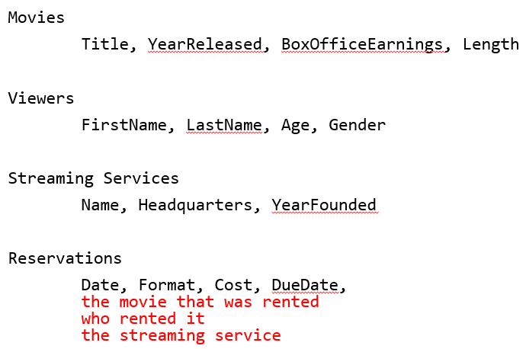
Primary key example – Movie Rental
We need to identify the primary key for
Movies
Rentals
Streaming Services
Reservations

Slide 25
Primary key for movie
Assuming no two movies released in the same year have the same title, we can write this functional dependence:
Title, YearReleased → BoxOffice, Length
So, the primary key for movie is the combination of Title and YearReleased

Slide 26
Primary key for a Renter
Assuming no two Renter have the same first name and last name:
FirstName, LastName → Age, Gender

Slide 27
Primary key for a StreamingService
Assuming no two streaming services have the same name:
Name → Headquarters, YearFounded

Slide 28
It is almost always better to choose primary keys that consist of just one column.
Why?

Slide 29
The answer has to do with relationships and how a database implements them.

Slide 30
Relationships
In the case of Reservation, some of the attributes (those in red) related to other entity sets
Date, Format, Cost, DueDate, the movie that was rented who rented it the streaming service
When some of the attributes relate to other entity sets, there is a relationship between the entity sets.
The attributes that relate to other tables are called foreign keys
The foreign keys that build a relationship have to uniquely identify the related entity
In other words, they need to duplicate the primary identifiers for the related entity
In other words, the foreign key attributes have to duplicate the primary key attributes of the other table.

Slide 31
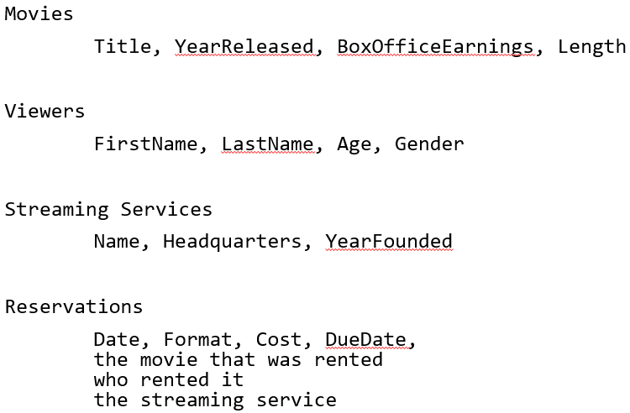
Relationships – consider reservations
We saw that a reservation contains attributes that link to other tables
Date, Format, Cost, DueDate, the movie that was rented who rented it the streaming service
We said that those linkages to other entity sets must refer to the unique identifier or primary key from the other entity set.
So, with our choice for primary keys so far, this is the set of attributes for a Reservation:
Date, Format, Cost, DueDate
MovieTitle, MovieYearReleased,
RenterFirstName, RenterLastName,
StreamingServiceName
These red fields are foreign keys – they relate to the primary identifiers of the other tables.

Slide 32
Primary Key for a Reservation actually consists of some of those foreign keys
Some of those red fields are part of what distinguishes one reservation from another.
In other words, part of the primary key for reservation consists of those red fields.
It seems you need to know the date, who rented it, the streaming service, and the movie that was rented to uniquely identify a reservation:
Date, RenterFirstName, RenterLastName, MovieTitle, MovieYearReleased, StreamingServiceName → Format, Cost, DueDate

Slide 33
That’s really cumbersome
Primary keys and foreign keys that consist of multiple attributes are difficult to maintain
The alternative: surrogate key
A unique identifier that is often auto-generated and assigned to each entity in an entity set.

Slide 34
Functional dependencies with surrogate keys
Movie:
MovieID → Title, YearReleased, BoxOfficeEarnings, Length
Renter:
RenterID → FirstName, LastName, Age, Gender
StreamingService:
StreamingServiceID → Name, Headquarters, YearFounded
Reservation:
ReservationID → Date, DueDate, Format, MovieID, RenterID, StreamingServiceID

Slide 35
Focus on Reservation
Notice how the foreign key links to the now single-attribute primary keys of the related tables
Reservation:
ReservationID → Date, DueDate, Format, MovieID, RenterID, StreamingServiceID
The relationships are now a lot less complicated to implement.

Slide 36
Conclusion: using single-attribute primary keys is usually better because it makes relationships easier to implement.

Slide 37
Now back to the logical model
We show
entity sets
attributes that are native to each entity set
primary identifiers (i.e. primary keys)
relationships

Slide 38
Add primary identifiers to this diagram to complete the logical model

Slide 39
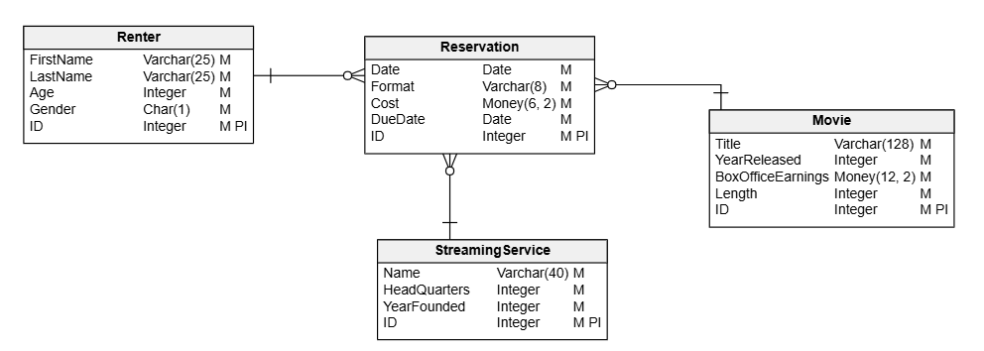
The completed logical model for Movie Rental

Slide 40
The Physical Model
The logical model expresses the meaning of the data
The physical model must map that meaning to physical components of a real database.
It targets a specific brand of relational database management system.

Slide 41
Mapping meaning to a physical database
Entity sets become tables
Attributes become columns of tables
Primary identifiers become primary keys
Relationships are implemented differently depending on their connectivity

Slide 42
One-to-one relationship
Relationships are implemented differently depending on their connectivity
Suppose entity set A and entity set B are involved in a one-to-one relationship based on column X.
Approach: add X to the list of attributes of either A or B

Slide 43
One-to-one relationship example
Relationships are implemented differently depending on their connectivity
For example, Person and Address
A person lives at one address
An address corresponds to one person
Add PersonID to the Address entity set to link an address with a person

Slide 44
One-to-many (1:M) relationships
Relationships are implemented differently depending on their connectivity
Suppose entity sets A and B have a 1:M relationship based on column X.
Suppose A has many B, but B has one A
i.e. B is on the many side of the relationship
Solution: add X to B, the entity set on the many side of the relationship

Slide 45
For 1:M relationships, the foreign key always goes on the M side of the relationship

Slide 46

Example: 1:M relationship
Relationships are implemented differently depending on their connectivity
A painter paints many paintings; each painting is painted by one painter
Painting is on the many side of the relationship
Add PainterID to Painting’s list of attributes

Slide 47
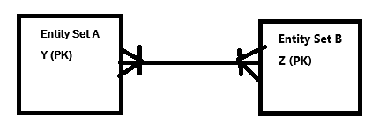
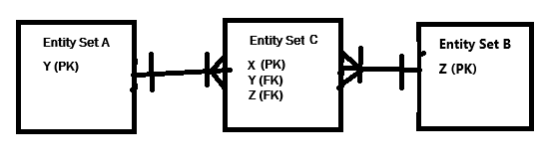
Many-to-Many (M:N) Relationships
Relationships are implemented differently depending on their connectivity
Suppose A and B are involved in a many-to-many relationship
A is related to many B; B is related to many A
Suppose each A is identified by column Y, and each B is identified by column Z
Solution: create a bridge entity C between A and B
C will consist of at least columns Y and Z
C will probably also add on its own surrogate key X as its primary key
Entity set C is called a bridge entity set

Slide 48
Bridge entity sets
Relationships are implemented differently depending on their connectivity
A bridge entity set is added to implement many-to-many (M:N) relationships between two other entity sets.
The bridge entity set turns the M:N relationship into two 1:M relationships
The bridge entity set will be on the “many” side of both.
The bridge entity set has
its own surrogate primary key
a foreign key to each of the two original entity sets it is joining
perhaps other attributes that provide details about the relationship itself

Slide 49
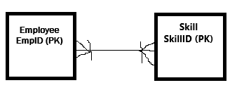
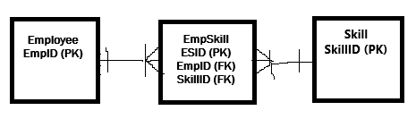
Example: Implementing a M:N relationship with a bridge entity set
Relationships are implemented differently depending on their connectivity
Employee has an EmployeeID
Skill has a SkillID
An employee learns many skills, each skill is learned by one employee
Logical Model:
Physical Model:

Slide 50
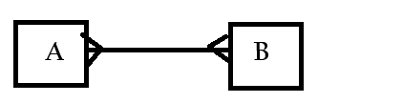

Rewriting M:N relationships using bridge entity sets
A bridge entity set helps us model a M:N relationship
A bridge entity set replaces one M:N relationship with two 1:M relationship
To create a bridge entity set, define its attributes like this:
Add the primary key of one of the entity sets involved in the M:N relationship
Add the primary key of the other entity set involved in the M:N relationship
Add a surrogate key as the primary key
Add any other attributes that are useful for describing the relationship

Slide 51
Summary: generating the physical model from the logical model
Recognize that each entity set becomes a table
Recognize that each attribute becomes a column
Recognize that each primary identifier becomes a primary key and may be shared with another entity set as a foreign key
Add foreign keys and/or bridge entity sets:
Add a foreign key that links to the other entity set’s primary key for a 1:1 relationships
Add a foreign key that links to the other entity set’s primary key to the many side of a 1:M relationship
Add a bridge entity set between two entity sets involved in a M:N relationship
The bridge has its own surrogate key
It has foreign keys that link to the primary keys of the entity sets it is bridging.
Add optimizations such as indexes, clusters, partitions, etc.
More on these in the future

Slide 52
Vertabelo makes it particularly easy to build a physical model from a logical model

Slide 53
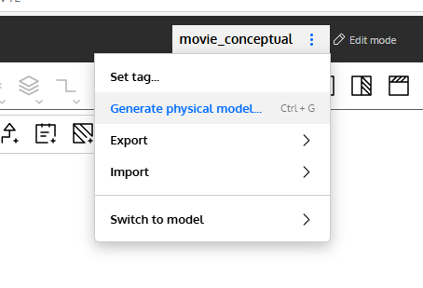
Then generate physical model

Slide 54
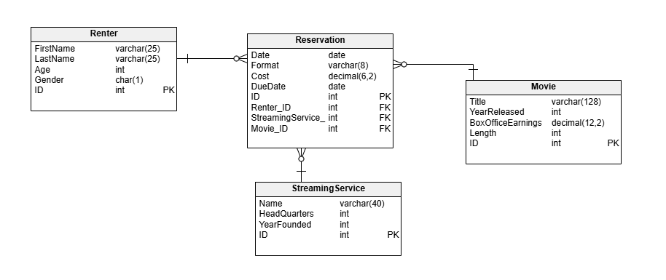
The resulting physical model for Movie Rental

Slide 55
Another outcome of the physical model: SQL DDL
SQL = Structured Query Language
DDL = Data Definition Language
DDL are commands that build, alter, and destroy database structures like tables, columns, keys, indexes, and relationships
SQL has a full set of DDL commands.

Slide 56
SQL Create a database
CREATE DATABASE MOVIERENTAL_DB;

Slide 57
SQL: Set a particular database as the current one to use for all queries
USE MovieRentalDB;

Slide 58
SQL: Create a table in the database
CREATE TABLE MOVIE (
ID INTEGER AUTO_INCREMENT NOT NULL UNIQUE,
TITLE VARCHAR(128),
LENGTH INTEGER,
BOX_OFFICE_EARNINGS DECIMAL(12,2),
YEAR_RELEASED INTEGER,
PRIMARY KEY(ID)
);

Slide 59
SQL: Create a table with a foreign key
CREATE TABLE PAINTER (
ID INTEGER AUTO_INCREMENT NOT NULL UNIQUE,
LASTNAME VARCHAR(32),
FIRSTNAME VARCHAR(32),
PRIMARY KEY (ID),
);
CREATE TABLE PAINTING (
ID INTEGER AUTO_INCREMENT NOT NULL UNIQUE,
PAINTER_ID INTEGER,
PRIMARY KEY (ID),
FOREIGN KEY (PAINTER_ID) REFERENCES PAINTER (ID)
ON DELETE CASCADE ON UPDATE CASCADE
);

Slide 60
SQL: ALTER A TABLE
For example, modify the data type for the movie title to be varchar(256):
ALTER TABLE MOVIE MODIFY TITLE VARCHAR(256);
Another example: drop a column:
ALTER TABLE MOVIE DROP COLUMN BOX_OFFICE_EARNINGS;
Another example: add a column:
ALTER TABLE MOVIE ADD COUNTRY_OF_ORIGIN CHAR(2);
Another example: add a relationship
ALTER TABLE RESERVATION ADD CONSTRAINT fk_Reservation_Movie FOREIGN KEY (MovieID) REFERENCES MOVIE (id) ON DELETE CASCADE ON UPDATE CASCADE

Slide 61
SQL: DROP A TABLE OR THE ENTIRE DATABASE
To remove a structure from a database is to drop it.
To drop a table:
DROP TABLE MOVIE;
To drop an entire database:
DROP DATABASE MOVIERENTAL_DB

Slide 62
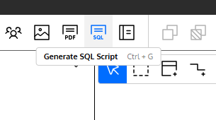
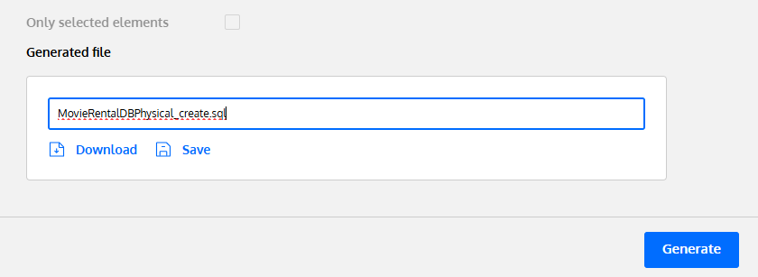
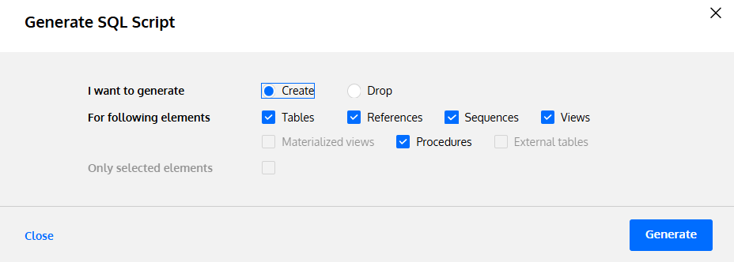
Vertabelo makes it very easy to generate SQL DDL from the physical model to create a database and its structures

Slide 63
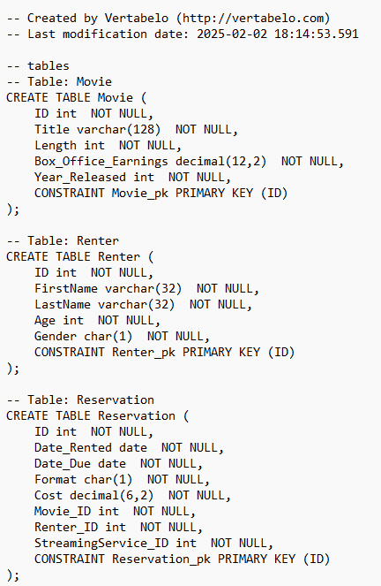
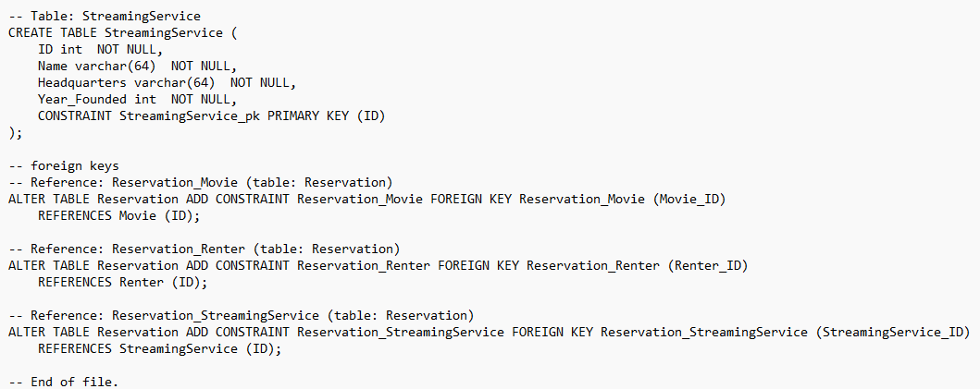

Slide 64
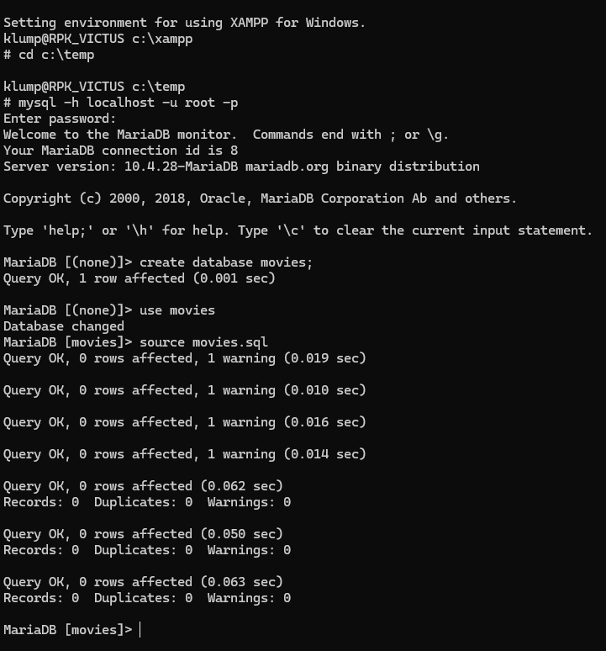
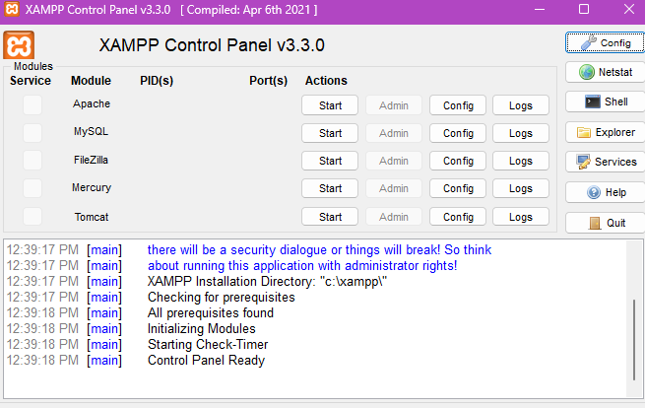

Import the script into mysql to build the database

Slide 65
We’ll do more examples next week

Slide 66
Last topic for this note set: Normalization

Slide 67
Sometimes identifying which attributes to assign to which entity sets is difficult
There is a process called normalization that can help.

Slide 68
Normalization
The process of making sure that attributes are in their right entity sets is called normalization
Normalization advances an entity set through a series of normal forms

Slide 69

1st Normal Form (1NF)
In 1NF, each attribute must have atomic (indivisible) values, and there should be no repeating groups or arrays of data.
This is not in 1NF:
To fix this, use separate tables: a student table, a course table, and an enrollment table.

Slide 70
2nd Normal Form (2NF)
A design is in 2NF if every non-determinant attribute depends on the entirety of the determinant
In other words, there are no partial dependencies

Slide 71
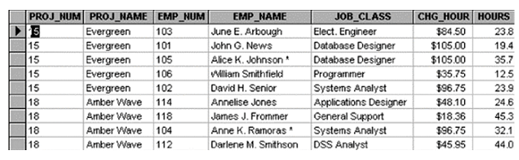
Example
This design is not in 2NF:
Primary key is PROJ_NUM + EMP_NUM
Here are the functional dependencies:
PROJ_NUM, EMP_NUM → PROJ_NAME, EMP_NAME, JOB_CLASS, CHG_HOUR, HOURS
But in reality
PROJ_NUM → PROJ_NAME
EMP_NUM → EMP_NAME, JOB_CLASS, CHG_HOUR
PROJ_NUM, EMP_NUM → HOURS
So, to get to 2NF, we need to break this one entity set into 3:
Project, Employee, and WorkAssignment

Slide 72
3rd Normal Form (3NF)
An entity set is in 3NF if there are no transitive dependencies
Every non-determinant depends only on the primary key
Not on another non-determinant
Solution:
PROJ_NUM → PROJ_NAME
EMP_NUM → EMP_NAME, JOB_CLASS
PROJ_NUM, EMP_NUM → HOURS
JOB_CLASS->CHG_HOUR

Slide 73
3NF Example
There’s a transitive dependence here:
PROJ_NUM → PROJ_NAME
EMP_NUM → EMP_NAME, JOB_CLASS, CHG_HOUR
PROJ_NUM, EMP_NUM → HOURS
The JOB_CLASS determines the CHG_HOUR value
To fix this:
Split the JOB_CLASS and CHG_HOUR into its own entity set
Leave JOB_CLASS in the EMPLOYEE entity set to serve as a foreign key
The result:
PROJ_NUM → PROJ_NAME
EMP_NUM → EMP_NAME, JOB_CLASS
JOB_CLASS → CHG_HOUR
PROJ_NUM, EMP_NUM → HOURS

Slide 74
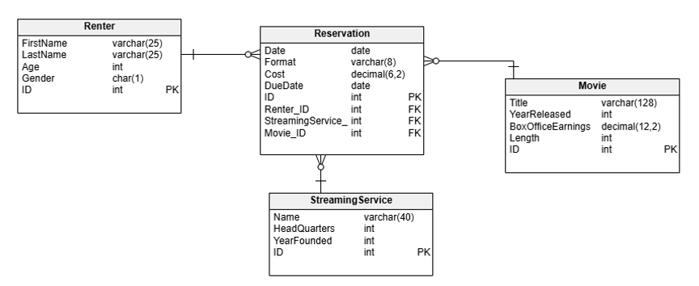
Validate our MovieRental Model
1NF – no repeating groups
2NF – no partial dependencies
3NF – no transitive dependencies

Slide 75
Summary
Moving from a conceptual model to a logical model
Moving from a logical model to a physical model
Using Vertabelo to automate tasks
Creating a database in MySQL
Using normalization to validate and refine a design

