Slide 1
Language Models
From Vectors to ChatGPT

Slide 2
Vectors

Slide 3
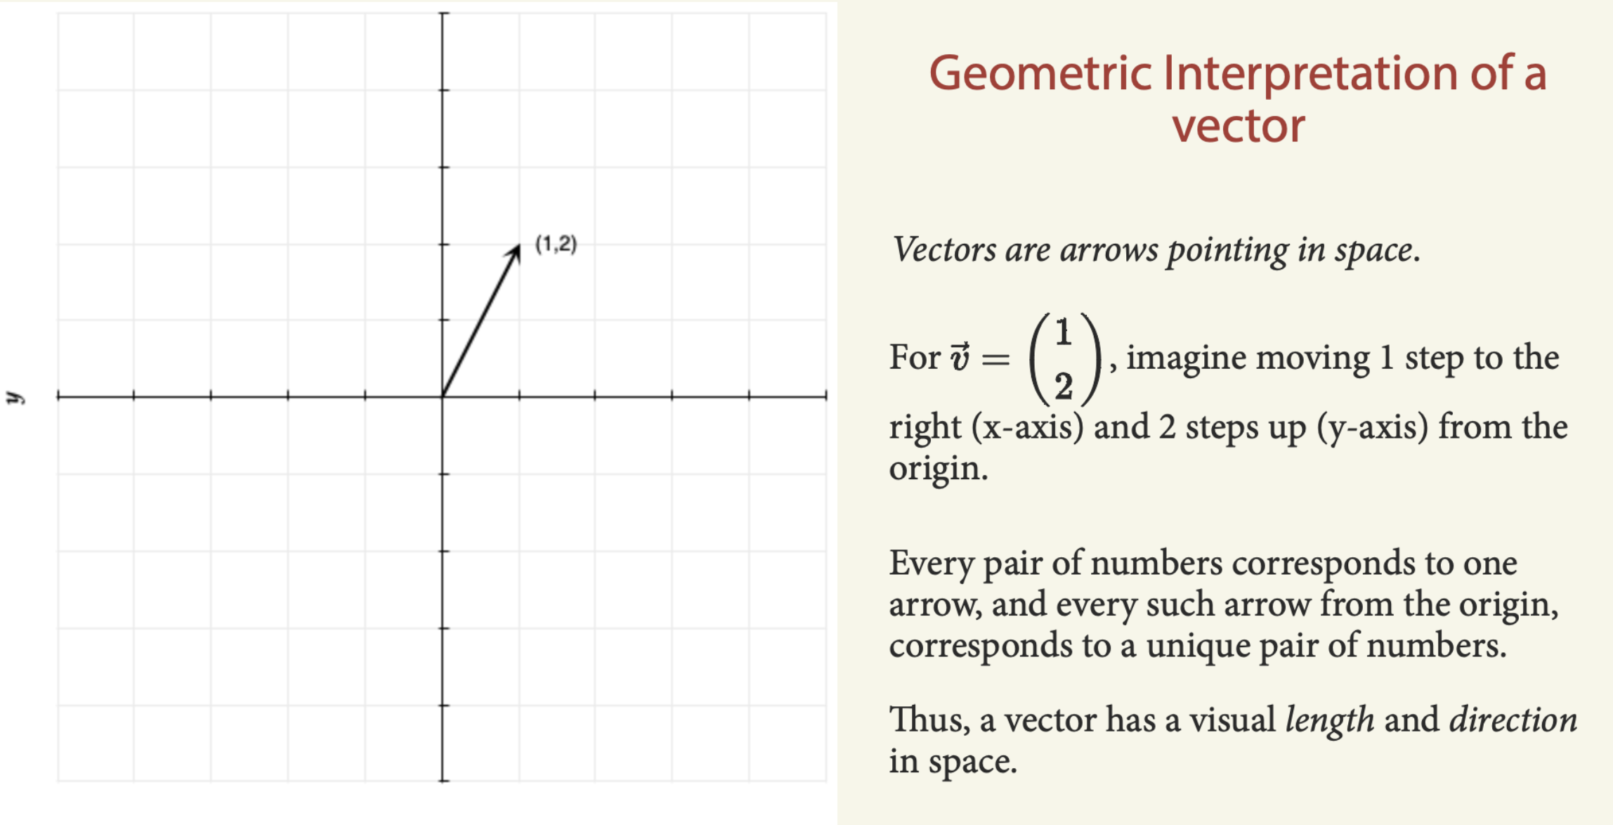

Slide 4
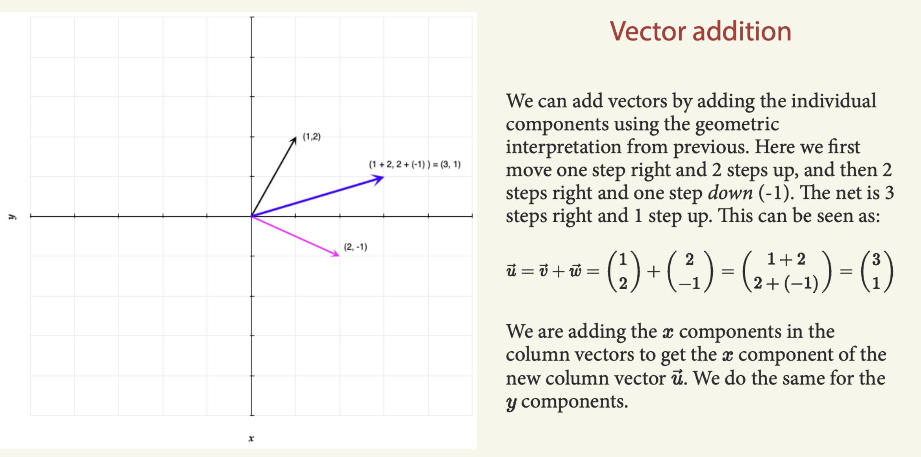

Slide 5
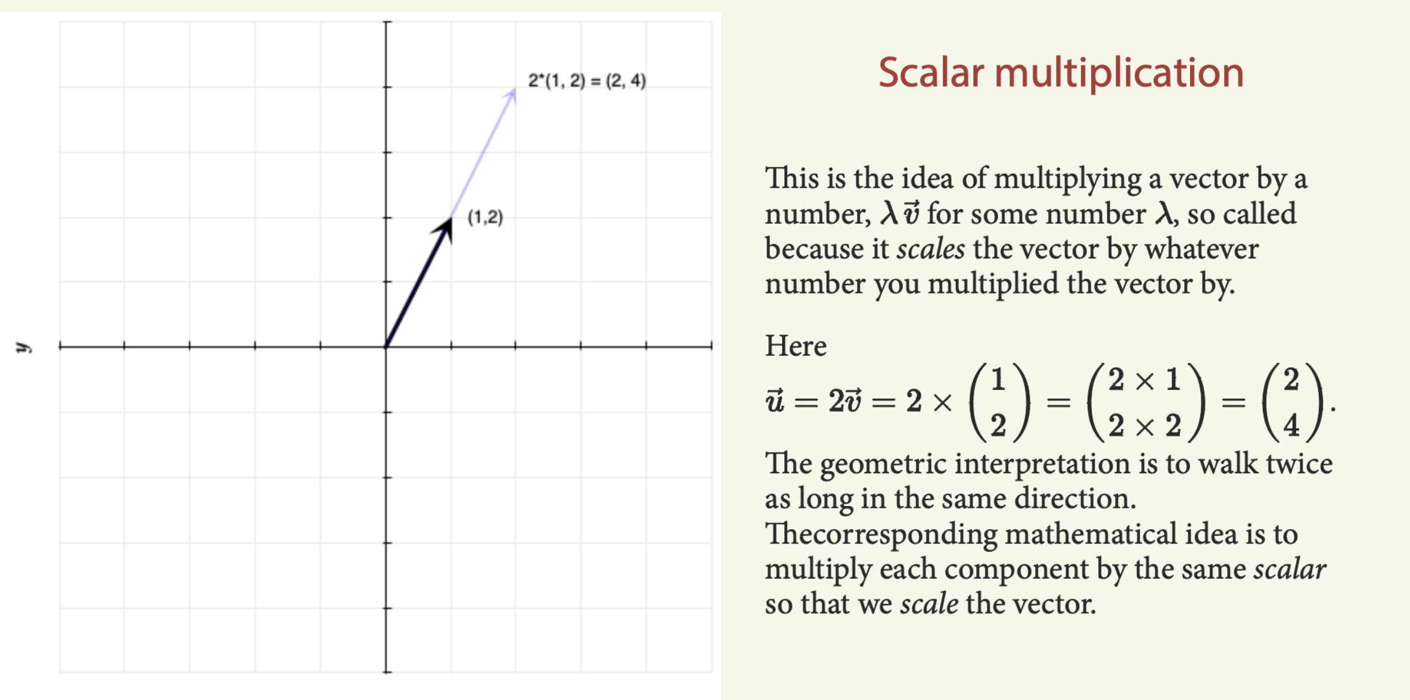

Slide 6
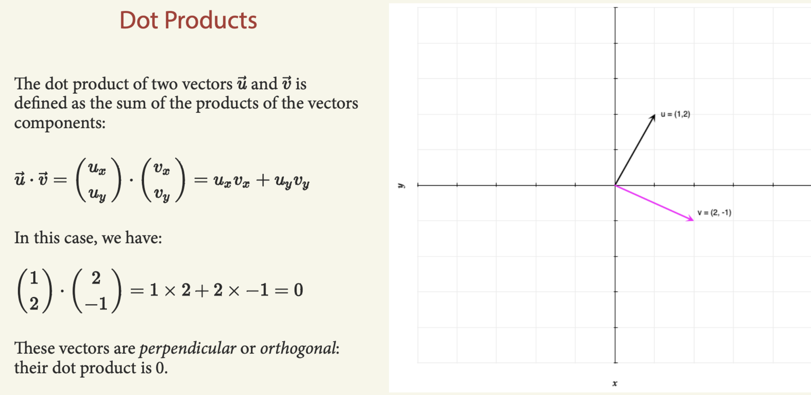

Slide 7
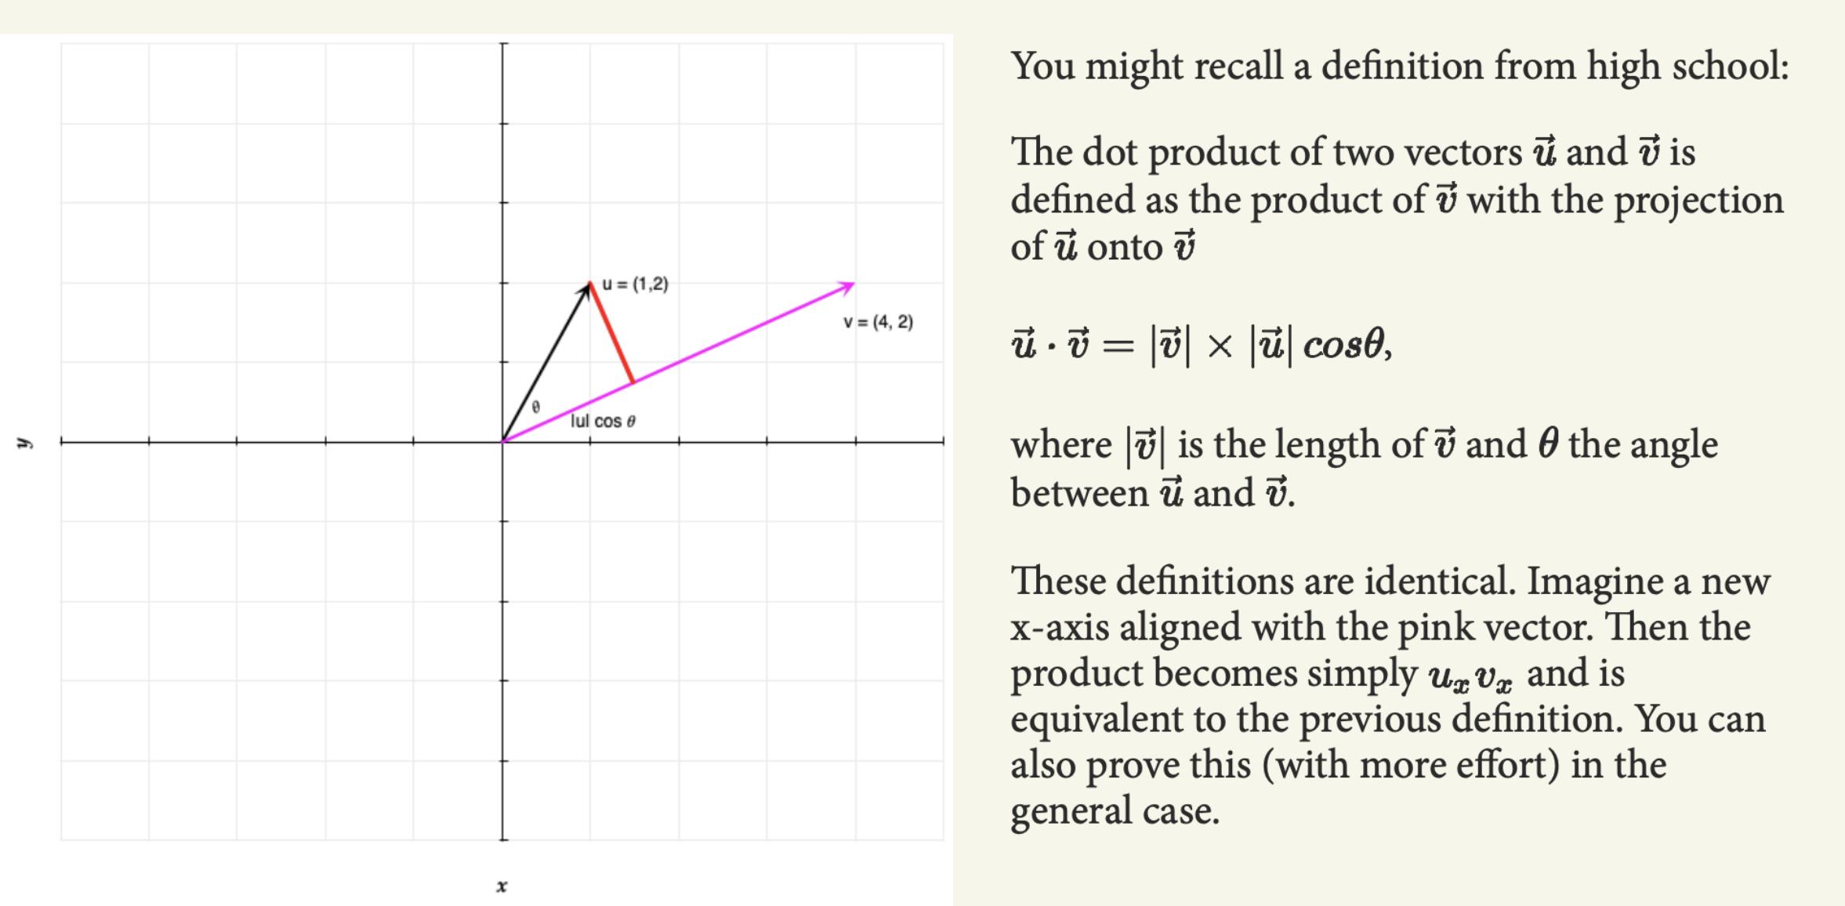

Slide 8
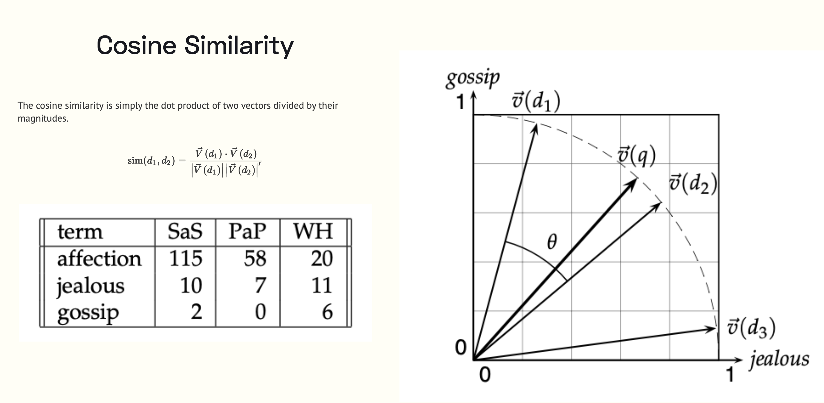

Slide 9
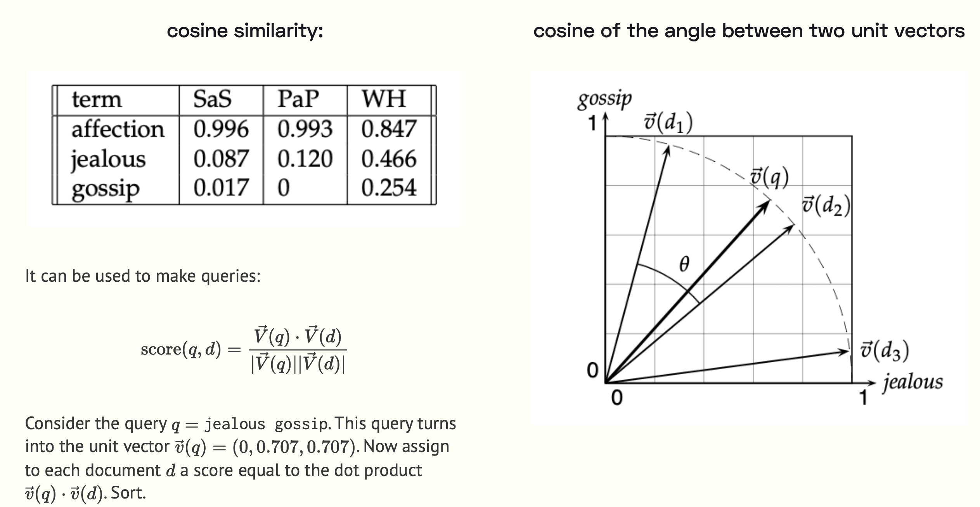

Slide 10
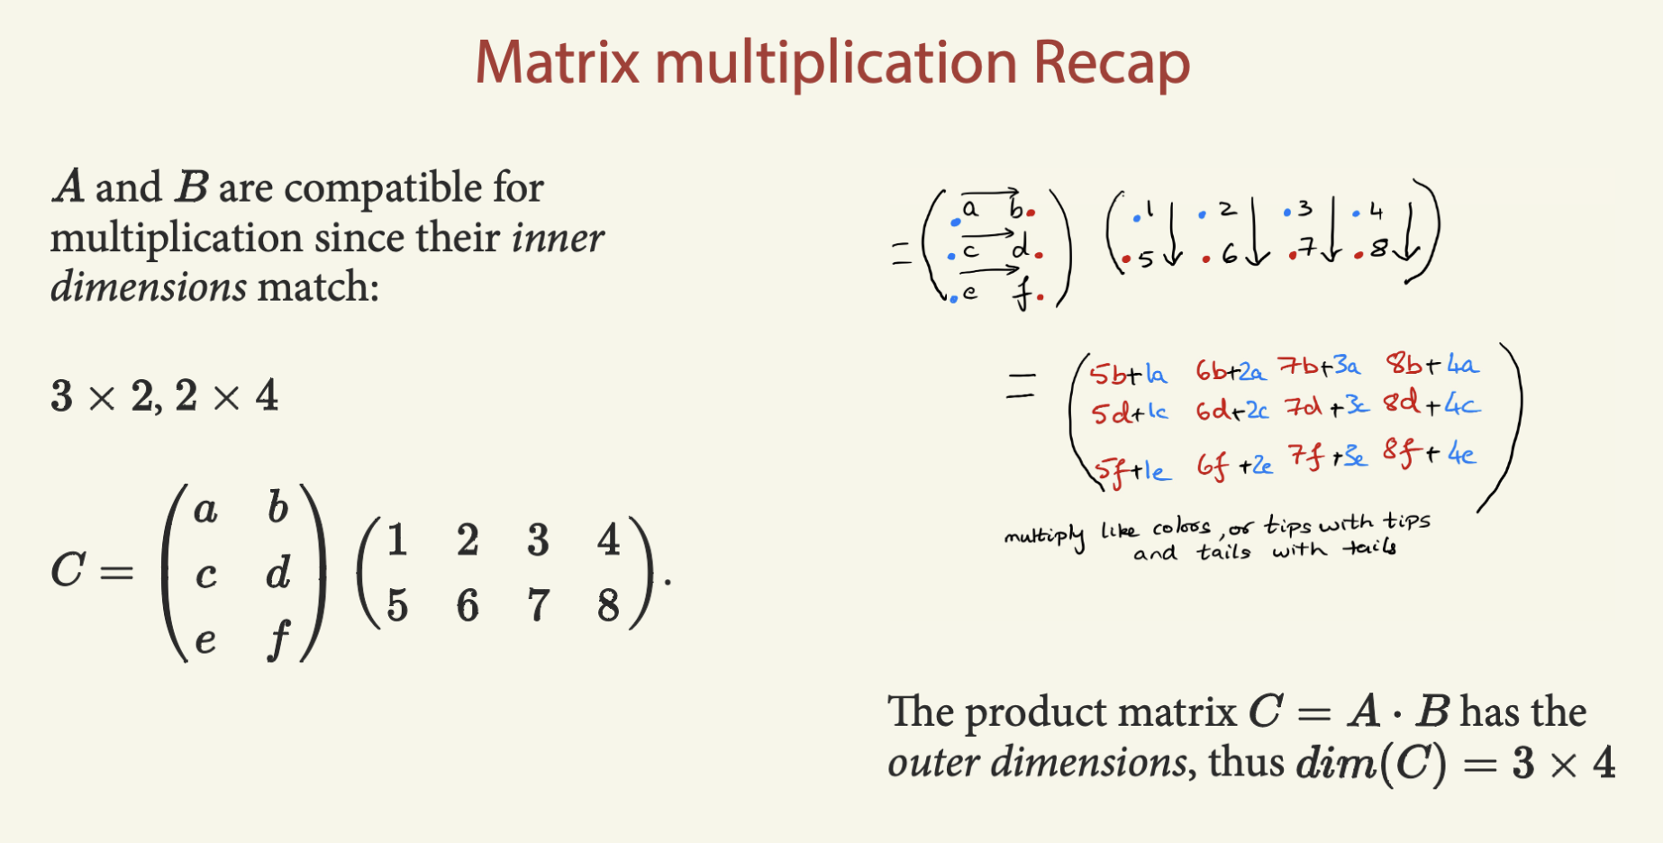

Slide 11
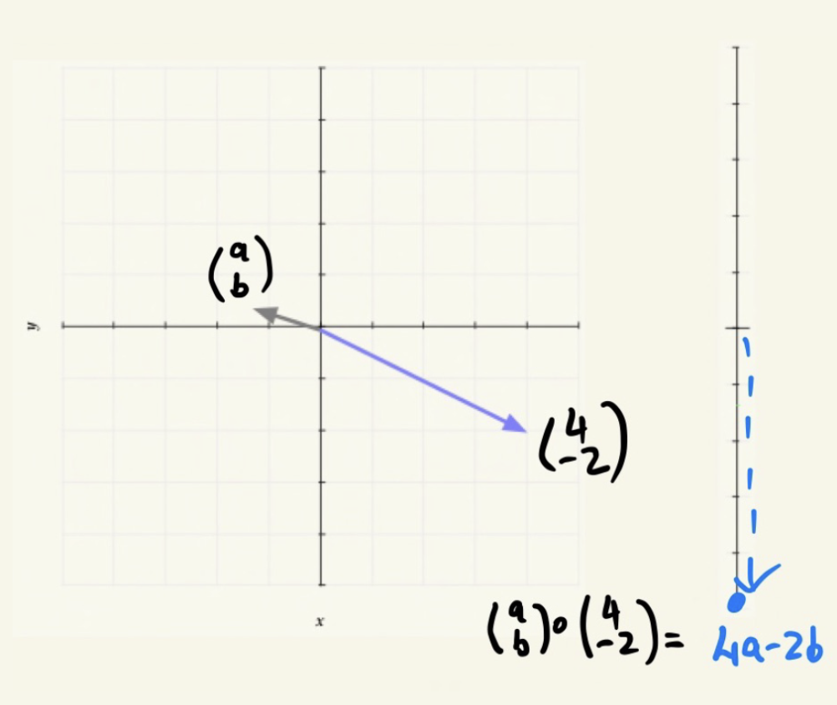
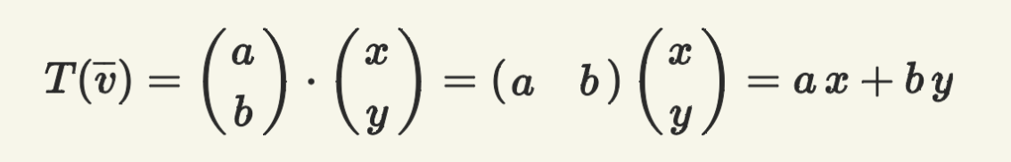
Dot products are a transform from 2D to 1D.
And can be thought of a very special kind of
matrix multiplication
Multiple dot products can transform to other dimensions

Slide 12
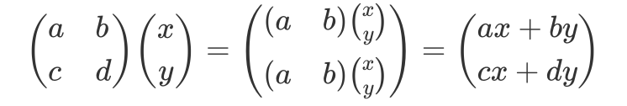
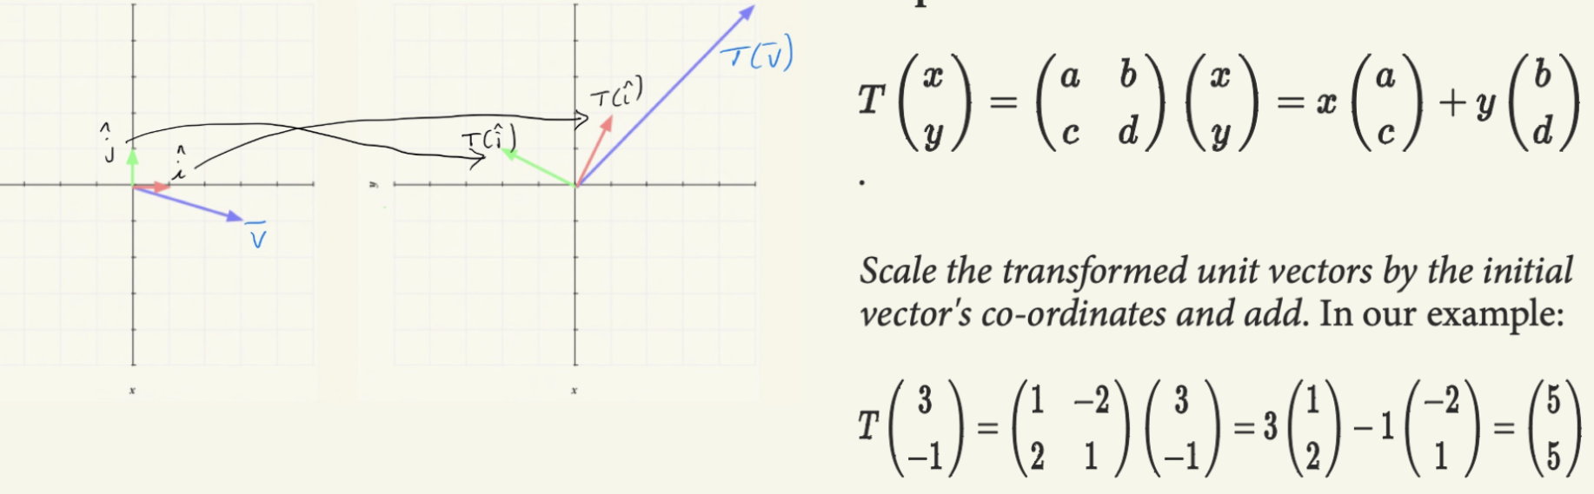
Two ways to see matrix multiplication

Slide 13
Embeddings

Slide 14
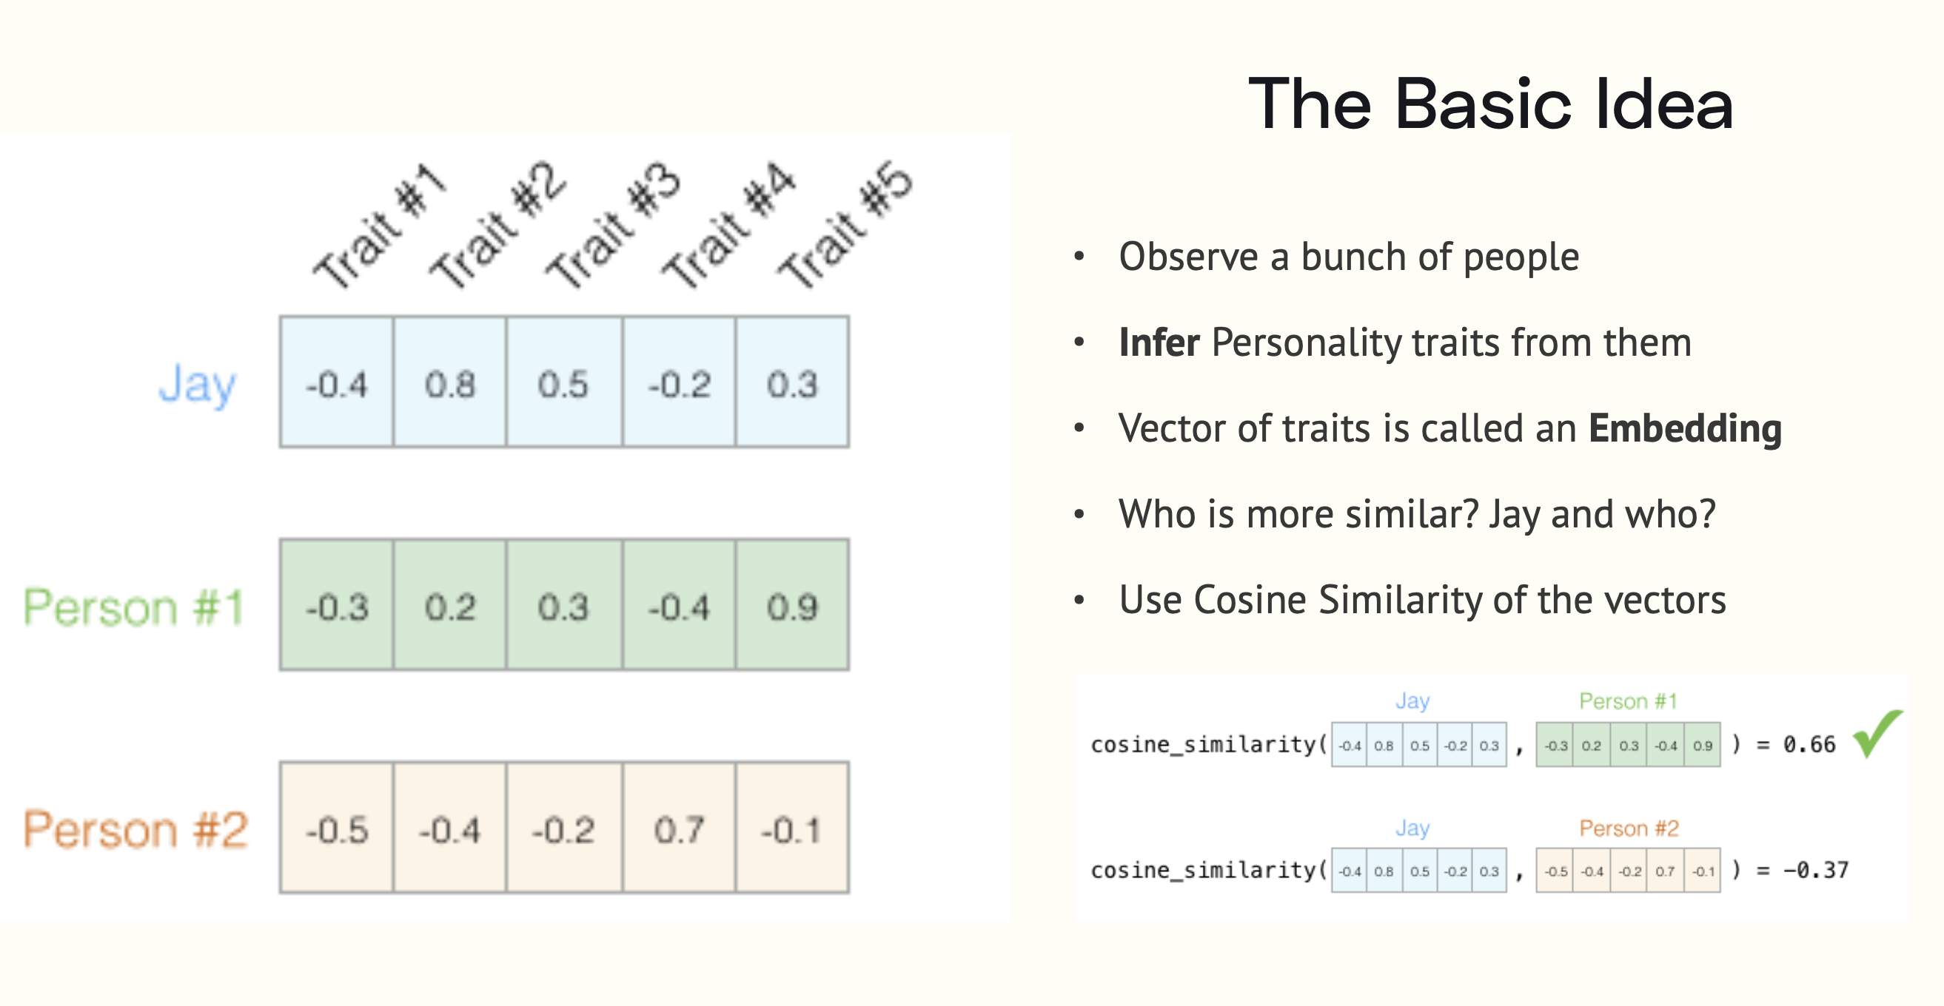

Slide 15
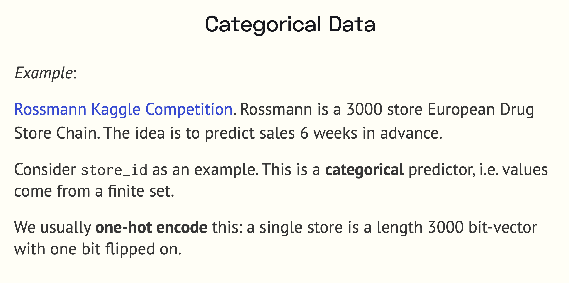

Slide 16
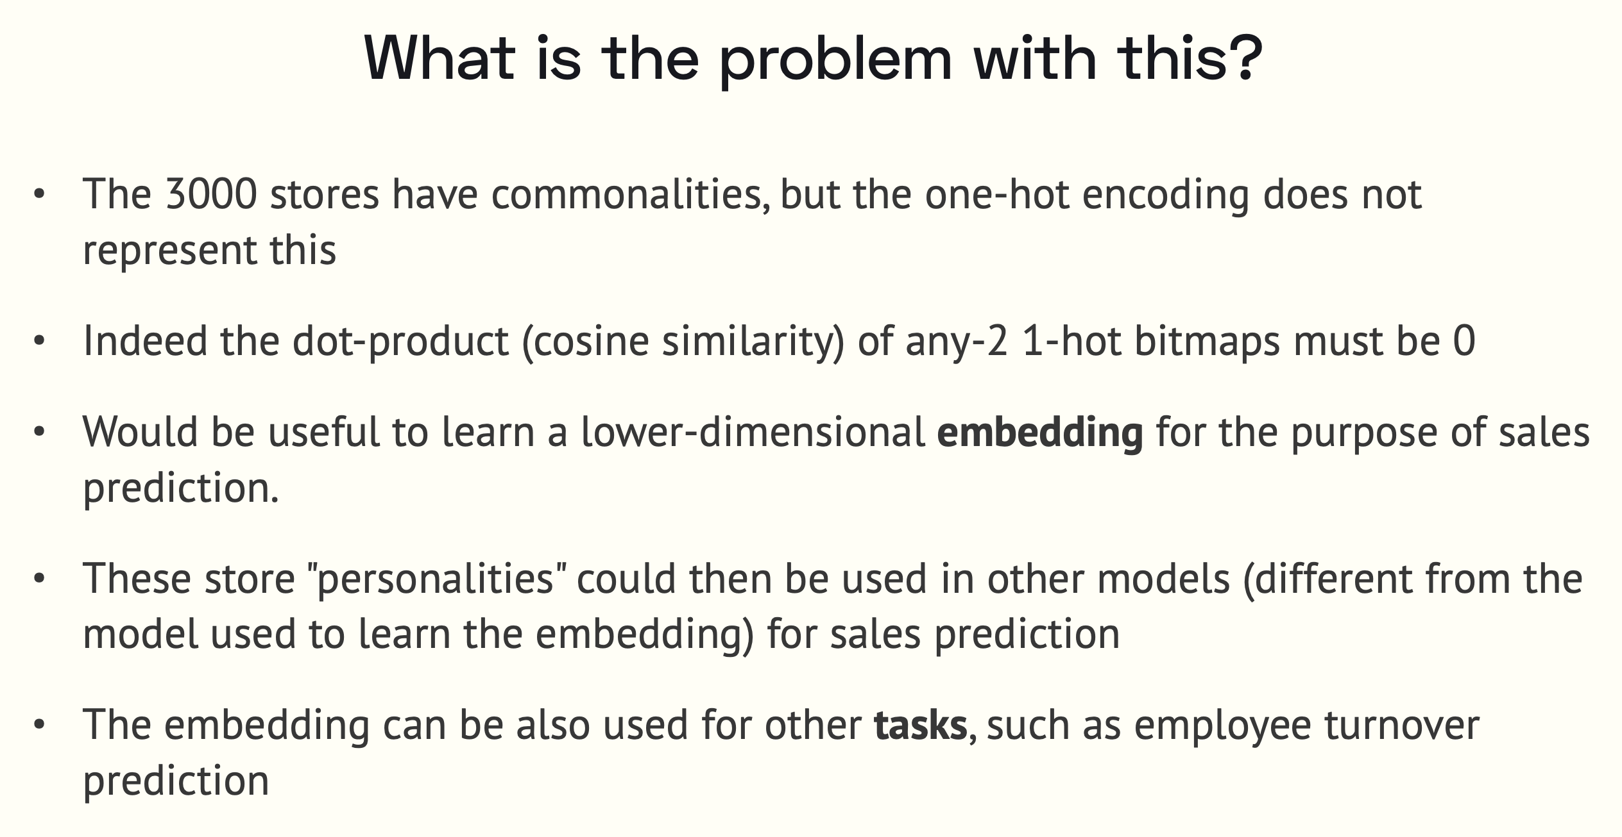

Slide 17
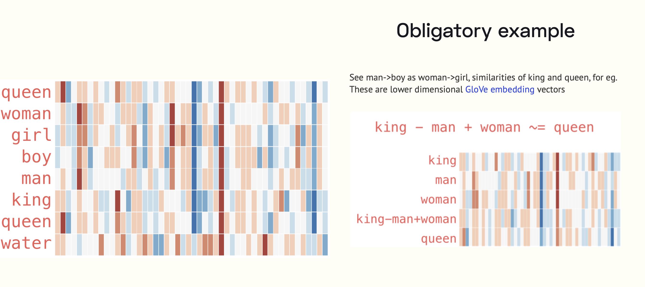

Slide 18
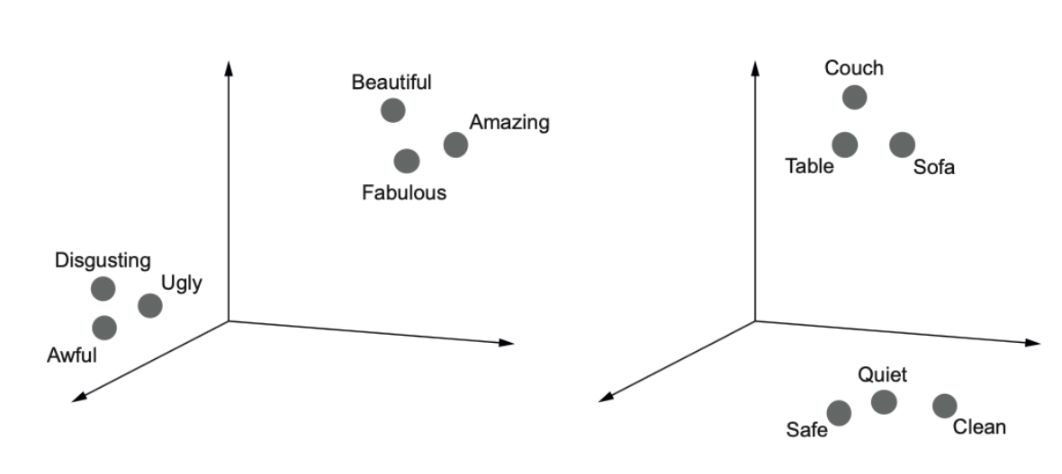
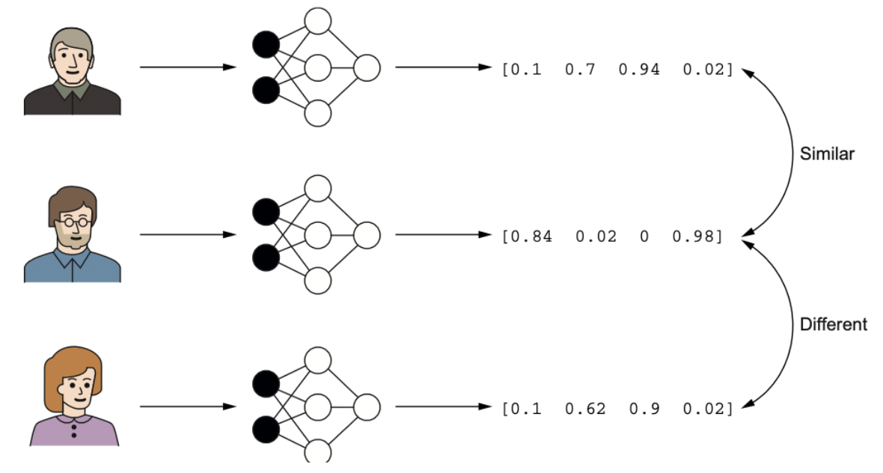
Embeddings map similar concepts to similar vectors
These concepts can be from different spaces, like users and movies
Any model can be used to produce embeddings: Apple face recognition.

Slide 19
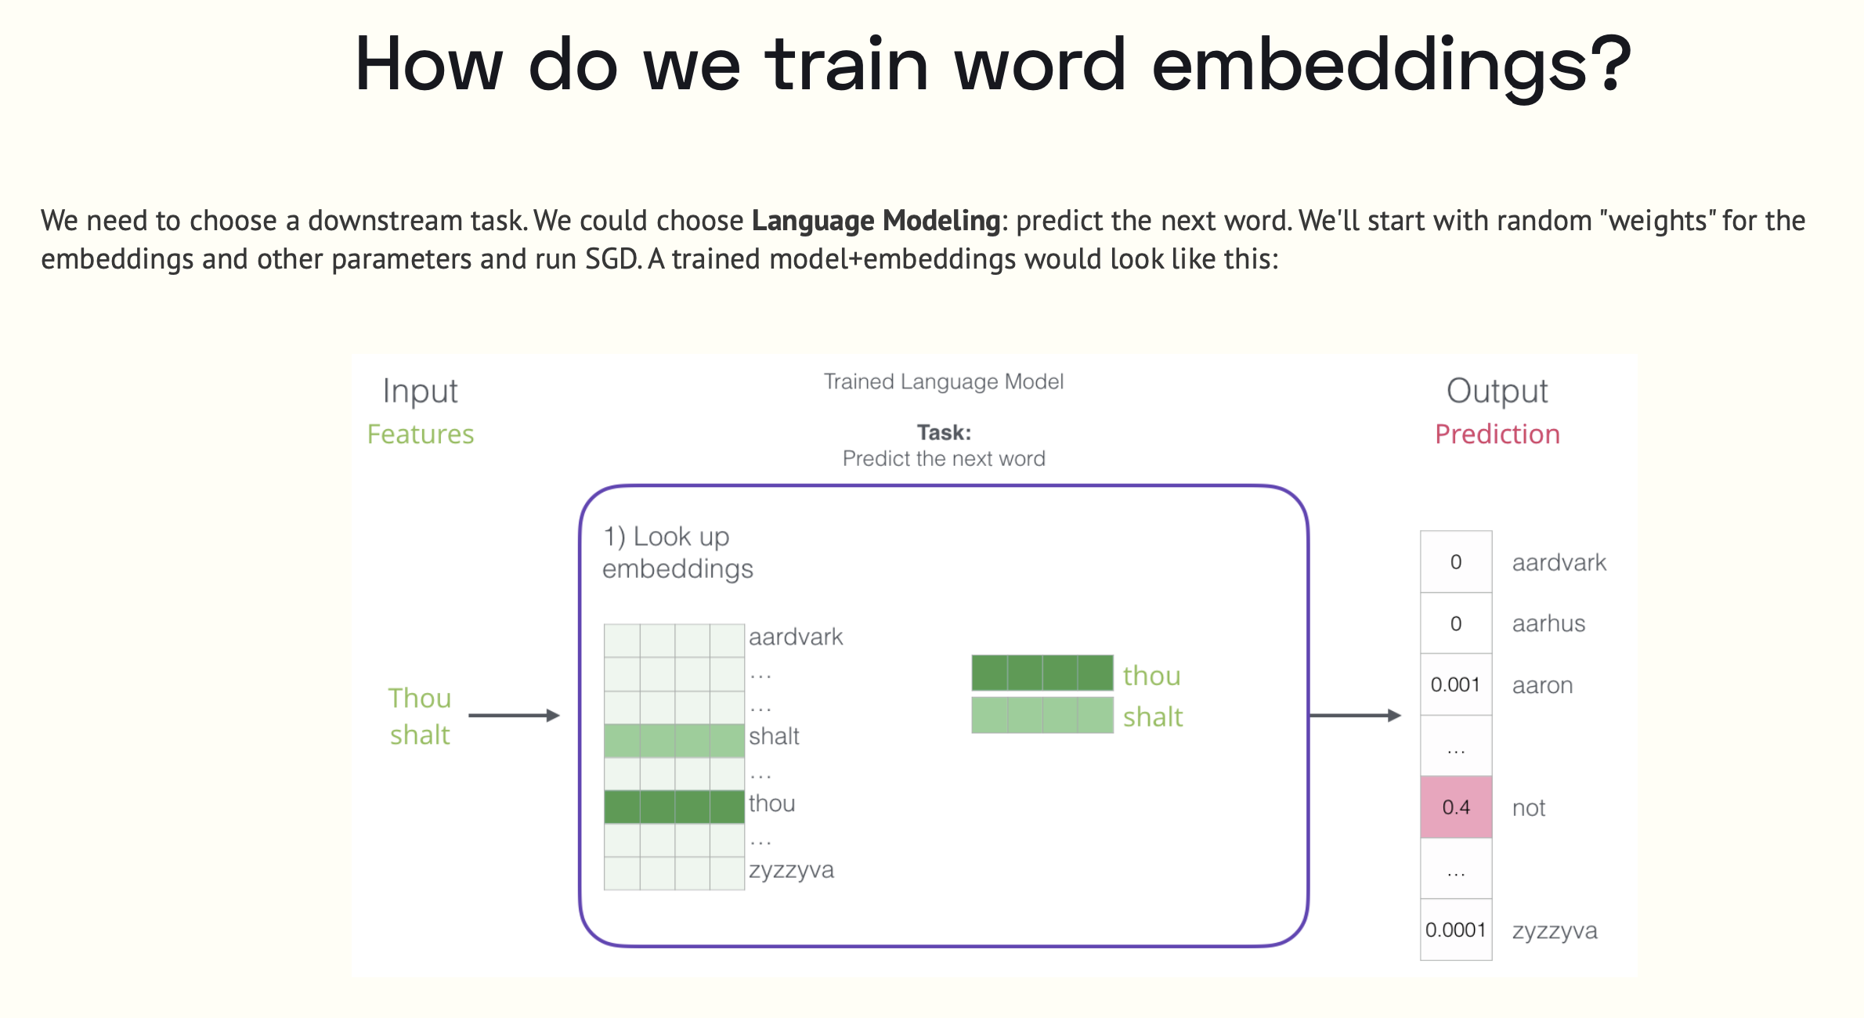

Slide 20
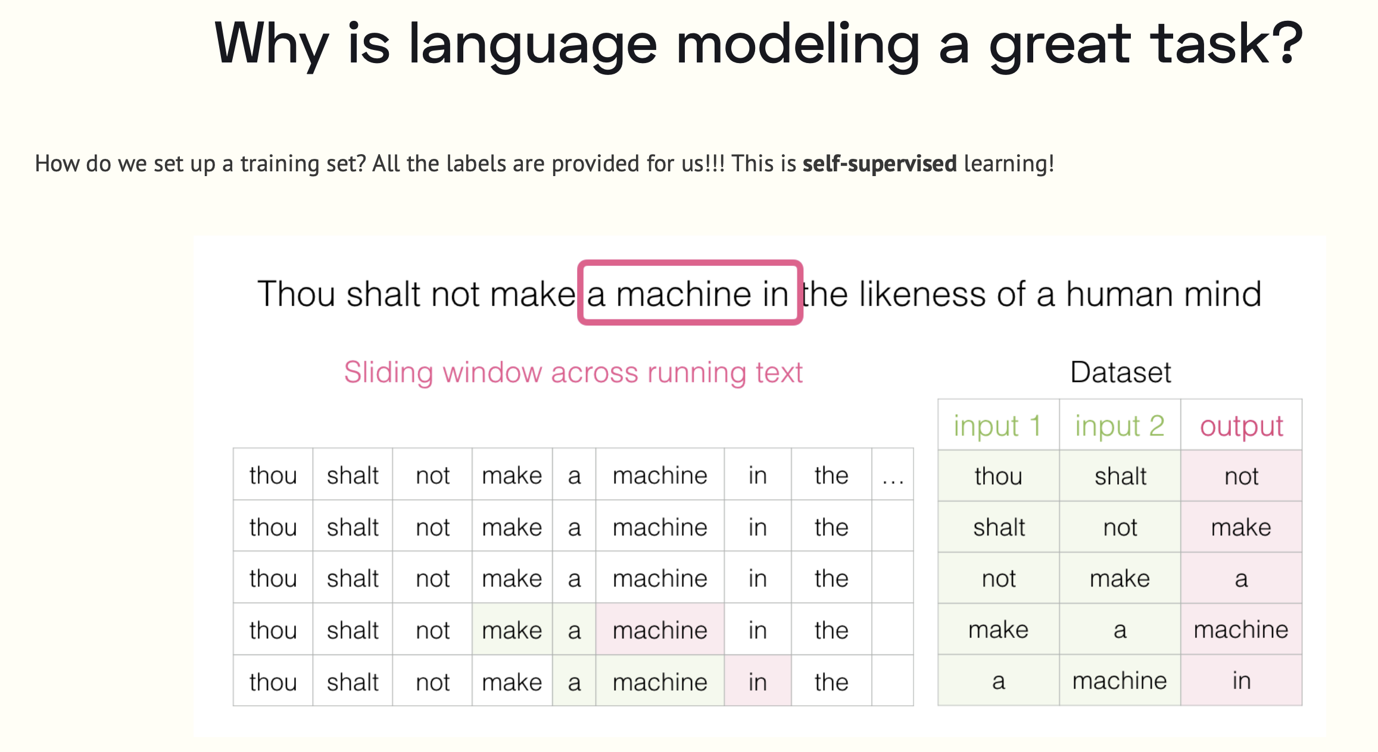

Slide 21
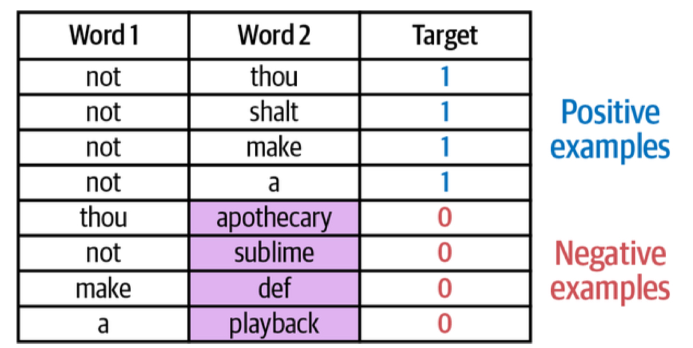
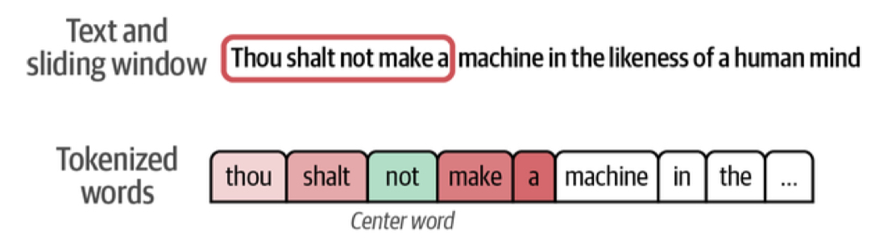
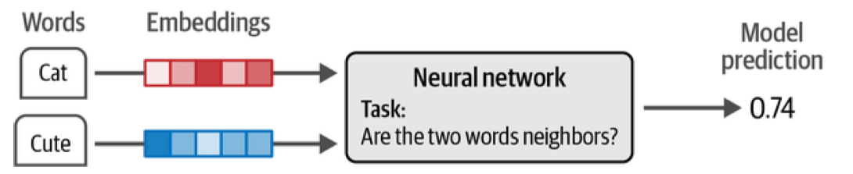
It is not enough to have just positive samples, you need negative samples too. These can be obtained by random sampling.

Slide 22
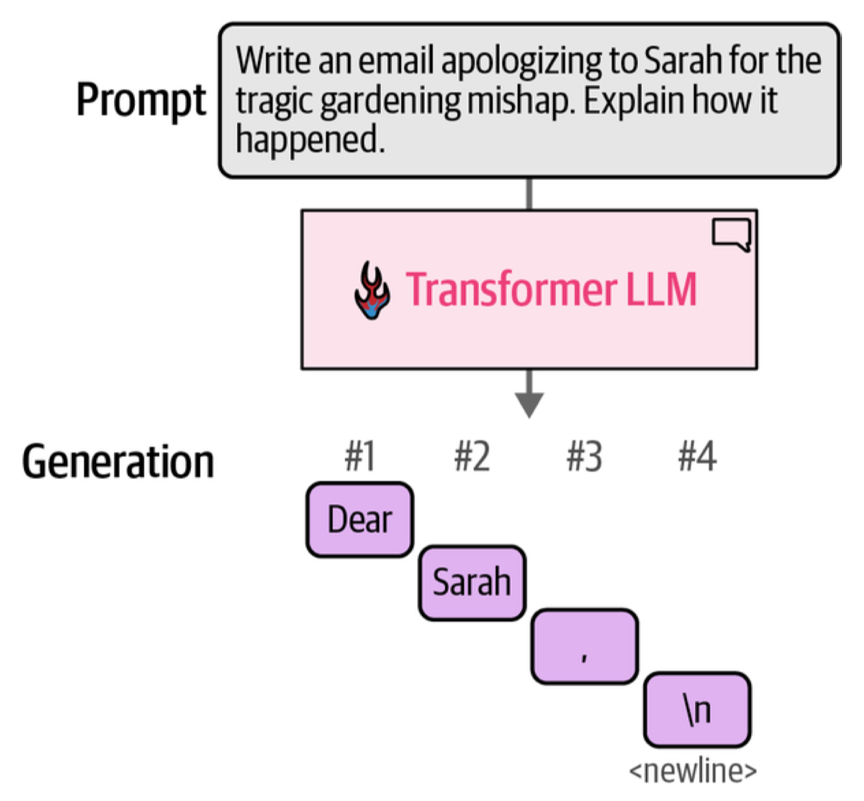
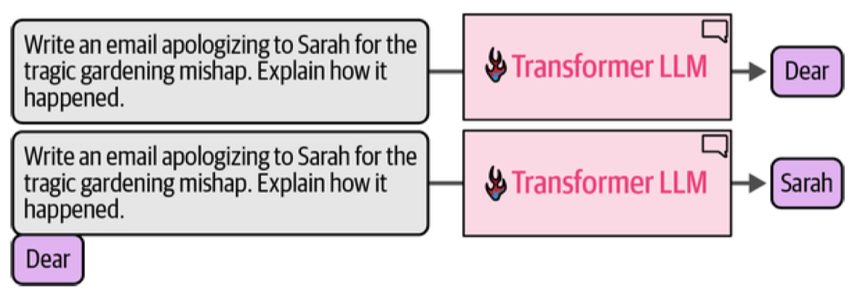
Generation happens token by token

Slide 23
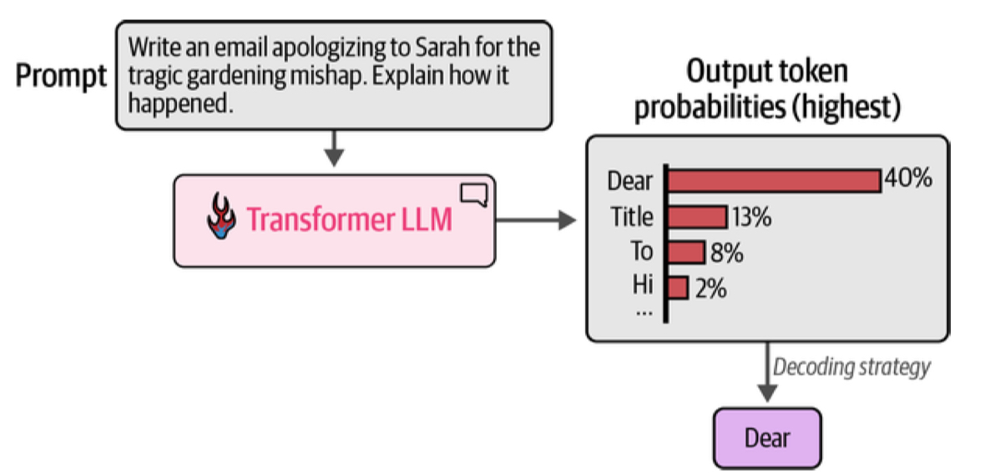
Probabilities drive everything
We sample from probabilities to get the next word

Slide 24
Why use a transformer architecture?
ATTENTION: The transformer has a mechanism to figure out which words in a context are important to understanding the meaning of a given word and thus impacting its embedding
MEMORY: The transformer has a MLP mechanism to associate with a word and its embedding facts that are pulled out from a kind of memory database.
PARALLELISM: At the level of parallel paths through tokens, parallel attention heads, and parallel paths through the memory bank (MLP) there are multiple opportunities to exploit the parallelism inherent in GPUs. This is in contrast to RNN mechanisms.

Slide 25
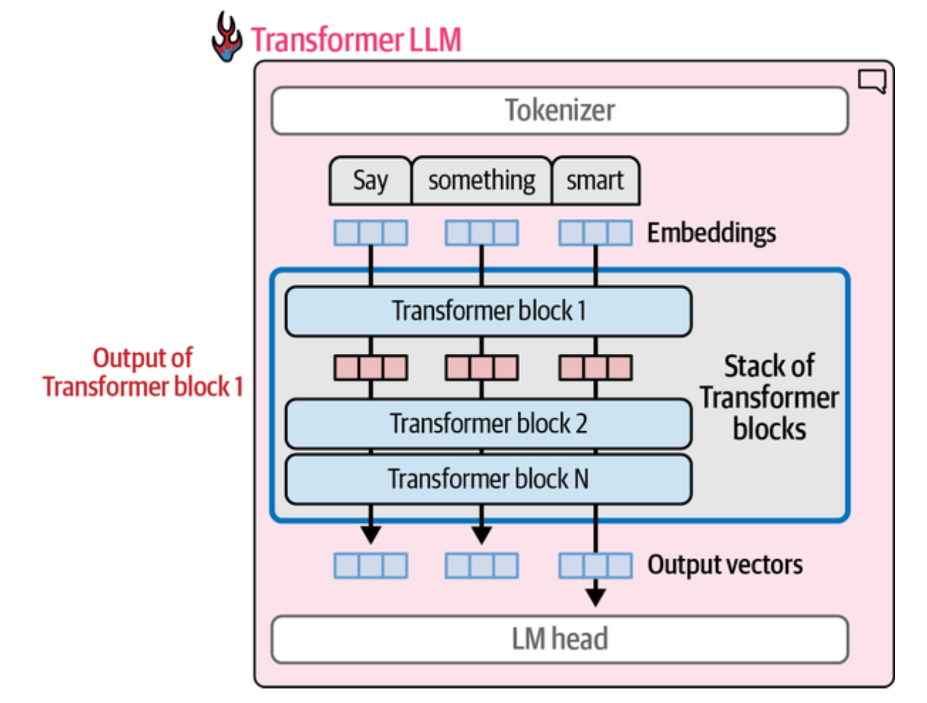
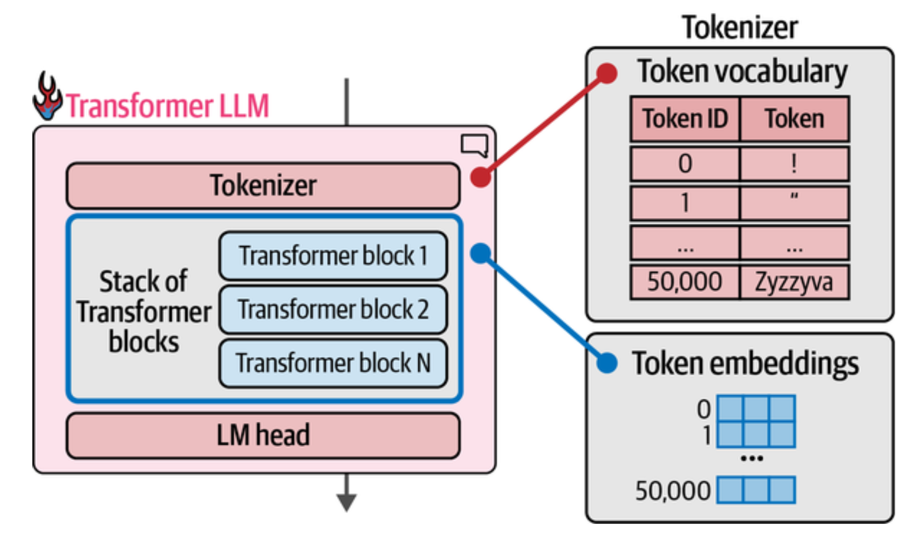
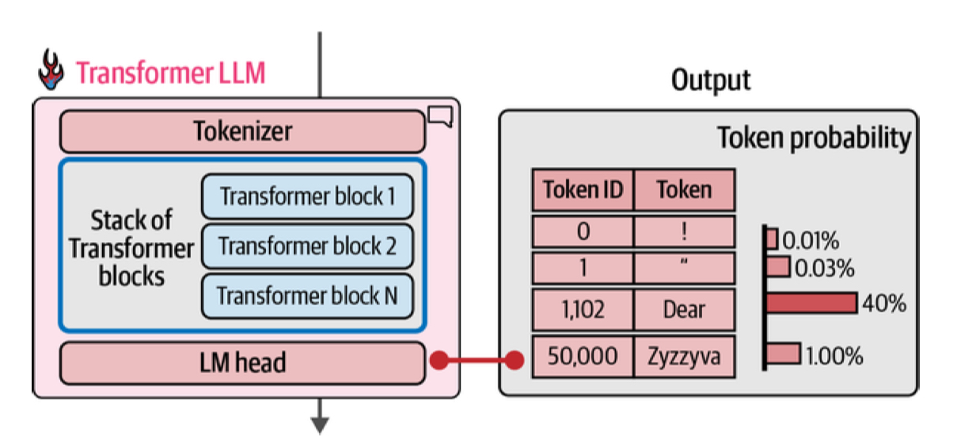
The GPT Architecture

Slide 26
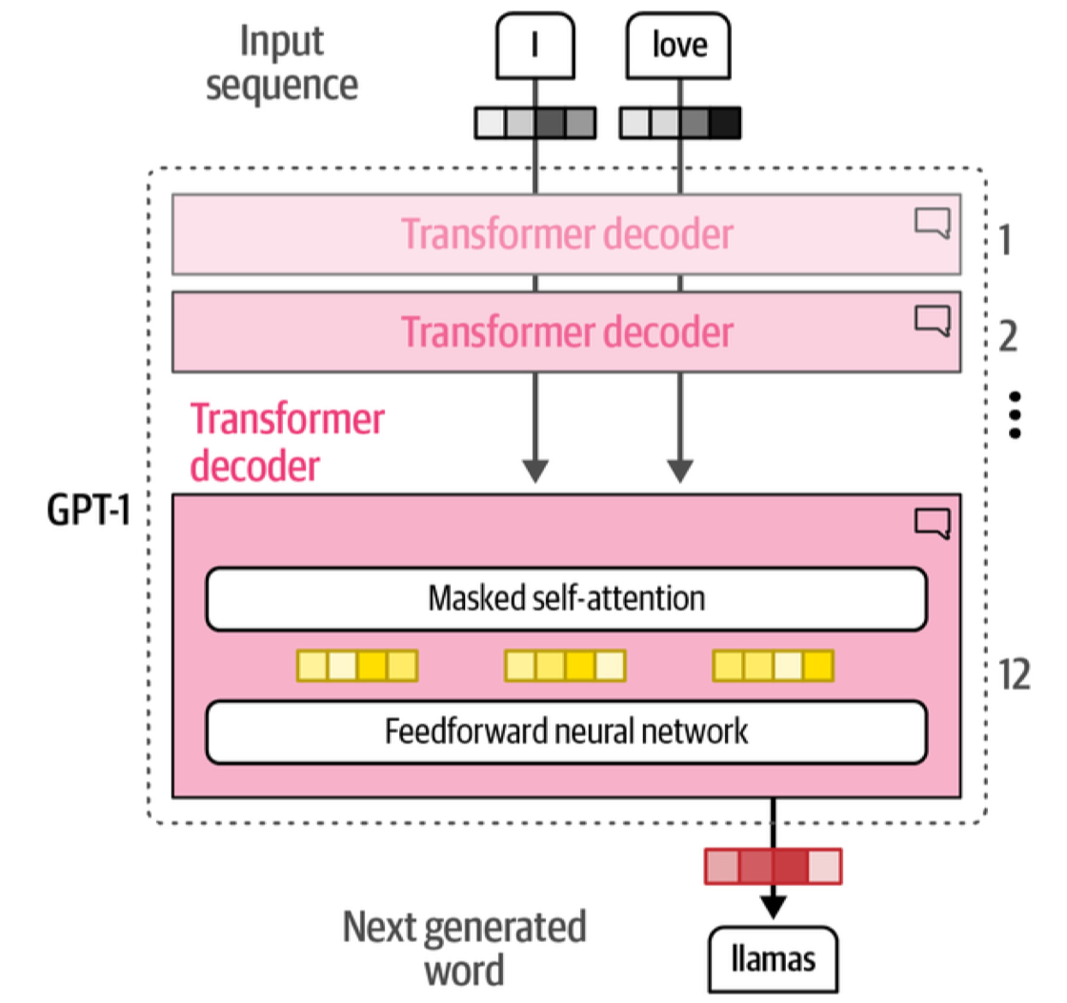
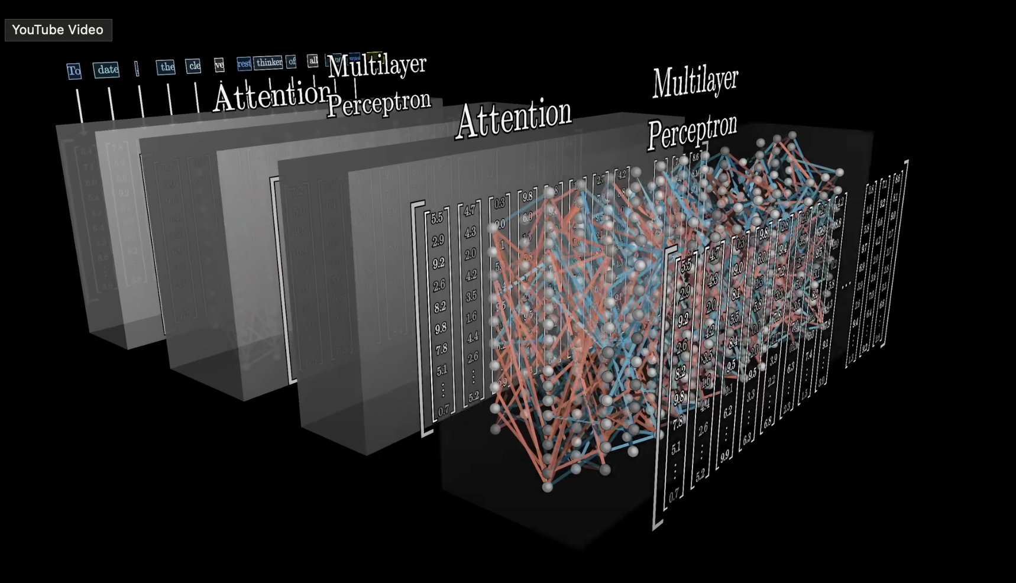
What does the Transformer Block look like?

Slide 27
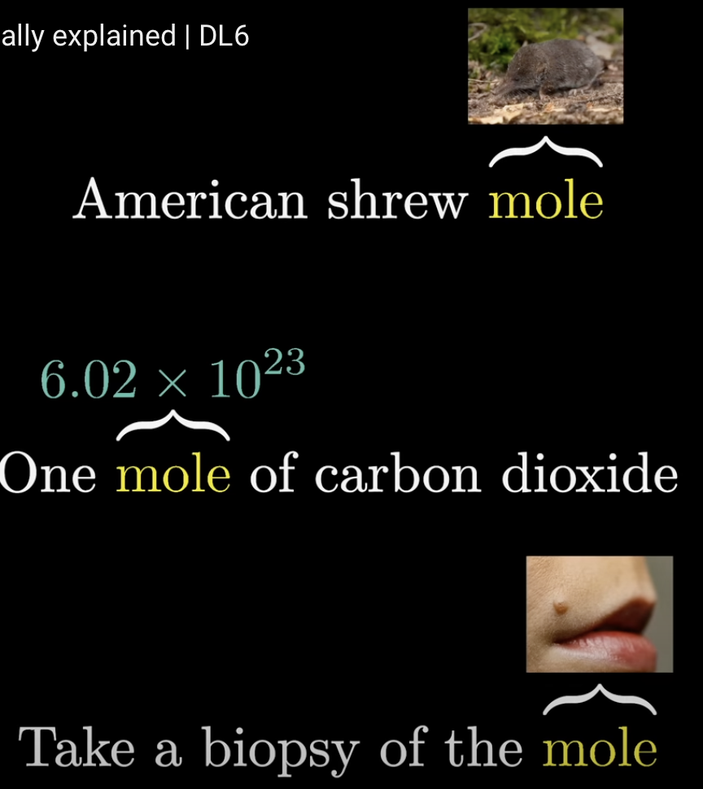
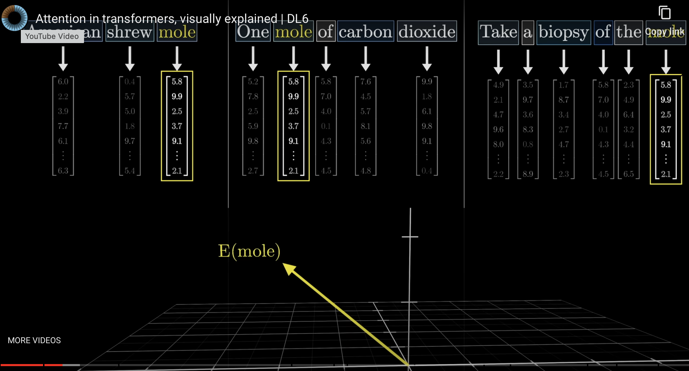
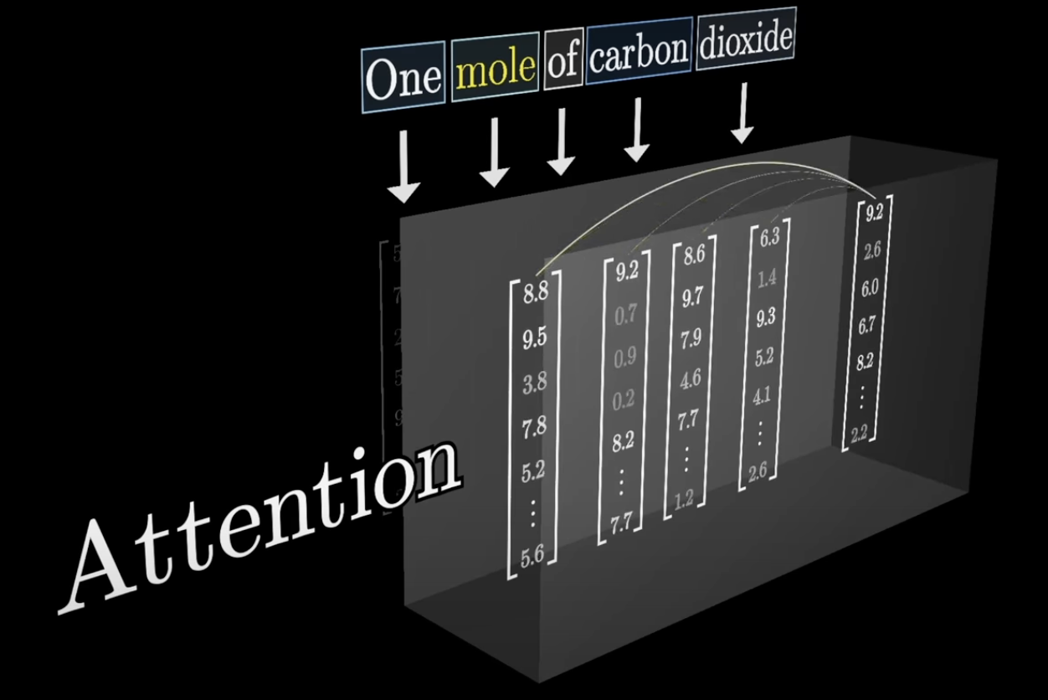
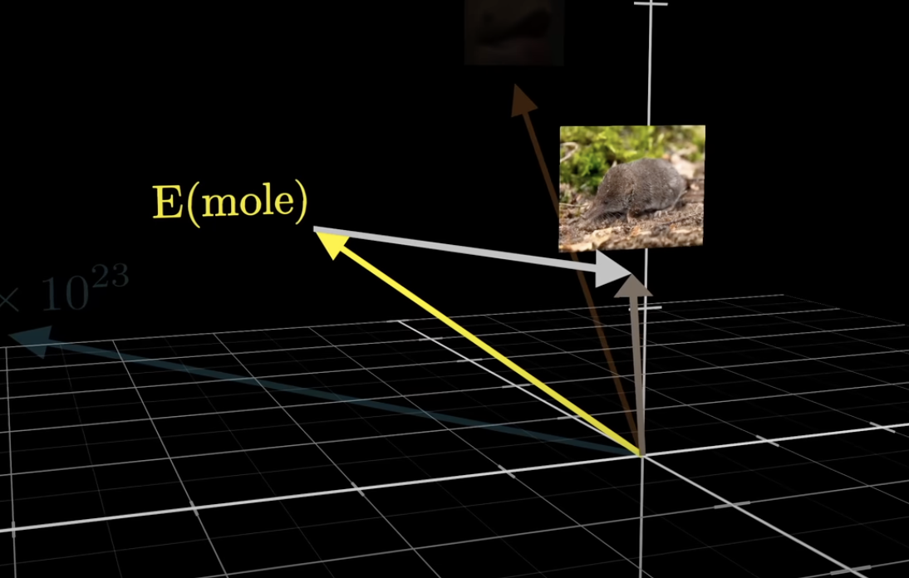
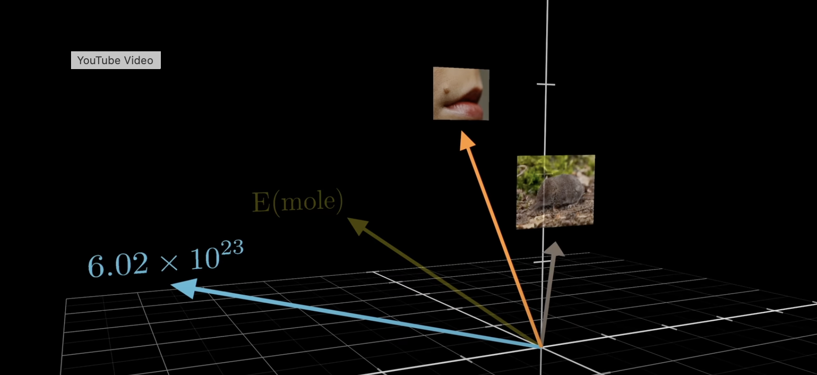
Attention Contextualizes
We start with un-contextualized embeddings for mole. The attention process produces vectors to add to the original mole embedding to contextualize them from their surrounding context.

Slide 28
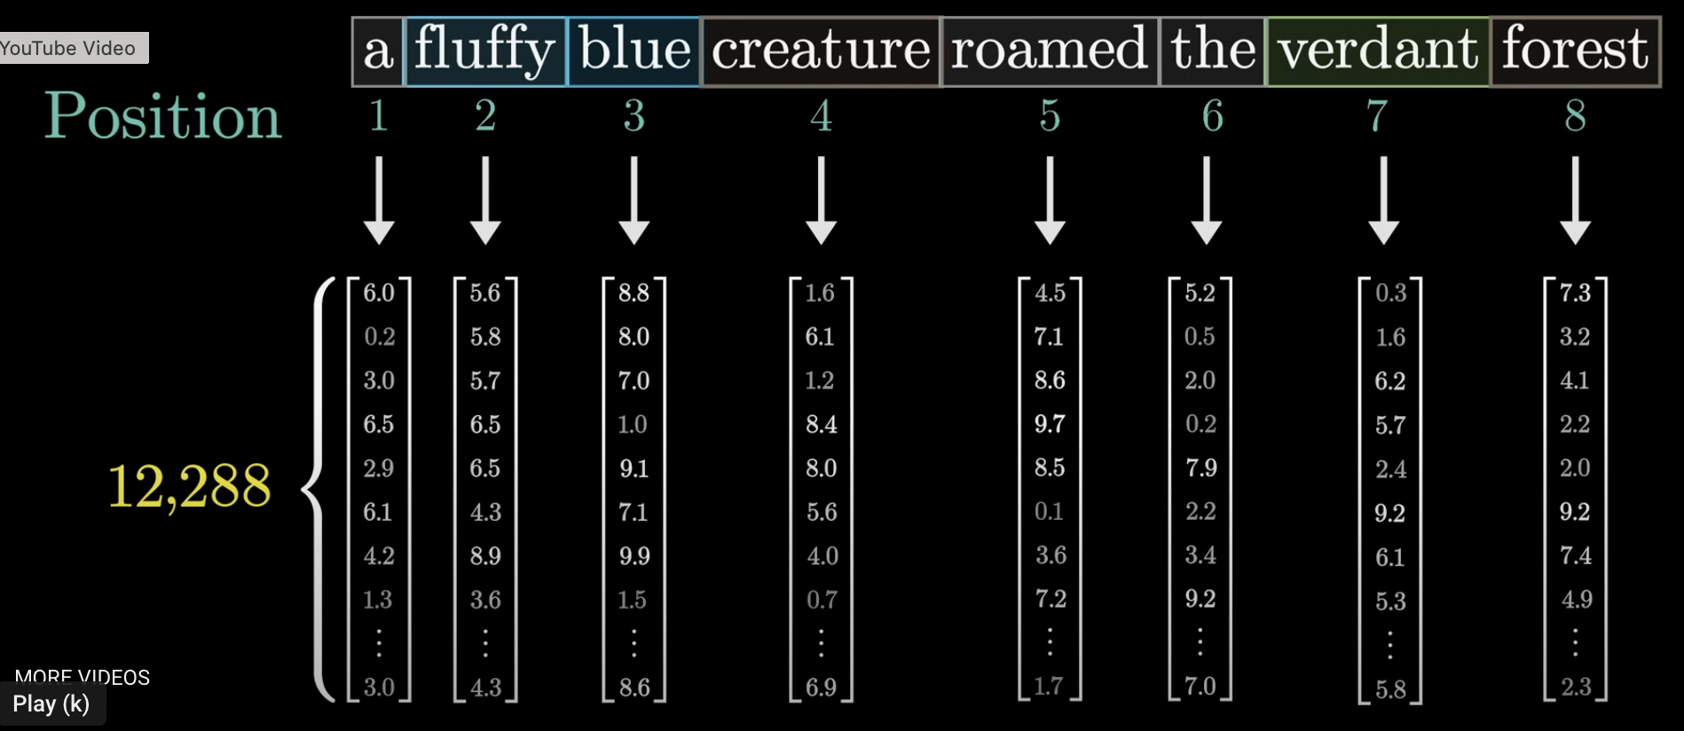
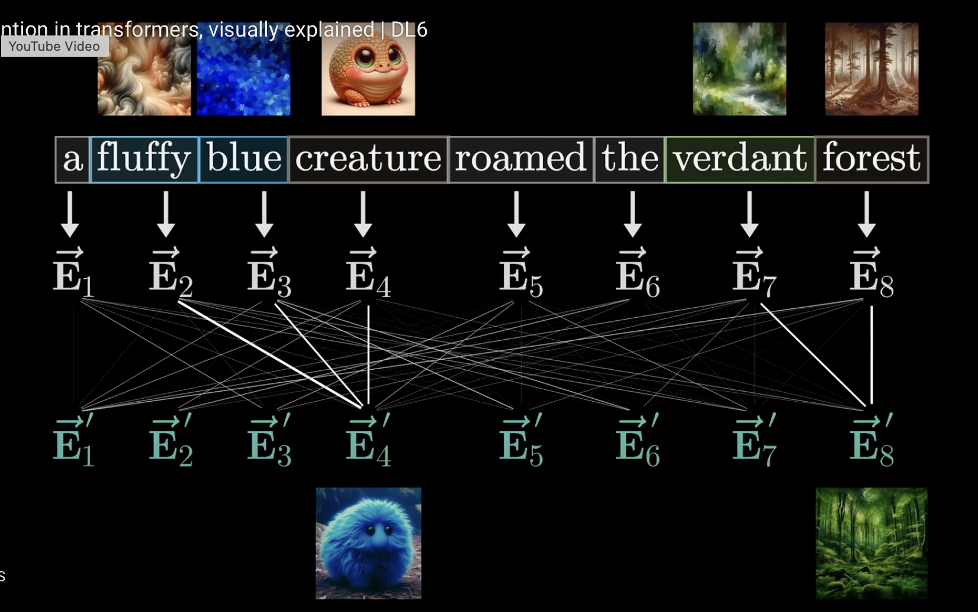
As an example consider the sentence above. You want the adjectives fluffy and blue to impact the word creature, and verdant to impact forest. In the image on the right, these are shown to have strong connections, or high attention values

Slide 29
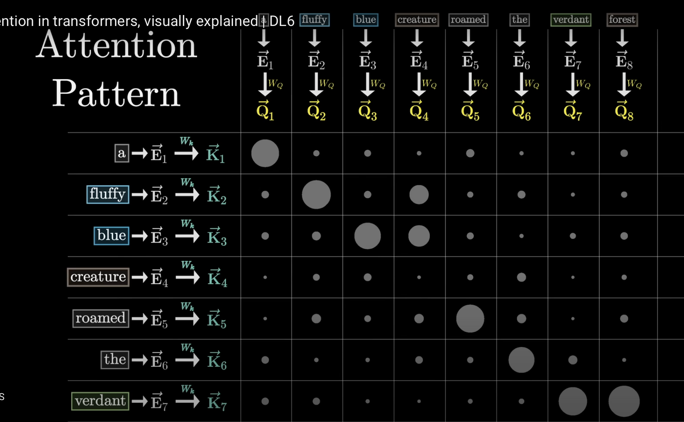
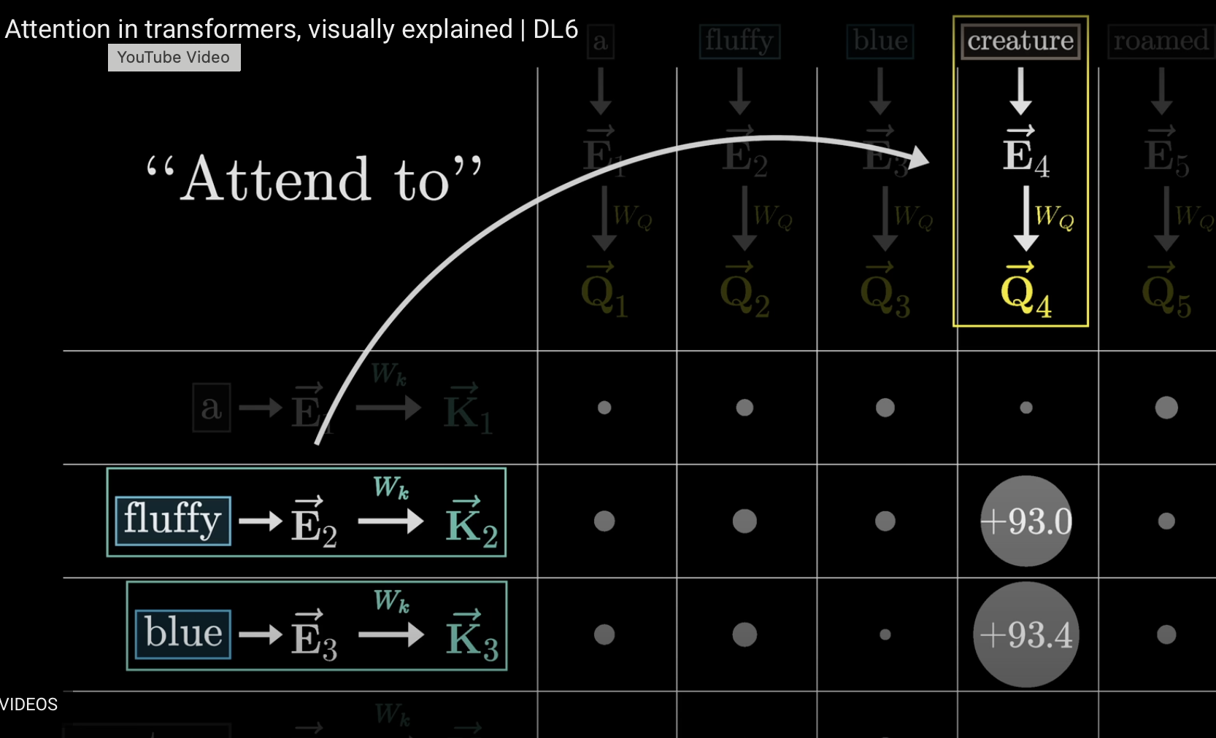
Attention
Dot Product

Slide 30
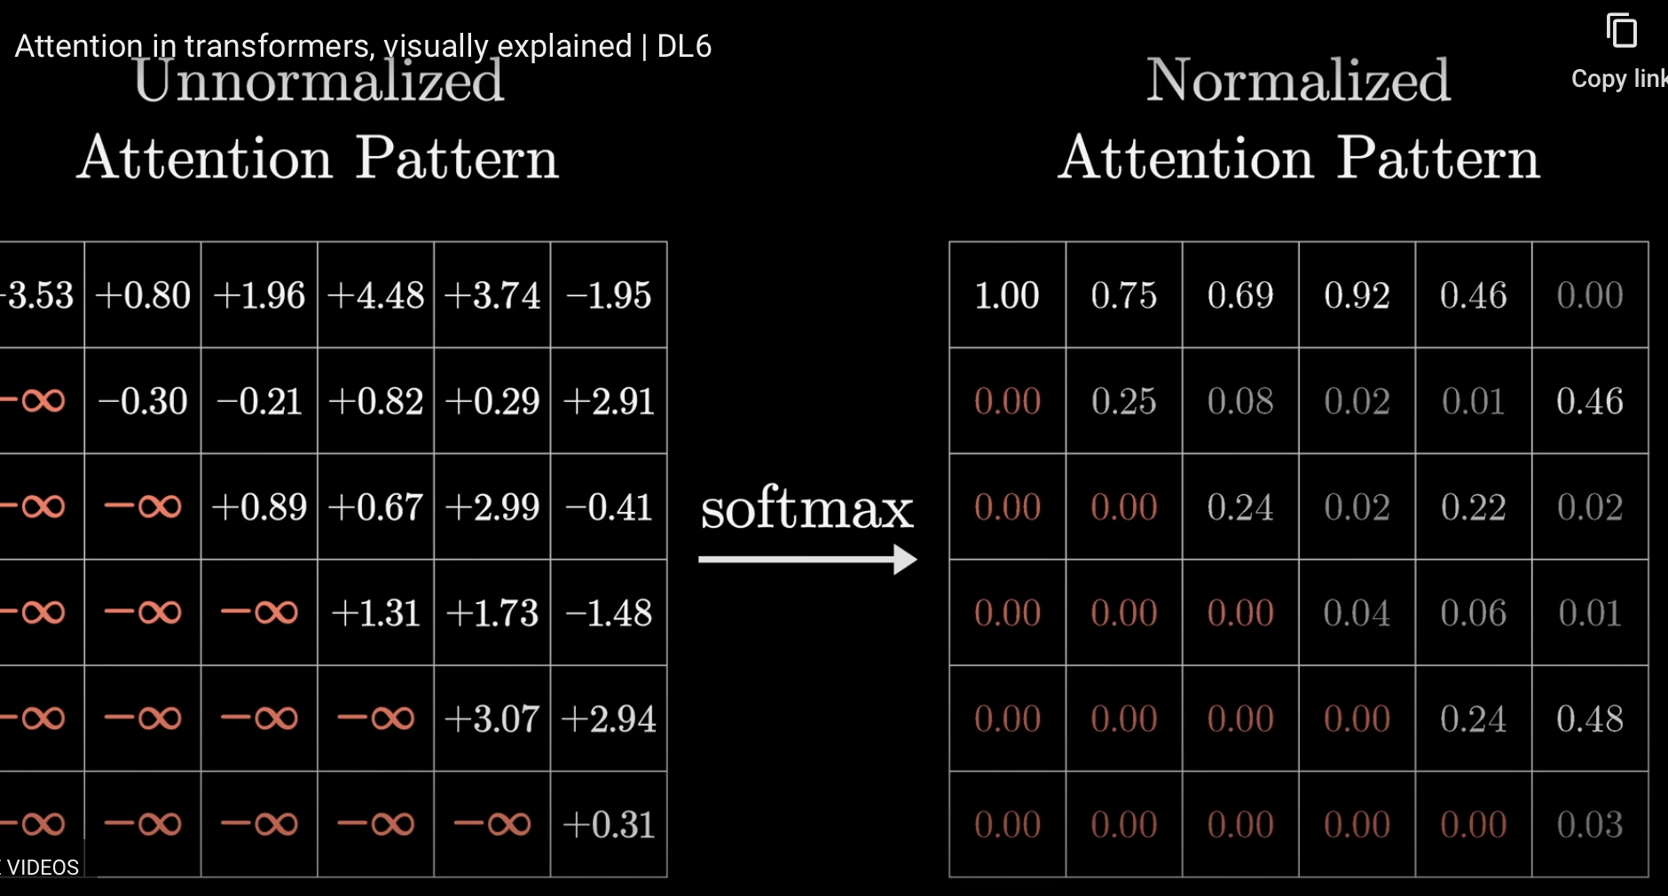
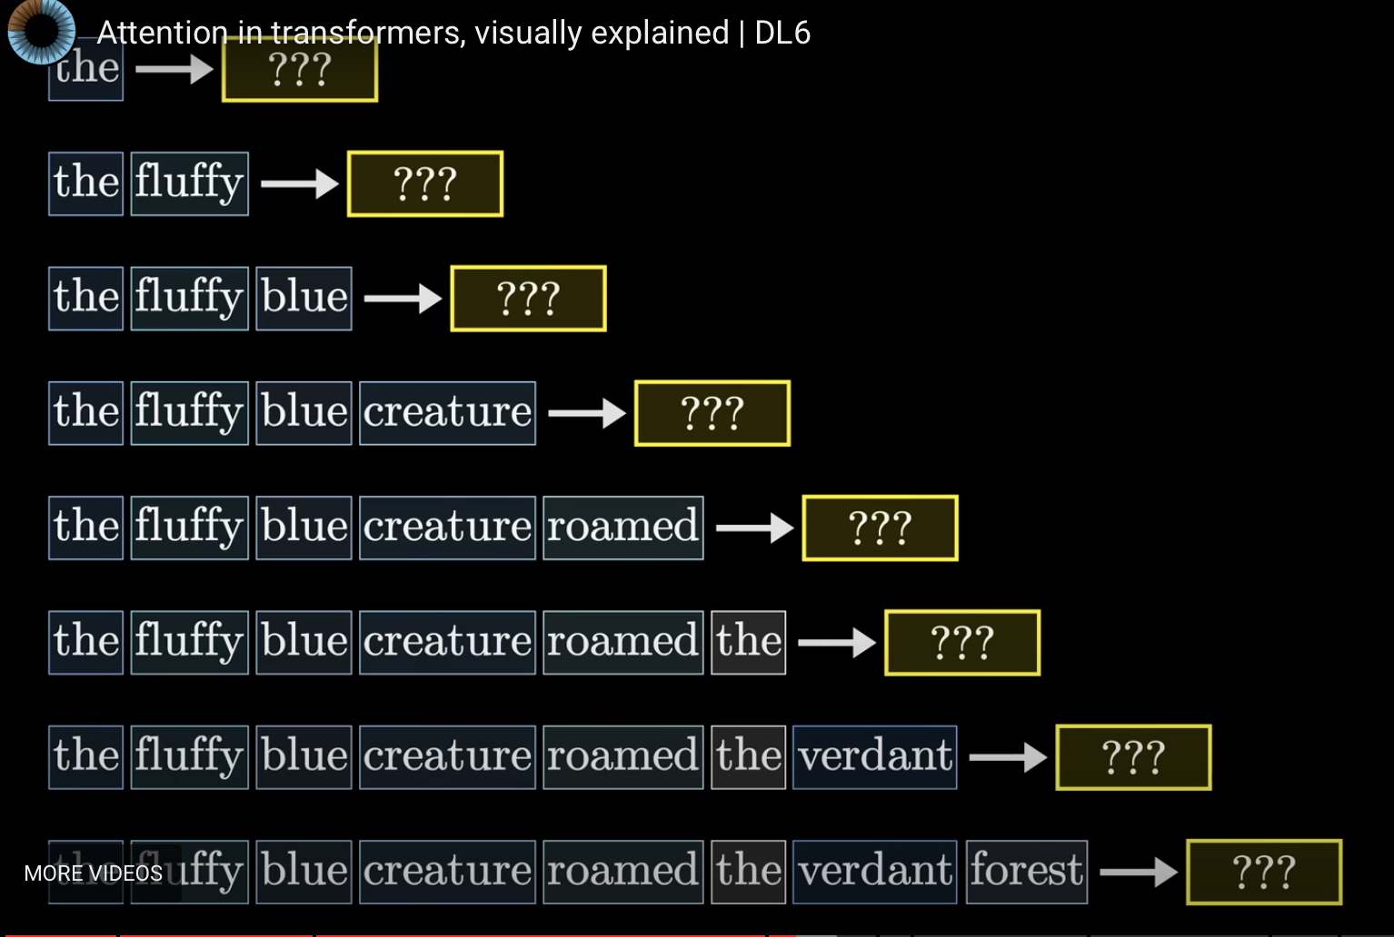
Masking
This is because we do not want future tokens in language to affect the past. So, for example, the only token hat can affect the is the. But creature can be impacted by the, fluffy, and blue. Setting the raw dot-product values to $-∞$ makes sure that on softmax, these go to 0, and the normalization is over the other tokens.

Slide 31
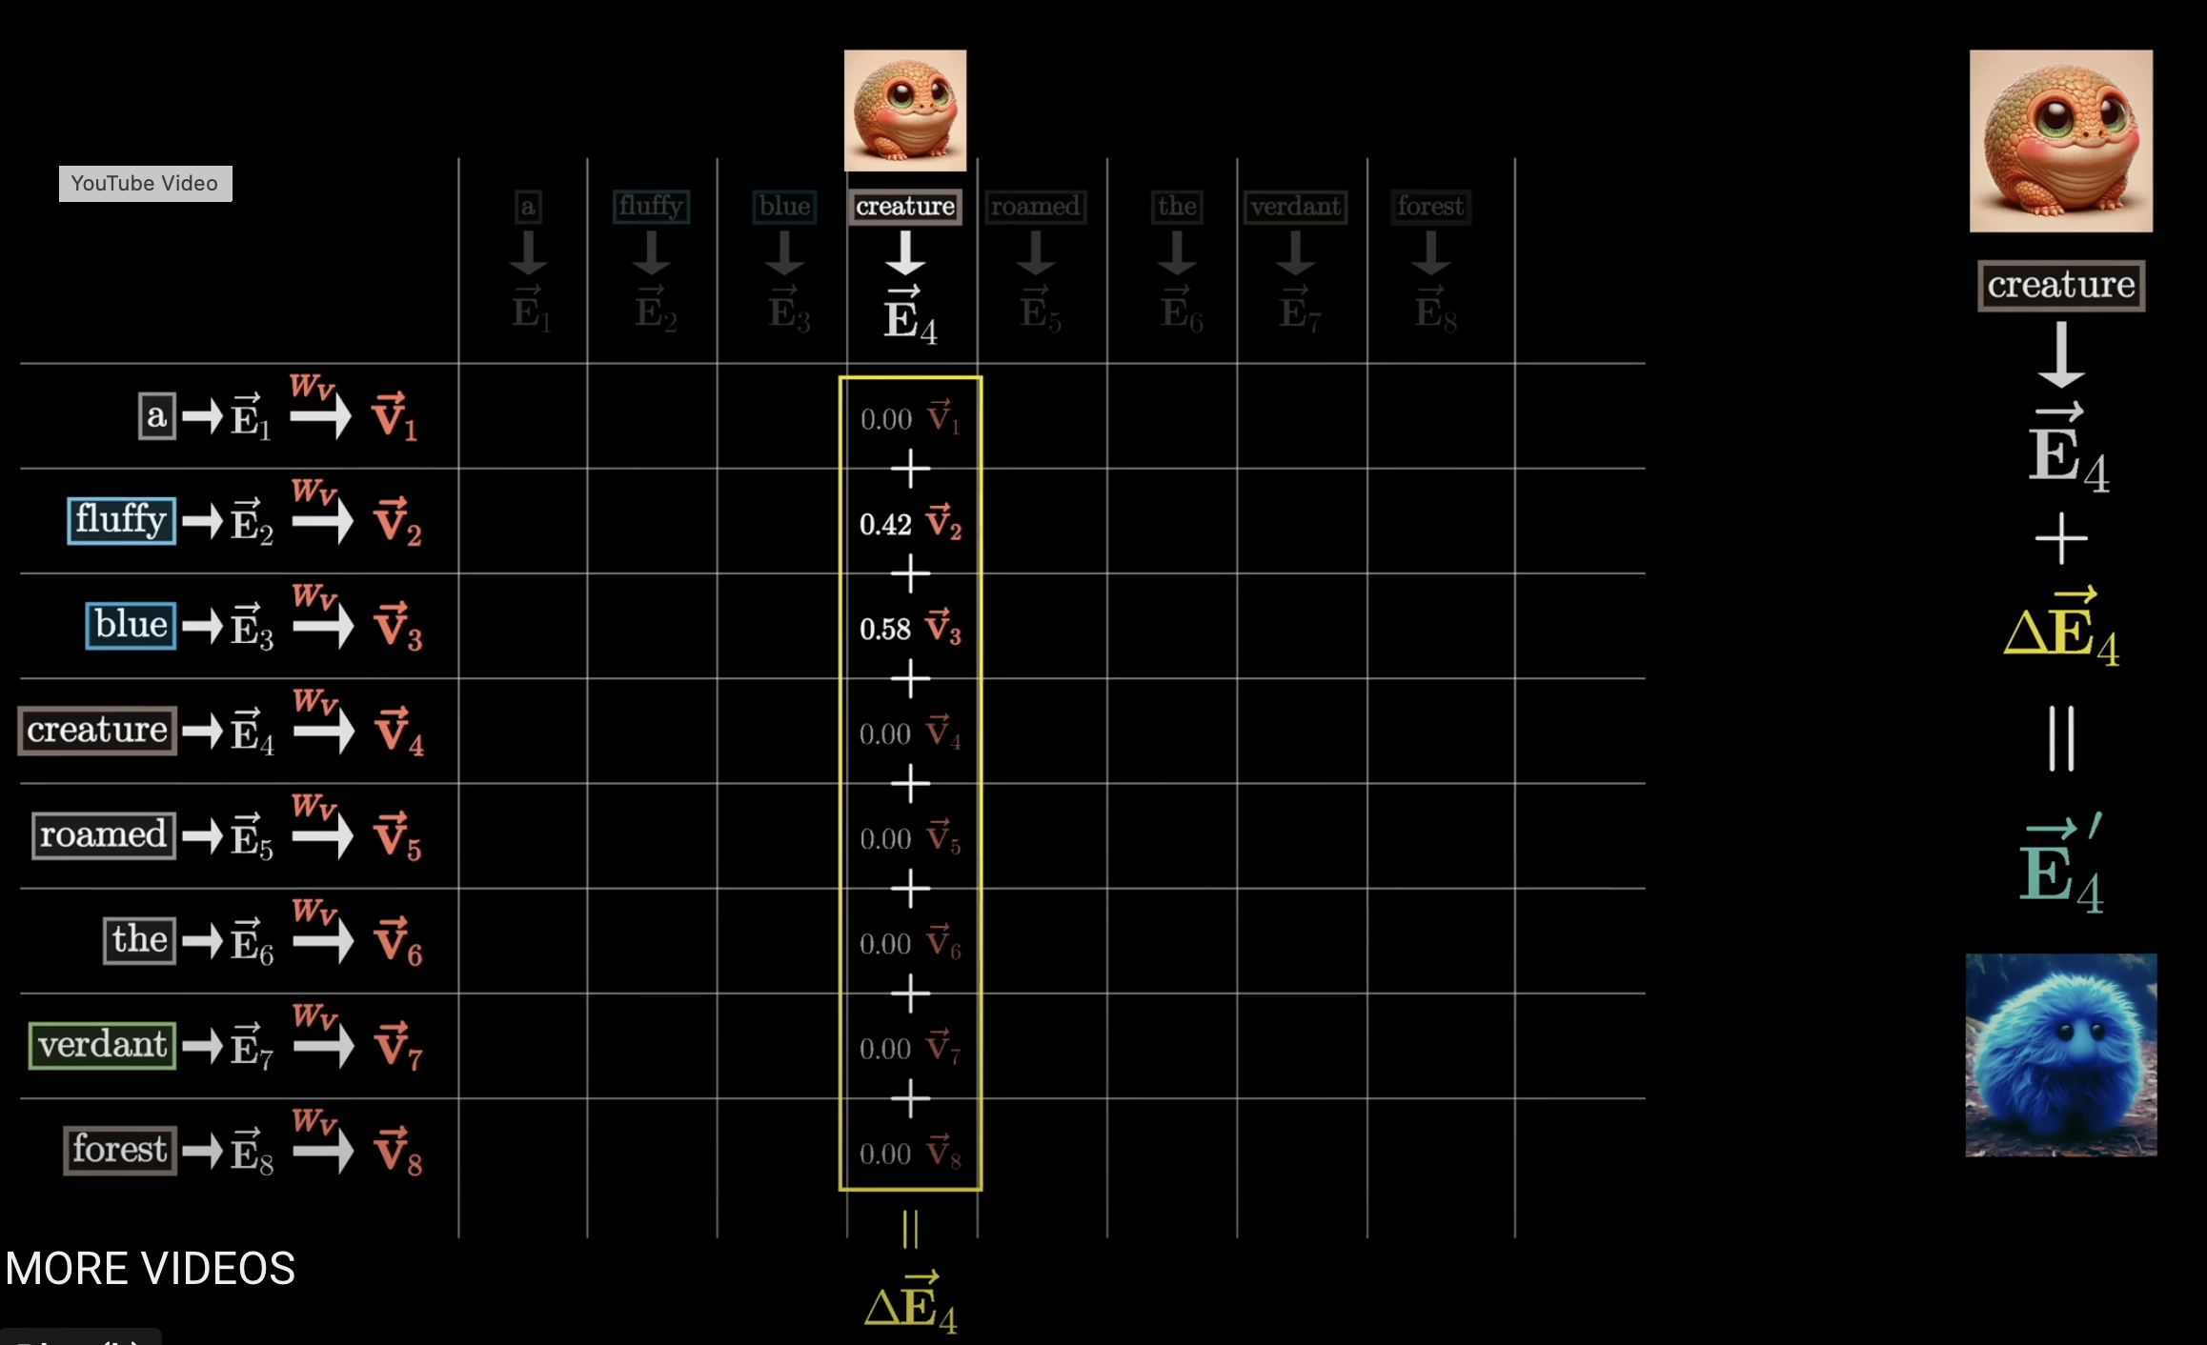
Now we multiply the $V$ for each of the context tokens by its attention based relevance score to combine the information from all the context in proportion to what is more important

Slide 32
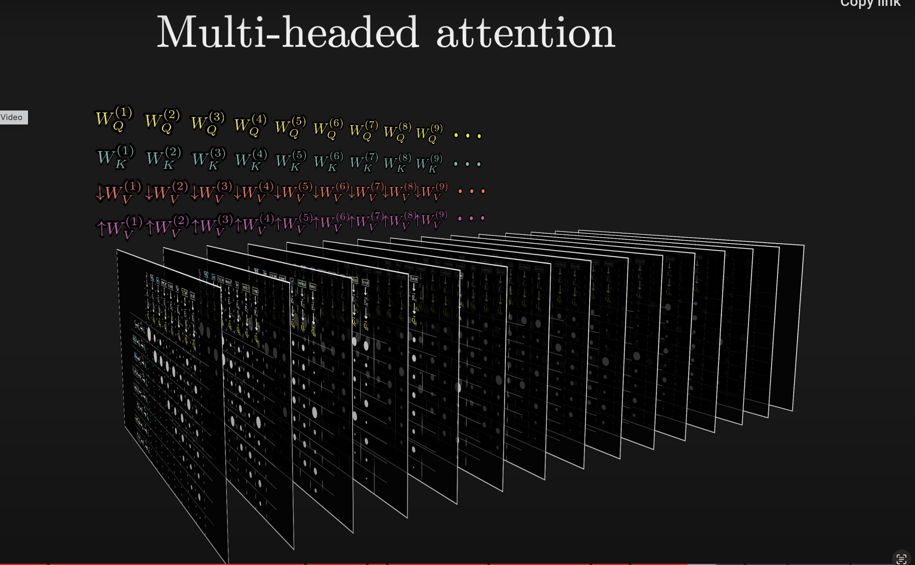

Slide 33
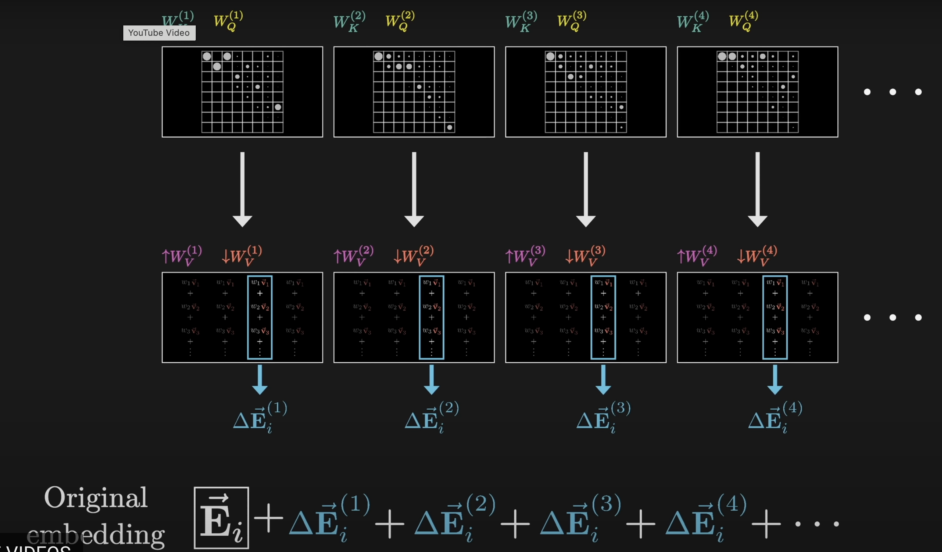
Now, in parallel, we calculate the nudge for each and every token

Slide 34
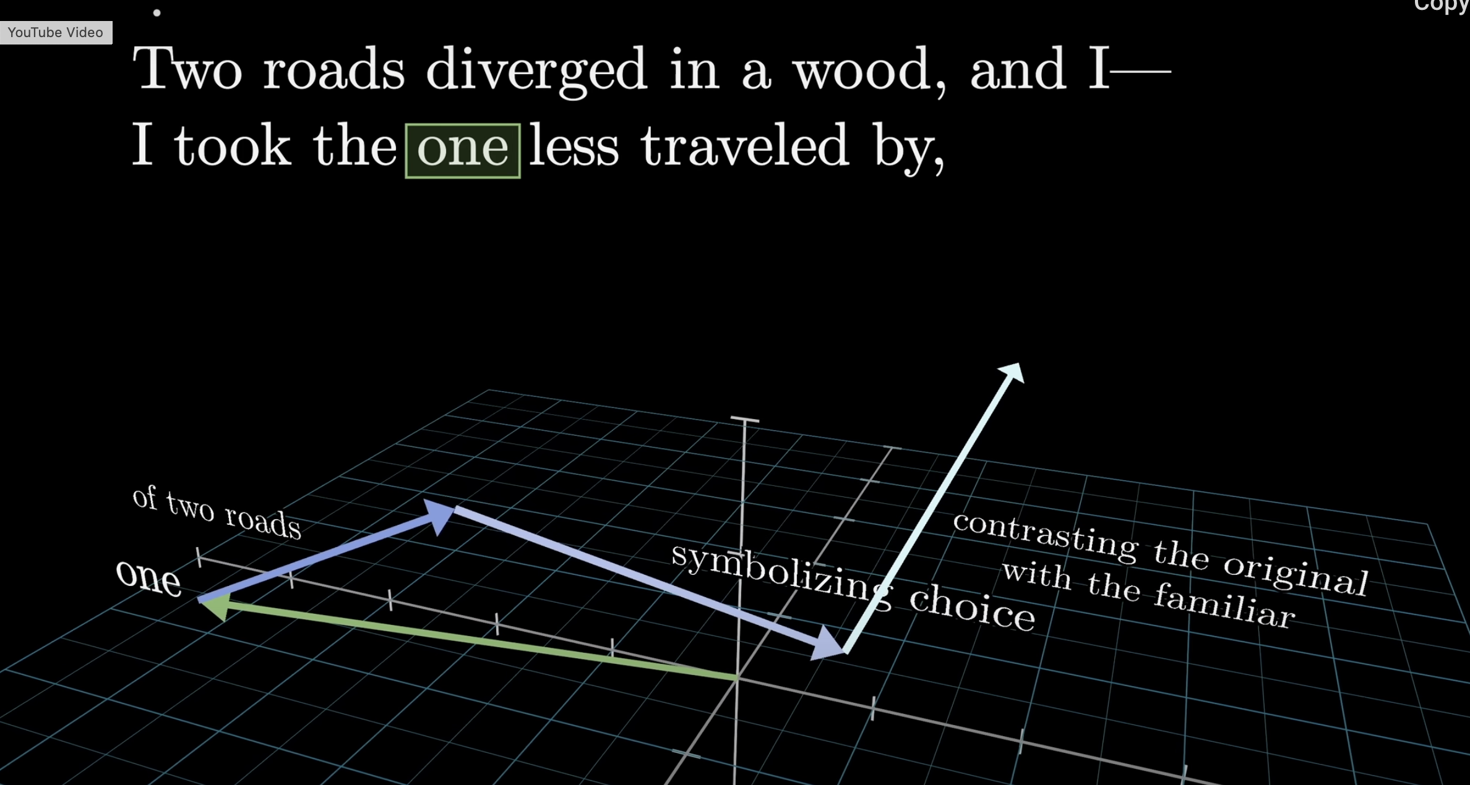
Remember: we are always adding to the original vector to nudge it

Slide 35
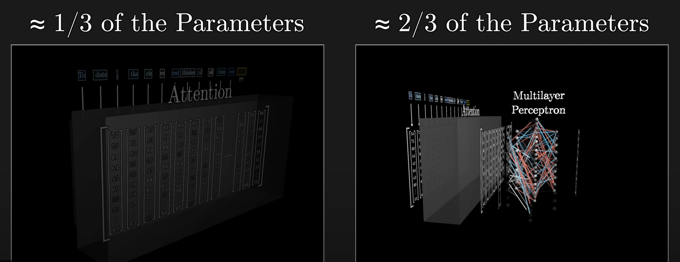
MLP provides the memory
Now that we have the context-nudged token, we want to see what equipping our model with a memory does to that token.

Slide 36
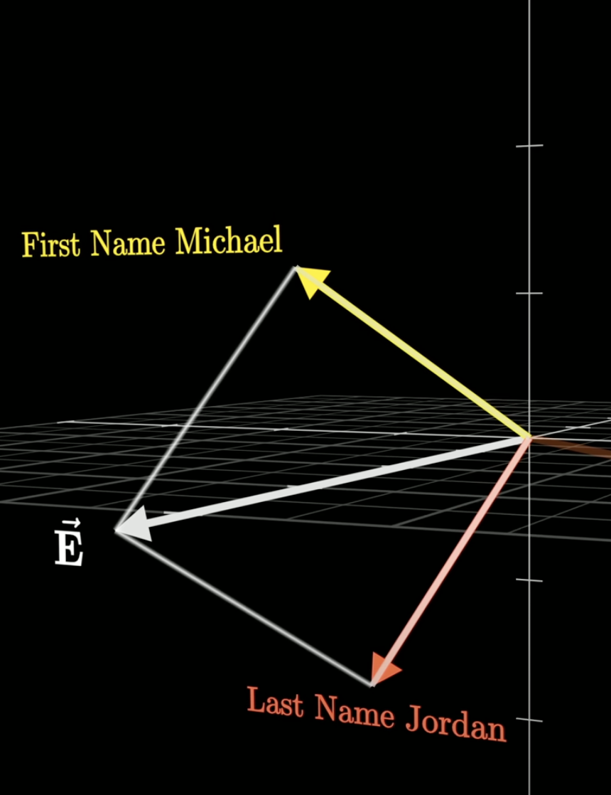
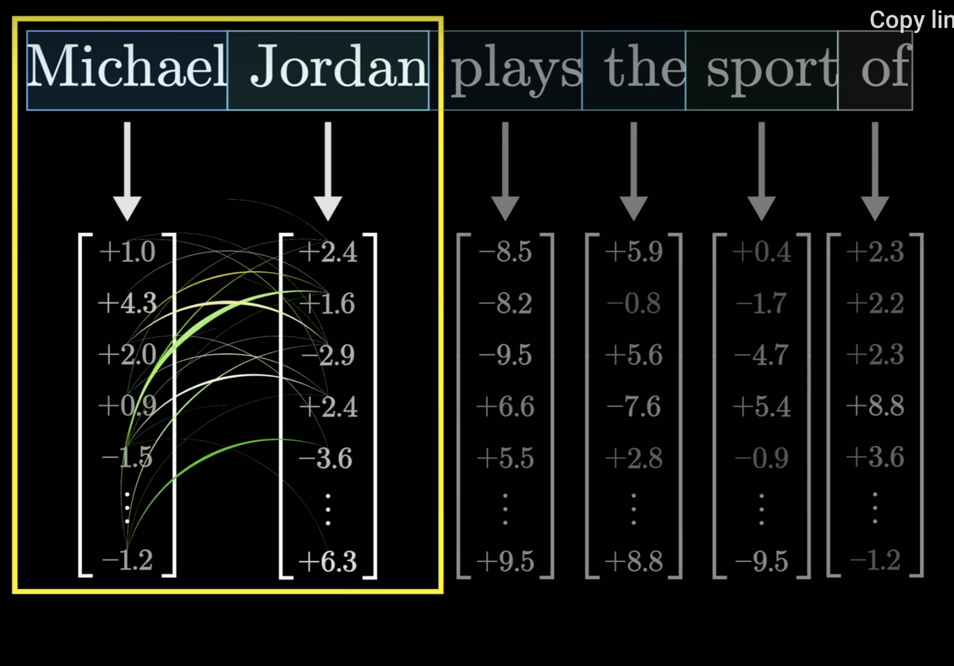
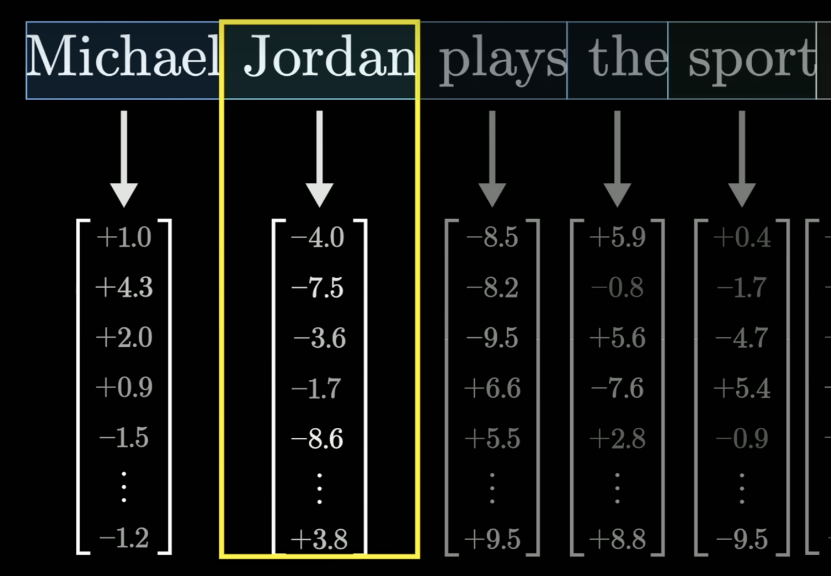
Lets say we want to complete the sentence “Michael Jordan plays the sport of …”. Lets say we went to the attention process, and nudged the embedding of “Jordan”by something that captures the first name “Michael”

Slide 37



Structure of the MLP
Our MLP works in parallel on the attention processed embeddings. We want it to take the “Michael Jordan” associated at token 2 and have that recall the token basketball somehow. We have an up-projection Linear layer, followed by a ReLU, and then a Linear down projection, back to embedding size.

Slide 38



The lookup key comes from the first layer
Imagine the first row of the up-projection matrix codes Michael and Jordan. Then its dot product with the attention-modified embedding at Jordan will be very high. Now we do a ReLU. This will eliminate all negative dot products, thus removing other Michaels and Jordans from consideration. A bias term helps with this. The other rows may encode other concepts in the memory as shown to the right.

Slide 39


So far we have done an up-projection and ReLU as seen to the left. Now we must down-project back to the size of the embedding as shown below. How do we associate “Michael Jordan” with Basketball using this down-projection?

Slide 40


The lookup value comes from the next layer
The trick is to notice that matrix multiplication can also be thought of as a weighted sum of columns.
basketball
Recall that the first entry of the up-projected vector is large because the first column of the up-projection matrix encoded “Michael Jordan”. Thus the first column will have an outsized influence on the finally calculated embedding nudge (its a nudge because we are adding this effect to the attention-processed embedding). If that first column encodes “basketball”, the values from the first column will be preferentially picked out.

Slide 41

The first column may encode more than the basketball notion: it might encode more facts about Michael Jordan

Slide 42

We started with “Jordan” at the second token in the sequence. The attention mechanism added the “Michael” vector onto it. Now the memory mechanism adds the “basketball” on to it, so that the “Jordan” embedding has been nudged into both having Michael picked up via the attention mechanism and basketball picked up via the memory mechanism.

Slide 43

The process of context and memory repeats many times in the transformer, allowing multiple contaxts and memories to be added. This is how gpt like models can seem to be reasoning: they are building in a lot of memory, and the interaction of multiple contexts with this memory seems like they can interpolate between multiple knowledge bases,

Slide 44


What are we trying to do with embeddings?
1. We want information to be picked from the current context: drinking, excesses
ATTENTION
2. We want information to come with a memory: Hamlet, Shakespeare, Claudius
3. We want information to come from multiple contexts.
MLP
MULTIPLE HEADS

Slide 45
Intelligence?
And so, between the attention and MLP layers, a transformer forms a building block that entwines context and memory, and gives us the notion of an intelligent being interpolating between different gobs of memory in the context of the current discussion. This explains why gpt models seem intelligent, and also hints at why they go off the rails with hallucinations at times.

Slide 46



From GPT-2 to GPT-3

Slide 47

The history of language modeling

