Slide 1
Point32Health Agentic AI
Notes:
Open by positioning the deck as an operating-model briefing. The BBVA example comes next as the regulated-enterprise proof point before the Point32Health platform model.

Slide 2
BBVA escaped pilot purgatory by giving AI demand a managed path
[Pre-story: regulated-bank example]
The bank saw that employees were already using AI. The safer move was not to freeze demand; it was to channel it into a secure tool, a fast approval path, and a social adoption system that employees wanted to join.
A big-bank context, not a startup exception
BBVA operated across 25 countries, served more than 77 million clients, employed about 125,000 workers, and worked under heavy regulation. Yet leaders compressed risk, legal, and compliance review into two months to avoid unmanaged shadow AI becoming the default.
Shadow usage was the riskUnmanaged AI already existed, so doing nothing would have left leaders blind to data, usage, and quality. Speed bypassed veto pointsThe team moved before friction could accumulate, with a managed enterprise interface and bank-hosted services. Status pulled adoptionScarce licenses, champions, and use-it-or-lose-it incentives made participation feel valuable rather than mandated. Trust made sharing possiblePrompt privacy, human ownership, quality scoring, and compliance-only access reduced resistance while keeping outputs accountable.
Source: Garicano, Li & Wu, Messy Jobs, ch. 7, "BBVA: escaping pilot purgatory"; user-provided screenshots.
Notes:
Use this as the executive hook: BBVA is useful because it is regulated, complex, and still moved quickly by managing adoption instead of letting local AI experiments harden invisibly.

Slide 3
Managed adoption beats pilot purgatory
[Pre-story: the lesson]
Adoption, governance, peer learning, human ownership, and evidence moved together.
3k->11kActive users scaled from roughly three thousand to eleven thousand. >83%Enterprise users worked with AI tools each week. 4,800Active internal GPTs were created by employees. 99%Auditors across countries became active AI users. 3-4hEstimated weekly time savings per auditor across more than 600 auditors.
For Point32Health, the lesson is: do not make governance a brake. Build the platform that lets safe adoption move quickly while evidence, standards, security, compliance, HITL, and evals are managed once.
Profiles give autonomy a safe contract. Catalog makes adoption and reuse visible. Runtime keeps execution inside controls. Evidence proves what happened and improves the next turn.
How to read it: profile declares intent; catalog makes it visible; runtime executes it; evidence proves and improves it.
Source: Garicano, Li & Wu, Messy Jobs, ch. 7, "BBVA: escaping pilot purgatory"; user-provided screenshots.
Notes:
Transition to the next slide by saying: BBVA is the external proof that a managed platform can increase adoption and control together. The remaining deck translates that pattern into Point32Health's platform model.

Slide 4
Managed rollout creates the evidence base for governed reuse
[Bank adoption + managed path]
BBVA shows why hidden demand needs a trusted path; the managed-adoption lesson is that useful work should happen where evidence, review, and reuse can be attached.
Work happensChats, products, harnesses, batch jobs, and reviews run through durable sessions. Evidence remainsDecisions, prompts, tool calls, approvals, evals, outputs, and lessons stay inspectable. Patterns can graduateGood work can later become profiles, prompts, context packs, eval cases, and capabilities. Reuse stays governedThe catalog makes approved artifacts searchable, permissioned, reusable, and productized.
The goal is not a raw transcript archive. The goal is governed company memory: approved run residue that can become reusable assets without losing security, privacy, or owner control.
Sources: conceptspec.md, catalog.md, agent_harnesses.md, evals.md
Notes:
Use this early slide to connect the bank rollout story to managed adoption and evidence. Save the explicit River-like and AI-native organization point for the end.

Slide 5
The 13-document package is now a decision package
[Current package map]
The planning package has grown from architecture description into a reviewable decision system: target architecture, implementation choices, profile contract, catalog product, security model, eval loop, future-practice stance, and SOW coverage.
Architecture contract
Concept, implementation, profile, catalog, and identity/security documents define what every application must share.
Build sequence
Harness intake and trace capture come first, then trace-fed memory, then the Synthetic Benefits full app proof.
Governance proof
Evidence, evals, release gates, technology choices, future practices, and SOW traceability show how the package will be reviewed.
Sources: readmefirst.md, Deliverables.md, sow_crosscut_traceability.md
Notes:
Use this as the update since the older deck: this is no longer only a concept deck. It is the executive map for a 13-source package with decisions, build sequence, and proof obligations.

Slide 6
Build the intake spine before the first full application proof
[Updated build sequence]
The first platform proof is not the Synthetic Benefits application. The first proof is that approved agent work can be captured, reviewed in richer surfaces than chat, archived, normalized, evidenced, and turned into governed memory without broad credentials or PHI exposure.
Thin intake spineProject, run, raw trace, canonical trace, evidence, agent-client, and instrumentation records. Managed harness captureCodex and Claude Code-style sessions copied into raw evidence, review surfaces, and normalized traces. Review and memory seedSpecs, outputs, HTML artifacts, feedback, summaries, cache records, context-pack candidates, and simple indexes. Synthetic Benefits MVPFirst full application proof using synthetic data, profile binding, broker, resolver, HITL, evals, and evidence. Pilots and AI-native scaleDAIS, payer pilots, shared capabilities, and tenant-scoped organizational memory.
This distinction matters: intake proves managed adoption; Synthetic Benefits proves the full application loop.
Sources: readmefirst.md, implspec.md roadmap, agent_harnesses.md, evals.md

Slide 7
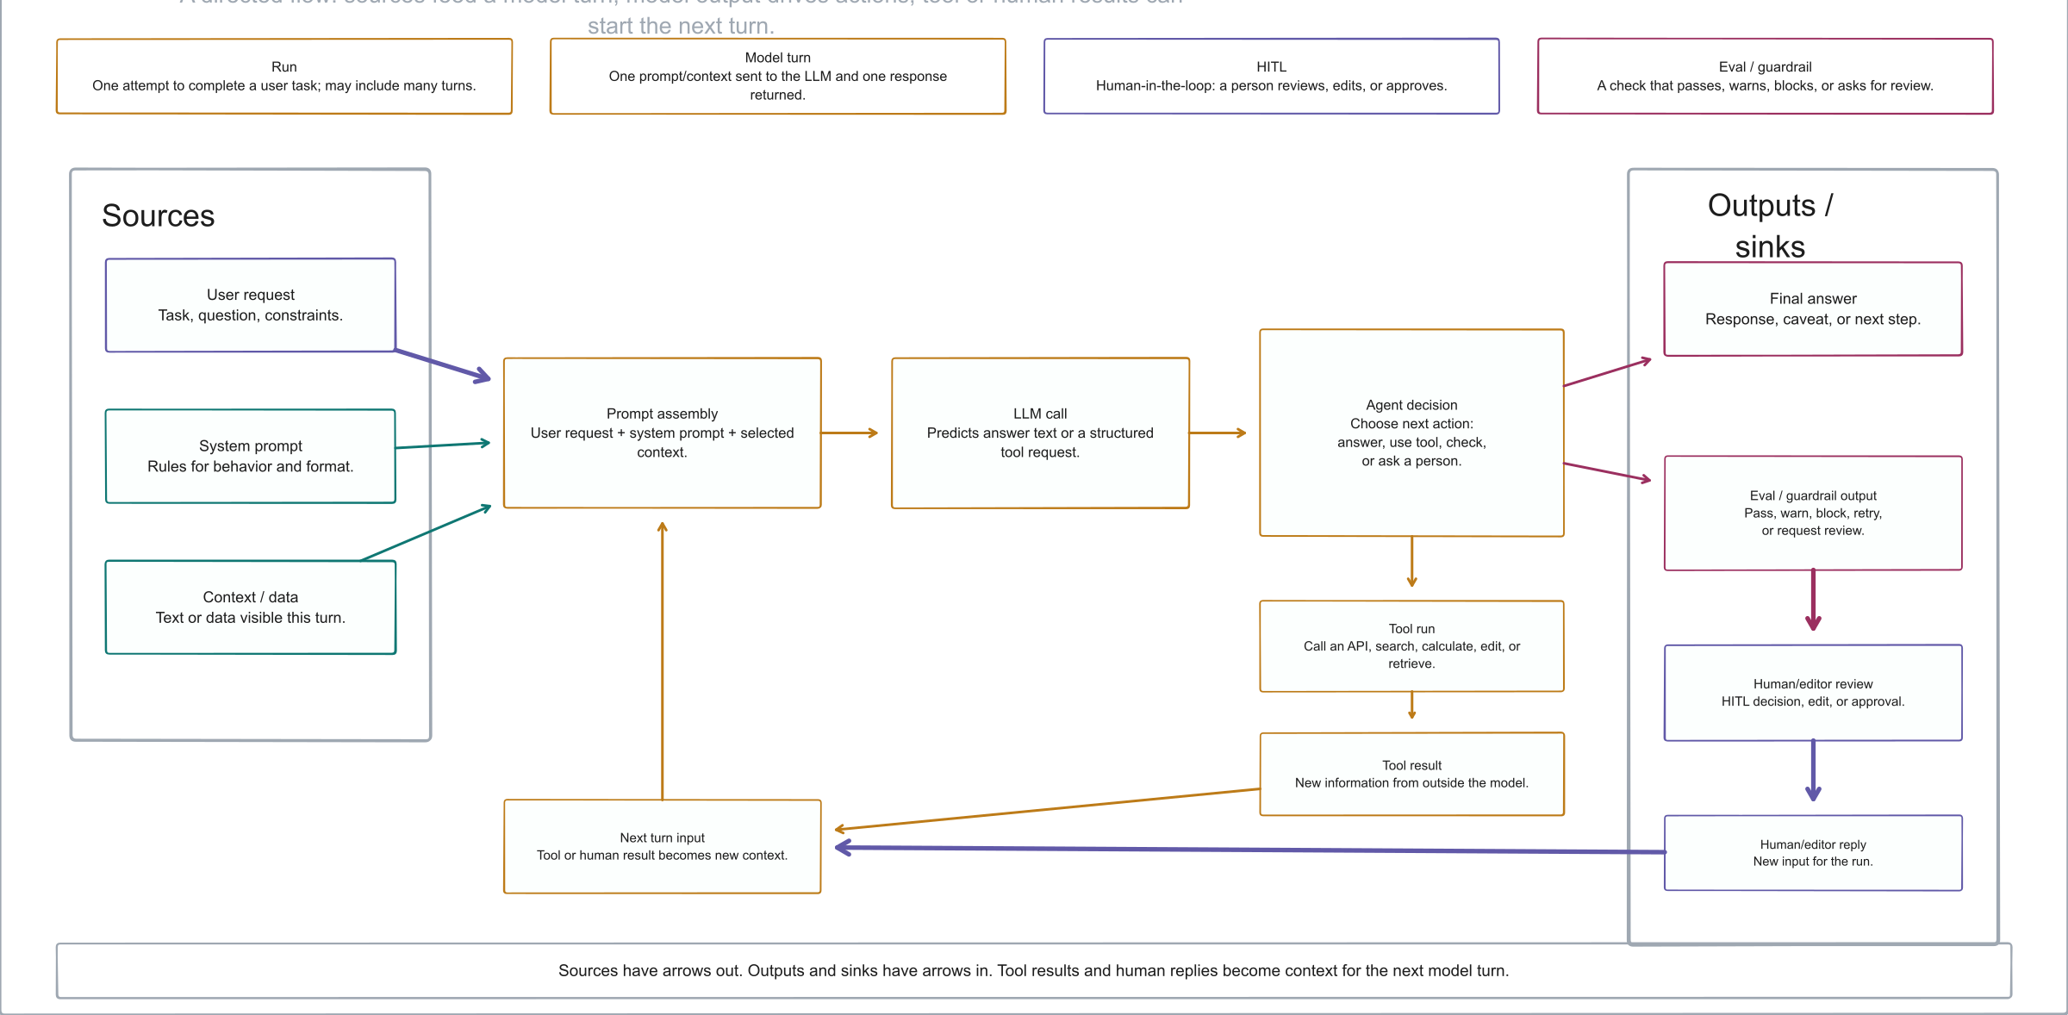
How An LLM Agent Run Works
Diagram explaining sources, model turns, tool runs, evals, human review, and evidence outputs in an LLM agent run
Notes:
Use this as the vocabulary primer before introducing the Point32Health platform model. The diagram intentionally keeps the terms generic: source, model turn, tool result, human-in-the-loop, eval or guardrail, and final answer.

Slide 8
Point32Health Needs A Platform
[Managed platform rationale]
Because agentic AI only scales when evidence, reuse, cooperation, security, compliance, HITL, evals, user simplicity, and standards are managed once for every team.
1Uniform StandardsOne operating contract across the enterprise. 2Evidence TracesDurable records for runs, approvals, evals, and outcomes. 3Reuse And CooperationShared capabilities and workflows compound across teams. 4Security And ComplianceRun-scoped access, PHI controls, signoff, and release gates. 5HITL And Easy EvalsHuman review and quality checks become shared services. 6User Simplicity And Future ReadinessUsers get protection while the platform absorbs technical change.
Sources: securityspec.md, future_practices.md, catalog.md
Notes:
Use this slide as the map for the deck: the case is that managed platform behavior keeps agentic work governable, reusable, secure, and understandable across the enterprise.

Slide 9
Uniform Standards

Slide 10
A governed enterprise platform for agentic AI work
[Point32Health agentic architecture]
The project is building the operating model and technical substrate for many agentic applications: visible, reusable, secure, auditable, and ready to move from prototype to controlled production.
ProfilesDeclare purpose, owners, authority, data, tools, evidence, evals, release stage. CatalogShows complete portfolio, governance, risk, evidence, and operational state. RuntimeExecutes profile-bound runs through brokered access and shared services. EvidenceRecords what happened so work can be audited, evaluated, optimized, and reused.
How to read it: profile declares intent; catalog makes it visible; runtime executes it; evidence proves and improves it.
Sources: conceptspec.md, catalog.md, implspec.md
Notes:
Open by making clear this is an internal enterprise platform initiative, not a vendor pitch or a single-app demo.

Slide 11
Agentic work will span the company; each team should not rebuild the control stack
[Enterprise need]
Local bots create blind spots
Executives and governance teams cannot see the full inventory, maturity, risk, cost, quality, and release posture.
Controls get reimplemented
Identity, data access, evidence, evals, approvals, prompt controls, and incident handling become inconsistent by app.
Learning fails to compound
Useful tools, retrievers, prompts, approval patterns, and evidence services mature locally but do not become reusable assets.
Notes:
The message is not that local experimentation is bad. It is that enterprise scaling requires a common substrate before local experiments become production systems.

Slide 12
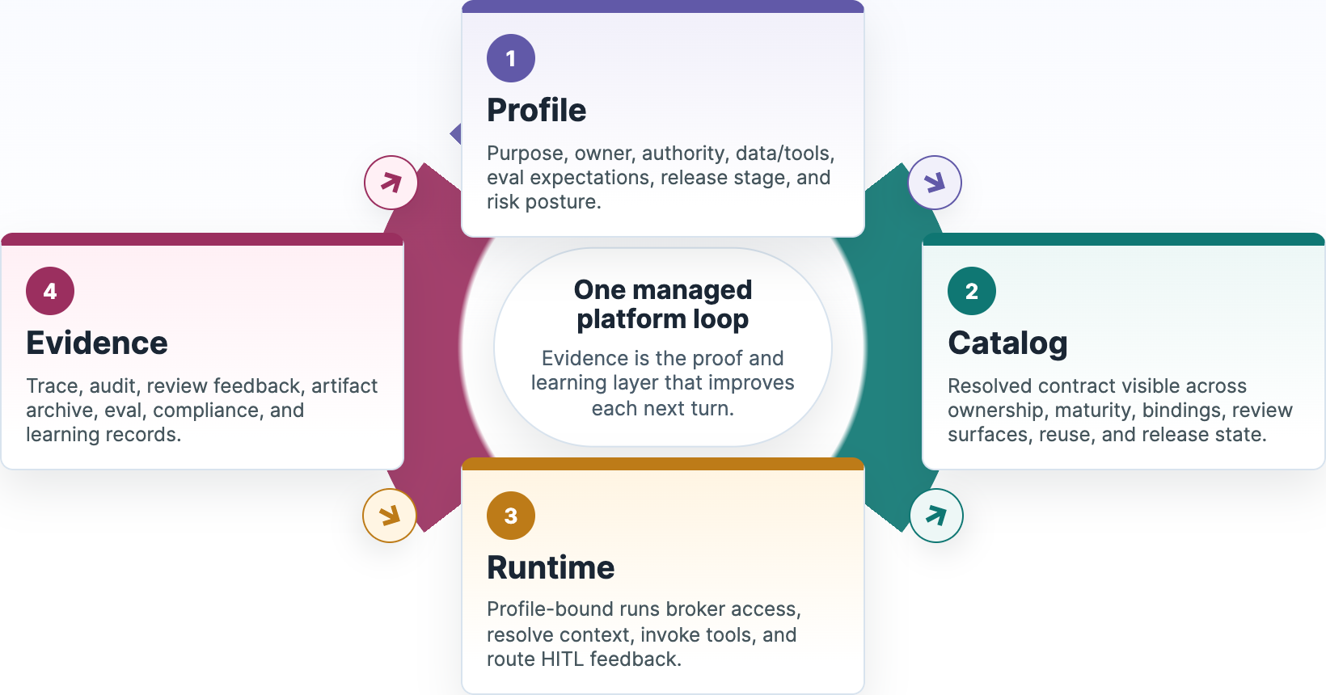
Profiles define the intent, catalog makes it shared, runtime enforces it, and evidence proves and improves it
[Operating model]
One managed platform loopEvidence is the proof and learning layer that improves each next turn. 1ProfilePurpose, owner, authority, data/tools, eval expectations, release stage, and risk posture. 2CatalogResolved contract visible across ownership, maturity, bindings, review surfaces, reuse, and release state. 3RuntimeProfile-bound runs broker access, resolve context, invoke tools, and route HITL feedback. 4EvidenceTrace, audit, review feedback, artifact archive, eval, compliance, and learning records. declare→ publish controls→ write proof→ learn and gate→
### Why this matters
Business teams get speed without bypassing controls. Security and compliance get proof, not promises. Platform teams get reusable learning instead of one-off app telemetry.
Profile makes the promise explicit. Catalog makes the promise shared. Runtime makes the promise enforceable. Evidence makes the promise auditable and improvable.
Profile, catalog, runtime, and evidence cycle showing how intent becomes shared, enforced, and evidenced

Slide 13
A profile turns governance from prose into a reviewable application contract
[Profile contract]
metadata:
name: synthetic_benefits_navigator_app
lifecycle_status: prototype
inheritance:
parent: enterprise_healthcare_agent_base
surfaces:
allowed_surface_types: [react_app, api, cli, teams, hitl_console]
authority:
default_level: L1_DRAFT
prohibited_actions:
- use_real_phi
- perform_real_writeback
data:
data_classification: internal
access:
access_broker_required: true
ambient_credentials_allowed: false
evidence:
bundle_required: true
evals:
release_gate_required: true
Application teams declare what is specific. The enterprise base profile supplies inherited controls for authority, access, sandboxing, evidence, evals, observability, release, and compliance.
Maturity path prototypeshadowassistivesupervised
Governance review can happen before deployment because the contract exists before the run.

Slide 14
Executives review profile decisions, not schema fields
[Profile review]
The YAML example matters because it turns abstract governance into visible decisions. The executive question is not “what is every field?” It is whether the declared contract is acceptable for the business, data, authority, and release stage.
Can this app exist?
Owner, business purpose, users, surface, value hypothesis, maturity stage, and unresolved risks.
Can it touch this data or tool?
Allowed data class, logical source names, access mode, broker requirement, tool risk, sandbox boundary.
Can it advance?
Required evidence events, human approvals, eval suites, release gates, monitoring, rollback, and signoff.
The base profile carries enterprise defaults. A child profile should make exceptions and application-specific choices obvious enough to approve, reject, or send back.
Source: profilespec.md catalog mapping and Synthetic Benefits overlay

Slide 15
Profiles make the control contract inspectable before an agent runs
[Profile examples]
Each child profile inherits enterprise defaults, then declares the few facts that change risk: surface, authority, data class, approval triggers, writeback posture, and catalog URLs.
Benefits explanationDraft-only call-center assist name: benefits_explanation_app surface: call_center_console authority: L1_DRAFT data: phi_pii source: datasource://point32health/benefits/prod/plan_documents approval: formal_determination
Provider directory integrityBatch audit with review gates name: provider_directory_integrity_app surface: ops_dashboard, batch authority: L2_RECOMMEND data: confidential source: datasource://point32health/providers/prod/directory gate: provider_removal
Medical necessity reviewReviewer assist, human decision name: medical_necessity_review_app surface: reviewer_workbench authority: L2_RECOMMEND data: highly_restricted sandbox: deny_by_default approval: adverse_determination
Claims exception resolutionPended-claim recommendation name: claims_exception_resolution_app surface: claims_workbench authority: L2_RECOMMEND data: highly_restricted writeback: approval_required gate: payment_or_denial_change
The profile names logical resources and policies; catalog binding records decide which concrete source, tool, model, prompt, index, or route is approved for the environment and release.
Source: profiles.md application-profile examples

Slide 16
Business purpose, runtime shape, data bindings, and release evidence
[Profiles carry multi-purpose information]
Here is the Synthetic Benefits profile. It is useful because it is safe, synthetic, and still exercises the real control contract leaders will review for production applications.
Purpose and authorityWhat the app may and may not do metadata: name: synthetic_benefits_navigator_app display_name: Synthetic Benefits Navigator inheritance: parent: enterprise_healthcare_agent_base authority: default_level: L1_DRAFT allowed_actions: [retrieve_context, call_tools, draft_response] prohibited_actions: [use_real_phi, perform_real_writeback]
Runtime compositionLead agent plus reusable candidates composition: component_policy: single_lead_agent components: - synthetic_benefits_domain_agent - synthetic_plan_document_retriever - synthetic_eligibility_lookup - synthetic_accumulator_lookup - evidence_bundle_writer - approval_router
Catalog-addressed dataLogical URLs, not hidden source paths data: data_classification: internal logical_reference_required: true sources: - logical_id: datasource://point32health/synthetic/dev/plan_documents access_mode: retrieval - logical_id: datasource://point32health/synthetic/dev/eligibility access_mode: database_readonly context_resources: - index://point32health/synthetic/dev/plan_documents/fulltext?at=build:1
Review, evidence, and gatesHow the run becomes auditable human_in_loop: reviewer_roles: [demo_reviewer, benefits_sme] escalation_triggers: [missing_plan_document, low_confidence] evidence: bundle_required: true required_events: [run_created, access_decision, retrieval, tool_call, approval, eval_result] evals: release_gate_required: true implementation_bindings: prompt_registry_refs: [prompts/synthetic_benefits/domain_agent/v0.1]
This is why a profile is more than metadata: it binds intent, allowed behavior, catalog resources, review gates, evidence, and release readiness into one inspectable contract.
Source: profilespec.md Synthetic Benefits overlay and resolved value view

Slide 17
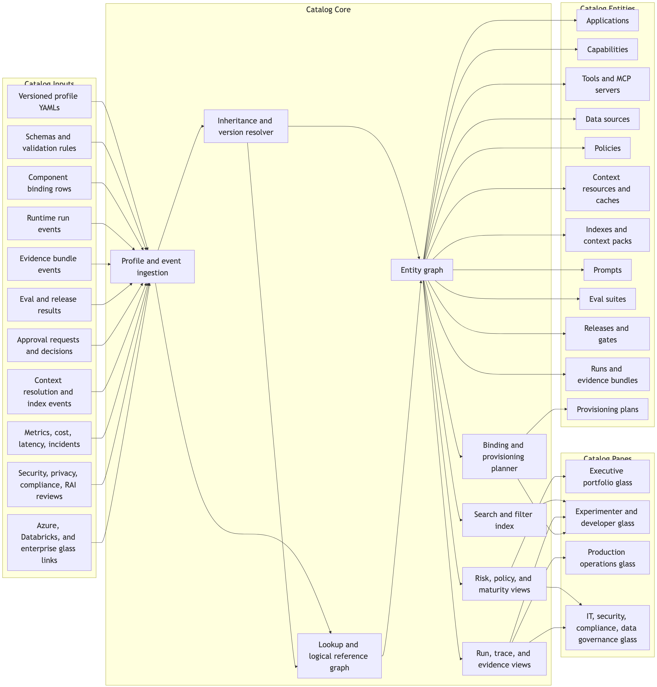
The catalog is the control product for agentic AI work
[Complete visibility]
### It answers the questions leaders, compliance, IT, and developers need
What exists? Who owns it? Which workflows does it touch? Which data, tools, models, prompts, and capabilities are used? What did it do? What risks remain? Is it safe to advance?
The catalog is both a portfolio lens and an operating control surface.
Current figure from conceptspec.pdf / conceptspec.md
Catalog core diagram

Slide 18
The catalog is operational, but it does not become a shadow admin portal
Action | What the catalog shows | How change happens
Provision or bind | Selected binding, rejected options, risks, approvals, external glass links | Preview, approval, queued provisioning worker, Azure or Databricks driver
Access posture | Identity, policy, data class, TTL stance, access-decision evidence | Access/Credential Broker and provider IAM drivers
Context refresh | Snapshot, index build, freshness, lineage, retrieval evidence | Context Resolver plus materialization and indexing workers
Release gate | Eval results, human approvals, exceptions, rollback target | Eval/release control API and release workflow
Additional context | The catalog records intent, decisions, evidence, and job state. It should not bypass the owning runtime, broker, context, evidence, provisioning, or provider systems. Source: catalog.md Glass Read/Write Model
[Operational glass]
The catalog should let leaders and teams see posture and request change, but every material action still goes through the owning service, approval workflow, queued job, policy API, or provider driver.

Slide 19
Catalog URLs are where controls attach
[Catalog URL format]
The same pattern names applications, agents, data sources, prompts, tools, evals, releases, runs, review surfaces, archived artifacts, and evidence trails. Applications use these handles; the catalog attaches the policy facts.
[Dev examples]
app://point32health/member/dev/benefits_explanation
capability://point32health/benefits/dev/domain_agent
datasource://point32health/synthetic/dev/plan_documents
prompt://point32health/benefits/dev/domain_agent/default?at=stage:draft
eval://point32health/benefits/dev/smoke/v1
review://point32health/benefits/dev/run_abc123/spec-review
[Prod examples]
app://point32health/member/prod/benefits_explanation
datasource://point32health/benefits/prod/plan_documents?at=snapshot:2026-06-01
prompt://point32health/benefits/prod/domain_agent/default?at=stage:approved
release://point32health/benefits/prod/benefits_explanation/2026_06
trace://point32health/benefits/prod/run_abc123/evidence
artifact://point32health/benefits/prod/run_abc123/html/verification-site
URL handle
Stable catalog object the application can pass.
Time-bound permission
Who can use it, for what purpose, scope, and duration.
Runtime binding
Which source, route, index, model, or tool endpoint is approved.
Evidence gate
Eval, review, archive, approval, release, rollback, and recording requirements.
Broker rule: compose the grants needed for the run, then narrow each one by every attached constraint: app/profile, agent, datasource, prompt, tool, eval, release, purpose, scope, expiry, and approval state.
Sources: catalog.md Universal Logical References, securityspec.md Access Envelope
Notes:
The key point is that the catalog URL is the stable attachment point. Permissions are not broad app-level permission blobs; the broker composes required grants and every relevant catalog object can narrow or deny the run.

Slide 20
Runtime turns intent into governed execution
[Runtime plane]
Executives do not need container details, but they do need to know what every run recomputes: access, approved context, model/tool use, human review, and evidence.
Resolve profileConfirm owner, purpose, authority, release state, and allowed surfaces. Compute accessBroker builds required grants, then narrows them by scope, expiry, approval, and policy. Resolve contextTurn catalog URLs into approved snapshots, caches, indexes, and retrieval handles. Execute safelyInvoke model routes, tools, capabilities, HITL steps, and kill-switch rules. Write evidenceRecord access, context, calls, outputs, evals, approvals, incidents, and metrics.
Runtime gives speed without ambient authority: agents get scoped handles and approved context, not broad credentials or unmanaged source paths.
Sources: implspec.md runtime/access/context sections, securityspec.md Access Envelope
Notes:
Use this to make runtime concrete for executives: it is the place where profile and catalog intent become per-run decisions, not just infrastructure hosting.

Slide 21
Executives see the agentic portfolio as a managed operating system, not scattered demos
Pane | Primary question | Example signal
Executive | Is this agentic work valuable and safe to scale? | Maturity, risk, adoption, cost, release posture
Operations | What is live, what is failing, and what can be rolled back? | Latency, failures, incidents, kill switches
Security and compliance | Is this allowed to run with this data and authority? | Policy, identity, PHI, evidence, signoff
[Leadership visibility] InventoryApplications, capabilities, tools, data sources, owners, and maturity stages. ValueExpected value, adoption, active users, run volume, quality, and cost trend. RiskPHI/PII exposure, authority level, writeback posture, vendor/model usage, open exceptions. ReadinessEval status, approval state, release gate, incidents, rollback path, and security signoff.

Slide 22
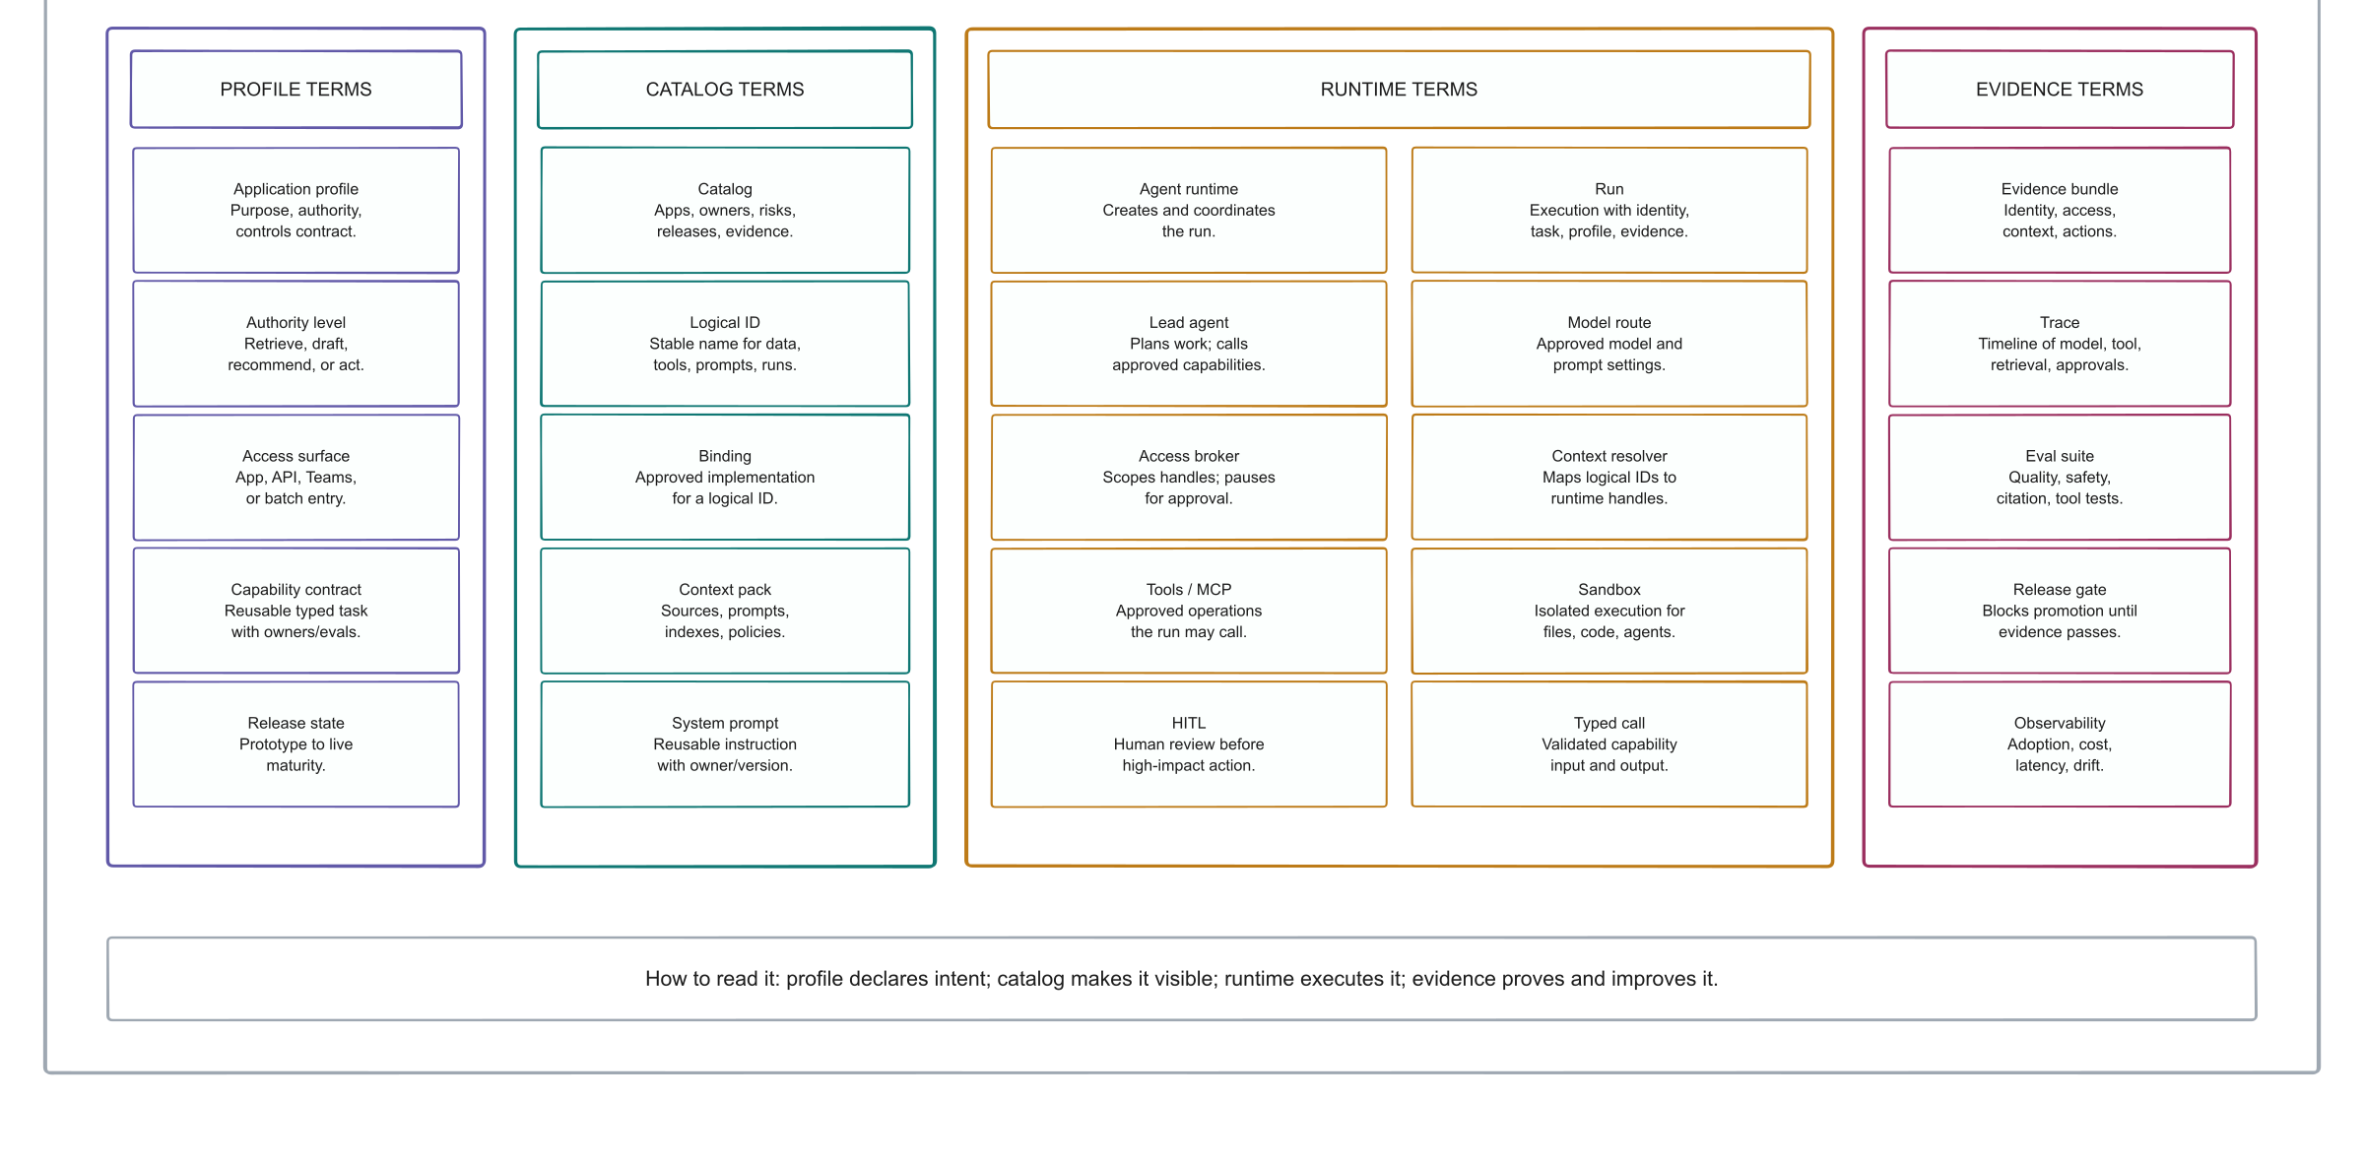
Anatomy Of An AI Application
Diagram defining profile, catalog, runtime, and evidence terms used in an enterprise AI application
Notes:
Use this as the close of Axis 1: the point is shared vocabulary. The same four semantic colors carry forward through the deck: profile, catalog, runtime, and evidence.

Slide 23
Evidence Traces

Slide 24
Every important run should leave a durable, navigable evidence trail
[Auditability] Profile resolvedApp version, inherited controls, release state. Access decidedBroker policy, scope, expiry, approval requirement. Context usedSource snapshot, cache, index, retrieval event, citation. Action recordedModel call, tool call, sandbox event, output artifact. Gate appliedApproval, eval result, release decision, exception.
Evidence supports audit, compliance, debugging, replay, regression tests, release gates, prompt optimization, RL-style learning, and executive visibility into risk and quality.

Slide 25
Evals turn captured work into release decisions
[Trace-based evaluation]
Evaluation is not a detached scorecard. It is the loop that turns real traces, human critique, known risks, and release candidates into a visible pass/fail decision.
Inspect tracesPrompts, context, citations, tools, approvals, outputs, costs, and failures. Name criteriaDomain experts convert critiques into owned criteria, cases, and review queues. Run checksLocal evals, Foundry evals, safety checks, citation checks, and calibrated judges. Compare baselineCandidate release versus approved baseline, with row-level failures visible. Gate releaseSafety, privacy, access, compliance, and critical quality failures can veto promotion.
The first eval proof should test harness intake itself before Synthetic Benefits carries the first application-specific eval suite.
Source: evals.md release gates and prototype path

Slide 26
Reuse And Cooperation

Slide 27
Application teams focus on workflows while shared services handle enterprise obligations
[Delivery benefit]
Reusable runtime
Run creation, durable state, tool calls, model routing, approvals, broker handoffs, and kill switches become common services.
Reusable governance
Profile inheritance carries enterprise controls into each application without making teams restate every rule.
Reusable integration
Catalog bindings connect profile intent to Azure, Databricks, APIM, Graph, Search, Key Vault, and enterprise APIs.
The platform should lower delivery friction and raise the control baseline at the same time.

Slide 28
Useful app-local work can graduate into shared enterprise capabilities
[Reuse] Local componentBuilt inside one app to prove a workflow. Reuse candidateAnother app needs the same pattern or service. Typed capabilityInput/output contract, owner, allowed callers, evals, evidence. Shared releaseVersioned, monitored, reviewed, and bound through the catalog. Platform primitiveMultiple consumers, runbooks, cost/quality/risk visibility.

Slide 29
Security And Compliance

Slide 30
Entra ID and RBAC remain foundational, but agent access is decided per run
[Security benefit] IdentityHuman, app, service principal, managed identity, group, surface. ProfileApplication, capability, authority, data class, allowed tool. PurposeTask, environment, maturity, release, approval state. DecisionGrant, deny, narrow scope, or require approval. EvidenceRecord decision, exchange, retrieval, tool call, output, approval.
The platform adds profile-aware access policy above identity and RBAC facts, so a user or service account cannot silently hand broad authority to an agent.

Slide 31
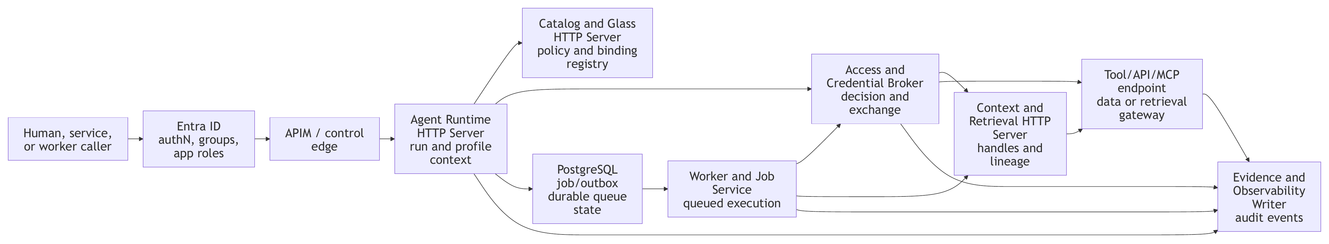
The broker gives agents bounded handles, not reusable enterprise credentials
[Credential boundary]
Current figure from securityspec.pdf / securityspec.md
Short lived
Tokens, handles, snapshots, or sessions expire and can be revoked.
Purpose bound
Access is tied to profile, task, source, operation, and release state.
Server side
Secrets remain in broker, Key Vault, APIM, managed identity, or source systems.
Audited
Every decision and exchange becomes evidence for review.
Run-scoped access flow

Slide 32
Healthcare-specific risks are designed into the platform rather than patched onto apps
Risk | Platform control
PHI/PII overexposure | Data classification, minimum necessary retrieval, redaction, evidence retention policy
Unauthorized tool use | Tool registry, APIM/MCP gateway, Access Broker, approval gates
Unsafe promotion | Evals, red-team tests, release gates, security signoff, rollback path
[Healthcare guardrails]
Data minimization
Retrieve the minimum necessary context at the approved redaction level before model calls.
Prompt and tool injection
Treat retrieved content as data, gate tools, label source trust, and test injection/exfiltration paths.
Human review
High-impact clinical, financial, adverse, external, or writeback actions require role-qualified approval.

Slide 33
A release is not production-ready until evidence, owners, exceptions, and rollback are visible
[Compliance and signoff]
Evidence completeness
Profile, release, access, credential exchange, guardrails, evals, approvals, and exceptions must be present.
Required reviewers
Product, data, IT/IAM, security, compliance, privacy, RAI, operations, and accountable executives approve bounded areas.
Fail-closed gate
Missing evidence, unresolved high-risk findings, unclear PHI reuse, or unowned exceptions block promotion.
Executive approval is additive: it accepts enterprise accountability, but it does not override missing data, security, compliance, tool, or production approval.

Slide 34
Shared release gates mean every app follows the same controlled path to production
[Dev to production]
A release gate is the common promotion checkpoint between environments. It lets different teams move quickly, but only after the catalog shows the right owner, bindings, evals, approvals, evidence, monitoring, and rollback plan for that stage.
Dev Prototype with synthetic or non-production paths. Prove the profile, logical IDs, baseline evals, and evidence events work. /dev/
Staging Exercise production-like bindings, reviewers, guardrails, runbooks, and failure modes before a wider audience sees the workflow. /staging/
Production Run only the approved release version, with catalog-visible owners, access, monitoring, incident response, and rollback. /prod/
The gate is shared because the platform owns the promotion rule once; each application supplies its own evidence, approvals, and environment-specific bindings.
Sources: catalog.md release page, governance workflows, maturity states
Notes:
Use this to explain why shared release gates are not another committee. The point is a common dev-to-prod control path: each app has its own facts and risks, but the promotion rule, evidence expectations, and catalog record are standardized.

Slide 35
HITL And Easy Evals

Slide 36
High-impact actions stay human-approved while routine quality checks get easier to reuse
[HITL and evals]
Human-in-the-loop
Clinical, financial, adverse-action, external communication, source-system writeback, and material exception paths route to role-qualified reviewers before action.
Reviewer decisions become evidence, not informal comments lost outside the system.
### Evaluation loop
Golden sets, citation checks, prompt/tool-injection tests, PHI leakage checks, red-team scans, and reviewer feedback become reusable release-gate material.
Teams can improve quality without inventing a new eval harness for every app.

Slide 37
Review surfaces turn agent work into governed artifacts
[Richer human feedback]
When chat is too narrow, the catalog gives reviewers a real surface: a spec with inline comments, an output draft with citations, a static HTML explanation, a browser-test replay, or a temporary live app.
Catalog endpoint
Humans open app://..., not raw local ports or unmanaged share links.
HITL packet
Runtime controls reviewer actions, TTLs, kill switches, and agent messages.
Feedback evidence
Comments, suggestions, decisions, and accepted edits become reviewevent://....
Artifact archive
Source, rendered view, feedback, screenshot, and logs stay under artifact://....
Sources: catalog.md, implspec.md Section 13, securityspec.md review-surface controls

Slide 38
User Simplicity And Future Readiness

Slide 39
New agent patterns should be adopted through experiments, not one-off production shortcuts
[Future work]
Subagents
Use bounded delegation, typed capabilities, context packets, budget limits, and parent/child evidence.
Memory
Start with hybrid retrieval, context packs, key-file packs, and trace-derived memory only after redaction and approval.
Optimization
Run prompt/program optimization and RL-style learning offline against approved benchmarks and release gates.
Compaction
Treat summaries as derivative artifacts with source links, validation, warnings, retention, and reuse policy.
Managed platforms
Use Azure, Databricks, OpenAI, or future services where they fit, then mirror traces into the catalog.
Governed feedback
Trace reuse, eval corpora, optimizer inputs, and learning datasets need classification and approval.
Source: future_practices.md

Slide 40
The default implementation stack is Azure where Azure is the enterprise control point
Kind | Software to use | Azure?
Catalog and profile registry | Azure App Service or equivalent, PostgreSQL or Azure SQL, Entra ID, and imports from Databricks. | Yes
Agent Runtime API | Point32Health Runtime API on App Service or Functions behind APIM, with canonical evidence hooks. | Yes
Managed agents and LLMs | Azure AI Foundry Agent Service, Foundry model catalog, and Azure OpenAI as the Azure-managed default. | Yes
Model, tool, API, and MCP gateway | Azure API Management AI gateway, API Center, Azure Functions, and App Service MCP endpoints. | Yes
Identity, access, and secrets | Entra ID, managed identities, Azure RBAC, Key Vault, and APIM credential manager. | Yes
Enterprise retrieval | Azure AI Search for enterprise application retrieval, vector, hybrid, and full-text search. | Yes
Hosting, jobs, and sandboxes | App Service, Functions, Logic Apps, and Container Apps for APIs, integration jobs, and selected sandbox jobs. | Yes
Evidence, traces, and artifacts | PostgreSQL or Azure SQL for metadata, ADLS or Blob for artifacts, Azure Monitor and App Insights for operations. | Yes
Source | Source: implspec.md Section 23 software-choice appendix
[Software choices]
The software plan turns the platform model into concrete defaults: use Azure for enterprise application surfaces, identity, API control, managed hosting, monitoring, search, owned operational state, and model governance where it fits.

Slide 41
Databricks and external tools are deliberate exceptions, not the default control plane
Kind | Software to use | Azure?
Lakehouse governance | Databricks Unity Catalog and Unity AI Gateway for Databricks data, model, MCP, and usage governance. | No
Data-side tools and MCP | Databricks MCP, Genie, SQL, notebooks, and custom Databricks-side tools where governed data lives there. | No
Data and ML pipelines | Databricks Jobs, Workflows, Lakeflow, Delta, and Runtime API handoff at the agent boundary. | No
Data-side model serving and evals | Databricks Model Serving, MLflow 3, Delta, and Unity Catalog for classifiers, experiments, and data-side agents. | No
Delta-native retrieval and analytics | Databricks AI Search plus Delta trace, evidence, eval, and cost mirrors for lakehouse analysis. | No
Prompt, eval, and trace pressure valves | LangSmith, Braintrust, Arize Phoenix, OpenTelemetry collectors, or similar only for validated gaps. | No
Workflow pressure valves | Temporal, Prefect, Dagster, or Airflow only when Azure and Databricks basics are not enough. | No
Specialized parsers and AI security | Docling, LlamaParse, HiddenLayer, Lakera, Protect AI, or similar after document/security gap review. | No
Source | Source: implspec.md Section 23 software-choice appendix
[Software choices]
Use Databricks where the work is lakehouse-native or data/ML-centered. Use external tools only as pressure valves after native Azure and Databricks options are mapped.

Slide 42
Synthetic Benefits is the first full application proof, after intake works
[Prototype proof]
Synthetic Benefits remains the right first full application MVP because it is safe, synthetic, and still exercises the real control contract. It should come after the intake spine can already name, capture, normalize, and evidence managed agent work.
Prototype question
Is physical therapy covered for this synthetic member, and what would they likely pay if they use this provider?
ProfileAllowed surfaces, inherited controls, synthetic data, prohibited actions, evidence, and evals. CatalogApplication page, profile lineage, logical IDs, binding preview, run timeline, approval, eval, and metrics. RuntimeResolve profile, broker synthetic access, resolve context, call tools, compose answer, and route approval. EvidenceCapture access, context, retrieval, tool calls, output, approval, evals, citations, and improvement candidates.
The proof value is not the benefits question itself. The proof value is that the full governed loop works before real PHI or source-system writeback.
Sources: prototype.md, profilespec.md, catalog.md, evals.md

Slide 43
The roadmap starts with managed adoption, not production automation
[Updated roadmap]
1. Intake spineMinimal catalog/project/run IDs, agent-client records, profile binding, evidence writing, and trace storage. 2. Harness MVPCodex and Claude Code-style sessions captured through managed launch context, hooks, telemetry, and normalizers. 3. Review and memory seedSpec/output review surfaces, archived artifacts, project memory files, trace summaries, context-pack candidates, and simple indexes. 4. Synthetic BenefitsFirst full app MVP with broker, resolver, HITL, evals, observability, and synthetic data. 5. Pilots and capabilitiesDAIS, benefits, provider, claims, HEDIS, and reusable platform capabilities. 6. AI-native scaleTenant-scoped memory across Teams, Excel, OneDrive, Databricks, apps, and project spaces.
Maturity states stay explicit in the catalog: proposed, design, prototype, shadow, assistive, supervised action, limited automation, and scaled automation.
Sources: readmefirst.md, implspec.md roadmap, catalog.md maturity states

Slide 44
The next decisions are about ownership, gates, and sequence
[Executive alignment]
The technology stack is now specific enough to review. The open executive questions are mostly operating-model questions: who owns the shared control product, which gates are mandatory, and which use cases move after the intake proof.
Confirm the catalog as the control product
Inventory, approvals, release state, evidence, security posture, and external glass links should converge there.
Name accountable owners
Business, platform, security, compliance, data governance, operations, and reusable capability ownership must be visible.
Approve the staged gates
Harness intake, Synthetic Benefits, controlled pilots, production hardening, and AI-native expansion each need different evidence.
Choose the first pilot lane
After Synthetic Benefits proves the full loop, choose DAIS or a payer pilot based on value, risk, data readiness, and reviewer capacity.
The executive value is fast managed adoption, reusable platform capability, and stronger security/compliance posture, not simply more AI usage.

Slide 45
A River-like operating model turns managed work into governed memory
[AI-native operating model]
The long-term goal is not a chatbot on every screen. It is work that becomes capturable, searchable, reusable, and governed inside the right tenant-like boundary.
Work runsTeams, Excel, apps, notebooks, harnesses, batch jobs, and reviews call the shared runtime envelope. Evidence remainsPrompts, decisions, tool calls, approvals, evals, outputs, and exceptions stay inspectable. Memory is promotedApproved residue becomes prompts, context packs, capabilities, eval cases, runbooks, and release evidence. Reuse stays boundedTenant scope, identity, classification, redaction, retention, owner approval, and release gates decide reuse.
Point32Health becomes AI-native when the next team can start from approved prior work without flattening privacy, security, compliance, or ownership boundaries.
Sources: riverness.md, agent_harnesses.md, catalog.md, evals.md
Notes:
Use this as the end-of-deck operating-model slide. It normalizes the River-like idea into healthcare-grade tenant-scoped sharing and governed company memory.

Slide 46
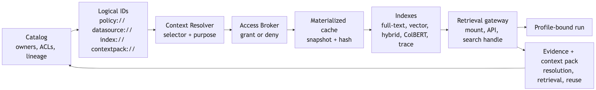
Five surrounding platform planes and the governed runtime
[Appendix figure]
Current figure from conceptspec.pdf
Five-plane architecture

Slide 47
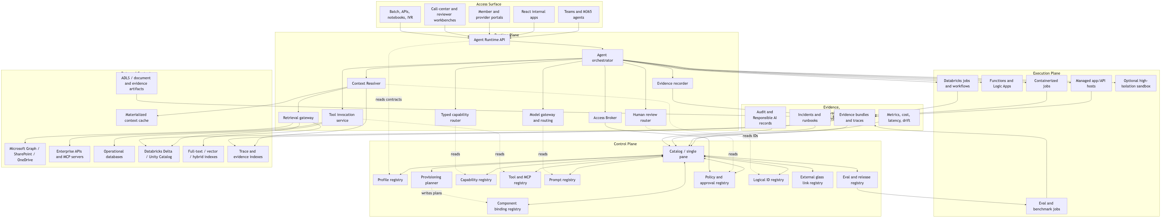
Logical references keep context stable while backing stores change
[Appendix figure]
Catalog-owned logical IDs such as policy://, datasource://, index://, and contextpack:// resolve into approved snapshots, caches, indexes, retrieval handles, and evidence.
Context resolver and memory plane

Slide 48
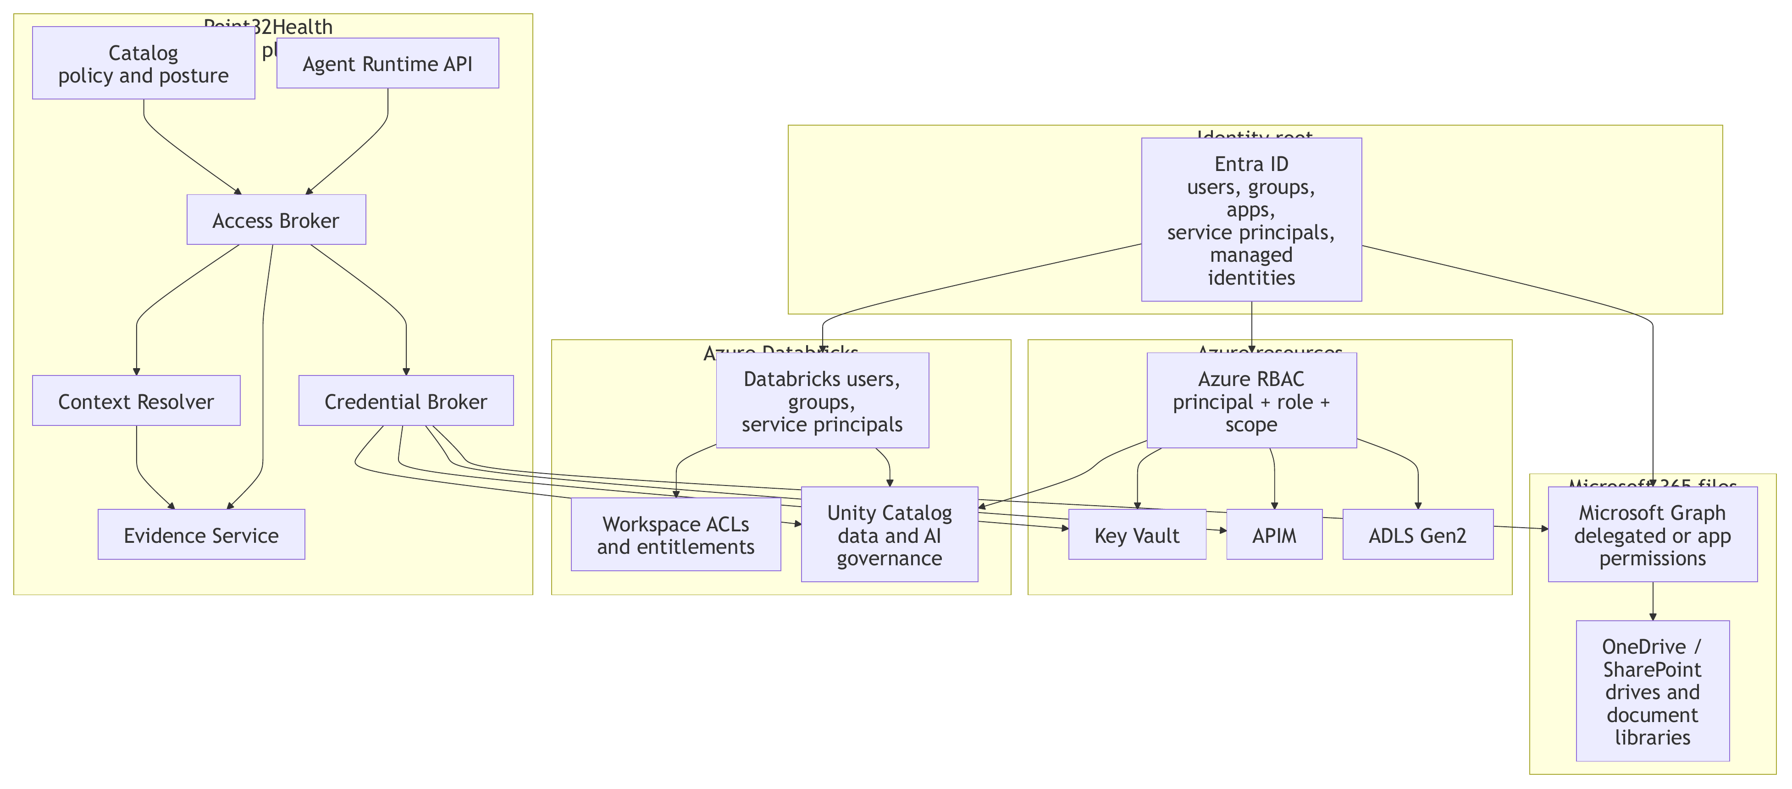
Identity and authorization layers compose under the broker
[Appendix figure]
Current figure from identity_auth_layers.pdf
Identity layers diagram

Slide 49
Example profile excerpt: Synthetic Benefits Navigator
[Appendix YAML]
metadata:
name: synthetic_benefits_navigator_app
lifecycle_status: prototype
inheritance:
parent: enterprise_healthcare_agent_base
business:
domain: member
business_metrics: [answer_accuracy, citation_fidelity, approval_flow_success, eval_pass_rate]
surfaces:
allowed_surface_types: [react_app, api, cli, teams, hitl_console]
authority:
default_level: L1_DRAFT
prohibited_actions: [use_real_phi, use_real_member_data, perform_real_writeback]
data:
data_classification: internal
sources:
- name: synthetic_plan_documents
logical_id: datasource://point32health/synthetic/dev/plan_documents
- name: synthetic_accumulators
logical_id: datasource://point32health/synthetic/dev/accumulators
evidence:
required_events: [run_created, profile_resolved, access_decision, context_resolved,
retrieval, tool_call, model_call, output_artifact, approval, eval_result]
Excerpted from profiles.md and profilespec.md

Slide 50
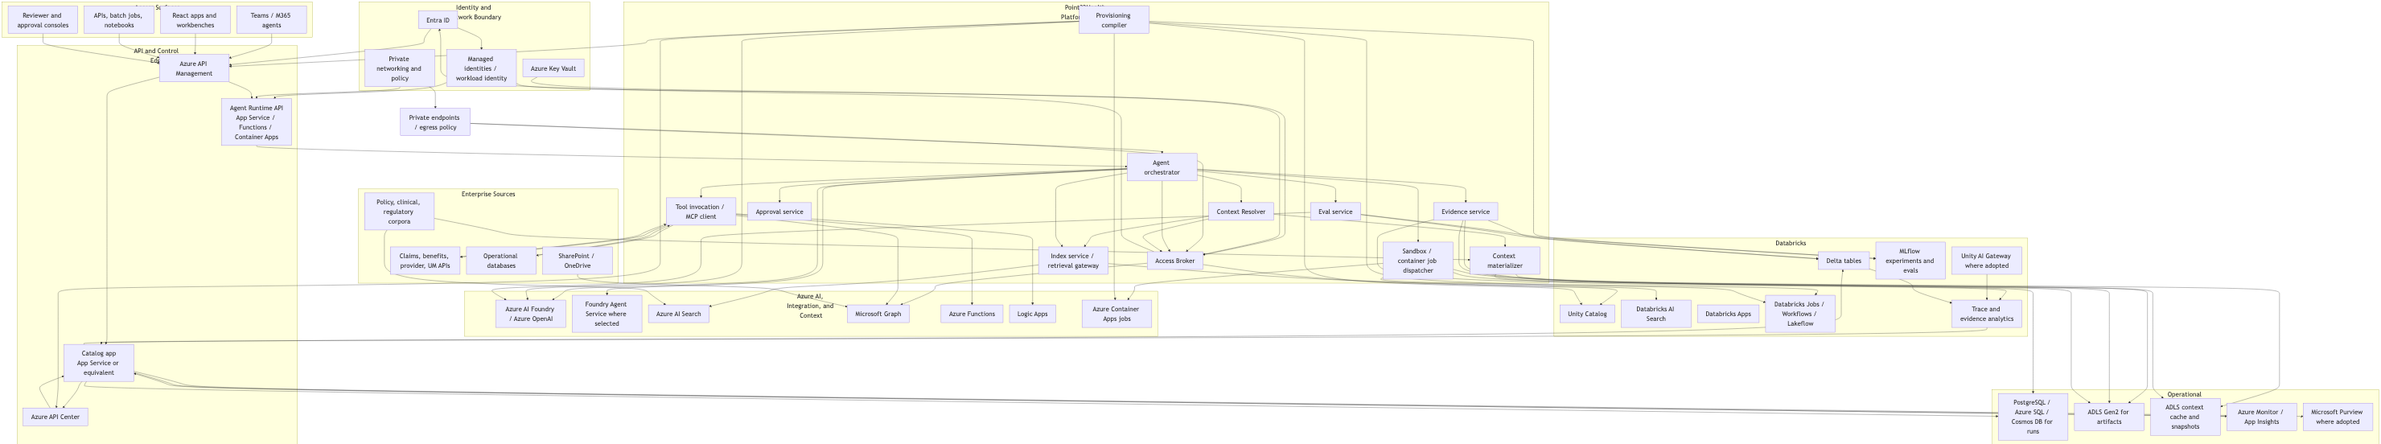
Azure-first implementation with Databricks where data and ML live
[Appendix figure]
The implementation can evolve. The durable contract is profile-bound runtime, catalog visibility, brokered access, logical context, evidence, evals, and release gates.
Azure and Databricks implementation map

Slide 51
Old Slides For Review
Appendix

Slide 52
Old Slide: A profile covers the decisions that make an agentic application safe to run
Appendix
[Old slide]
The profile is not just an owner line or a YAML example. It is the enterprise contract for purpose, users, authority, data, runtime behavior, controls, release posture, and operating accountability.
Who and why
metadata, business, users, maturity, risks.
Where it appears
catalog, surfaces, owner views, portfolio views, observability views.
What it may do
authority, data, access, tools, composition.
How it runs
execution, sandbox, brokered credentials, context handles.
How it is checked
human_in_loop, evidence, evals, observability.
How it goes live
security, regulatory, release, operations, implementation_bindings.
The base profile supplies inherited enterprise defaults; each child profile declares the application-specific choices and exceptions leaders can review.
Source: profilespec.md base profile walkthrough and catalog mapping

Slide 53
Old Slide: Synthetic Benefits proves the full loop without real PHI or source-system writeback
Appendix
[Old slide]
Prototype question
Is physical therapy covered for this synthetic member, and what would they likely pay if they use this provider?
ProfileAllowed surfaces, authority, tools, synthetic data, evidence, evals. CatalogDisplay profile, run, evidence timeline, approval, eval result, and observability metrics. RuntimeResolve profile, broker synthetic access, retrieve context, call tools, compose answer. EvidenceCapture timeline, approvals, eval outcomes, citations, and improvement candidates.

Slide 54
Old Slide: Start safe, then move through controlled maturity gates
Appendix
[Old slide]
FoundationCatalog MVP, schemas, profiles, runtime skeleton, evidence, broker, resolver. Synthetic BenefitsFull loop with synthetic data, approval, evals, and observability. DAIS / documentsSharePoint snapshots, DOCX/PDF sandbox, redlines, writeback approval. Payer pilotsBenefits assist, provider audit, HEDIS shadow, MNG, claims assistant. Production hardeningRelease gates, prompt/PHI tests, incident runbooks, dashboards, DR.
Maturity states stay explicit in the catalog: idea, design, prototype, shadow, assistive, supervised action, limited automation, scaled automation.

Slide 55
Old Slide: The next decisions are operating-model decisions, not only technology decisions
Appendix
[Old slide]
Confirm catalog-centered visibility
Agentic work should be inventoried, governed, operated, and reviewed through a shared catalog.
Assign accountable owners
Business, platform, security, compliance, data governance, and operations ownership must be visible per app and capability.
Approve staged maturity gates
Prototype, shadow, assistive, supervised, and automation stages need evidence and release criteria.
Choose the post-prototype pilot path
Use Synthetic Benefits to prove the contract, then select DAIS or a payer pilot based on value, risk, and readiness.
The executive value is complete visibility, faster safe delivery, reusable capabilities, and a stronger security/compliance posture for agentic AI.

Slide 56
Old Slide: Riverbed makes managed work compound into an AI-native organization
Appendix
[Old slide]
The platform is not only a safer way to run AI projects. It is the substrate that lets managed work become reusable organizational memory.
Work runsManaged chats, products, harnesses, workflows, and reviews happen inside profile-bound sessions. Evidence staysPrompts, decisions, tool calls, approvals, evals, outputs, and exceptions remain inspectable. Memory becomes usableThe catalog turns approved residue into prompts, context packs, capabilities, eval cases, and release evidence. The org learnsFuture teams start from governed prior work, not a blank prompt or private chat history.
That is the Riverbed goal: Point32Health becomes AI-native when every approved run can leave behind something the next team can safely trust, reuse, and improve.
Sources: Shopify Engineering, “Under the River”; riverness.md, agent_harnesses.md, catalog.md, evals.md

