Slide 1
Point32Health Agentic AI
[Technical architecture]
A reference architecture for governed, reusable agentic applications across profile, catalog, runtime, brokered access, context, evidence, eval, and release planes.
The engineering question: how do every app, agent, worker, and surface share the same control contracts before production?
Notes:
Use this as the architectural frame. The BBVA example follows to explain why the platform must make adoption fast, visible, and controlled rather than leaving usage to harden invisibly.

Slide 2
BBVA shows why regulated AI adoption needs a managed platform path
[Regulated-bank example]
BBVA is useful technically because it turned hidden AI demand into a governed path: secure entry, fast approval, observable use, human ownership, and reusable patterns before unmanaged usage became the default.
Managed entry pointUsers had a supported way to reach AI services instead of copying sensitive work into unsanctioned tools. Human ownershipPrompt privacy, ownership rules, and quality expectations kept people accountable for outputs. Reusable patternsChampions, use cases, internal GPTs, and shared prompts made adoption visible and productizable. Evidence loopUsage, quality, controls, and outcomes became measurable enough to improve the next wave.
For Point32Health, the platform implication is concrete: every approved surface should enter through profile, catalog, runtime, broker, resolver, evidence, eval, and release contracts instead of becoming another local exception.
Source: Garicano, Li & Wu, Messy Jobs, ch. 7, “BBVA: escaping pilot purgatory”; user-provided screenshots.
Notes:
Use this as the bridge from adoption story to architecture: the bank example is not a technology prescription; it is a platform requirement.

Slide 3
Engineering now has a concrete build sequence
[Technical package orientation]
The current document package turns the architecture into an executable sequence: intake first, trace capture second, review/archive plus memory seed third, then the first full application proof.
1Thin intake spineProject, run, agent-client, raw-trace, canonical-trace, and evidence IDs. 2Managed harness captureCodex and Claude Code-style sessions launch with instrumentation and review context. 3Review and memory seedSpecs, outputs, HTML artifacts, feedback, archives, summaries, context-pack candidates, and simple indexes. 4Synthetic Benefits MVPFirst full app proof across profile, broker, resolver, runtime, HITL, evals, and catalog glass. 5Pilots and capabilitiesDAIS, payer workflows, shared capabilities, and release-gated reuse. 6AI-native expansionRiver-like operating model only after governed memory and evidence are real.
Sources: readmefirst.md, implspec.md Section 21, catalog.md, agent_harnesses.md, evals.md

Slide 4
Uniform Standards

Slide 5
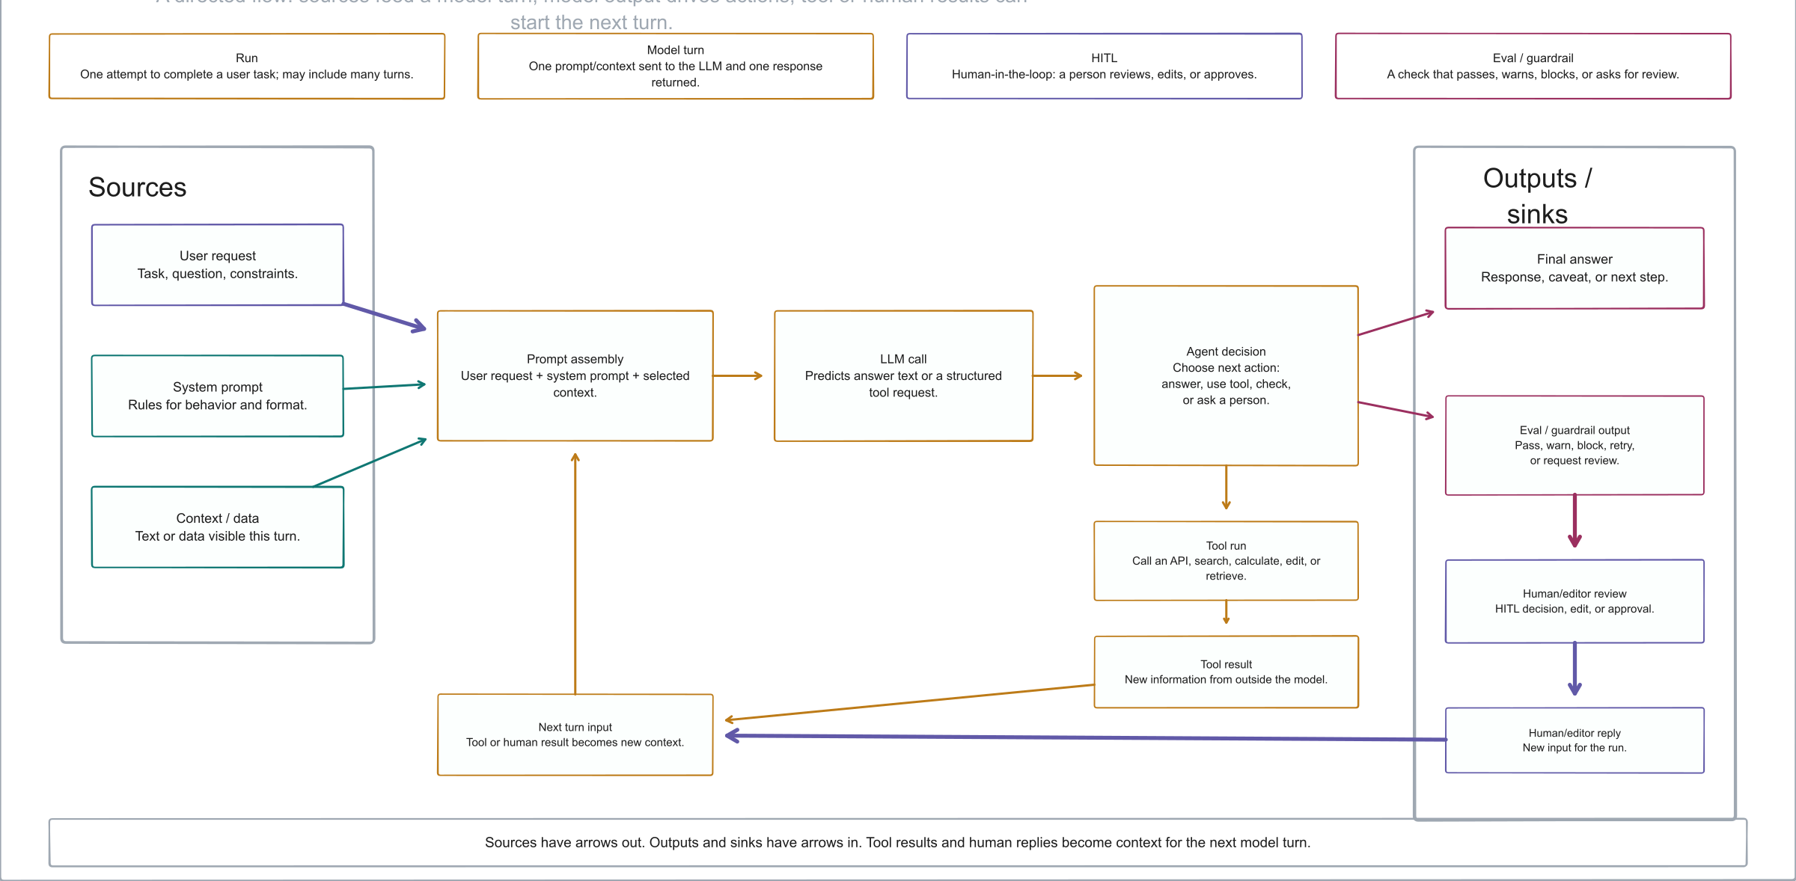
How An LLM Agent Run Works
Diagram explaining sources, model turns, tool runs, evals, human review, and evidence outputs in an LLM agent run
Notes:
Use this as the technical vocabulary primer. It keeps the terms generic before introducing Point32Health-specific profile, catalog, runtime, and evidence names.

Slide 6
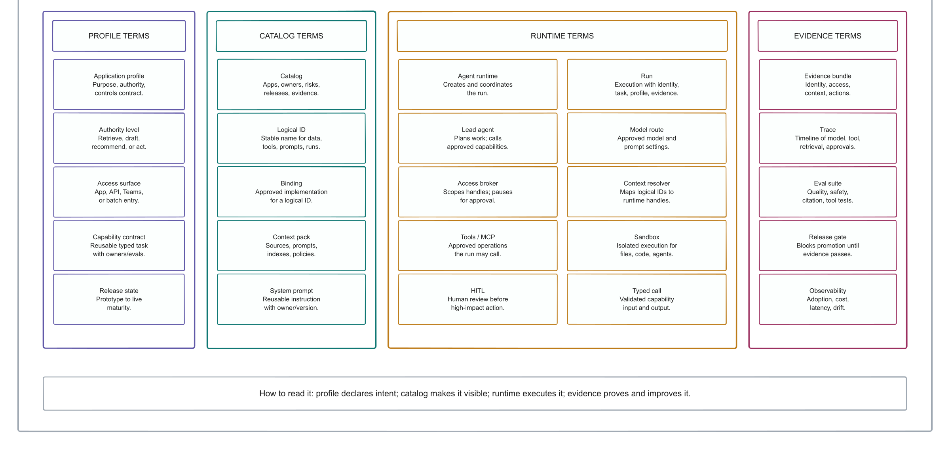
Anatomy Of An AI Application
Diagram defining profile, catalog, runtime, and evidence terms used in an enterprise AI application
Notes:
Use this to anchor the four semantic lanes used throughout the deck: profile, catalog, runtime, and evidence.

Slide 7
A buildable substrate for governed, reusable agentic applications
[Reference architecture]
The architecture prevents each application from rebuilding runtime, access, tool governance, evidence, eval, approval, release, and observability primitives. The common substrate lets teams move faster while making the work visible and controllable.
ProblemLocal app stacks hide risk, duplicate controls, and make evidence and reuse inconsistent. ArchitectureProfiles, catalog, runtime, broker, resolver, evidence, evals, and deployment bindings. OutcomeComplete visibility, safer delivery, shared capabilities, and staged production readiness.
Sources: conceptspec.md, implspec.md, catalog.md, profilespec.md

Slide 8
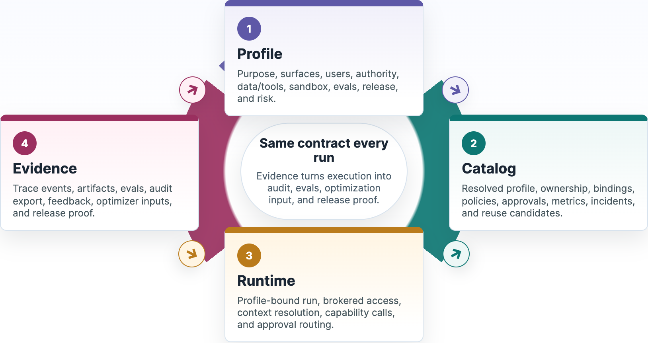
The platform loop is profile, catalog, runtime, evidence, then the next controlled turn
[System loop]
Same contract every runEvidence turns execution into audit, evals, optimization input, and release proof. 1ProfilePurpose, surfaces, users, authority, data/tools, sandbox, evals, release, and risk. 2CatalogResolved profile, ownership, bindings, policies, approvals, metrics, incidents, and reuse candidates. 3RuntimeProfile-bound run, brokered access, context resolution, capability calls, and approval routing. 4EvidenceTrace events, artifacts, evals, audit export, feedback, optimizer inputs, and release proof. resolve contract→ publish controls→ write proof→ gate and learn→
### Implementation rule
Any UI, batch job, notebook, or external agent client should enter through this loop instead of bypassing profile, catalog, runtime, or evidence contracts.
Profile is the typed input. Catalog is the system of record. Runtime is the enforcement point. Evidence is the proof and learning layer.
Profile, catalog, runtime, and evidence cycle with the next controlled turn

Slide 9
An agentic application is a governed composition, not just an agent
[Application model]
Business surface
React app, Teams, portal, call-center console, reviewer workbench, API, batch, notebook, IVR.
Runtime composition
Lead agent, deterministic services, retrievers, tools, typed capabilities, sandbox jobs, approval objects.
Governance envelope
Authority, data class, policies, evidence, evals, observability, release gates, risks, implementation bindings.
composition:
component_policy: single_lead_agent
components:
- synthetic_benefits_domain_agent
- synthetic_plan_document_retriever
- synthetic_eligibility_lookup
- evidence_bundle_writer
- approval_router

Slide 10
Profiles are human-readable contracts and machine-actionable inputs
[Profile model]
Intent
Business purpose, domain, owners, users, value hypothesis, maturity.
Authority
Surfaces, default authority level, autonomous actions, approval-required actions, prohibited actions.
Runtime
Composition, data, access modes, tools, execution, sandbox, implementation bindings.
Controls
Human review, evidence, evals, observability, security, regulatory, release, operations, risks.
authority:
default_level: L1_DRAFT
access:
access_broker_required: true
ambient_credentials_allowed: false
sandbox:
network_policy: deny_by_default
evidence:
bundle_required: true
evals:
release_gate_required: true

Slide 11
Profile sections map directly to platform behavior
Decision area | Profile sections | Platform behavior
Portfolio identity | metadata, catalog, business, maturity, risks | Owner views, value hypothesis, lifecycle state, portfolio filters, risk review.
Entry and users | surfaces, users | Allowed UI/API/batch entry points, identity classes, external-facing risk flags.
Authority and data | authority, data, access, tools | Autonomous actions, approvals, PHI posture, logical refs, broker grants, tool risk.
Runtime shape | composition, execution, sandbox | Lead agent/workflow graph, durable modes, sandbox substrate, network and secrets policy.
Human control | human_in_loop | Reviewer roles, approval actions, escalation triggers, edit-and-approve paths.
Proof and gates | evidence, evals, observability, release | Required events, artifacts, metrics, eval suites, release gates, rollback readiness.
Production readiness | security, regulatory, operations, implementation_bindings, provisioning | Least privilege, HIPAA/docs, runbooks, selected resources, preview/apply jobs.
Additional context | Field-level lineage matters: reviewers need to know which values came from the base profile, which were overridden by the app, and which loosened controls need approval. Source: profilespec.md sections 3-4
[Profile section map]
The resolved profile is the typed control document consumed by catalog, validators, provisioning preview, runtime, brokers, resolvers, evidence, evals, release gates, and operational views.

Slide 12
Profile fragments show how one schema changes runtime and governance
[Profile examples]
These authored profiles keep the same base contract but change surfaces, authority, logical IDs, access modes, binding refs, HITL triggers, evidence, and release risk.
Benefits explanationLogical source plus prompt/eval refs metadata.name: benefits_explanation_app authority.default_level: L1_DRAFT data.classification: phi_pii data.sources: - logical_id: datasource://point32health/benefits/prod/plan_documents access_mode: retrieval implementation_bindings: prompt_refs: [prompt://point32health/benefits/prod/domain_agent/default] eval_refs: [eval://point32health/benefits/prod/golden_set/v1] hitl.gates: [formal_determination]
Provider directory integrityBatch flow, provider-removal gate metadata.name: provider_directory_integrity_app surfaces: [ops_dashboard, provider_portal, batch] authority.default_level: L2_RECOMMEND data.classification: confidential data.sources: - logical_id: datasource://point32health/providers/prod/directory access_mode: api_delta_event writeback.mode: approval_required hitl.gates: [provider_removal, network_status]
Medical necessity reviewHighly restricted reviewer assist metadata.name: medical_necessity_review_app component_pattern: multi_agent_application authority.default_level: L2_RECOMMEND data.classification: highly_restricted data.sources: - logical_id: datasource://point32health/clinical/prod/prior_auth_packet access_mode: mounted_snapshot sandbox.egress: deny_by_default hitl.gates: [adverse_determination]
Claims exception resolutionRecommendation with controlled writeback metadata.name: claims_exception_resolution_app surfaces: [claims_workbench, batch_queue] authority.default_level: L2_RECOMMEND data.classification: highly_restricted data.sources: - logical_id: datasource://point32health/claims/prod/pended_claims access_mode: readonly_delta writeback.mode: approval_required hitl.gates: [payment_change, denial, fwa_referral]
When a profile references a logical URL such as datasource://... or prompt://..., the selected concrete binding belongs in the catalog binding registry and release binding set, not in agent code.
Source: profiles.md application-profile examples

Slide 13
Synthetic Benefits shows how a resolved profile drives runtime, broker, resolver, and release controls
[Profile deep dive]
One project can exercise the full contract without PHI: app identity and authority, component graph, logical data refs, brokered access, context materialization, evidence, evals, and bindings.
App envelope and authorityInherited base plus app-specific guardrails metadata.name: synthetic_benefits_navigator_app inheritance.parent: enterprise_healthcare_agent_base maturity.stage: prototype surfaces.allowed_surface_types: [react_app, api, cli, hitl_console] authority: default_level: L1_DRAFT allowed_actions: [retrieve_context, call_tools, draft_response] approval_required_for: [mark_response_as_approved, simulated_send_response] prohibited_actions: [use_real_phi, use_real_member_data, perform_real_writeback]
Components, access, and sandboxHow the runtime constrains execution composition.component_policy: single_lead_agent components: - synthetic_benefits_domain_agent: agent - synthetic_plan_document_retriever: retrieval_service - synthetic_eligibility_lookup: tool - evidence_bundle_writer: service/platform_candidate access: access_broker_required: true default_access_duration: run_scoped ambient_credentials_allowed: false sandbox.network_policy: deny_by_default
Logical data and contextCatalog refs resolve to approved handles data: data_classification: internal logical_reference_required: true sources: - logical_id: datasource://point32health/synthetic/dev/plan_documents type: markdown_document_corpus access_mode: retrieval - logical_id: datasource://point32health/synthetic/dev/accumulators type: csv_table access_mode: database_readonly context_resources: - logical_id: datasource://point32health/synthetic/dev/plan_documents resolver: static_local indexes: [index://point32health/synthetic/dev/plan_documents/fulltext?at=build:1]
Evidence, evals, and bindingsRelease readiness is explicit human_in_loop.escalation_triggers: [missing_plan_document, conflicting_data, low_confidence] evidence: bundle_required: true required_events: [run_created, profile_resolved, access_decision, context_resolved, retrieval, tool_call, model_call, approval, eval_result] evals: eval_types: [golden_set, citation_fidelity, tool_correctness, refusal, regression] release_gate_required: true implementation_bindings: infrastructure_stack_ref: deploy/infrastructure/dev prompt_registry_refs: [prompts/synthetic_benefits/domain_agent/v0.1] eval_suite_refs: [evals/synthetic_benefits/golden_set/v0.1]
At runtime, these fields become concrete checks: resolve profile, compute broker grants, materialize context, enforce HITL, write evidence, run eval gates, and attach the selected binding set.
Source: profilespec.md Synthetic Benefits overlay and resolved value view

Slide 14
Child profiles declare app-specific facts while inheriting enterprise controls
[Profile inheritance] Base profileSection set, defaults, allowed values, control expectations, evidence/eval/security/release posture. Child overlayApp-specific purpose, surfaces, components, data sources, tools, context, metrics, risks, bindings. Resolved profileMerged view consumed by catalog, validators, runtime, broker, resolver, evals, provisioning, evidence.
The resolver should preserve source lineage for each field: inherited, overridden, added, rejected, or accepted as an extension.

Slide 15
The resolved profile is the shared input to control, runtime, and governance services
[Contract consumption]
Catalog
Pages, panes, lookup names, maturity, owners, risks.
Provisioning
Binding preview, selected resources, approvals, glass links.
Runtime
Run envelope, allowed surface, tools, capabilities, budgets.
Broker/Resolver
Access decision, logical refs, context handles, lineage.
Evidence/Evals
Required events, artifacts, metrics, thresholds, release gates.
source lineage per field:
profile: synthetic_benefits_navigator_app
parent: enterprise_healthcare_agent_base
field_path: access.ambient_credentials_allowed
value: false
resolution: inherited
consumed_by: [runtime, access_broker, security_glass, release_gate]

Slide 16
The system must make agentic work visible at portfolio, runtime, and control levels
Question | Catalog answer
What can this app access? | Profile data section, logical references, access modes, broker policy, binding rows, evidence events.
What did this run do? | Run timeline, access decision, context handles, retrieval, tool/model calls, outputs, approvals, eval result.
What can be reused? | App-local components, consumers, typed capability candidates, eval/readiness signals, owner and release state.
[Visibility]
Technical visibility
Profiles, components, tools, APIs, MCP servers, data sources, logical references, prompts, evals, and bindings.
Runtime visibility
Runs, state, context resolution, retrieval, model calls, tool calls, sandbox jobs, outputs, and approvals.
Security visibility
Identity posture, access decisions, PHI/PII exposure, credential exchange, policy versions, exceptions, incidents, and signoff.

Slide 17
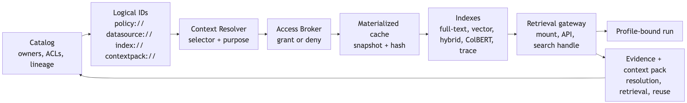
The governed runtime binds five surrounding planes during a run
[Architecture map]
Current figure from conceptspec.pdf
Five-plane architecture

Slide 18
Surfaces normalize user and system entry points into profile-bound runtime calls
[Access surface plane] SurfaceTeams, React, portal, console, API, batch, notebook, IVR. APIM edgeAuthentication, route policy, quotas, gateway controls. Runtime APICreates run, validates profile/surface/release. Shared servicesBroker, resolver, tools, model route, evidence, approval. CatalogDisplays run, evidence, risk, release, metrics, and incidents.
Adding a new UI should not create a new security model, evidence model, or tool-access model.

Slide 19
The platform supplies the support stack that every app would otherwise rebuild
[Shared substrate]
Control
Catalog, profile registry, bindings, provisioning, policies, prompts, eval/release registry.
Runtime
Run lifecycle, durable workflow, capability router, model gateway, tool invocation, approval routing.
Access/context
Access Broker, Credential Broker, Context Resolver, materialization, cache, indexes, retrieval gateway.
Governance
Evidence bundles, traces, observability, cost, evals, release gates, incidents, capability graduation.

Slide 20
Company memory is a governed index over managed runs and evidence
Managed-memory input | System of record | Guardrail
Harness and chat work | Runtime session + catalog surface refs | Permission boundary and owner review
Products and patterns | Profile/catalog registry | Release state and binding set
Evidence and lessons | Canonical trace/evidence bundle | Retention, redaction, reuse eligibility
Additional context | Project AI helps one team finish a task. Governed company memory preserves the residue of the task so the next team starts from evidence, not a blank prompt. Sources: catalog.md, agent_harnesses.md, implspec.md, evals.md
[Durable memory bank]
A Teams thread, harness session, product run, batch workflow, or Databricks job should all resolve to the same profile-bound session, evidence, and catalog model so useful work can be inspected and reused later.
Work surfaceTeams, app, API, notebook, batch, reviewer workbench, harness. Managed runRun envelope, actor, profile, release, state, brokered context. Evidence timelinePrompt, access, retrieval, model, tool, approval, eval, output. Catalog memoryProducts, capabilities, prompts, context packs, decisions, owners. Reusable assetApproved profiles, eval cases, skills, playbooks, and lessons learned.

Slide 21
Harness Intake Foundation

Slide 22
Managed agent sessions enter through a launch envelope
[Harness runtime]
The first runtime slice does not need every application feature. It needs a managed launch context that names the project, run, agent client, allowed data class, instrumentation profile, collector route, and review obligations.
RegisterApproved agent client, owner, allowed use, tool policy. LaunchProject/run IDs, workspace, hook refs, collector route. ConstrainNo broad credentials, no PHI by default, scoped files/tools. CapturePrompt, context, files, tools, artifacts, reviewer notes. ReviewTrace health, candidate resources, approval state.
managed_session:
project_ref: project://point32health/platform/dev/agentic_intake_demo
agent_client_ref: agentclient://point32health/platform/dev/codex
instrumentation_ref: instrumentation://point32health/platform/dev/codex-otel-v1
allowed_data_class: internal_non_phi
evidence_required: [raw_trace, canonical_trace, artifacts, reviewer_notes]
ambient_credentials_allowed: false
Sources: agent_harnesses.md Sections 8-12, securityspec.md Section 18.1

Slide 23
Raw traces become canonical evidence before they become memory
[Trace conversion]
The platform should preserve the copied raw trace, but use a canonical trace and evidence record for audit, evals, search, memory review, and catalog promotion.
Managed runInteractive harness session with run, project, agent-client, and instrumentation IDs. Raw traceNative transcript, telemetry, hooks, files touched, artifacts, errors, costs. NormalizerMaps native events into stable run, tool, model, file, artifact, and reviewer event types. Canonical traceRedaction state, evidence references, provenance packet, and reuse eligibility. Decision pointKeep audit-only, create eval case, draft catalog resource, or propose memory/context candidate.
The memory layer must not treat trace residue as truth by default. Reuse requires classification, redaction, retention, poisoning/staleness checks, and owner approval.
Sources: agent_harnesses.md Sections 10-13, catalog.md Governance Workflows, future_practices.md Section 6

Slide 24
Approved traces seed memory and context, not broad prompt history
Trace-derived artifact | Minimum control | Catalog value
Project memory file | Owner, source trace, retention, sensitivity, unresolved assumptions. | Lets the next run start with reviewed project context.
Trace summary | Raw/canonical refs, redaction state, reviewer note, confidence. | Supports audit, search, and human handoff without exposing the full transcript.
Cache or context-pack candidate | Source hashes, ACL, allowed profiles, freshness, approval state. | Creates reusable context only when policy allows reuse.
Simple index coverage | Source set, build ID, excluded paths, tenant/project scope. | Shows what the prototype can retrieve and what it cannot.
Draft catalog candidate | Observed vs inferred vs AI-drafted vs approved fields separated. | Turns repeated work into profiles, prompts, tools, eval cases, or capabilities.
Source | Sources: catalog.md Prototype-Supporting Catalog MVP, agent_harnesses.md Section 16, evals.md Section 6
[Memory seed]
The first reusable-memory layer should be deliberately small: project memory files, trace summaries, cache manifests, context-pack candidates, simple BM25/full-text indexes, and draft catalog candidates.

Slide 25
The architecture names logical services; the baseline implementation keeps ownership practical
[Implementation packaging]
17 logical services
Stable platform capabilities exposed to profiles, runtime, provisioning, catalog views, governance, and operations.
8 owned deployables
Initial Point32Health-operated units that host related logical services while using Azure, Databricks, and enterprise managed backends.
The service count should not be read as 17 custom servers. Only rows named HTTP Server in the baseline table are long-lived custom HTTP services.
Source: implspec.md Sections 2.1 and 2.2

Slide 26
Eight baseline units define ownership for the first controlled implementation
Unit | Main responsibility
Catalog and Glass HTTP Server | Registries, profile resolution, approvals, release/eval records, provisioning preview, role-aware UI.
Agent Runtime HTTP Server | Run lifecycle, durable session state, orchestrator handoff, sandbox dispatch, kill switch.
Access and Credential Broker HTTP Server | Policy decision, token/session exchange, run-scoped credential/cache policy.
Context and Retrieval HTTP Server | Logical ID resolution, context-pack resolution, retrieval handles, lineage.
Evidence and Observability Writer HTTP Server | Canonical append API for evidence, trace, cost, observability, and imported summaries.
Worker, Sandbox, Tool/API/MCP Pack | Queued work, isolated execution, and gateway-backed tool/API/MCP wrappers.
[Owned implementation units]

Slide 27
HTTP servers validate and enqueue; workers perform long-running work
[Execution boundary] RequestCaller asks for run, provisioning, eval, index, import, or sandbox work. Control APIValidates caller, profile, policy, approval, and idempotency key. Job/outboxPostgreSQL durable state stores lease, retry, dead-letter, evidence refs. WorkerRequests fresh broker access at execution time and performs the work. EvidenceProgress, completion, failure, policy version, output, and rollback refs.
Queue payloads carry logical IDs, handles, policy versions, run IDs, and idempotency keys. They do not carry reusable secrets or raw PHI payloads.

Slide 28
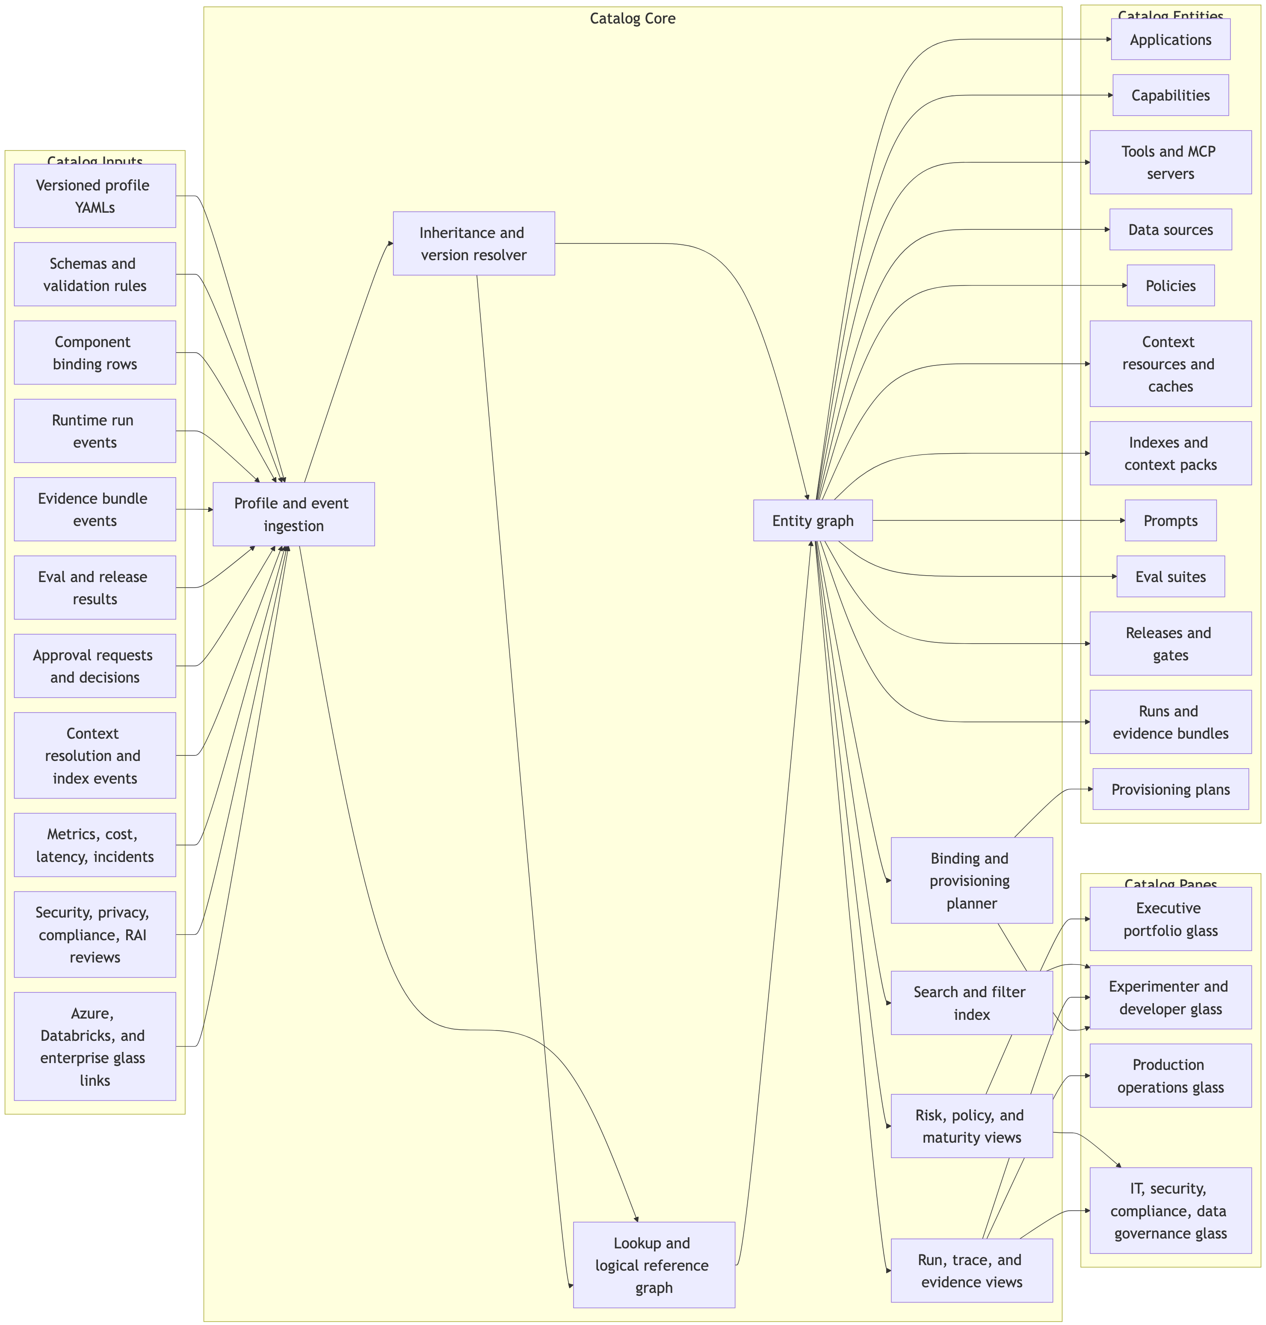
The catalog is where profile intent, binding choices, runtime evidence, and governance posture meet
[Catalog core]
Catalog core diagram

Slide 29
Catalog URLs are the routing contract between profiles, harnesses, resolvers, bindings, and evidence
Segment | Platform behavior
scheme | Selects object family: project, app, agent client, instrumentation, hook, collector, raw trace, trace import, run, trace, review, feedback event, artifact, data, index, context pack, prompt, eval, release, glass.
area | Finds owner domain, platform service, policy scope, and portfolio grouping.
environment | Chooses dev, staging, or prod binding set and permission posture.
selector | Pins version, stage, snapshot, build, release, commit, or timestamp.
Additional context | Resolver outputs include the physical handle, policy version, binding row, snapshot or artifact hash, and evidence reference needed for replay and audit. Sources: catalog.md Universal Logical References, implspec.md Section 7.1, agent_harnesses.md Sections 10-12
[Logical reference contract]
Services exchange logical references instead of physical paths, endpoints, or vendor IDs. The catalog, runtime, harness intake, broker, and resolver choose the approved binding for the caller, profile, environment, release, and policy state.
://point32health///?
prompt://point32health/benefits/prod/domain_agent/default?at=stage:approved
datasource://point32health/benefits/staging/plan_documents?at=snapshot:2026-06-01
eval://point32health/benefits/prod/golden_set/v1
trace://point32health/benefits/prod/run_abc123/evidence
project://point32health/platform/dev/agentic_intake_demo
agentclient://point32health/platform/dev/codex
rawtrace://point32health/platform/dev/codex/session/native_session_123
traceimport://point32health/platform/dev/codex-hook-normalizer-v1
review://point32health/platform/dev/research/run_20260813_001/spec-review
reviewevent://point32health/platform/dev/research/run_20260813_001/spec-review/cmt_03
artifact://point32health/platform/dev/research/run_20260813_001/reviews/spec-review

Slide 30
POST /runs is the main entry point for access surfaces
[Runtime plane] ResolveApplication profile and inherited defaults. ValidateSurface, user/app identity, release, budget. RecordDurable run ID and initial evidence. BrokerAccess decisions for data/tools/context. InvokeTools, capabilities, model route, sandbox jobs. ReviewRegister review surfaces, feedback events, and live endpoints. ReturnStatus, outputs, approval state, evidence link.
POST /runs
{
"application_profile": "synthetic_benefits_navigator_app",
"surface": "benefits_demo_react_app",
"user_context": {"roles": ["benefits_sme"]},
"task": {"type": "benefits_question"},
"requested_outputs": ["answer", "citations", "limitations"]
}

Slide 31
Review surfaces give HITL a richer runtime contract
Backing mode | Use it for | Archive
Markdown/spec review | Plans, specs, rubrics, release notes. | Source, rendered HTML, feedback manifest.
Static HTML artifact | Generated sites, dashboards, browser-test replays. | Asset bundle, hashes, screenshot, feedback.
Live HITL app | Temporary reviewer UI, prototype, eval workbench. | Static export where possible; screenshot/HAR/log manifest otherwise.
External glass | Azure, Databricks, Foundry, Purview, GitHub, SharePoint views. | External ID/URL, synced status, local decision evidence.
Additional context | Generated HTML is useful but untrusted: sandboxed frame, strict CSP, no ambient credentials, signed expiring access, hash checks, and scans before agent reuse.
[Review object model]
The same HITL mechanism should expose Markdown specs, output drafts, static HTML bundles, live reviewer apps, eval reports, and external glass views through catalog-owned endpoints.
review://point32health/benefits/dev/run_abc123/spec-review
app://point32health/benefits/dev/hitl/run_abc123/spec-review
hitl://point32health/benefits/dev/run_abc123/review/spec-review
reviewevent://point32health/benefits/dev/run_abc123/spec-review/cmt_03
artifact://point32health/benefits/dev/run_abc123/reviews/spec-review

Slide 32
The catalog can be operational without becoming a shadow admin portal
Action | Write path | Catalog record
Provision resource | Preview, approval, queued worker, provider driver | Plan, job ID, resource IDs, links, rollback
Disable tool/model route | Runtime/API gateway/model policy driver | Actor, reason, affected releases, evidence
Launch eval/red-team run | Eval control API, queued worker, Foundry/MLflow driver | Dataset, job ID, results, gate impact
[Glass behavior]
Reads through owners
Provider APIs, platform APIs, telemetry exports, event imports, and external glass links.
Writes through workflows
Typed platform APIs, provisioning compiler, policy API, approval API, and provider drivers.
Stores evidence
Action request, actor, policy version, binding row, provider resource, result, rollback or revocation handle.

Slide 33
A relational registry spine makes lookup, lineage, versioning, and promotion practical
Core table | Purpose
registry_objects | Governed object by type, key, owner, risk, status.
registry_object_versions | Immutable profile, prompt, policy, schema, tool, binding, release versions.
registry_relationships | Typed graph across apps, tools, data, policies, releases, evidence.
registry_bindings | Concrete implementation rows by provider, environment, resource.
registry_events | Append-only audit trail for create, approve, select, provision, sync.
Why relational first | Owners, releases, approvals, versions, policy assignments, evidence links, and external glass links need joins, constraints, and version history. Large artifacts can live in ADLS/Blob/Delta.

Slide 34
Evidence Traces

Slide 35
The evidence bundle must reconstruct the run without trusting the agent’s memory
Evidence use | Required behavior
Audit and compliance | Export chain of custody, policy versions, reviewer decisions, source links, retention and legal-hold state.
Debug and replay | Recover the exact profile, release, context handle, prompt/config, model route, tool path, and output artifact.
Reuse and evals | Separate raw trace, redacted trace, eval case, optimizer input, and memory artifact with distinct approvals.
[Evidence schema]
Run identity
Human/caller, app, surface, capability, workload identity, environment, release, approval state, run ID.
Control events
Profile resolution, policy decision, credential/handle exchange, context resolution, guardrail result, eval gate.
Artifact lineage
Snapshots, indexes, prompts, model routes, tool calls, outputs, hashes, storage refs, raw/redacted state.

Slide 36
Reuse And Cooperation

Slide 37
Synthetic Benefits is the first full application proof after intake works
[Full app proof]
### Why it comes after intake
The intake spine proves run identity, trace capture, canonical evidence, review state, and memory candidates first. Synthetic Benefits then exercises the full app path without PHI or source-system writeback.
Catalog renders base profile, Synthetic Benefits overlay, logical refs, bindings, and release gate. Profile resolves allowed surfaces, authority, synthetic data, tools, evidence, evals, and approval rules. Broker grants scoped synthetic data access and resolver selects snapshot/cache/index handles. Runtime retrieves plan context, calls tools, drafts answer, and routes review where needed. Evidence captures access, context, retrieval, tool/model calls, approvals, evals, and citations. Catalog shows successful and blocked runs, eval state, observability, and candidate reuse.
Sources: prototype.md, catalog.md Prototype-Supporting Catalog MVP, implspec.md Phase 2

Slide 38
Reusable capabilities are invoked through typed contracts, not arbitrary agent conversations
[Composability]
Bad control protocol
Benefits Agent asks Claims Agent in natural language what happened with a claim, inheriting unclear context and authority.
Good control protocol
Benefits app invokes claims.accumulator_explanation@v1 with validated inputs and receives typed outputs plus evidence refs.
capability:
name: claims.accumulator_explanation
allowed_callers: [benefits_explanation_app, claims_exception_resolution_app]
input:
member_ref: scoped_member_id
plan_year: integer
claim_refs: list[claim_ref]
output:
answer: markdown
accumulator_events: list[accumulator_event]
evidence_refs: list[evidence_ref]

Slide 39
Subagents are allowed when their scope, tools, context, budget, and evidence are explicit
[Delegation model] Lead runProfile-bound app owns user contract, authority, release state, and final evidence. Context packetPass task-specific files, source refs, constraints, and stop conditions instead of full transcript. Child agentResearch, review, retrieval, test triage, policy lookup, or document comparison with scoped tools. Handoff traceParent/child run IDs, tool calls, guardrails, cost, intermediate outputs, and synthesis refs. GateHuman or evaluator review before high-impact use, promotion, or reusable capability graduation.
Recursive delegation deeper than one level stays watchlist until depth, cost, termination, handoff validation, and trace-inspection controls are mature.

Slide 40
App-local components become shared capabilities only after they earn it
[Reuse path] App-localUseful inside one profile with local assumptions. CandidateSecond consumer or repeated pattern appears. Typed betaContract, allowed callers, owner, evals, evidence hooks. StableVersioning, release gate, observability, runbook, security review. PrimitivePlatform-owned capability with multiple consumers and cost/quality telemetry.
Likely graduates: evidence bundle writer, approval router, access broker, context resolver, retrieval/index gateway, document understanding, provider identity resolution, Delta table query tool.

Slide 41
Tools are registered, risk-scored, allowlisted, versioned, routed, and evidenced
Registry field | Why it matters
allowed_callers | Prevents broad reuse outside approved profiles.
operation_contract | Validates input/output and supports SDK/schema generation.
evidence_hook | Ensures tool use appears in run evidence and release review.
[Tool governance] RegisterTool, MCP server, API route, operation contract, owner. ClassifyRisk level, data class, writeback/external communication flags. AuthorizeAllowed callers, broker policy, approval requirements. RouteAPIM/API Center/MCP gateway/function/backend route. RecordRequest/response summary, redaction, output, evidence ref.

Slide 42
Security And Compliance

Slide 43
Every material run joins the identities and controls needed for one bounded task
[Identity model]
Caller
Human, service job, app identity, allowed surface, role facts.
Profile
Application, capability, authority level, tool policy, release state.
Resource
Data source, context pack, index, tool, MCP route, model route, artifact.
Environment
Dev, synthetic, staging, production, regulated workspace, data-side execution.
Evidence
Run ID, policy version, access decision, approval basis, retention state.
identity root + RBAC facts + profile policy + purpose + data classification
+ approval state + environment + release state
-> access decision
-> short-lived credential or handle
-> evidenced use

Slide 44
The broker turns identity facts into run-scoped authorization
[Access broker]
Who
User, app identity, surface, service principal, group.
What
Profile, capability, tool/API/MCP operation, data source.
Why
Purpose, task, environment, maturity, release state.
Risk
Data class, PHI/PII, writeback, high-impact action, external comms.
State
Approval, exception, policy version, TTL, evidence obligations.
{
"decision": "grant",
"granted_mode": "mounted_snapshot",
"scope": {"document_id": "doc-456", "version": "v12", "mode": "read_only"},
"expires_at": "2026-06-03T15:05:00Z",
"policy_ref": "access/sharepoint_contract_readonly.policy.yaml"
}

Slide 45
Agents receive handles and artifacts; credentials stay inside platform boundaries
[Credential boundary]
Allowed exchange outputs
OBO delegated token server-side, managed identity call, signed URL, retrieval handle, read-only snapshot, MCP session.
Disallowed exposure
Prompts, traces, queues, context cache, semantic cache, and agents must not receive broad reusable credentials.
Broker cache stance
Only encrypted, scoped, TTL-bound, revocable, evidenced, and broker-internal when performance requires it.
Credential cache, semantic cache, context/materialization cache, queue state, and trace/evidence stores are separate security domains.

Slide 46
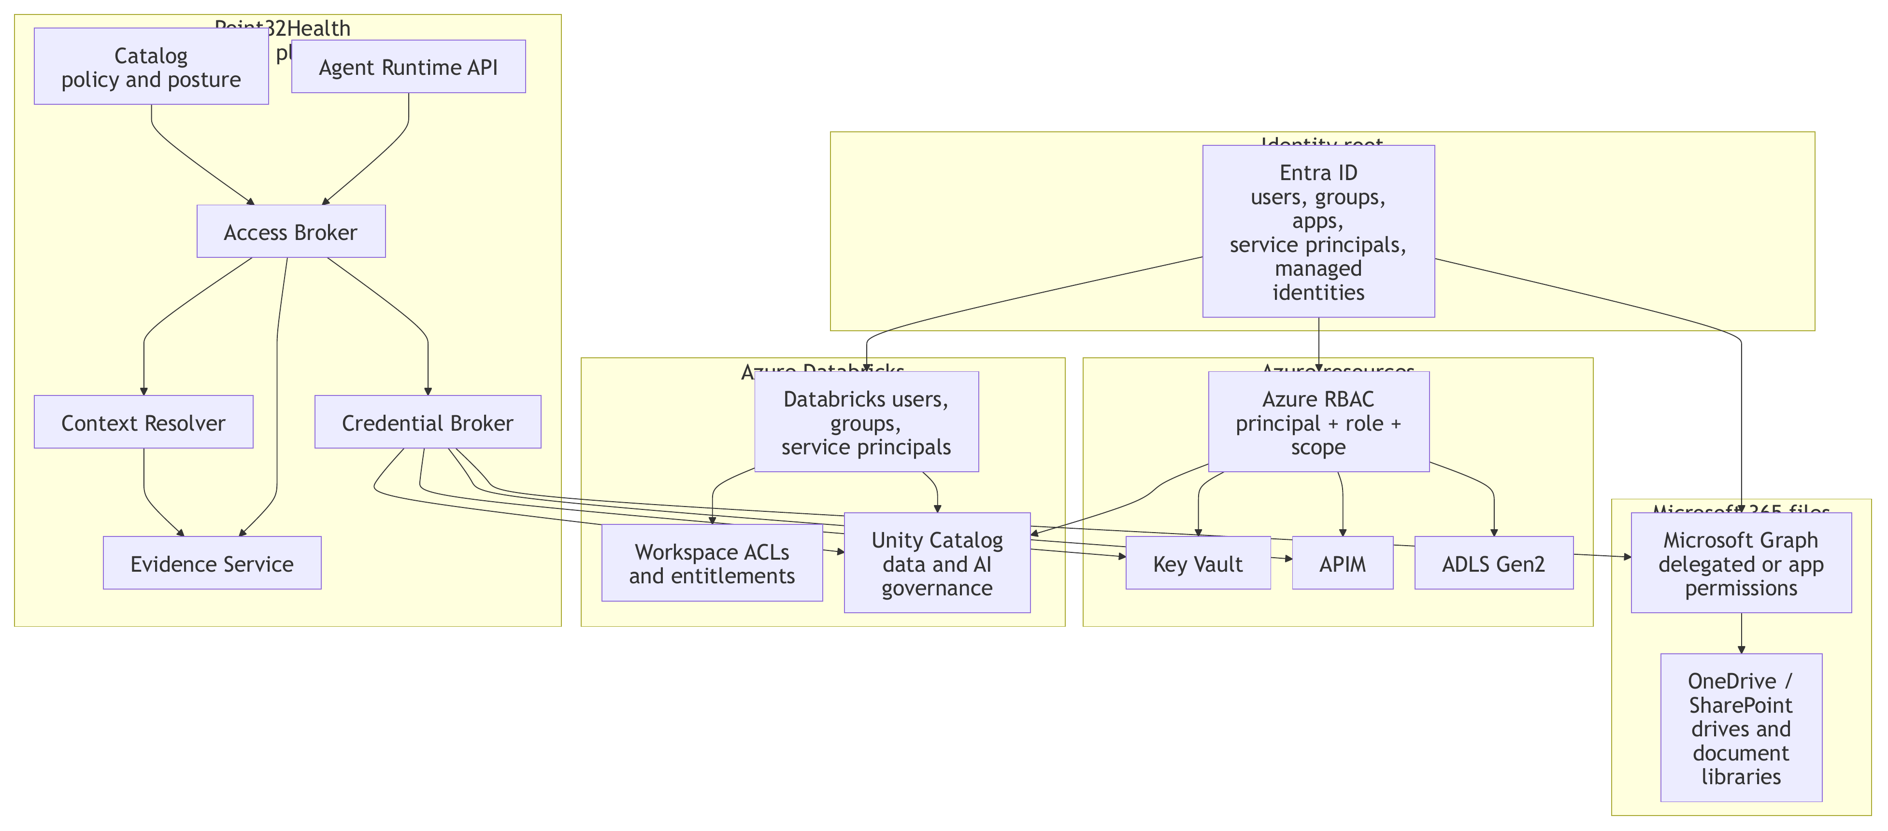
Point32Health policy composes enterprise identity and cloud-specific controls
[Identity and authorization]
Current figure from identity_auth_layers.pdf
Identity layers diagram

Slide 47
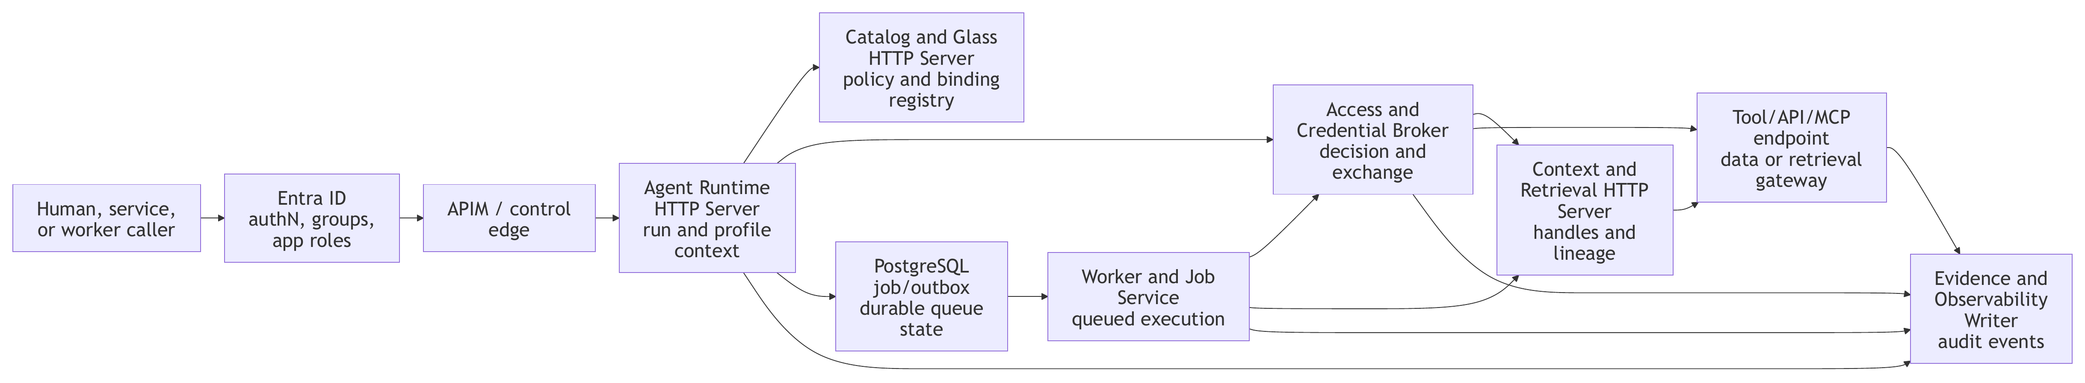
Every material run routes through identity, profile policy, brokered access, workers, tools, and evidence
[Security flow]
Runtime
Creates run envelope before source access.
Catalog
Supplies profile, policy, release, binding, approval facts.
Broker
Grants, denies, scopes, exchanges, and logs access.
Evidence
Platform services write audit events instead of trusting agent self-logging.
Run-scoped access flow

Slide 48
Untrusted content may inform answers, but it must not become operational authority
[Guardrail stack]
Source controls
Label retrieved chunks, trace memory, tool responses, uploads, and context packs by trust, data class, owner, lineage, and reuse eligibility.
Action controls
Run prompt/document attack detection, task-adherence checks, tool gates, model/output inspection, and red-team evals.
Escalation controls
Block, redact, route to reviewers, or require exception records depending on environment, data, tool, and impact.
Guardrail evidence records detector/evaluator version, mode, decision, severity, policy version, source/context IDs, route, reviewer target, and release gate consumed.

Slide 49
Sandbox jobs and external agent clients run as controlled execution workloads
[Execution plane]
Inputs
Explicit artifacts, context handles, allowed tools, run-scoped credentials only when unavoidable.
Runtime policy
Signed images, deny-by-default egress, resource limits, timeout/kill policy, ephemeral filesystem.
Outputs
Artifact-only outputs, evidence hooks, log redaction, cleanup, telemetry import for external clients.
sandbox:
required_for: [document_ingestion, chunking, index_building]
substrate: local_docker_then_container_apps
network_policy: deny_by_default
filesystem_policy: ephemeral_only
secrets_policy: broker_injected_short_lived
image_policy: signed_images_required

Slide 50
System staging must fail closed when required evidence or signoff is missing
Reviewer function | Decision scope
Data and source owners | Classification, minimum necessary access, lineage, reuse permission, source constraints.
Security, IT/IAM, platform | Identity, broker posture, gateways, sandbox, monitoring, revocation, route controls.
Compliance, privacy, RAI, operations | PHI handling, auditability, eval adequacy, residual AI risk, rollback, incident readiness.
[Release gate]
Evidence required
Profile, release, prompt, model, data, tool, broker, guardrail, eval, approval, retention, and rollback versions.
Human approval
Writeback, external communication, clinical, financial, adverse, regulatory, exception, and PHI reuse paths need role-qualified review.
Promotion blockers
Unresolved high-risk findings, missing guardrail evidence, unclear redaction posture, unowned exceptions, or untested incident paths.

Slide 51
Environment is part of the contract, so promotion cannot hide inside app code
[Release control]
The catalog stores selected binding rows for each profile version, environment, and release. URLs and logical IDs make dev, staging, and production token prod explicit; release gates record what passed before promotion.
Dev Local or synthetic bindings, schema validation, smoke evals, evidence event coverage, and prototype owner approval. …/dev/…
Staging Production-like bindings, broker policy, guardrails, HITL routing, regression evals, runbook, and rollback rehearsal. …/staging/…
Production Approved release version, immutable binding set, monitoring, incident hooks, kill switch, and catalog-visible rollback target. …/prod/…
environment: staging
logical_id: datasource://point32health/synthetic/staging/plan_documents
binding_set: release-binding-set://synthetic-benefits/staging/v3
release_gate: release-gate://synthetic-benefits/promote-to-production
gate_requires: [eval_pass, approval, broker_policy, evidence_trace, rollback]
Sources: catalog.md lookup/binding model, release page, governance workflows

Slide 52
HITL And Easy Evals

Slide 53
Evals start with harness capture, then move to application behavior
Eval layer | What it checks | Gate before moving on
Harness capture evals | Prompt, context, files touched, tool calls, artifacts, review surfaces, feedback events, archive manifests, cost/error/completion state. | Run, project, agent-client, raw-trace, canonical-trace, evidence, and redaction state are present.
Trace-memory evals | Approved summaries, memory files, cache records, context-pack candidates, and BM25/full-text index records. | Observed, inferred, AI-drafted, and approved catalog facts are clearly separated.
Synthetic Benefits local suite | 15-25 benefits questions, answer accuracy, citation fidelity, retrieval completeness, refusal, tool correctness, no PHI leakage. | Release gate blocks unsupported writeback, missing citation, PHI leakage, or critical answer failure.
Foundry bridge | Eligible case export, Foundry evaluator runs, row results, local/human comparison, external links. | Catalog stores the lineage and decides which external evals are advisory or gating.
Source | Source: evals.md Section 6
[Evaluation path]
The first eval question is whether the platform can capture and normalize managed agent work. The second is whether Synthetic Benefits answers safely and with evidence. Foundry and other tools are useful backends, while the catalog remains the release record.

Slide 54
Runs become promotable only when evidence and evals support the release state
[Governance plane] EvidenceRun, profile, access, context, retrieval, prompt, model, tool, sandbox, output, approval. EvalsGolden set, regression, citation fidelity, safety, latency, cost, human agreement. ReleaseGate result, failing cases, approver decisions, rollback target, exceptions. ObservabilityRun count, active users, p95 latency, cost, failure, fallback, approval, drift. OperationsIncidents, runbooks, kill switches, rollback, disabled routes/tools/models.
The catalog connects these views so technical debugging, security review, compliance audit, and executive visibility use the same underlying evidence record.

Slide 55
User Simplicity And Future Readiness

Slide 56
Context Memory And Trace Reuse

Slide 57
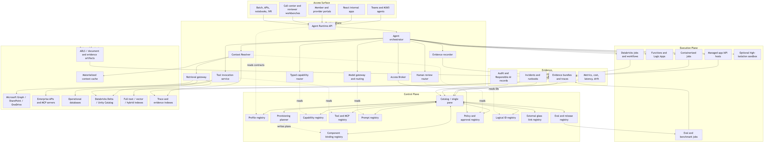
Profiles and runs use logical references; resolver services select approved physical context
[Context contract]
data:
sources:
- logical_id: datasource://point32health/synthetic/dev/plan_documents
context_resources:
- logical_id: datasource://point32health/synthetic/dev/plan_documents
materialized_snapshot: snapshot://synthetic-benefits-demo/plans/v1
indexes:
- index://point32health/synthetic/dev/plan_documents/fulltext?at=build:1
Context resolver flow

Slide 58
Context work must preserve lineage, policy, and evidence across derived artifacts
Required metadata | Why
source hash or selector | Reproducibility and audit.
ACL and data class | Minimum necessary and policy enforcement.
chunk/index policy | Retrieval quality and release-gate comparison.
evidence refs | Run trace and compliance review.
[Data and context plane] SourceSharePoint, OneDrive, API, DB, Delta, policy docs, traces. SnapshotVersion, hash, retention, ACL, redaction state. CacheMaterialized context under policy and freshness rules. IndexFull-text, vector, hybrid, ColBERT, structured, trace. HandleRetrieval, mount, search session, artifact reference. EvidenceResolution event, retrieval event, source lineage, index build.

Slide 59
Memory artifacts need separate IDs, approvals, retention rules, and eval gates
Artifact | Governance rule
Raw trace | Canonical evidence; access stays limited to approved review and audit audiences.
Redacted trace or eval case | Derivative artifact with its own classification, allowed consumers, hash, and approval basis.
Reusable memory | Never treated as self-evidently true; must link to sources and pass stale-policy, PHI leakage, and overgeneralization tests.
[Future-ready memory]
Context packs
Catalog artifacts with logical ID, owner, source versions, allowed profiles, sensitivity labels, freshness rules, and expected citations.
Compaction
Derivative summaries with source refs, unresolved decisions, constraints, omitted-context warnings, validation status, and replay links.
Trace memory
Reusable memory only after redaction/de-identification, permissioning, retention review, poisoning checks, and revocation support.

Slide 60
Every future-practice experiment should be catalog-visible before it influences a release
Practice | Initial stance
Subagents and goal loops | Bounded internal work with stop conditions, budgets, and parent/child evidence.
Context packs and compaction | Ready for prototype when source-linked, validated, and policy controlled.
Trace-derived memory | Only after redaction, approval, retention review, and poisoning/staleness tests.
Managed agent platforms | Use where useful, mirror essential trace/eval records into the catalog.
[Adoption control]
### Required experiment fields
Hypothesis, affected profile, data class, baseline, evaluation suite, evidence artifacts, promotion gate, rollback target, owner, and allowed environments.
External traces from OpenAI, Azure, Databricks, MLflow, or other tools can be useful, but the catalog remains the enterprise record.

Slide 61
Optimizers and learned policies propose candidates; they do not update production directly
[Optimization and learning]
Prompt/program optimization
Manual prompts, DSPy/MIPROv2, GEPA, and similar optimizers run offline against approved benchmark corpora.
Safe RL-like targets
Start with routing, retrieval selection, prompt/template selection, tool retry policy, delegation policy, and reviewer queue routing.
Release controls
Candidate artifacts need owners, metrics, safety results, human review where required, rollback targets, and evidence links.
optimization_record:
baseline_release: benefits_prompt@v3
optimizer: GEPA_or_MIPROv2
inputs: [approved_benchmark, redacted_trace_snapshot]
gates: [citation_fidelity, PHI_leakage, prompt_injection, cost, latency]
promotion: reviewer_approved_release_artifact

Slide 62
Build Roadmap

Slide 63
Build the intake spine first, then harden through application proofs
[Build path] 1. Harness intake foundationThin catalog, profile binding, managed session launch, raw/canonical trace, evidence writer, review surfaces, memory seed. 2. Synthetic Benefits MVPProfile ingestion, broker, resolver, snapshot/cache/index, sandbox job, tool registry, HITL, review pages, evals, glass. 3. DAIS and document substrateSharePoint snapshot, DOCX/PDF parser, redline sandbox, approval, writeback, DAIS evals. 4. Payer use-case pilotsBenefits assist, provider directory, HEDIS, medical necessity review, pended-claim assistant. 5. Shared capabilitiesEvidence writer, access broker, context resolver, materialization/cache, retrieval gateway, review router. 6. Production and AI-native expansionDashboards, release gates, cost, incident runbooks, security tests, prompt/PHI evals, DR, governed memory.
Open decisions stay concrete: run identity schema, enterprise role mapping, credential TTLs, break-glass chain, provisioning schema, Databricks handoffs, security glass screens, mandatory evidence schema, and production release gates.
Source: implspec.md Section 21 and securityspec.md Section 18

Slide 64
A River-like operating model follows from governed run residue
Reusable asset | Promotion gate | Reuse boundary
Prompt or context pack | Owner approval + eval evidence | Profile, role, data class, retention
Capability or tool path | Risk score + broker policy | Scoped invocation, not ambient credential
Lesson, exception, or incident | Review outcome + control update | Catalog-visible, privacy-filtered memory
Source | Sources: riverness.md, agent_harnesses.md, catalog.md, securityspec.md, evals.md
[AI-native expansion]
The technical platform earns a River-like operating model only when useful run residue can be promoted into governed memory, context packs, prompts, eval cases, tools, capabilities, decisions, and lessons without bypassing policy.
Managed workHarness sessions, Teams, apps, batch jobs, notebooks, reviews. Profile-bound sessionOwner, purpose, authority, release state. Brokered executionScoped tools, context, credentials, approvals. Evidence bundlePrompt, access, retrieval, model, tool, eval, output. Catalog promotionPrompt, context pack, capability, eval case, decision. Governed memoryNext run starts with scoped, source-linked, revocable prior work.
Notes:
Use this as the technical payoff slide. It should feel like the end state of the substrate, not the first build step.

Slide 65
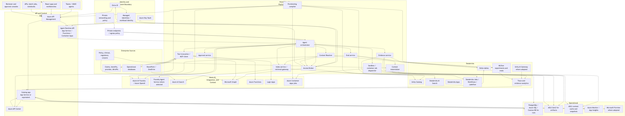
Azure-first implementation with Databricks for lakehouse, Unity Catalog, MLflow, and data-side execution
[Appendix figure]
Current figure from implspec.pdf
Azure and Databricks implementation map

Slide 66
Base profile excerpt: inherited enterprise controls
[Appendix YAML]
api_version: agentic.p32h/v0.1
kind: AgenticApplicationProfile
metadata:
name: enterprise_healthcare_agent_base
catalog:
visibility:
value: catalog_visible
executive_summary_required:
value: true
engineering_view_required:
value: true
authority:
default_level:
value: L1_DRAFT
approval_required_for:
value: [source_system_writeback, external_communication, adverse_action,
payment_change, clinical_determination, pricing_decision, regulatory_filing]
access:
access_broker_required:
value: true
ambient_credentials_allowed:
value: false
evidence:
bundle_required:
value: true
evals:
required:
value: true
release_gate_required:
value: true

Slide 67
Synthetic Benefits resolved value view: app-specific controls
[Appendix YAML]
metadata:
name: synthetic_benefits_navigator_app
lifecycle_status: prototype
inheritance:
parent: enterprise_healthcare_agent_base
surfaces:
allowed_surface_types: [react_app, api, cli, teams, hitl_console]
authority:
default_level: L1_DRAFT
autonomous_actions_allowed: [retrieve, summarize, explain_plan_language, draft_response]
prohibited_actions: [use_real_phi, use_real_member_data, perform_real_writeback]
data:
data_classification: internal
sources:
- logical_id: datasource://point32health/synthetic/dev/plan_documents
- logical_id: datasource://point32health/synthetic/dev/eligibility
- logical_id: datasource://point32health/synthetic/dev/accumulators
access:
allowed_access_modes: [database_readonly, mounted_snapshot, api]
writeback_default: disabled
evidence:
required_events: [run_created, profile_resolved, access_decision, context_resolved,
snapshot_or_cache_selected, index_selected, retrieval, tool_call, model_call,
output_artifact, approval, eval_result]

Slide 68
Runtime payload pattern: profile-bound run creation
[Appendix JSON]
{
"application_profile": "dais_contract_redlining_app",
"surface": "dais_react_app",
"user_context": {
"user_id": "user-123",
"roles": ["legal_reviewer"]
},
"task": {
"type": "contract_redline",
"description": "Review contract against approved clause policy"
},
"artifacts": [{
"type": "sharepoint_document",
"document_id": "doc-456",
"version": "v12"
}],
"requested_outputs": ["redlined_docx", "clause_summary", "risk_summary"]
}
Source: implspec.md Section 8.2

Slide 69
Minimum evidence timeline for a runtime-connected catalog
[Appendix schema]
run_created
profile_resolved
catalog_lookups_resolved
implementation_bindings_selected
surface_validated
managed_session_launched / trace_imported
access_decision
context_resolved
snapshot_or_cache_selected
index_selected
context_pickup_decision
retrieval
tool_call
agent_runner_started / agent_runner_completed
model_call or mock_model_call
output_artifact
approval_requested
approval_decision
eval_result
run_completed
Source: catalog.md Prototype Run Timeline and Governance Workflows

Slide 70
Decisions to close before controlled pilot and production
Decision | Why it matters
Run identity schema | Determines evidence fields, policy evaluation, and incident review.
Enterprise role mapping | Maps Entra groups, app roles, Azure RBAC, Databricks roles, and Unity grants into policy facts.
Credential TTL classes | Balances performance, revocation, audit, and source-system risk by environment and data class.
Prompt/tool injection gates | Defines release-blocking tests for exfiltration, unsafe action, PHI leakage, and hallucinated citations.
Security glass screens | Defines which controls are read-only, queued actions, or approval-required provider-side effects.
Provisioning schema | Makes environment, binding policy, generated resources, approvals, and external links explicit in profiles/catalog.
[Appendix decisions]

Slide 71
Old Slides For Review
Appendix

Slide 72
Engineering Needs One Platform
Appendix
[Managed platform rationale]
Because every implementation should share the same runtime, access, evidence, memory, compliance, HITL, eval, and release contracts before it reaches production.
1Uniform StandardsProfiles, APIs, broker rules, evidence, evals, and releases. 2Evidence TracesIdentity, access, context, guardrails, approvals, and outputs. 3Reuse And CooperationTyped capabilities, inheritance, subagents, and handoffs. 4Security And ComplianceRun identity, brokered handles, PHI controls, signoff, and release gates. 5HITL And Easy EvalsUser-safe workflows, reviewer routing, and reusable eval machinery. 6User Simplicity And Future ReadinessStable user workflows while memory, optimization, and platform choices evolve.
Sources: securityspec.md, future_practices.md, implspec.md, catalog.md

Slide 73
Synthetic Benefits exercises the full architecture with safe synthetic data
Appendix
[Prototype proof]
### Question path
User asks whether physical therapy is covered for a synthetic member and what the likely cost is with a selected provider.
Profile resolves allowed surfaces, data, tools, evidence, evals, and approval rules. Broker grants scoped synthetic data access. Resolver selects synthetic snapshot/cache and simple index. Runtime retrieves plan context, calls tools, and drafts answer. Evidence captures timeline, citations, approvals, evals, and improvement candidates. Catalog displays run timeline, approval, eval, metrics, and profile lineage.

Slide 74
Build Roadmap
Appendix

Slide 75
Build the smallest executable platform slice, then harden through pilots
Appendix
[Build path] FoundationCatalog MVP, YAML schemas, profile ingestion, runtime skeleton, evidence, broker, resolver. Synthetic BenefitsSynthetic data, retrieval, tools, evidence timeline, approval, golden evals, metrics. DAIS/docsSharePoint snapshot, DOCX/PDF sandbox, redline generation, writeback approval. Payer pilotsBenefits assist, provider audit, HEDIS shadow, MNG, claims pended-claim assistant. ProductionRelease gates, security tests, PHI/prompt evals, dashboards, incident runbooks, DR.
Open decisions: enterprise role mapping, credential TTLs, provisioning schema, Databricks handoffs, security glass screens, mandatory evidence schema, production release gates.

Slide 76
Riverbed makes the runtime an AI-native organization substrate
Riverbed asset | Promotion gate | Reuse boundary
Prompt or context pack | Owner approval + eval evidence | Profile, role, data class, retention
Capability or tool path | Risk score + broker policy | Scoped invocation, not ambient credential
Lesson, exception, or incident | Review outcome + control update | Catalog-visible, privacy-filtered memory
Source | Sources: riverness.md, agent_harnesses.md, catalog.md, securityspec.md, evals.md
Appendix
[Riverbed addition]
The runtime, broker, resolver, catalog, evidence store, and eval workbench are the Riverbed: the governed layer where useful run residue becomes reusable system capability.
Harness or product runTeams, apps, batch jobs, notebooks, reviews. Profile-bound sessionOwner, purpose, authority, release state. Brokered executionScoped tools, context, credentials, approvals. Evidence bundlePrompt, access, retrieval, model, tool, eval, output. Catalog promotionPrompt, context pack, capability, eval case, decision. Reusable memoryNext run starts with governed prior work.

