Slide 1
Language Models
From Vectors to ChatGPT

Slide 2
Vectors

Slide 3
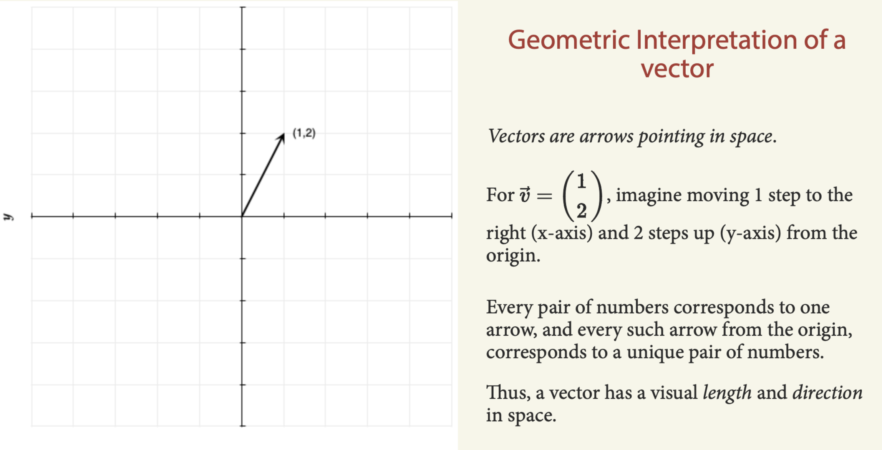

Slide 4
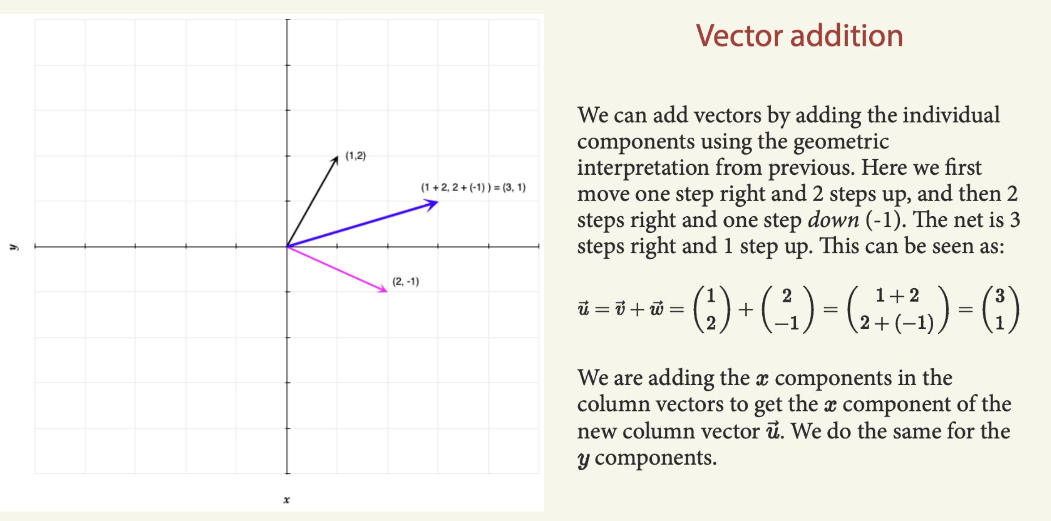

Slide 5
Embeddings

Slide 6
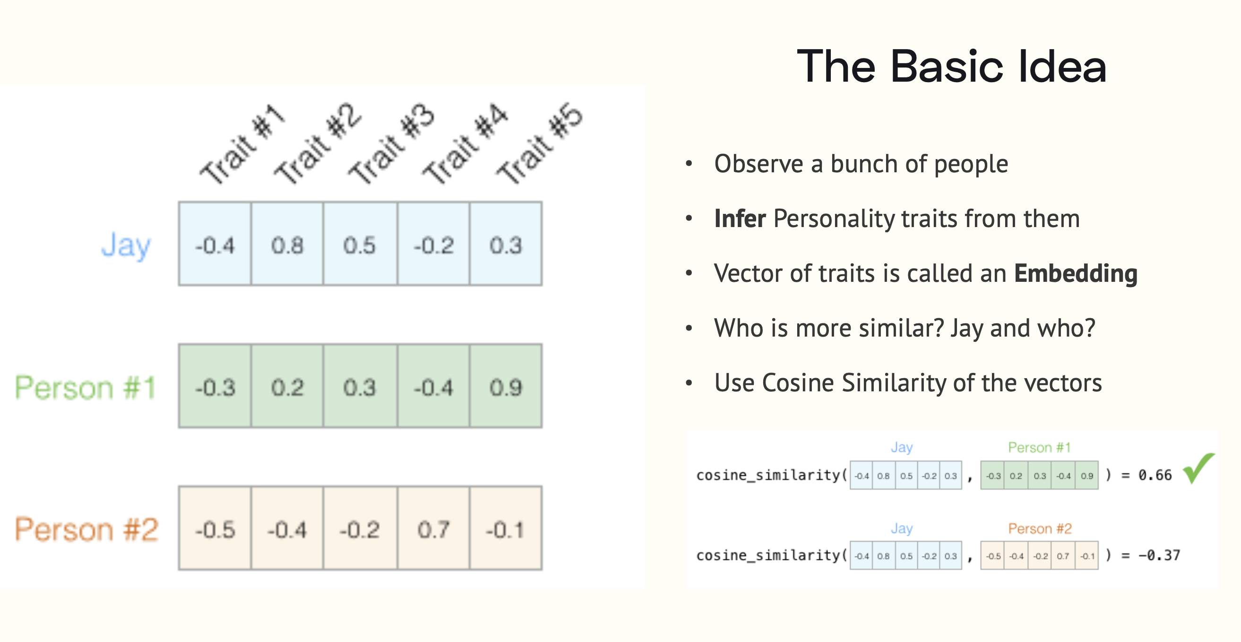

Slide 7
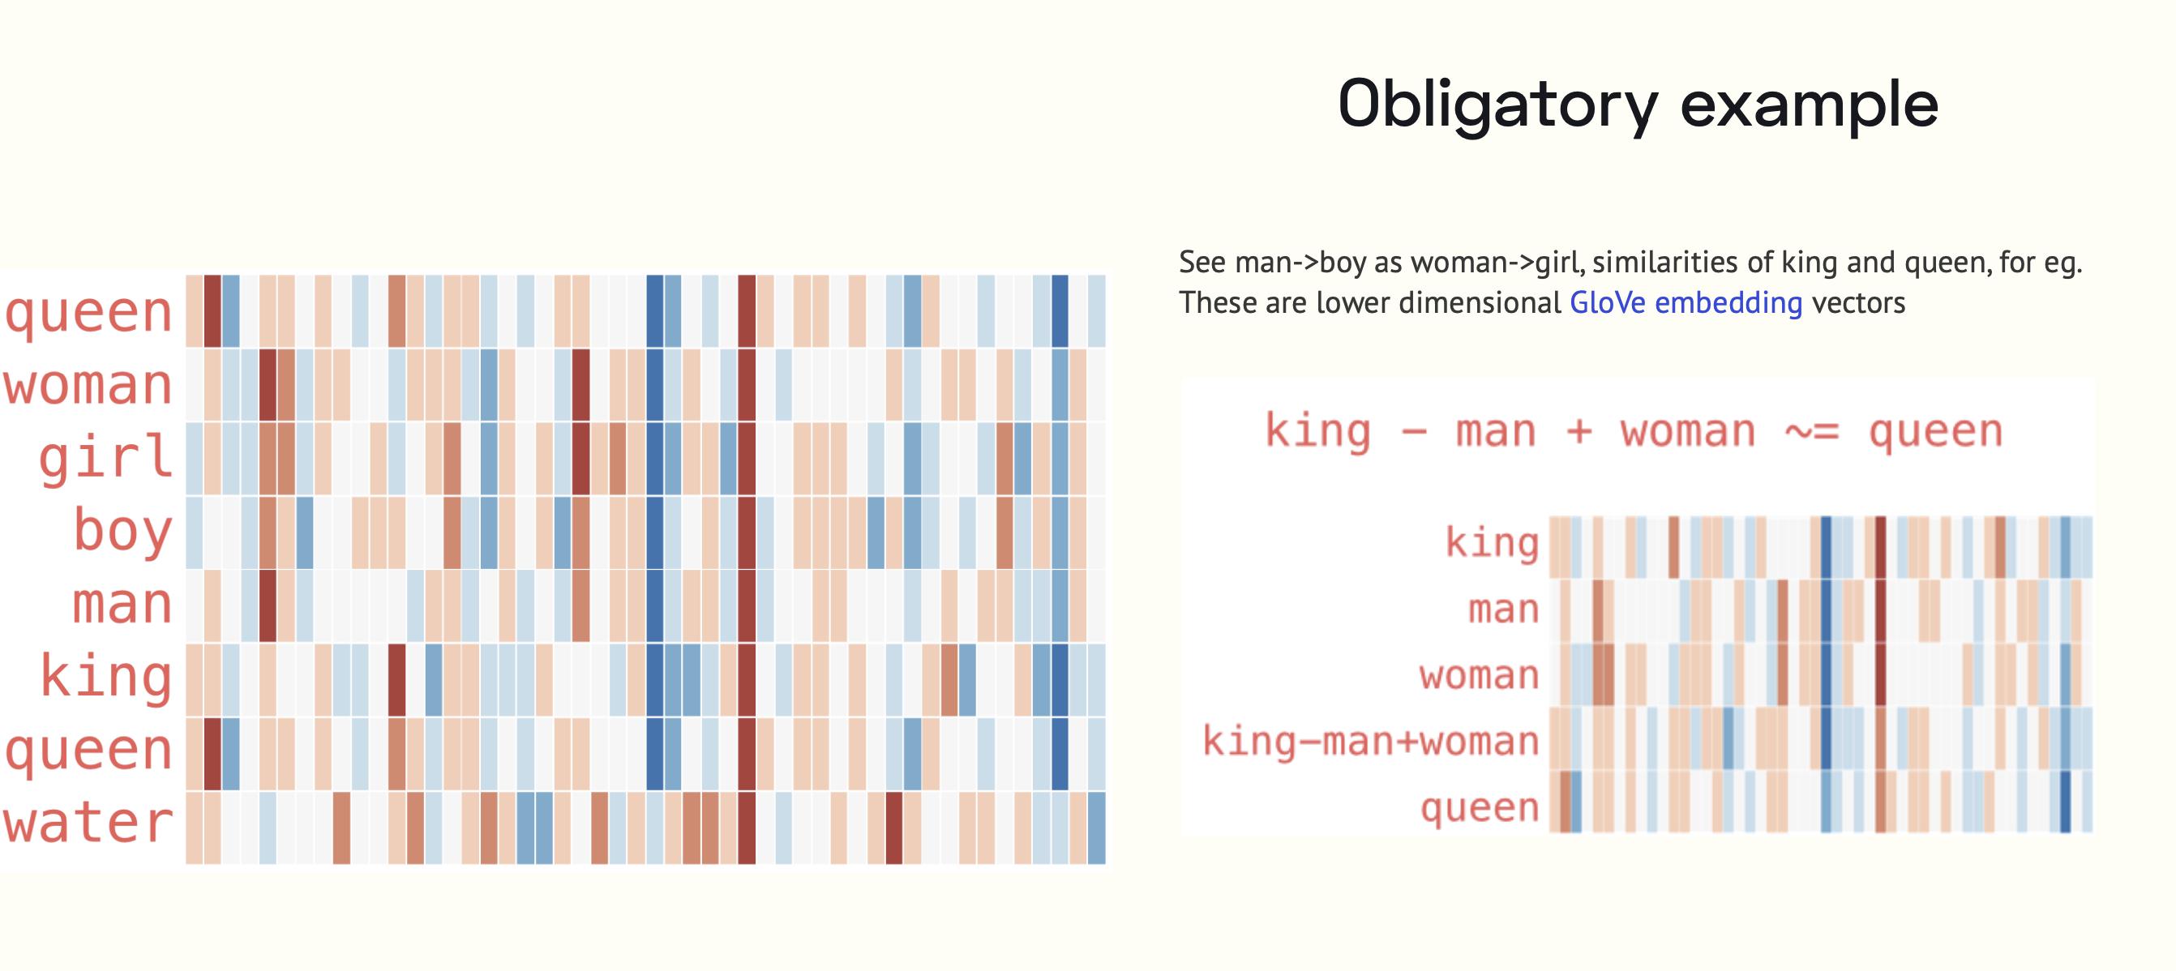

Slide 8
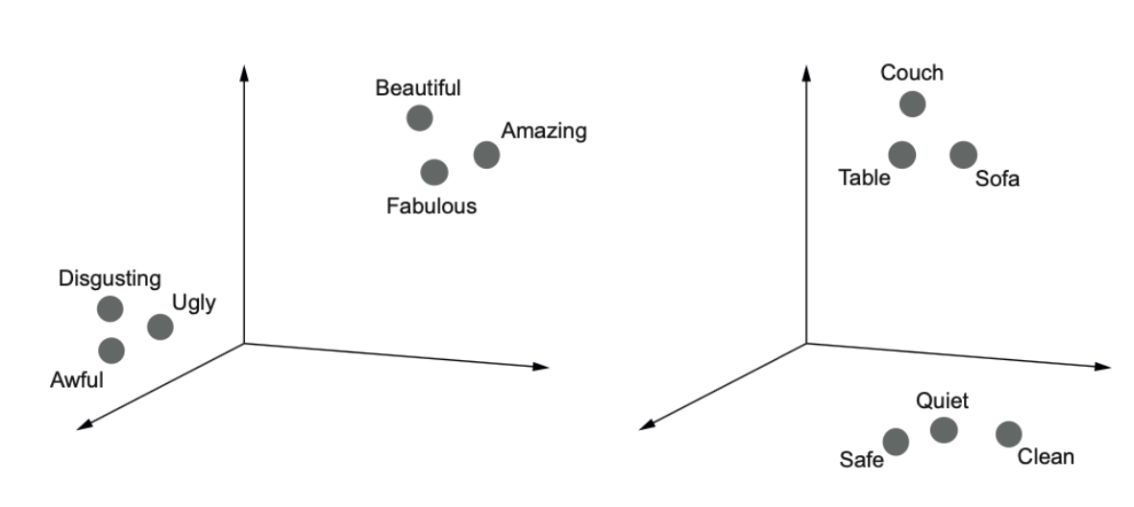
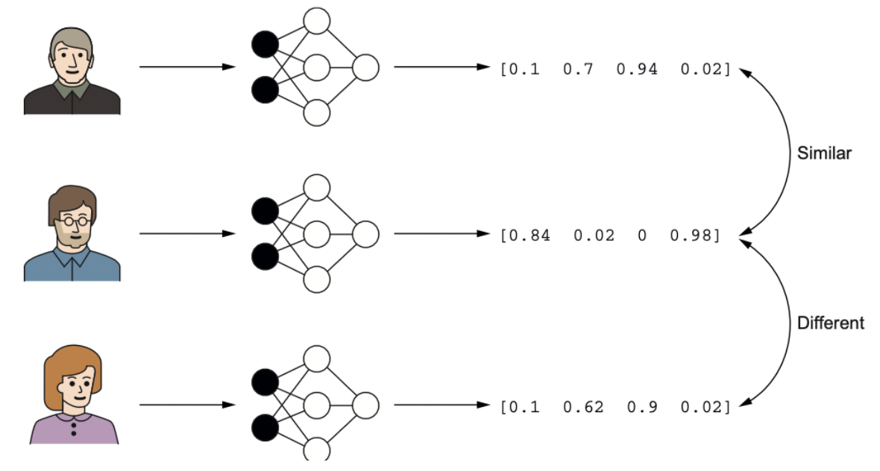
Embeddings map similar concepts to similar vectors
These concepts can be from different spaces, like users and movies
Any model can be used to produce embeddings: Apple face recognition.

Slide 9
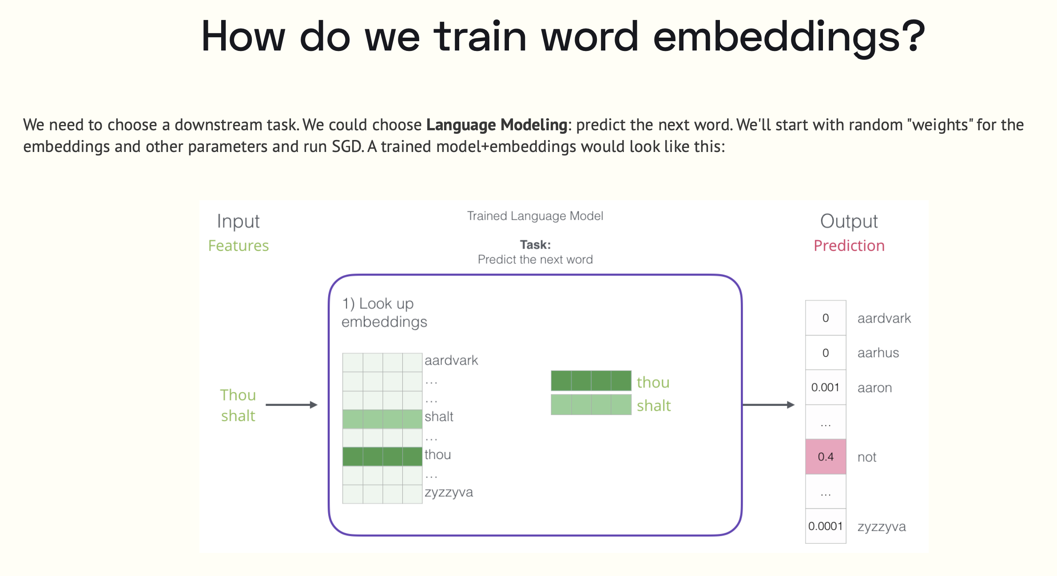

Slide 10
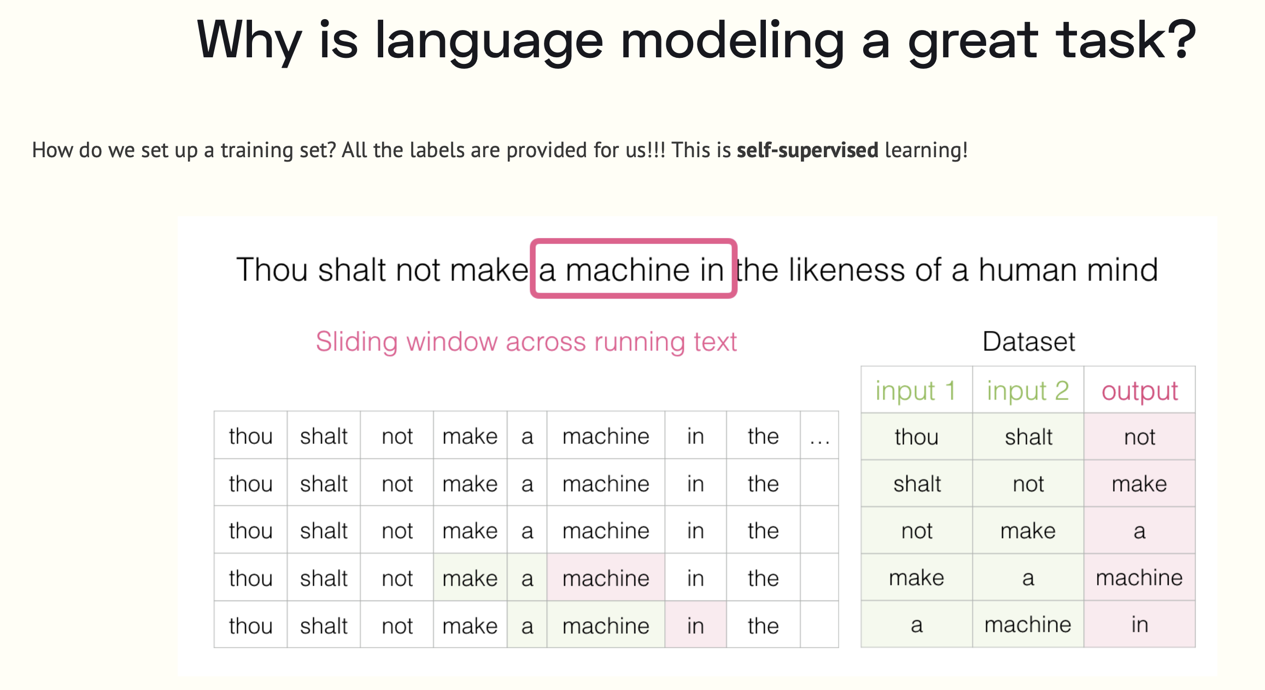

Slide 11
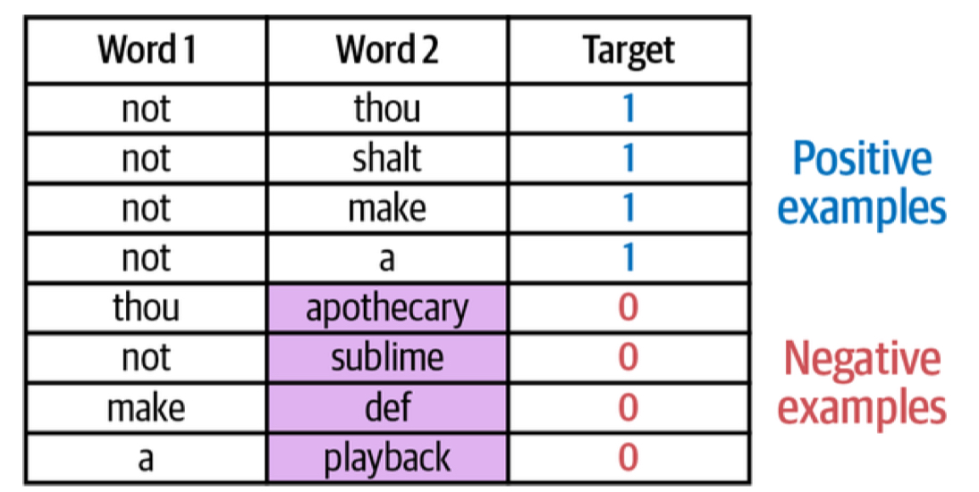
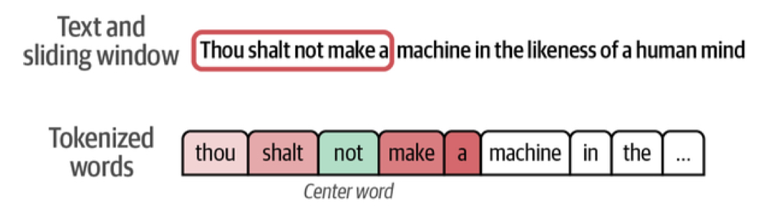
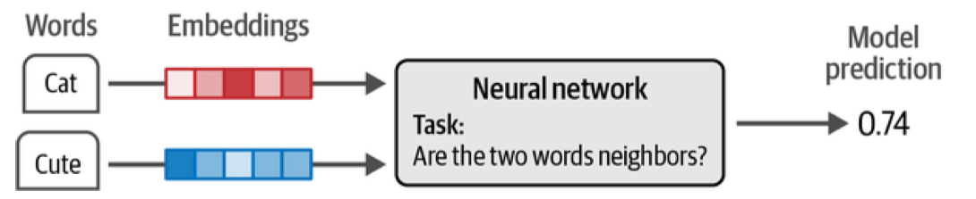
It is not enough to have just positive samples, you need negative samples too. These can be obtained by random sampling.

Slide 12
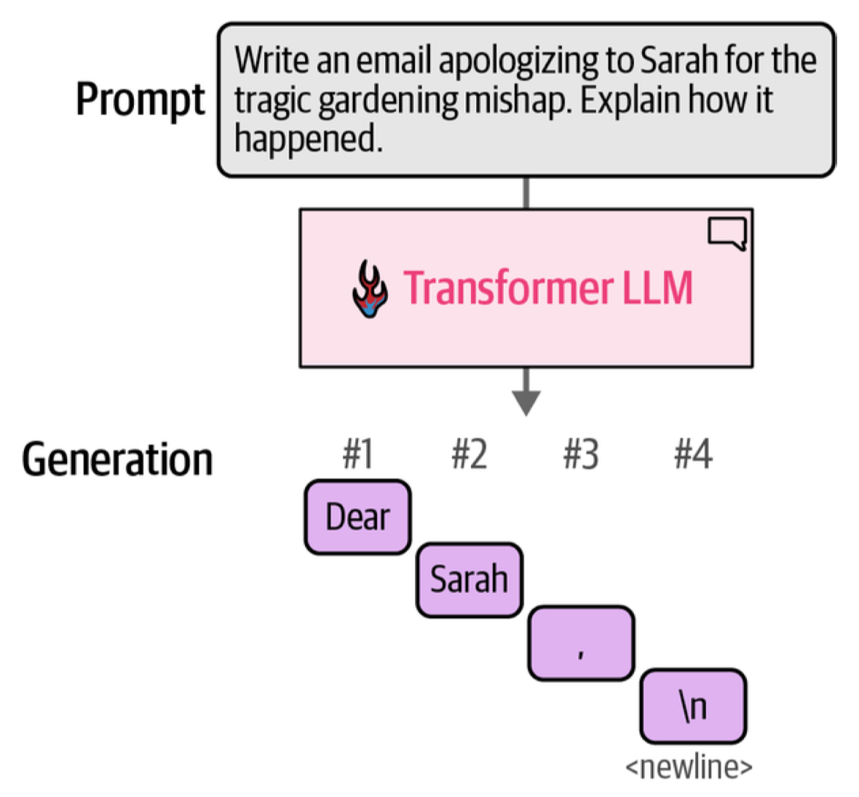
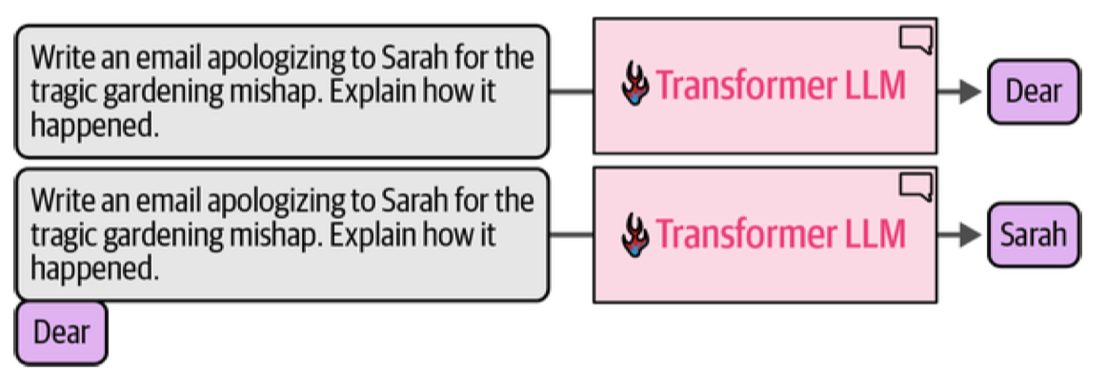
Generation happens token by token

Slide 13
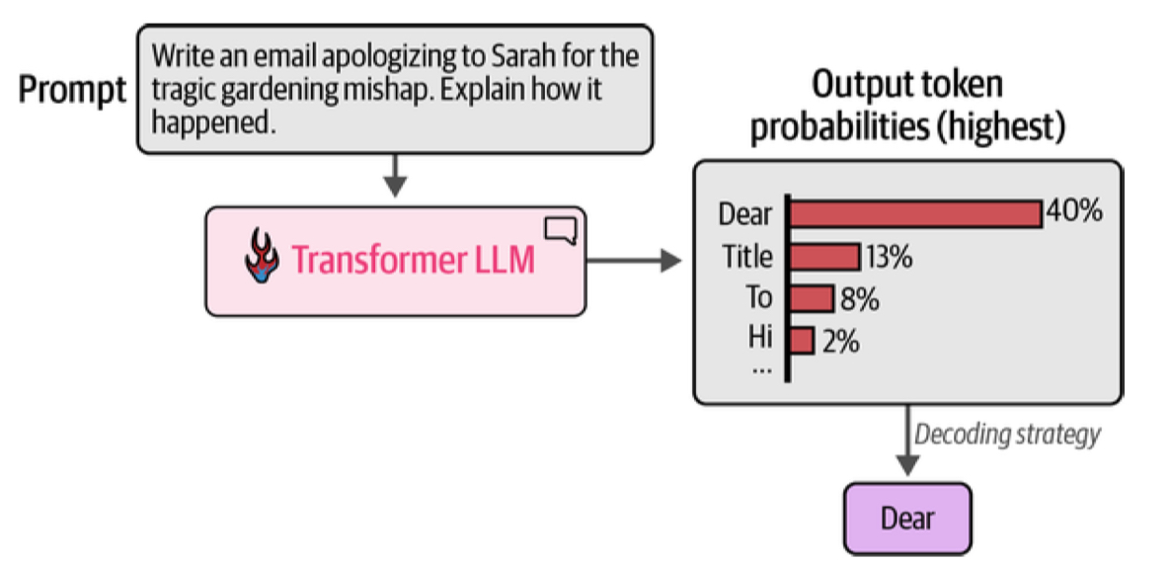
Probabilities drive everything
We sample from probabilities to get the next word

Slide 14
Why use a transformer architecture?
ATTENTION: The transformer has a mechanism to figure out which words in a context are important to understanding the meaning of a given word and thus impacting its embedding
MEMORY: The transformer has a MLP mechanism to associate with a word and its embedding facts that are pulled out from a kind of memory database.
PARALLELISM: At the level of parallel paths through tokens, parallel attention heads, and parallel paths through the memory bank (MLP) there are multiple opportunities to exploit the parallelism inherent in GPUs. This is in contrast to RNN mechanisms.

Slide 15
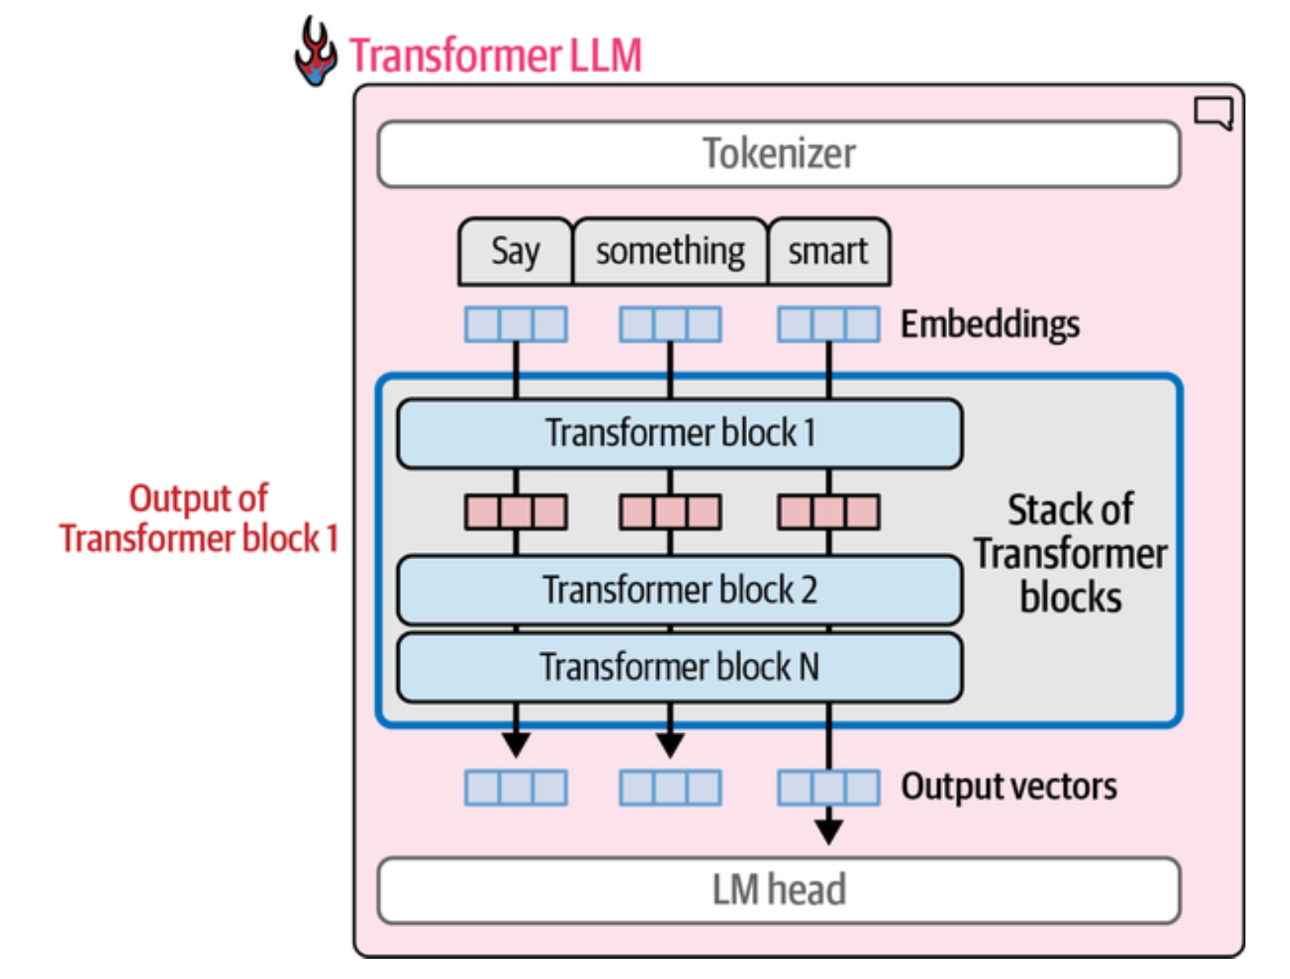
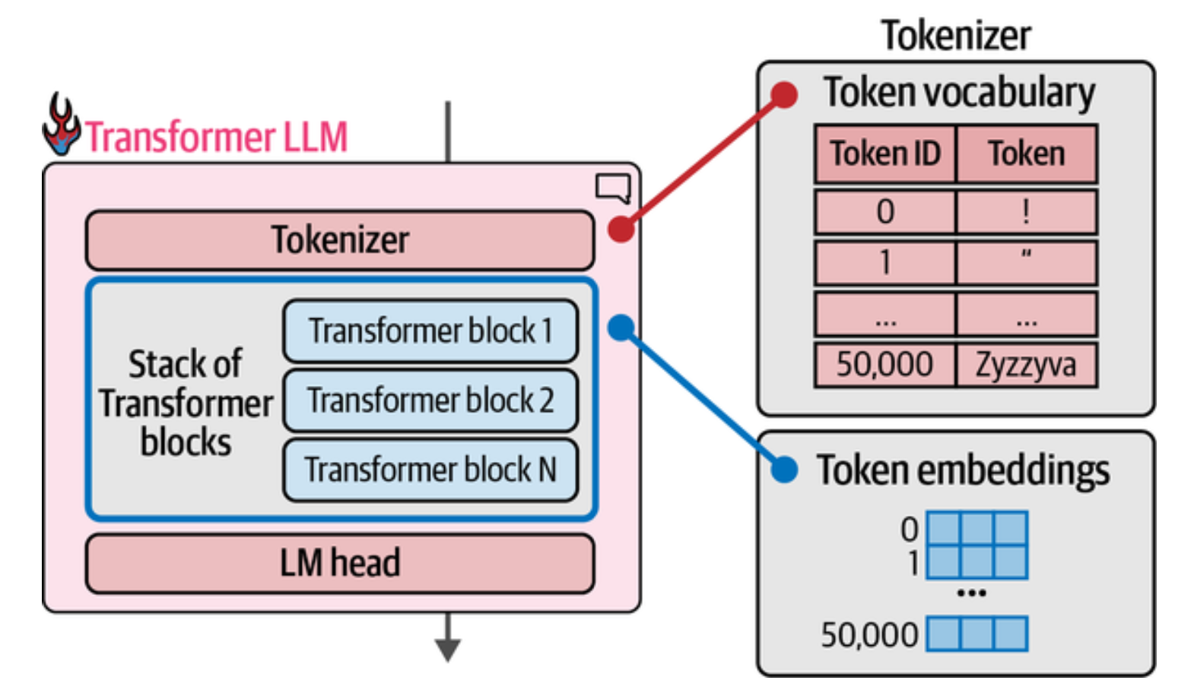
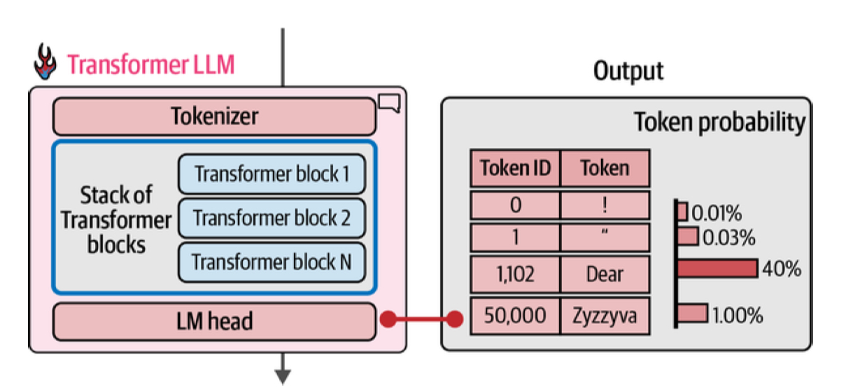
The GPT Architecture

Slide 16
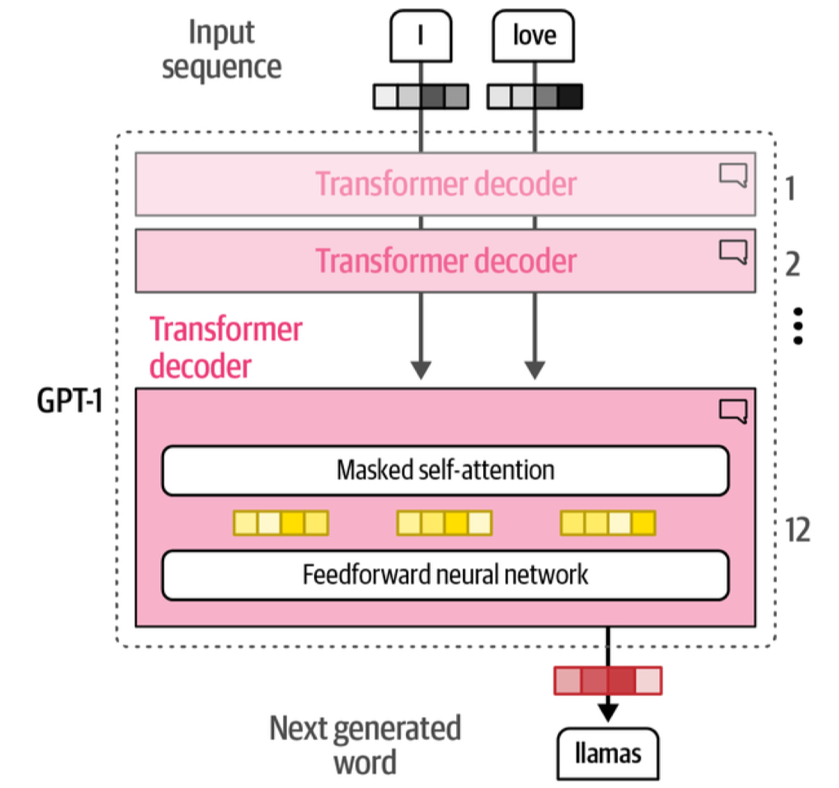
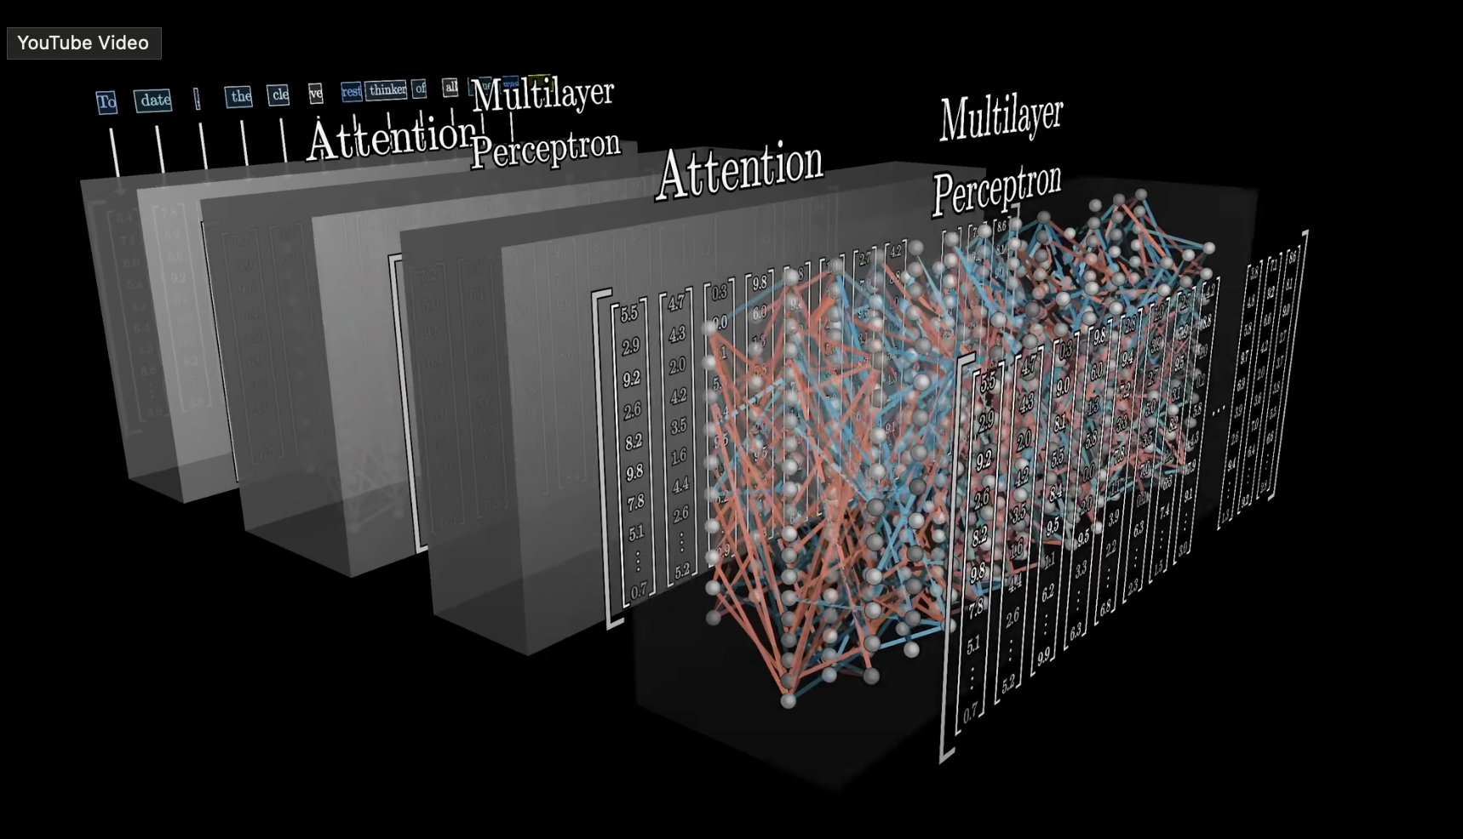
What does the Transformer Block look like?

Slide 17
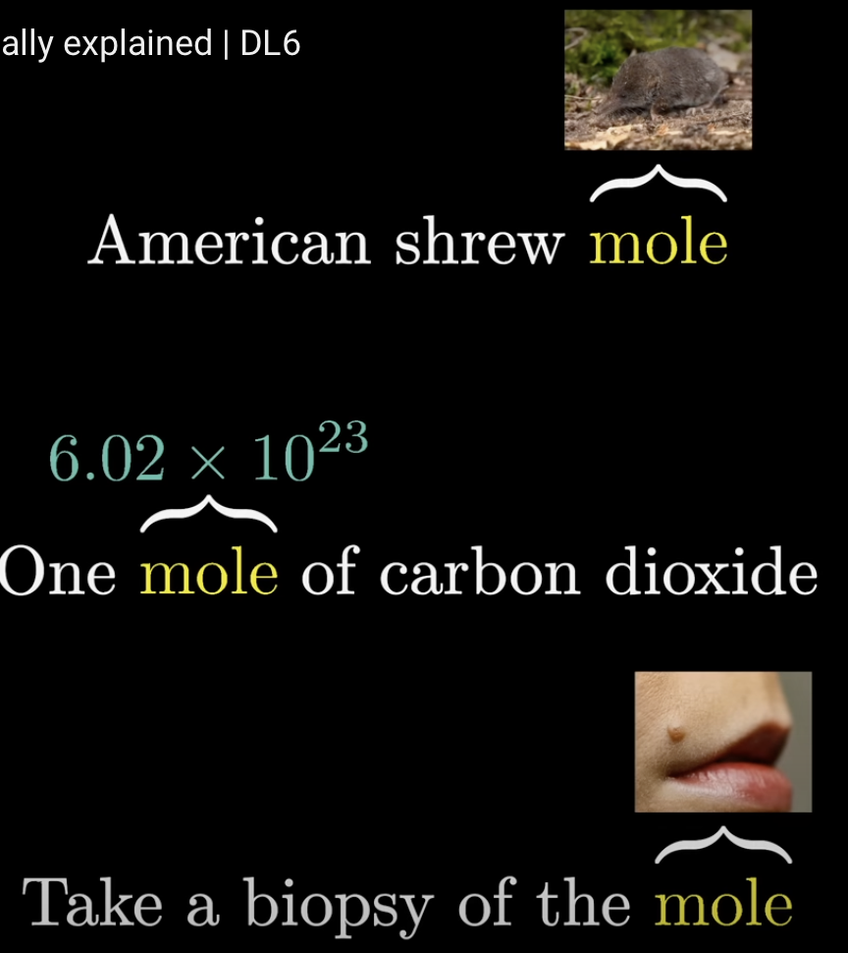
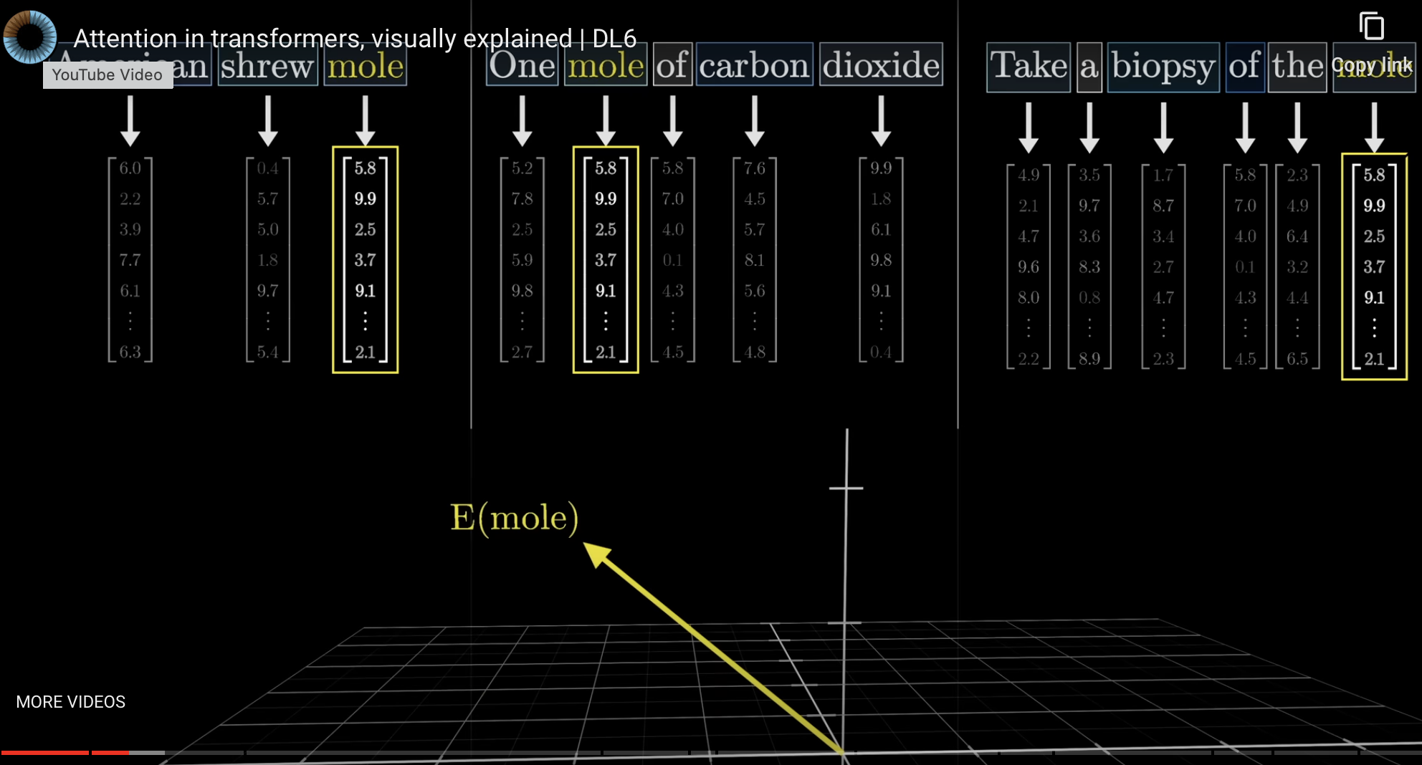
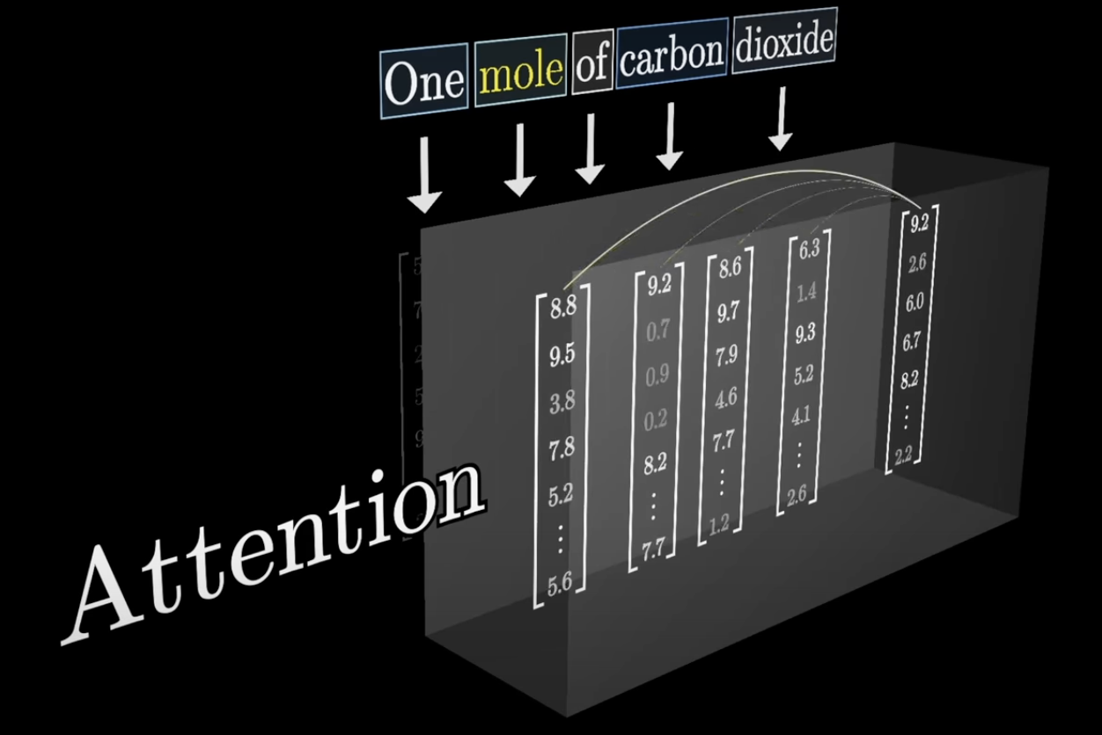
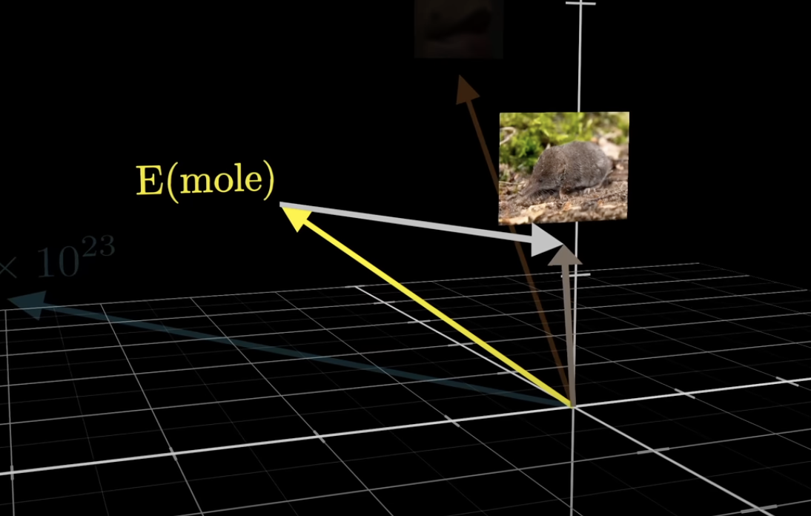
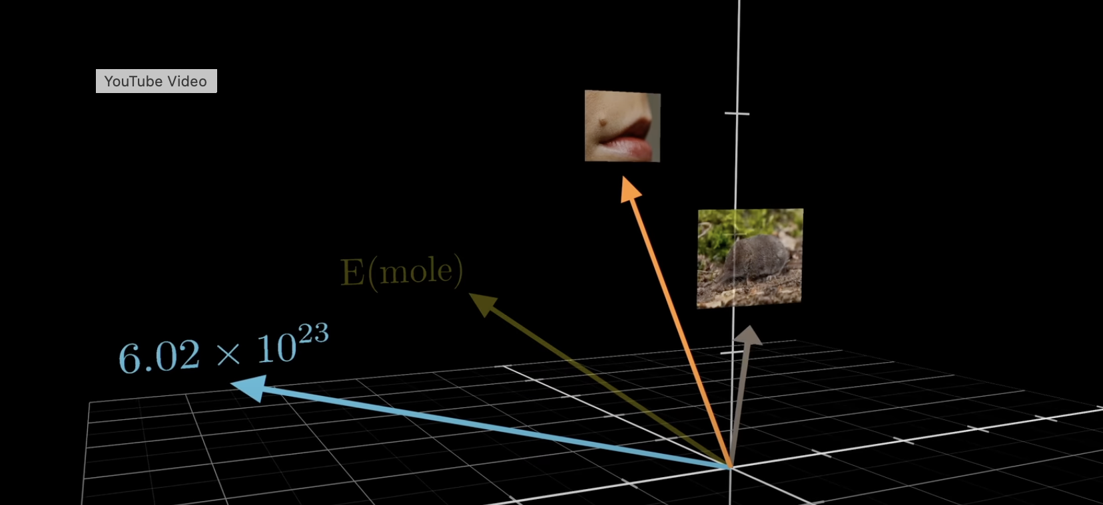
Attention Contextualizes
We start with un-contextualized embeddings for mole. The attention process produces vectors to add to the original mole embedding to contextualize them from their surrounding context.

Slide 18
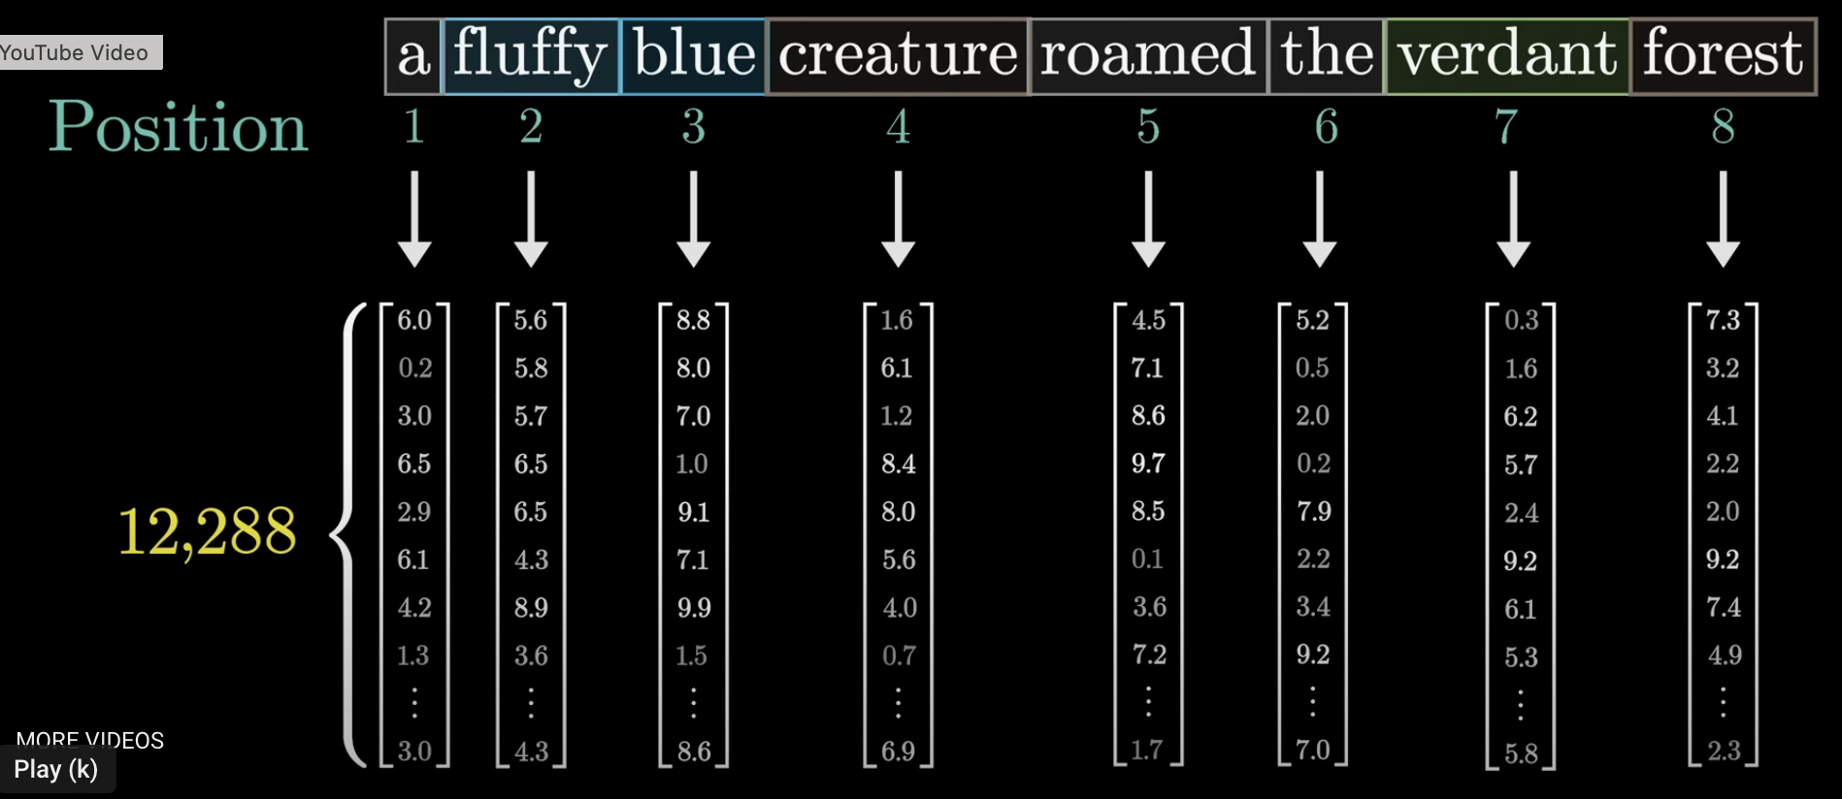
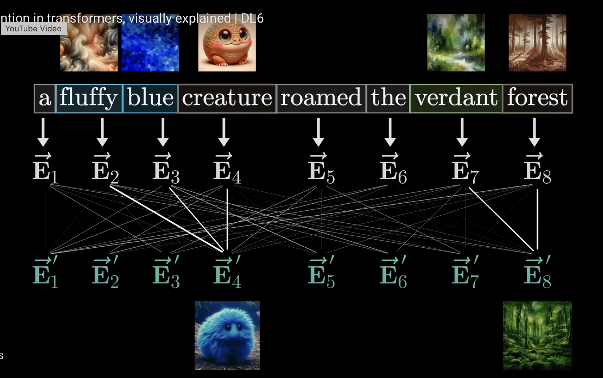
As an example consider the sentence above. You want the adjectives fluffy and blue to impact the word creature, and verdant to impact forest. In the image on the right, these are shown to have strong connections, or high attention values

Slide 19
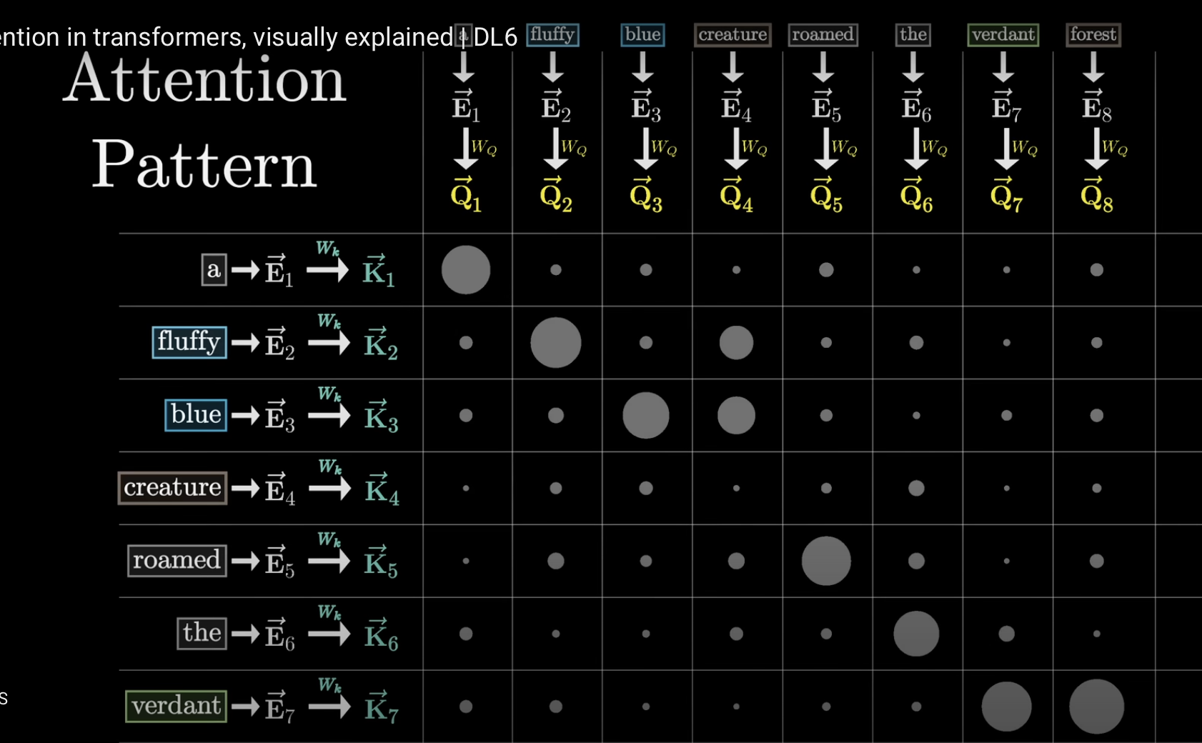
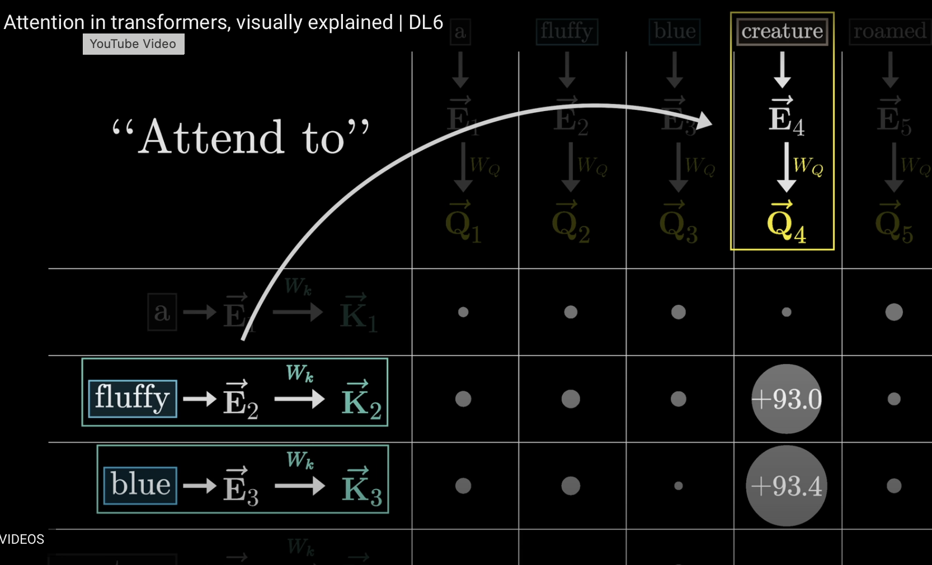
Attention
Dot Product

Slide 20
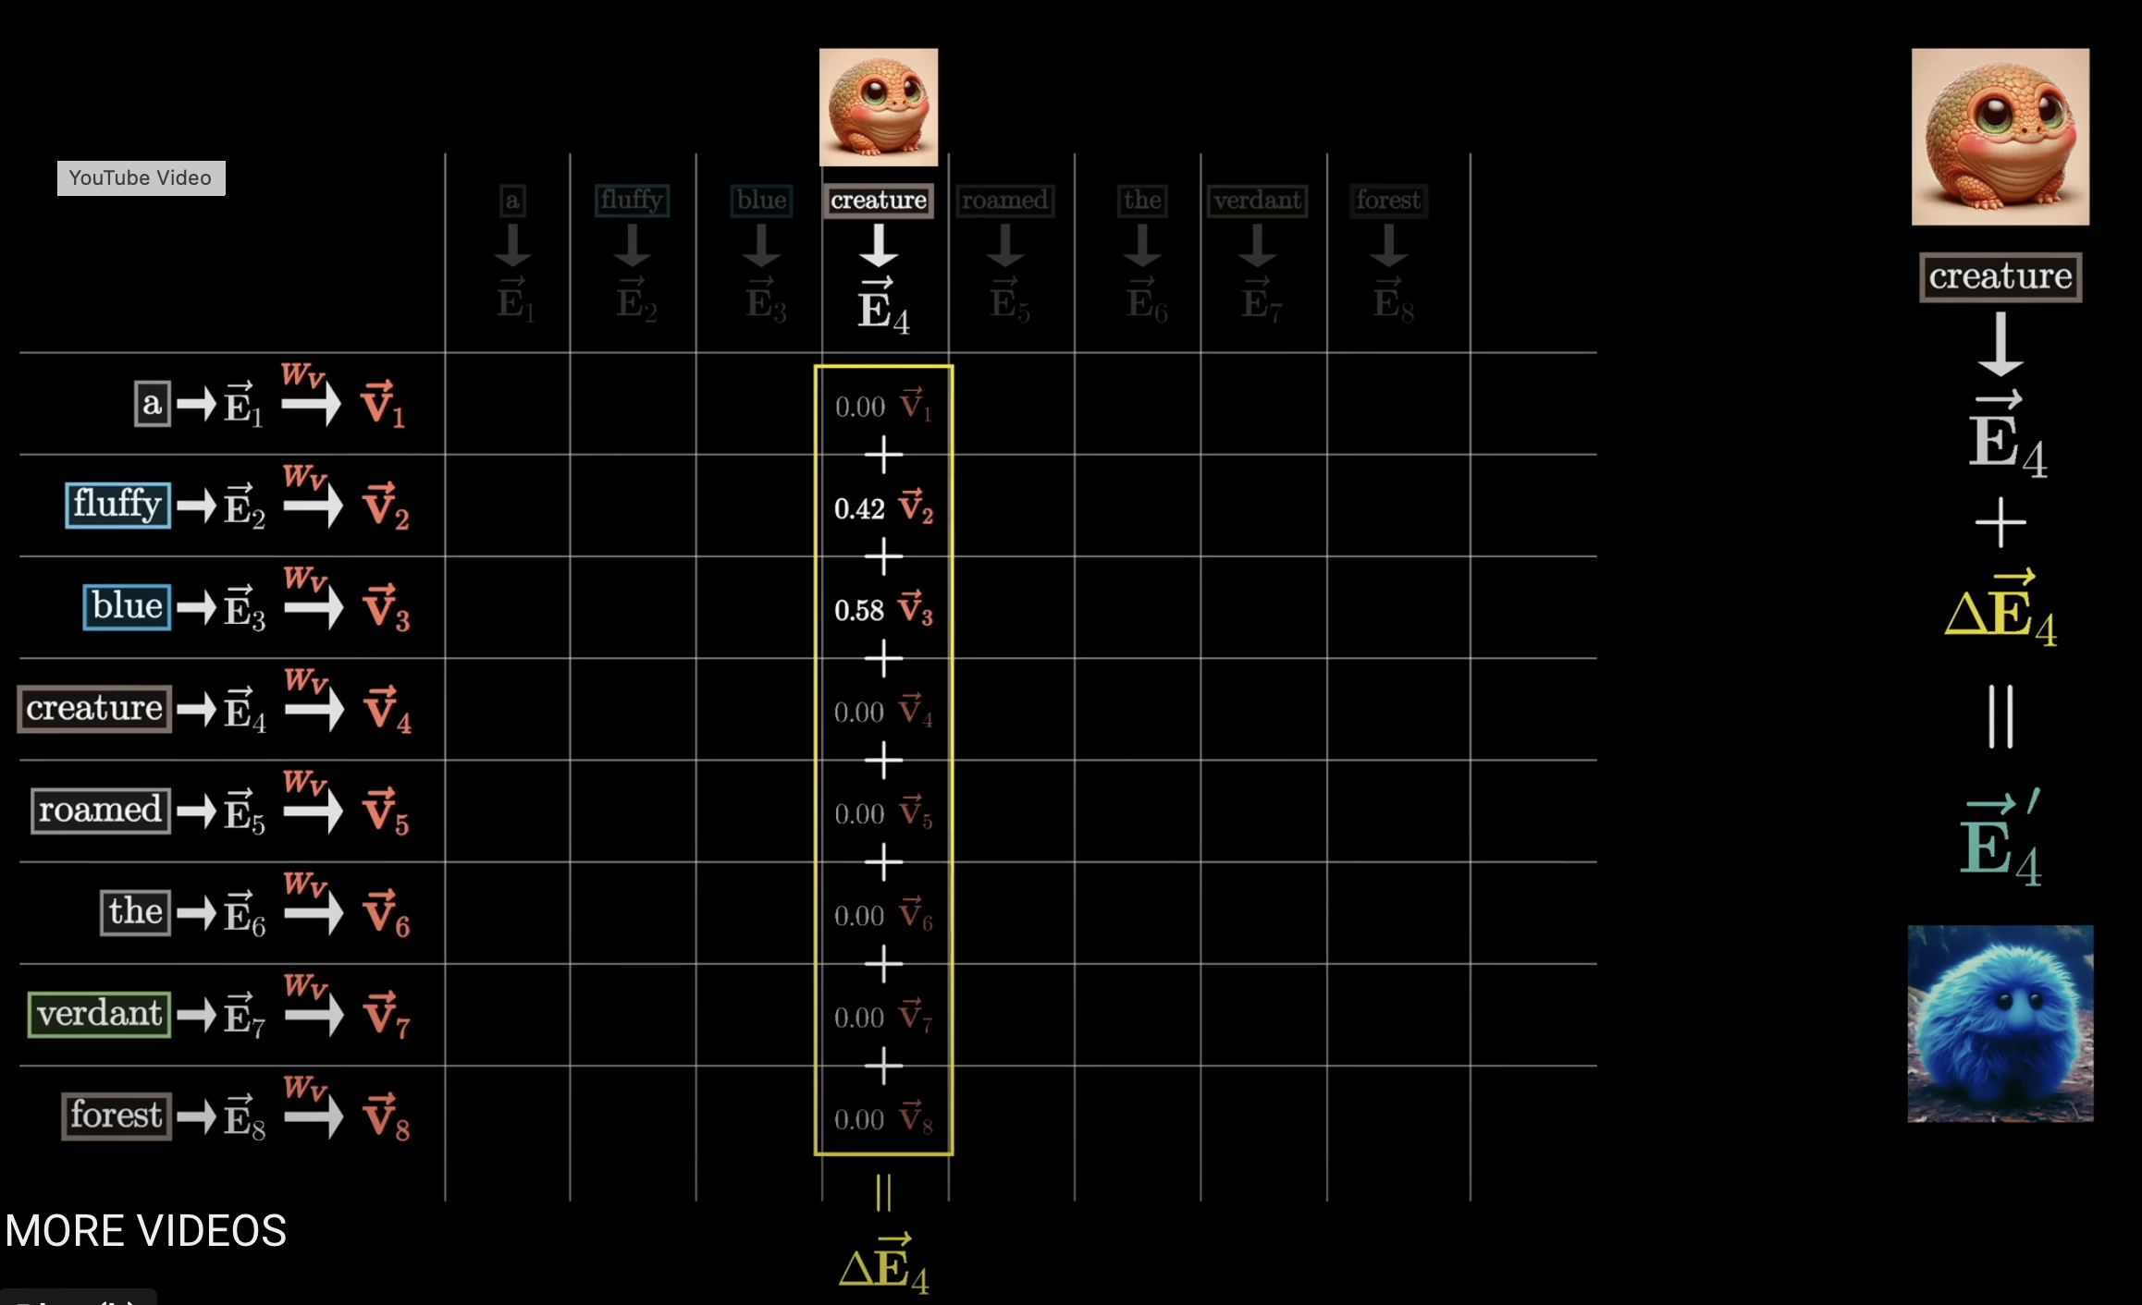
Now we multiply the $V$ for each of the context tokens by its attention based relevance score to combine the information from all the context in proportion to what is more important

Slide 21
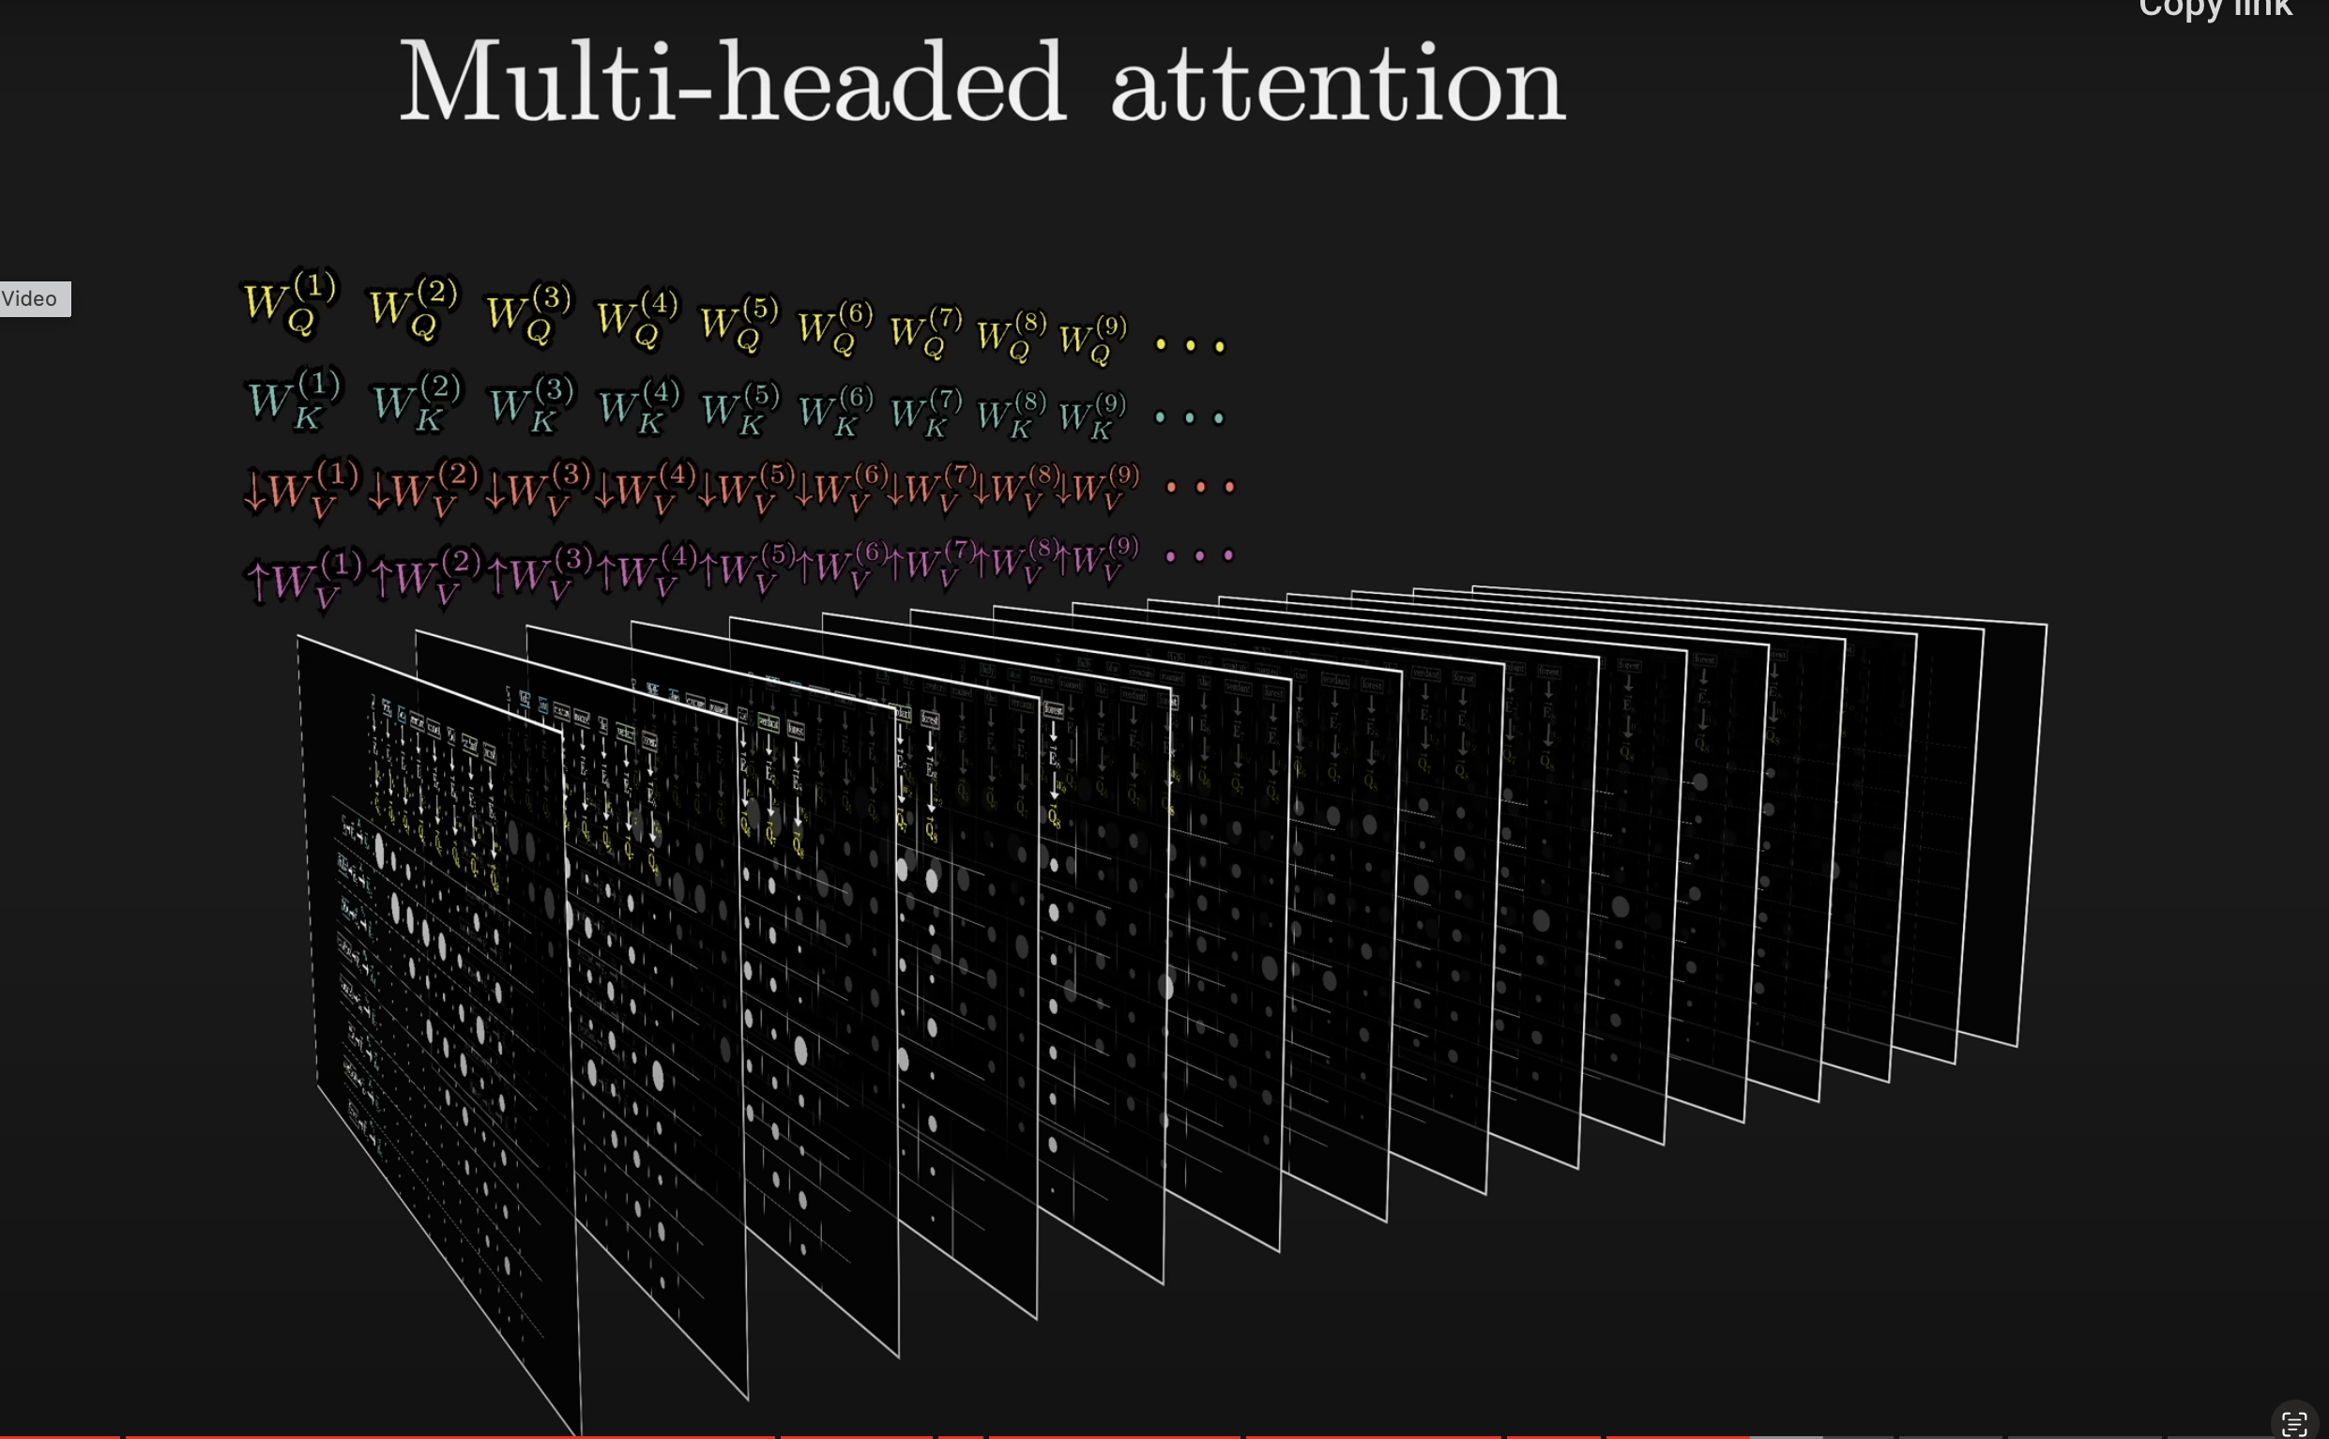

Slide 22
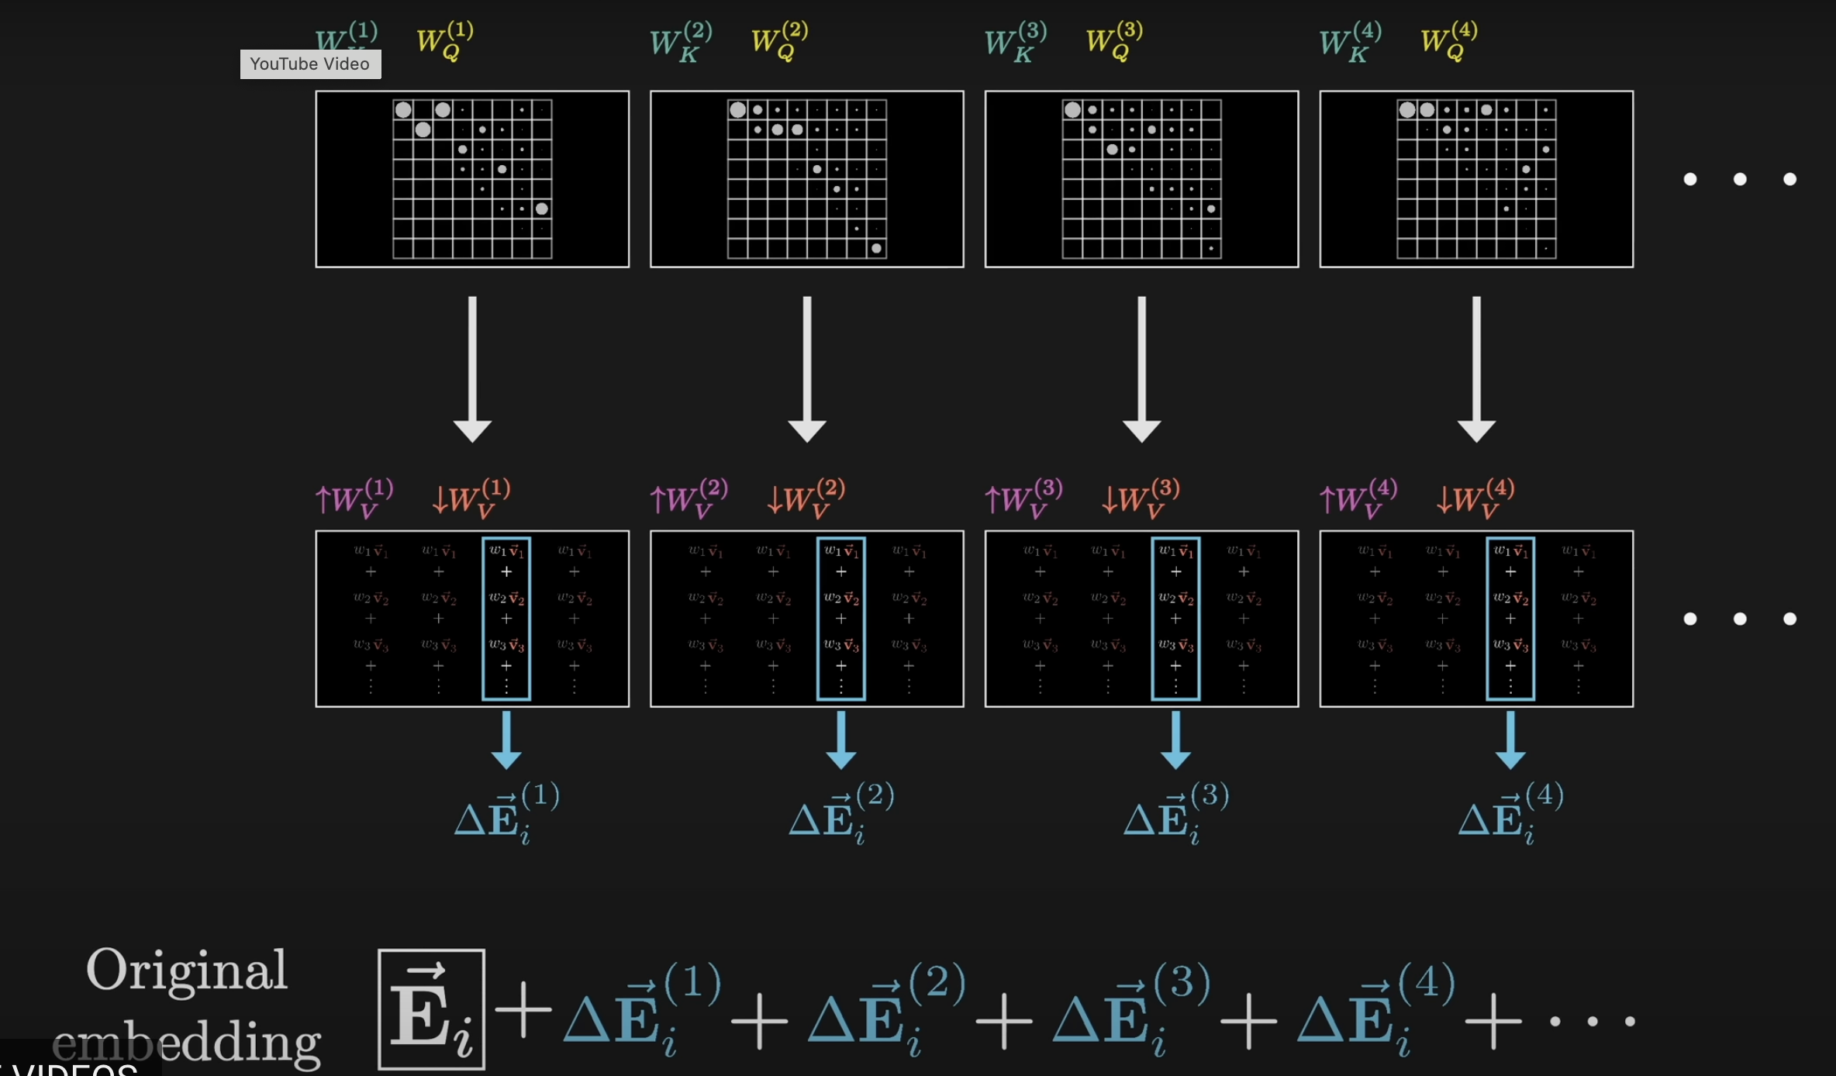
Now, in parallel, we calculate the nudge for each and every token

Slide 23
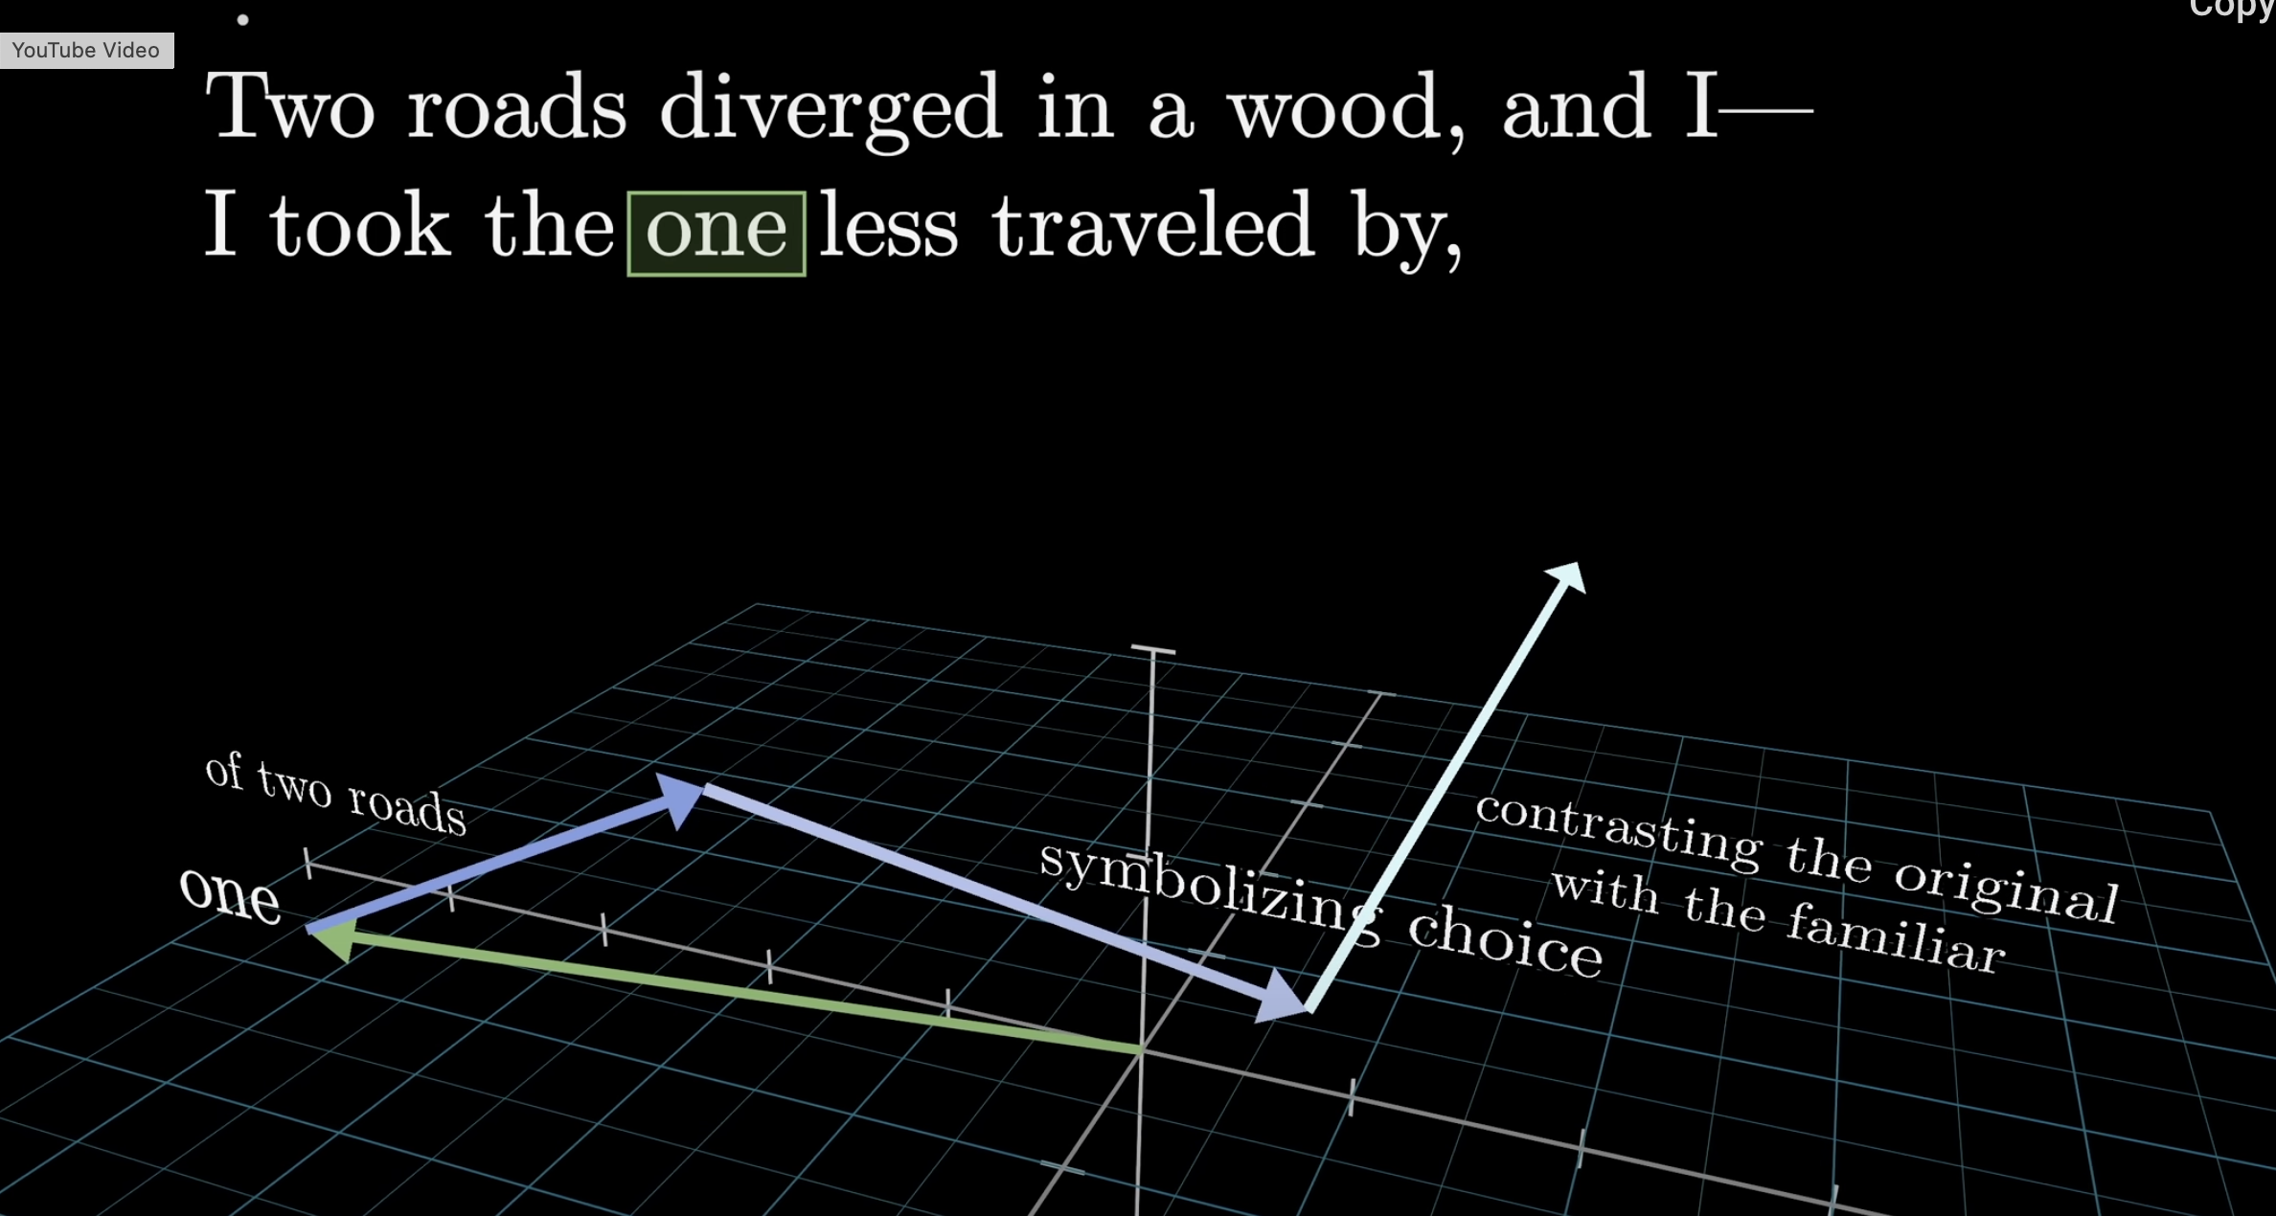
Remember: we are always adding to the original vector to nudge it

Slide 24
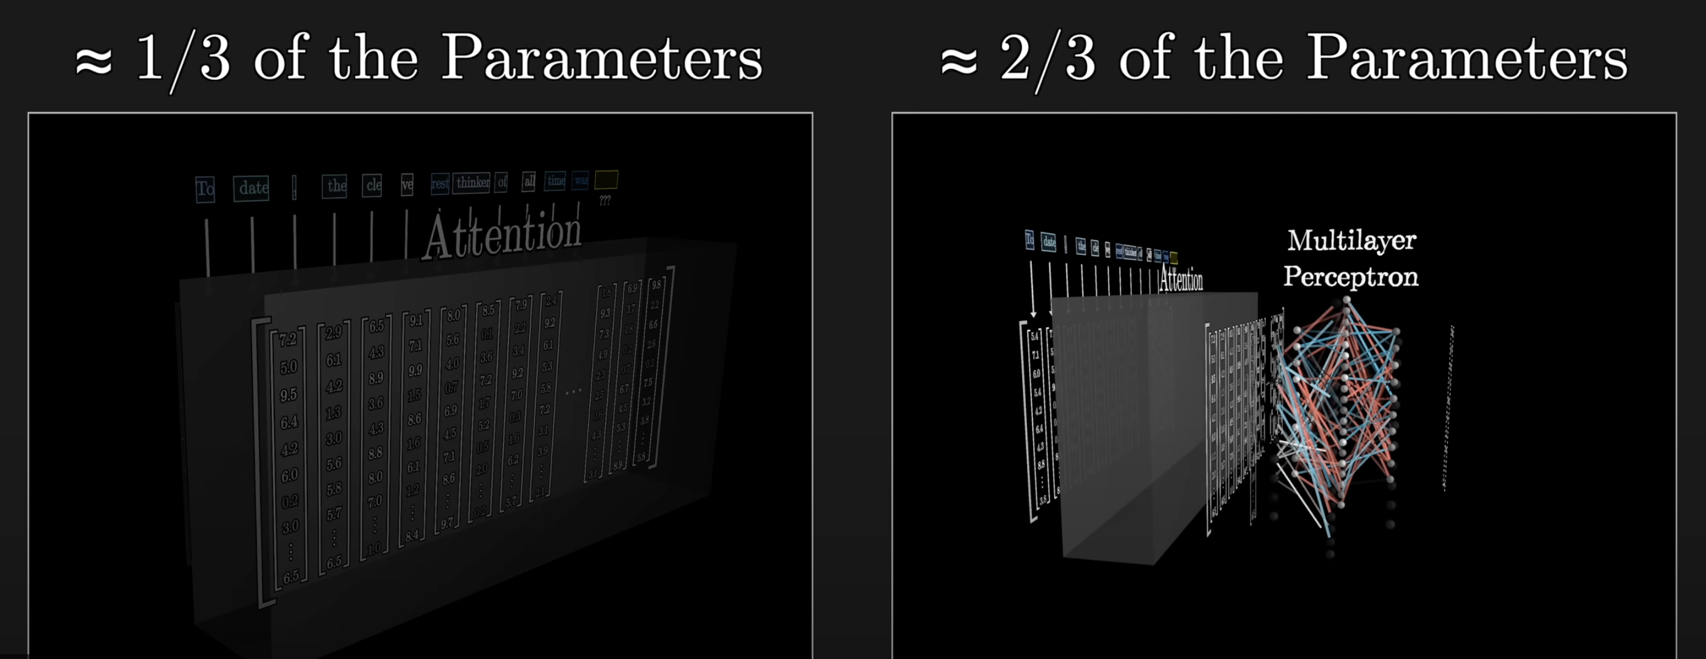
MLP provides the memory
Now that we have the context-nudged token, we want to see what equipping our model with a memory does to that token.

Slide 25
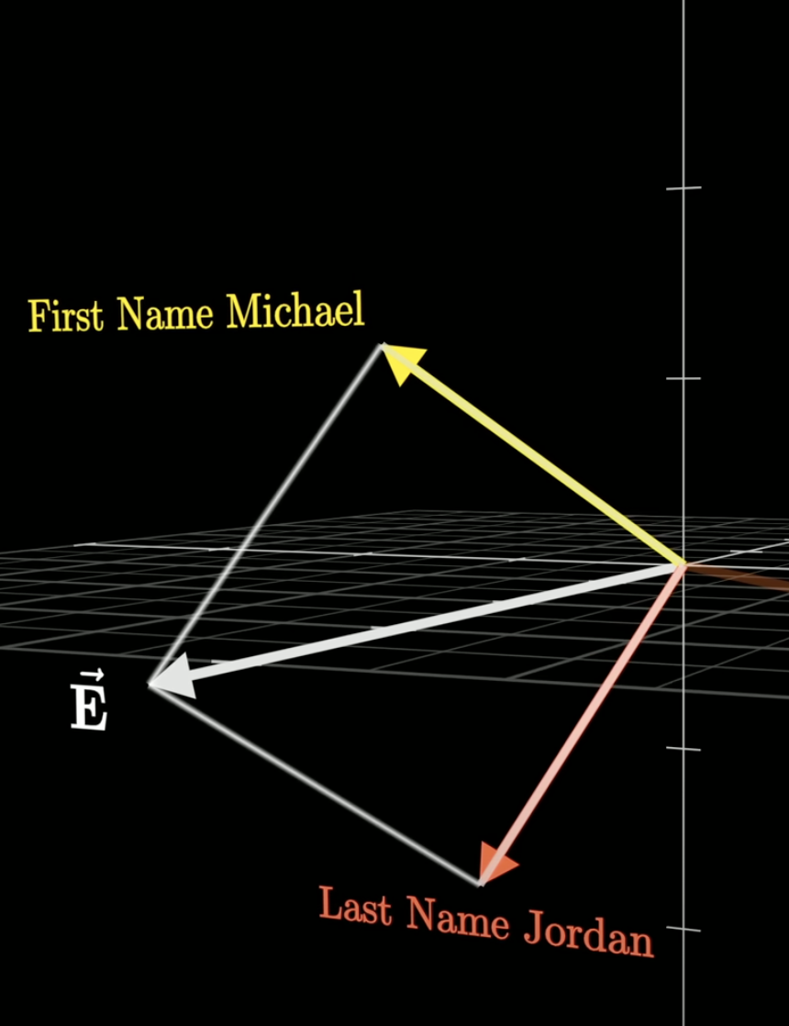
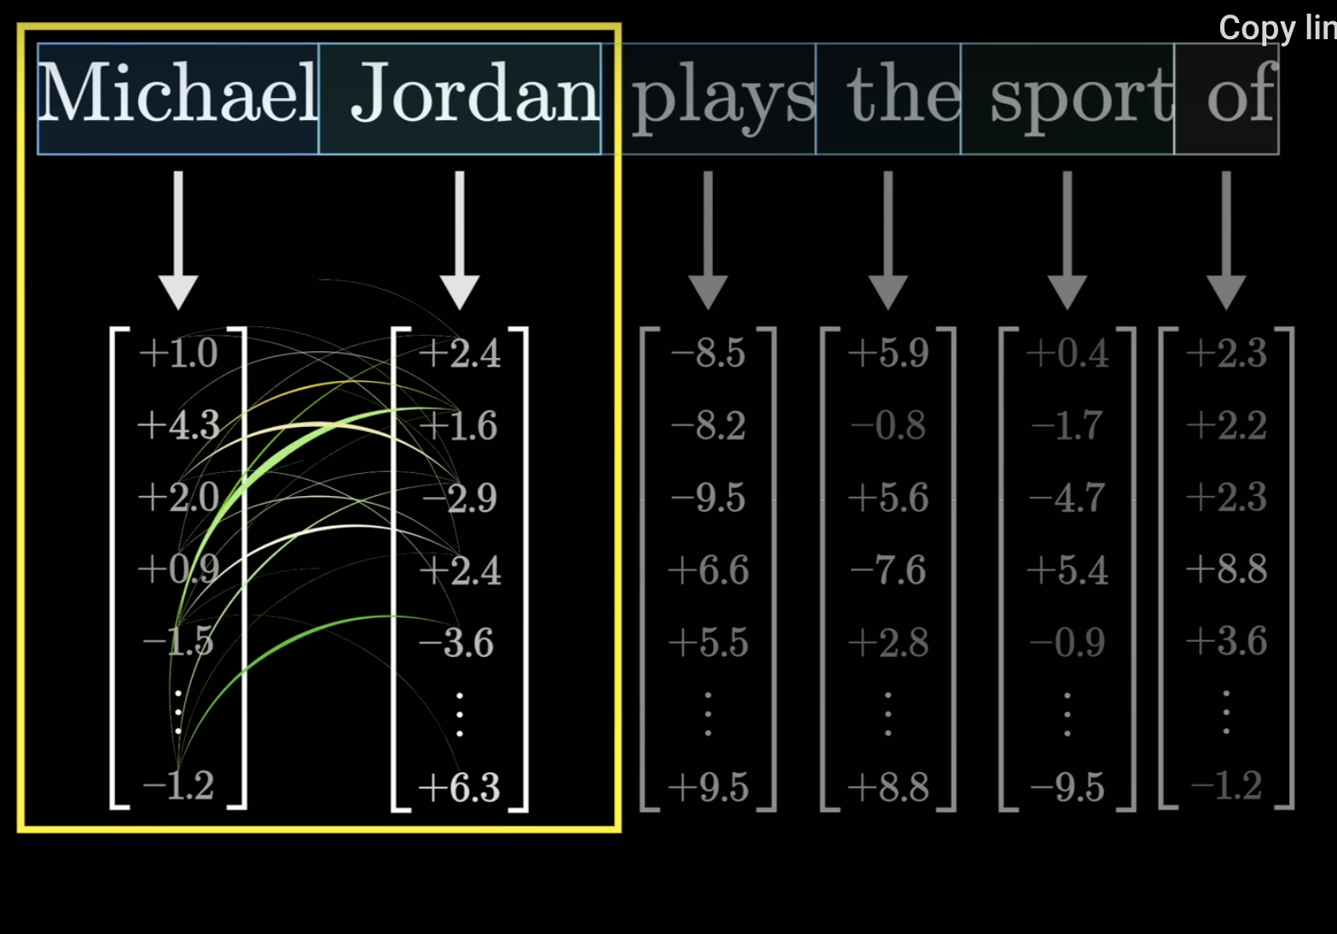
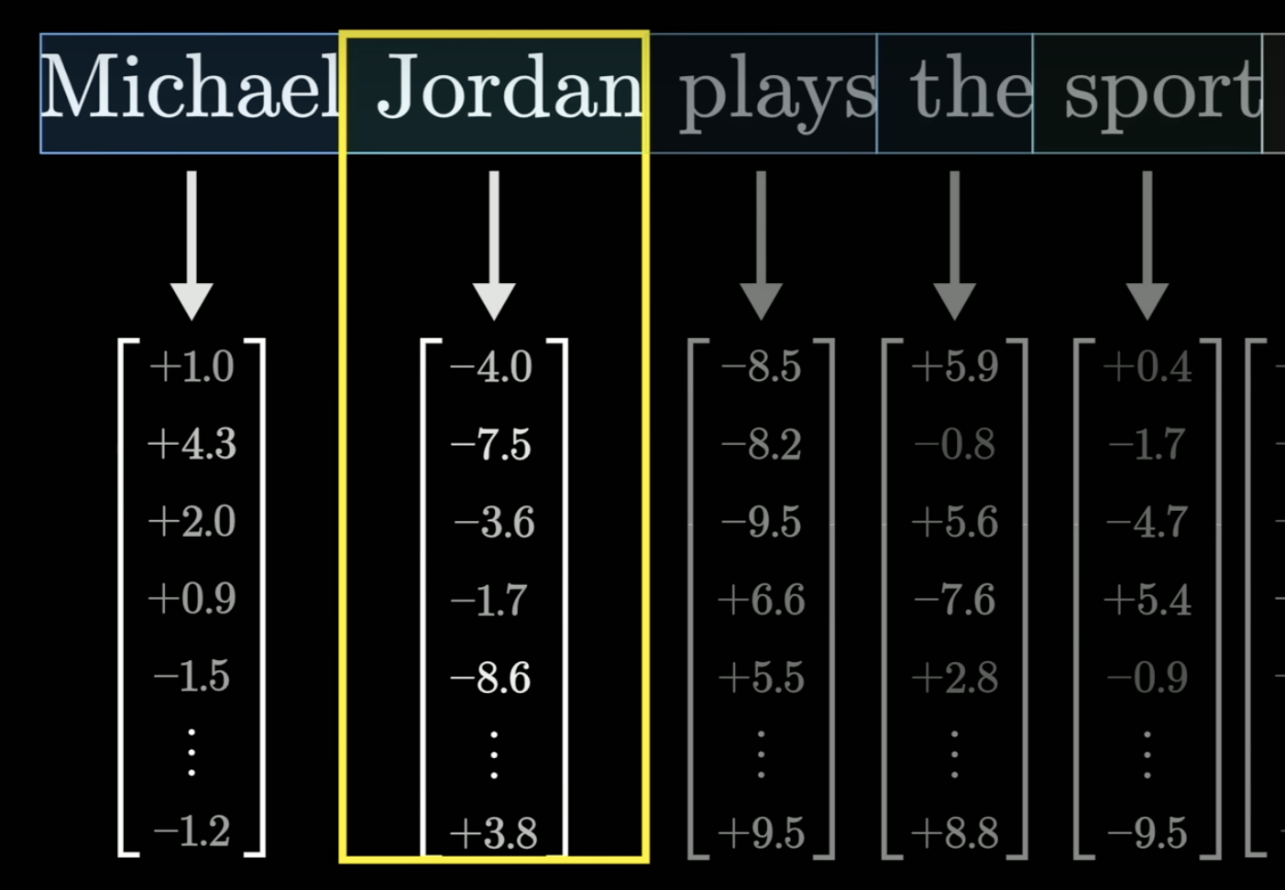
Lets say we want to complete the sentence “Michael Jordan plays the sport of …”. Lets say we went to the attention process, and nudged the embedding of “Jordan”by something that captures the first name “Michael”

Slide 26
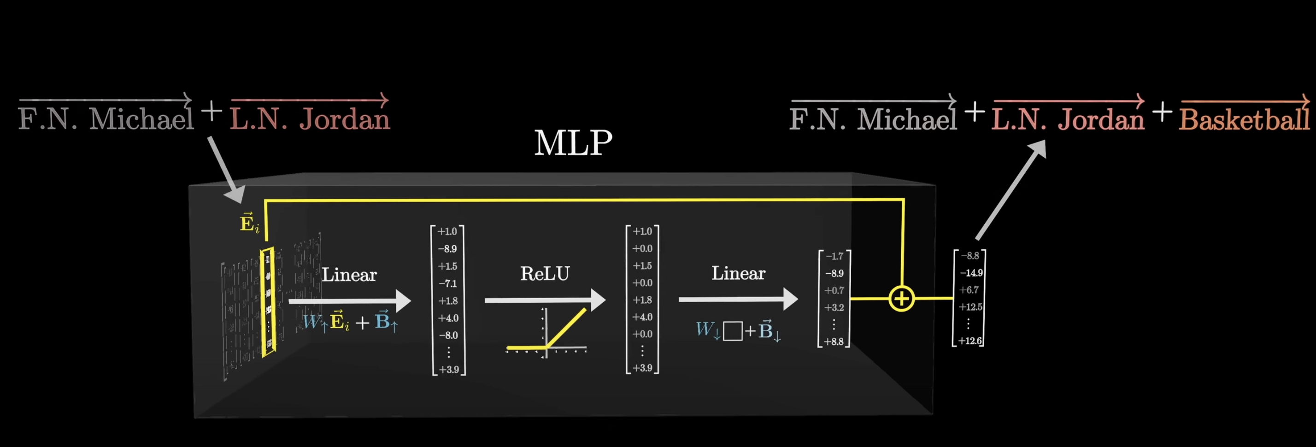
We started with “Jordan” at the second token in the sequence. The attention mechanism added the “Michael” vector onto it. Now the memory mechanism adds the “basketball” on to it, so that the “Jordan” embedding has been nudged into both having Michael picked up via the attention mechanism and basketball picked up via the memory mechanism.

Slide 27
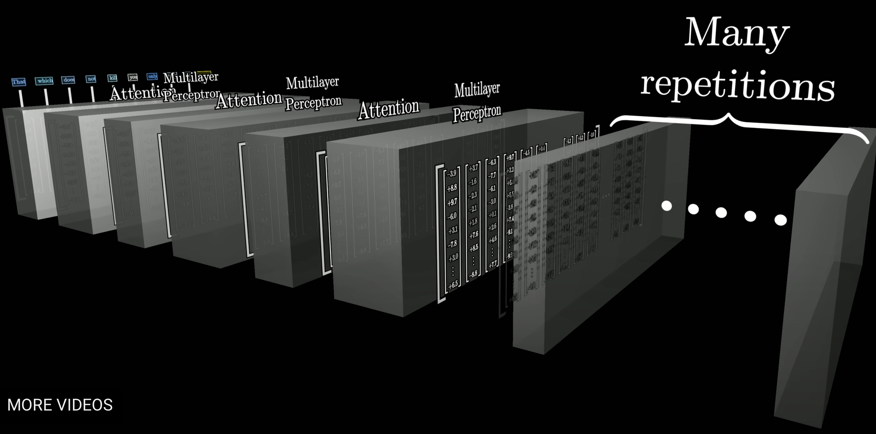
The process of context and memory repeats many times in the transformer, allowing multiple contaxts and memories to be added. This is how gpt like models can seem to be reasoning: they are building in a lot of memory, and the interaction of multiple contexts with this memory seems like they can interpolate between multiple knowledge bases,

Slide 28
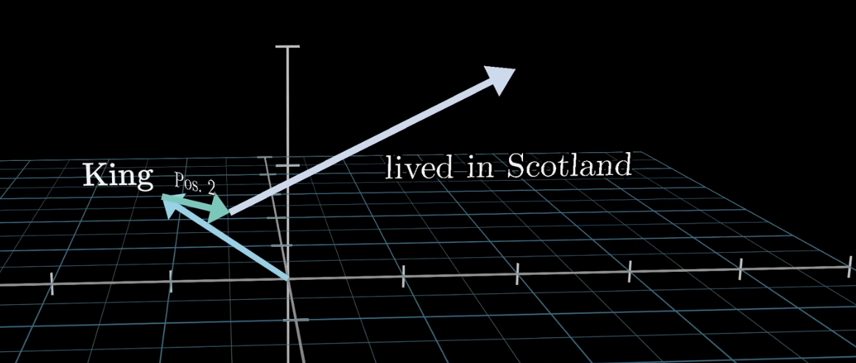
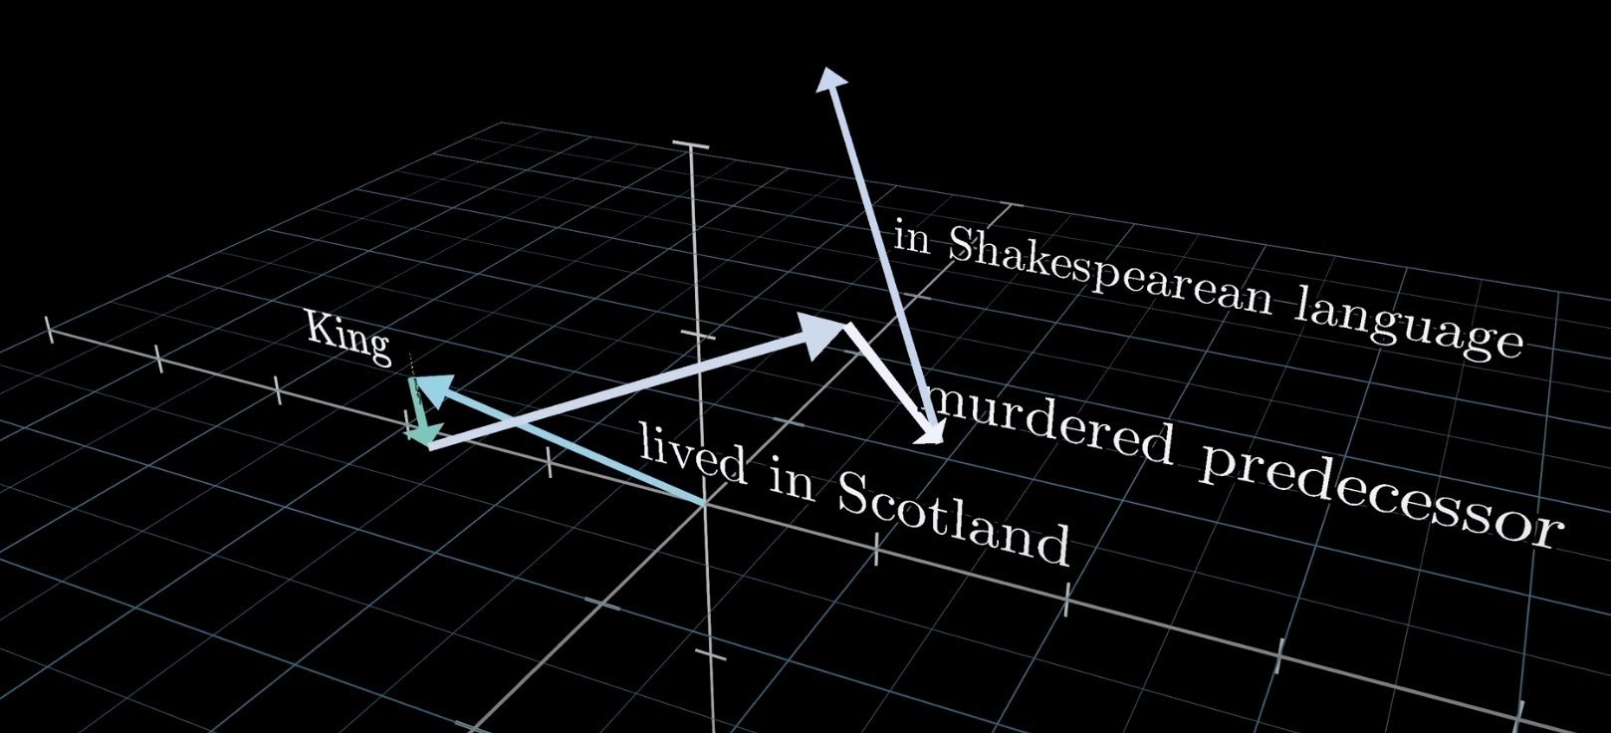
What are we trying to do with embeddings?
1. We want information to be picked from the current context: drinking, excesses
ATTENTION
2. We want information to come with a memory: Hamlet, Shakespeare, Claudius
3. We want information to come from multiple contexts.
MLP
MULTIPLE HEADS

Slide 29
Intelligence?
And so, between the attention and MLP layers, a transformer forms a building block that entwines context and memory, and gives us the notion of an intelligent being interpolating between different gobs of memory in the context of the current discussion. This explains why gpt models seem intelligent, and also hints at why they go off the rails with hallucinations at times.

Slide 30
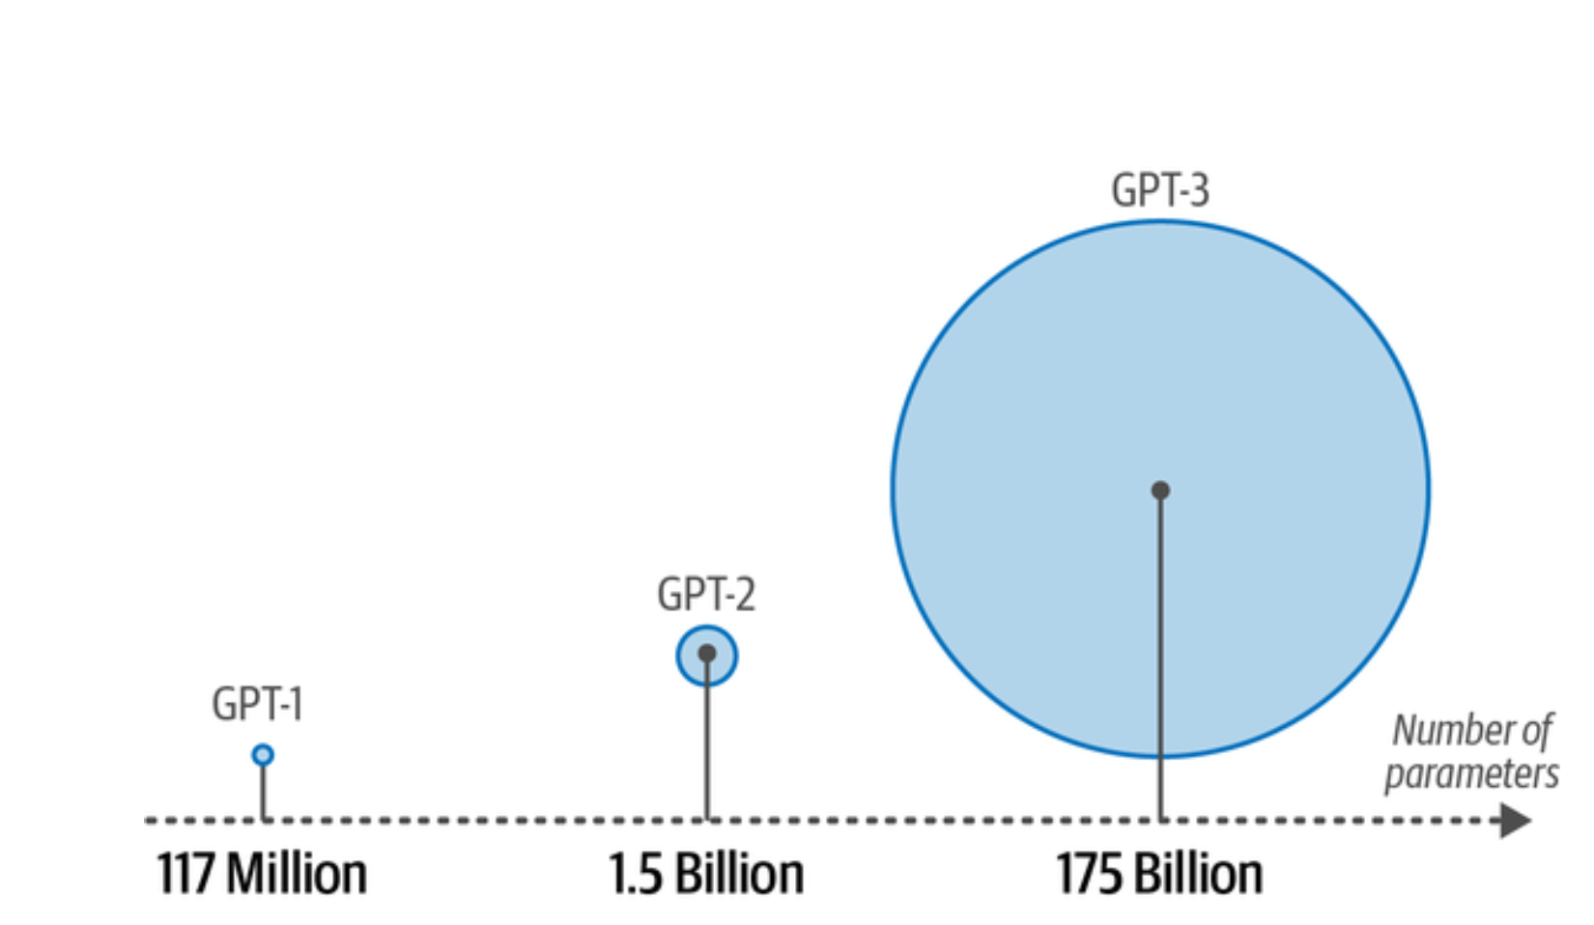
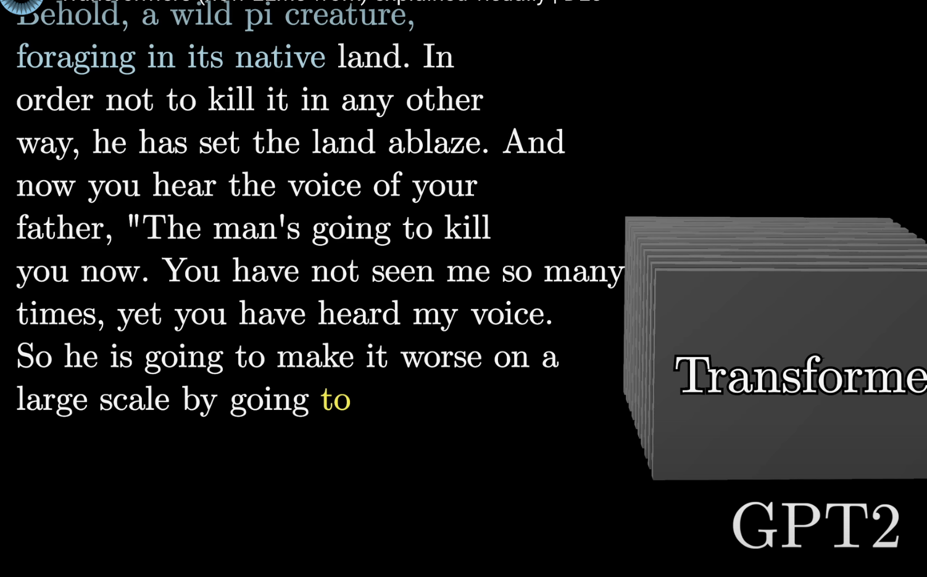
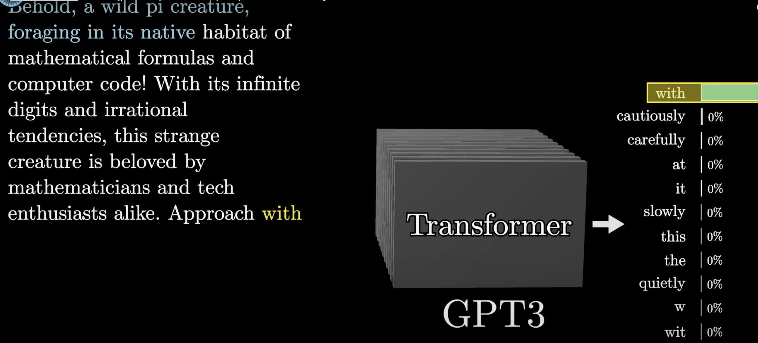
From GPT-2 to GPT-3

Slide 31
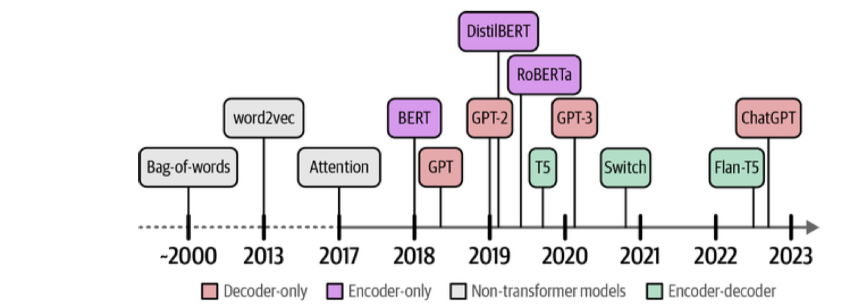
The history of language modeling

Slide 32
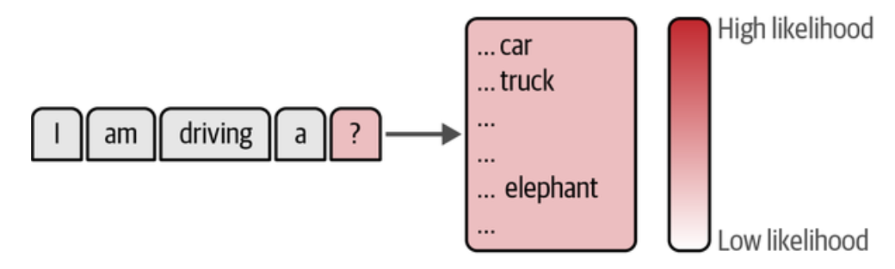
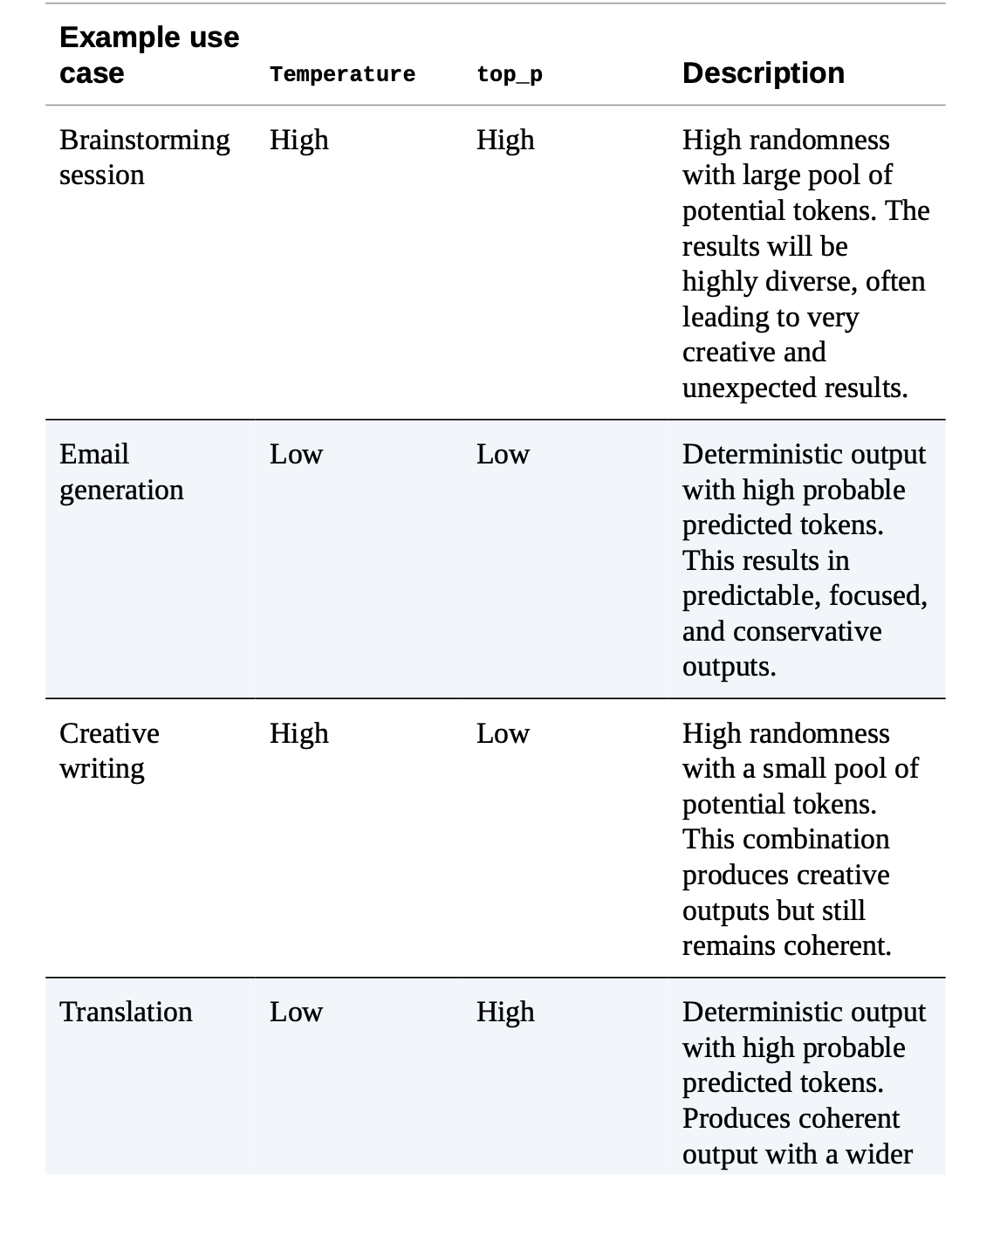
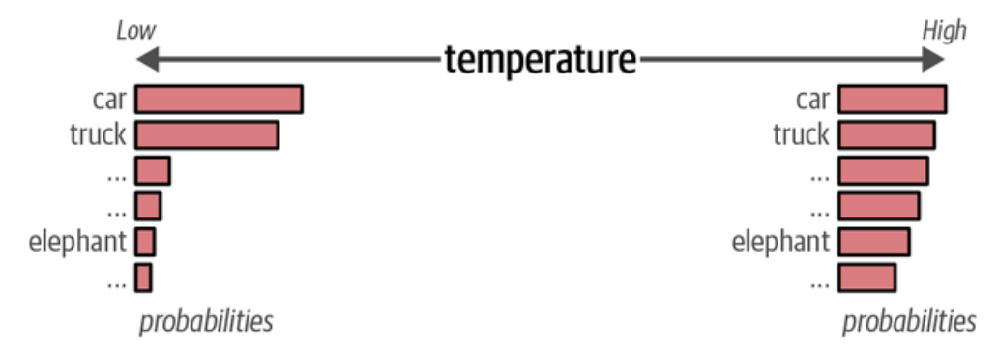
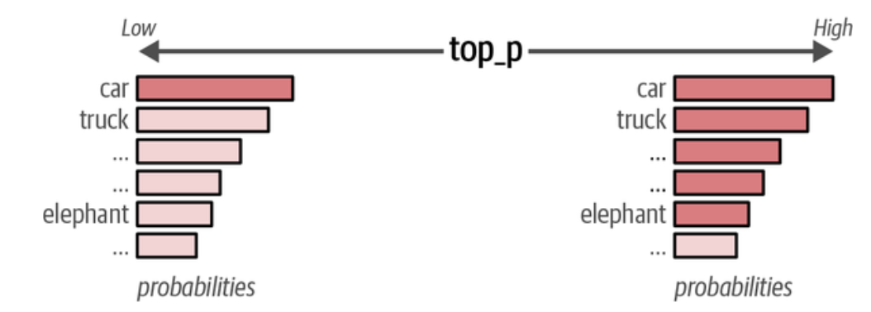

Slide 33
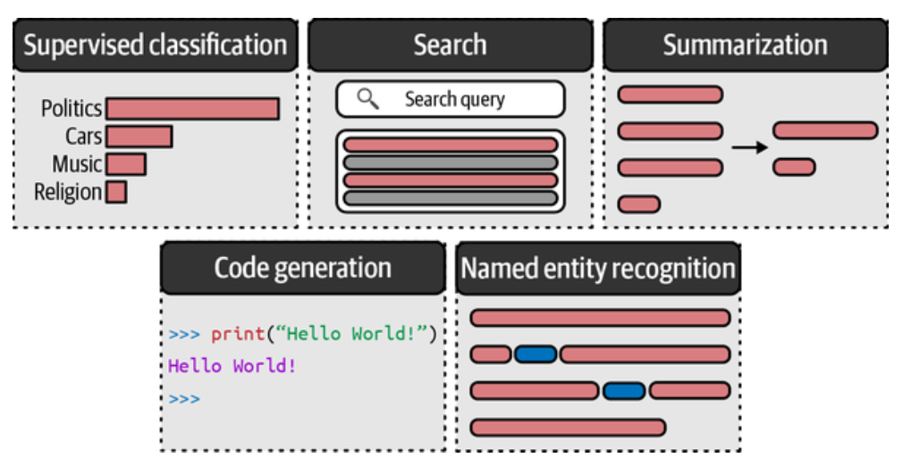
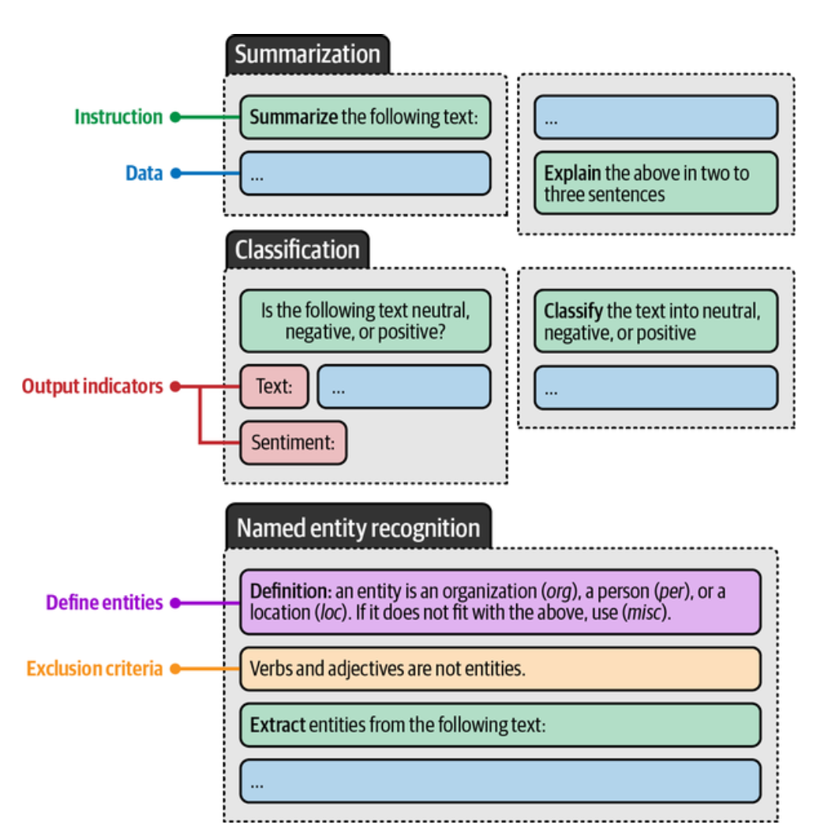
What can you do?

Slide 34


From simple to structured

Slide 35


Prompt Structure

Slide 36

Example based prompting

Slide 37



Prompt Structure

Slide 38


Prompt Versioning
and Feedback

Slide 39

From
Examples…

Slide 40

To setting up
for reasoning

Slide 41


Games with temperature and sampling..

Slide 42


How does chatting happen?

Slide 43



Local memory

Slide 44


Embeddings again

Slide 45



RAG
or how to
stuff context

Slide 46


Anatomy of a trained model
how do we train models so that they follow instructions, chat, and all that?

Slide 47

Detailed
Chat
Anatomy

Slide 48


Artifacts

Slide 49


Tool Usage and Agents

Slide 50

Example with
multiple tools

Slide 51



Slide 52


meai tool
does agentic RAG

Slide 53



Slide 54


Evaluation

Slide 55

Training Further

