Slide 1
Iotic Labs
Workshop
Mark Wharton, CTO
Sophie Peachey, Bus Dev

Slide 2
Workshop Objectives
At the end of the session you will have:
Learnt how to create and find other Things using the Space app
Connected virtual Iotic things to local Python code
Shared and received data using Iotic Space (in code)
Publicised a control interface and received actuations (in code)
Searched for things using code and automatically bound to them
Implemented your own simple application
The ability to continue to develop your ideas using Iotic Space after the session

Slide 3
Workshop Plan
Intro to Iotic Space and the 4 interactions
Using the space app demo
Getting accounts setting up
“Hello World” in code
Practical coding workshop (in groups)
Show off your application (using RPi if you have one or want to)

Slide 4
Workshop Plan
Intro to Iotic Space and the 4 interactions (Mark)
Using the space app demo (Mark)
Consequences game (All)
Getting accounts setting up (Mark)
“Hello World” in code (Mark)
Practical coding workshop (in groups)
Show off your application (using RPi if you have one or want to)

Slide 5
Intro to Iotic Space

Slide 6

Traditional approach: Endure API pain just to create more silos
Silo 1: Weather
Data base
Different formats
Different API keys
Different REST APIs
Different marshalling
No metadata
Human-only understanding
Integrate many times
No way to share insights
Data but not control
Polling model
API 1
Web server
json
New Silo
Data base
Silo 2: Traffic
Data base
Mash App
XML
API 2
Web server
CSV
Silo 3: Air quality
Data base
API 3
Web server

Slide 7
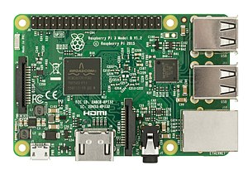

Iotic Space – a more flexible approach
Iotic Space
API 1
Same formats
No API keys
No REST APIs
UBJSON marshalling
Semantic metadata
Machine understanding
Integrate once
Share insights
Controls and data
Event driven
Extensible
Versatile and flexible
Negotiated pub-sub
Visualiser Platform
Virtual weather
Integrator
API 2
Integrator
Virtual Sensors
Virtual traffic
Virtual Controls
Virtual Air Quality
Integrator
Predictions
API 3
Big Data
Analytics Platform

Slide 8
What is Iotic Space? Design principles
The Thing is in control of its own destiny
It can choose what to share, with whom, and on what schedule
Protected from attack by its virtual counterpart
It can choose to offer control interfaces and to be controlled
Metadata describes the API
Semantic web technologies used internally: RDF and SPARQL
Searchable data objects delivered to your callback
Programmatic and UI search
Extensible – using semantic linked data
Store as little data as possible
Things can request “recent data” storage – the most recent share(s)
Followers can then request the recent data – if follow is allowed by the producer’s policy
Feed and control data is queued & available if Things go offline and then come back online
Everything is asynchronous, event-driven
All APIs are “push”
No polling
Mitigates against DoS attacks

Slide 9



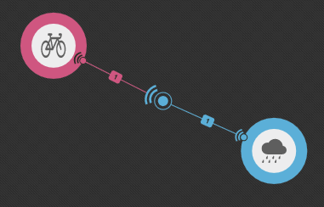
Four interactions
1. I advertise a feed
3. I offer a control
2. I follow someone else’s feed
4. I actuate someone else’s control

Slide 10
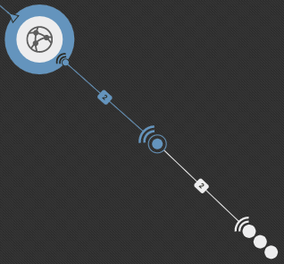
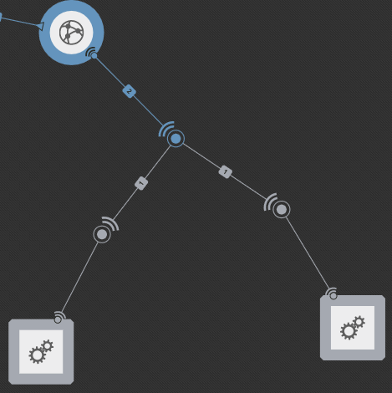
Other UI Conventions
I’m following or controlling things I don’t own
Click on the … and it will expand Square things are not yours

Slide 11
Horizontally Scalable and Distributed
Horizontally scalable architecture consisting of:
Registrar Root of trust, brokerage, allocation of IDs. Metadata store for globally visible Things. Hosted by Iotic Labs
Private Spaces Distributed part of the Iotic Space. They Host metadata for virtual Things it contains. ‘Walled Garden’ management for enterprise. Hosted by Iotic Labs or by customer.
All Spaces have certificates issued by the Registrar so space-to-space communications is via https with a known certificate
Iotic Agent Interface between Iotic Space and the real world of apps and sensors. Supports one or more virtual things each. Connectivity agnostic.
Registrar
HTTPS
Iotic Space
Public Space
Private Space 1
Private Space n
Virtual Things
AMQPS
AMQPS
Iotic Agent n
Iotic Agent 1
Connectivity Agnostic
Physical Thing 1
Physical Thing n

Slide 12


Visibility in Iotic Space – Choose who can find you
Public Meta Data
Iotic Space
Public search
Iotic Space
Registrar
Registrar
Core
Public metadata pushed to registrar
Community space
User privacy
Owned Search
RDF
public
RDF
user 1
public
user 2
user 3
Visible to all users in this space
Private space
Space privacy
Local search

Slide 13
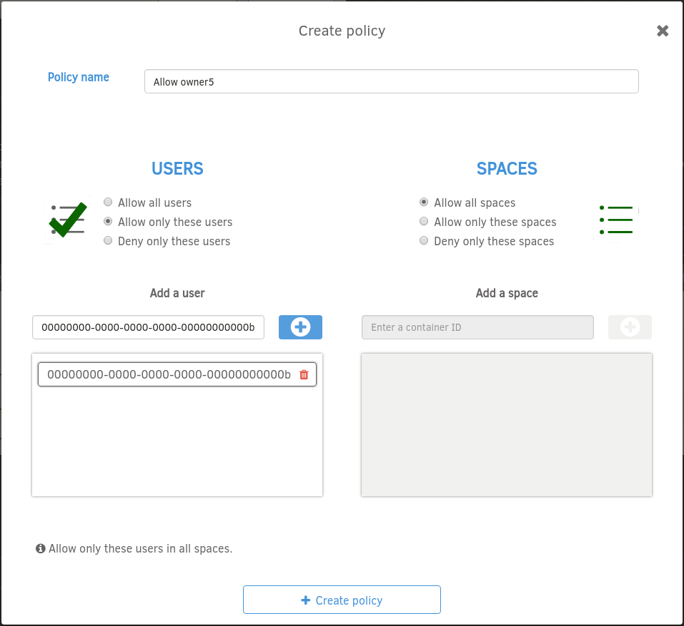
Note on access control (profile page)

Slide 14
Demo

Slide 15
Consequences
A location
An input stream from a sensor or sensors
Another input (from an API?). Or make one up…
A mash-up algorithm e.g. rolling average and test current against average
An output action… and then…
The “pitch deck”

Slide 16
Account setup
https://developer.iotic-labs.com

Slide 17
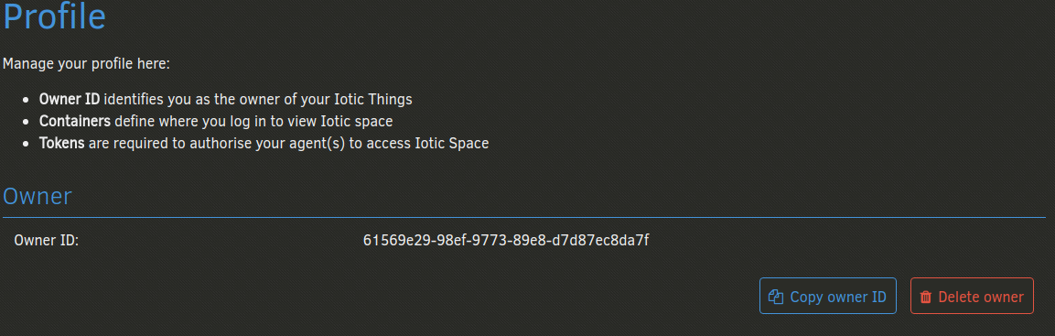
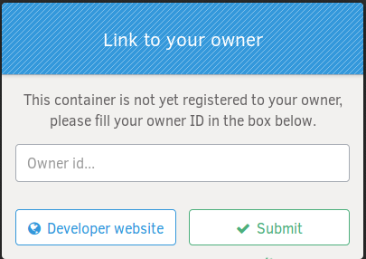
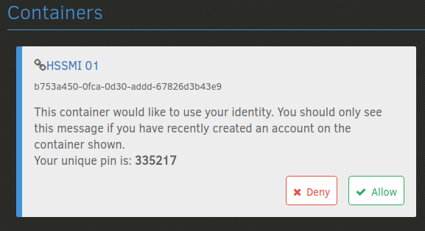
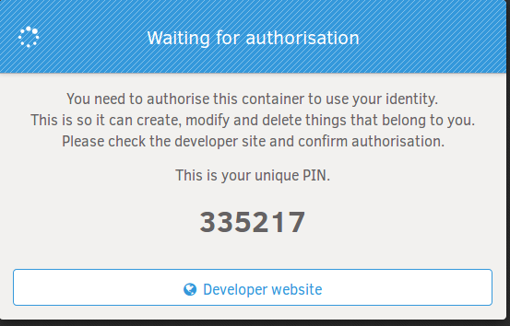
Linking your owner to another sub-space (container)
developer.iotic-labs.com
<your domain>.iotic-labs.com
Owner id is in the profile
First time you use the space app
1
2
3
4

Slide 18
Hello world

Slide 19
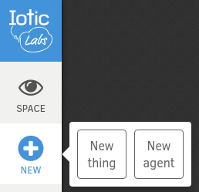
Hello world
from IoticAgent import IOT
with IOT.Client(config="Getting_Started.ini") as client: print("Connected? ...", client.is_connected())
From which you’ll see you’re going to need (there are various ways to achieve this…)
pip3 install py-IoticAgent
pip3 install –t 3rd py-IoticAgent
virtualenv venv
And to create an agent .ini file

Slide 20
Getting Going

Slide 21
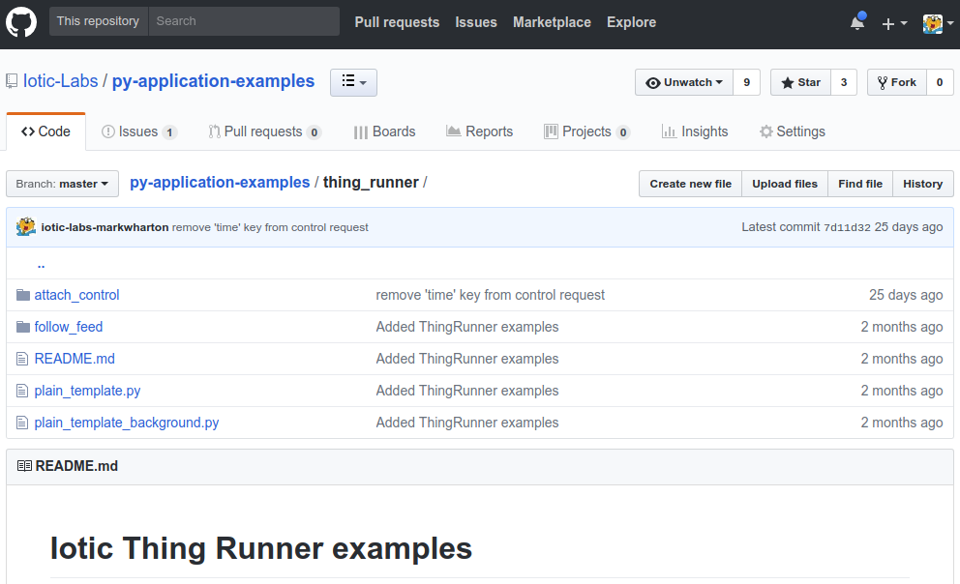
Examples in github - https://github.com/iotic-labs

Slide 22
Guts of simple share (1/2)
def on_startup(self):
self.__thing = self.client.create_thing('share_basic')
with self.__thing.get_meta() as meta:
meta.set_label('share basic label')
meta.set_description('share basic description')
meta.set_location(52.2053, 0.1218)
self.__thing.create_tag(['test', 'example'])
self.__feed = self.__thing.create_feed('share_basic_feed', save_recent=-1)
with self.__feed.get_meta() as meta:
meta.set_label('share basic feed label')
self.__feed.create_value('count', Datatypes.INTEGER, description="Random Counter", unit=Units.COUNTS_PER_MIN)
self.__thing.set_public(public=True)

Slide 23
Guts of simple share (2/2)
def main(self):
templ_feed = self.__feed.get_template()
while True:
start = monotonic()
templ_feed.values.count = randint(50, 100)
self.__feed.share(templ_feed)
stop = monotonic()
if self.wait_for_shutdown(max(0, self.LOOP_TIMER - (stop - start))):
break

Slide 24
Guts of simple follow
def on_startup(self):
self.__thing = self.client.create_thing('follow_basic')
self.__thing.follow(('share_basic', 'share_basic_feed'), callback_parsed=self.__callback_parsed) def __callback_parsed(args):
values = args['parsed'].filter_by(types=(Datatypes.INTEGER,), units=(Units.COUNTS_PER_MIN,), text=("random",))
if values:
logger.debug('Found parsed data for key %s: value: %s', values[0].label, values[0].value)
else:
logger.debug('Parsed data not found')

Slide 25
Wrap Up

Slide 26
Workshop Objectives
At the end of the session you will have:
Learnt how to create and find other Things using the Space app
Connected virtual Iotic things to local Python code
Shared and received data using Iotic Space (in code)
Publicised a control interface and received actuations (in code)
Searched for things using code and automatically bound to them
Implemented your own simple application
The ability to continue to develop your ideas using Iotic Space after the session

Slide 27
Wrap up
Any further questions?
Resource Links
API docs – https://iotic-labs.github.io/py-IoticAgent/
Developer site - https://developer.iotic-labs.com

