Slide 1
Travel Mate 2.0
Team Krafterz
Miracle D’souza
Rahul D’costa
Notes:
Note: Please View Deck in slideshow mode

Slide 2
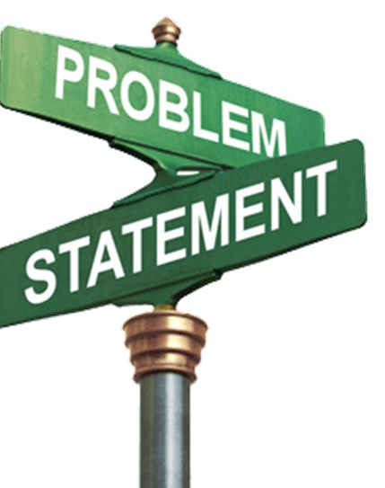
Problem Statement
Booking the WRONG itinerary options can end up in a bad traveler experience.
Travelers don’t have time to find out best places to visit on arrival and end up visiting same places again.

Slide 3

Idea
To develop an application which will cater to the problems faced by traveler while making itinerary choices
Feel it and book with confidence
Making use of VR and 360 degree technology
Providing the best customer feedback experience through video/audio
Hassle free activity planner that know your time slots
Using customer preferences to provide a more customized experience to traveler.
Bringing to you a more realistic booking experience like never before through Travel Mate 2.0

Slide 4
The New Travel Booking Experience

Slide 5


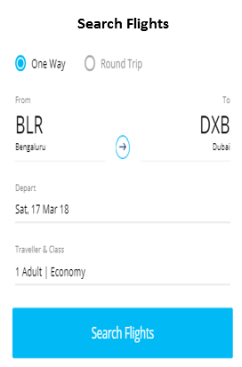
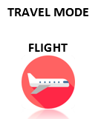

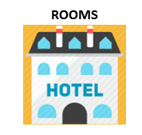

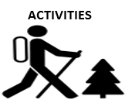

Choose your mode of Travel

Slide 6
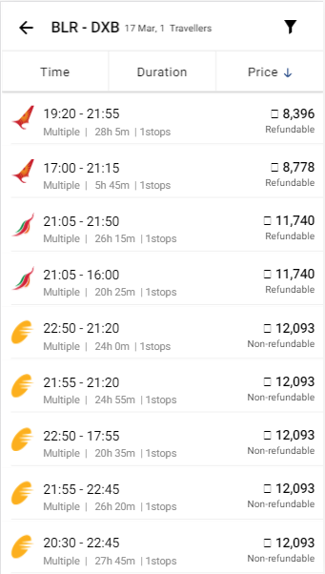
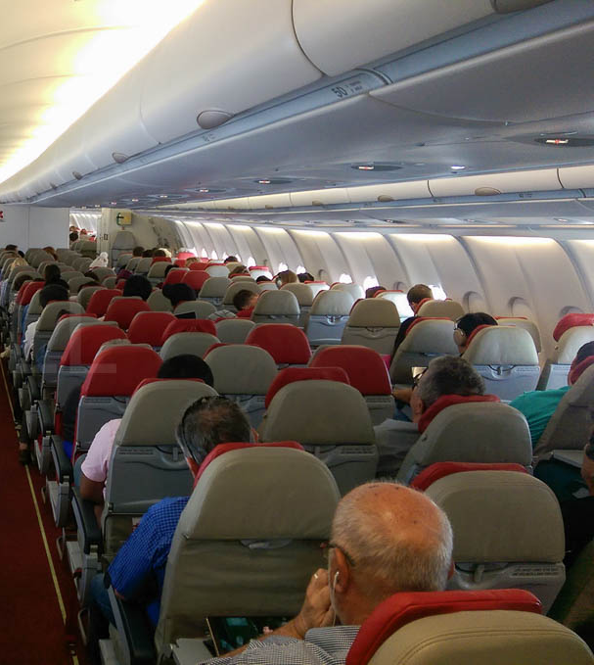



Check the flight in VR mode
Know the reality about the seat map, leg room, luggage space before getting in – Pay the option that deserves your money
Notes:
Avoid unpleasant trips due to lack of information or awareness

Slide 7
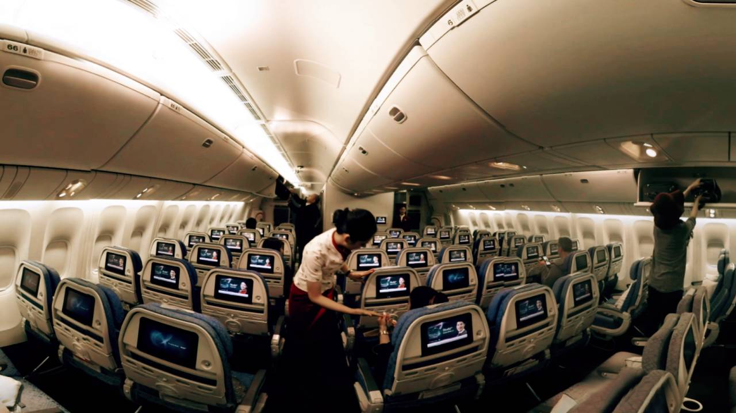

No VR, No worry – Go the 360 degree way

Slide 8



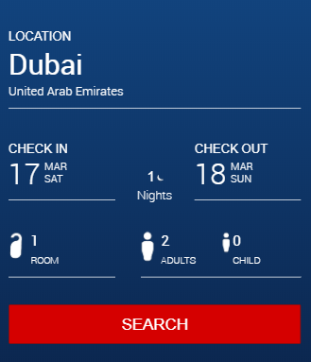

Confirm flight – Now Lets find you a place to stay

Slide 9
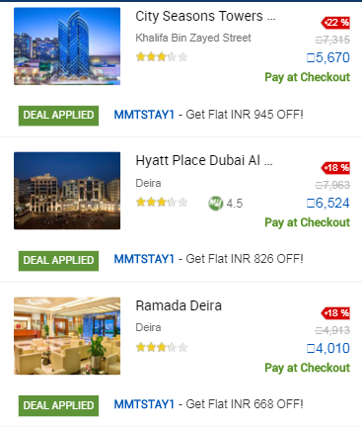
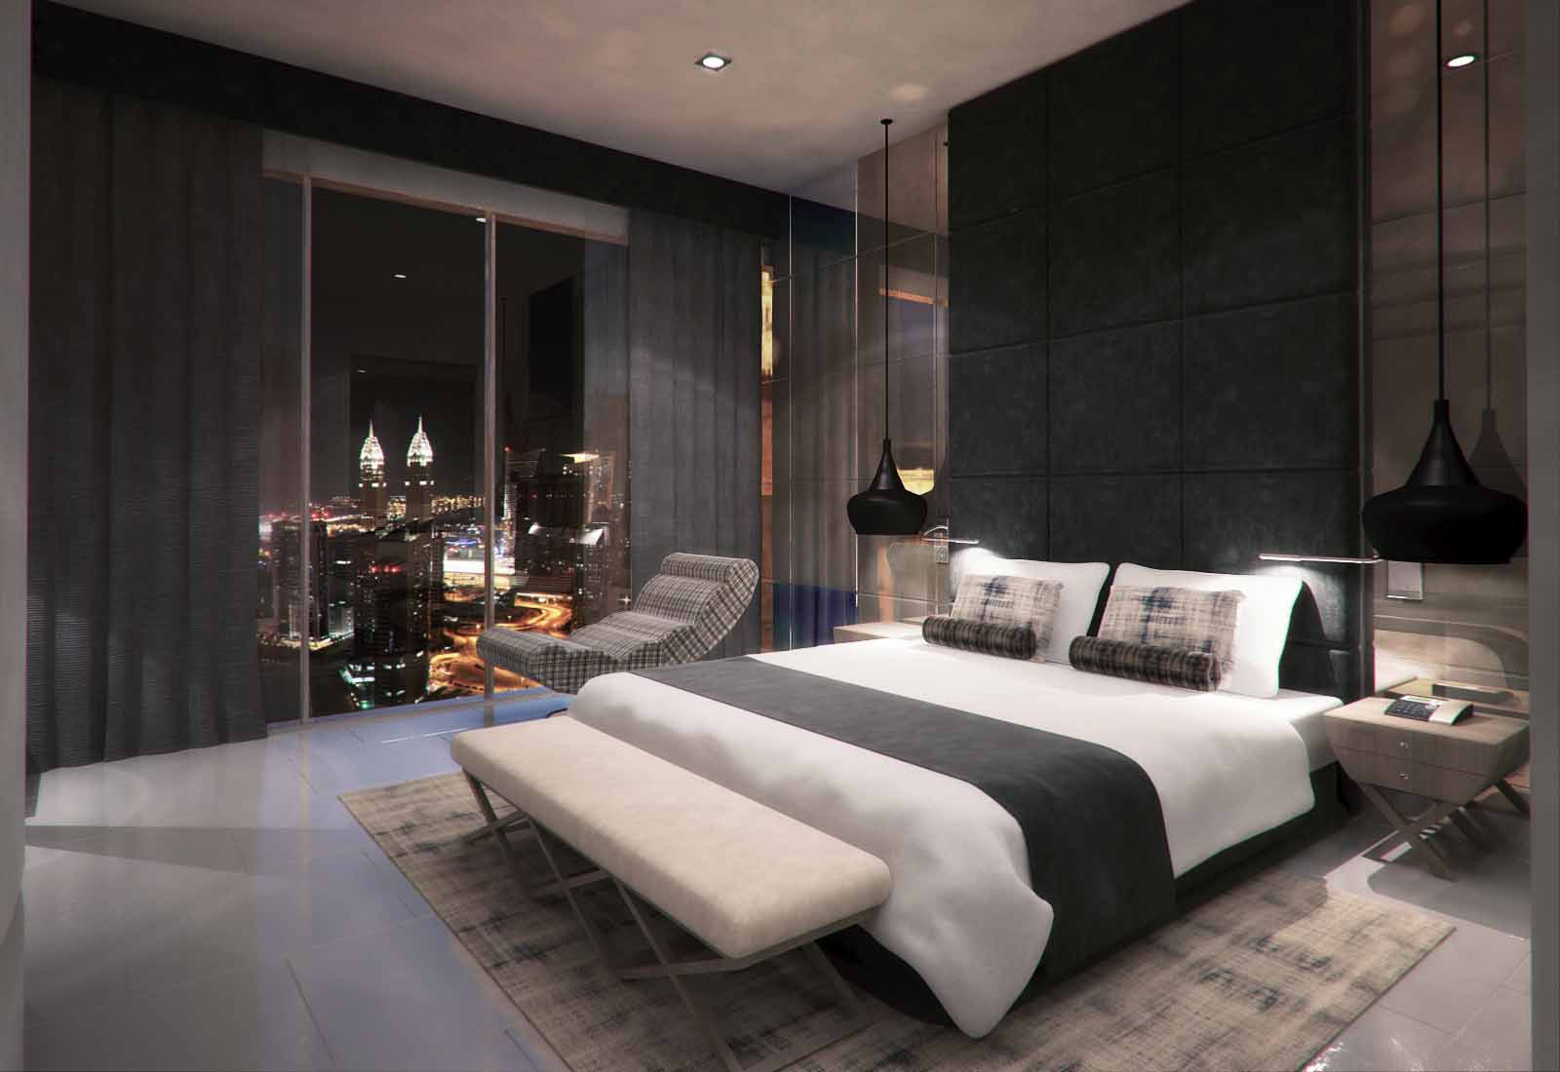
VR Inspect your room even before you get there

Slide 10
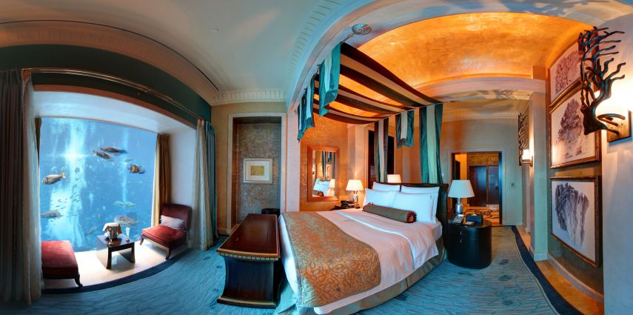
Else…take the 360 degree check!
This opens up lesser known, cheaper yet comfortable options for customer consideration..
Saves company/traveler dollars!!
Notes:
Ensures good service to our traveler from hotels
Opens up business option s to the lesser known hotels

Slide 11



Hotel checked! Lets Plan Leisure – Sync your schedule to collate your Spare Time

Slide 12

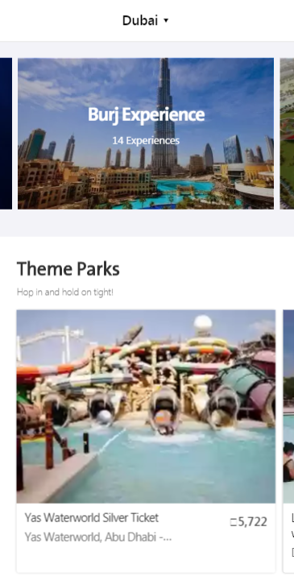




Explore options that we have…
Notes:
Options could be using customers interests and likes - analytics

Slide 13
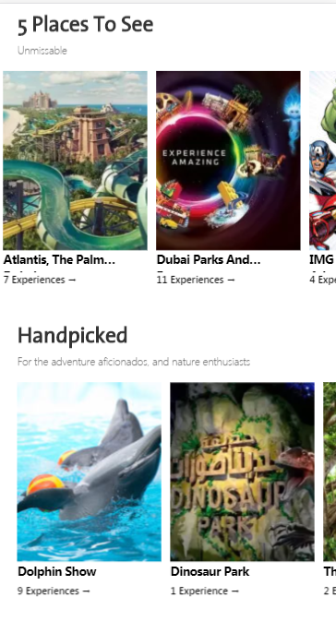
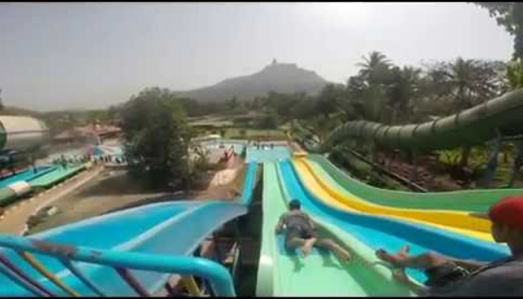
via VR or 360deg….

Slide 14
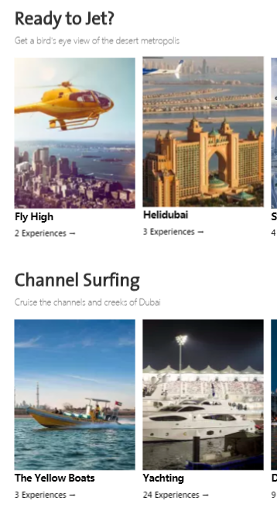

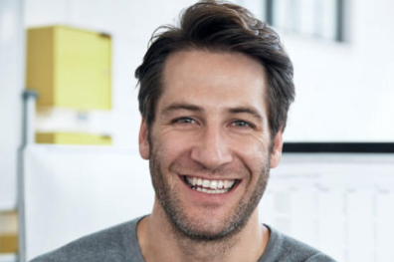



Add the options and check the video/audio feedback….

Slide 15



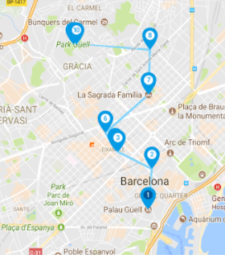



And confirm….to help us make a plan for you!
Special Reminder

Slide 16
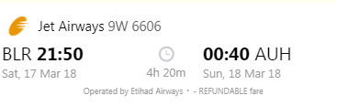
View your journey summary in one screen

Slide 17
Key Market Differentiator
VR and 360 experience among online booking tools is absent.
An organized activities planner is one of a kind.
The first B2B application to take care of Travel, Stay and Activities for cooperates.
Special activity reminder so that you are on time and don't miss out on planned activities.
VR/360 experience while booking leisure activities is first of its kind.

Slide 18
Impact and Applicability
Bleisure is on the rise it has jumped to 23% in 2017 from 11% in 2012.
Now is the right time for Sabre to tap into this domain as by 2020 Bleisure is expected to double.
It can be integrated with Trip Case, GetThere or can go out as stand alone application.
The idea can be extended by including Virtual Payments.
Solutions to existing problems
It would allow customers to plan their activities by feeling it first and confidently book it.
Allows new upcoming Hotels / airlines a chance to attract customers
No more worries and regrets of selecting the wrong itinerary options.
Full transparency for all.

Slide 19
ROI
Customer :- Hotel /Airlines /Activities authorities
Total hotel booking in last 6 months:- 15K (count)
Total flight booking in last 6 months:- 7 millon
Initial cost for authorities to get their services to the customer via app= $500.
Per app booking cost of $1 is charged to Airline authorities , $2 is charged to Hotel authorities , $2 is charged to Activity authorities .
Assuming 10% increase in booking because of customer experience
Total revenue from hotels:- 20(Top hotels)* 500+ (15000*2)+ (1500*2) = $43000 in 6 months
Total revenue from airlines:- 20(Top airlines)* 500+ (7000000 *2)+ (700000*2) = $ 7710000 in 6 months
Assuming 100000 activities are purchased by customers
Total revenue from activity planners:-20(Top activity planners)*500+2* 100000 = $ 210000
Total revenue:- 43000+ 7710000+ 210000=$ 77353000
Notes:
Marketing= $30k
Development= $30k

Slide 20




Benefits
Confident Booking
Special
Activity
Reminder
Help build trust in Hotel/Airlines
Organized
Activity Planner
Pay the option
that deserves
your money

Slide 21
Thank You

