Slide 1
TEX UI LearnIT Series

Slide 2



Presenters
Rahul Dcosta
Miracle DSouza
Rahaman Sharif
Software Developer
Travel Network
Software Developer
Travel Network
Senior Software Developer
Travel Network

Slide 3

Series
1
Series 1: HTML -Rahul
2
Series 2: JavaScript/Jquery - Rahaman
3
Series 3: CSS -Rahaman
4
Series 4: Accessibility and WCAG 2.0 – Miracle
5
Series 5: Bootstrap 4 – Miracle/Rahul

Slide 4



Hyper Text Markup Language
Rahul D’costa
Series 1
25/04/2018
Notes:
SHORT TITLE

Slide 5
Agenda
1
Module 1: Intro
2
Module 2: HTML Elements(Tags)
3
Module 3: HTML Attributes
4
Module 4: HTML Styling Basics
5
Module 5: HTML Links & Images
6
Module 6: Hands On

Slide 6
Agenda
7
Module 7: HTML Blocks (Div and Span)
8
Module 8: HTML Tables and Lists
9
Module 9: HTML i-Frame and Layouts
10
Module 10: HTML Entities(Symbols)
11
Module 11: HTML Form and Form Elements
12
Module 12: Hands On H/W

Slide 7
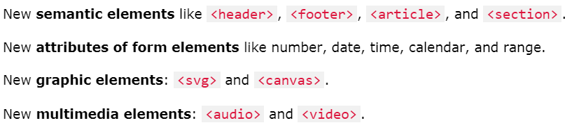
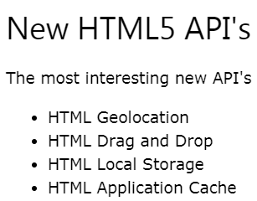
What's new in HTML5
The DOCTYPE declaration for HTML5 is very simple:
The character encoding (charset) declaration is also very simple:
Notes:
<META http-equiv="Content-Type" content="text/html; charset=EUC-JP">
<!DOCTYPE HTML PUBLIC "-//W3C//DTD HTML 4.01//EN" "http://www.w3.org/TR/html4/strict.dtd">
SVG = Scalable Vector Graphics draw shapes u want
The HTML <canvas> element is used to draw graphics, on the fly, via JavaScript.

Slide 8
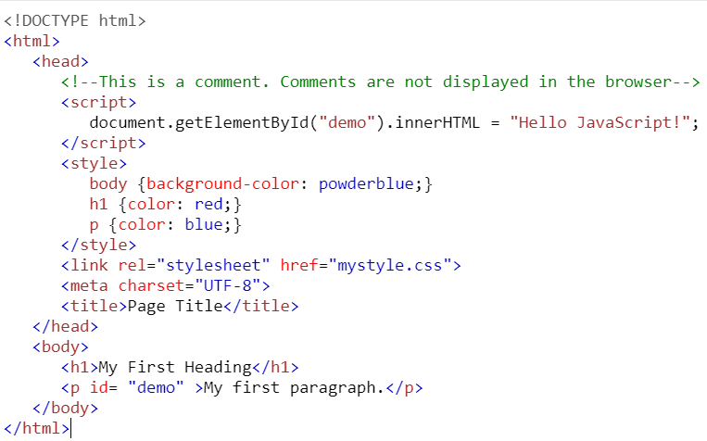
Introduction
Describes the structure of Web pages using markup
Elements(tags) are the building blocks of HTML pages
Browsers do not display the HTML tags, but use them to render the content of the page
Editors – Notepad++ /Brackets/Sublime Text
Ex.1 – create a html file
Notes:
Talk about HTML structure(nested elements) and important intro tags
The <!DOCTYPE html> declaration defines this document to be HTML5
The <html> element is the root element of an HTML page
The <head> element contains meta information about the document
The <title> element specifies a title for the document
The <body> element contains the visible page content
The <h1> element defines a large heading
The <p> element defines a paragraph

Slide 9

HTML Elements (Tags)
An HTML element usually consists of a start tag and end tag, with the content inserted in between.
Notes:
Do Not Forget the End Tag as it will cause rendering issues
Content less Tag BR tag
HTML tags are not case sensitive: <P> means the same as <p>

Slide 10
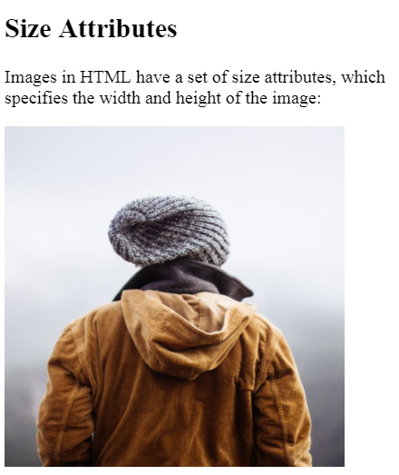
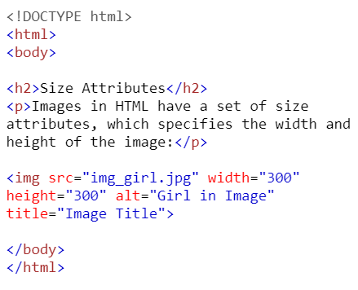
HTML Attributes
Attributes provide additional information about an element.
All HTML elements can have attributes
Notes:
All HTML elements can have attributes
Attributes are always specified in the start tag
Attributes usually come in name/value pairs like: name="value"

Slide 11
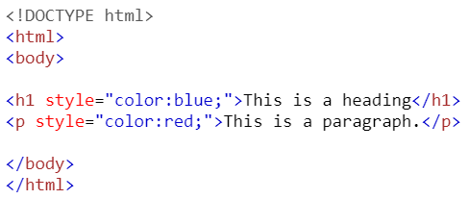
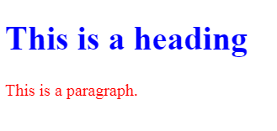
HTML Styling Basics
Setting the style of an HTML element, can be done with the style attribute.

Slide 12

HTML Links
You can click on a link and jump to another page
Links allow users to navigate smoothly.
Notes:
A link does not have to be text. It can be an image or any other HTML element.
_blank - Opens the linked document in a new window or tab
_self - Opens the linked document in the same window/tab as it was clicked (this is default)
_parent - Opens the linked document in the parent frame
_top - Opens the linked document in the full body of the window
framename - Opens the linked document in a named frame

Slide 13
HTML Images
Images can improve the design and the appearance of a web page
https://www.w3schools.com/html/tryit.asp?filename=tryhtml_images_map2
Notes:
Talk about the attributes of img tag
Image as link
Animated images

Slide 14
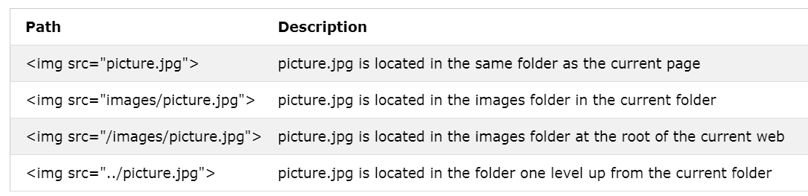
HTML File Paths

Slide 15
Hands On
Create a Heading as “TEX UI SERIES - HTML”
Create a Paragraph with text as “Today we are learning HTML in a Hands on Session”
Create a image with attributes width==height==300 and title as “Random image guys”
Create a link with www.sabre.com as the text/url
Raise your hand

Slide 16
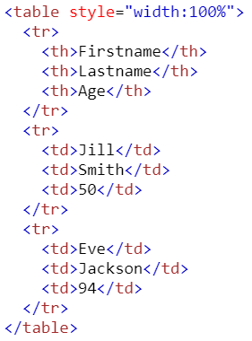
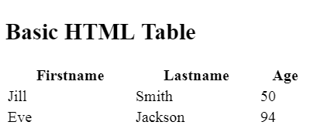
HTML Tables
Notes:
An HTML table is defined with the <table> tag
Each table row is defined with the <tr> tag.
A table header is defined with the <th> tag.
By default, table headings are bold and centered. A table data/cell is defined with the <td> tag

Slide 17
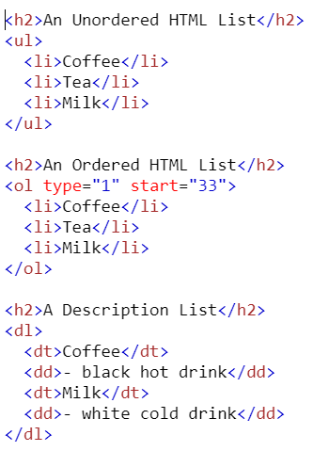
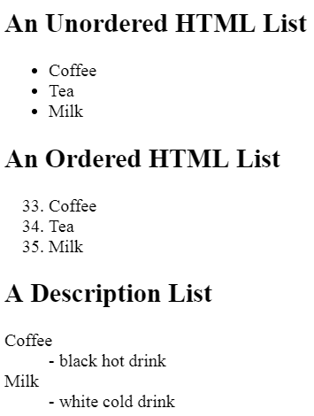
HTML Lists
An unordered list starts with the <ul> tag. Each list item starts with the <li> tag
Notes:
type="1"The list items will be numbered with numbers (default)
type="A"The list items will be numbered with uppercase letters
type="a"The list items will be numbered with lowercase letters
type="I"The list items will be numbered with uppercase roman numbers
type="i"The list items will be numbered with lowercase roman numbers

Slide 18
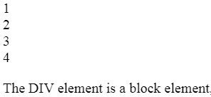

HTML Blocks (Div and Span)
The default display value for most elements is block or inline.
INLINE
BLOCK
Notes:
Every HTML element has a default display value depending on what type of element it is.

Slide 19
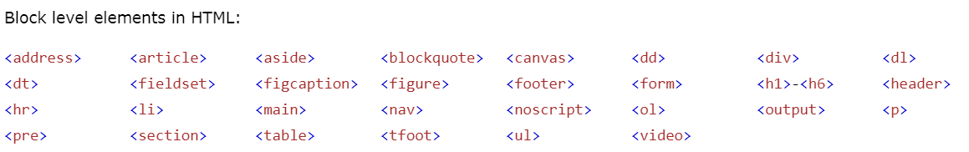
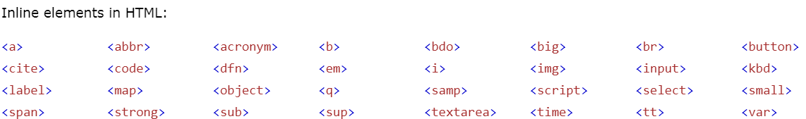
Block vs Inline in HTML

Slide 20
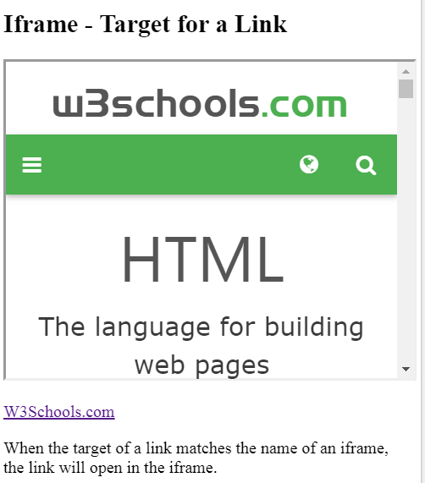
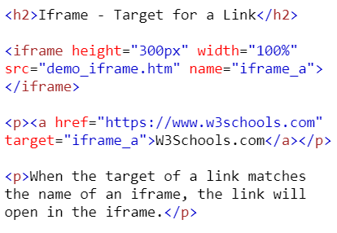
HTML i-Frame
An iframe is used to display a web page within a web page.
Notes:
The target attribute of the link must refer to the name attribute of the iframe:

Slide 21
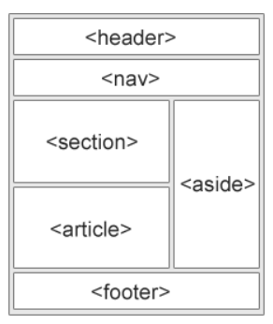
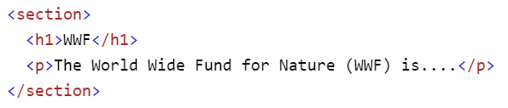
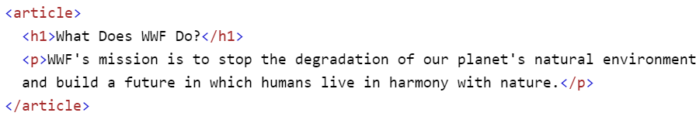
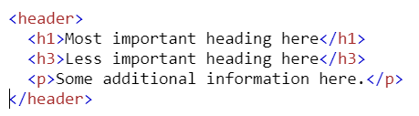
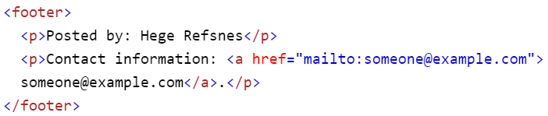
HTML Layouts
Websites often display content in multiple columns(like a magazine or newspaper).
Notes:
HTML5 offers new semantic elements that define the different parts of a web page.
<header> - Defines a header for a document or a section
<nav> - Defines a container for navigation links
<section> - Defines a section in a document
<article> - Defines an independent self-contained article
<aside> - Defines content aside from the content (like a sidebar)
<footer> - Defines a footer for a document or a section
<details> - Defines additional details
<summary> - Defines a heading for the <details> element

Slide 22
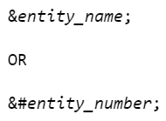
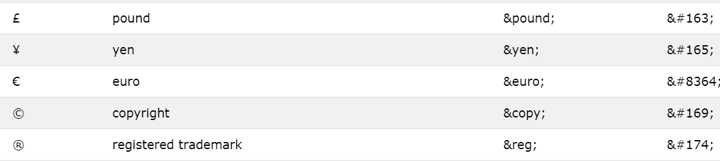
HTML Entities(Symbols)
Some characters are reserved in HTML
If you use the less than (<) or greater than (>) signs in your text, the browser might mix them with tags.
Character entities are used to display reserved characters in HTML
Notes:
Characters that are not present on your keyboard can also be replaced by entities.

Slide 23
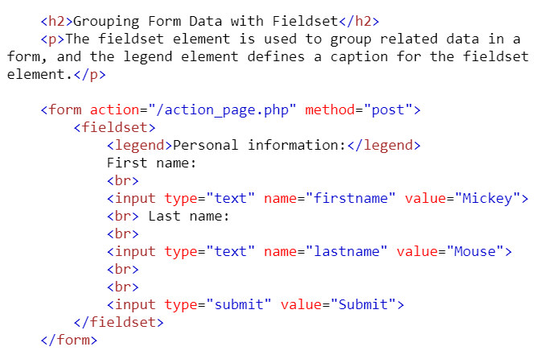
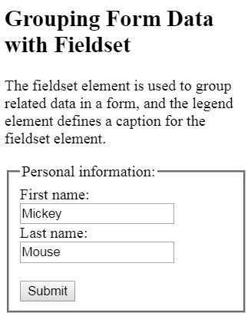
HTML Form
Notes:
The HTML <form> element defines a form that is used to collect user input:
Form elements are different types of input elements, like text fields, checkboxes, radio buttons, submit buttons, and more.
Talk about name /action/method/type attributes

Slide 24
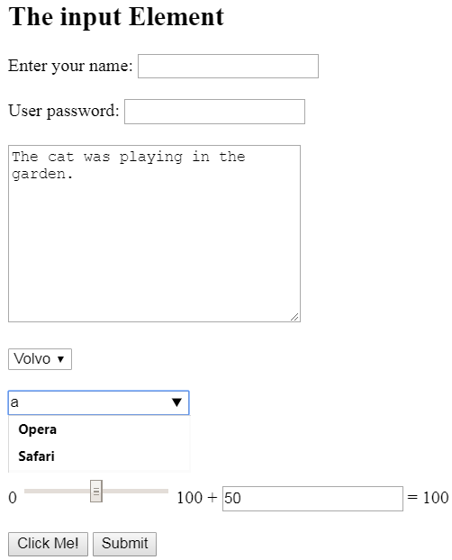
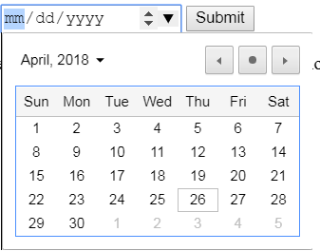
HTML Form Elements
used to collect user input
TextBox
Password
Radio
Checkbox
TextArea
Date
Dropdown (Single/Multi)
Datalist
Output

Slide 25
What's new in HTML5
The DOCTYPE declaration for HTML5 is very simple:
The character encoding (charset) declaration is also very simple:
Notes:
<META http-equiv="Content-Type" content="text/html; charset=EUC-JP">
<!DOCTYPE HTML PUBLIC "-//W3C//DTD HTML 4.01//EN" "http://www.w3.org/TR/html4/strict.dtd">
SVG = Scalable Vector Graphics draw shapes u want
The HTML <canvas> element is used to draw graphics, on the fly, via JavaScript.

Slide 26
Hands On H/W
Create a Form to capture Name ,Location(DFW/KRK/BLR) ,Gender ,Reason for Travel.
Create a Table with columns Location and Teams Count (random no.) against Location BLR/DFW/KRK
Create a unordered list consisting of all SabreNext values
Create a Paragraph with random text and make use of 3 HTML entities .
Complete it before next UI Series Session

Slide 27
References
https://www.w3schools.com/html/default.asp

Slide 28
Thank YOu
Upcoming in Next Series – Jquery /Javascript by Rahaman

