Slide 1

Techno College Of Engineering Agartala
Seminar on Contemporary Engineering Topics- II (SE CS 806)
Department of Computer Science & Engineering Academic Year: 2025–2026
A SEMINAR PRESENTATION ON
MCP Server + AI: Future of Intelligent Systems
Presented By:
Rahul Deb
TU Roll No: 226704133 Student ID: 2230401060 Semester: 8th
Department of Computer Science and Engineering

Slide 2

Introduction to MCP
Problem: Fragmented AI integrations require custom APIs.
Solution: MCP introduces a unified client-server protocol.
Benefit: Enables dynamic tool and data interaction.
Impact: MCP can become the HTTP of AI integrations.
User
AI
MCP
Tool
Response

Slide 3
MCP Architecture
Client: AI model initiates requests
Server: MCP manages communication
Tools: Executable external actions
Resources: Data and context
JSON-RPC
AI Client
MCP Server
Tools
Resources
Prompts

Slide 4
How MCP Communicates (JSON-RPC)
Protocol: JSON-RPC for structured communication
Purpose: AI invokes tools using standard requests
Key Idea: Machine-to-machine interaction
JSON Request
Invoke Result
AI Client
MCP Server
Tool
Response
Example Request
{ "method": "tools.call", "name": "get user data" }

Slide 5

How MCP Works
User sends query to AI
AI processes intent
MCP invokes tool
Tool returns result
AI responds to user
User
AI
MCP
Tool

Slide 6
Paper 1: ReAct (Reason + Act)
Shunyo Yao et al. (Princeton)
Objective: Combine reasoning with real-world actions
Method: Iterative loop of Thought → Action → Observation
Implication: Reduces hallucination and improves decision accuracy
Limitation: Complex reasoning chains increase prompt overhead
MCP Link: Forms the cognitive backbone of AI agents in MCP
Thought
Action
Feedback
Result
Observation

Slide 7
Paper 2: ToolLLM
Author: Qingyang Wu et al.
Objective: Enable LLMs to use APIs
Method: Convert text into API calls
Implication: Real-world interaction
Limitation: Limited to static APIs
MCP: Shows need for standard protocol
User
LLM
API

Slide 8
Paper 3: AutoGen
Chu Wang et al.( Microsoft Research)
Multi-agent collaboration
Task delegation across agents
Improves complex workflows
Foundation for MCP orchestration
Agent A
Agent B
Agent C

Slide 9
Paper 4: MemGPT (2023)
Charles Packer et al.
Objective: Enable LLMs to manage their own memory hierarchically.
Methodology: Implemented OS-inspired active and archival memory tiers.
Implication: Allows long-term context retention across sessions.
Limitation: Memory retrieval degrades for massive archival stores.
MCP Connection: Directly influenced MCP’s Resource primitive for persistent data.
Read / Write
LLM
Memory

Slide 10
Paper 5: Gorilla (2023)
Rohit Singh(UC Berkley)
Objective: Train models to generate executable API calls accurately.
Methodology: Used RAG to provide up-to-date API documentation.
Implication: RAG combined with generation reduces API hallucinations.
Limitation: Focuses only on read-only, single-call scenarios.
MCP Connection: Validates the document-grounded approach used by MCP.

Slide 11
Paper 6: AgentBench (2024)
Xingyao Wang et al.
Objective: Provide a comprehensive benchmark for LLM tool use.
Methodology: Evaluated 25+ LLMs across 8 interactive environments.
Implication: Revealed major gaps in open-source model tool capabilities.
Limitation: Curated environments do not reflect full production complexity.
MCP Connection: Provides the empirical baseline for evaluating MCP error reduction.

Slide 12
Paper 7: HuggingGPT (2023)
Yangchao Wang et al. (Microsoft)
Objective: Use an LLM as a controller to delegate tasks to specialized models.
Methodology: Used ChatGPT to parse requests and invoke Hugging Face models.
Implication: Validated the AI orchestrator concept for heterogeneous tools.
Limitation: High latency due to sequential, non-standardized model invocations.
MCP Connection: A direct precursor to MCP’s multi-server orchestration architecture.

Slide 13
MCP vs Traditional APIs
Feature | MCP | Traditional APIs
Standardization | High | Low
Dynamic Tool Use | Yes | No
Scalability | High | Limited
Integration Effort | Low | High
Flexibility | High | Low
Key Insight
MCP eliminates repeated integrations and enables scalable AI systems

Slide 14
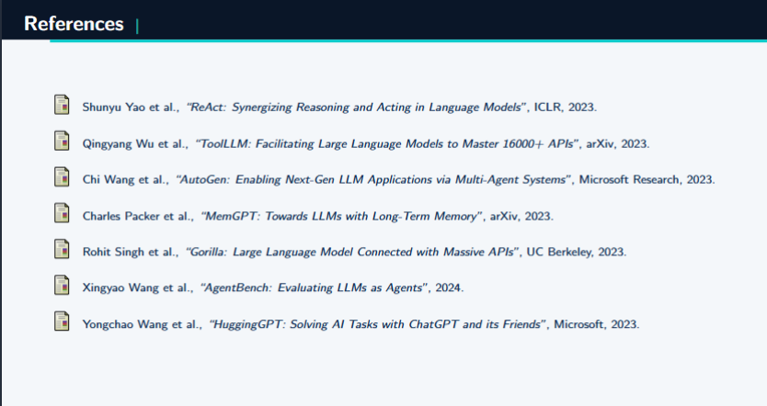

Slide 15
Conclusion
Summary: MCP bridges the gap between AI reasoning and real-world action.
Impact: Enables dynamic discovery and seamless multi-agent coordination.
Future: Solves the fragmentation crisis in AI system development.
Outlook: MCP can become the HTTP of AI integrations — a universal standard for connecting AI systems to real-world tools.
Thank You!

