Slide 1
FINAL PRESENTATION · RESPONSIBLE AI & DATA ETHICS (PEL, SS2026)
Responsible AI for
Credit Scoring
A fairness-audited, explainable and attack-tested credit system
Devagiri Rahul Shrikant · Mehatab
43 tests · 99% coverage
3 bias audits
3 attack studies
live app
Notes:
Good morning. We're presenting our Responsible AI credit scoring project. The question we set out to answer was not just 'can we predict credit risk' — but 'can we build a model a bank could actually deploy, legally and ethically'.

Slide 2
THE PROBLEM
Credit scoring is high-risk — by law
The EU AI Act names credit scoring a HIGH-RISK use case (Annex III). It is not a grey area.
GDPR Article 22 gives every applicant the right to an explanation of an automated decision.
A wrong decision denies someone a loan, or hands a bank a default. Both are real harm.
Our data: 1,000 German loan applicants, 70% good / 30% bad credit.
Our goal
Not just an accurate model — an auditable, explainable, fair and legally defensible one.
The model recommends. A human loan officer decides.
Notes:
Credit scoring isn't an ordinary machine learning problem. The EU AI Act explicitly names it as high-risk, and GDPR gives applicants a right to an explanation. So from day one our goal was not just accuracy — it was building something a bank could legally and ethically deploy, where the model recommends and a human decides.

Slide 3
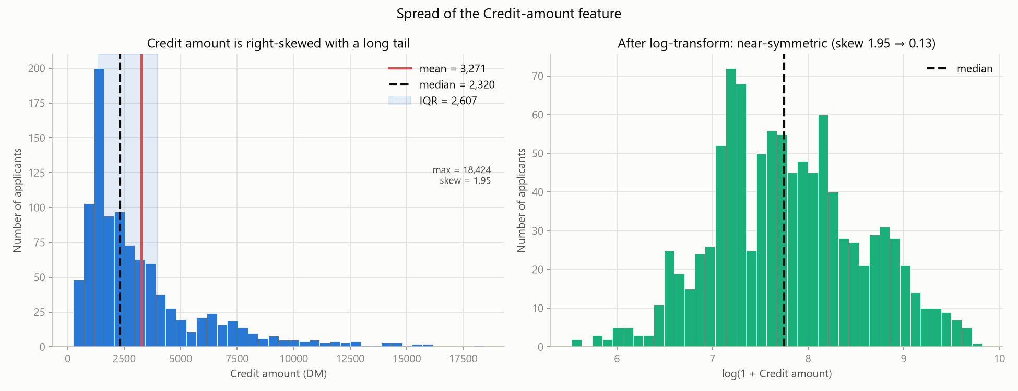
WEEK 1 · DATA
What the data told us
39% of applicants had no checking-account value. We checked the ORIGINAL UCI file — it has zero missing values.
Those blanks are really 'no account exists'. So we encoded them as a category instead of guessing a number.
Loan amounts are heavily skewed — a few very large loans. We log-transform rather than delete them.
Sensitive attributes present: age, sex — and in the full dataset, foreign-worker status.
Loan amounts before (left) and after (right) the log-transform.
Notes:
In week one we studied the data. One finding shaped everything: 39% of checking-account values were blank. We went back to the original UCI file and found it has zero missing values — those blanks actually mean the person has no account. So we encoded that as real information instead of guessing. And loan amounts are skewed, so we log-transform rather than throw away the big loans.

Slide 4
THE CORE DECISION
Why we do NOT optimise accuracy
Approving a bad loan costs a bank about 5x more than rejecting a good one. So we optimise recall — catching bad credit — not accuracy.
0.72
0.15
Highest accuracy
...but it catches only 15%
model with NO cost-weighting
of the bad loans
The 'most accurate' model is the worst lender. Our model scores lower on accuracy — on purpose.
Notes:
This is the single most important decision in our project. If we chase accuracy, we get 72 percent — the highest number in our whole study. But that model catches only 15 percent of bad loans. It would be a disaster for a bank. Approving a bad loan costs about five times more than rejecting a good one, so we optimise recall instead. Our accuracy is lower on purpose.

Slide 5
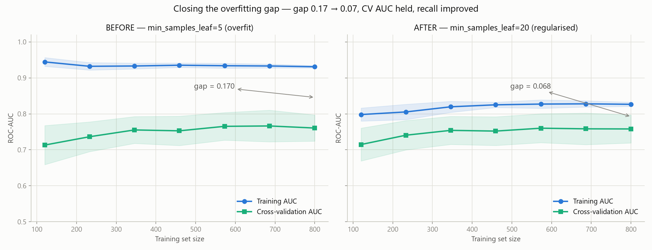
WEEKS 2–3 · THE MODEL
The model — and proof it generalises
0.75
recall on bad credit (our primary metric)
0.77
ROC-AUC — 0.78 with the full 20-feature data
Three models compared: Logistic Regression, Decision Tree, Random Forest.
We checked for overfitting — and found a large train/validation gap.
We regularised the model: the gap fell from 0.17 to 0.07, and recall went UP.
Before and after regularisation — the gap between the two lines is overfitting.
Notes:
We trained three models and picked Random Forest. It catches 75 percent of bad credit with an AUC of 0.77. But we also asked: is it overfitting — just memorising? We measured the gap between training and validation. It was large, so we regularised the model. The gap fell from 0.17 to 0.07, and recall actually improved. The two lines now converge — that's proof it generalises.

Slide 6
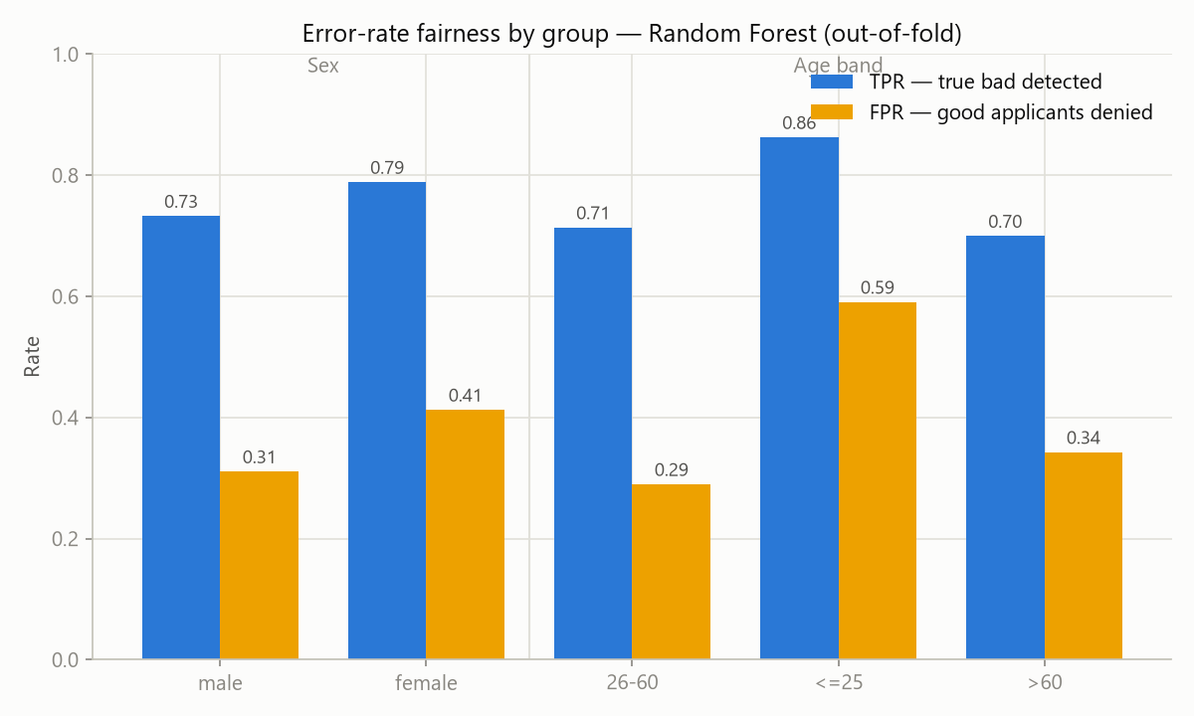
WEEK 2 · FAIRNESS
We found real bias
AGE fails the 80% fairness rule badly — ratio 0.50.
A creditworthy applicant under 26 is wrongly denied 59% of the time — versus 29% for ages 26–60.
SEX is borderline (0.80): creditworthy women are denied more often than men.
FOREIGN WORKER fails too (0.71) — but this is only visible in the full 20-feature dataset.
Dropping a sensitive column would have HIDDEN this bias — not removed it.
Yellow = creditworthy people wrongly denied. Look at the under-26 bar.
Notes:
Then we audited fairness. And we found real bias. Age fails the 80 percent rule badly — a creditworthy applicant under 26 is wrongly denied 59 percent of the time, versus 29 percent for middle-aged applicants. Sex is borderline. And foreign-worker status also fails — but only the full dataset can show it. That's the key lesson: dropping a sensitive column would have hidden this bias, not removed it.

Slide 7
WEEK 3 · MITIGATION
We fixed it — and found where fixing breaks
SEX
AGE
FOREIGN WORKER
0.80 → 0.96
0.50 → 0.82
0.71 → 0.93
BUT recall crashes 0.76 → 0.47
now fair — at no accuracy cost
passes the 80% rule; young denials halved 59% → 29%
they are 96% of applicants
Fairness mitigation is not always free.
When the disadvantaged group is a tiny minority, a naive fix trades away the model's whole purpose. So we treat foreign-worker fairness as a POLICY decision — signed off by people — not an automatic switch. Knowing when NOT to auto-fix is the real skill.
Notes:
So we fixed it. Group-specific thresholds brought sex from 0.80 to 0.96, and age from 0.50 to 0.82 — halving wrongful denials for young people. But here's the honest part. When we applied the same fix to foreign-worker status, it backfired: fairness improved on paper, but recall crashed from 0.76 to 0.47, because foreign workers are 96 percent of applicants. The lesson: fairness mitigation is not always free. Knowing when NOT to auto-fix is the real responsible-AI skill.

Slide 8
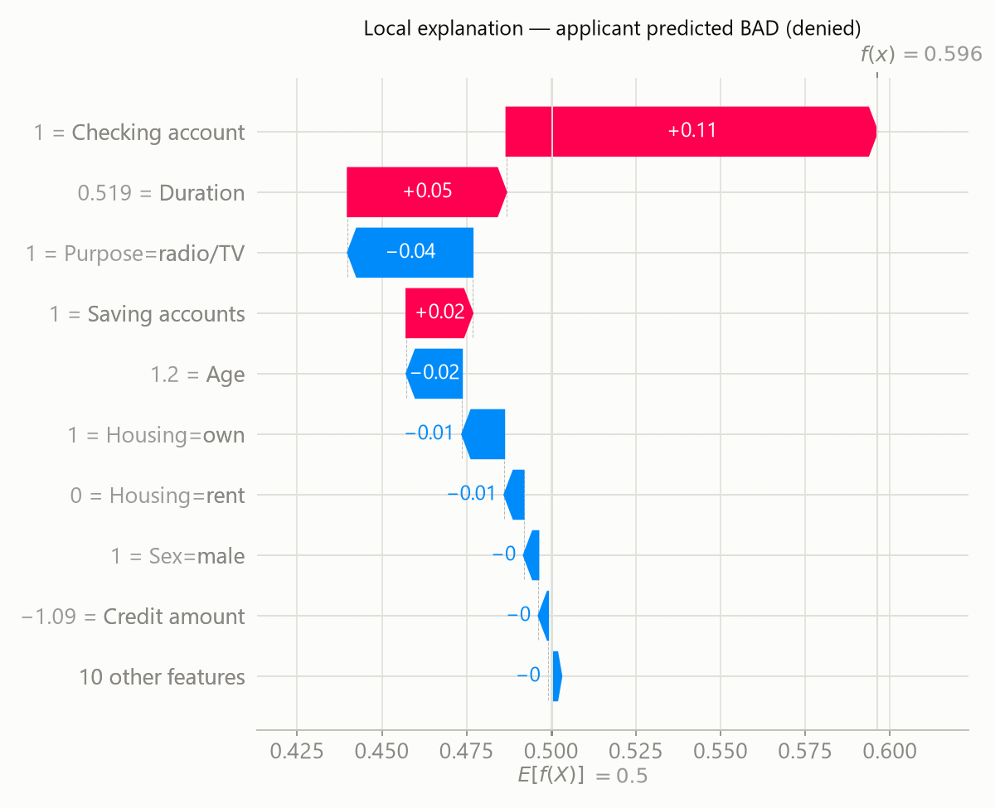
EXPLAINABILITY
Why the decision — and how to change it
Globally the model is driven by financial signals — checking account, then loan duration.
Locally, SHAP explains ONE decision: 'declined because of low balances and a long term.' That is GDPR Article 22 made real.
And we go one step further
Our app also tells the applicant HOW to get approved — e.g. 'reduce the loan from 8,000 to 6,000 DM'. A denial should come with a path, not just a reason.
SHAP: why THIS applicant was declined.
Notes:
Next, explainability. Globally the model is driven by financial signals — checking account and loan duration, which is what a loan officer looks at. Locally, SHAP explains one specific decision — declined because of low balances and a long term. That's the GDPR right to explanation, made real. And we went one step further: our app tells the applicant how to actually get approved — for example, reduce the loan from 8,000 to 6,000. A denial should come with a path, not just a reason.

Slide 9
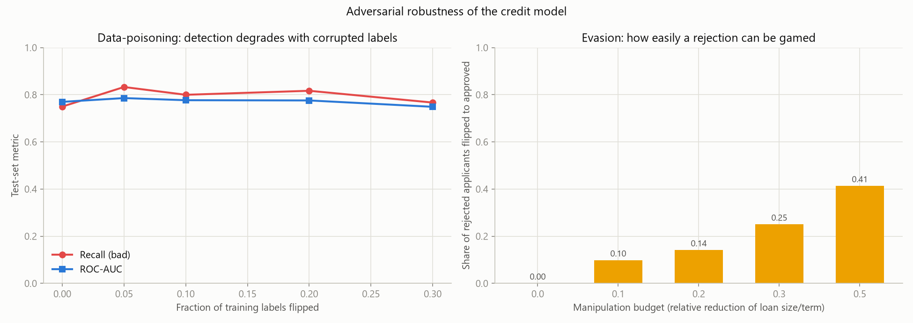
ROBUSTNESS & SAFEGUARDS
Tested — and attacked
43
automated tests
99%
code coverage (enforced ≥80%)
We attacked our own model: poisoning, gaming and privacy.
Tests check correctness, not just that code runs — e.g. shrinking a loan can never LOWER approval odds.
Privacy: we tested whether anyone can tell if a person was in our training data. Attack AUC 0.53 — barely better than a coin flip.
Human-in-the-loop, every decision logged with its explanation.
41%
of rejected applicants could game their way to 'approved' just by asking for a smaller loan — a real risk a bank must know.
Notes:
We didn't just test the model — we attacked it. 43 automated tests at 99 percent coverage, and they check correctness, not just that the code runs. Then three attacks: gaming, where 41 percent of rejected applicants could flip to approved just by asking for a smaller loan; data poisoning, where the model degrades only slowly; and a privacy attack, which is barely better than a coin flip. So the privacy risk is small, and we know exactly where the model is weak.

Slide 10
FROM A MODEL TO A DEPLOYABLE SYSTEM
What makes this different
Performant
Fair
Accountable
Catches 75% of bad credit — the metric a lender actually pays for.
Bias found, measured and mitigated — and we say where the fix breaks.
Explainable, attack-tested, human-in-the-loop, fully documented.
A bank can deploy this without regulatory or reputational blowback — because we found the problems before a regulator would.
Remaining work: a policy-level fix for foreign-worker fairness · production logging & monitoring.
Thank you · Questions?
Notes:
To close. What makes this different is the combination: it's performant on the metric a lender actually pays for, it's fair — we found the bias, measured it, fixed what could be fixed and were honest about what couldn't — and it's accountable: explainable, attack-tested, human-in-the-loop and fully documented. A bank could deploy this without regulatory or reputational blowback, because we found the problems before a regulator would. Remaining work is a policy-level fix for foreign-worker fairness and production logging. Thank you — happy to take questions.

