Slide 1
WEEK 3 · RESPONSIBLE AI CREDIT SCORING
Understanding & Testing
the Model
Opening the black box with explainable AI, then testing — and attacking — it.
SHAP explainability
43 tests · 99% coverage
3 adversarial attacks
Notes:
Last week we built our model and found a fairness problem. This week was about going deeper — understanding WHY the model decides what it decides, and then testing it. Goals: analyze the model, use explainable AI, write automated tests, and hit at least 80% coverage.

Slide 2
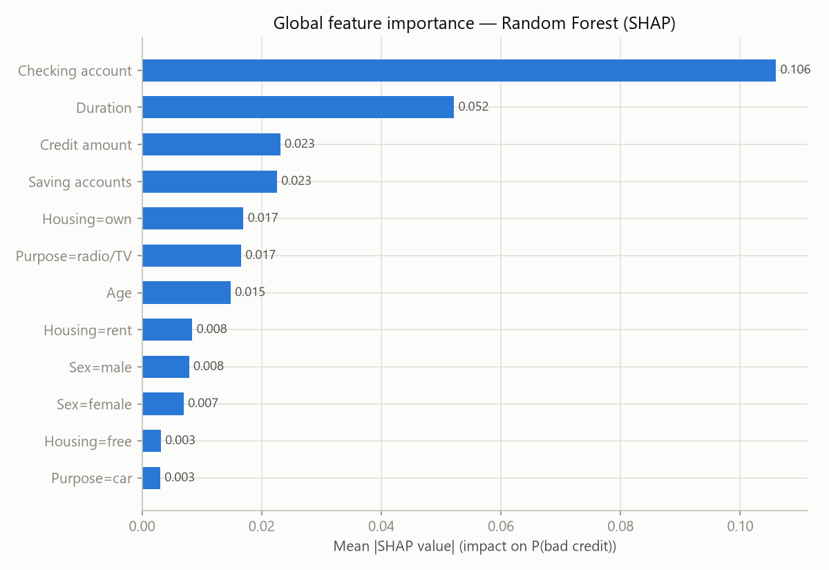
EXPLAINABILITY · GLOBAL
What drives the decision?
SHAP shows what the model weighs overall — and it's reassuring:
Checking-account status dominates, then loan duration, savings and credit amount.
These are exactly the financial signals a human loan officer looks at.
But Age and Sex carry a small, non-zero influence — the model is not perfectly neutral.
Why it matters
Because sensitive attributes leak in even when they aren't the main driver, dropping them wouldn't fix bias — so we audit instead of assume.
Global feature importance — mean |SHAP| toward P(bad credit).
Notes:
The heart of this week is explainability. SHAP shows globally what the model cares about — top drivers are all financial: checking-account status, duration, savings, credit amount. That's exactly what a loan officer looks at. But Age and Sex do have a small influence, which is why we audit.

Slide 3
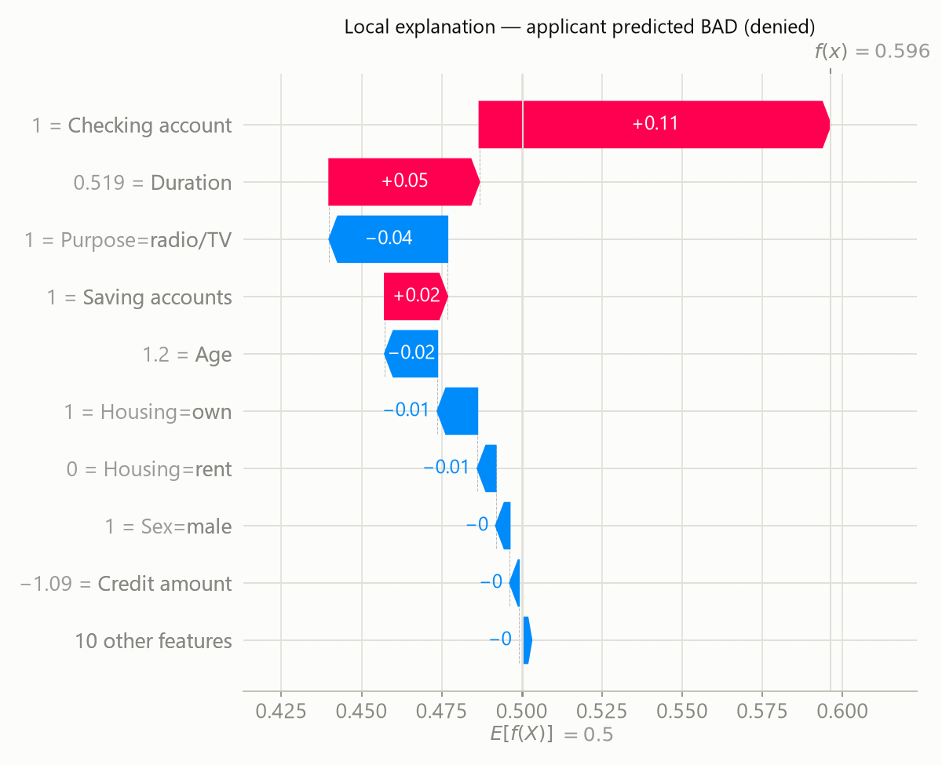
EXPLAINABILITY · LOCAL
Why this applicant?
SHAP also explains one specific decision:
Not just 'denied' — but 'denied because of low account balances and a long loan term.'
Under GDPR Art. 22, a person has the right to an explanation of an automated decision. This is that explanation, made concrete.
Live decision-support app
Enter an applicant → get a risk score, a recommendation, and this SHAP explanation live — plus a fairness warning if they're in a flagged group.
Per-applicant SHAP — red pushes risk up, blue pushes it down.
Notes:
The second way is local — why did the model decide one specific case? This chart explains a single applicant: which features pushed risk up, which pushed it down. That matters legally — GDPR gives a right to explanation. We wrapped this into a small app that gives a score, recommendation and explanation live, plus a fairness warning.

Slide 4
FAIRNESS · MITIGATION
We found bias — and fixed it
Group-specific decision thresholds repair the disparities we found, at little accuracy cost.
SEX
AGE
0.80 → 0.96
0.50 → 0.82
disparate impact — now fair, at no accuracy cost
now passes the 80% rule
59% → 29%
Wrongful-denial rate for applicants under 26 — roughly halved. That is the harm the audit set out to reduce.
Notes:
Last week we found the model fails the fairness test for age — young applicants wrongly denied 59% of the time. This week we fixed it. Group-specific thresholds brought the age fairness ratio from 0.50 to 0.82 — now passing — and roughly halved those wrongful denials to 29%. We'd already done the same for sex, 0.80 to 0.96, essentially for free.

Slide 5
FAIRNESS · THE HARD CASE
...and where the fix breaks
Applying the SAME fix to foreign-worker status backfires — an honest, important result.
0.71 → 0.93
0.76 → 0.47
Fairness improves...
...but recall collapses
foreign workers are ~96% of applicants
Fairness mitigation is not always free.
When the disadvantaged group is a tiny minority, a naive fix trades away the model's purpose — so this is a policy decision, not an automatic switch.
Notes:
Here's the honest part. When we applied that same fix to foreign-worker status, it backfired. Fairness improved on paper, but overall recall collapsed from 76% to 47% — because foreign workers are 96% of applicants, so tightening the rule makes the model miss half of all bad loans. The lesson: fairness mitigation is not always free. When the disadvantaged group is a tiny minority, a naive fix trades away the model's whole purpose, so we treat it as a policy decision. Knowing when NOT to auto-fix is the real responsible-AI skill.

Slide 6
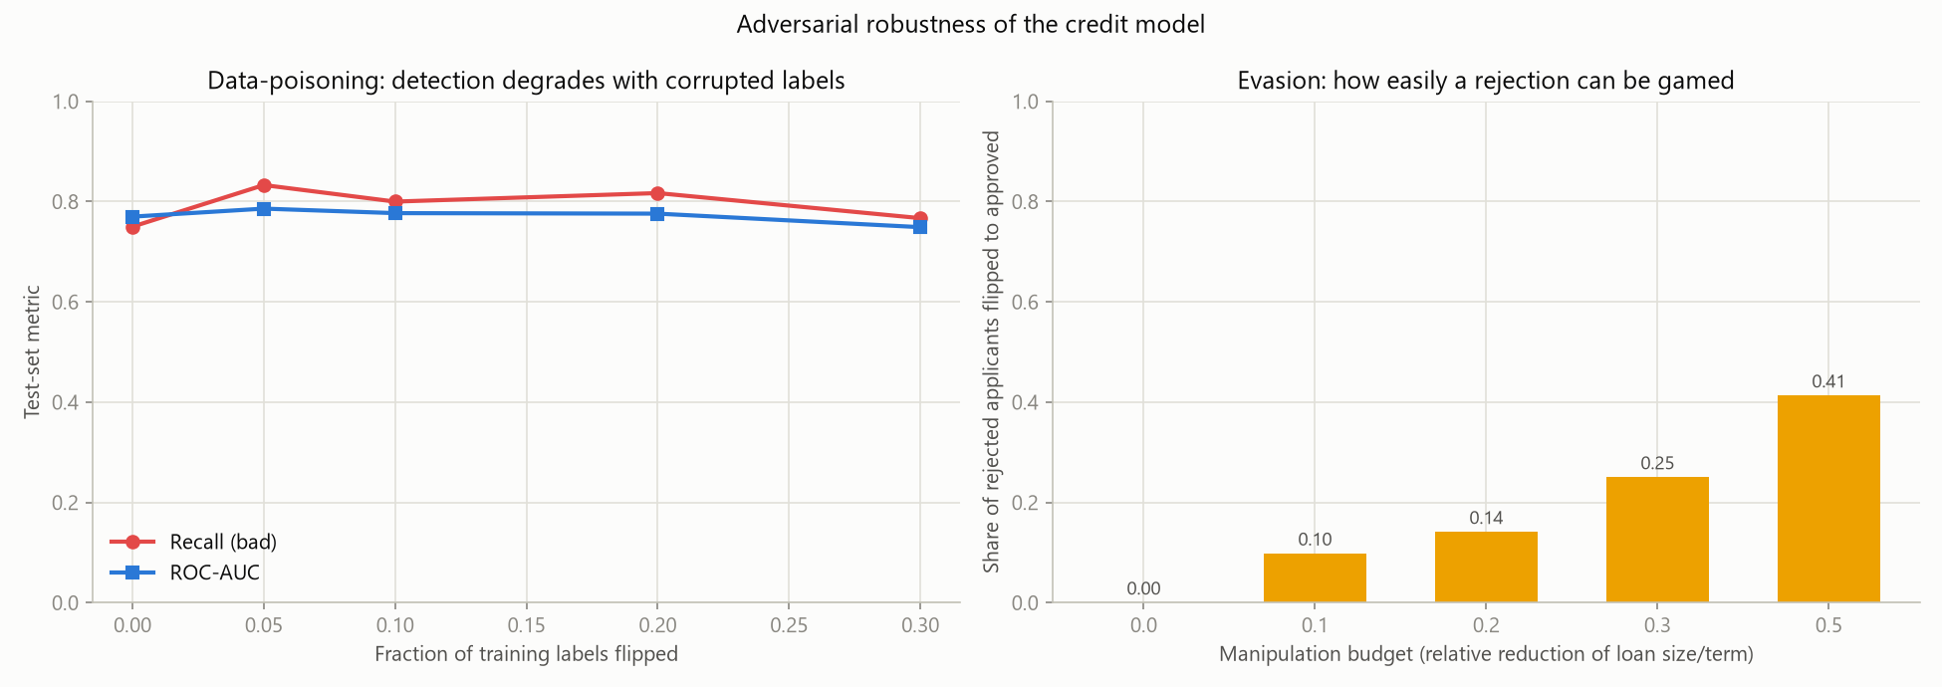
TESTING & ROBUSTNESS
Tested — and attacked
38
automated tests
99%
code coverage (enforced ≥80%)
We attacked our own model: poisoning, evasion & privacy.
The tests catch real weaknesses, not just 'does it run':
e.g. an invariant test: shrinking a loan can never LOWER approval odds.
of rejected applicants could game their way to 'approved' just by halving the requested loan — a real risk a bank must know.
~41%
Notes:
Testing: 43 automated tests at about 99% coverage, set to fail below 80. The point isn't the number — the tests catch real weaknesses, like an invariant that shrinking a loan can never lower approval odds. And we went further: because this is a high-risk system, we attacked our own model and found over 40% of rejected applicants could game their way to approval by halving their loan.

Slide 7
RESPONSIBLE AI · SAFEGUARDS
Privacy, Security & Accountability
PRIVACY
SECURITY
ACCOUNTABILITY
Membership-inference tested → mild leak (attack AUC 0.53)
Data minimisation: only credit-relevant features used
Per-decision explanation (SHAP) — GDPR Art. 22 & 25
3 attacks quantified: evasion, poisoning, privacy
43 tests guard correctness against regressions
Pinned library versions — EU AI Act Art. 15
Human-in-the-loop — never autonomous (Art. 14)
Each decision logged with inputs + explanation
Model card + regulatory analysis documented
Honest gaps (named, not hidden):
production event logging · post-market monitoring · encryption & access control — this is a student prototype, not a deployed bank system. Naming the gaps is itself what the AI Act's continuous risk management expects.
Notes:
We don't just claim privacy and security — we measured them. Privacy: a membership-inference attack shows only a mild leak, AUC 0.53. Security: three attack studies plus 43 tests and pinned versions. Accountability: a human always decides, every decision is logged with its explanation, and it's all documented. And we're honest about what a student prototype can't do — live logging, monitoring, encryption — which we name as future work rather than hide.

Slide 8
FROM A MODEL TO A RESPONSIBLE SYSTEM
This week, in three moves
Understood
Tested
Attacked
SHAP explains what the model weighs — and every single decision.
43 tests at 99% coverage catch real weaknesses automatically.
Three adversarial studies quantify how it can be gamed or leaked.
Next (Week 4): final documentation · top-management pitch · a policy-level fix for foreign-worker fairness (sex & age now mitigated).
That's the difference between a model and a responsible, deployable system.
Thank you · Questions?
Notes:
To sum up: this week we didn't just build a model — we understood it with SHAP, tested it thoroughly, and even attacked it to find weaknesses. That's the difference between a model and a responsible, deployable system. Next week is documentation, the management pitch, and extending the fairness fix. Thank you — happy to take questions.

