Slide 1
PRESENTATION
ON
WHOLESALE BUSINESS MANAGEMENT project
By:-
Chitraniva Karmakar
Prakash Kumar
Puja Mishra
Md. Rezauddin
Tanmoy Bhowmik
Soumita Ghosh

Slide 2
Acknowledgment
We take this oppourtunity to express profound gratitude and deep regards to our faculty Mr. Dayamay Halder for his guidance, monitoring and constant encouragement throughout the course of this project. His frequent blessings, help and cooperation shall carry us a long way in the journey of life on which we are about to embark. Also a heartiest thanks to Team Globsyn for organizing the entire training procedure.

Slide 3
Contents
Introduction
Functional Requirement
Objective of the project
Activities involved
Basic features of the
project
Resources required
Future scope of improvement
Conclusion

Slide 4
WHAT is a WHOLESALE BUSINESS?
‘Wholesale’ means to sell goods in relatively large quantities.
The wholesalers buy goods and commodities in large quantity from the manufacturers for the purpose of further selling them in small quantities to the retailers.
Vital link between the supplier and the retailer.
Buys in bulk quantities from the manufacturer and resells them to the retailers in small quantities.
Deals with limited number of products.
basic functions of a wholesaler are:
Assembling,bulk-breaing,product assortments.
Warehouse and Storage.
Grading.
Transportation
Financing
Ensuring uninterrupted flow of goods
Providing market information

Slide 5
Functional Requirement
The system allows user to login.
Upon successful login the page containing the homepage will come up having five sections retailer, stock, product, report and order.
In retailer section wholesaler will be able to add, remove or update details about the retailer.
In product section wholesaler will be able to add, remove or update details about the product.
Similarly in stock and order section all the details will be available.
And all the selling details will be maintained in the report section by the wholesaler.

Slide 6
OBJECTIVE
Allows administrator to add and update good’s details.
Allows all the four basic function of persistent stage [CRUD(create,read,update and delete)].
Users friendly UI to facilitate searching and buying goods.
Allows retailers for searching of goods by wholesale generated goods Id.
Shows the retailers the list of products available in the stock.
Allows users to login to their accounts to avail special discount on selected products.
Helps the wholesale to manage all his business details is a single software.

Slide 7
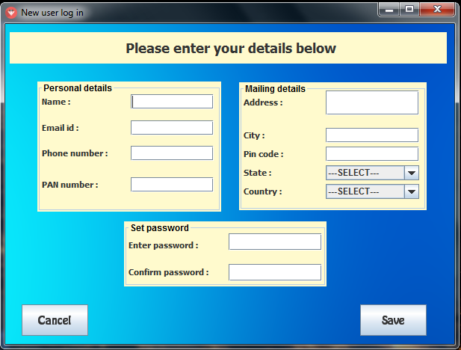
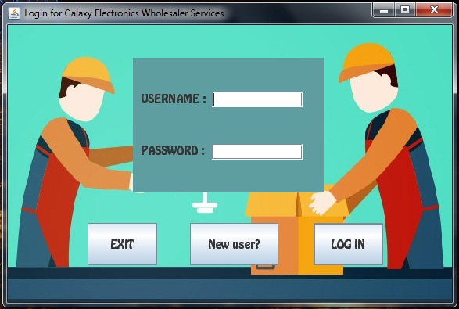
New USER And LOGIN

Slide 8
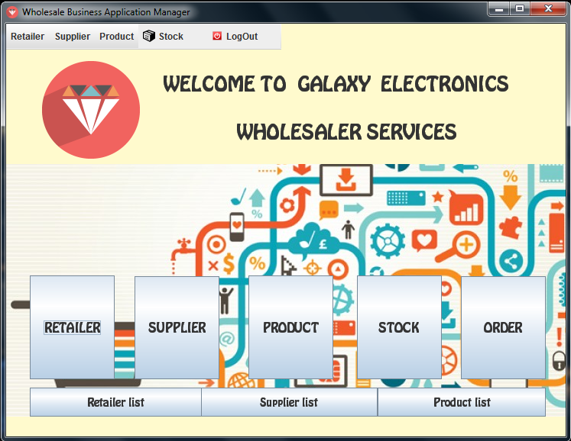
HOME

Slide 9
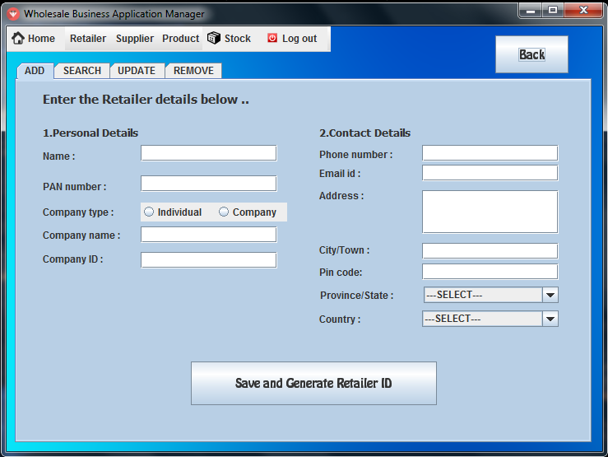
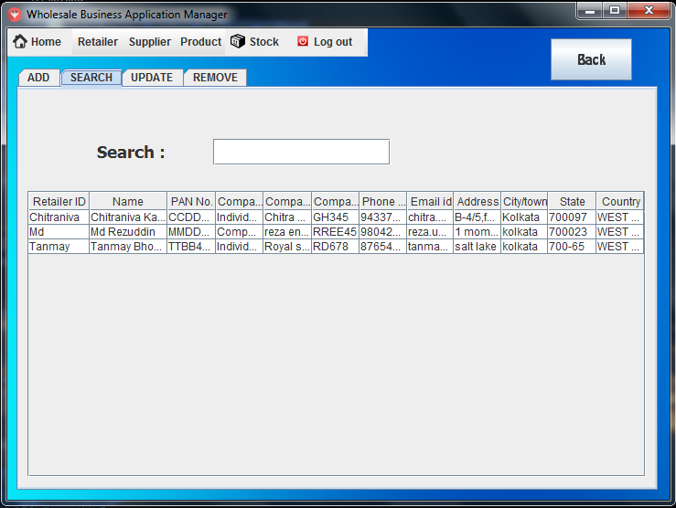
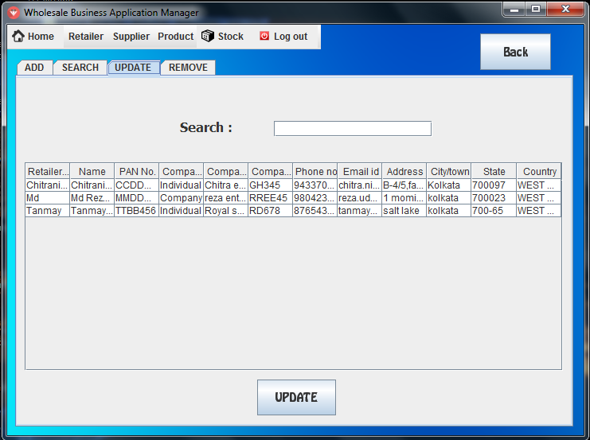
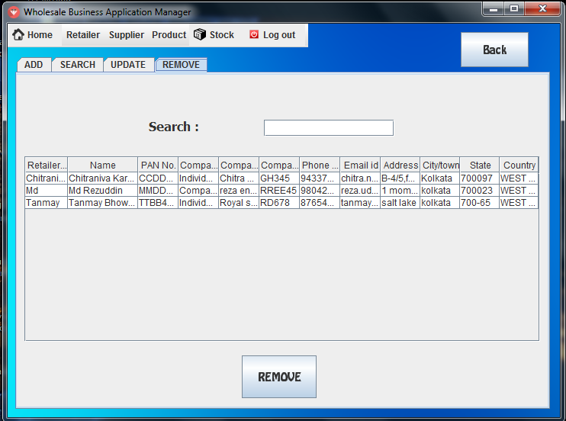
Retailer section:
Add:
Search:
Update:
Remove:

Slide 10
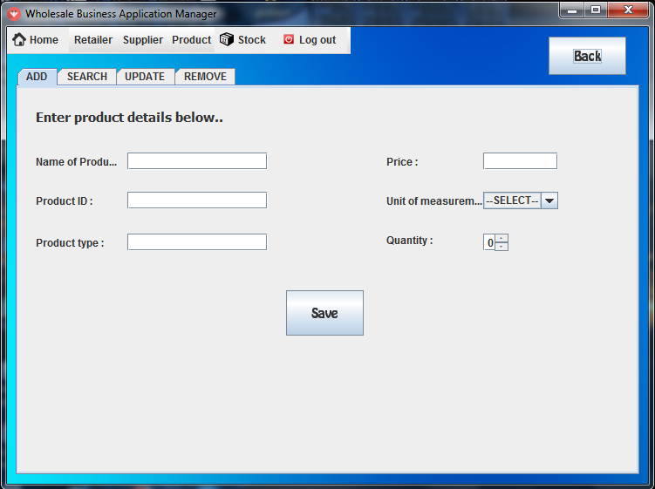
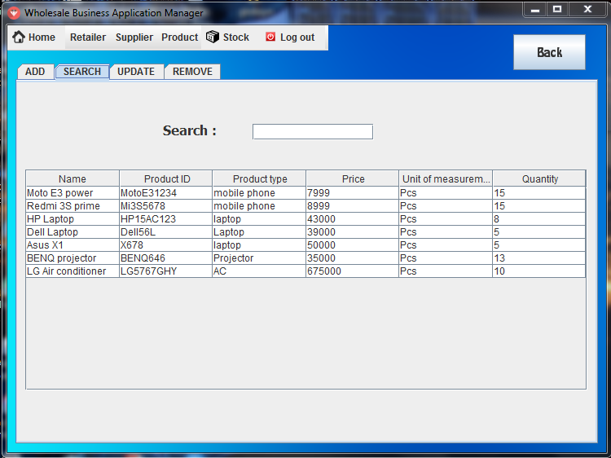
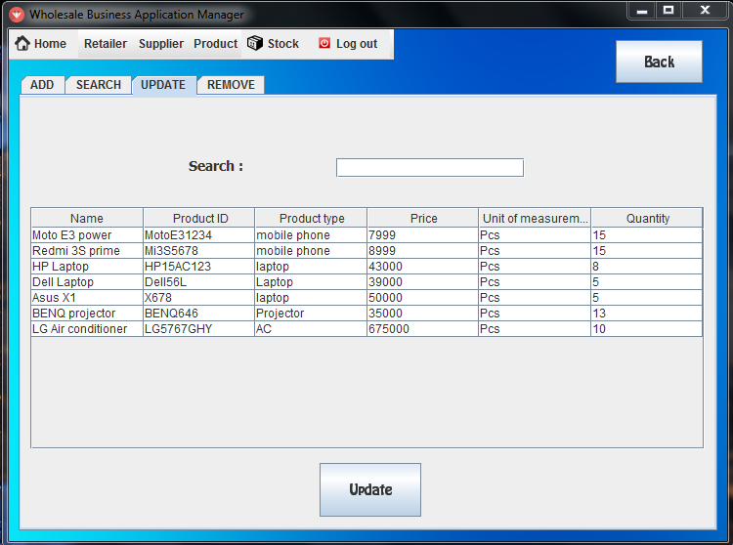
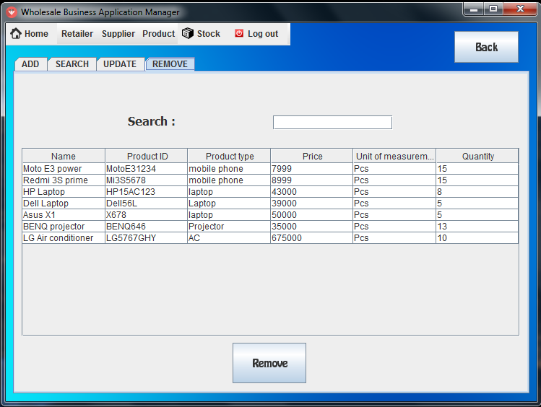
Product section:
Add
Search:
Update
Remove

Slide 11
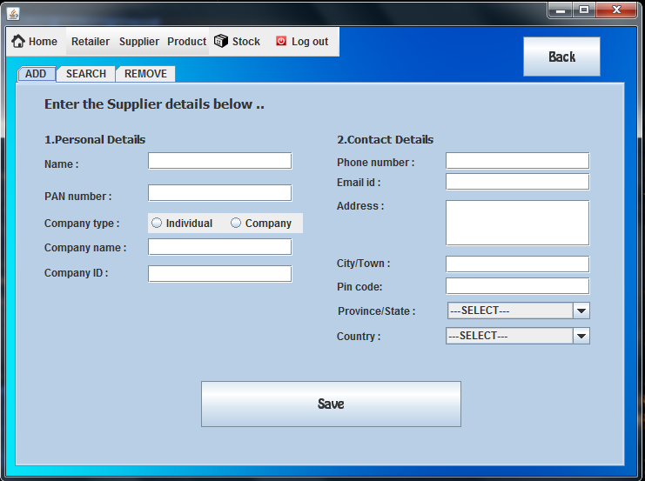
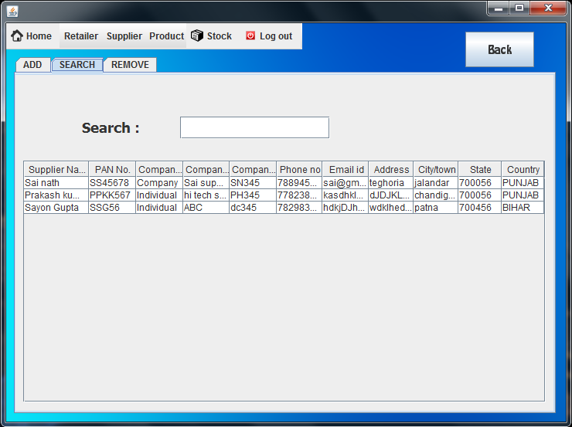
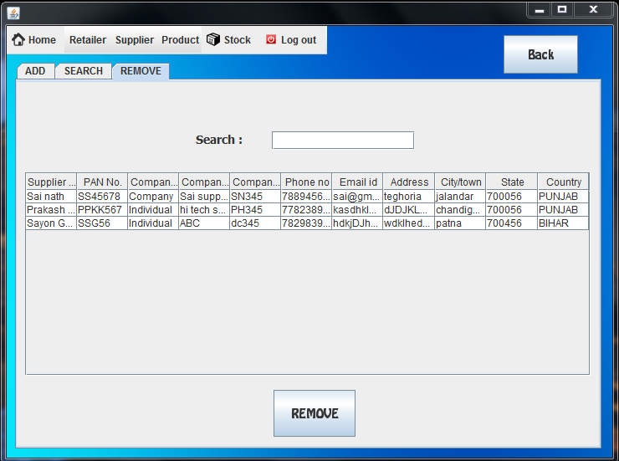
Supplier section:
Add
Search:
Remove

Slide 12
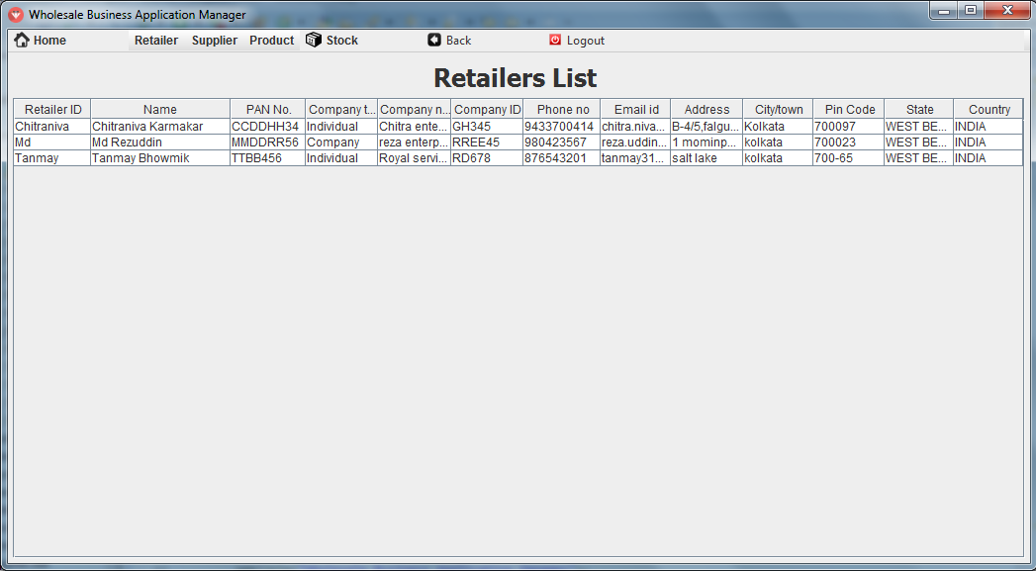
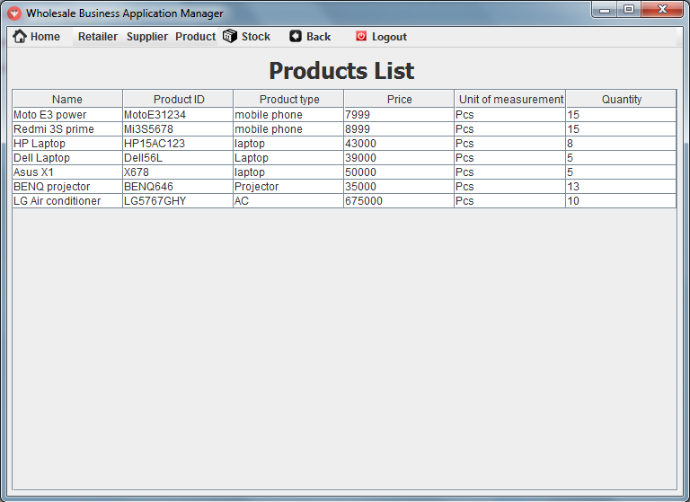
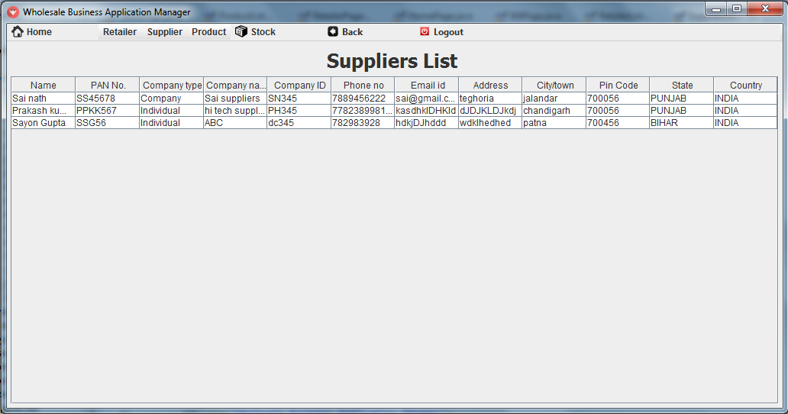
Menu Bar And menu items :
Menu bar :
Menu items :

Slide 13
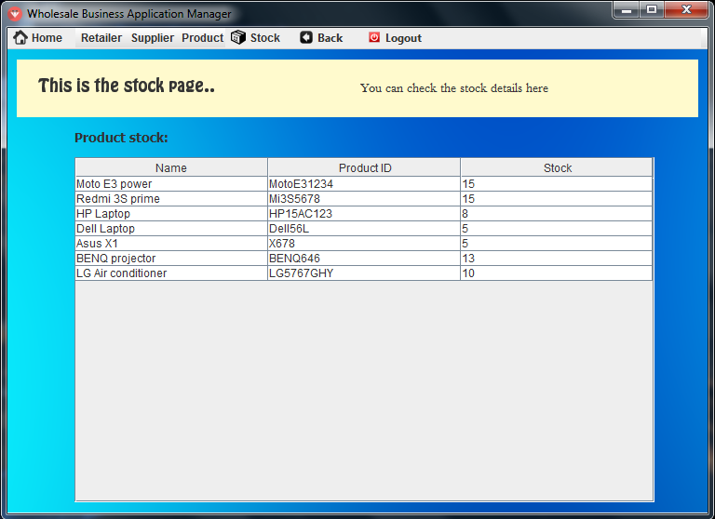
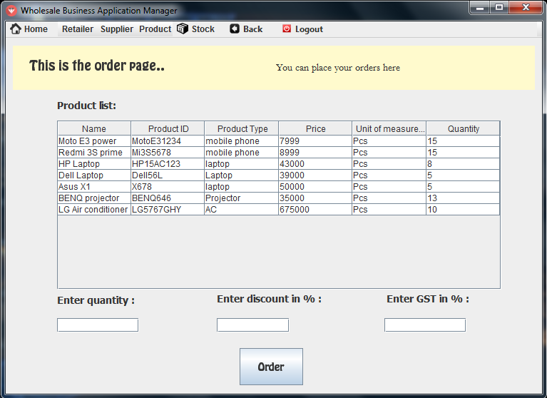
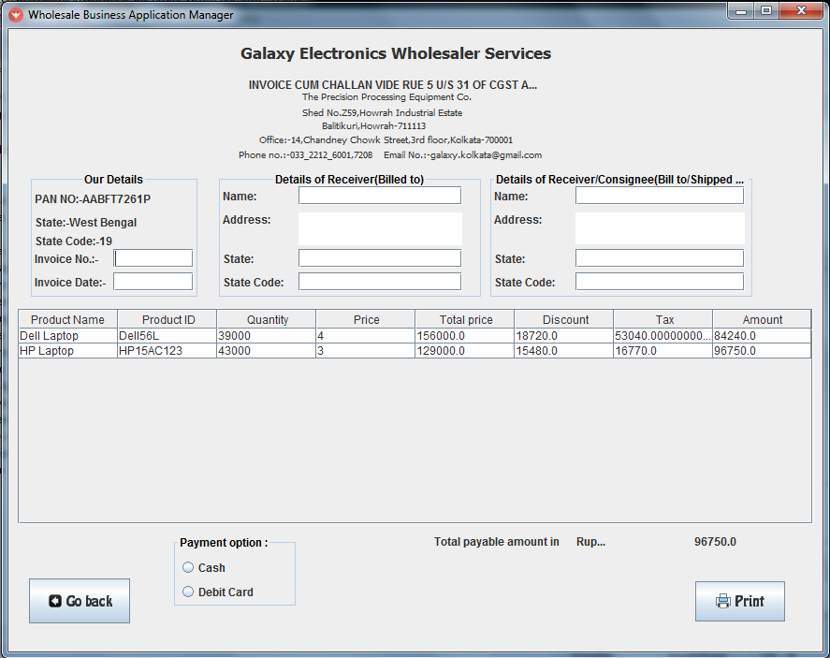
Stock and Order section:
Stock management :
Placing order :
Bill page :

Slide 14


RESOURCES REQUIRED
Software required:-

Slide 15
RESOURCES REQUIRED
Hardware required:
Server side
Processor:- Pentium processor
RAM:256 MB

Slide 16
Future Scope of Improvement
Report of sales can be added.
Automatic stock out alert can also b added.
More data field can be added.
Shortcuts can be created.
We can also add picture of the retailers.
We can also make one mobile or online app for the retailers to order goods easily.

Slide 17
CONCLUSION
Market economic activities are organised through wholesale business.
For buying and selling commodities,retailers and suppliers didn’t require to meet wholesaler personally.
For smooth functioning of system this software will help in coordination and management between wholesaler and retailer.

Slide 18


