Slide 1
Create a New Repository on GitHub

Slide 2
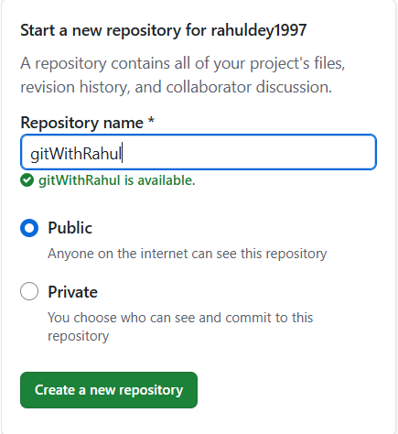
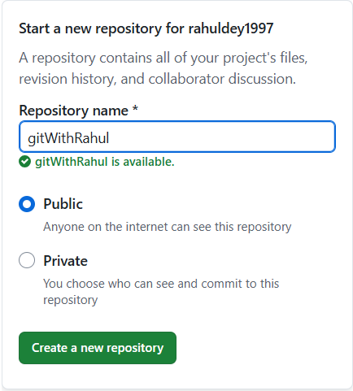
Click on Create a new repository

Slide 3
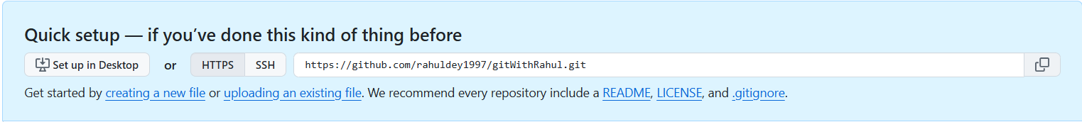
Copy the repository url

Slide 4
1. Now open your project in vs code or other code editor.
2. Open a new terminal

Slide 5

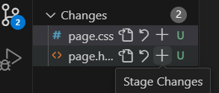

a. Initialize Git Project
b. Add the file (you can see this on left side in vs code)
c. git add .

Slide 6
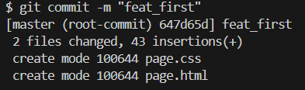

d. Commit the change: git commit –m “commit message”
e. Link to Remote Repository
f. Push the Code to the Repository:
Note: Branch name can be master, main etc.

Slide 7
Pushing New Code In GitHub

Slide 8


1. First change the branch to the main/master branch
Clicking here we will get option of different branch
2. Take pull from main/master branch

Slide 9

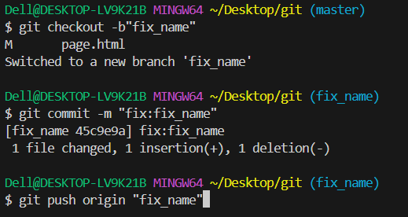
3. Add File
4. Checkout Commit Push
Note: In case of new feature write feat and
in case of fixing write fix

Slide 10

5. In github click on your project repository
6. Compare and pull

Slide 11
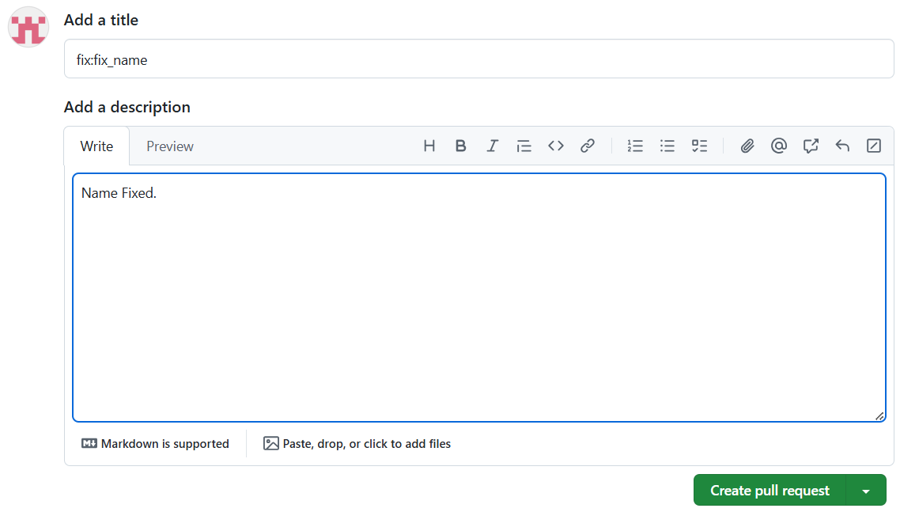
7. Pull Request
After adding description click on create pull request

Slide 12
Resolving Conflict

Slide 13

Main/Master branch flow
Main
Commit 1
Commit 2
Conflict
With main/
master
Commit 1
Commit 2
Feature/ Fix flow

