Slide 1
IT Ticket Dashboard Analysis
Optimizing Support Operations
By - Rahul

Slide 2
The Cost of Delay
Every unresolved IT ticket is not just a delay, it’s lost productivity across the organization.
Slow Resolutions → Frustrated Users → Productivity Loss
High-Priority Tickets Unresolved → Direct Business Risk
Inefficient Processes = Hidden Costs → More downtime, wasted effort.

Slide 3
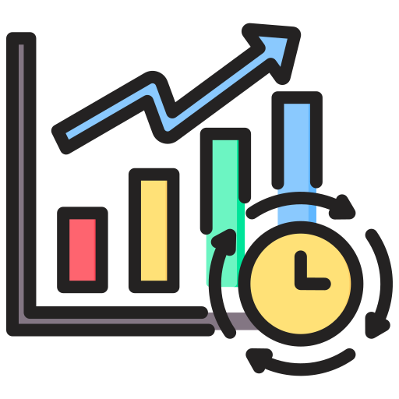


Objectives
Analyze ticket trends and agent workloads to predict peak periods.
Pinpoint process bottlenecks (e.g., assignment failures, Hardware delays).
Recommend actionable strategies (Training, Tools, Staffing) to scale support.

Slide 4
Data Overview
The Foundation for Change
2 datasets (Tickets + IT Agents) spanning several years.
Size:
10 attributes in Tickets
5 in IT Agents, providing deep insight into performance.
Cleaned: Corrected the "Mayor → Major" error to ensure data validity.
Data captures performance, workloads, and satisfaction across agents.

Slide 5
Methodology
How Project is approached
How Project is approached
Data Cleaning & Preparation
Objective Analysis
Subjective Insights
Recommendations
Dashboard building

Slide 6
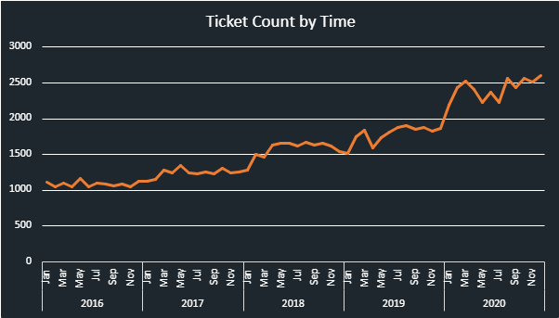
The Rising Tide
Ticket Volume Over Time
Average daily tickets = 53.36.
Volume is increasing yearly.
The peaks in August, October, and December are predictable, but current staffing cannot handle the surge.

Slide 7
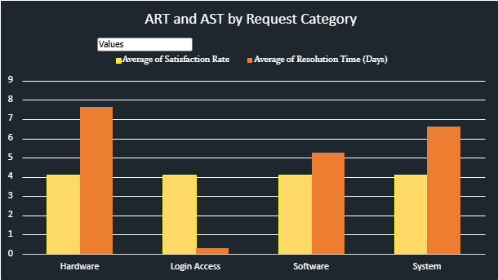
Identifying the Biggest Bottleneck Hardware Delays
Login Access issues: resolved in 0.3 days (fastest).
Hardware issues: 7.6 days average (the biggest bottleneck).
System & Software: medium but still heavy contributors.
Insight: Complex categories create the longest delays → direct impact on satisfaction.

Slide 8
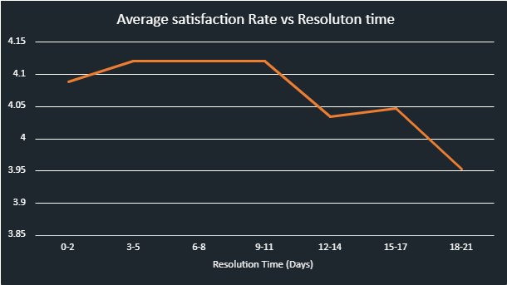
Quantifying the Cost:
Resolution Time vs. Satisfaction
Avg resolution time = 4.1 days.
Avg satisfaction = 4.1/5.
Negative correlation → the longer an issue stays unresolved, the lower the satisfaction.
Insight: Improving resolution time has a direct, measurable payoff.

Slide 9
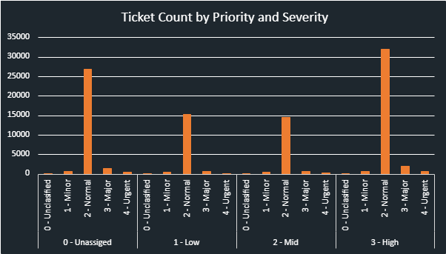
System Failure
The Unassigned Ticket Crisis
29,410 tickets unassigned → software/process breakdown.
35,549 tickets marked High Priority waiting.
Outdated assignment system causes delays → affecting customer trust.

Slide 10
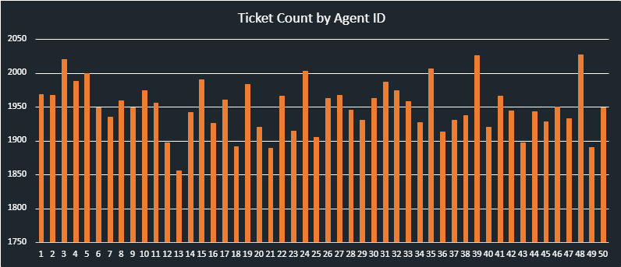
Workload Imbalance
The Myth of Equal Distribution
Avg workload per agent = 1950 tickets.
Some agents carry much heavier loads.
The issue isn’t the number of agents, it’s workload imbalance & efficiency gaps.

Slide 11
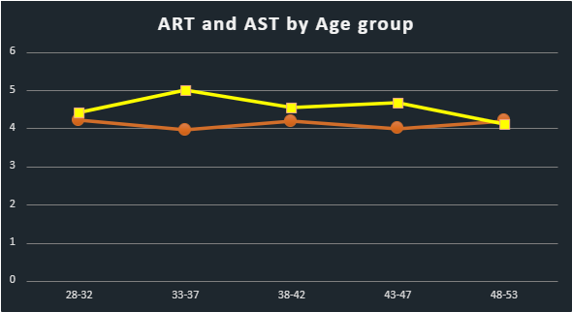
Experience Wins
Age Drives Performance
Avg agent age = 40 years
48–53 age group = best performers (high satisfaction, low resolution time).
33–37 age group = lowest performers
Mentorship from senior agents can uplift younger cohorts.

Slide 12
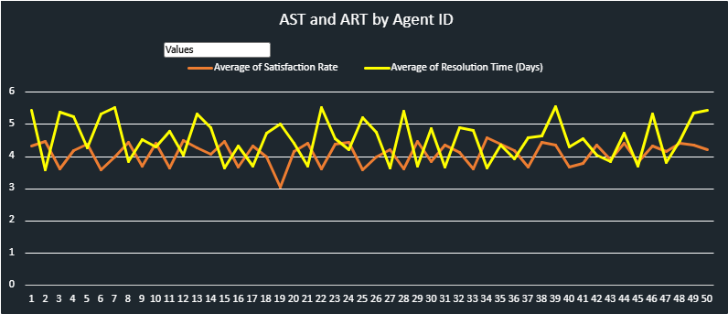
Targeting Gaps
Who Needs Training?
Mid-range (Training Group) IDs 30, 43, 26, 18, 14, 32, 20, 47, 36.
Low Performers (Risk/Termination)
IDs 6, 25, 28, 3, 22.
Insight: Targeted training can lift mid-performers into the high bracket.

Slide 13
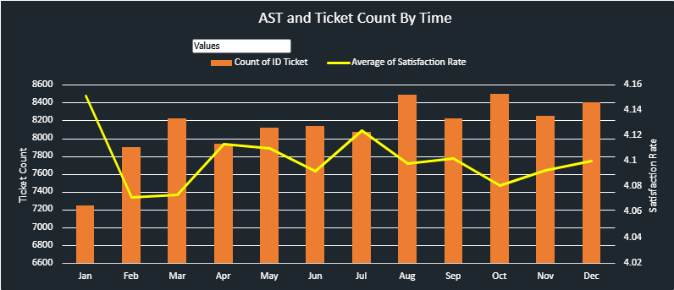
Every Winter
Tickets Spike and Satisfaction Falls
Ticket peaks = Aug, Oct, Dec.
Lowest volume = January
Satisfaction drops whenever ticket volume rises.
Insight: Seasonality should shape staffing & tool readiness.

Slide 14
Core Challenges
Summary of Findings
Assignment Failures are causing a massive unassigned backlog.
Hardware Bottlenecks are driving the longest resolution times.
Training Gaps persist among mid-range agents, creating inconsistency.
Uncontrolled Seasonal Peaks hurt satisfaction every Q3/Q4.

Slide 15
Recommendations
The Road to Transformation
From Bottlenecks to Breakthroughs

Slide 16
Invest in People
Training as the Fastest ROI
Fix the System
“Upgrade Ticket Management Software”
Targeted Training for mid-range agents on complex issues.
Implement a Mentorship Model leveraging top performers (48–53 age group).
Focus training curriculum on Hardware and System troubleshooting.
Expected Impact: Resolution times cut by 20–25%, satisfaction +0.3 pts.
Automate ticket assignment.
Prioritize urgent/high-severity instantly.
Reduce 29,000+ unassigned tickets → zero backlog.
Expected Impact: Faster assignment, smoother operations, happier users.

Slide 17
Recognize the Stars, Support the Strugglers
Process Improvements
Smarter Processes for Everyday Efficiency
Self-service portal for Login Access issues (fast & cheap).
Knowledge base for recurring hardware/software issues.
Proactive staffing in peak months.
Expected Impact: Free agents’ time for complex issues, improve satisfaction.
High Performers: Retain + reward (IDs 2, 8, 15, 21, 29, 34).
Mid Performers: Intensive training & mentoring.
Low Performers: PIP → Termination if no improvement.
Expected Impact: Healthy, high-performing team culture.

Slide 18
What Success Will Look Like
Zero Unassigned Tickets – every request routed instantly to the right agent.
Faster Resolution – Avg resolution time reduced from 4.1 → <3 days.
Happier Users – Satisfaction scores consistently above 4.5/5.
Skilled Workforce – Mid-range agents trained & mentored into high performers.
Scalable System – New software & processes that handle seasonal peaks smoothly.

Slide 19
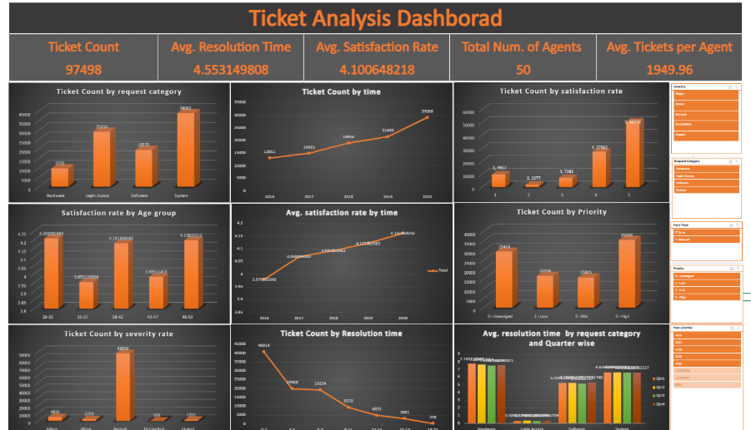
Bringing It All Together: The Interactive Dashboard

Slide 20
From Data to Action: The Way Forward
Rising ticket volumes → requires scalable solutions (Software upgrade).
Training + Software upgrade = faster fixes & happier users.
Proactive planning for peak months avoids future satisfaction dips.
Strong systems and skilled people don’t just solve tickets – they build trust, productivity, and future-ready organizations.

Slide 21
Thankyou

