Slide 1
IDEA SUBMISSION- Round 1
IDEA TITLE : EXTERNAL VISUAL DISPLAY ON VEHICLES

Slide 2


PLEDGE TO PROGRESS Sustainability Hackathon
Sponsored By
Team Name : Digital Artists
Team bio : We thrive to disrupt the Automobile & Marketing industry with our innovative Product idea.
Date : 24 Apr 2023

Slide 3
EXTERNAL DISPLAY TECHOLOGY FOR VEHICLES - A SUSTAINABLE FUTURE TECHNOLOGY
The automobile industry has now approached the verge of becoming completely electrically powered accounting to the reasons of depleting resources and increasing greenhouse effects and pollution. The future also delves into flying cars for which many prototypes are being tested by researchers in different parts of the globe.
The solar or other renewable forms of energy at moving vehicles disposal combined with innovative display technology can be innovatively implemented for utilizing the exterior surface of private and public vehicles as a digital advertisement space hence overcoming the energy consumption/ over consumption by the vehicle. There is a huge space which becomes available once the concepts like self-driving cars are put into motion.

Slide 4
The Solution V/S Existing Trends
With increasing globalization and rise in entrepreneurial wave across the globe it is obvious that new brands will be built using newer techniques to capture attention of the consumer the technology could be a breakthrough in marketing industry. The capability of vehicles to carry marketing logos & important information totally keeps in view the requirements of the future:
As of now there is no concurrent organised competition existing all over the world as this is a novice concept. Other contemporary technology is nanopaints, which is expected to be very costly and quite complex in implementation. Also the nano paints is just a visual enhancement feature but doesn’t address any solution the information disposal which makes the concept unsustainable.
The companies usually have preferred advertisements on electronic hoardings which obviously require separate supply and for targets bottleneck locations are not ensured other than the print media, online platforms which are innovative and television commercials as well. It costs a huge amount to the manufacturers in terms of advertisement fee, brand ambassador charges and more reasons. Still the viewership is limited and consequently the impact of the campaign.

Slide 5
Plan of Action:
External Space on Vehicles
Display Technology
AI/ML, Cloud & Networking
Utilising technologies of the future practically for information mobility and disaster management
Providing Reusable Surface area for Information to be published.
Developed using low power consumption technology and using renewable energy wind/solar at moving vehicle

Slide 6
SUSTAINIBILITY CAUSE - POINT OF VIEW
Urban emissions is one of the prime factor which has led to climate depletion. Considering the current methods of Hoarding/Paper-Paint advertising industry this solution presents a safer re-usable physical marketing spots if we consider the material consumption and chemical nature of current methods of conventional banner marketing.
In this digital era this trend is inevitable already it is clearly visible from the technology such as LED boards in market centers, this technology could make the job of a marketeer much easy and can prove to be a breakthrough if an OEM is developed furthering the concept. It presents a great opportunity to compete with current trends of web/print marketing and also can prove to be a great tool for information management.
The multi-functional display enabled external parts replaces the traditional metallic body surface with fabricated material based oled or similar screen which helps in reducing the carbon footprint and preserves natural resources for future gens.
Future technologies shall cater the needs of future. This external displaying option in vehicles of future could be an ultimate necessity considering the view point of competition, problems and the influence of contemporary enablers like improvements in cloud & internet technology.

Slide 7
Tools & Resources Needed to Develop & Test Prototype
Hardware Requirements: A used vehicle two/four wheeler(conditional to availibility). Electronics tools, networking devices, etc. with chip development & testing facility for Developing a low power consumption display technology. Software & Internet tools: Azure IOT and Azure Networking services are required for enabling inter-connected device framework to be implemented in product design. Azure Sphere & Azure RTOS will be utilised for designing & testing. Consumer database management & prototype test data would make use of SQL Studio (SSMS). MS SQL will be used as Backend database sever with Microsoft AI applications. One Drive & Microsoft Azure for cloud implementation to make real time information available. Microsoft Teams & Office for virtual team collaboration & project management.

Slide 8
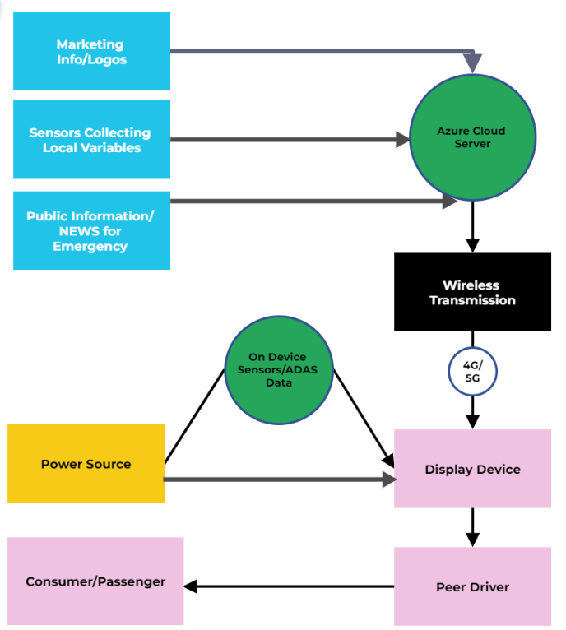
Product Architecture Design & Functioning:
SQL Server
(Backend Database)

Slide 9
Adopting User Segment & Important Factors
Initially the user segment that could be identified is the mobility tech firms as a marketing platform to target the right customer in right location and at the right time.
Govt. services could be the prime consumer of the technology to broadcast road status, climate conditions, other emergency information such as ambulance passing by or nearby information instantly at the correct places.
It could further be adopted Construction/Infra firms for preventing accidents and broadcasting critical information.
In later stages with the self-driving and automated cars coming in the common car-owner individual could be targeted as this would create a need for such a platform that engage the consumer appropriately.
Age factor could be ignored here, as the youngsters & oldies should be equally curios to get to see their vehicles lighten up. Yes there could be resistance by governments initially it is debatable that this technology could be implemented keeping in view traffic rules. But ultimately it is for the better and sustainable future. The level of impact it could bring could be similar to what mobile phones brought!

Slide 10
APPLICATIONS
The ability to display critical and valuable information instantly on a wide spread scale and in specific areas will no doubt help the government and authorities for better provision of services and maintenance of order in haphazard conditions or emergencies. This could be a life saver in Hilly terrains & remote areas for safer operations with the increasing logistics requirements.
Even for the huge equipment used in the civil/infra projects such as roadways or railways construction to prevent the accidents by making the real-time information available to the engaged stakeholders. Also for the oil & gas tankers it could address the fellow drivers on the road with the real time information.
The advertisement on vehicle’s space can be the obvious idea for the sustainable future competition among the automobile companies, although currently being practiced but not on as massive scale and without any OEMs. Hence there arises a need for designing such a renewably powered display device and setting up a SOP in this space which can appropriately be used for the betterment of mankind.
Visual enhancement is of course a feature which could be considered for launching Make To Order products for amateurs.

Slide 11
FUTURE SCOPE AND SCALIBILITY
How far it can go?
Sky is not even the limit if the technology gets implemented and executed properly. The eventual adoption could be progressed to airplanes, trains, metros and who knows soon enough to flying cars (if they develop it soon). OEMs could be brought out creating a whole new arena of competiotion in the future.
The marketing giants including franchisee businesses would surely be interested for its implementation on a widest scale.
The arrival of self-driving cars in the scenario will provide the scalability for the market as the user will be available to actively indulge in the outside space once they are accessing the ease of sitting in a vehicle without driving it.
Anyways the public transport market already exists providing a reasonably good platform to trial the innovation for market-fit as it could primarily replace the paper & paint in the poster-market with a reusable space and with one time installation.

Slide 12
Thank You!
Rahul Dogra – Product & Design Engineer
Rahul Kadgavkar – Cloud/IT Engineer
Amit Nilajkar – Sr. Software & Web Expert
Koushik Karan – Electronics & IOT Engineer
Veena Viswanathan – Stakeholders & Analytics Expert
Mohammed Aamid – Mechanical Design Expert (Technical Advisor)

