Slide 1
E-commerce Customer Review Rating System

Slide 2
Objective:
Development of a predictive model for customer review for the e-commerce products.
This model is centered around predicting customer satisfaction with a product which can be deduced after predicting the user product rating once the user makes the purchase.
Benefits:
Detection of unsatisfied customers.
Gives better insight of customers base.
Helps in detecting products with bad review ratings.
Helps in sustaining the customer by suggesting better offers

Slide 3
Data Sharing Agreement :
Sample file name (ex olist_customers_dataset)
Number of Columns
Column names
Column data type

Slide 4
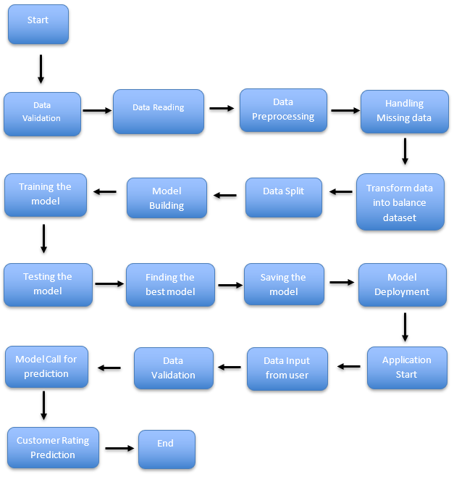
Architecture

Slide 5
Data Validation :
Name Validation - Validation of files name as per the DSA. We have created a regex pattern for validation. It checks for correct name format if these requirements are satisfied, we move such files to "Good_Data_Folder" else "Bad_Data_Folder.“
Data Preprocessing :
Dataset Merge- Merging the datasets into one csv file and saving the merge file with a name of ‘merge_data.csv’.
Null values in columns - If any of the columns in a file have all the values as NULL or missing, we will impute the null values both from the categorical and numerical features.
Removing unnecessary columns from the imputed dataset.
Handling the categorical data – encoding the categorical data and saving the file with the name of ‘preprocessed_file.csv’.

Slide 6
Model Training:
Data Export from Db :
The accumulated data from db is exported in csv format for model training
Data Preprocessing
Performing EDA to get insight of data like identifying distribution , outliers ,trend
among data etc.
Check for null values in the columns. If present impute the null values.
Encode the categorical values with numeric values.
Perform Standard Scalar to scale down the values.

Slide 7
Decision Tree Classifier –
Decision Tree Classifier algorithm is used to train the preprocessed data and then getting the accuracy score on the test data.
Random Forest Classifier –
The Random Forest classifier model algorithm is used to train the preprocessed data and then getting the accuracy score on the test data.
Model Selection –
After the models have been created, we find the best model for each classifier. We calculate the Accuracy scores for both models and select the model with the best score. All the models are saved for use in prediction

Slide 8
Prediction:
We perform data pre-processing techniques on it preprocessed data.
Decision Tree Classifier model created during training is loaded and is used to predict the rating from that data.
Once the prediction is done. The predictions are saved in csv format and shared.

Slide 9
Q & A:
Q1) What’s the source of data?
The data for training is provided by the client in multiple batches and each batch contain multiple files
Q 2) What was the type of data?
The data was the combination of numerical and Categorical values.
Q 3) What’s the complete flow you followed in this Project?
Refer slide 4th for better Understanding
Q 4) What techniques were you using for data pre-processing?
Removing unwanted attributes
Visualizing relation of independent variables with each other and output variables
Checking and changing Distribution of continuous values
Removing outliers
Cleaning data and imputing if null values are present.
Converting categorical data into numeric values.
Scaling the data

Slide 10
Q 5) How logs are managed?
We get the logs maintained for in Ecom_logs folder as per the steps that we follow in validation, Preprocessing, Data Insertion , Model finder etc.
Q 6) How training was done or what models were used?
Before diving the data in training and validation set we performed train test split to divide the data into training and testing dataset in the ration 8:2.
Algorithms like Decision Tree classifier , Random Forest Classifier were used based on the accuracy score final model was used for each prediction and we saved that model .
Q 7) How Prediction was done?
The user will input the customer data in flask application. Then on the basis of user input model is loaded and perform prediction. In the end we get the prediction rating.
Q 8) What are the different stages of deployment?
When the model is ready we deploy it in flask .

