Slide 1
Image Based Positioning System
Ankit Gupta
Rahul Garg
Ryan Kaminsky

Slide 2
Outline
Motivation
System Implementation
Technical Overview
Evaluation
Future Work

Slide 3
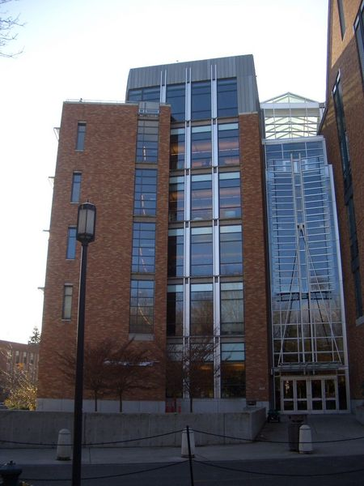
Motivation

Slide 4
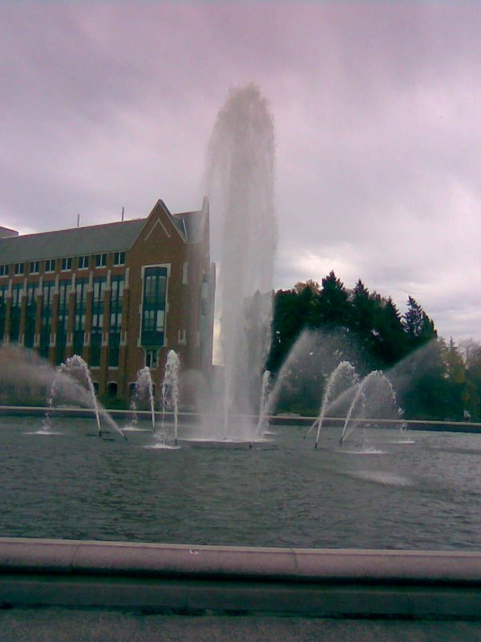
Motivation

Slide 5

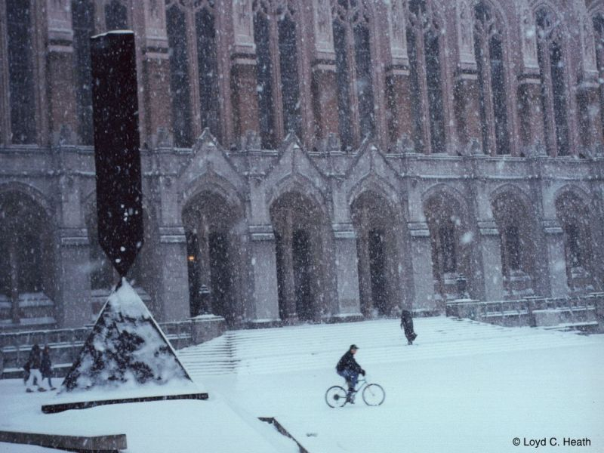
Motivation

Slide 6
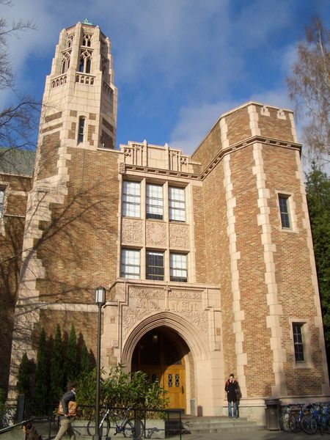
Motivation

Slide 7

Motivation
It’s made of brick and has many windows.
The bricks are red.
There are some trees around here also.
Hey there, I‘m think I’m lost!
I have no idea.
Well, there is a building.
Where are you?
Umm, that doesn’t really help.
Anything else, Einstein?
I need to get back to work.
What is around you?
Ok great, describe it for me.

Slide 8
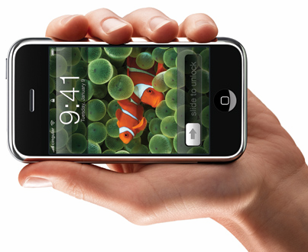
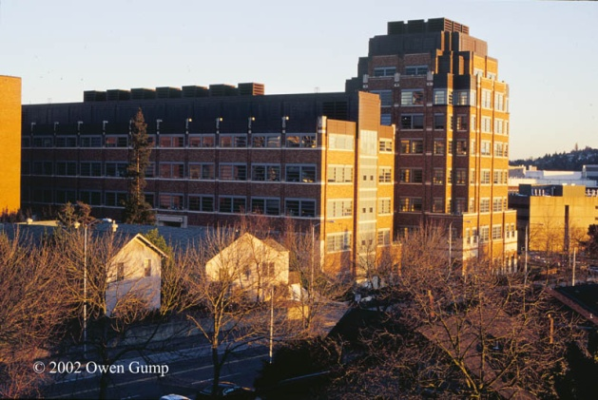
Motivation

Slide 9
Problem Definition
Given an input image, identify a location on a map by querying for similar images

Slide 10
Demo

Slide 11
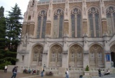
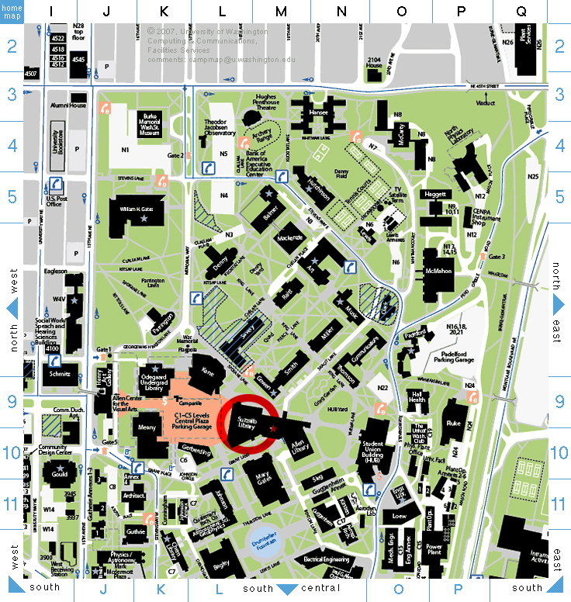
Web Architecture
Feature
Extraction
Feature
Descriptors
Query System
Network
(Each Feature)
Location
Voting
Query
Engine
Feature DB
(Best Location Match)

Slide 12
Query System Architecture
Query Image
1
Feature
Descriptors
[a,b,c], [x,n,d]
Feature
Extraction
OID Vector LocationID
00 [x,y,z] 1
01 [a,b,c] 2
…
100 [x,a,d] 0
(Each Feature)
3
Feature DB
2
LocationID Votes
0 2
1 0
2 120
… …
N 4
Query Processor
[a,b,c] ≈ [a,b,c]
[x,a,d] ≈ [x,n,d]
(Location)

Slide 13
Outline
Motivation
System Implementation
Technical Overview
Evaluation
Future Work

Slide 14
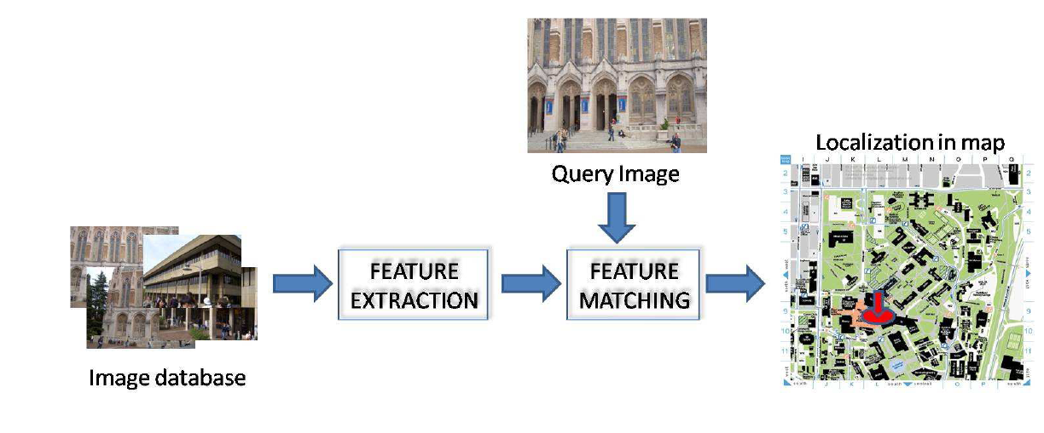
Technical Overview
Two key aspects:
Feature point extraction
Nearest Neighbor matching for each query image feature
Notes:
Talk briefly abt feature matching

Slide 15

Feature Point Extraction
Interest Point Detector of Schmid et. al. CVPR’06
Build feature vector encoding the visual appearance around the interest point [Lowe et. al, IJCV’04]
Notes:
We want to detect interest points in the image. We use interest point detector of ….. Once identified we need to compute a descriptor encoding the local info around the point so that it can be matches across different images. We use SIFT

Slide 16
Nearest Neighbor Search
Exact Approaches – Linear Search, Local Polar Coordinate (LPC) based indexed NN search
[Cha et. al. IEEE Transactions on multimedia]
Approximate Approaches – kd-tree, priority search using kd-tree
Notes:
Talk abt linear search being slow, and LPC optimizes over IO accesses. Also say one in harddisk and other in memory

Slide 17
LPC-based Indexed NN search
Obtain a compact representation of features that allows for selection of candidates without using the full representation
Database of features
Database of compact features
Candidates
For NN
Query
Feature
Filtering Stage
Compute NN among candidates
NN

Slide 18
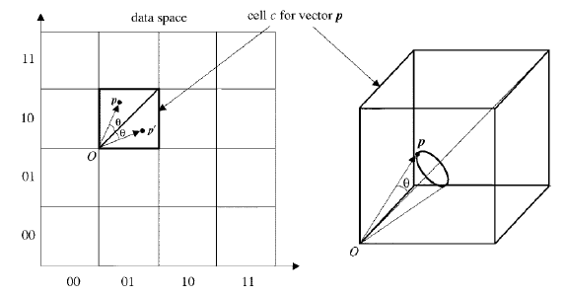
LPC: Deriving compact representation
Divide space into discrete cells, and calculate local polar coordinates of each point in its cell
Compact representation = <c,r,θ>

Slide 19
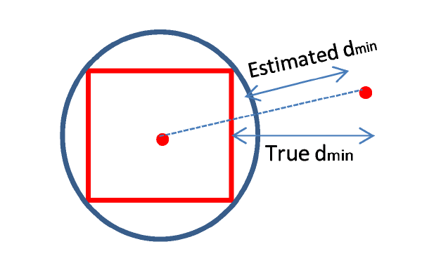
Accelerating the LPC filtering
Expensive calculation of d_{min} and d_{max}
Can we get coarser estimate of d_{min} efficiently? - estimate by distance of the cell from the query point
Notes:
Also add at the end how you avoid calculation of dmin and dmax.

Slide 20
Approximate Nearest Neighbor Strategies
Spatial division using KD-trees
Standard ANN Search
Priority based ANN Search

Slide 21
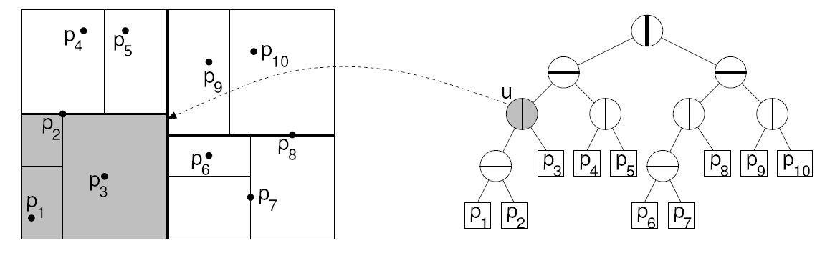
KD-Trees [Freidman et al, 77]

Slide 22
Standard ANN Search [Freidman et al, 77]
A
A
B
C
B
C
D
B
D
E
E
Pass 1

Slide 23
Standard ANN Search [Freidman et al, 77]
A
A
B
C
B
C
D
B
D
E
E
Pass 2

Slide 24
Standard ANN Search [Freidman et al, 77]
A
A
B
C
B
C
D
B
D
E
E
Pass 3

Slide 25
Standard ANN Search [Freidman et al, 77]
A
A
B
C
B
C
D
B
D
E
E
Pass 4

Slide 26
Standard ANN Search [Freidman et al, 77]
A
A
B
C
B
C
D
B
D
E
E
Pass 5

Slide 27
Optimization
q
s
r
D
p
B
t
E
Not process E
(outside the sphere of radius r)

Slide 28
Approximation
r/(1+Є)
q
s
r
D
p
B
t
E
Not process B
(outside the sphere of radius r/(1+Є)

Slide 29
Standard ANN Search [Freidman et al, `77]
Need to parse all leaves !
Can do better if look at cells in sorted order of distance from the query – Priority-based ANN Search [Arya et al, `93]
Need to maintain a priority queue

Slide 30
Outline
Motivation
System Implementation
Technical Overview
Evaluation
Future Work

Slide 31
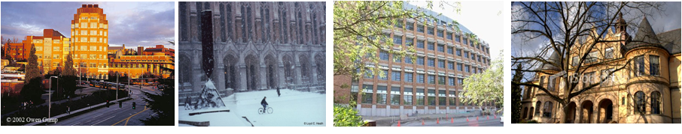
Evaluation
Training database of 66 images – 11 classes (buildings)
Query database of 50 images
Internet
Shot around campus

Slide 32
Evaluation: On-Disk storage
We compare Linear Search, LPC, LPC-S
Strategy | Avg Time Per query feature (ms) | Avg Number of I/O Accesses per query feature
Linear Search | 1703.36 | 101394207
LPC | 265.94 | 3692842
LPC-S | 247.88 | 3724397
The standard LPC filters out 97.23% data points in first pass
The sphere test filters out 50.30%

Slide 33
Evaluation: In-Memory Storage
Search Type | Avg Response Time Per Query Image (seconds) | Accuracy(%)
Linear Search | 86.12 | 90.0
kd-Tree Exact | 76.76 | 90.0
kd-Tree ANN (ε=2) | 7.78 | 88.0
kd-Tree Priority ANN (ε=2) | 7.61 | 88.0

Slide 34
Evaluation: In-Memory Storage
As є increases,

Slide 35
Outline
Motivation
System Implementation
Technical Overview
Evaluation
Future Work

Slide 36
Future Work - Databases
Survey of Better spatial division structures
BD Trees [Arya et al, J. ACM, `98]
MD Trees [Nakamura et al, ICPR`88], G-Trees [Kumar, `94]
Hybrid Storage Strategy
Better dimension mapping techniques

Slide 37
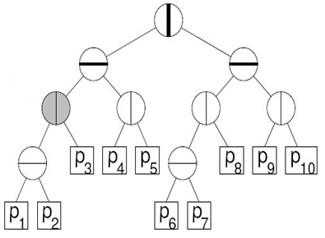
Future Work - Databases
Better spatial division structures
Hybrid Storage Strategy
Disk: easy to update but hard to query
Memory: easy to query but hard to update
Better dimension mapping techniques
MEMORY
DISK

Slide 38
Future Work - Databases
Better spatial division structures
Hybrid Storage Strategy
Better dimension mapping techniques
Non linear dimension reduction [Vu et al, SIGMOD`06]

Slide 39
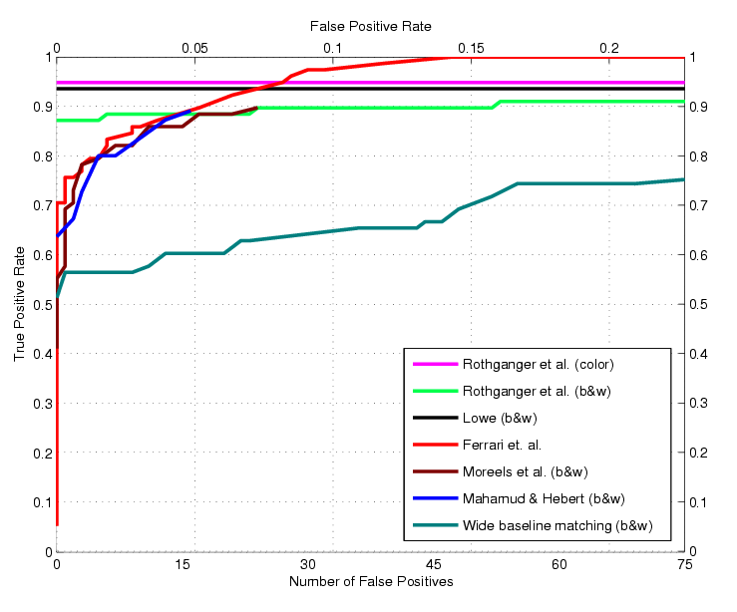
Future Work – Computer Vision
Better descriptors for robustness
Better ANN algorithms
Full 3D scene calibration
Geometric Blur [Berg et al, CVPR01], Local self similarities [Schectman et al, CVPR07]

Slide 40
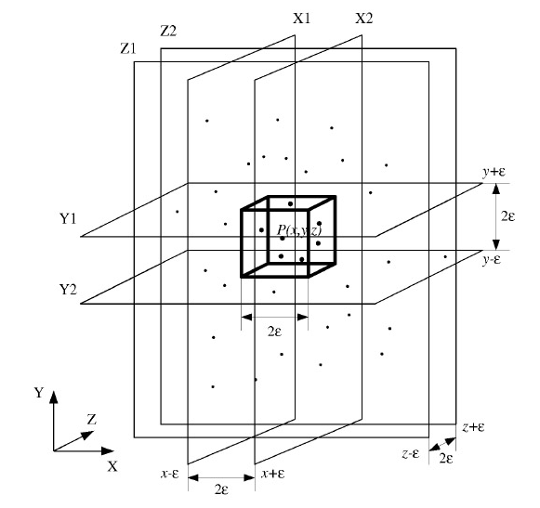
Future Work – Computer Vision
Better descriptors for robustness
Better ANN algorithms
Full 3D scene calibration
Locality-sensitive Hashing [Indyk, Motwani, STOC `98]

Slide 41
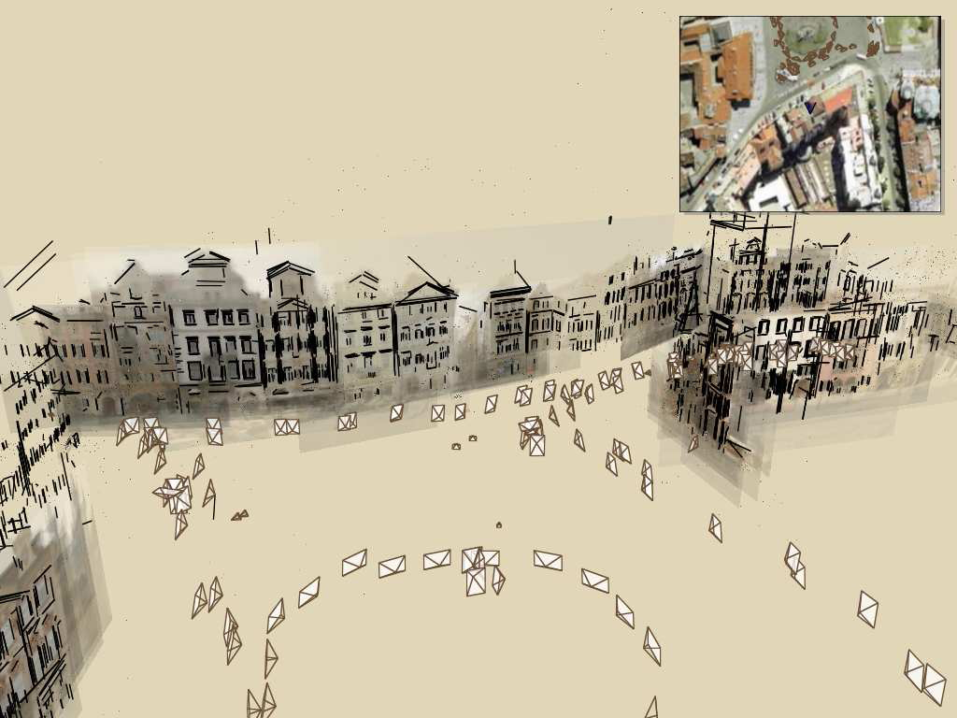
Future Work – Computer Vision
Better descriptors for robustness
Better ANN algorithms
Full 3D scene calibration
Photo Tourism [Snavely et al, SIGGRAPH `06]

Slide 42
Ultimate Visualization
Dynamic hybrid storage system
People uploading and removing photographs
3D scene calibration
Extensions to museums

Slide 43
Thank You

Slide 44
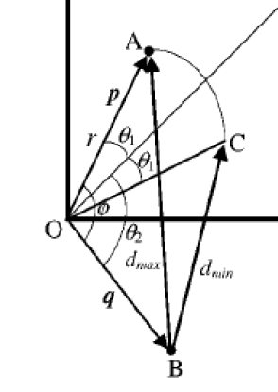
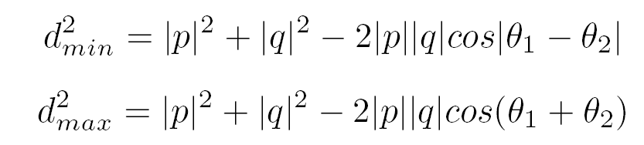
LPC: Filtering
<c,r,θ> allows for calculation of bounds d_{min} and d_{max} on actual distance of data point from query
if
d_{min} > current estimate of NN distance
Reject point
else
Accept point
Notes:
Don’t talk abt calculation of dmin and dmax, based on these bounds……

Slide 45
Our System vs. GPS
Advantages
Internet connectivity only
Not dependent on satellite signal strength
More detailed information
Disadvantages
Accuracy
Speed
More universal

Slide 46
Motivation
Hey there, I‘m think I’m lost!
I have no idea.
Well, there is a building.
Good idea! See you in a bit.
Where are you?
What is around you?
Ok great, send a picture of it to campusfind.com.

