Slide 1


IPL MATCH PREDICTIONS
Team members
Rahul (rr3687)
Ammar bin Ayaz (aba450)
Aswathy Mohan (am9094)
Sesha Sai Sreevani Kappagantula (ssk785)

Slide 2
INTRODUCTION
Sports Analytics is a method of collecting and analyzing historical game information to derive essential knowledge from it, with the aim that it will promote successful decision-making.
In this project, the past data of IPL containing the players’ details, match venue details, teams, ball to ball details, etc is taken and analyzed to draw various conclusions which help in the improvement of a player’s performance, predict outcomes and bid on a player.

Slide 3
PROJECT OUTCOMES
Scrapping the data and cluster players based on the features collected.
Simulating the entire IPL match using ball by ball data and clustered players from the previous step. We will be trying to calculate player vs player probability.
Each innings is simulated and batsmen/bowlers are interchanged for every 6 balls. Selection of bowlers will also be decided.
Train Machine Learning classifier and predict the results. The predictions consist of the number of runs scored by each batsman, the number of wickets taken by each bowler and the final scores for the match.

Slide 4
DATASETS USED
Data files used for match simulation
Deliveries data (ball to ball details of matches played)
Matches data (details of every match played between teams)
Players data (player skills and records)
Auction data (player price and buyer details)
T20 ODI Data(2010-2019)

Slide 5
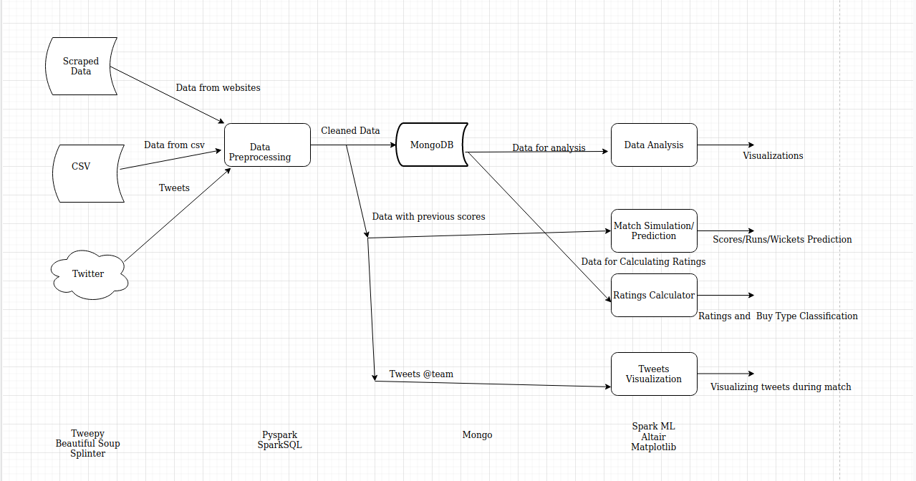
PROJECT ARCHITECTURE

Slide 6
TECHNOLOGIES USED
BeautifulSoup
Splinter
Tweepy
Pyspark
Spark SQL
Mongodb (Mongodb atlas)
Spark ML
Matplotlib
Altair

Slide 7
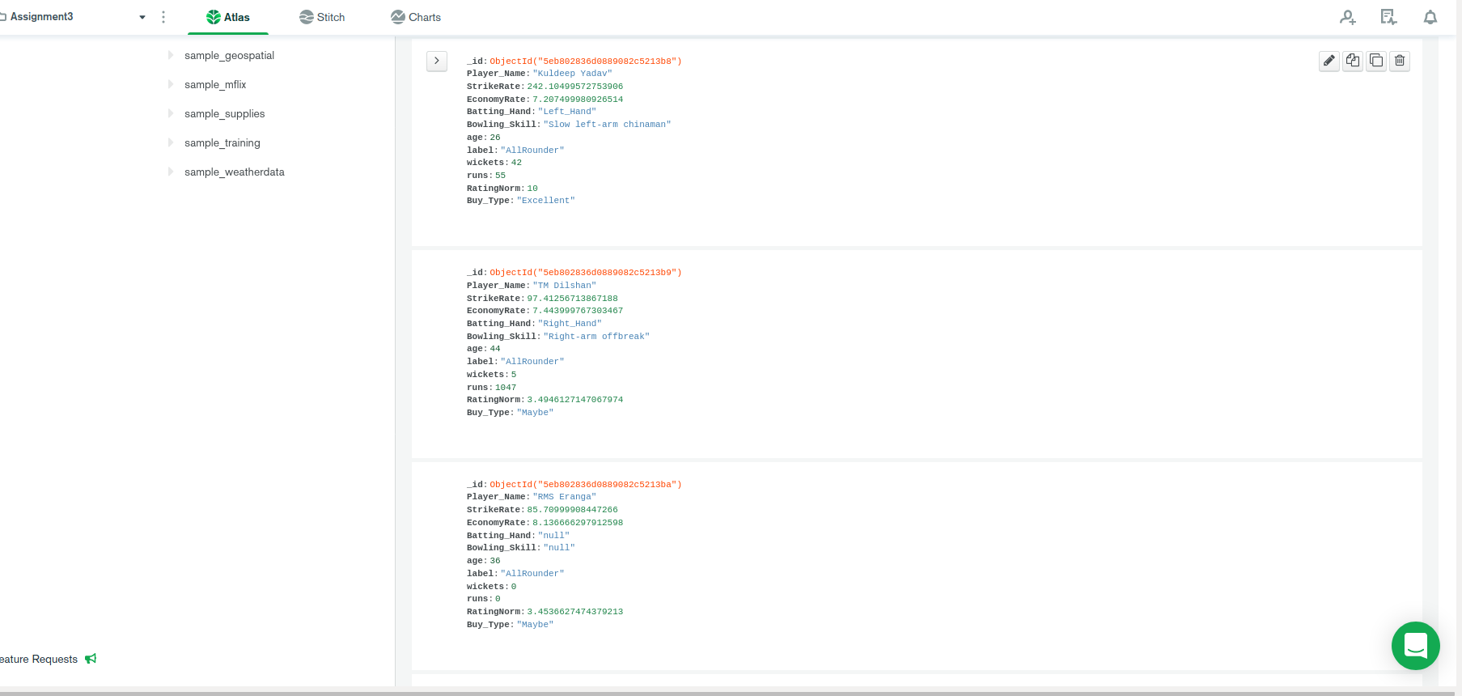
Mongodb Atlas

Slide 8
DATA ANALYSIS

Slide 9
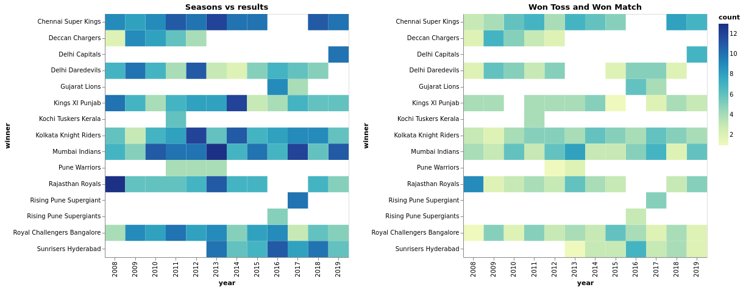
Toss-Analysis

Slide 10
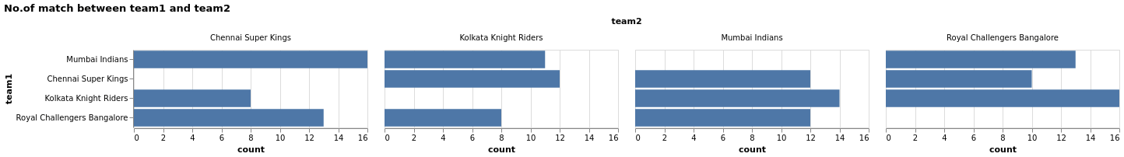
Matches Between Teams:

Slide 11
Match Analysis
Umpire analysis
Venue analysis
Batsman analysis
Bowler analysis
Wickets analysis
Fielders analysis

Slide 12
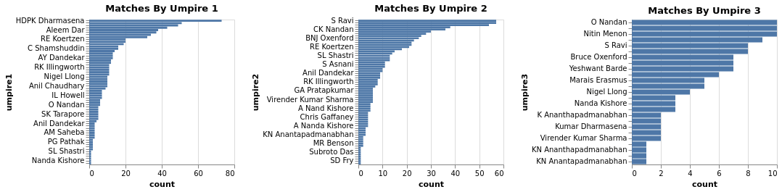
Umpire-Analysis

Slide 13
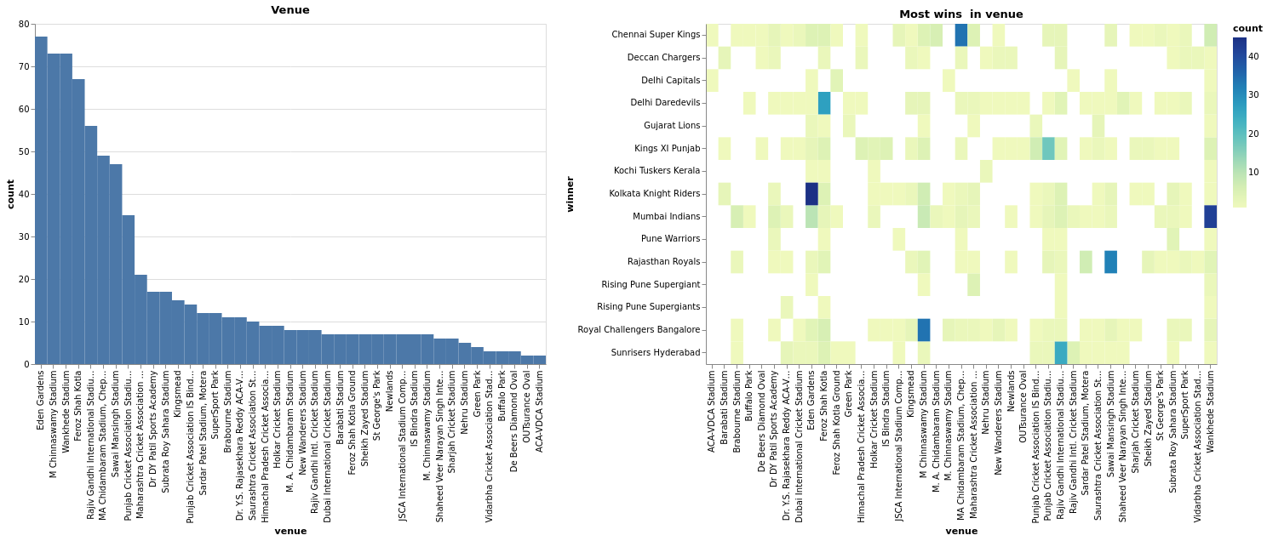
Venue-Analysis

Slide 14
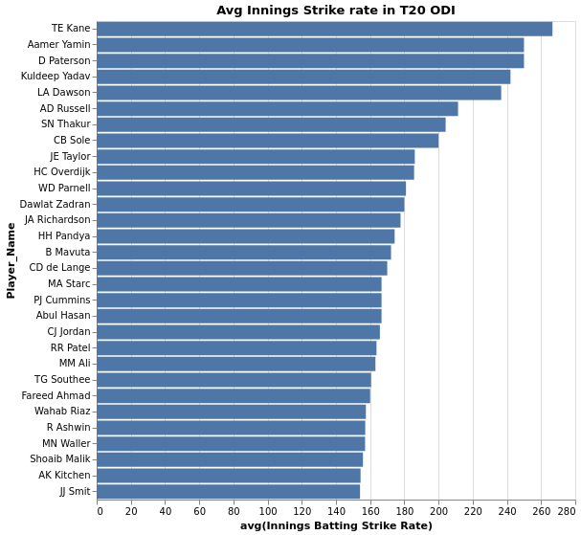
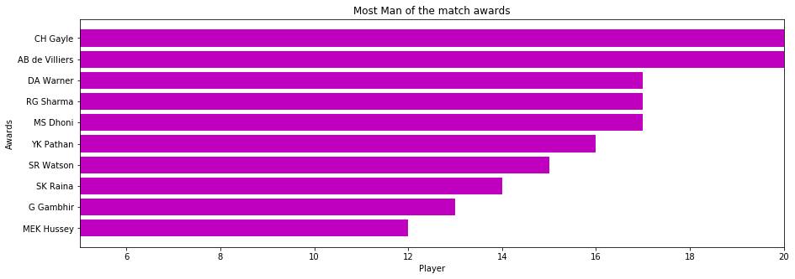
Batsman performance analysis
Man of the match awards winners
Average innings strike rate in T20 ODI

Slide 15
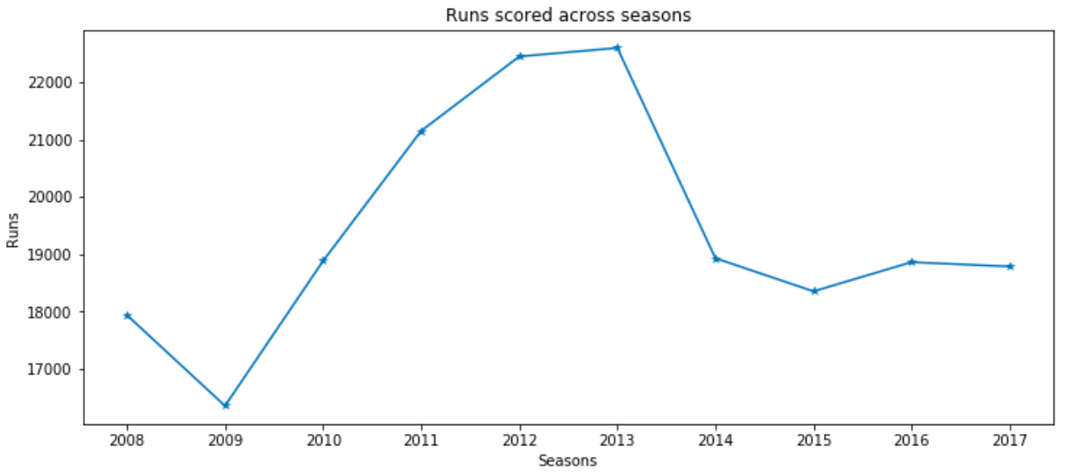

Slide 16
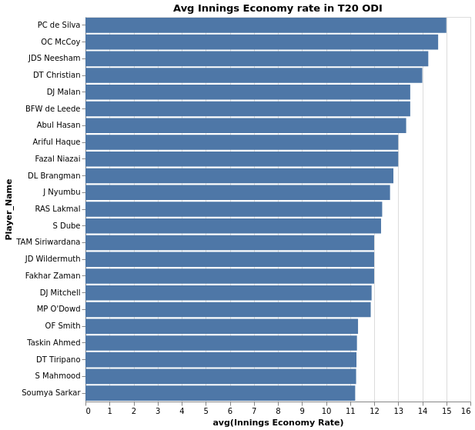
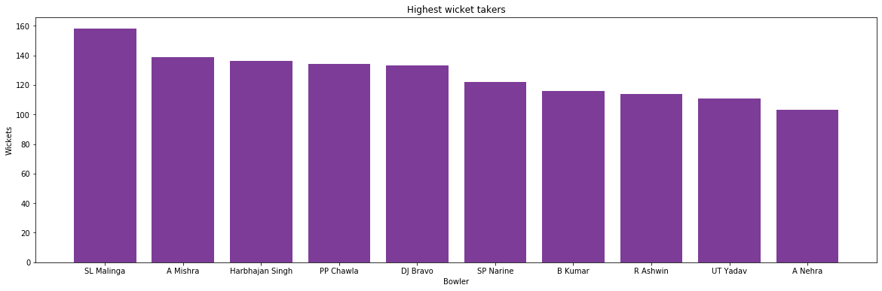
Bowler performance analysis
Highest wicket takers
Average innings economy rate in T20 ODI

Slide 17
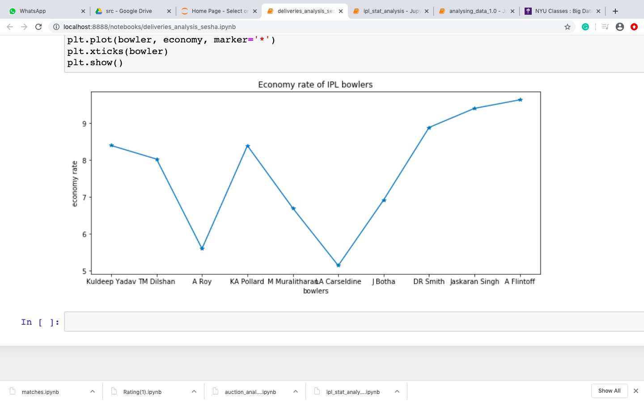
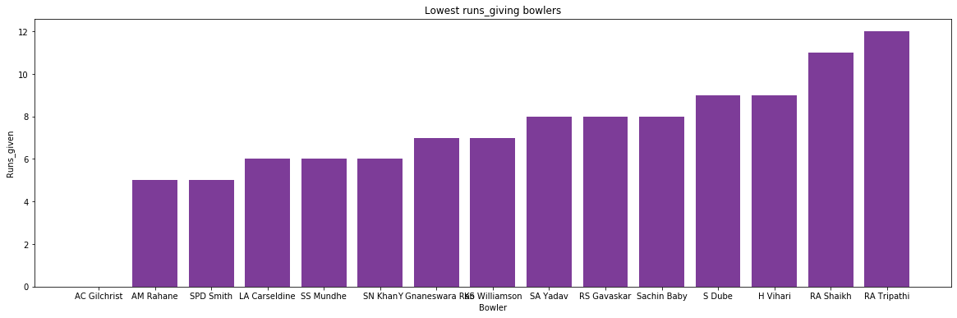
Bowler performance analysis

Slide 18
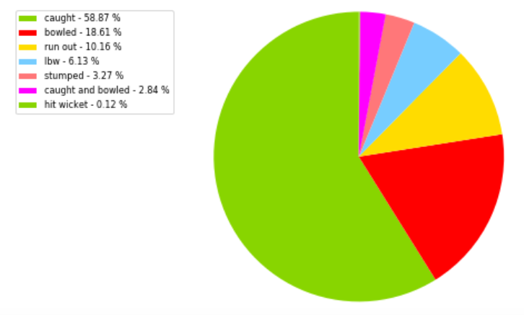
Wickets analysis

Slide 19
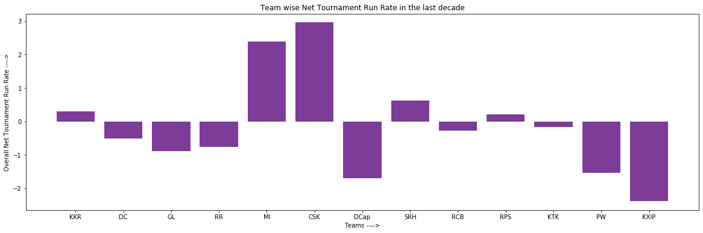
Run Rate

Slide 20
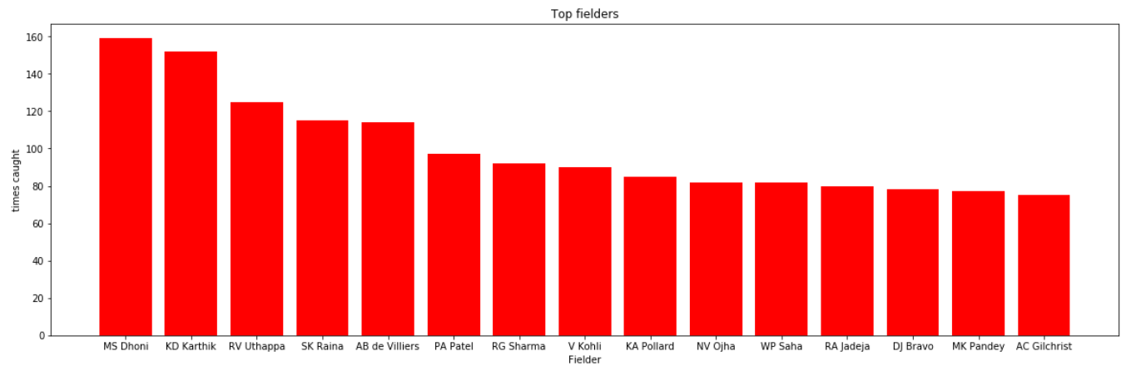
Fielders analysis

Slide 21
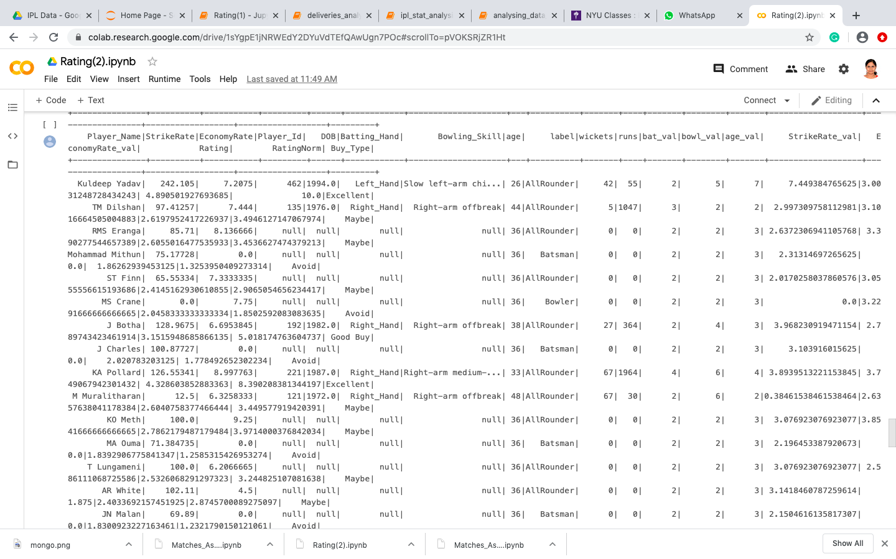
Ratings Calculator

Slide 22
Ratings
Based on certain features, each player is given a rating
The features considered are: Runs, wickets ,strike rate ,economy rate(from ODI) and age
Based on the ratings, players are divided into 4 categories
Avoid
May Be
Good
Excellent
These categories are used to determine whether the Player is good for next IPL season.
Random Forest is used to train the model
Random Forest accuracy=73%

Slide 23
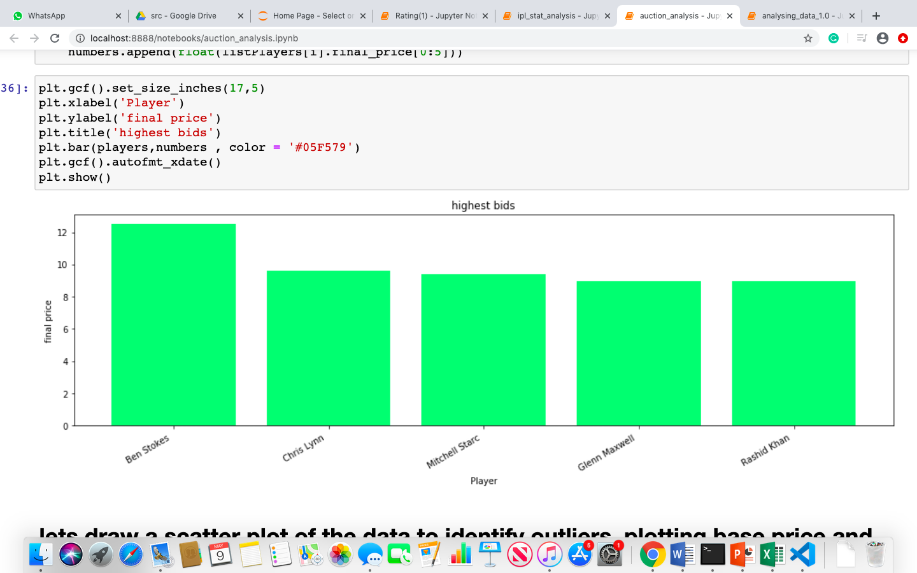
Auction Analysis
Most bid players from outside India (in INR (crores))

Slide 24
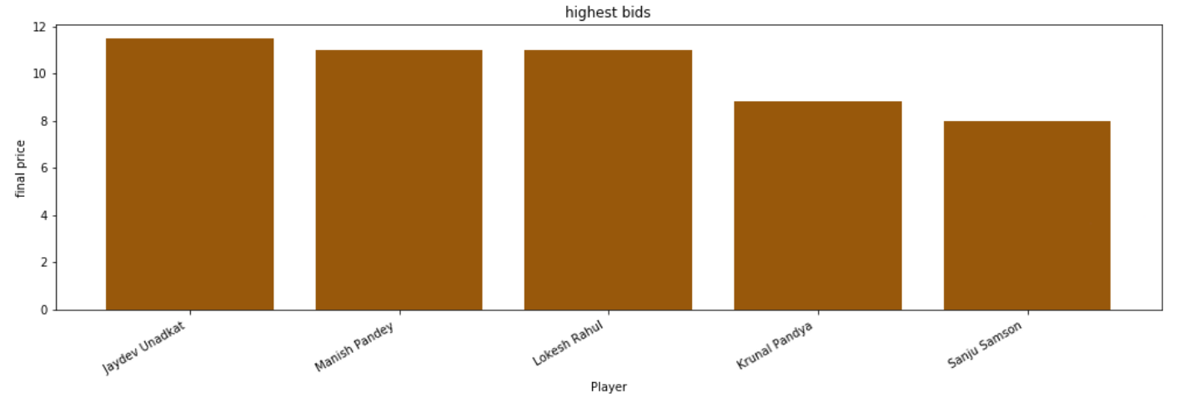
Most bid Indian players (in INR (crores))

Slide 25
MATCH PREDICTIONS/SIMULATION

Slide 26
MATCH PREDICTION
Classifier | Accuracy | Cross-validation score
Logistic Regression | 23.270% | 21.852%
Random Forest | 89.151% | 47.806%
AdaBoost | 19.811% | 16.663%
Support Vector Machine | 25.786% | 18.707%
Multi layer perceptron | 28.302% | 25.154%
Gradient Boost | 89.151% | 54.251%

Slide 27
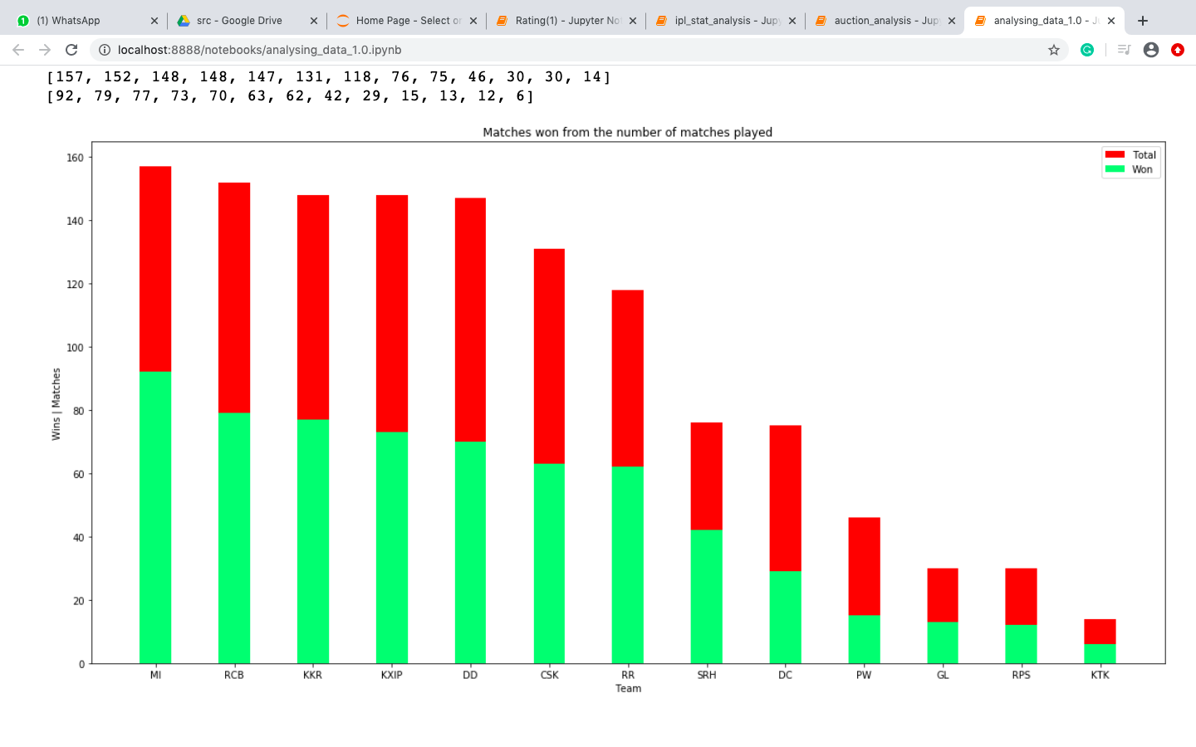
Red=Lost
Green=Won

Slide 28
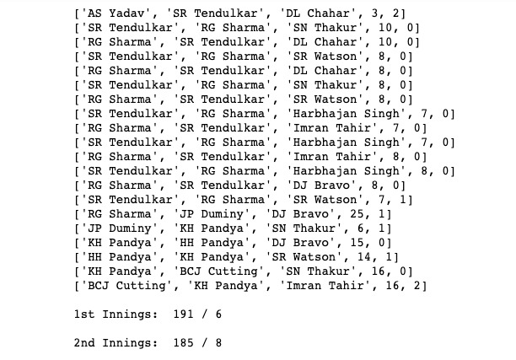
MATCH SIMULATION

Slide 29
TWEETS VISUALIZATION

Slide 30
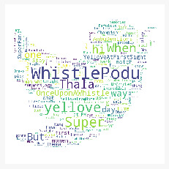
Chennai Super Kings team tweet visualization

Slide 31
Summary
Analysed different aspects of an IPL Match
Calculated ratings of every player based on certain parameters
Predicted Outcome of the Match using Machine Learning
Simulated a ball by ball match between two teams
Analysed Tweets

Slide 32
IMPLICATIONS
This analysis can be used by potential bidders and make better investment decisions (team and players bidding)
Simulation of the Match with different permutations can help in getting a realistic idea about the batting/bowling order
Tweets cloud can be used in merchandising. It helps in accessing the public opinion on the matches,teams and players.

Slide 33
REFERENCES
[1].https://www.dexlabanalytics.com/blog/how-stat-this-ipl-season-embrace-big-data-analysis-and-predict-it-right
[2]. Analyzing and predicting outcome of IPL cricket data, International Journal of Innovative Research in Science, Engineering and Technology - Vol. 8, Issue 4, April 2019
[3]. Predictive Analysis of IPL Match Winner using ML, International Journal of Innovative Technology and Exploring Engineering (IJITEE) ISSN: 2278-3075, Volume-9 Issue-2S, December 2019
[4].https://towardsdatascience.com/analysing-ipl-data-to-begin-data-analytics-with-python-5d2f610126a

Slide 34

Q/A

