Slide 1



IPL MATCH PREDICTIONS
Presenter: Rahul (rr3687)
Instructor: Prof. Baris Coskun
Course: Machine Learning (CSGY – 6923)

Slide 2
INTRODUCTION
The Indian Premier League (IPL) is a professional Twenty20 cricket league in India usually contested between March and May of every year by eight teams representing eight different cities or states in India.
It is one of the most attended cricketing events in the world, valued at $6.7 billion¹ in 2019.
Sports Analytics is a method of collecting and analyzing historical game information to derive essential knowledge from it, with the aim that it will promote successful decision-making.
1 Figure provided by Duff and Phelps, a multinational financial consultancy firm based in New York City.
Notes:
ghjgbujhuuiuiu

Slide 3
OVERVIEW
Used past data of IPL matches from 2008 to 2017 containing the batting team, bowling team, runs, wickets, overs, runs in last 5 overs, wickets in last 5 overs, etc.
Trained various machine learning models to analyze and predict the first innings score of the batting teams

Slide 4
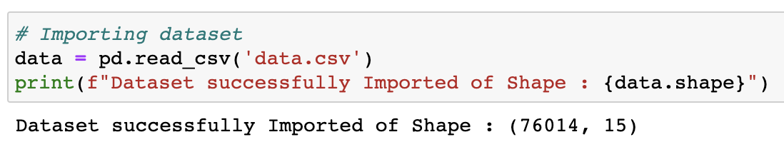
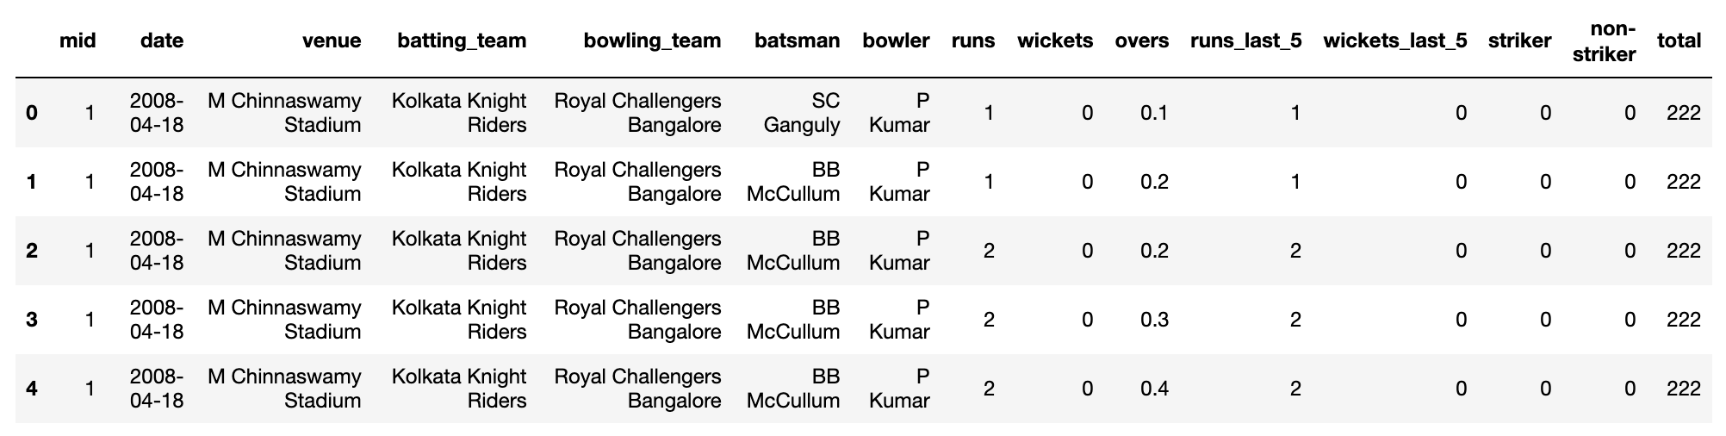
DATASET
Data was downloaded from Kaggle

Slide 5
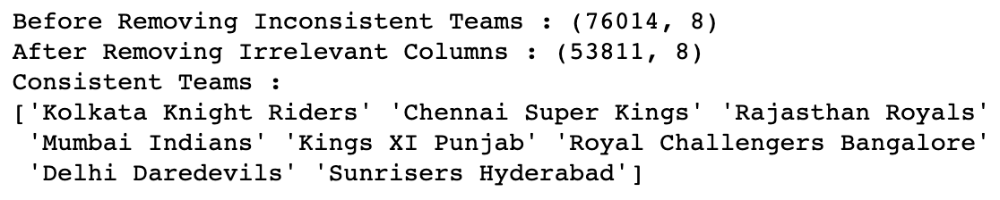

DATA CLEANING
Irrelevant features
Rows with null values
Inconsistent teams
Removed data of first five overs (to have better prediction results)

Slide 6
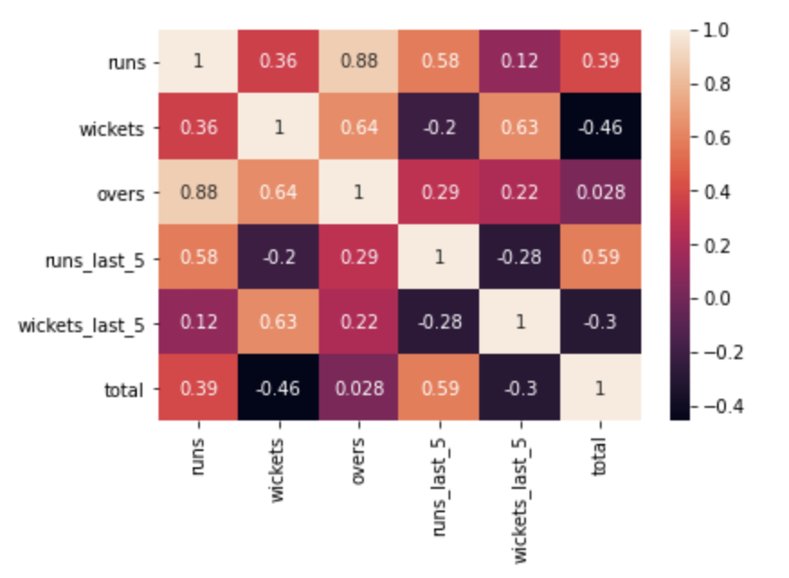
CORRELATION MATRIX

Slide 7
DATA PREPROCESSING & ENCODING
Label Encoding (Batting Team, Bowling Team)
One Hot Encoding and Column Transformation

Slide 8
MODELS USED
Linear
Lasso
Ridge
Kernel Ridge
Elastic Net
Support Vector
Decision Tree
Gradient Boost
Bagging
Random Forest
Multi-Layer Perceptron

Slide 9
LINEAR REGRESSION
---- Linear Regression - Model Evaluation ----
Mean Absolute Error (MAE): 13.065
Mean Squared Error (MSE): 303.561
Root Mean Squared Error (RMSE): 17.422
Two Most Important Features
overs
wickets

Slide 10
LASSO REGRESSION
---- Lasso Regression - Model Evaluation ----
Mean Absolute Error (MAE): 13.13
Mean Squared Error (MSE): 313.033
Root Mean Squared Error (RMSE): 17.692
Two Most Important Features
overs
wickets

Slide 11
RIDGE REGRESSION
---- Ridge Regression - Model Evaluation ----
Mean Absolute Error (MAE): 13.065
Mean Squared Error (MSE): 303.56
Root Mean Squared Error (RMSE): 17.422
Two Most Important Features
overs
wickets

Slide 12
KERNEL RIDGE REGRESSION
---- Kernel Ridge Regression - Model Evaluation ----
Mean Absolute Error (MAE): 13.067
Mean Squared Error (MSE): 303.603
Root Mean Squared Error (RMSE): 17.424

Slide 13
ELASTIC NET REGRESSION
---- Elastic Net Regression - Model Evaluation ----
Mean Absolute Error (MAE): 13.179
Mean Squared Error (MSE): 316.931
Root Mean Squared Error (RMSE): 17.802
Two Most Important Features
overs
wickets

Slide 14
SUPPORT VECTOR REGRESSION
---- Support Vector Regression - Model Evaluation
Mean Absolute Error (MAE): 12.869
Mean Squared Error (MSE): 312.557
Root Mean Squared Error (RMSE): 17.679
Two Most Important Features
runs_last_5
batting_team_Chennai Super Kings

Slide 15
DECISION TREE REGRESSION
---- Decision Tree Regressor - Model Evaluation ---
Mean Absolute Error (MAE): 3.699
Mean Squared Error (MSE): 117.436
Root Mean Squared Error (RMSE): 10.817
Two Most Important Features
runs_last_5
runs

Slide 16
GRADIENT BOOST REGRESSION
---- Gradient Boost Regressor - Model Evaluation ----
Mean Absolute Error (MAE): 12.464
Mean Squared Error (MSE): 279.393
Root Mean Squared Error (RMSE): 16.715
Two Most Important Features
runs_last_5
wickets

Slide 17
BAGGING REGRESSION
---- Bagging Regressor - Model Evaluation ----
Mean Absolute Error (MAE): 4.629
Mean Squared Error (MSE): 65.41
Root Mean Squared Error (RMSE): 8.045

Slide 18
RANDOM FOREST REGRESSION
---- Random Forest Regression - Model Evaluation ----
Mean Absolute Error (MAE): 4.611
Mean Squared Error (MSE): 59.887
Root Mean Squared Error (RMSE): 7.734
Two Most Important Features
runs_last_5
runs

Slide 19
MULTI-LAYER PERCEPTRON REGRESSION
---- Neural Networks Regression - Model Evaluation ----
Mean Absolute Error (MAE): 10.581
Mean Squared Error (MSE): 219.629
Root Mean Squared Error (RMSE): 14.333

Slide 20
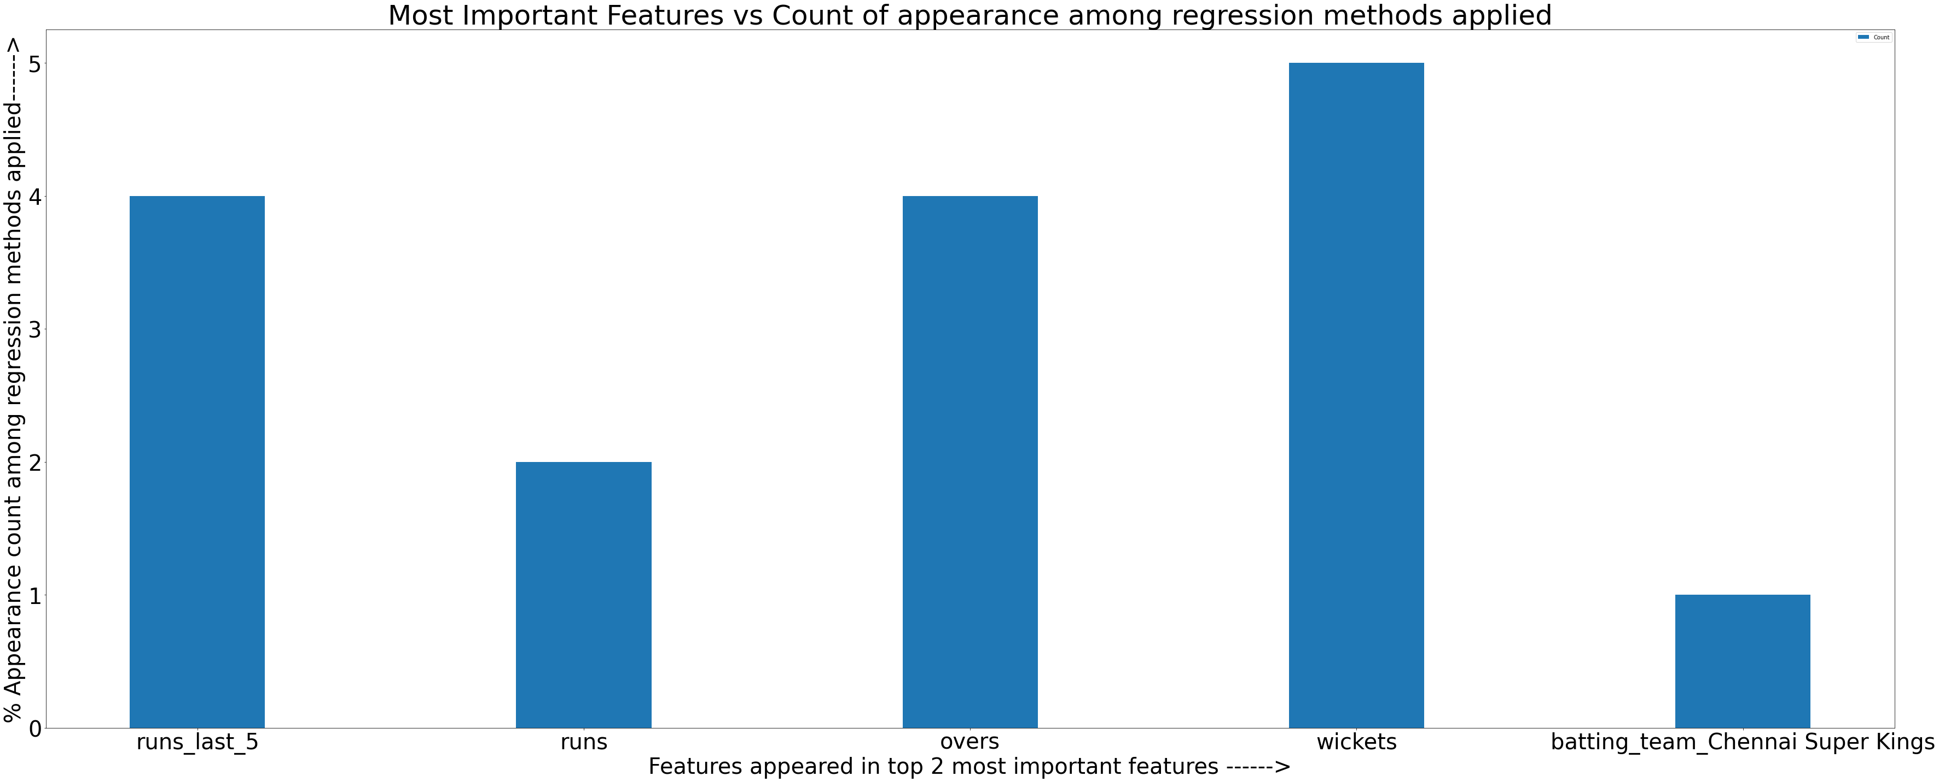
MOST IMPORTANT FEATURES

Slide 21
MOST IMPORTANT FEATURES
wickets
overs, runs_last_5 (tie)

Slide 22
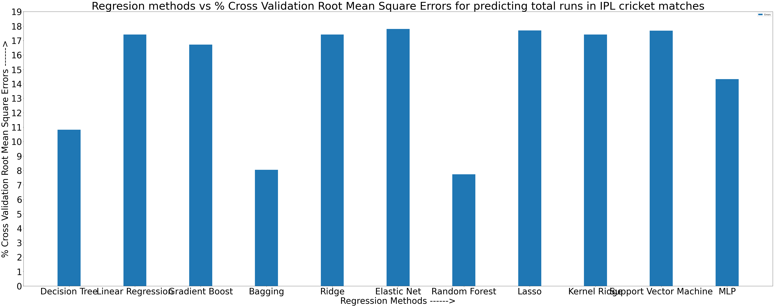
BEST MODEL SELECTION

Slide 23
BEST MODEL
Random Forest has the least RMSE, closely followed by Bagging, Decision Tree, and Multi Layer Perceptron. So, I chose Random Forest as the final model for making score predictions.

Slide 24
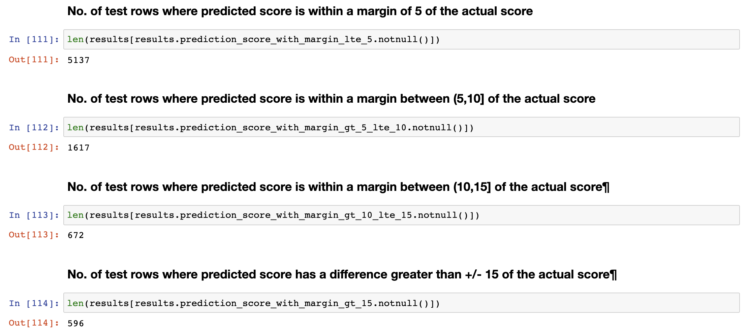
TEST RESULTS
No. of test rows = 8022

Slide 25
TEST RESULTS
1. Out of 8022 test rows, the score prediction for 5137 test rows is within a margin of 5 runs, the score prediction for 1617 rows is within a margin of greater than 5 and less than equal to 10 runs, the score prediction for 672 rows is within a margin of greater than 10 and less than equal to 15 runs and finally for 596 rows, the margin is greater than 15 runs.
2. It means that there are around 64% chances that the predicted score will be in a margin of 5 with the actual score. There are around 20% chances for the margin between (5, 10], and around 8% percent chances for predicted score to be in a margin (10, 15]. Finally, there are around 7% chances for predicted score to be in a margin greater than 15 of the actual score.

Slide 26
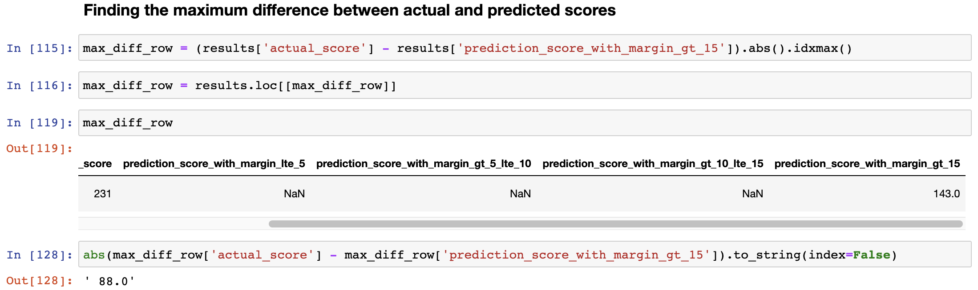
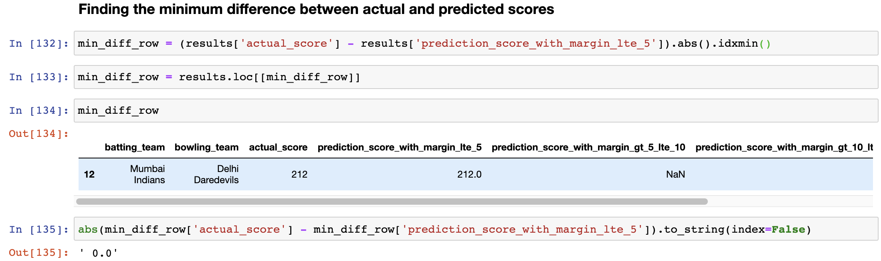
TEST RESULTS

Slide 27
TEST RESULTS
The maximum difference between actual and predicted scores appeared is 88 while the minimum difference appeared is 0.

Slide 28
TEST RESULTS
As it can be seen above, for 953 test rows, the difference between actual and predicted scores is 0 which means that there are around 12% chances that the predicted score will be equal to the actual score.

Slide 29

Q/A

