Slide 1
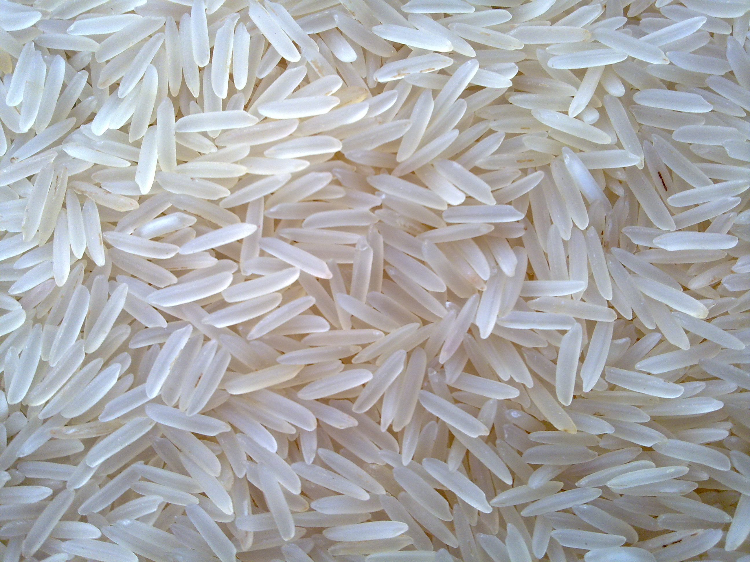


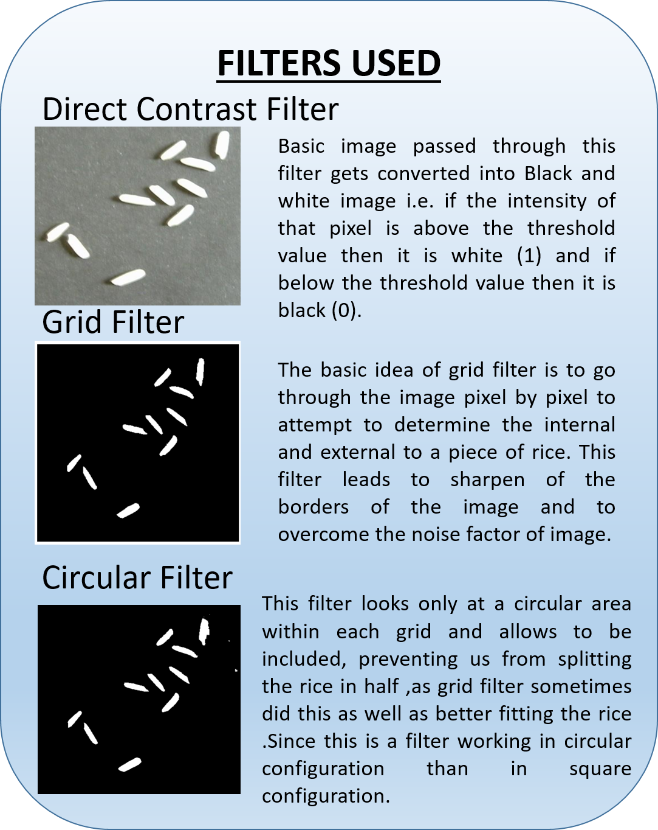
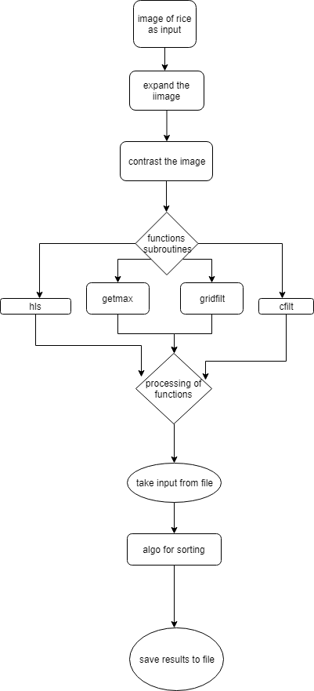



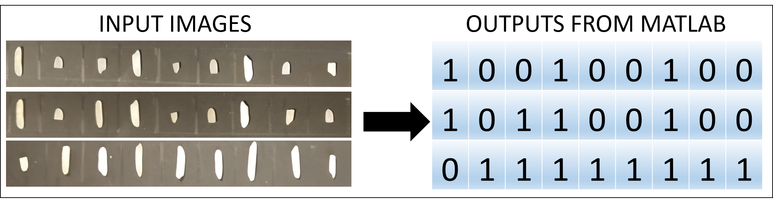
RICE SORTER
LAKSHAY AGGARWAL 101506091
PULKIT BAHL 101506131
RAGHAV SHARMA 101506132
RAHUL GARG 101506133
RAJAN BANSAL 101506135
SAKET PANCHORI 101506145
LAKSHAY AGGARWAL 101506091
PULKIT BAHL 101506131
RAGHAV SHARMA 101506132
RAHUL GARG 101506133
RAJAN BANSAL 101506135
SAKET PANCHORI 101506145
TEAM NUMBER 32
MENTOR: DR. VINAY KUMAR
INTRODUCTION
This study explores the pattern to separate out rice grains according to their size differences. Due to system complexity and huge research in the field of signal processing, the principle and implementation of a system of rice sorter is proposed. The system refers to automatically sorting the heterochromatic particles out of the batch of raw rice, removing such impurities in this process improves the quality of the rice. Improvement in food safety due to the removal of foreign materials is the primary aim of the proposed study.
FLOWCHART
RESULTS
SOFTWARE USED
CUSTOMERS
Food processing industry
Agro based industry

