Slide 1

EventConnect
Supervisor:
Dr. Anil Chhangani
Presented by:
Arnav Das
Rahul Gavhar
Saish Dhuri

Slide 2
EventConnect: Event Management Platform
EventConnect is a comprehensive platform designed for organizing and attending both virtual and in-person events. This innovative solution combines various technologies to offer a seamless experience for event management, featuring key functionalities such as video calls, live streaming, chat, maps, user authentication, notifications, and event scheduling.

Slide 3
Key Features and Technologies
1
User Authentication
2
Video Calls
3
Live Streaming
Use WebRTC for video communication and Socket.io for signaling.
Implement with WebRTC, media servers like Kurento or Jitsi, and HLS for large audiences.
Secure user login and registration using JWT and bcrypt.

Slide 4
Key Features and Technologies (continued)
1
Real-time Chat
2
Maps Integration
3
Event Scheduling
Real-time messaging with Socket.io and MongoDB.
Use Google Maps API or Leaflet.js to show event locations and navigation.
Manage events with a calendar using FullCalendar.js.

Slide 5
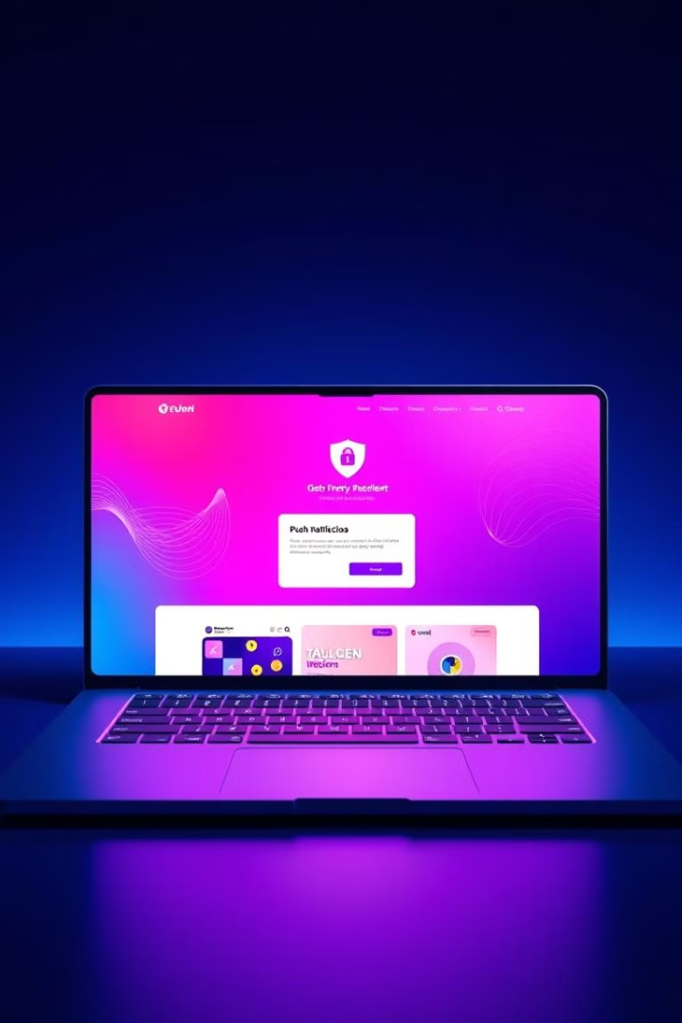
Key Features and Technologies (final part)
1
Notifications System
Notify users with Push.js, Socket.io, or Firebase Cloud Messaging (FCM).
2
Responsive UI/UX
Build a user-friendly interface with React and Material-UI or Bootstrap.
3
Security and Performance
Enhance security with Helmet.js and rate limiting, and use Redis for caching.

Slide 6
Development Process
Planning and Design
1
Define features and create wireframes and database schema.
2
Backend Development
Set up Node.js server, develop APIs, and integrate WebRTC and Socket.io.
Frontend Development
3
Build React components for each feature and integrate with backend APIs.
4
Testing and Deployment
Conduct testing and deploy using platforms like Heroku or AWS.

Slide 7
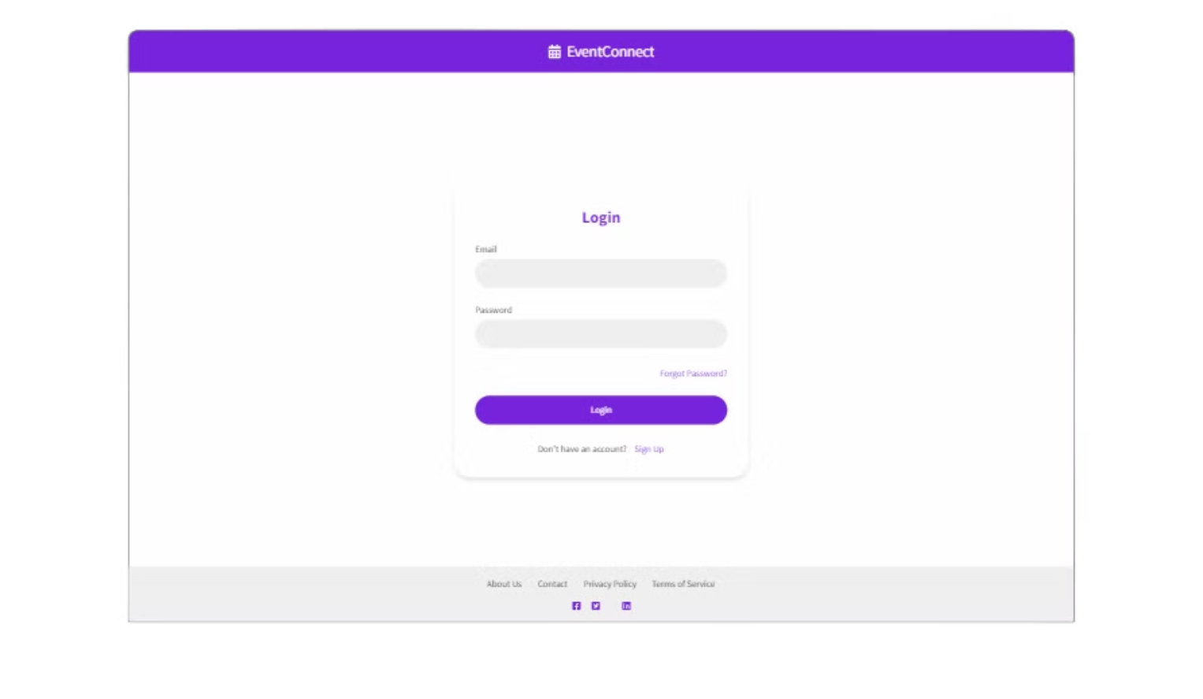

Slide 8
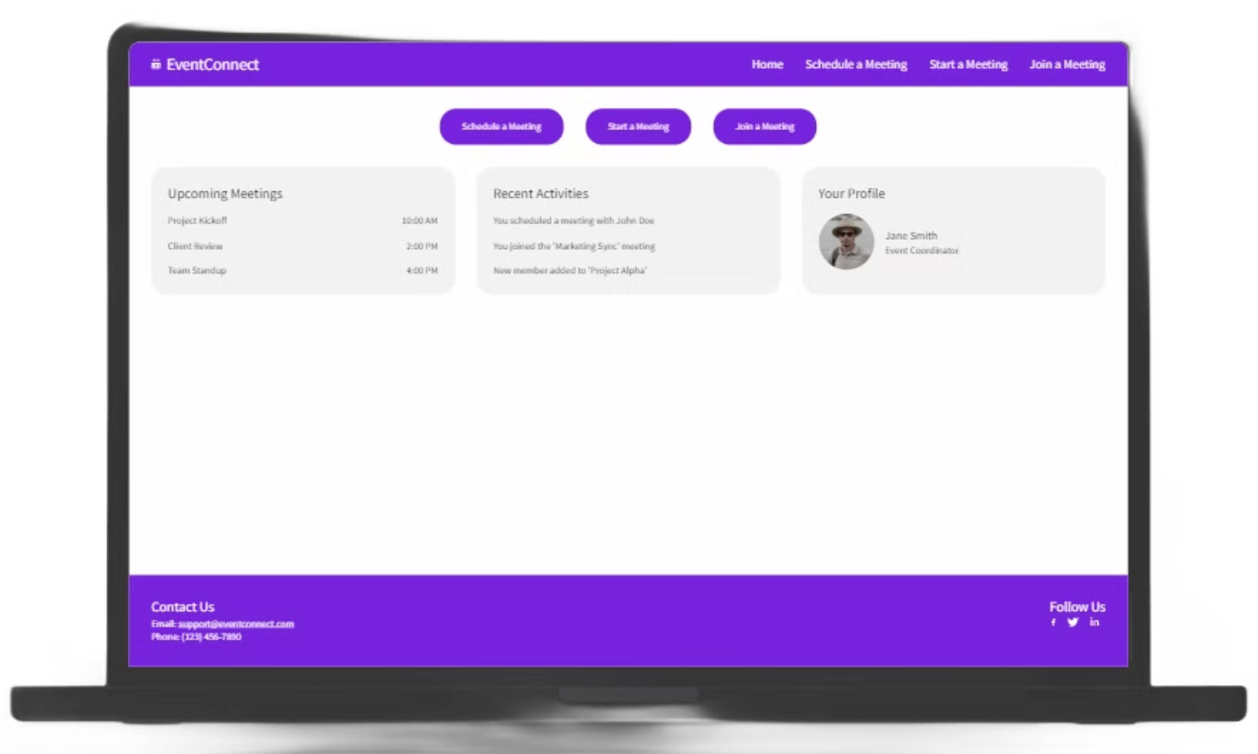

Slide 9
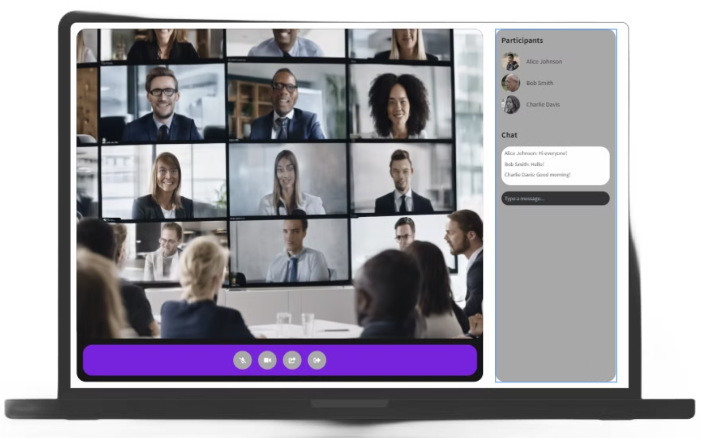

Slide 10
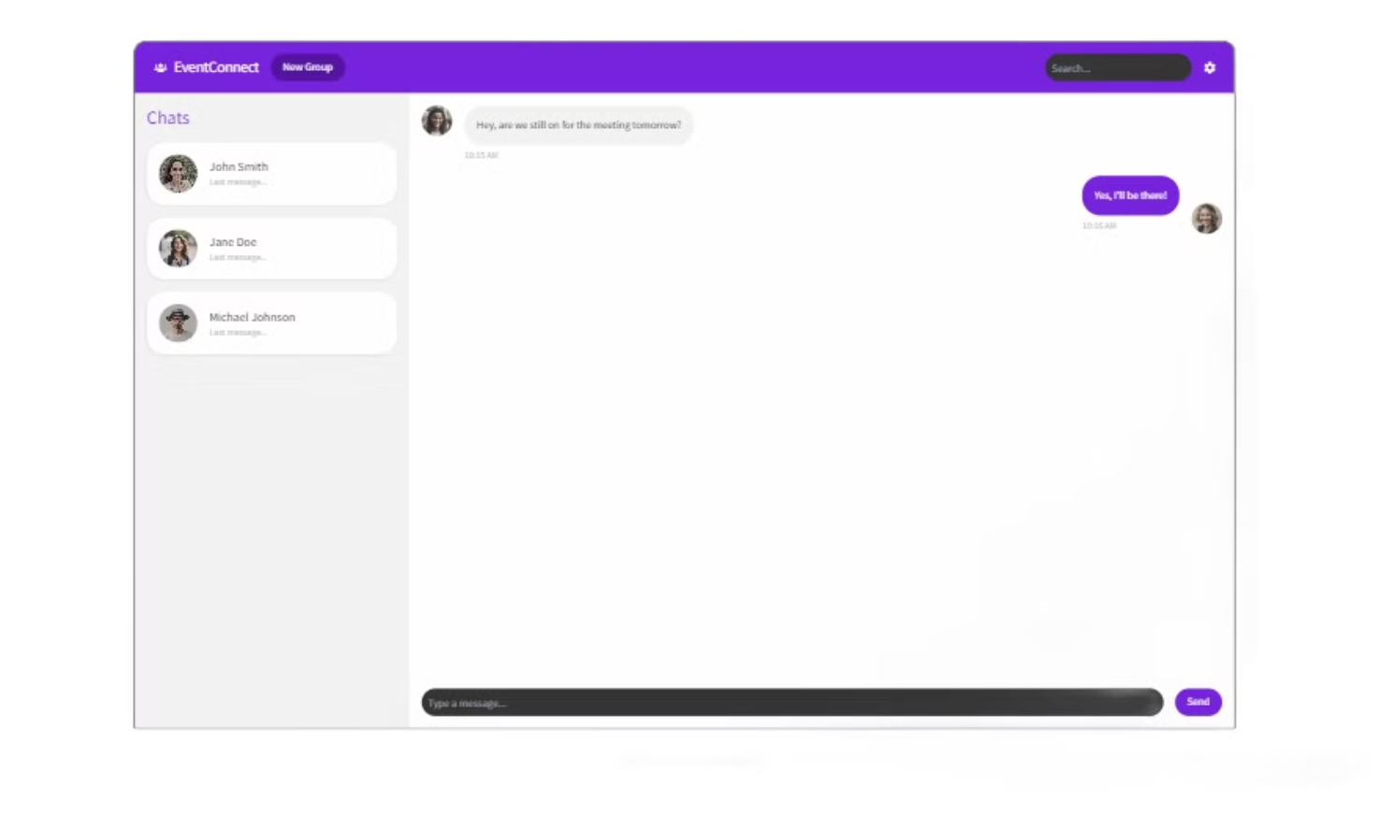

Slide 11
Rersearch Papers:
Alan B. Johnston and Daniel C. Burnett, WebRTC: APIs and RTCWEB protocols of the HTML5 real-time web, Digital Codex LLC, 2013.
Google Scholar
WebRTC Architecture [S/OL], [online] Available: https://www.webrtc.org/architecture.

Slide 12
Thank You
Appreciation
To wrap things up, We appreciate your interest and participation today.

