Slide 1



EventConnect: Event Management Platform
EventConnect is a platform for organizing and attending both virtual and in-person events. Key features include video calls, live streaming, chat, maps, user authentication, notifications, and event scheduling.

Slide 2

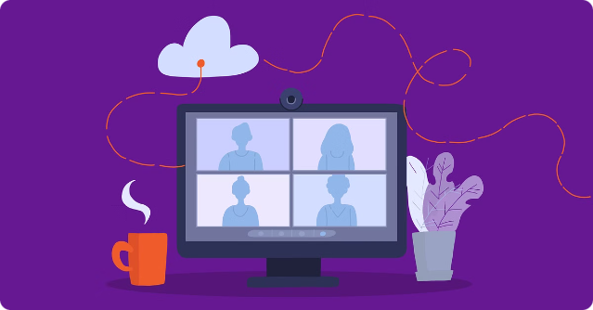
Overview
1
Virtual and In-Person Events
EventConnect is a platform for organizing and attending both virtual and in-person events.
2
Key Features
Key features include video calls, live streaming, chat, maps, user authentication, notifications, and event scheduling.

Slide 3
Key Features and Technologies
User Authentication
Video Calls
Live Streaming
Secure user login and registration using JWT and bcrypt.
Use WebRTC for video communication and Socket.io for signaling.
Implement with WebRTC, media servers like Kurento or Jitsi, and HLS for large audiences.

Slide 4
Key Features and Technologies (cont.)
Real-time Chat
Maps Integration
Event Scheduling
Real-time messaging with Socket.io and MongoDB.
Use Google Maps API or Leaflet.js to show event locations and navigation.
Manage events with a calendar using FullCalendar.js.

Slide 5
Key Features and Technologies (cont.)
Notifications System
Responsive UI/UX
Security and Performance
Notify users with Push.js, Socket.io, or Firebase Cloud Messaging (FCM).
Build a user-friendly interface with React and Material-UI or Bootstrap.
Enhance security with Helmet.js and rate limiting, and use Redis for caching.

Slide 6


Development Process
1
Planning and Design
Define features and create wireframes and database schema.
2
Backend Development
Set up Node.js server, develop APIs, and integrate WebRTC and Socket.io.
3
Frontend Development
Build React components for each feature and integrate with backend APIs.
4
Testing and Deployment
Conduct testing and deploy using platforms like Heroku or AWS.

Slide 7


Target Markets
Event Organizers
Event organizers can use EventConnect to manage their events, from registration to live streaming.
Businesses
Businesses can use EventConnect to host webinars, conferences, and other events.
Educational Institutions
Educational institutions can use EventConnect to host online courses, lectures, and other events.
Community Groups
Community groups can use EventConnect to organize meetings, events, and fundraisers.

Slide 8


Target Markets (cont.)
Entertainment Industry
The entertainment industry can use EventConnect to host concerts, festivals, and other events.
Freelancers
Freelancers can use EventConnect to host workshops, webinars, and other events.
Small Businesses
Small businesses can use EventConnect to host networking events, product launches, and other events.

Slide 9

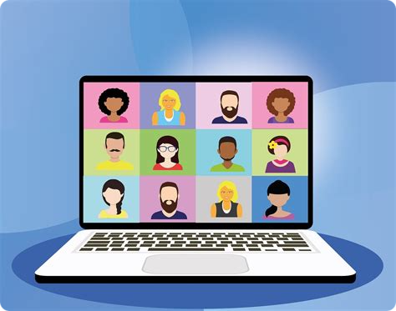
Conclusion
EventConnect aims to be a comprehensive solution for event management, combining various technologies to offer a seamless experience for organizing and attending events.

